Slide 1
Fundamentals of Biochemistry
Fifth Edition
Donald Voet • Judith G. Voet • Charlotte W. Pratt
Chapter 22
Mammalian Fuel Metabolism:
Integration and Regulation

Slide 2
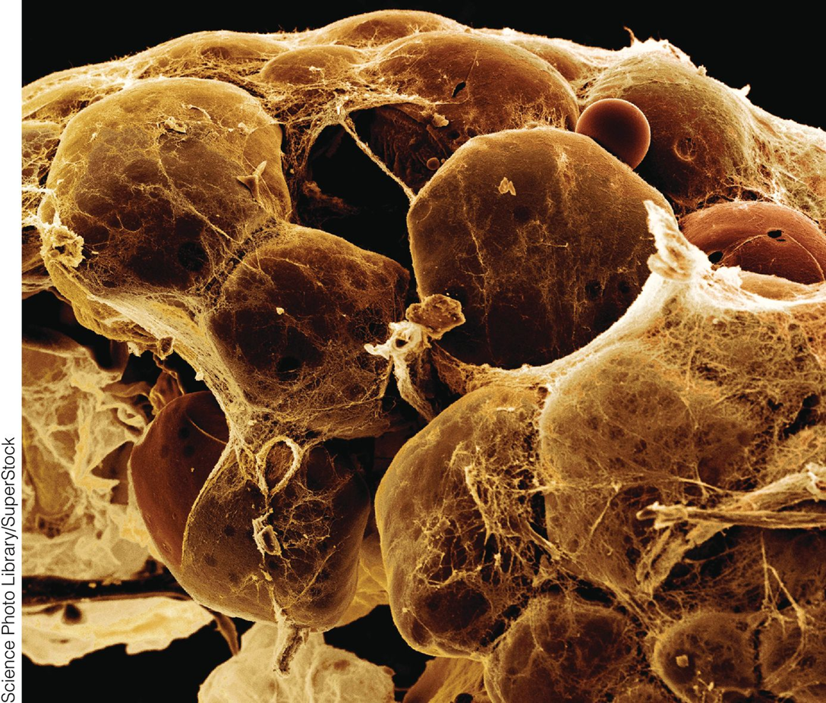
Mammalian Fuel Metabolism: Integration and Regulation

Slide 3
Chapter 22: Organ Specialization (1 of 4)
Key Concepts 22.1
The major metabolic pathways for glucose, fatty acids, and amino acids center on pyruvate and acetyl-CoA.
Glucose is the primary fuel for the brain.
Muscles can generate ATP anaerobically and aerobically.
Adipose tissue stores triacylglycerols and releases fatty acids as needed.
The liver makes all types of fuel available to other tissues.
Some metabolic processes require cooperation among organs.

Slide 4
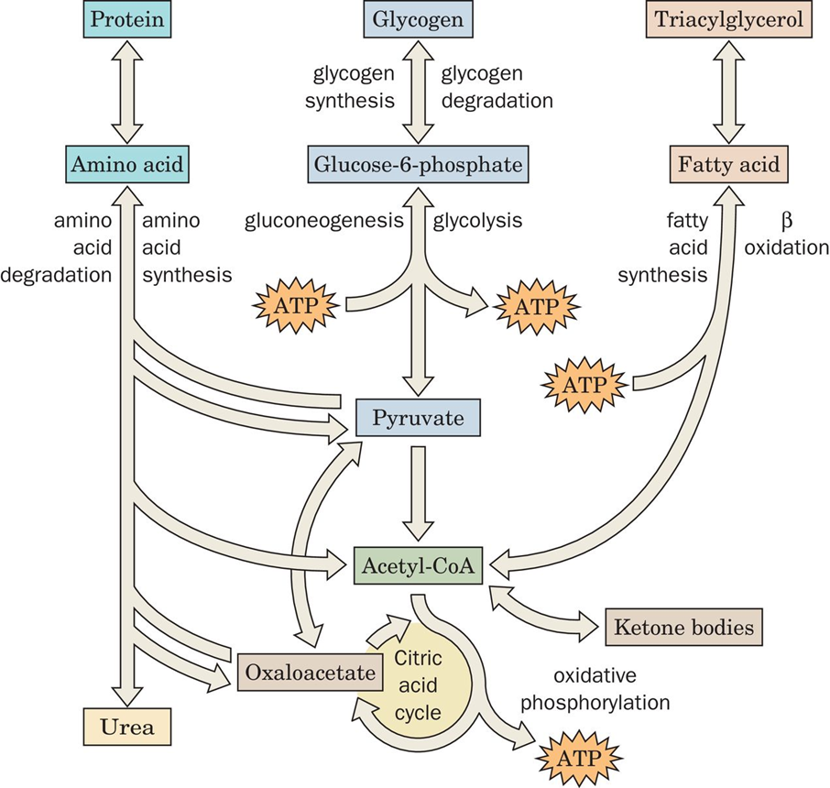
Major Fuel Metabolism Pathways

Slide 5
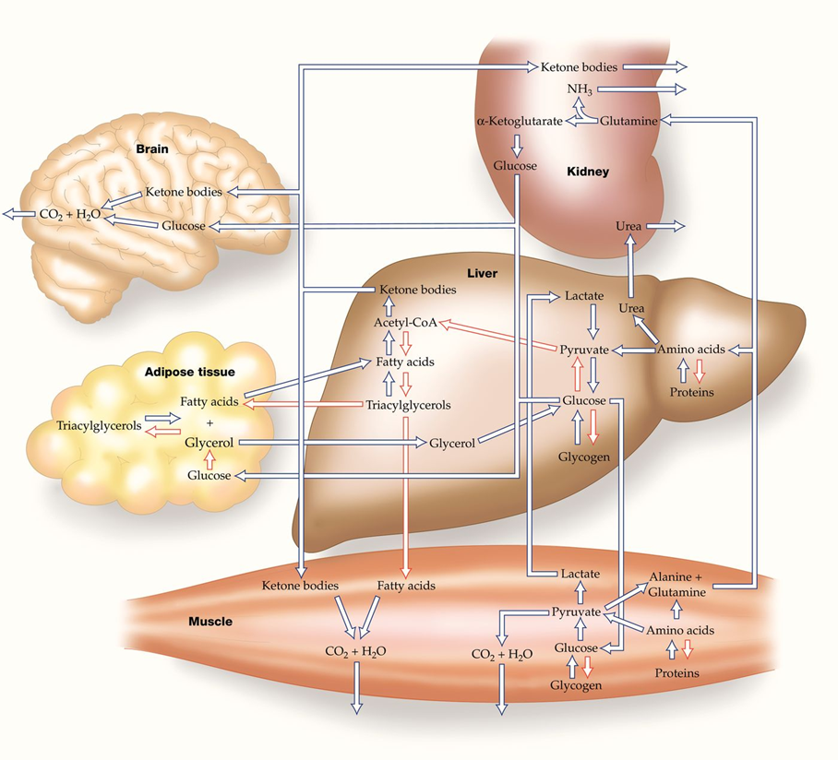
Metabolic Interrelationships: Brain, Adipose, Muscle, Liver, and Kidney

Slide 6
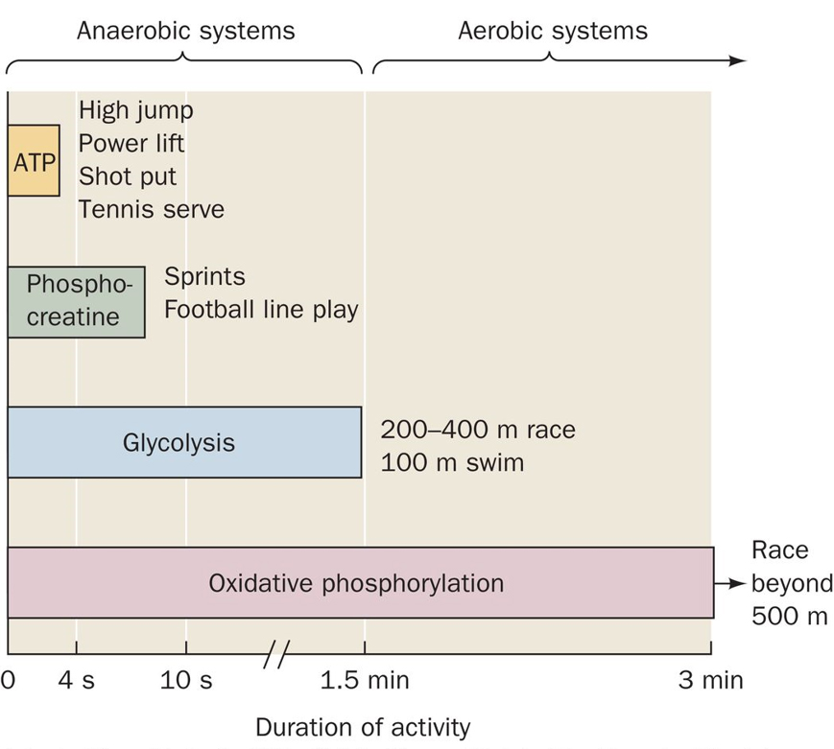
ATP Source During Exercise
Adapted from McArdle, W.D., Katch, F.I., and Katch, V.L., Exercise Physiology, 2nd ed., Lea & Febiger (19 86), p. 348.

Slide 7
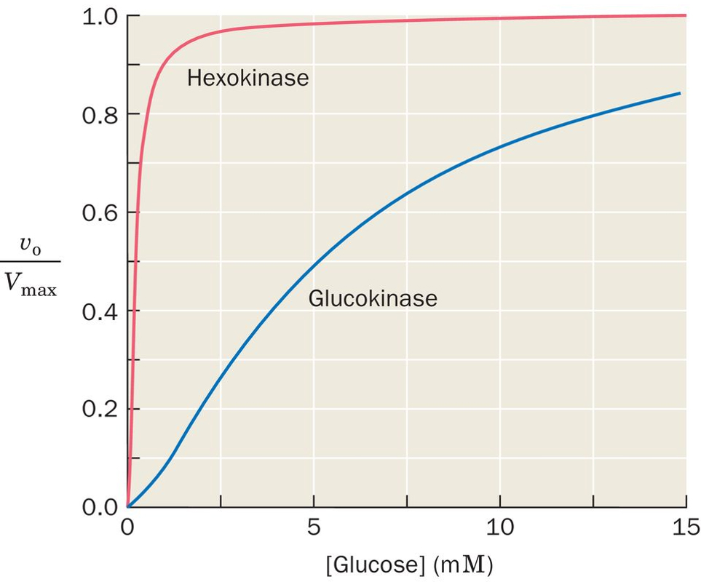
Hexokinase vs. Glucokinase
Obtained from Cardenas, M.L., Rabajille, E., and Niemeyer, H., Eur. J. Biochem. 145, 163–171 (19 84).

Slide 8
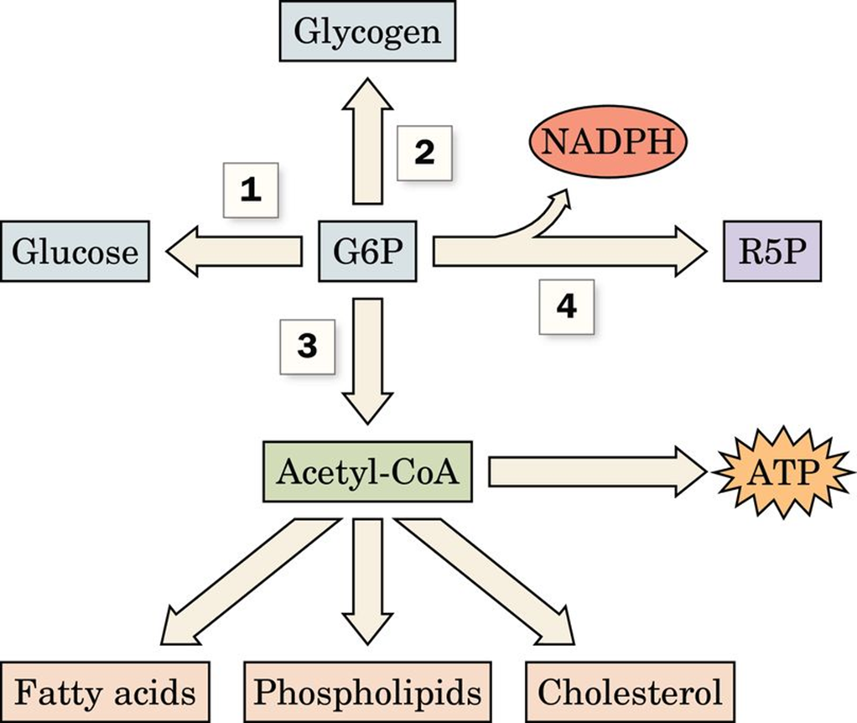
Metabolic Fate of G6P

Slide 9
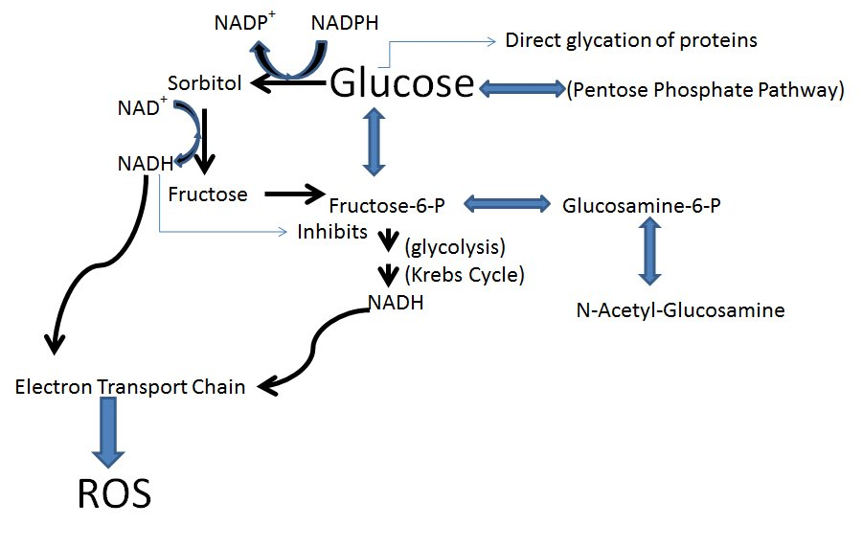

Slide 10
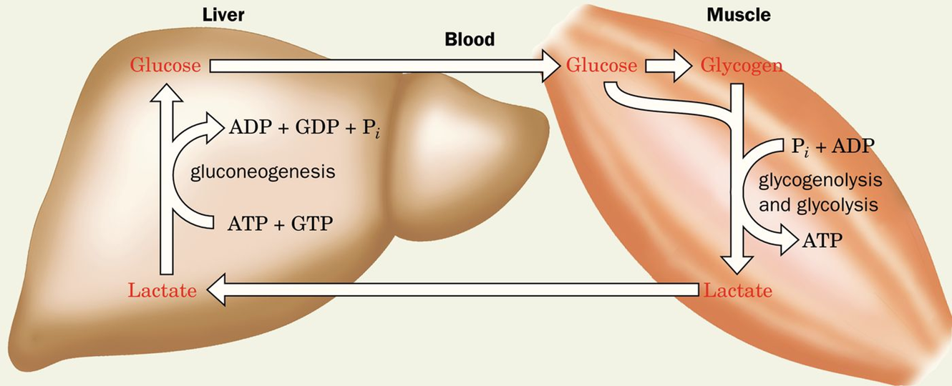
Cori Cycle

Slide 11
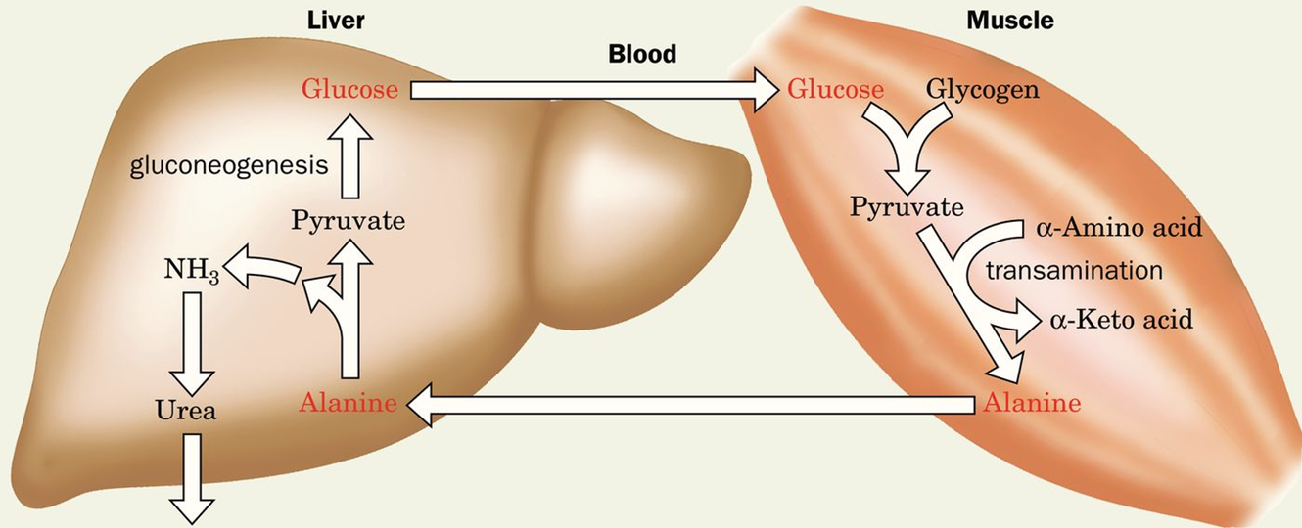
Glucose-Alanine Cycle

Slide 12
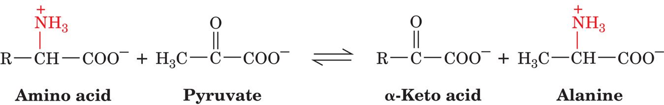
Muscle Aminotransferases Convert Pyruvate to Alanine

Slide 13
Chapter 22: Organ Specialization (2 of 4)
Checkpoint 22.1
Summarize the importance of pyruvate and acetyl-CoA for catabolism and anabolism.
Without looking at Figure 22-1, draw a diagram of the major metabolic pathways involving proteins, glycogen, and triacylglycerols.
Summarize the major features of fuel metabolism in the brain, muscle, adipose tissue, liver, and kidney.
Explain why the high KM of glucokinase is important for the role of the liver in buffering blood glucose.
List all the possible fates for a glucose molecule in the liver.
Describe the conditions under which the Cori cycle and the glucose–alanine cycle operate.
Without looking at the text, draw diagrams of these two metabolic cycles.

Slide 14
Chapter 22: Hormonal Control of Fuel Metabolism (1 of 2)
Key Concepts 22.2
Insulin release in response to glucose promotes fuel uptake and storage.
Glucagon and the catecholamines promote fuel mobilization.

Slide 15
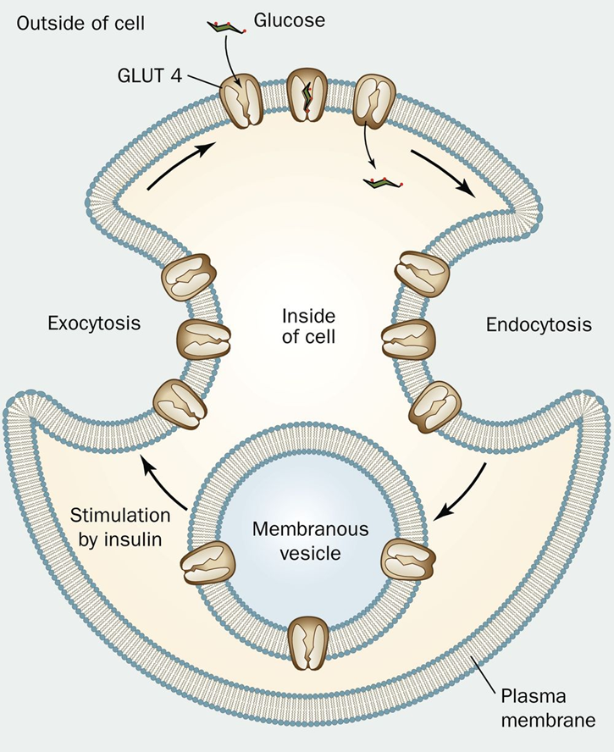
GLUT4 Activity

Slide 16
Hormonal Effects on Metabolism by Tissue
Table 22-1 Hormonal Effects on Fuel Metabolism
Tissue | Insulin | Glucagon | Epinephrine
Muscle | ↑ Glucose uptake | No effect | ↑ Glycogenolysis
 | ↑ Glycogen synthesis
Adipose tissue | ↑ Glucose uptake | ↑ Lipolysis | ↑ Lipolysis
 | ↑ Lipogenesis
 | ↓ Lipolysis
Liver | ↑ Glycogen synthesis | ↓ Glycogen synthesis | ↓ Glycogen synthesis
 | ↑ Lipogenesis | ↑ Glycogenolysis | ↑ Glycogenolysis
 | ↓ Gluconeogenesis |  | ↑ Gluconeogenesis

Slide 17
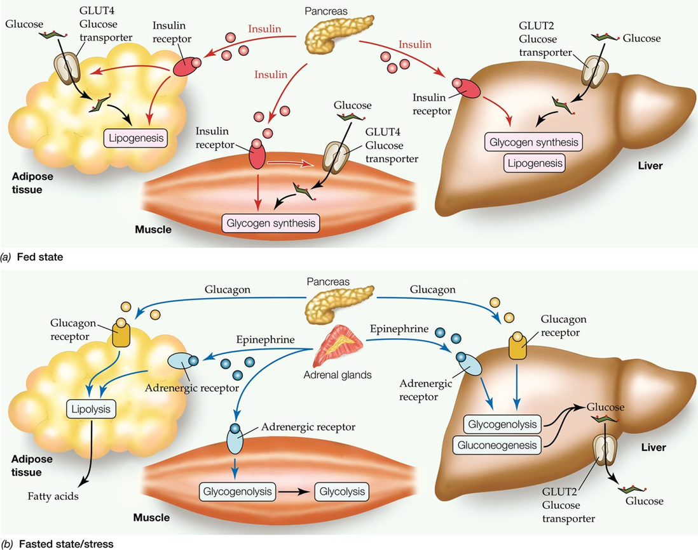
Overview of Hormonal Control

Slide 18
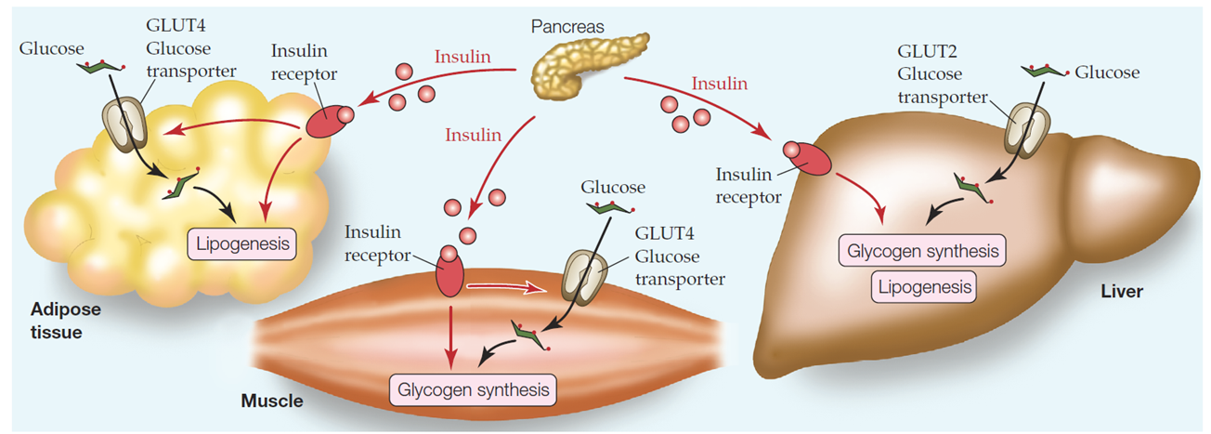
Hormonal Control: Fed State

Slide 19
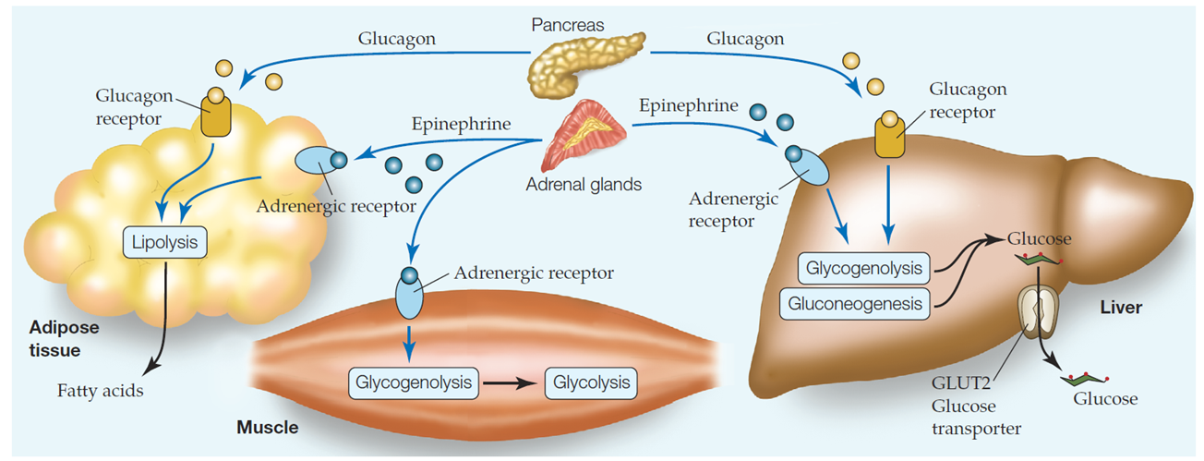
Hormonal Control: Fasted State

Slide 20
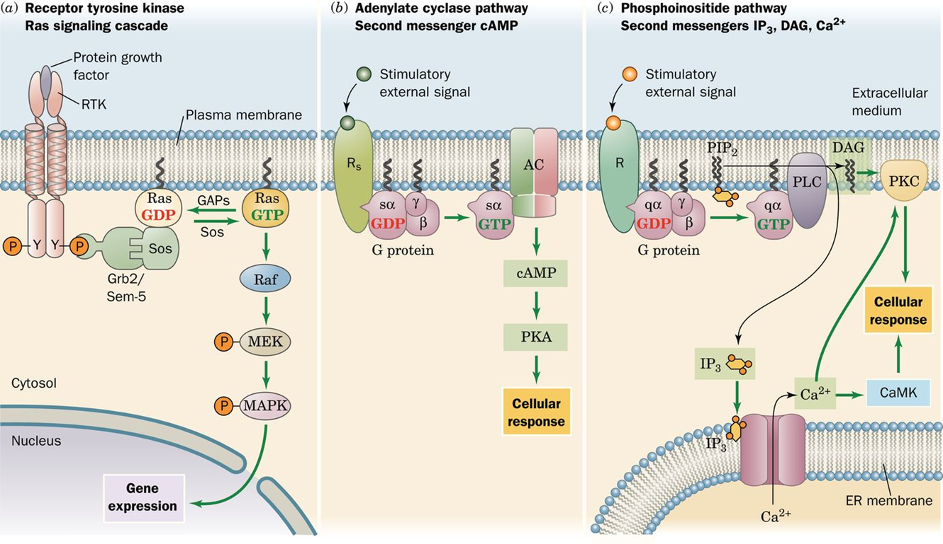
Overview of Signal Transduction Pathways (1 of 4)

Slide 21
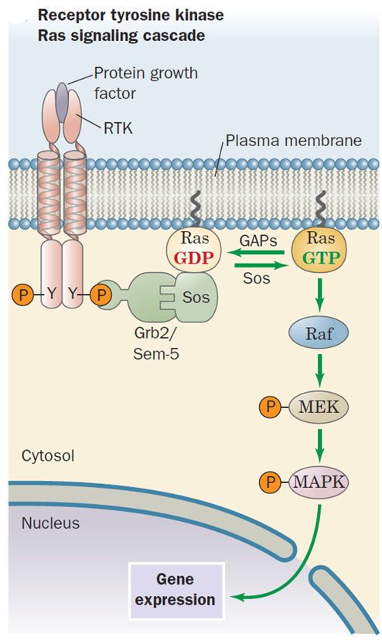
Overview of Signal Transduction Pathways (2 of 4)

Slide 22
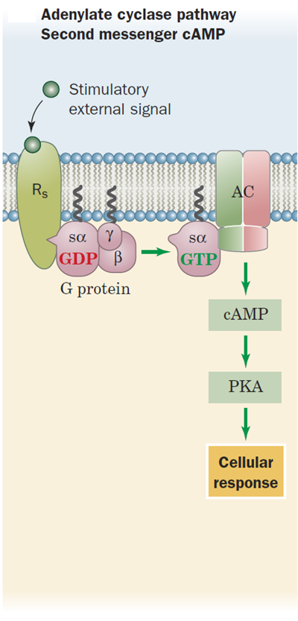
Overview of Signal Transduction Pathways (3 of 4)

Slide 23
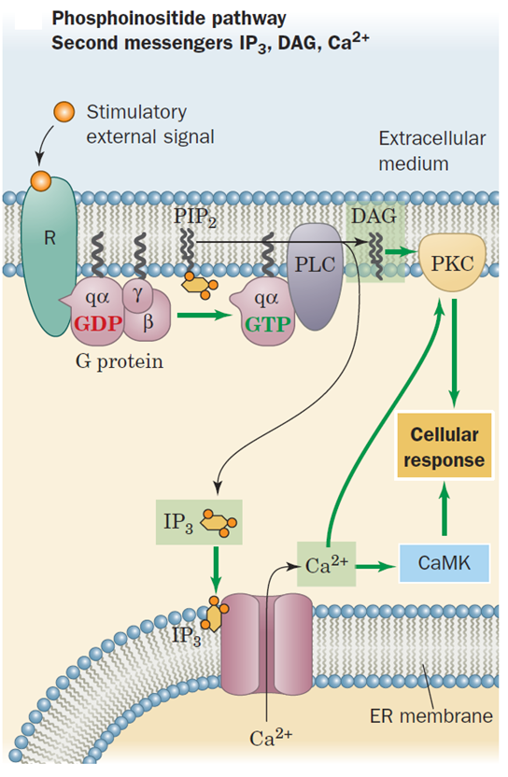
Overview of Signal Transduction Pathways (4 of 4)

Slide 24
Chapter 22: Hormonal Control of Fuel Metabolism (2 of 2)
Checkpoint 22.2
How does the pancreas sense glucose levels?
Summarize the role of insulin in regulating fuel metabolism in the liver, muscle, and adipose tissue.
How do glucagon and epinephrine affect fuel metabolism in liver, muscle, and adipose tissue?
Describe the three main types of signaling pathways that participate in metabolic regulation.

Slide 25
Chapter 22: Metabolic Homeostasis: Regulation of Energy Metabolism, Appetite, & Body Weight (1 of 2)
Key Concepts 22.3
AMP-dependent protein kinase activates A T P-generating processes and inhibits A T P-consuming processes.
Fuel use and appetite are regulated by the adipose tissue hormones adiponectin and leptin as well as by hormones produced by the hypothalamus, stomach, and intestine.
Thermogenesis helps balance energy expenditure with energy intake.

Slide 26
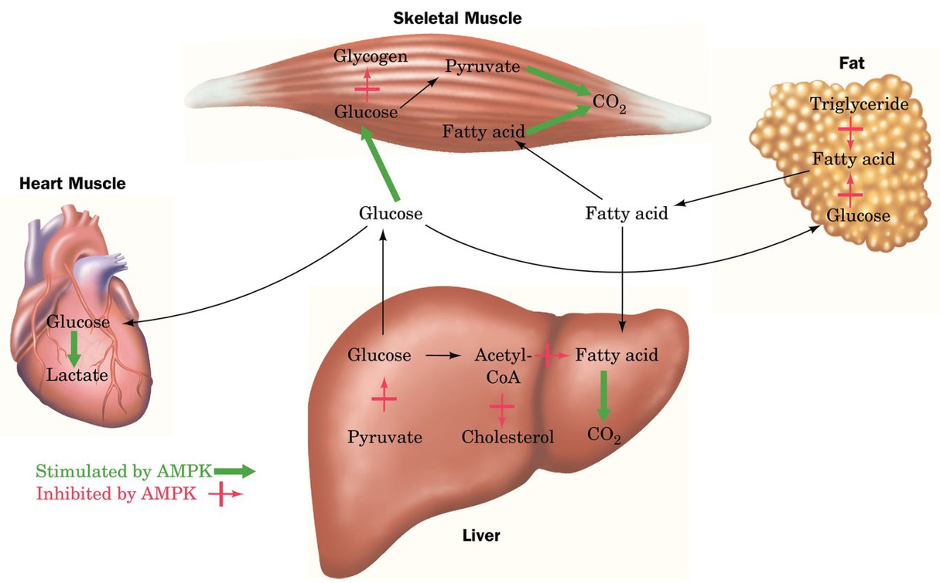
Effects of AMPK
After M.C. Towler and D.G. Hardie, Circulation Res. 100, 328 (2007).

Slide 28
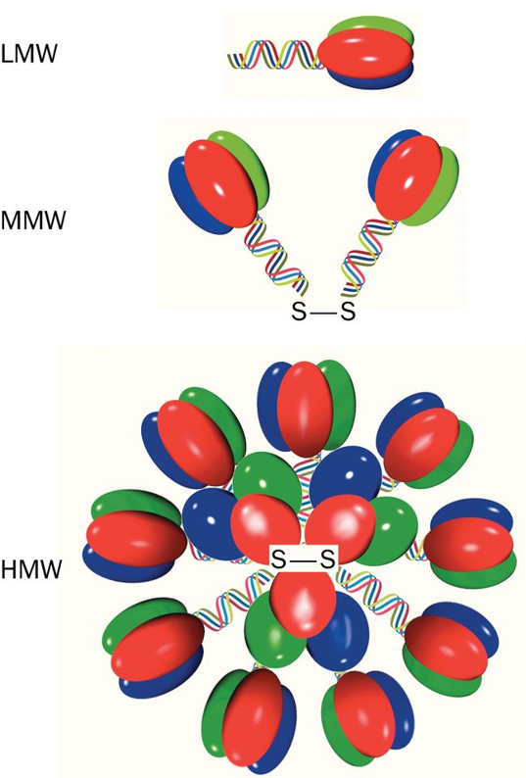
Adiponectin Regulates AMPK
After Kadowaki, T. and Yamauchi, T., Endocrine Rev. 26, 439 (2005).

Slide 29
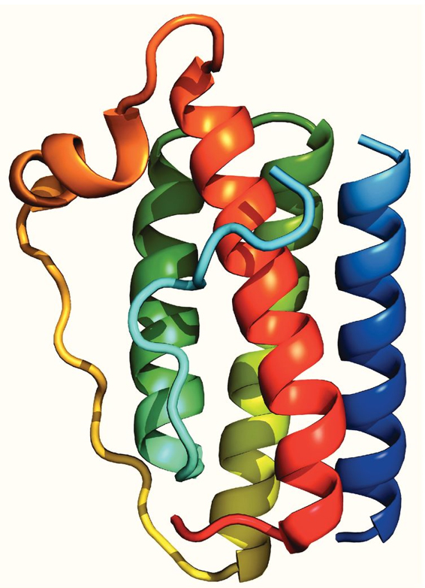
Leptin-E100
Based on an X-ray structure by Faming Zhang, Eli Lilly & Co., Indianapolis, Indiana. PDBid 1AX8.
Human leptin-E100 PDBid 1AX8

Slide 30
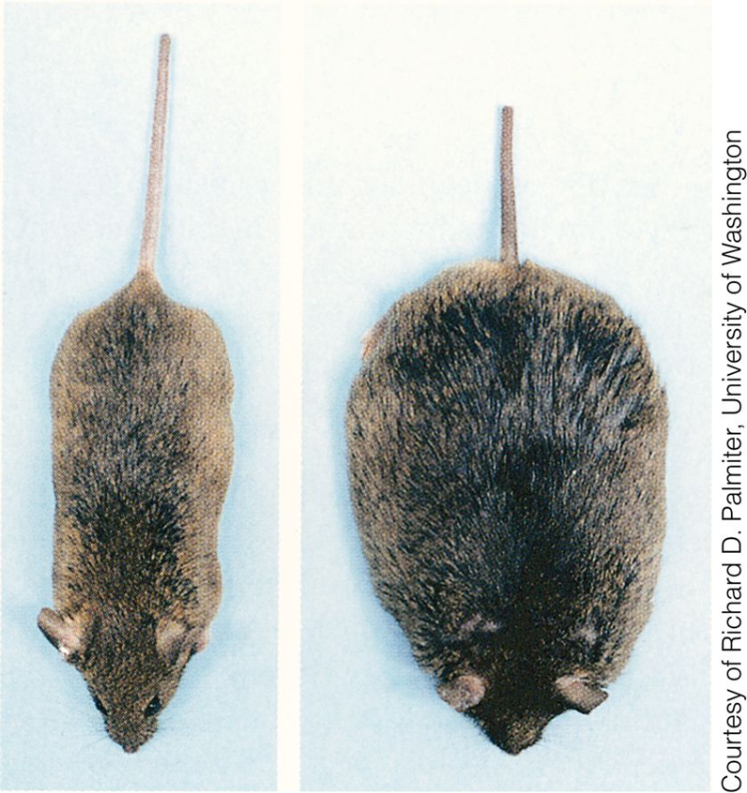
Normal & Obese Mice

Slide 31
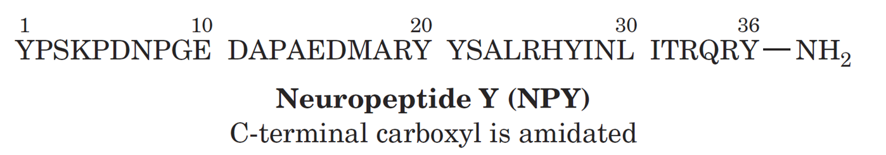
Neuropeptide Y Stimulates Appetite

Slide 32
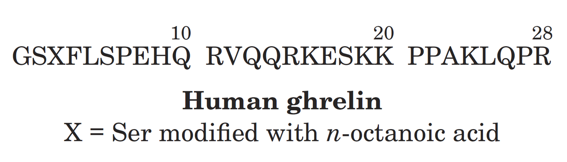
Ghrelin: Appetite Stimulating Peptide

Slide 33
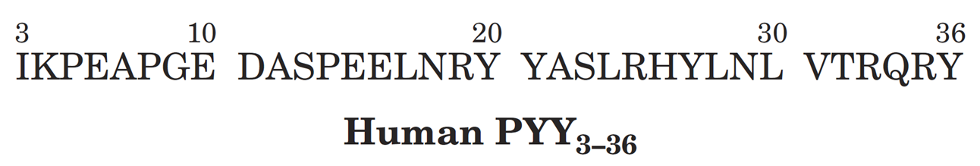
PYY₃₋₃₆: Appetite Suppressing Hormone

Slide 34
Chapter 22: Metabolic Homeostasis: Regulation of Energy Metabolism, Appetite, & Body Weight (2 of 2)
Checkpoint 22.3
Why is AMPK called the cell’s fuel gauge?
Summarize AMPK’s activity in liver, muscle, and adipose tissue.
Compare the roles of leptin, ghrelin, insulin, and PYY in controlling appetite.
How does thermogenesis help prevent obesity?

Slide 35
Chapter 22: Organ Specialization (3 of 4)
Key Concepts 22.4
During starvation, the body makes metabolic changes to maintain blood glucose levels.
Diabetes may be caused by either insufficient production of insulin (type 1) or an insensitivity to its presence (type 2).
Obesity may result from improper regulation of appetite or energy expenditure.

Slide 36
Fuel Reserves
Table 22-2 Fuel Reserves for a Normal 70-kg Man
Fuel | Mass (kg) | Calories ª
Tissues
Fat (adipose triacylglycerols) | 15 | 141,000
Protein (mainly muscle) | 6 | 24,000
Glycogen (muscle) | 0.150 | 600
Glycogen (liver) | 0.075 | 300
Circulating fuels
Glucose (extracellular fluid) | 0.020 | 80
Free fatty acids (plasma) | 0.0003 | 3
Triacylglycerols (plasma) | 0.003 | 30
Total |  | 166,000
ª 1 (dieter’s) Calorie = 1 kcal = 4.184 kJ.
Source: Cahill, G.E., Jr., New Engl. J. Med. 282, 669 (19 70).

Slide 37
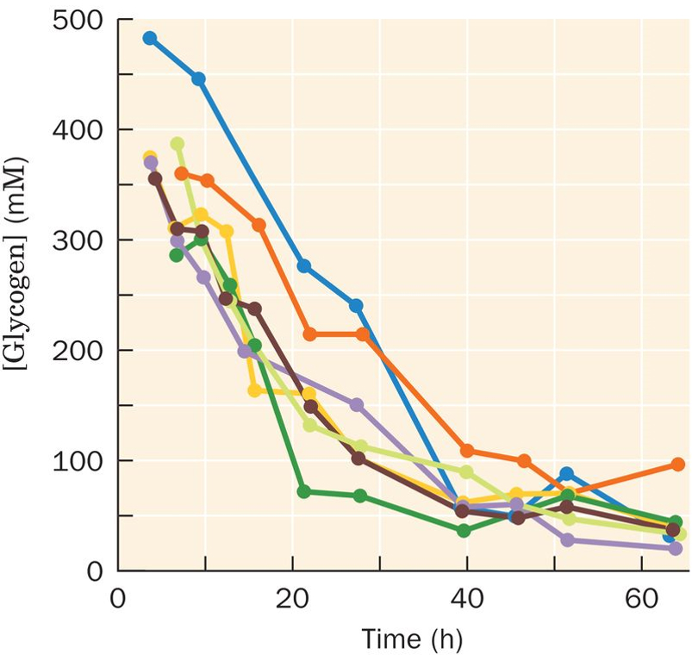
Glycogen Depletion
After Rothman, D.L., Magnusson, I., Katz, L.D., Shulman, R.G., and Shulman, G.I., Science 254, 575 (19 91).

Slide 38
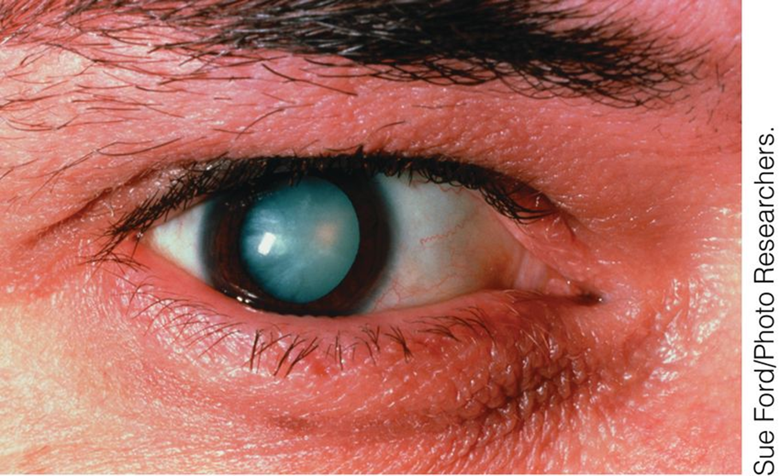
Diabetic Cataract

Slide 39
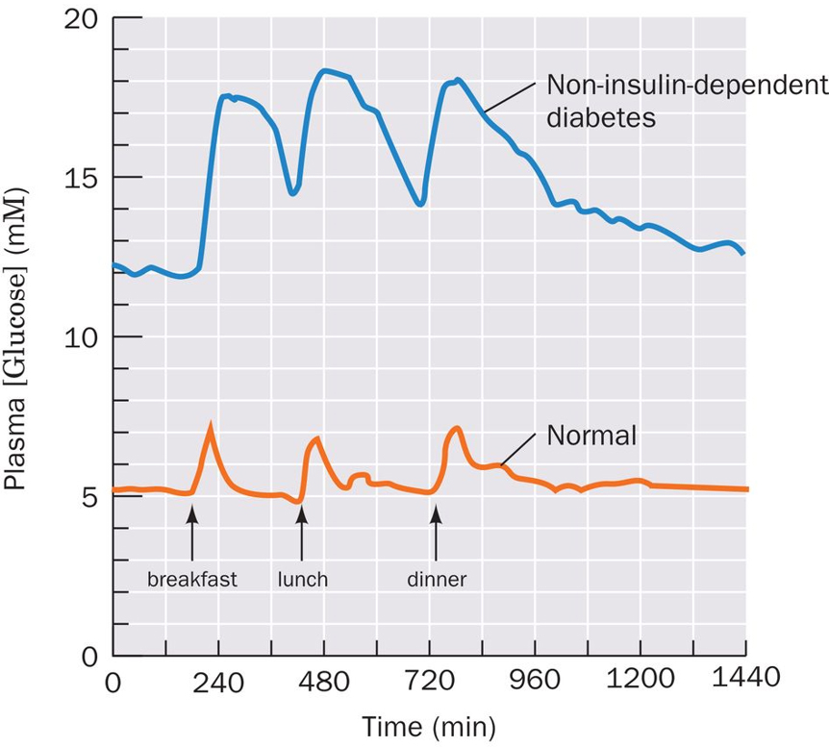
Diabetes: Plasma Glucose Profile
After Bell, G.I., Pilkis, S.J., Weber, I.T., and Polonsky, K.S., Annu. Rev. Physiol. 58, 178 (19 96).

Slide 40
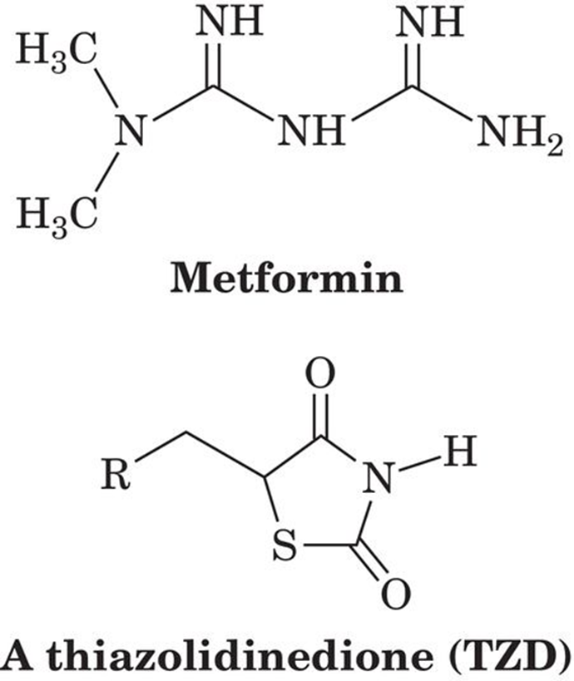
Drugs Decrease Insulin Resistance

Slide 41
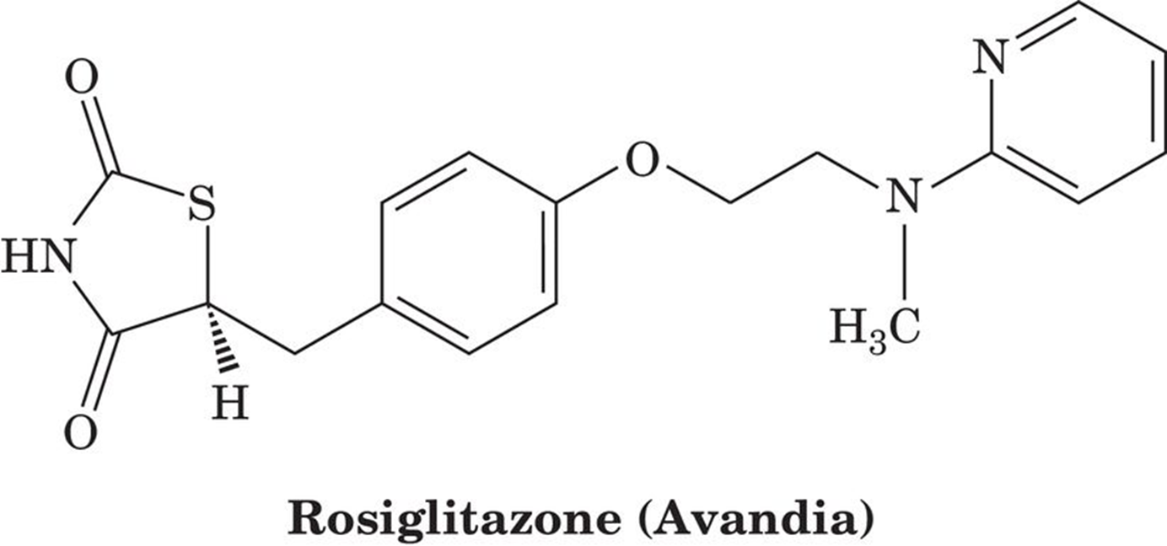
Some Increase Risk of Heart Attack & Stroke

Slide 42
Chapter 22: Organ Specialization (4 of 4)
Checkpoint 22.1
How does the body allocate food-derived fuel molecules?
Describe the metabolic changes that occur during early and late starvation.
Distinguish insulin-dependent and non-insulin-dependent diabetes mellitus.
How does insulin resistance or the lack of insulin contribute to the typical symptoms of diabetes?
How is obesity related to non-insulin-dependent diabetes mellitus?

Slide 43
Copyright
Copyright © 2016 John Wiley & Sons, Inc.
All rights reserved. Reproduction or translation of this work beyond that permitted in Section 117 of the 19 76 United States Act without the express written permission of the copyright owner is unlawful. Request for further information should be addressed to the Permissions Department, John Wiley & Sons, Inc. The purchaser may make back-up copies for his/her own use only and not for distribution or resale. The Publisher assumes no responsibility for errors, omissions, or damages, caused by the use of these programs or from the use of the information contained herein.

