Slide 1
Essential Biochemistry
Fourth Edition
Charlotte W. Pratt | Kathleen Cornely
Lecture Notes for
Chapter 18
Nitrogen Metabolism

Slide 2
Nitrogen Fixation and Assimilation
Section 18.1
Learning Objective
Describe the chemical reactions of nitrogen fixation and assimilation

Slide 3
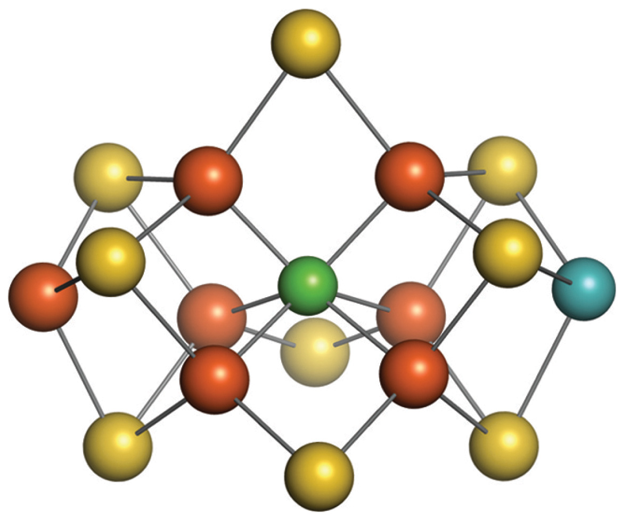
Model of the FeMo Cofactor of Nitrogenase

Slide 4
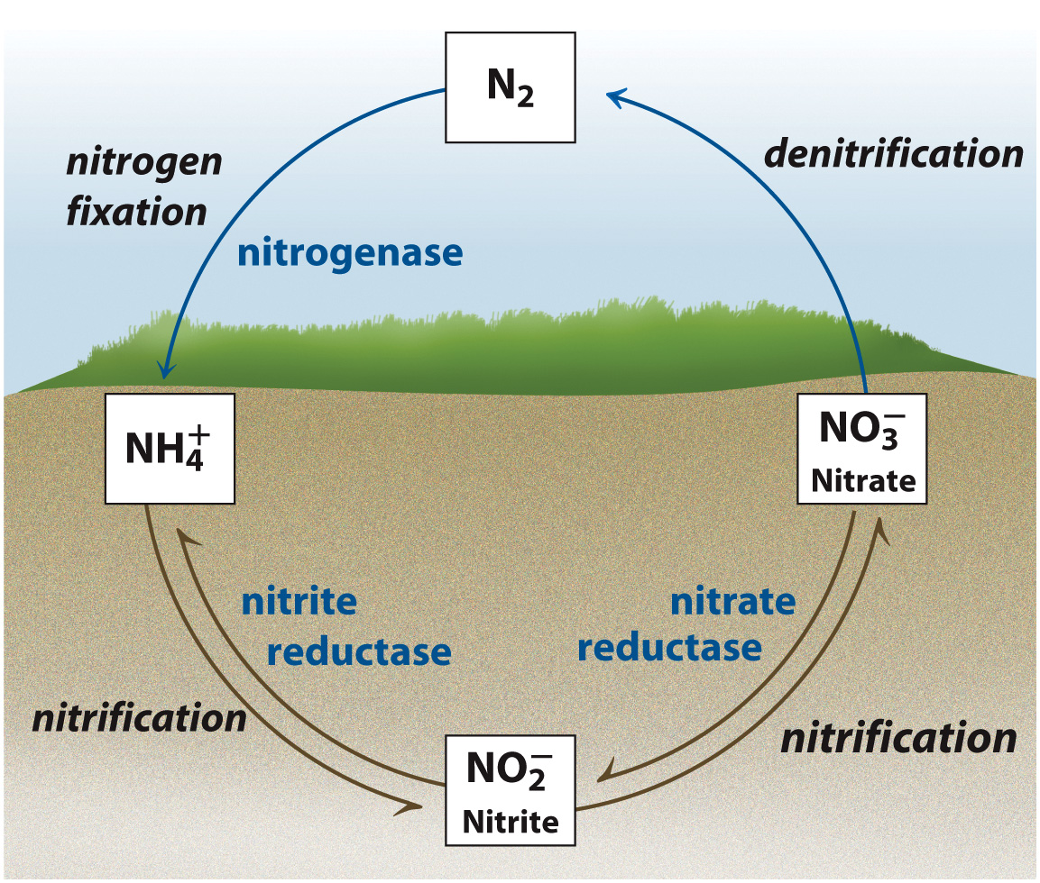
The Nitrogen Cycle

Slide 5
Glutamate Synthetase Reaction

Slide 6
Glutamate Synthase Reaction

Slide 7
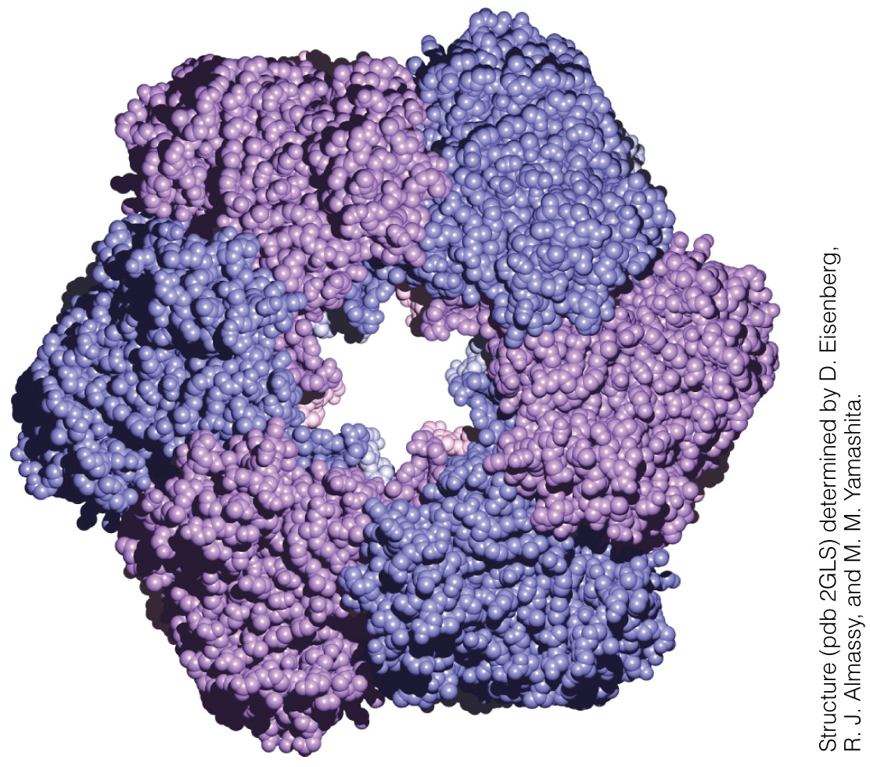
Structure of E. coli Glu Synthetase

Slide 8
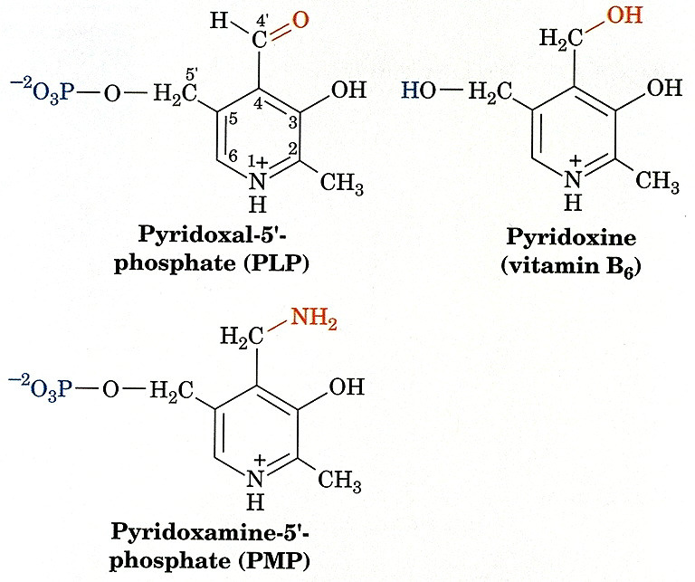
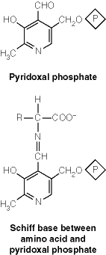
Transamination:

Slide 9
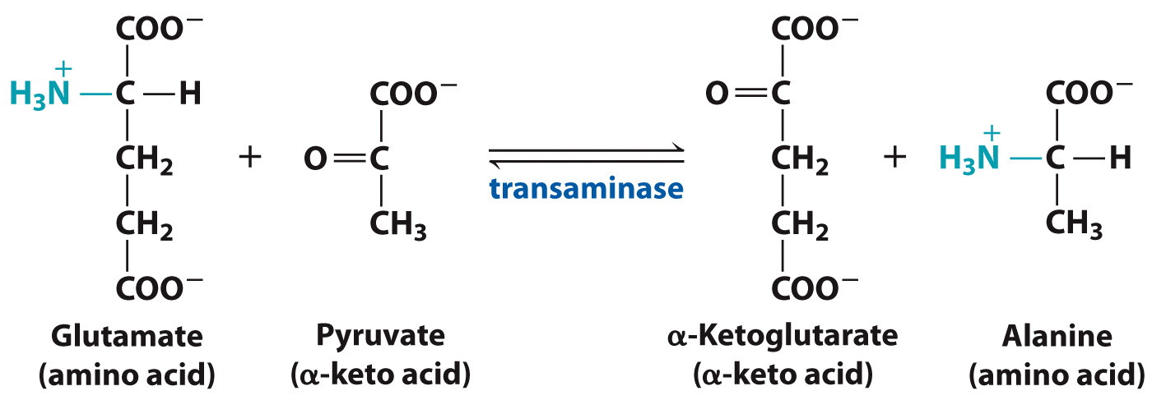
Transaminase Reaction

Slide 10
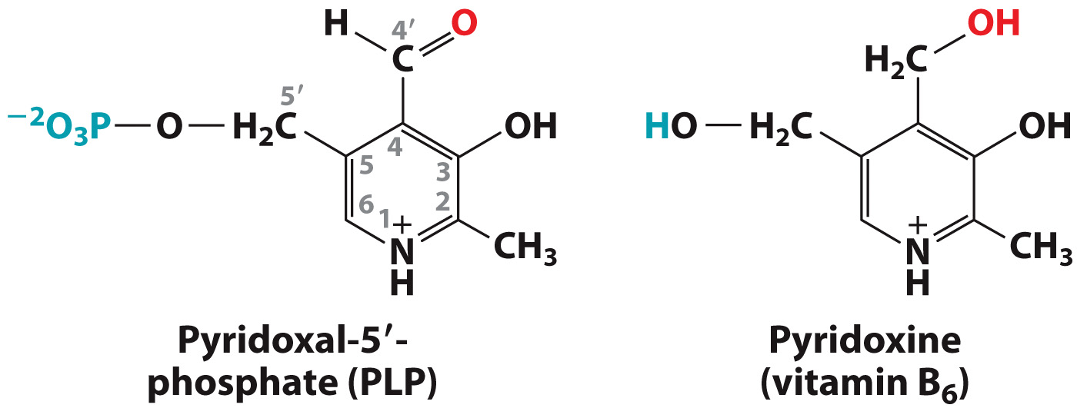
Pyridoxal-5’-Phosphate is a derivative of pyridoxine

Slide 11
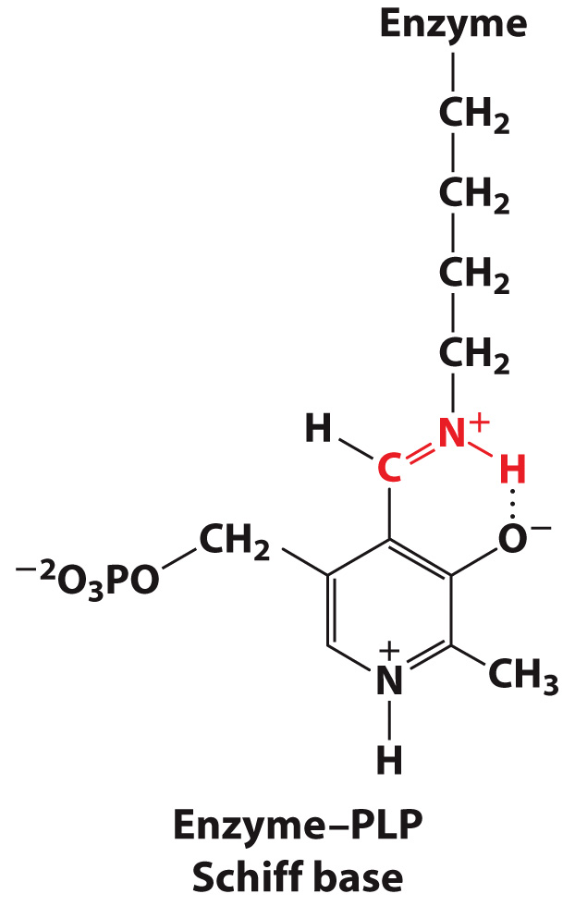
Transaminase Binding to PLP

Slide 12
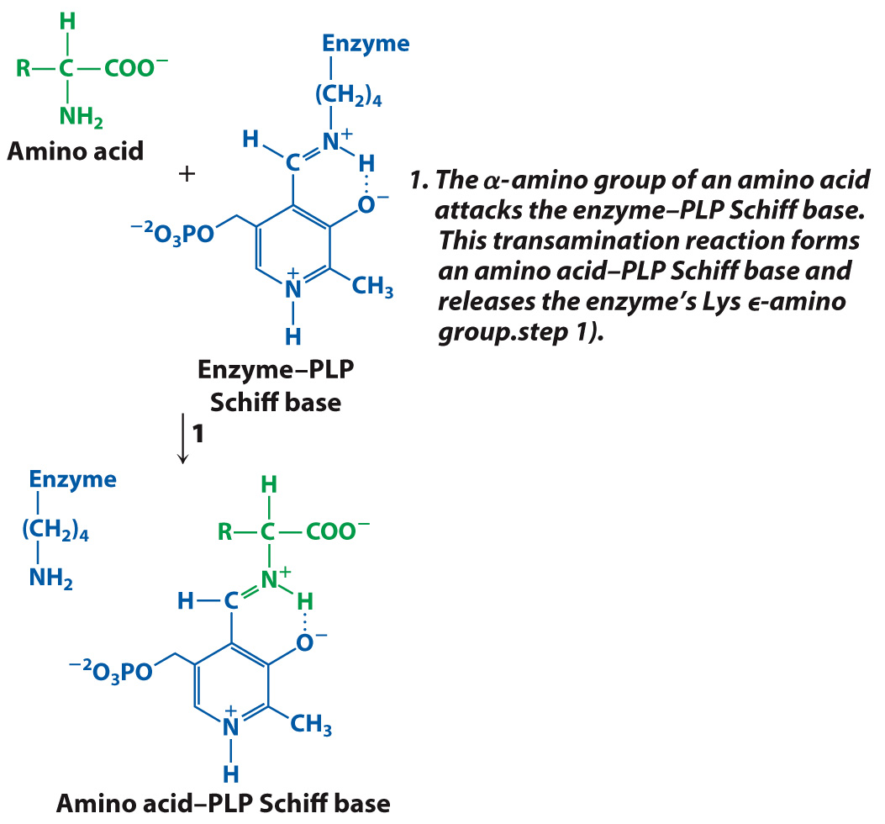
The Mechanism of Transamination

Slide 13
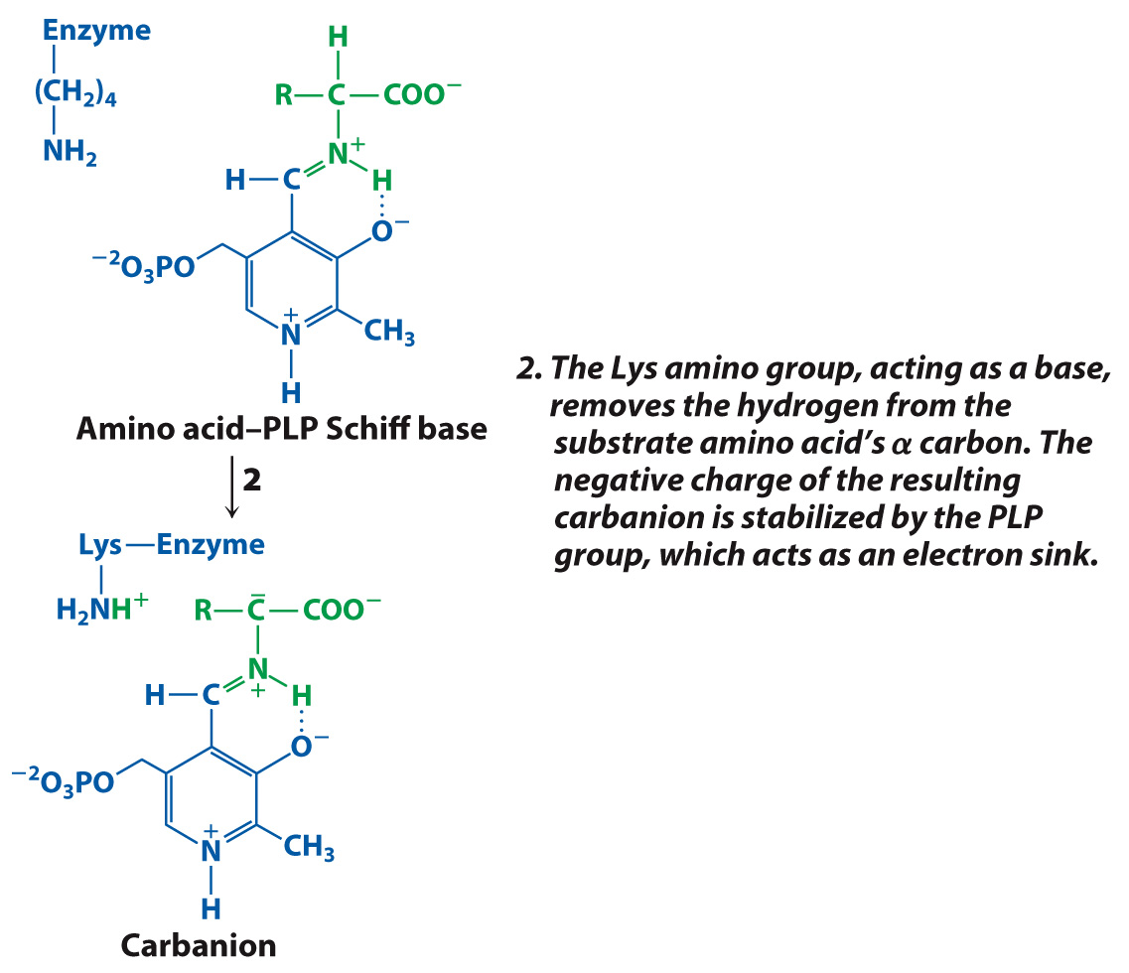
The Mechanism of Transamination

Slide 14
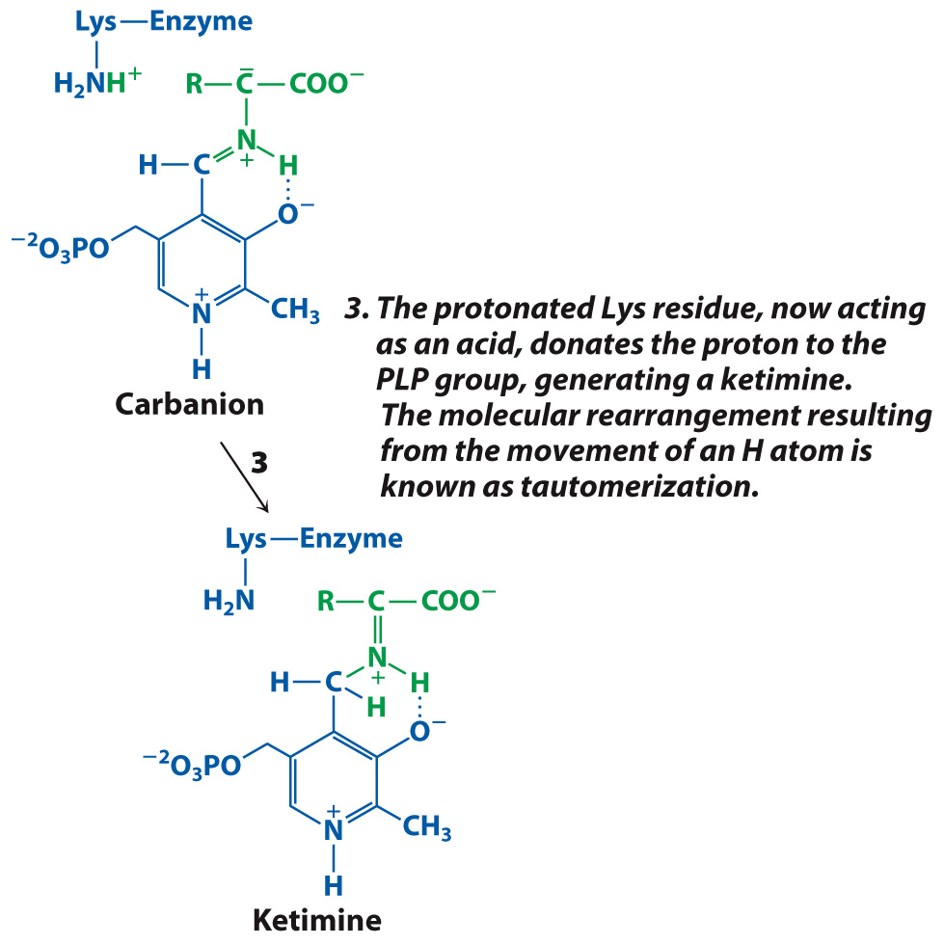
The Mechanism of Transamination

Slide 15
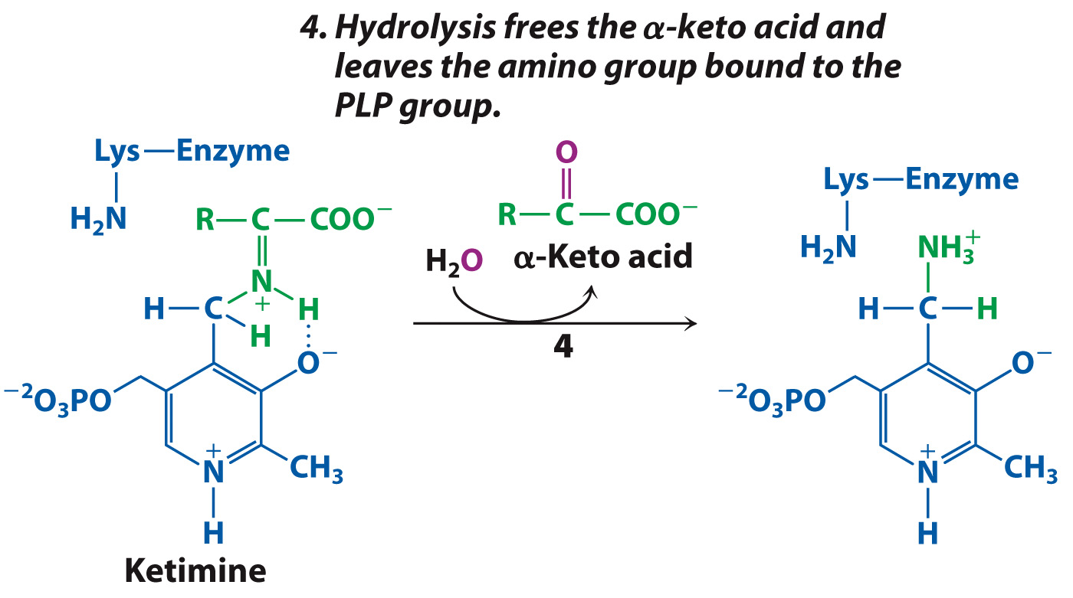
The Mechanism of Transamination

Slide 16
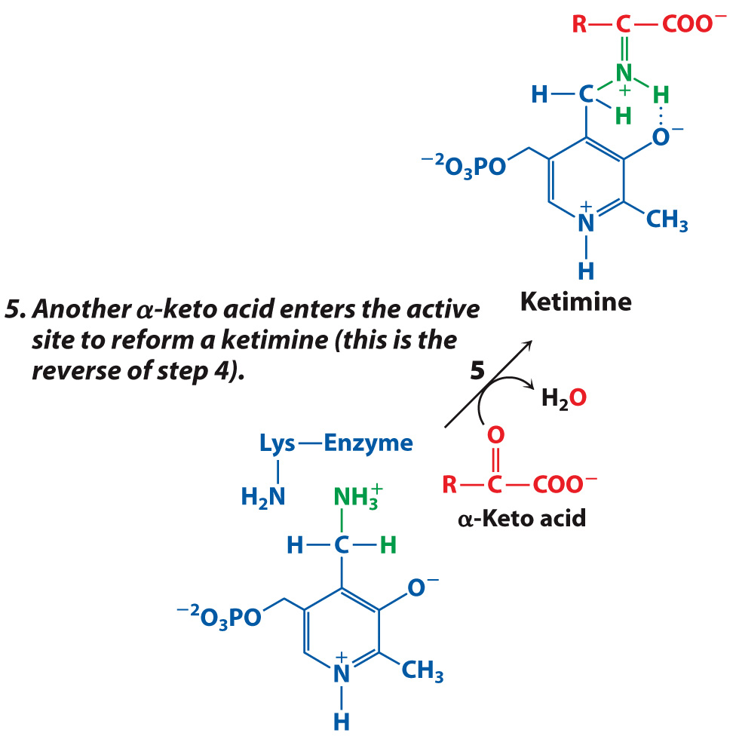
The Mechanism of Transamination

Slide 17
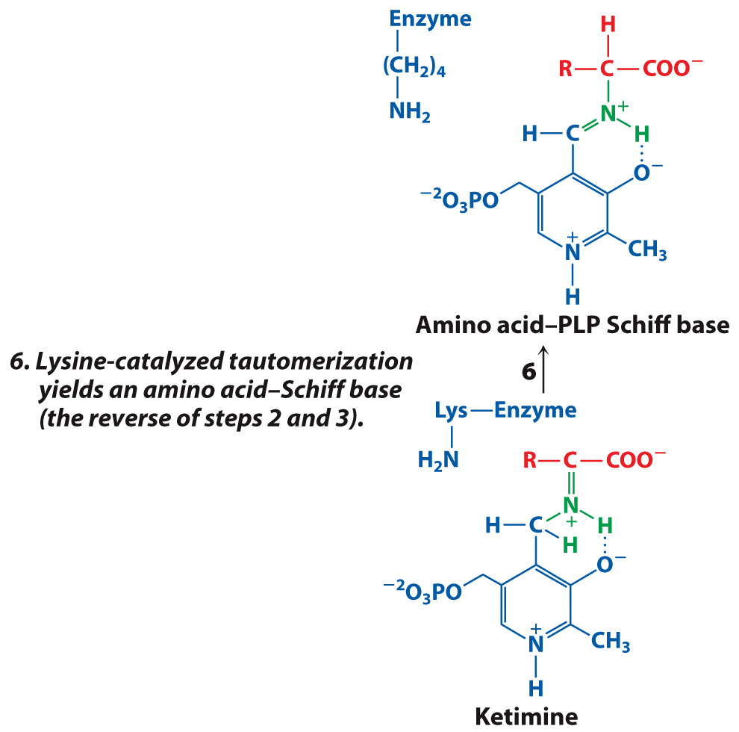
The Mechanism of Transamination

Slide 18
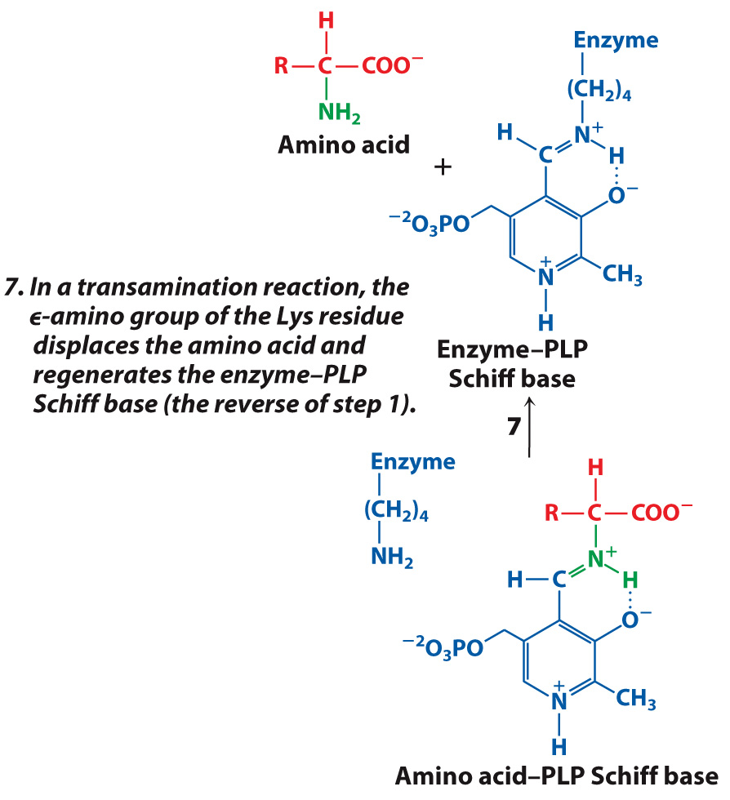
The Mechanism of Transamination

Slide 19
Amino Acid Biosynthesis
Section 18.2
Learning Objective
Summarize the pathways for synthesizing the essential and nonessential amino acids

Slide 20
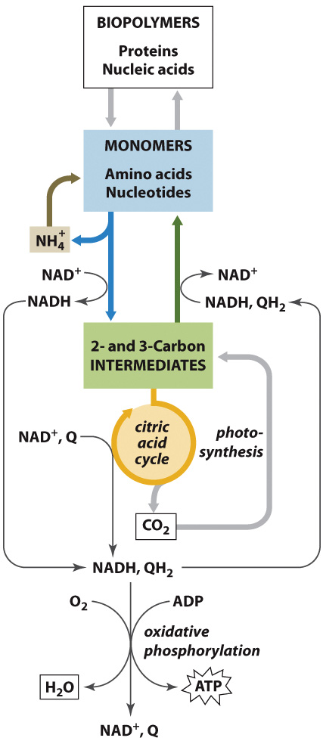
Nitrogen Metabolism in Context

Slide 21
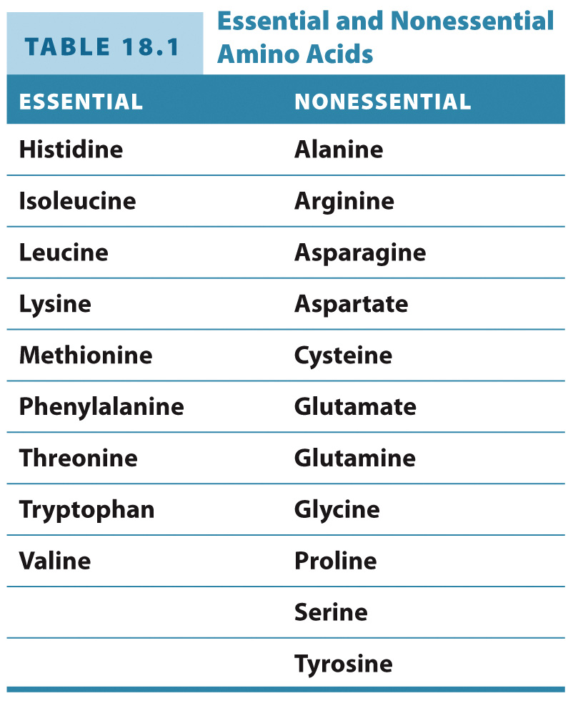

Slide 22
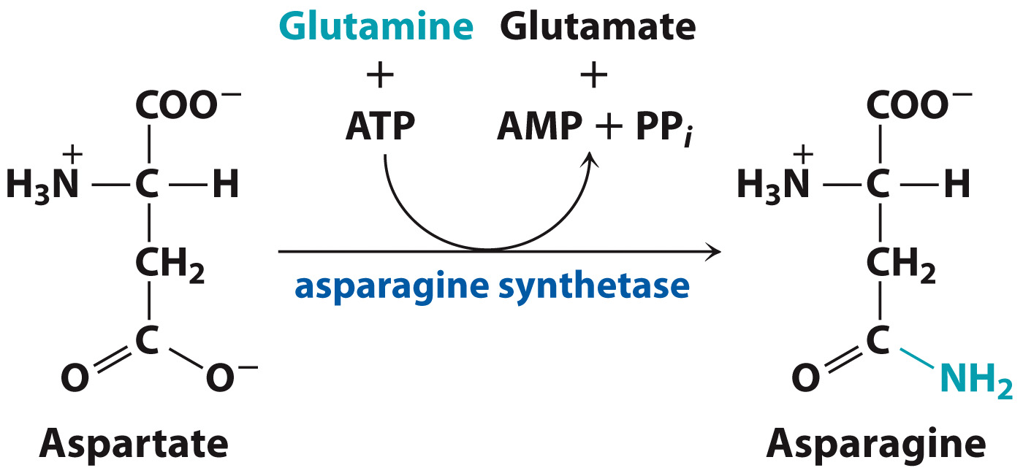
Several amino acids are easily synthesized from common intermediates

Slide 23
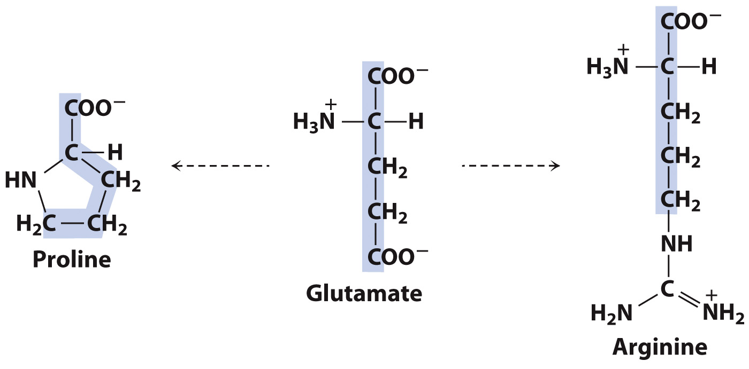
Several amino acids are easily synthesized from common intermediates.

Slide 24
Several amino acids are easily synthesized from common intermediates.

Slide 25
Several amino acids are easily synthesized from common intermediates.

Slide 26
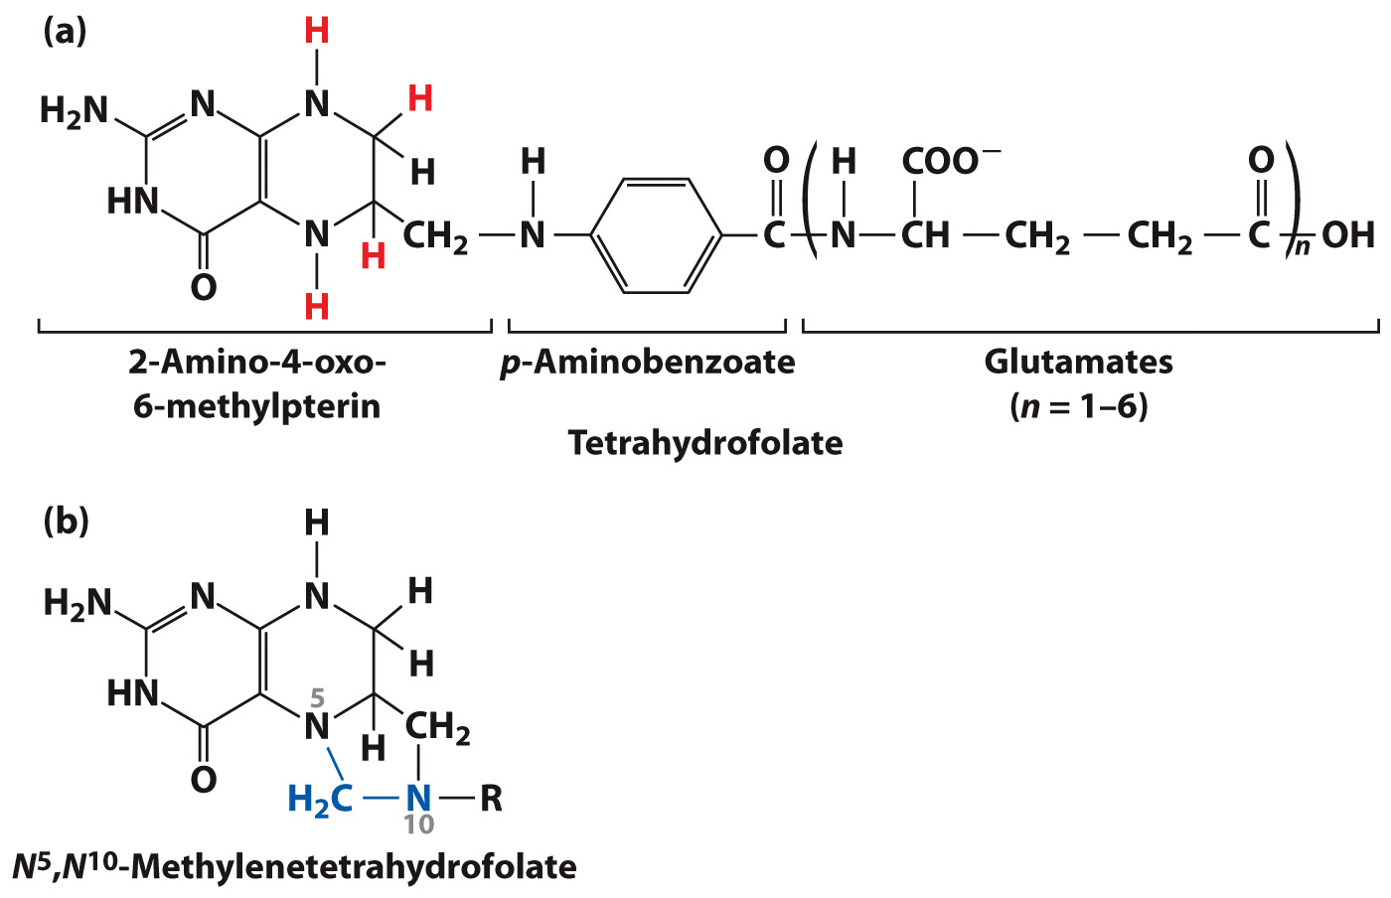
Tetrahydrofolate

Slide 27
Amino acids with sulfur, branched chains, or aromatic groups are more difficult to synthesize

Slide 28
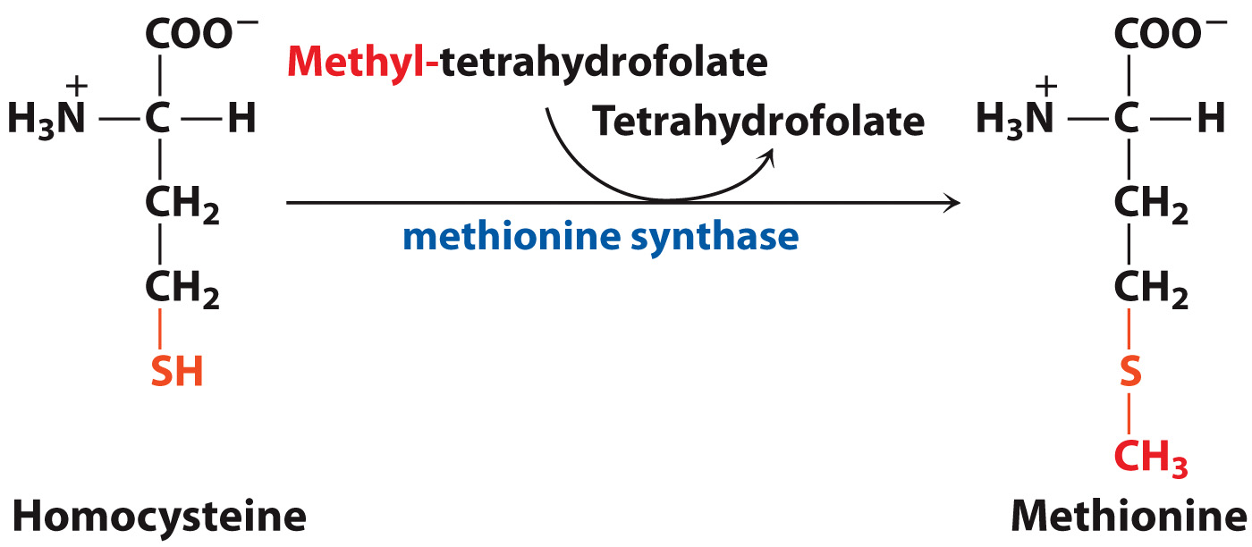
The Methionine Synthase Reaction

Slide 29
In humans, serine reacts with homocysteine to form cysteine

Slide 30
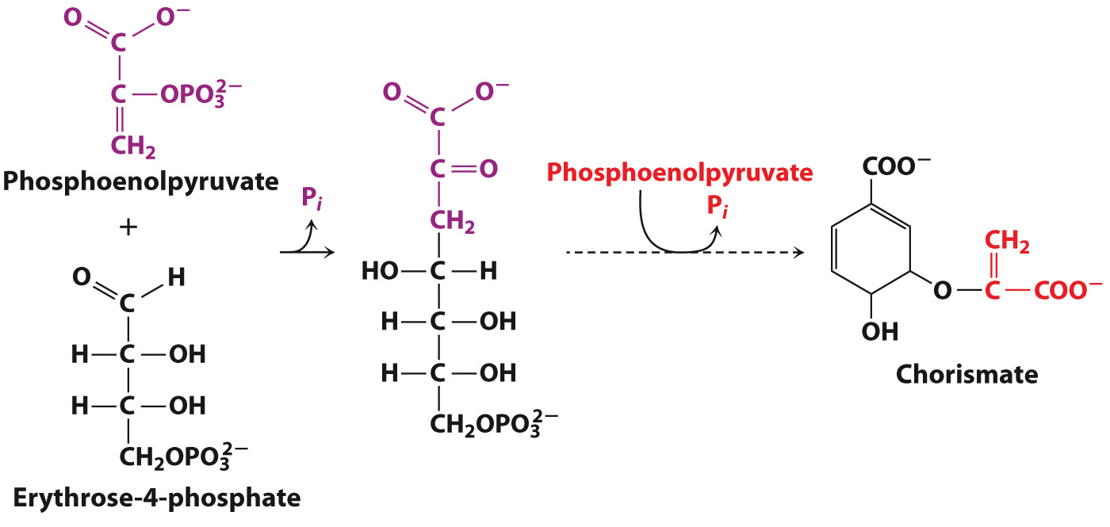
Phenylalanine and tyrosine are derived from chorismate

Slide 31
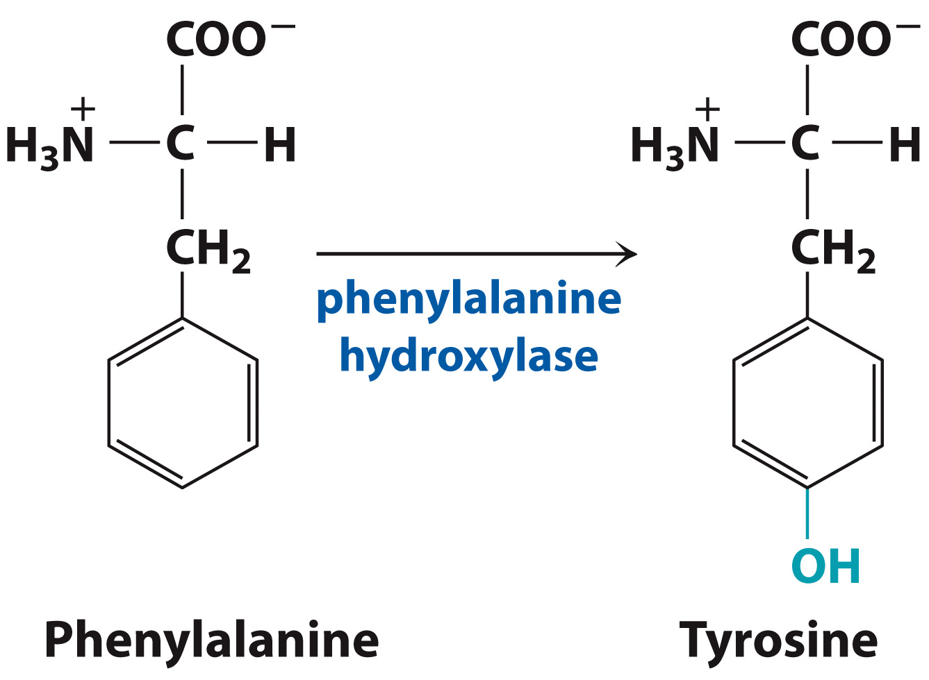
Phenylalanine Hydroxylase Reaction

Slide 32
Tryptophan synthase catalyzes the final two steps of Trp synthesis

Slide 33
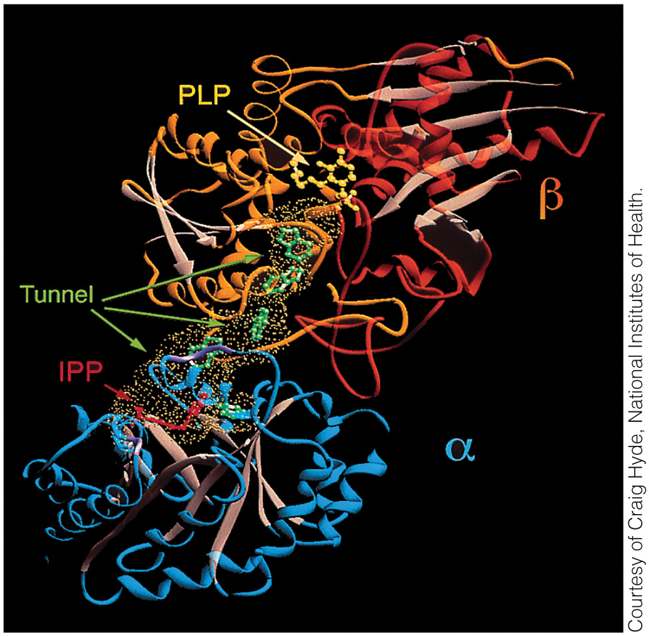
Tryptophan Synthase

Slide 34
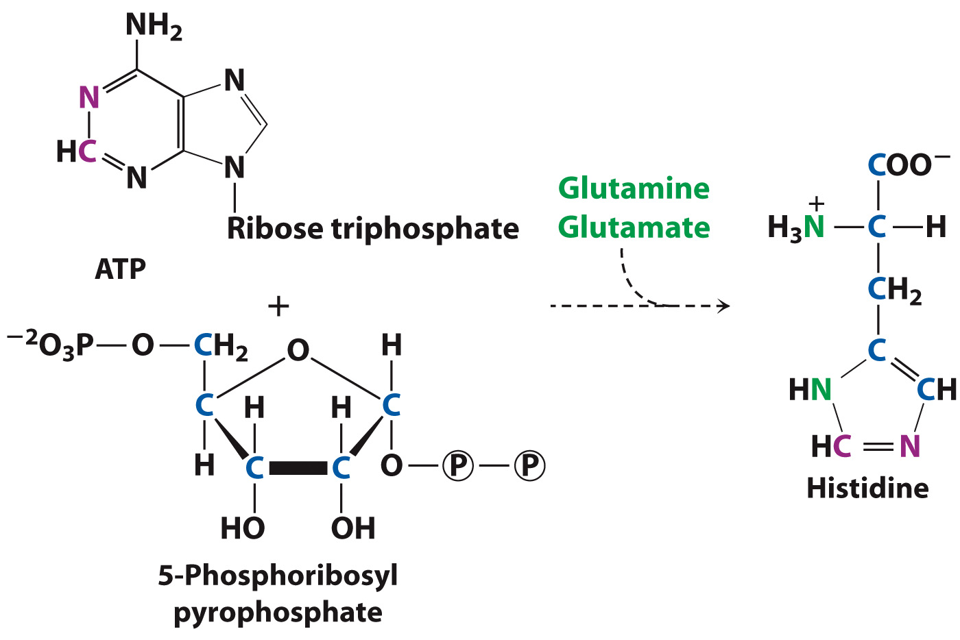
Histidine is not formed from carbohydrate metabolites

Slide 35
Amino acids are precursors of some signaling molecules

Slide 36
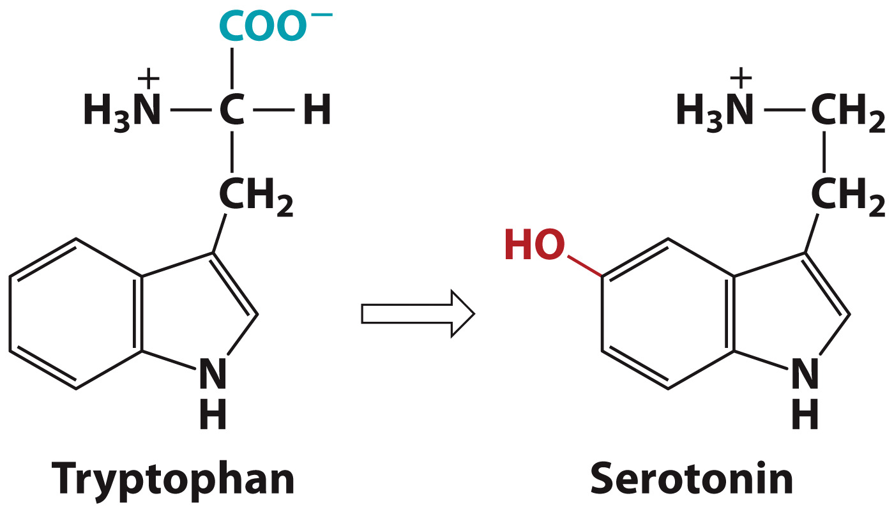
Tryptophan is the precursor of serotonin

Slide 37
Amino Acid Catabolism
Section 18.3
Learning Objective
Summarize the pathways for degrading amino acids

Slide 38
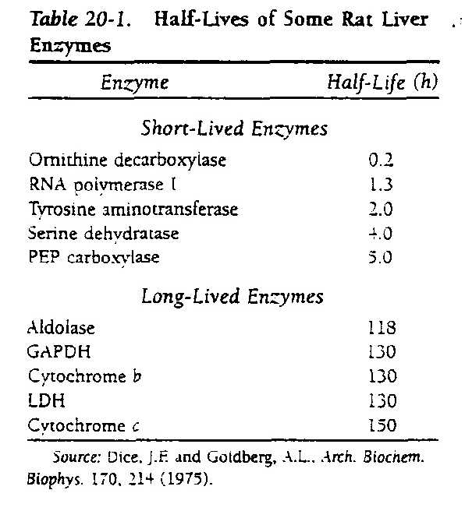
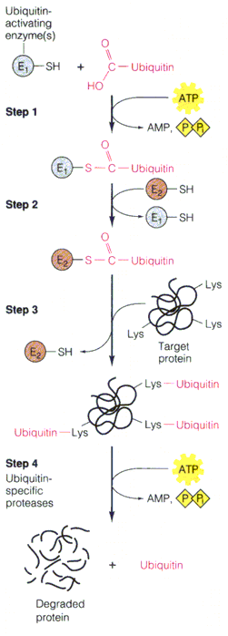
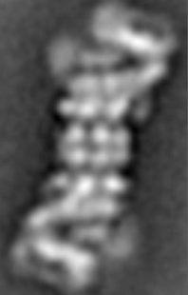
26S proteasome
One way to get amino acids:
breakdown of proteins

Slide 39
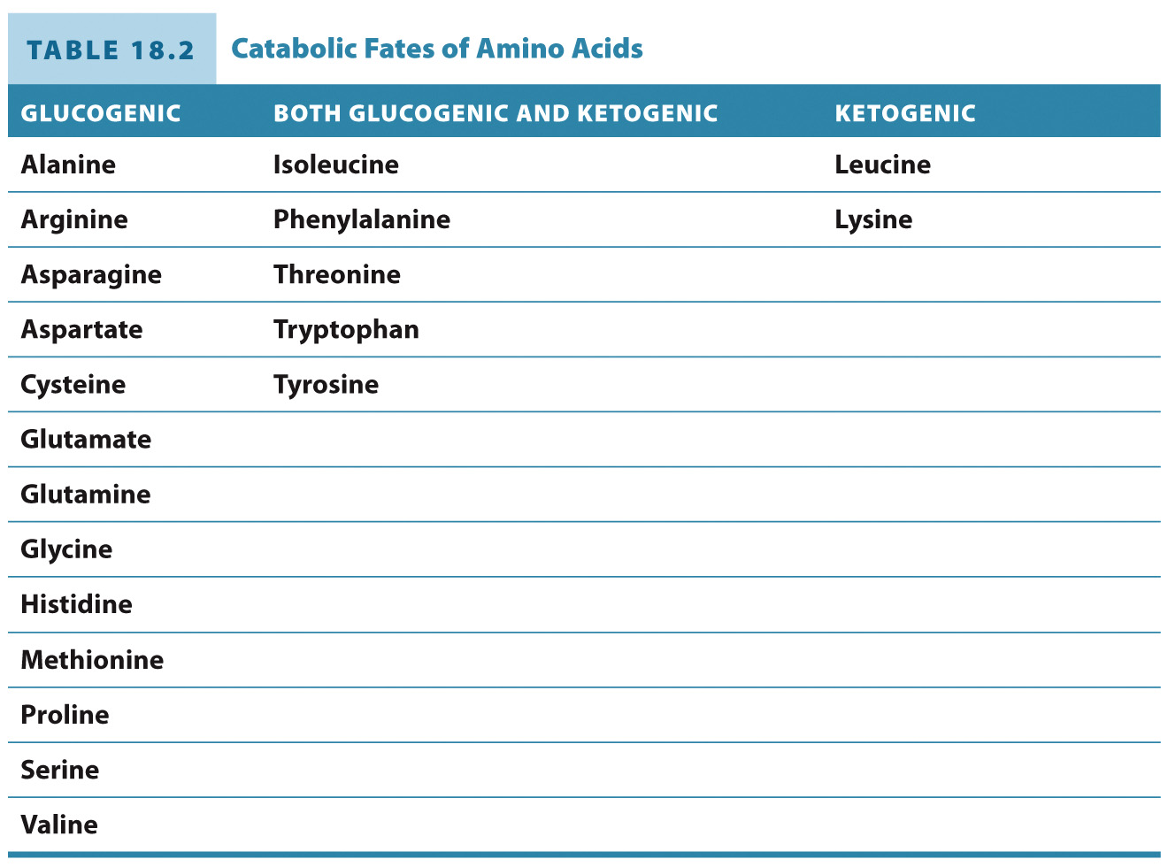
Catabolic Fates of Amino Acids

Slide 40
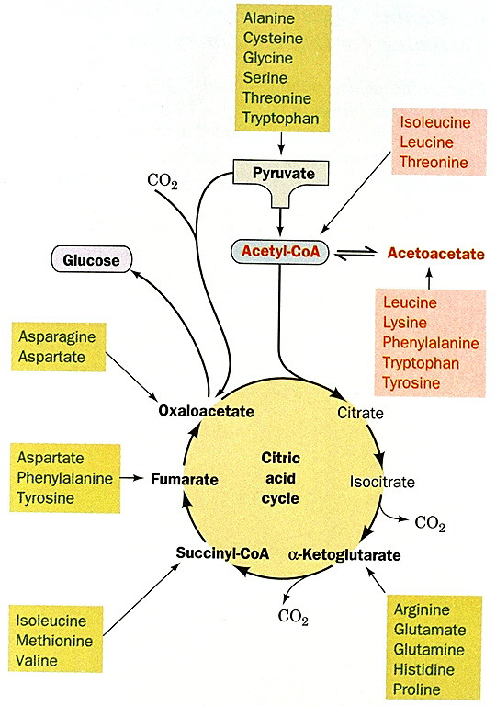
General amino acid
degradation
Ketogenic
(all else,
glucogenic)

Slide 41
Some amino acids are converted to gluconeogenic substrates via transamination

Slide 42
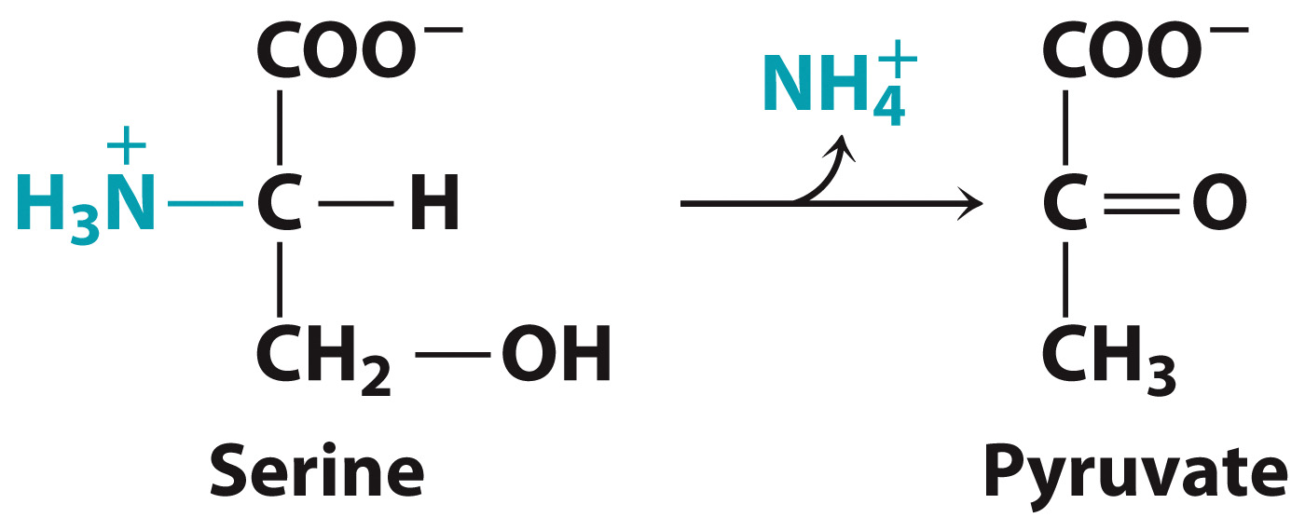
Serine is converted to pyruvate via transamination

Slide 43
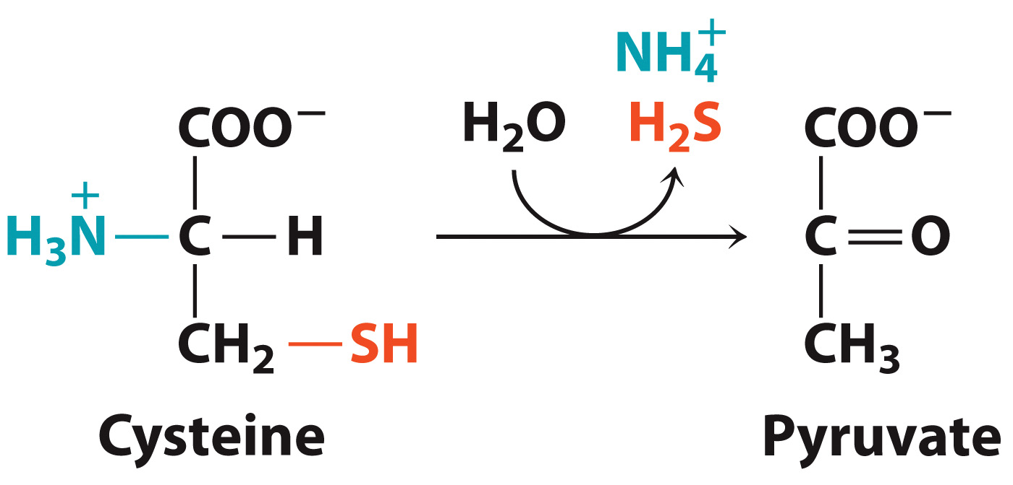
Cysteine is converted to pyruvate

Slide 44
Threonine is both glucogenic and ketogenic

Slide 45
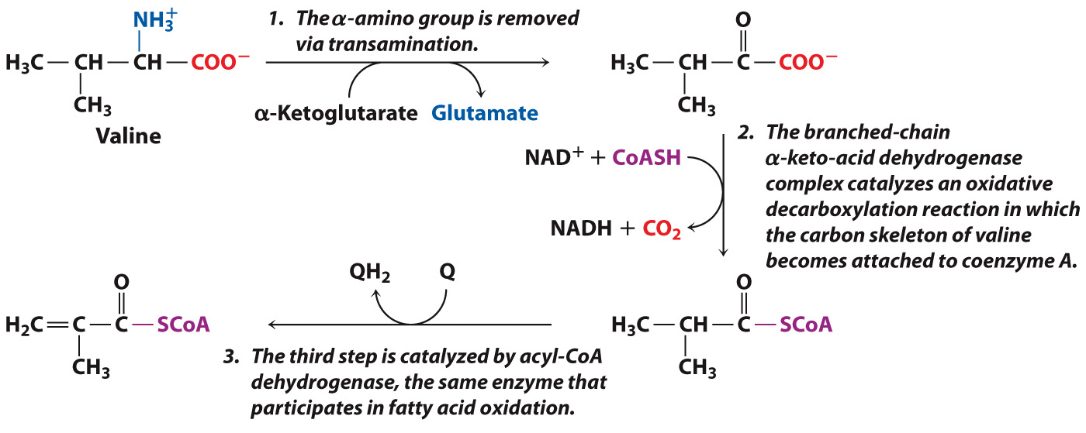
Initial Steps of Valine Degradation

Slide 46
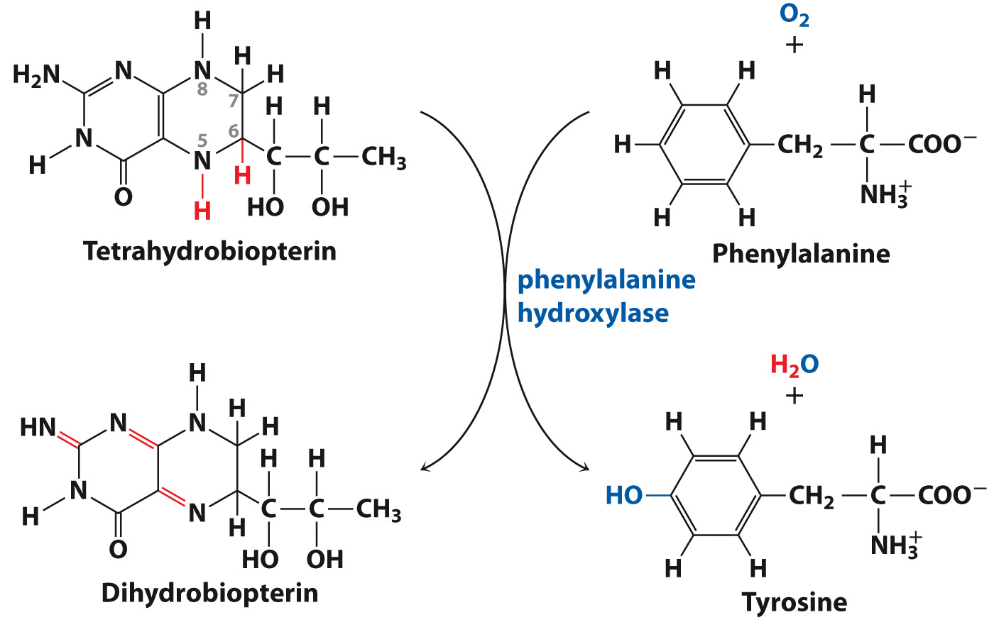
Phenylalanine Hydroxylase

Slide 47
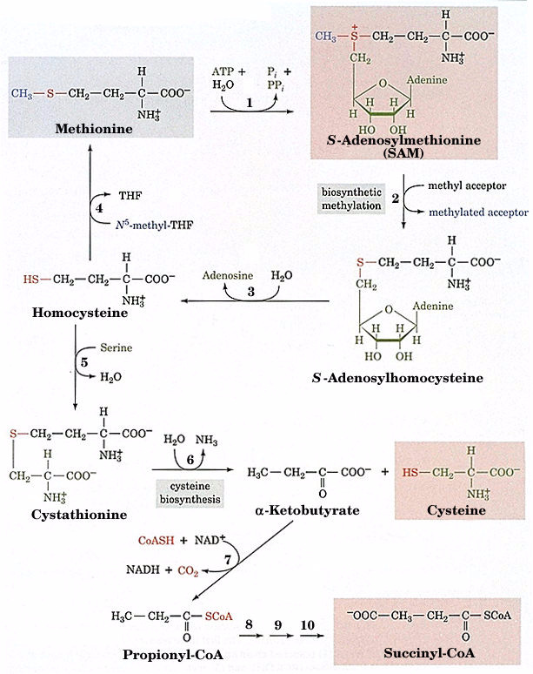
Methionine degradation
and involvement of THF, B12 & B6
Met adenosyl-
transferase
Met synthase
(and B12)
methylase
Adenosyl homo-
cysteinase
Cystathionine
β-synthase
(and PLP)
Cystathionine γ-lyase
α-keto acid DHase

Slide 48
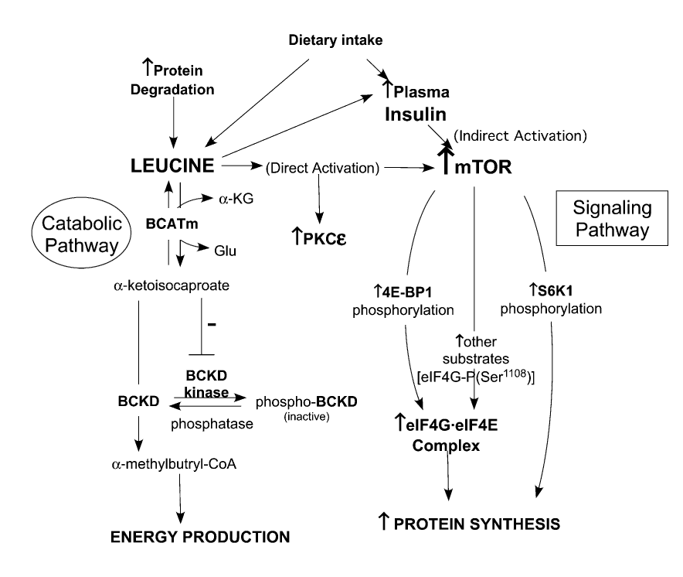
Vary & Lynch, 2007

Slide 49
Nitrogen Disposal: The Urea Cycle
Section 18.4
Learning Objective
Describe the chemical reactions of the urea cycle

Slide 50
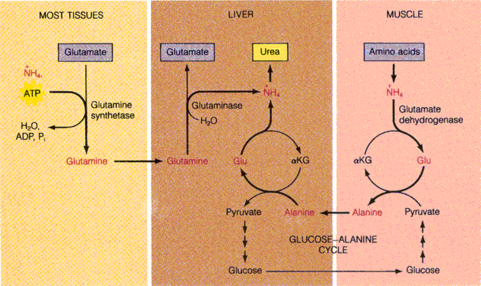
Transport of ammonia to the liver for urea synthesis.

Slide 51
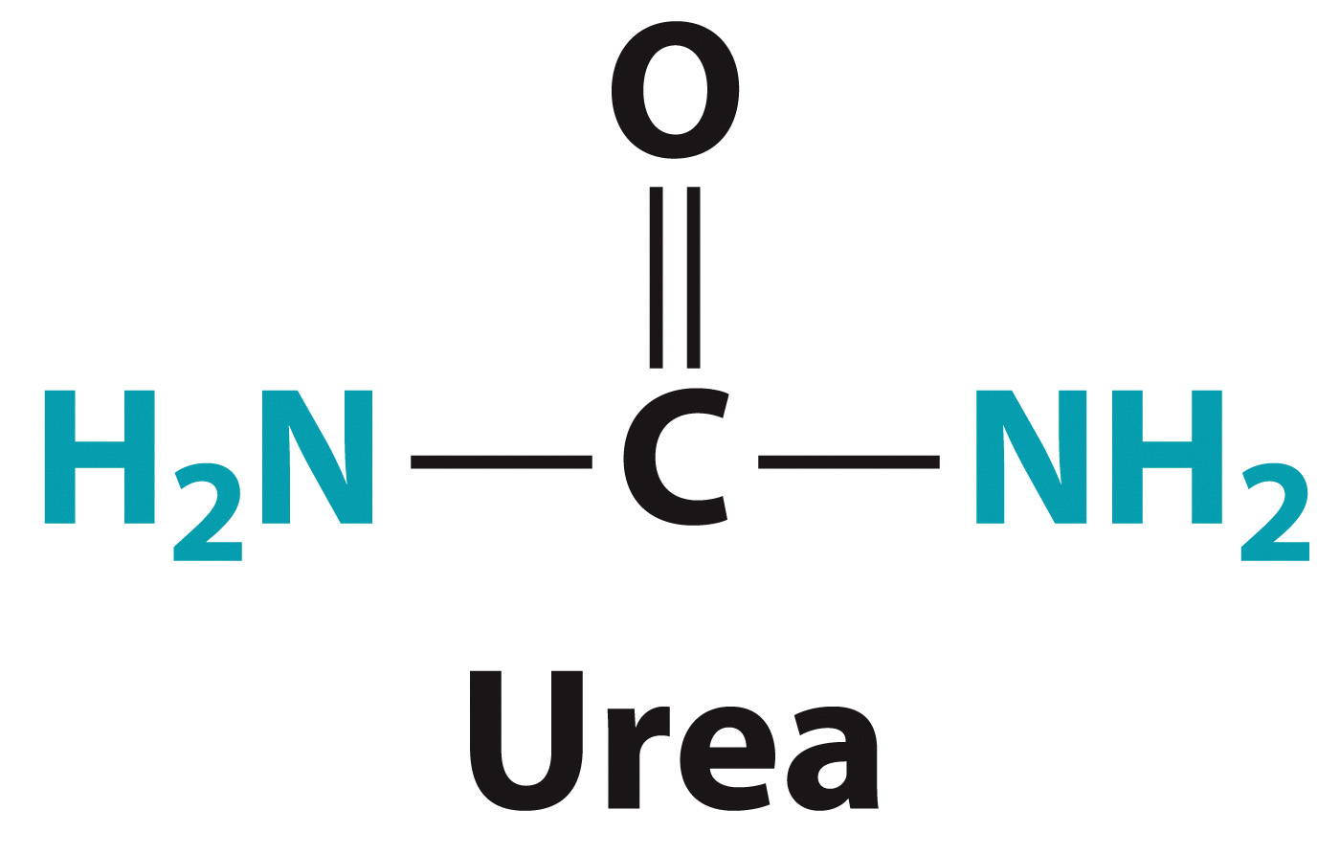
Approximately 80% of excess nitrogen is excreted as urea

Slide 52
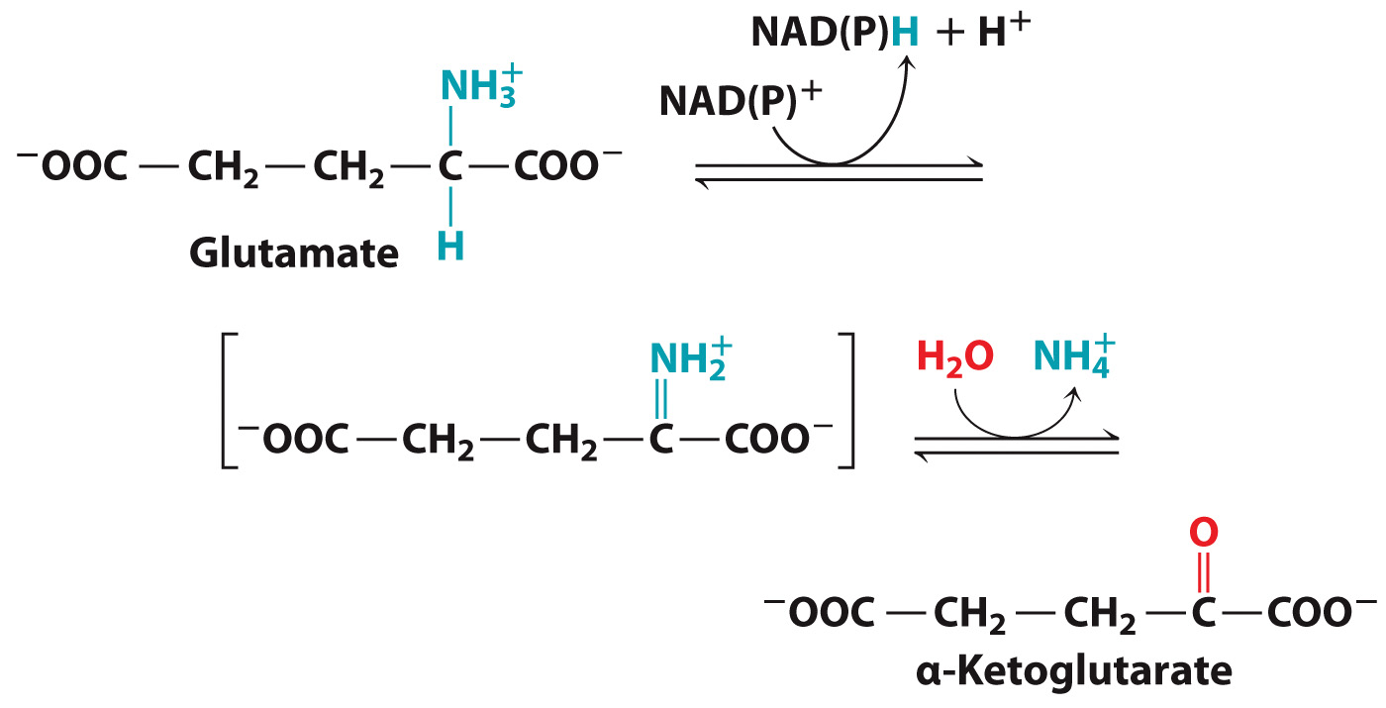
The Glutamate Dehydrogenase Reaction

Slide 53
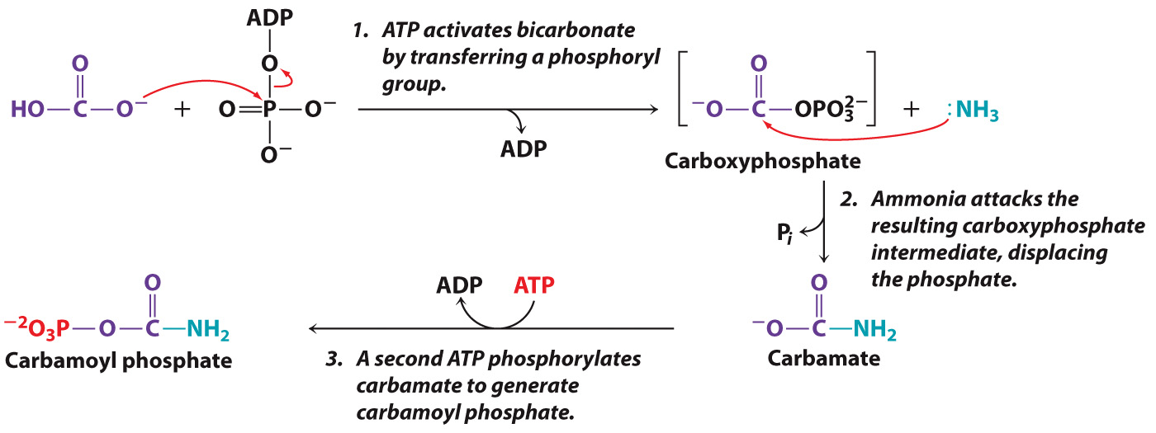
The Carbamoyl Phosphate Synthetase Reaction

Slide 54
N-Acetylglutamate activates Carbamoyl Phosphate Synthetase

Slide 55
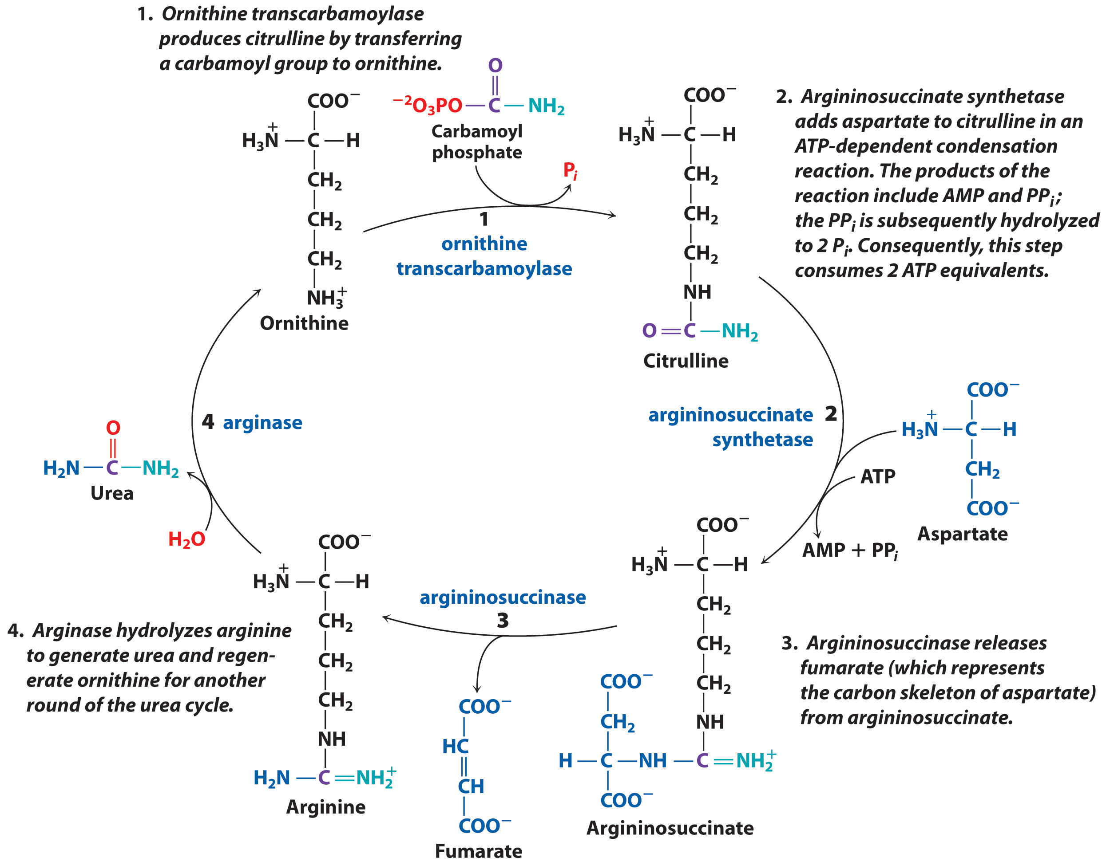
The Urea Cycle

Slide 56
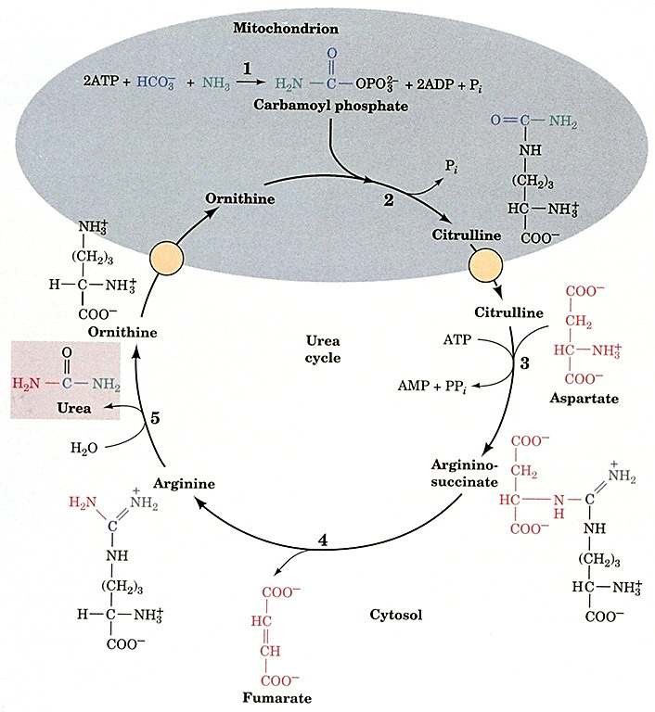
Sidenote...
Carbamoyl phosphate synthetase
Ornithine
transcarbamoylase
Argininosuccinate synthetase
arginase
argininosuccinase

Slide 57
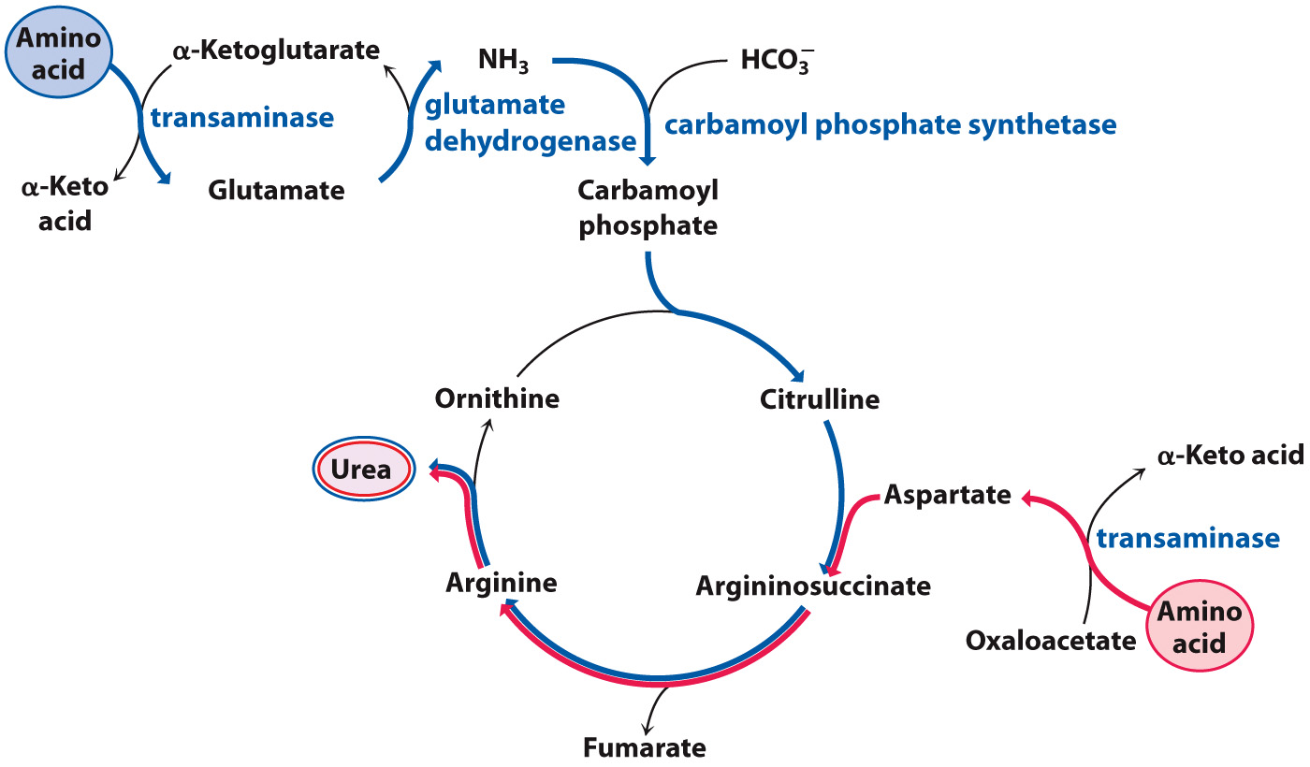
Amino groups can be disposed of via two routes

Slide 58
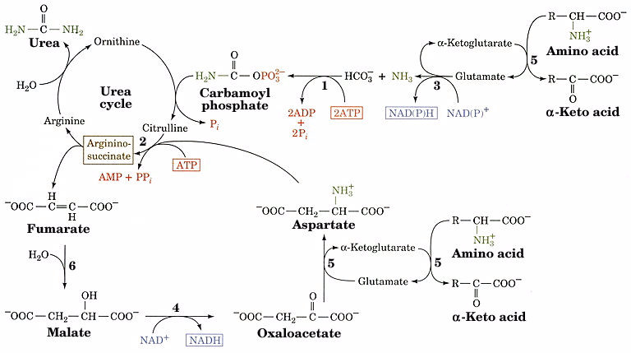
Regeneration of aspartate from fumarate
fumarase
transaminase
malate DHase

Slide 59
The Urease Reaction

Slide 60
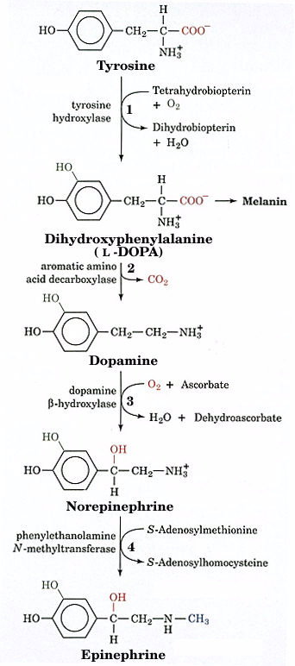
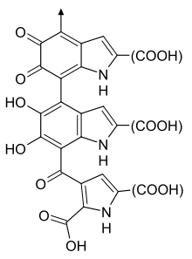
Catecholamine
Synthesis
Melanin

Slide 61
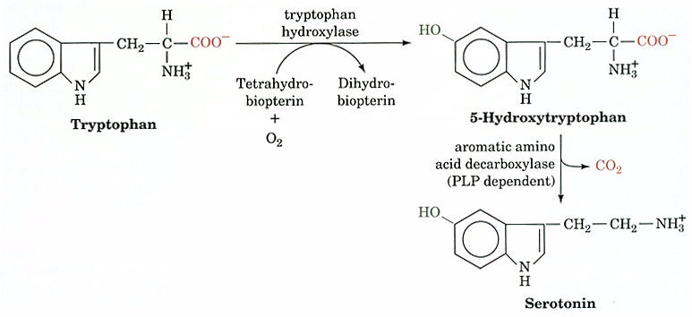
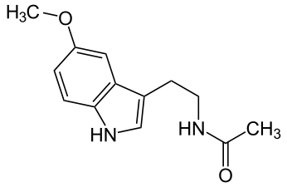
Melatonin

Slide 63
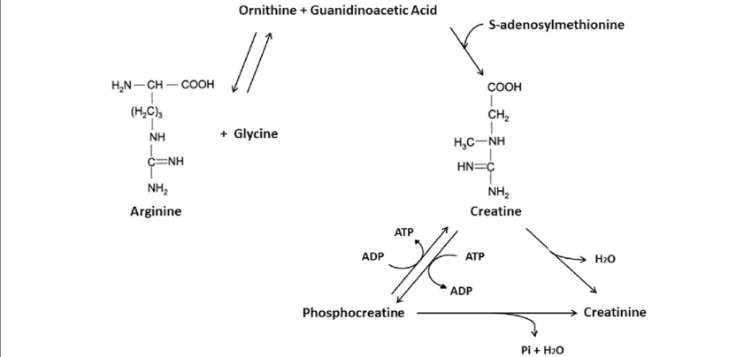

Slide 66
Nitric Oxide Synthase (NOS)

Slide 67
Glutathione Synthesis
Glutathione
synthetase
γ-glutamylCys
synthetase

Slide 68
Nucleotide Metabolism
Section 18.5
Learning Objective
Describe the key reactions in the synthesis and degradation of nucleotides and deoxynucleotides

Slide 70
Example
HGPRT

Slide 72
The Ribose Phosphate Pyrophosphokinase Reaction

Slide 73
Inosine Monophosphate

Slide 74
AMP and GMP Synthesis from IMP

Slide 75
Uridine Monophosphate

Slide 76
The CTP Synthetase Reaction

Slide 77
The Ribonucleotide Reductase Reaction

Slide 78
The Thymidine Synthase Reaction

Slide 80
Methotrexate

Slide 81
Formation of Ribose 1-Phosphate

Slide 82
Purine Degradation
Urea cycle
Urea cycle

Slide 83
Urate

Slide 85
Gout

Slide 86
Inhibition of Uric Acid Synthesis
Febuxostat / Uloric
XO

Slide 87
Pyrimidines are eventually converted to amino acids

