Slide 1
Essential Biochemistry
Fourth Edition
Charlotte W. Pratt | Kathleen Cornely
Lecture Notes for
Chapter 16
Photosynthesis

Slide 2
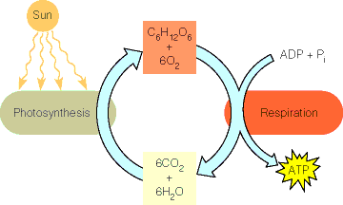
Photosynthesis

Slide 3
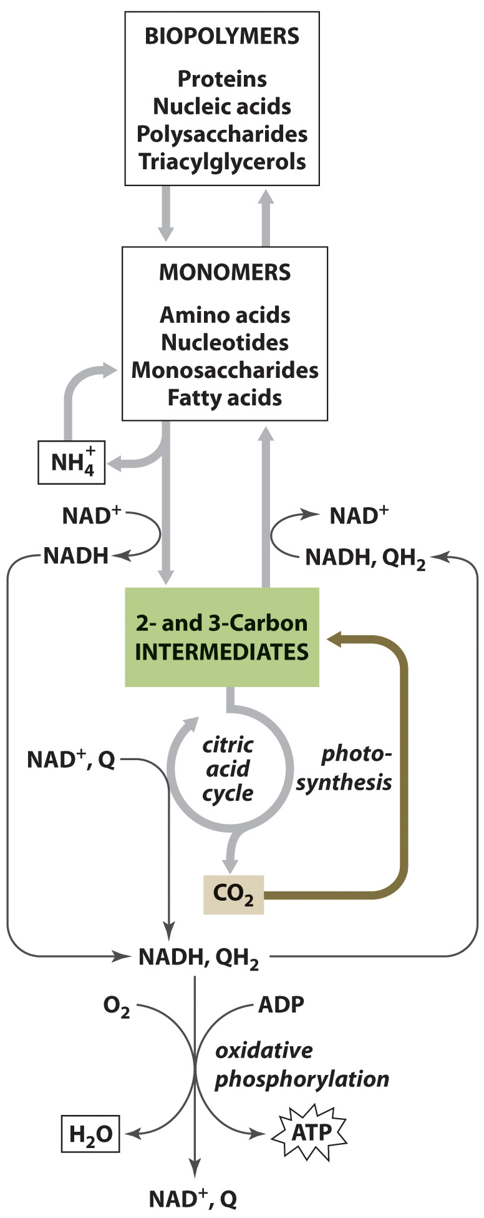
Photosynthesis in Context

Slide 4
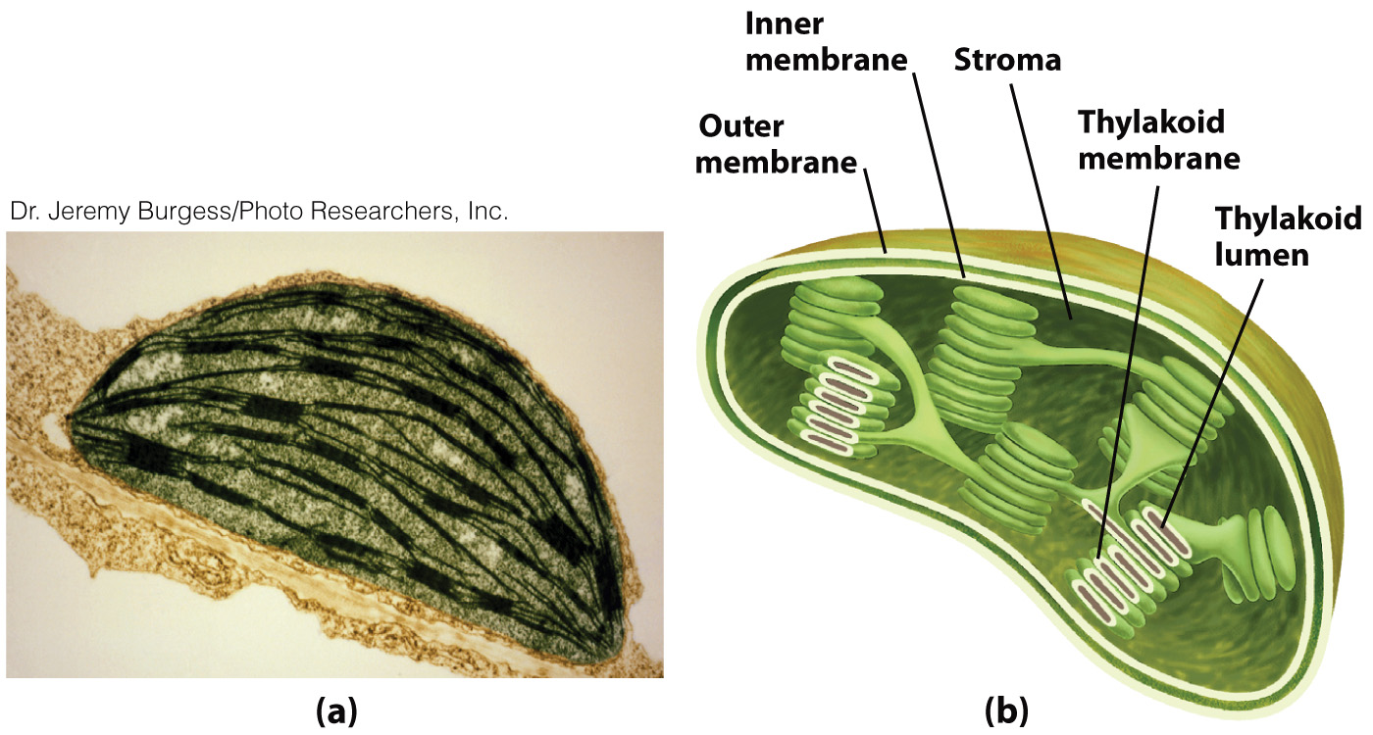
The Chloroplasts

Slide 5
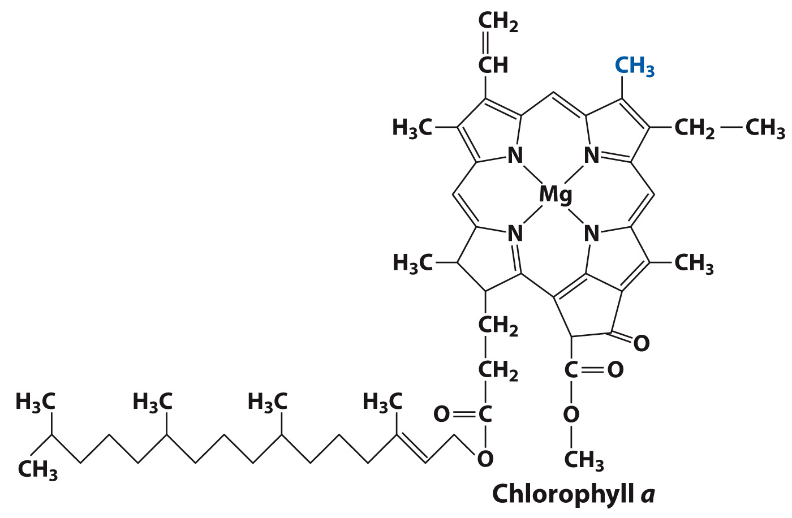
Common Chloroplast Photoreceptors

Slide 6
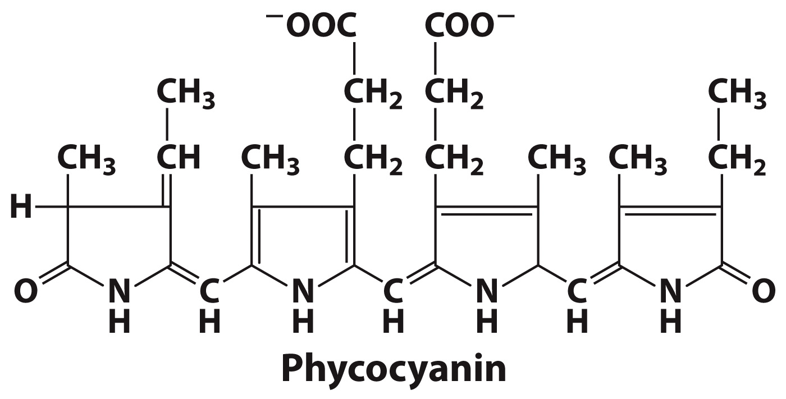
Common Chloroplast Photoreceptors

Slide 7
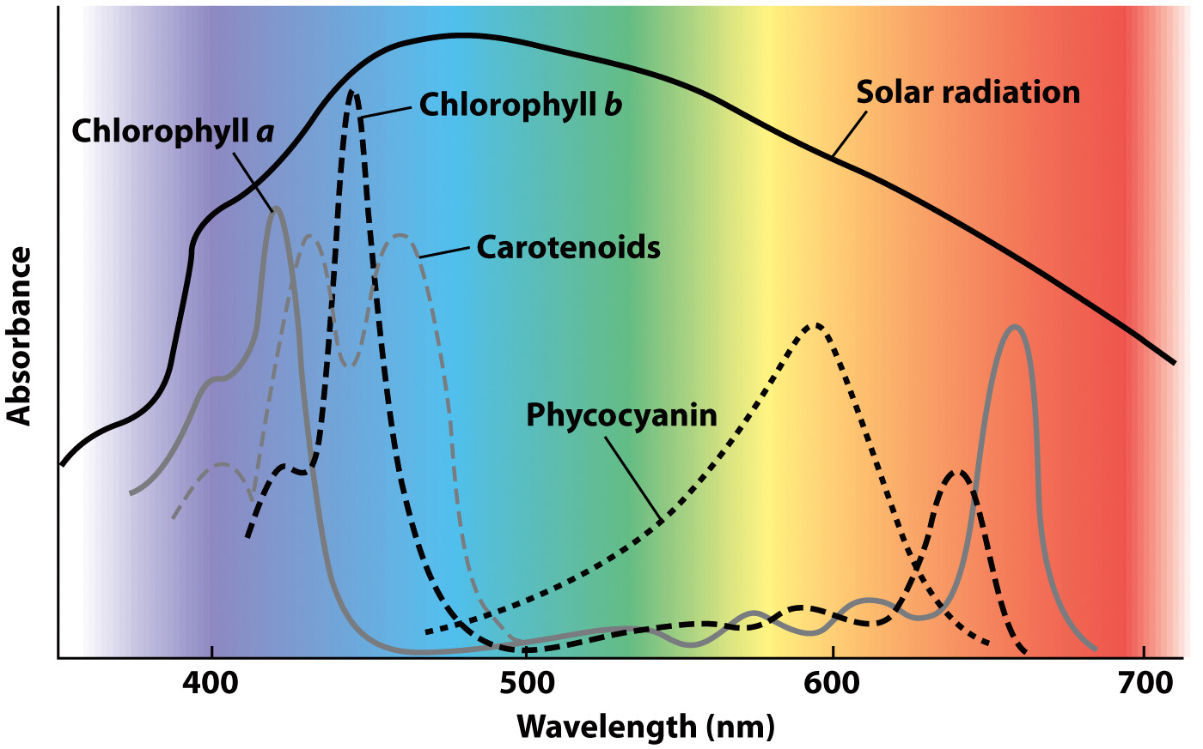
Visible Light Absorption by Some Photosynthetic Pigments

Slide 8
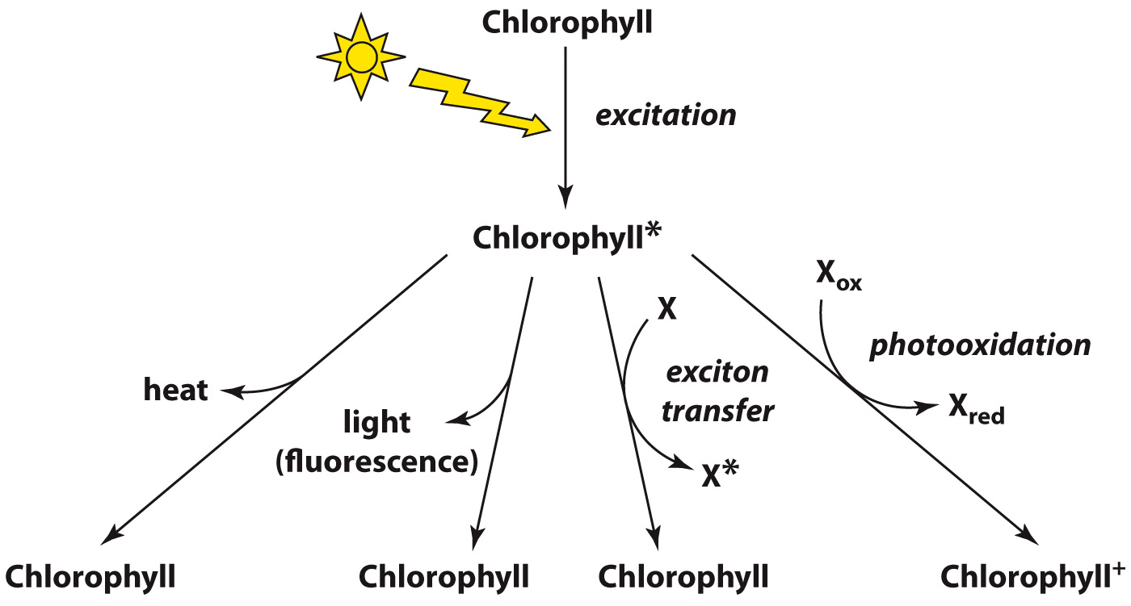
Dissipation of Energy in a Photoexcited Molecule

Slide 9
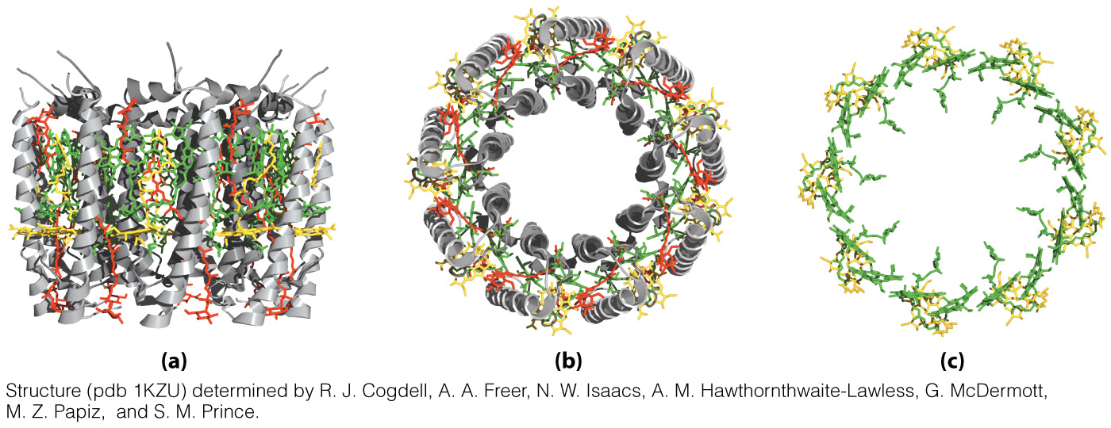
A Light-Harvesting Complex
Top View showing only chlorophyll
molecules
Side View
Top View

Slide 10
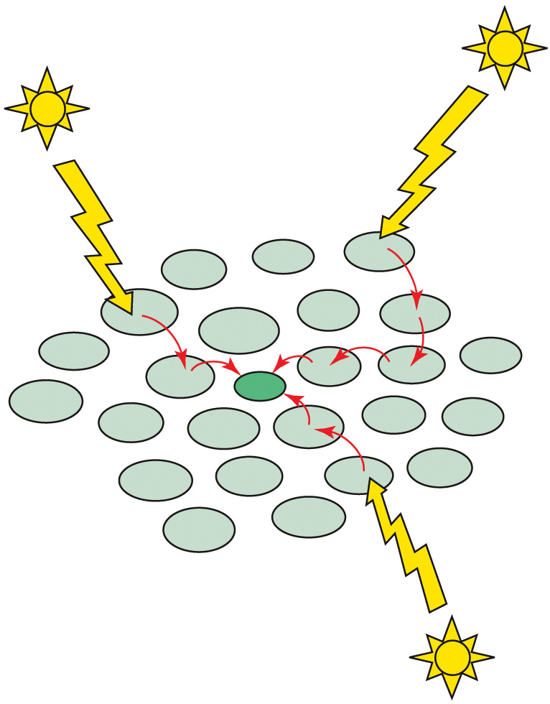
Function of Light-Harvesting Complexes

Slide 11
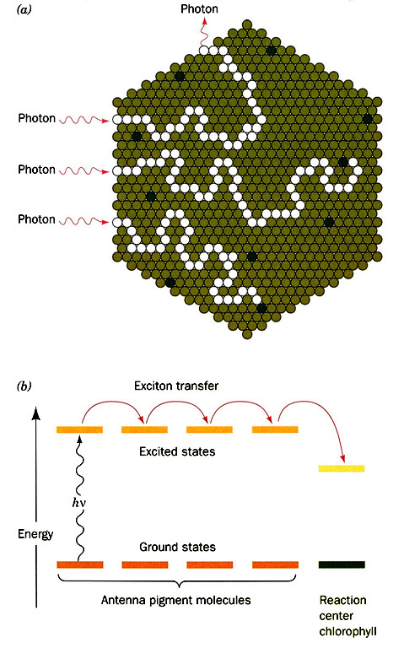
Time for typical search?
~ 10⁻¹⁰ sec.
Why does this one
chlorophyll ‘grab’
the electron?
…lower energy due to
environment.

Slide 12
The Light Reactions
Section 16.2
Learning Objective
Trace the energy transformations that takes place during the light reactions of photosynthesis

Slide 13
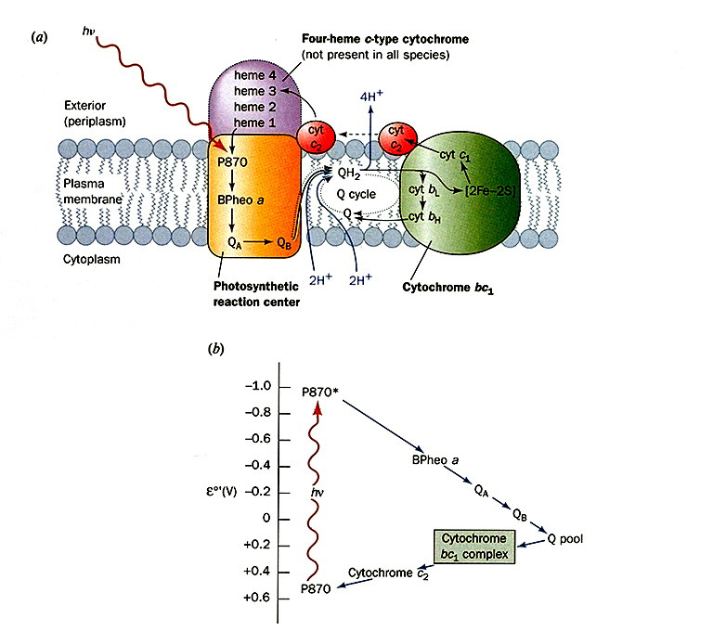

Slide 14
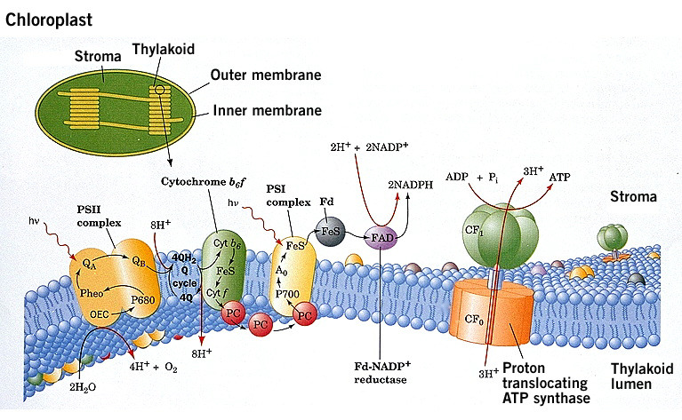
Two Center Electron Transport.
Non-cyclic Electron Flow first...

Slide 15
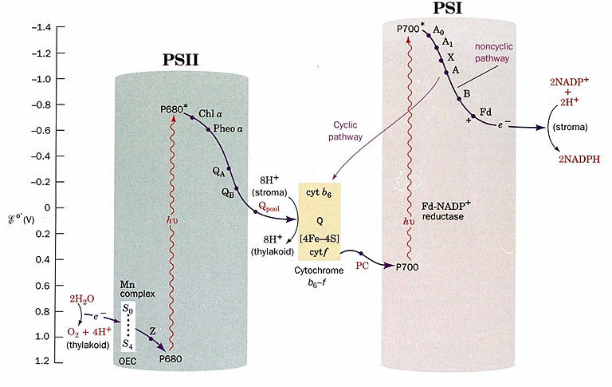
(FNR)
Tyrosine Radical
(OEC=Oxygen
Evolving Complex)

Slide 16
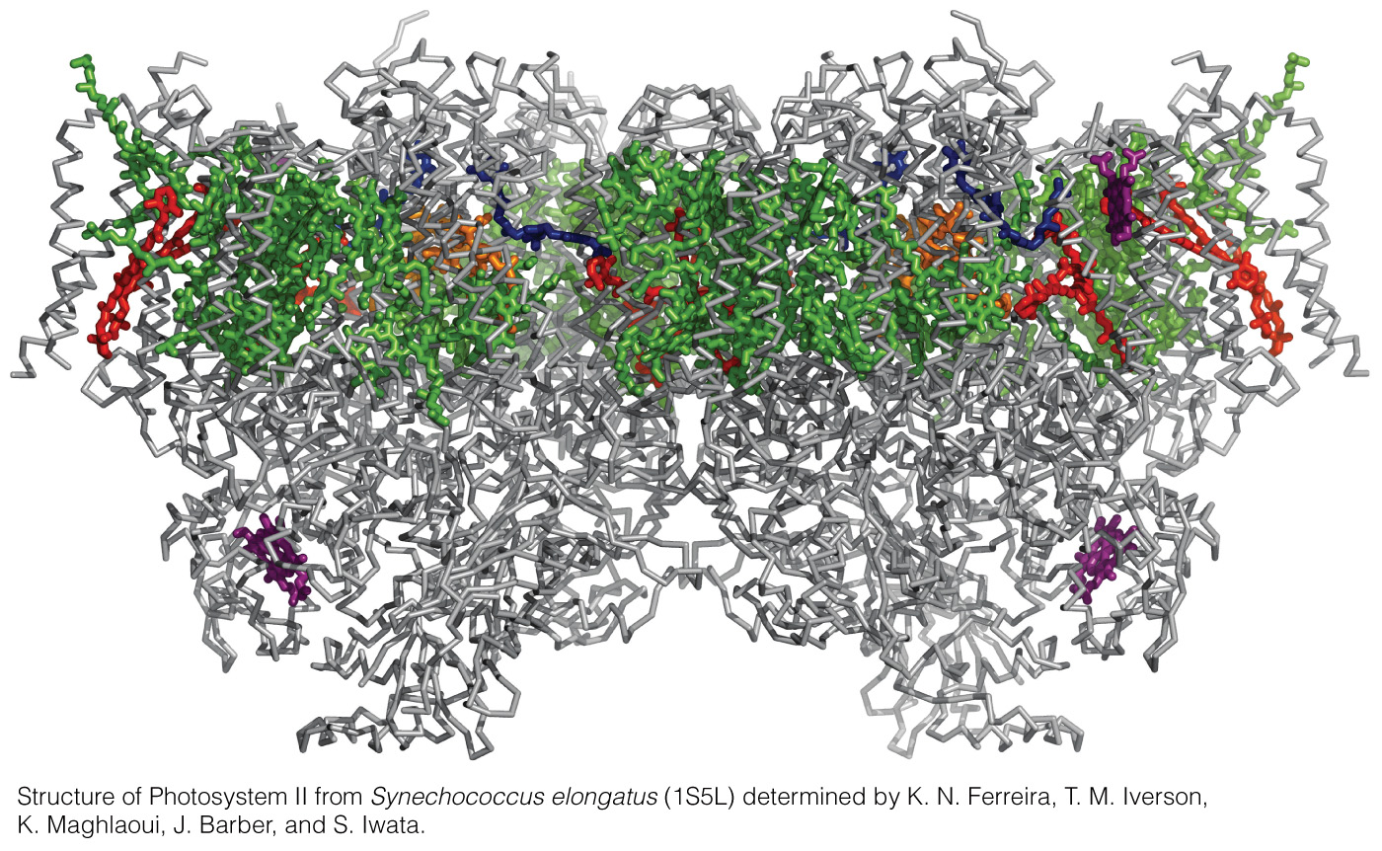
Structure of Cyanobacterial Photosystem II

Slide 17
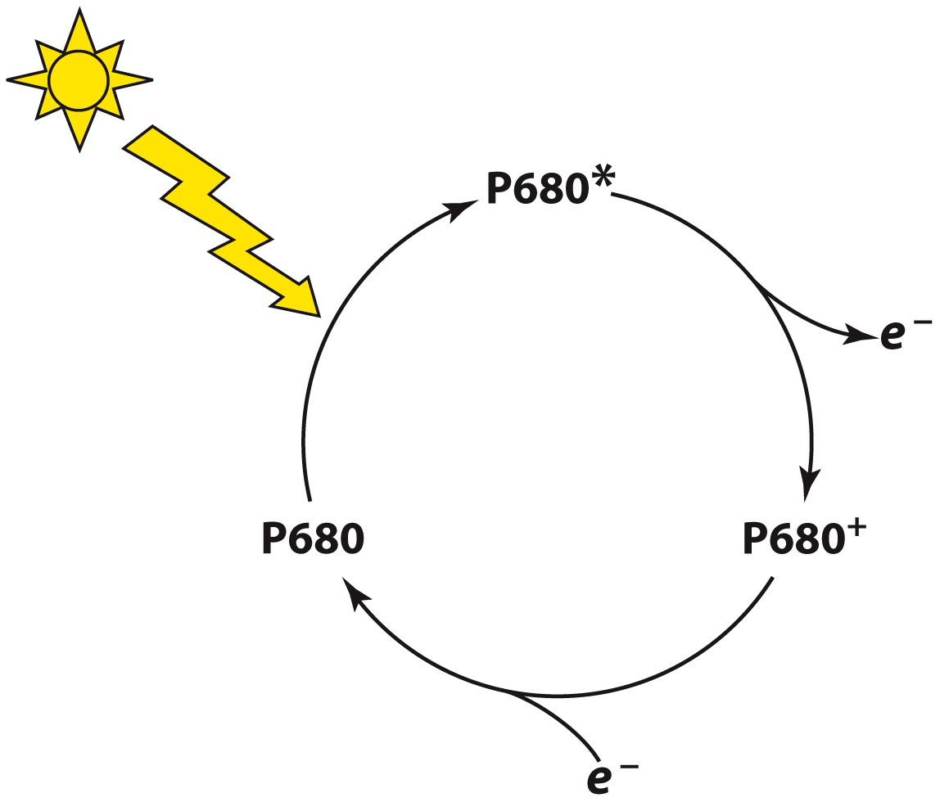
Chlorophyll molecules in Photosystem II funnel energy to reaction centers containing P680

Slide 18
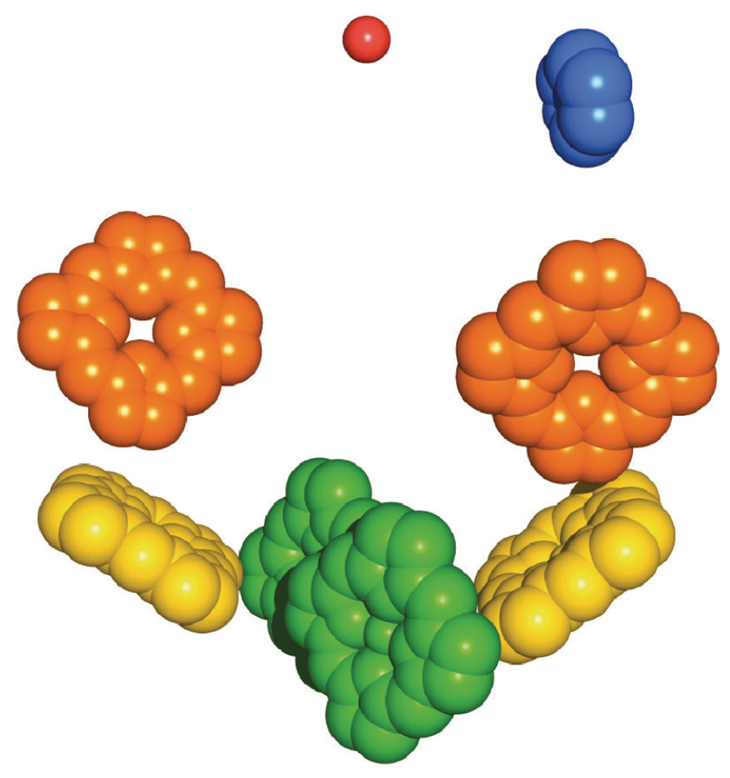
Arrangement of Prosthetic Groups in Photosystem II

Slide 19
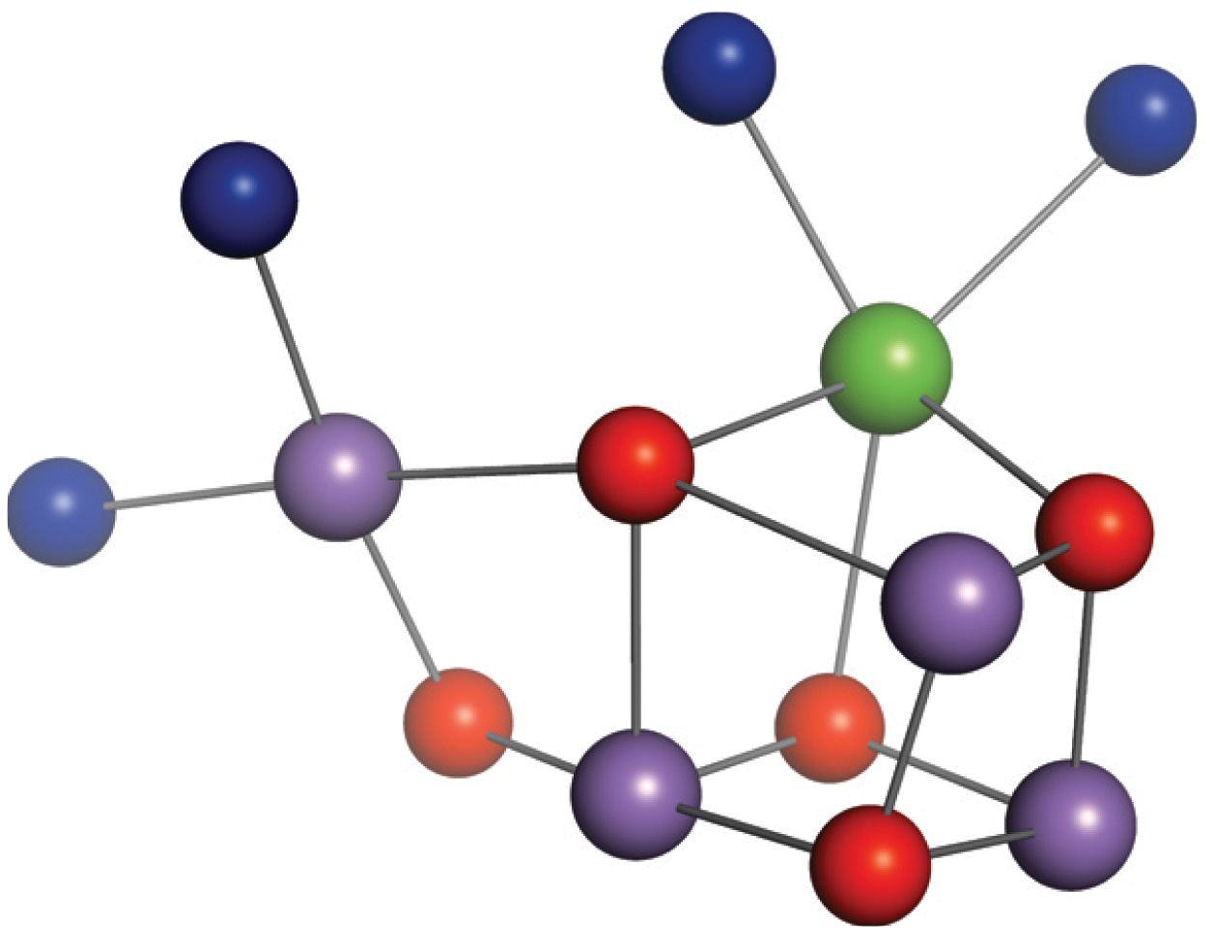
Structure of the Mn₄CaO₅ Cluster

Slide 20
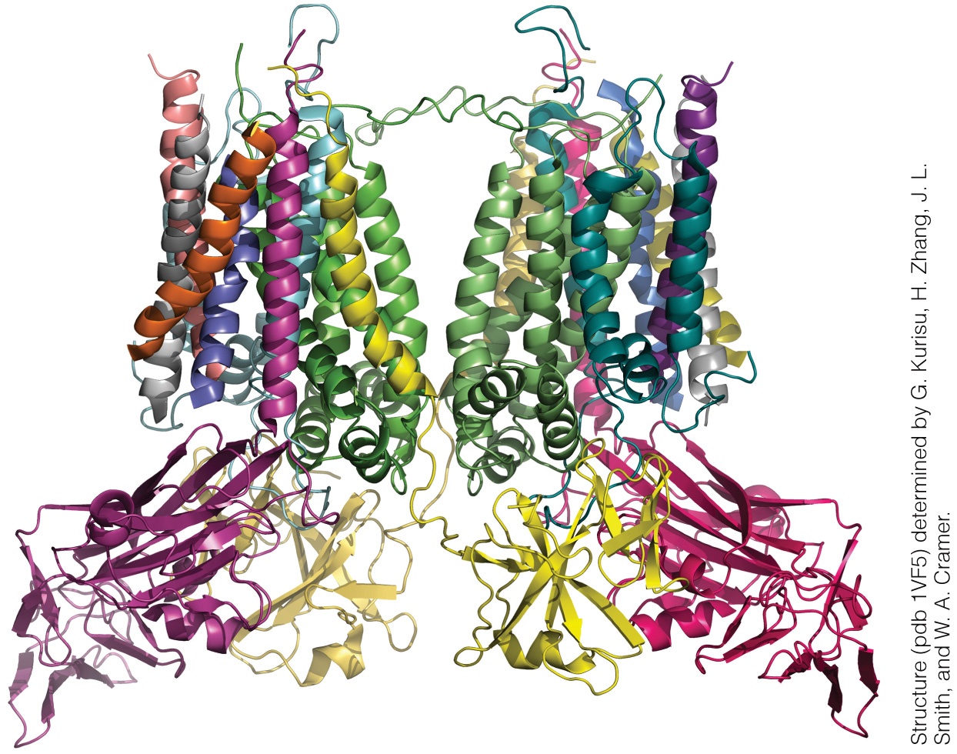
Structure of Cyanobacterial Cytochrome b₆f

Slide 21
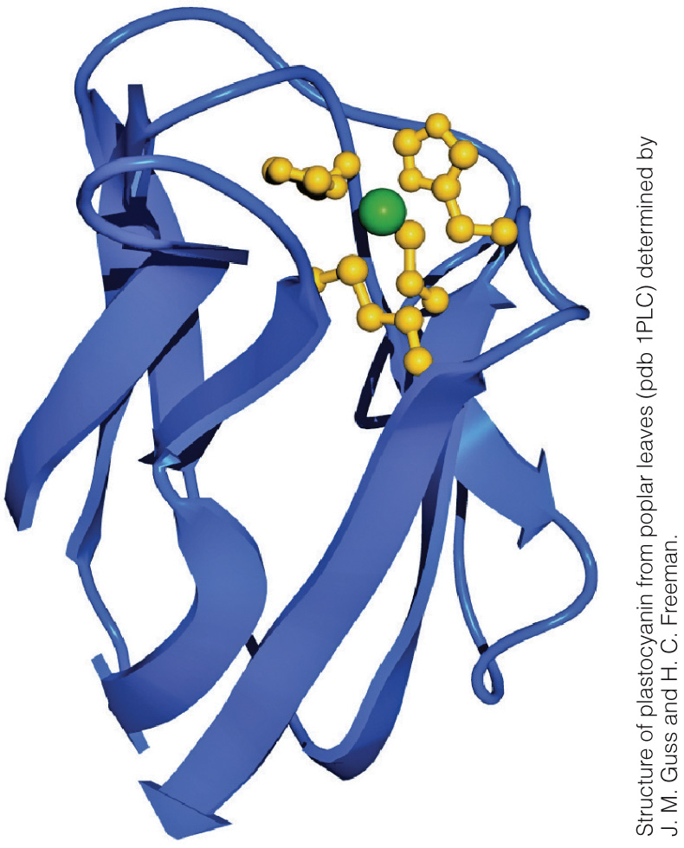
Plastocyanin

Slide 22
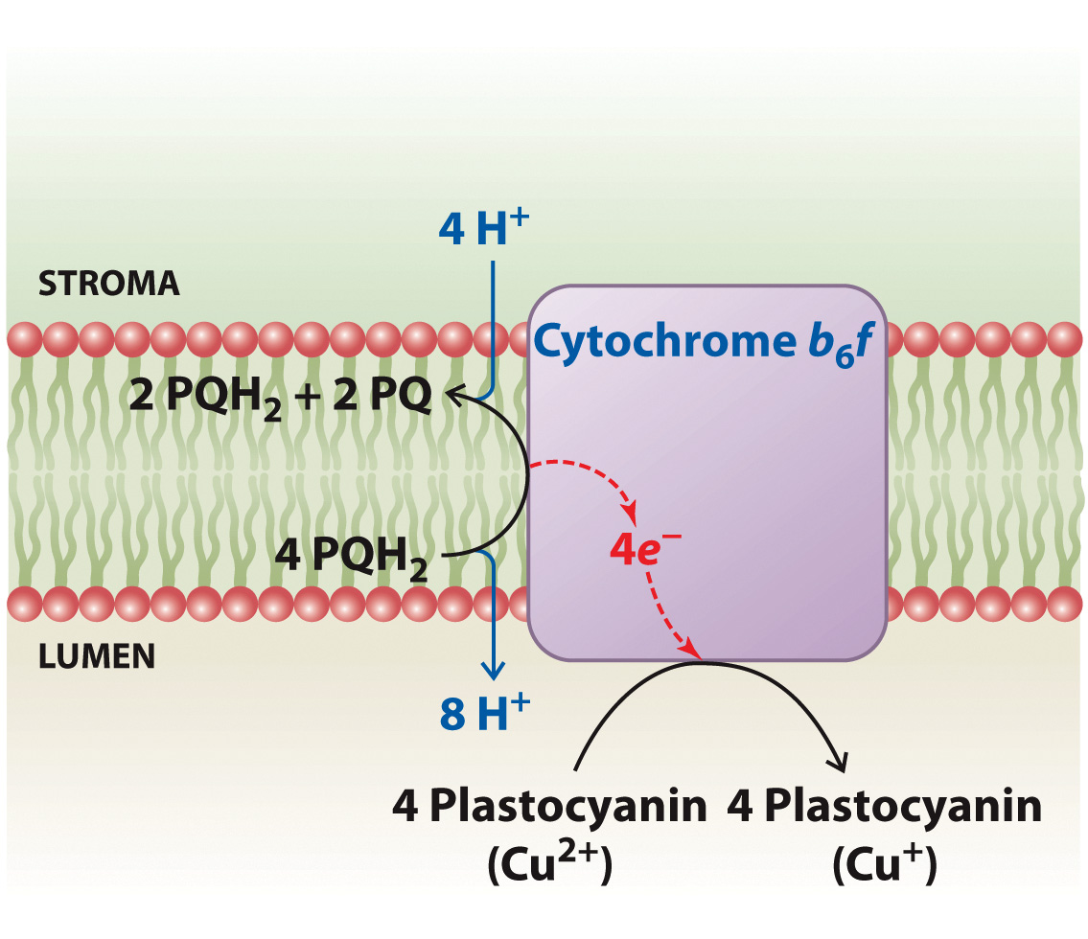
Cytochrome b₆f Function

Slide 23
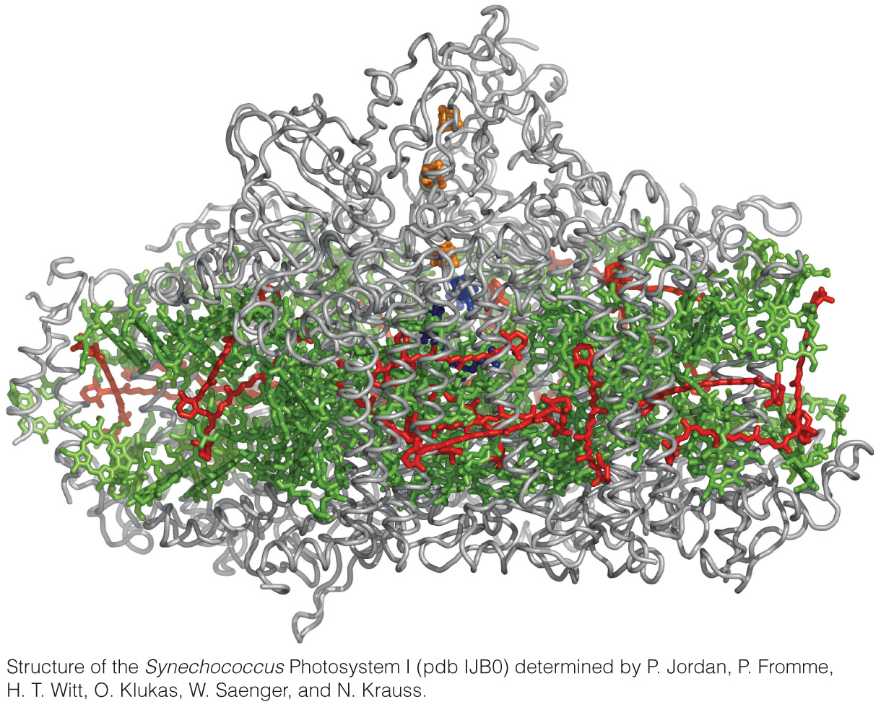
Structure of Cyanobaterial Photosystem I

Slide 24
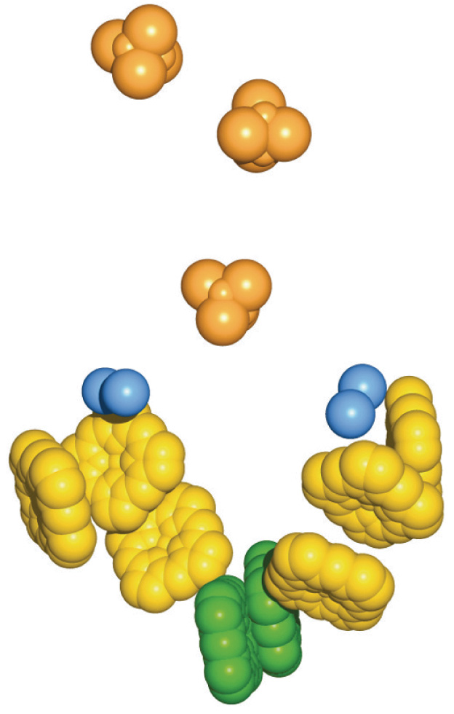
Prosthetic Groups in Photosystem I

Slide 25
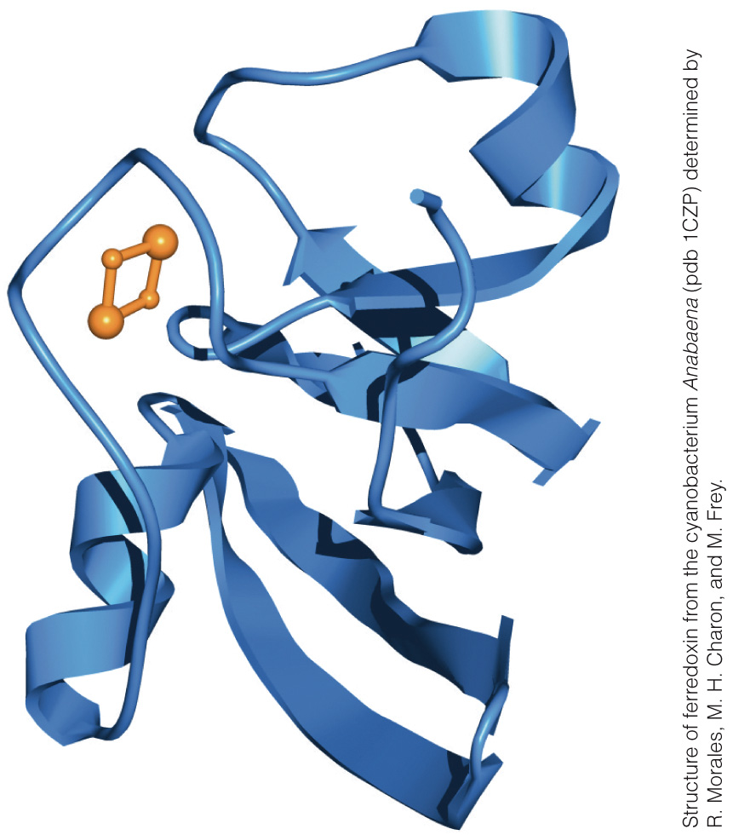
Ferredoxin

Slide 26
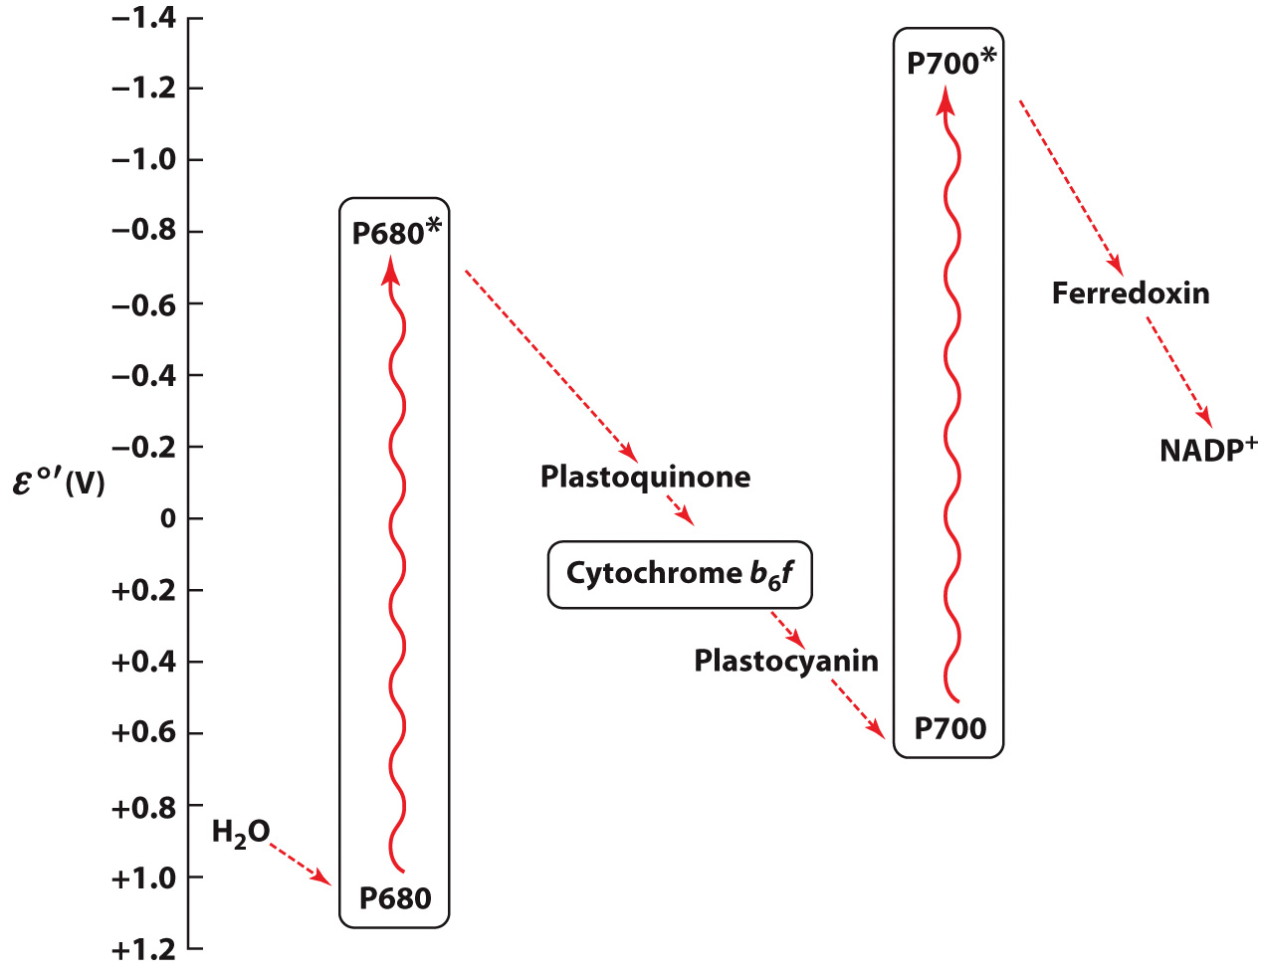
The Z-Scheme of Photosynthesis

Slide 27
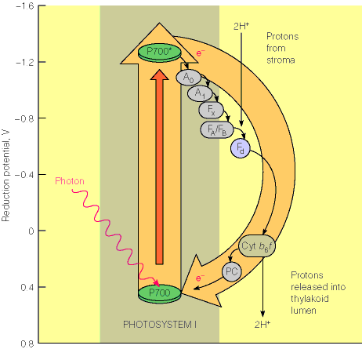
Cyclic
Electron
Flow
-alternative
used when
ATP wanted,
but enough
NADPH

Slide 28
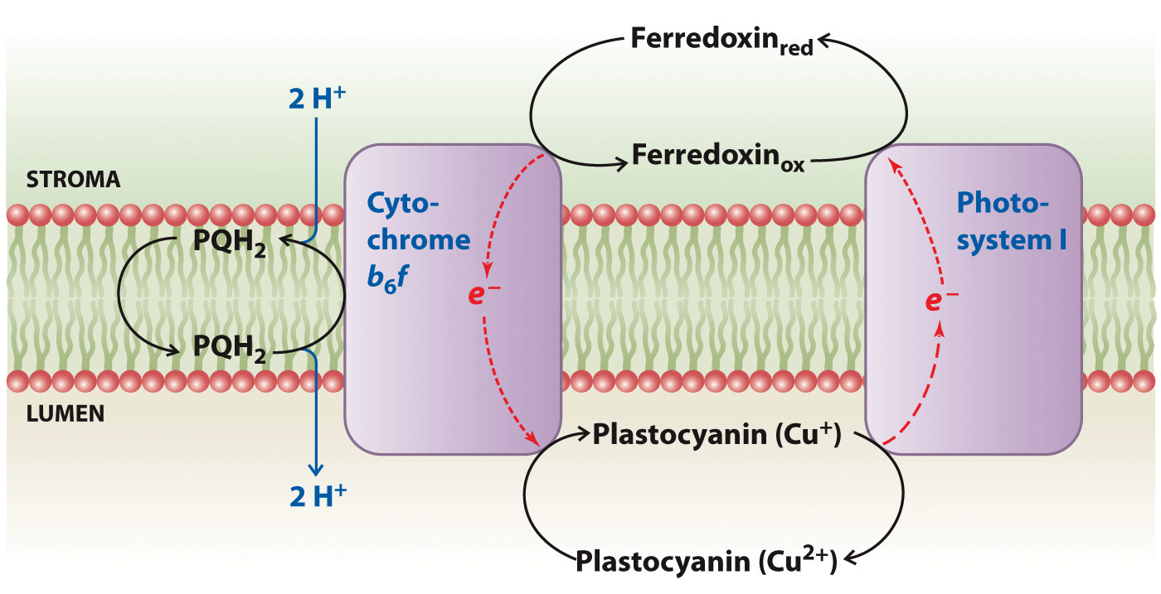
Cyclic Electron Flow

Slide 29
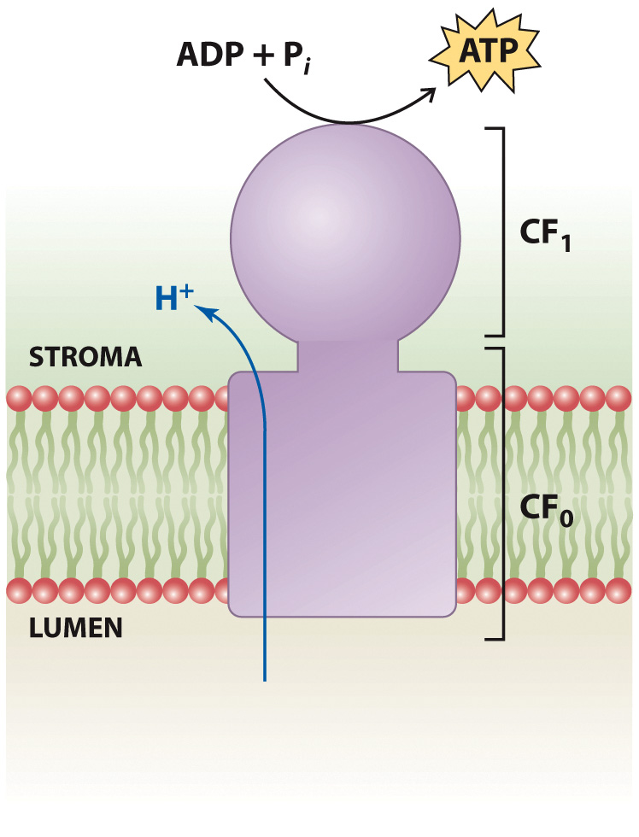
Photophosphorylation

Slide 30
Carbon Fixation
Section 16.3
Learning Objective
Describe the steps of carbon fixation by the Calvin cycle

Slide 31
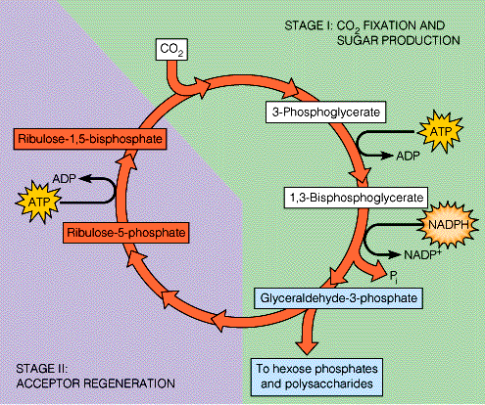

Slide 32
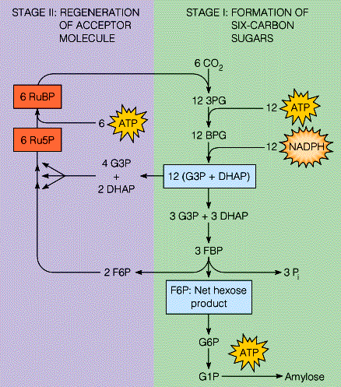
If the goal is glucose…
(6 turns)

Slide 33
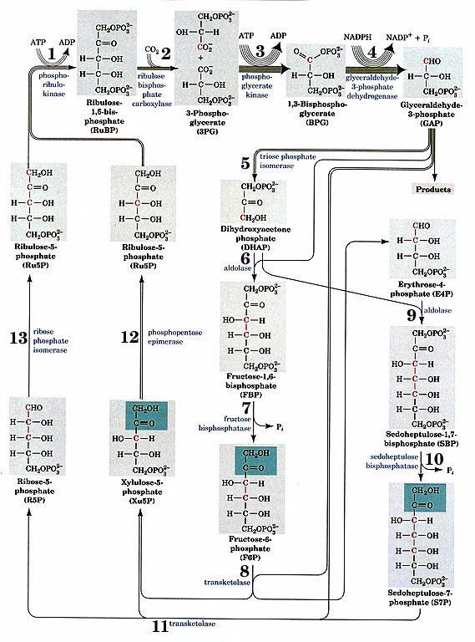
C5
2C3
C3
C3
C5
C5
C3
Every 3 rounds, one GAP exits
C4
C6
C7
C5
C5
C6
C7
* C3+C6->
C5+C4
*

Slide 34
Ribulose-1,5-bisphosphate carboxylase oxygenase (RuBisCO)

Slide 35
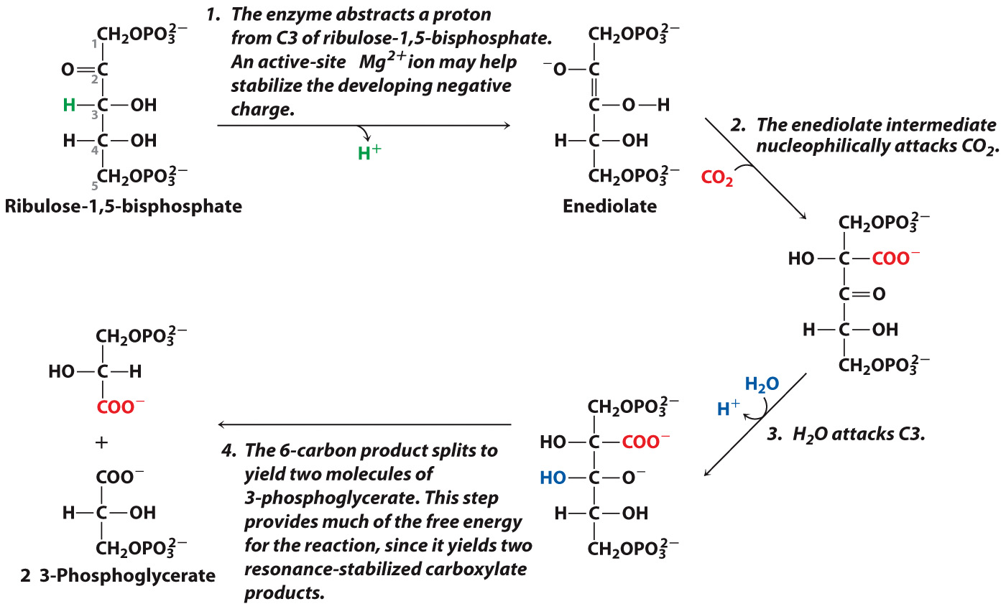
The Rubisco Carboxylation Reaction

Slide 36
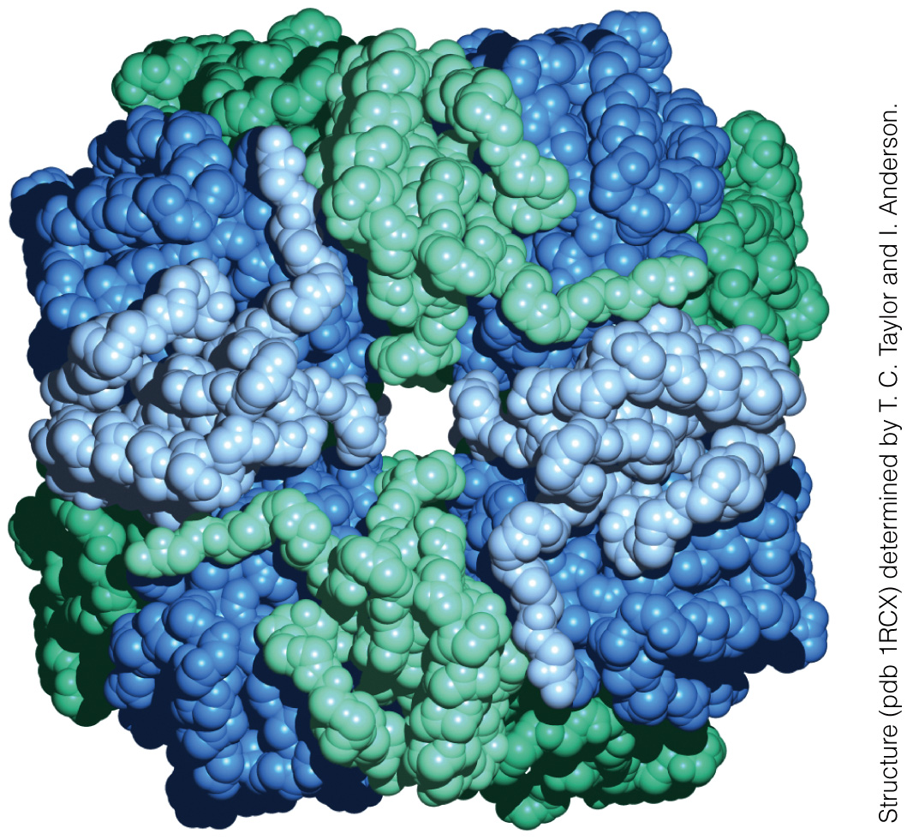
The Structure of Spinach Rubisco

Slide 37
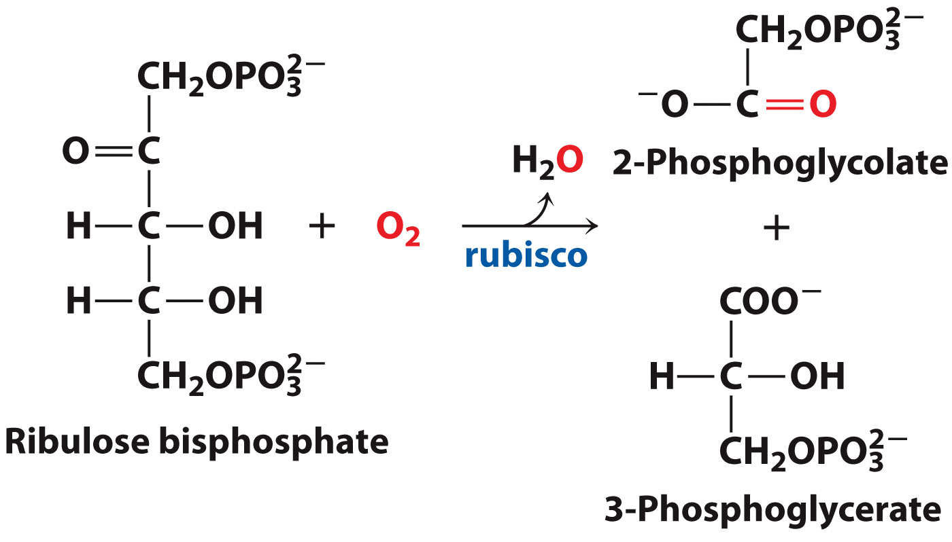
Rubisco is not a highly specific enzyme

Slide 38
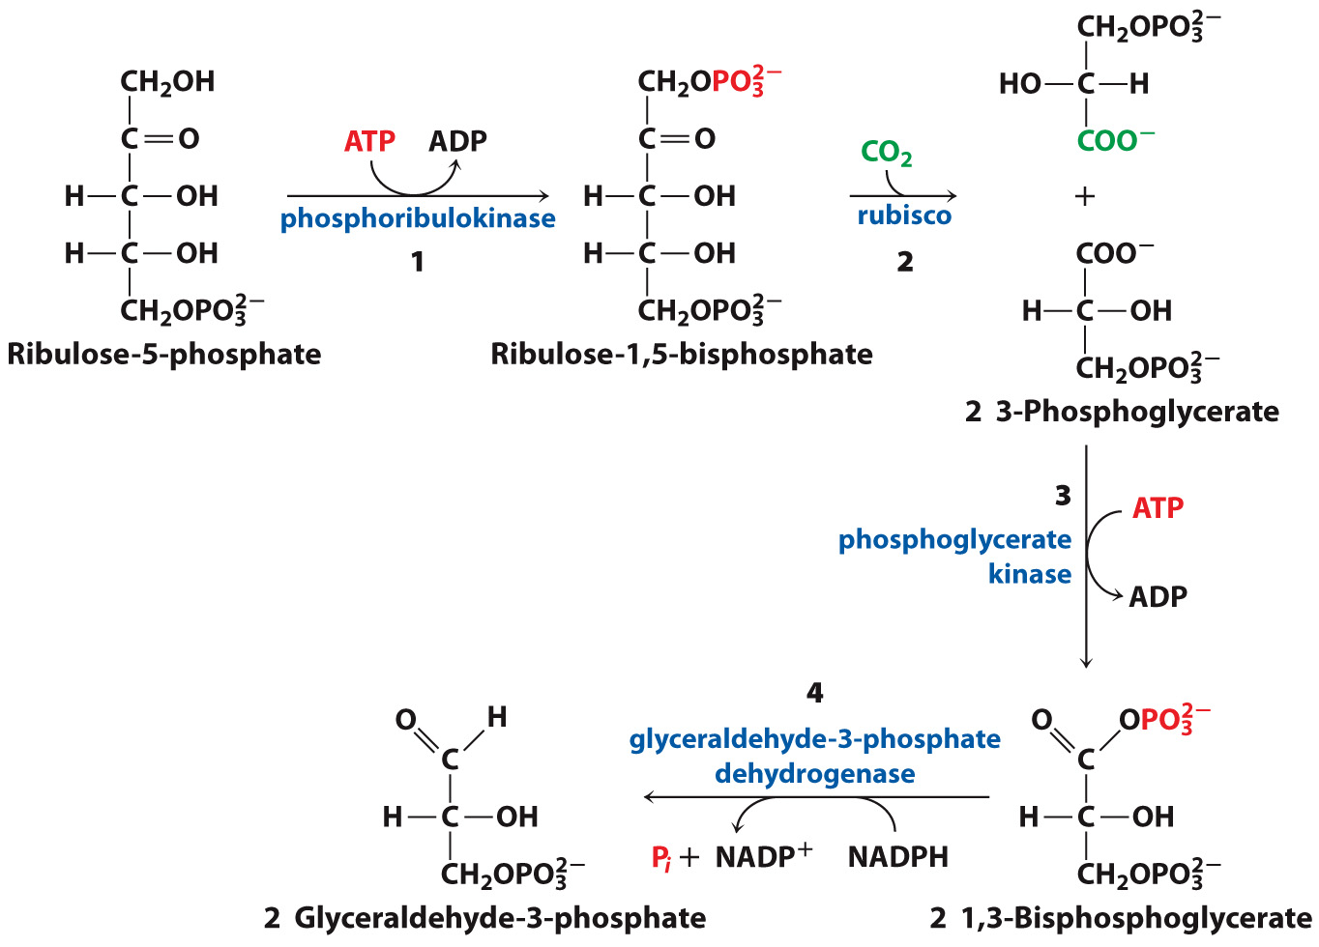
Initial Reactions of the Calvin Cycle

Slide 39
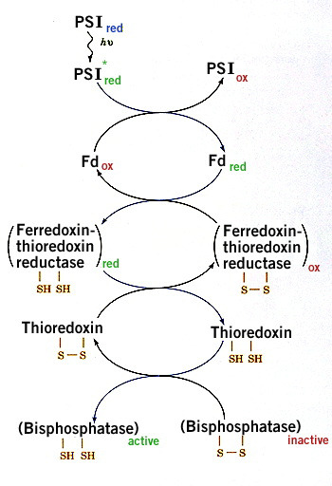
How are the Dark Cycle reactions regulated?
1) pH8 in stroma, optimum of RuBisCo
upon illumination (pH7 in thylakoid)
(activates RuBisCO)
2) Mg⁺² efflux from thylakoid to stroma
(activates RuBisCO)
3) RuBisCo Activase, which helps release
2-carboxyarabinitol-1-phosphate (an
inhibitor)
4) Redox-sensitive F1,6BPase and
Sedoheptulose bisphosphatase are
activated by electrons derived from PSI.
(See right panel) (Therefore, dark
reactions actually stop in the dark…)

Slide 40
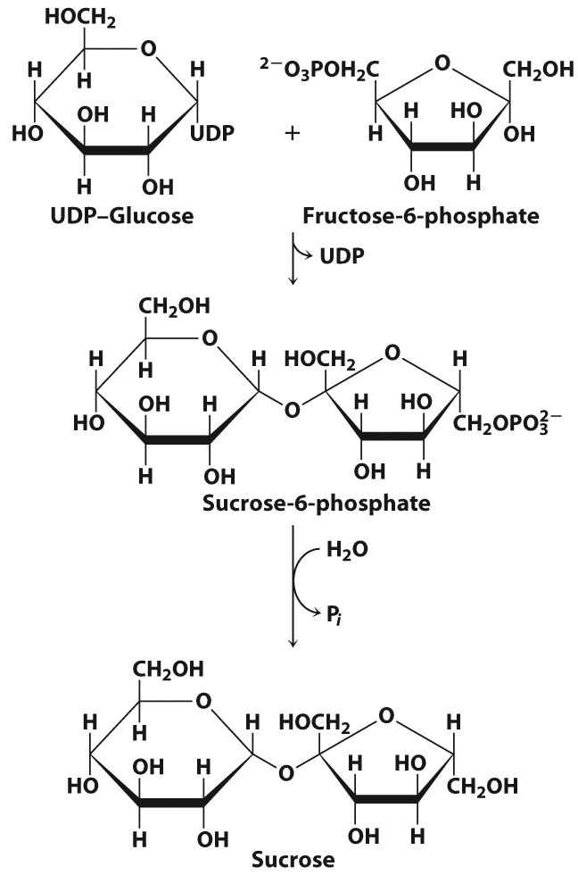
Calvin cycle products are used to synthesize sucrose

Slide 41
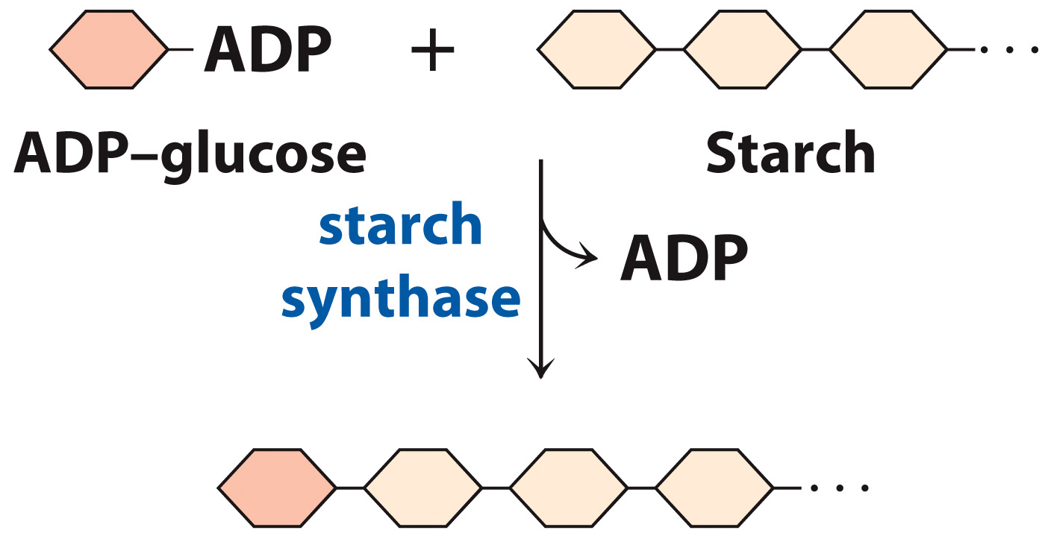
Calvin cycle products are used to synthesize starch

