Slide 1
Essential Biochemistry
Fourth Edition
Charlotte W. Pratt | Kathleen Cornely
Lecture Notes for
Chapter 15
Oxidative Phosphorylation

Slide 2
The Thermodynamics of Oxidation-Reduction Reactions
Section 15.1
Learning Objective
Summarize the thermodynamics of oxidation-reduction reactions

Slide 3
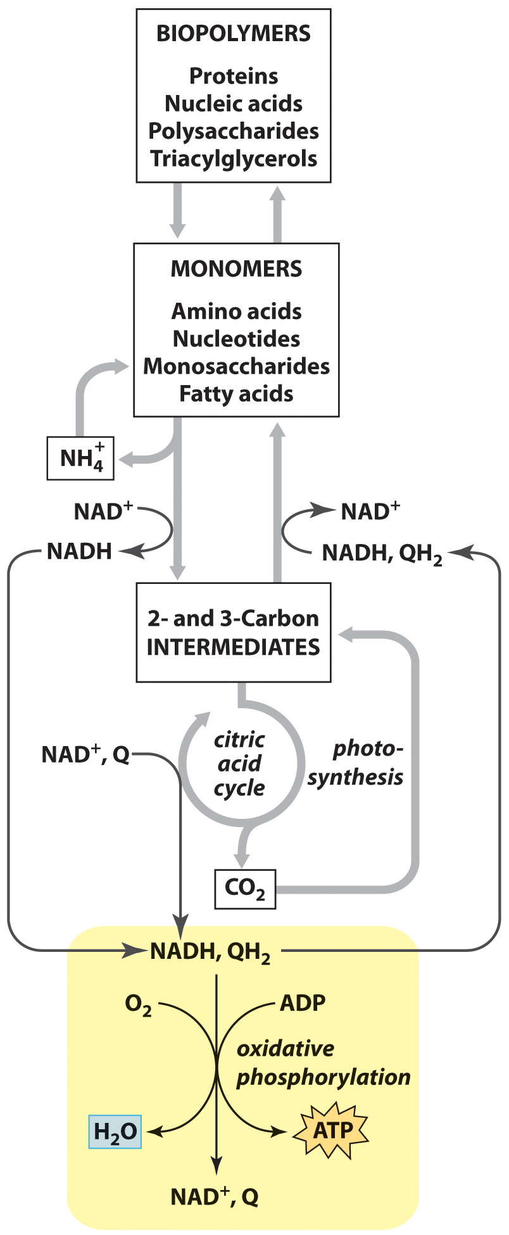
Oxidative Phosphorylation in Context

Slide 4
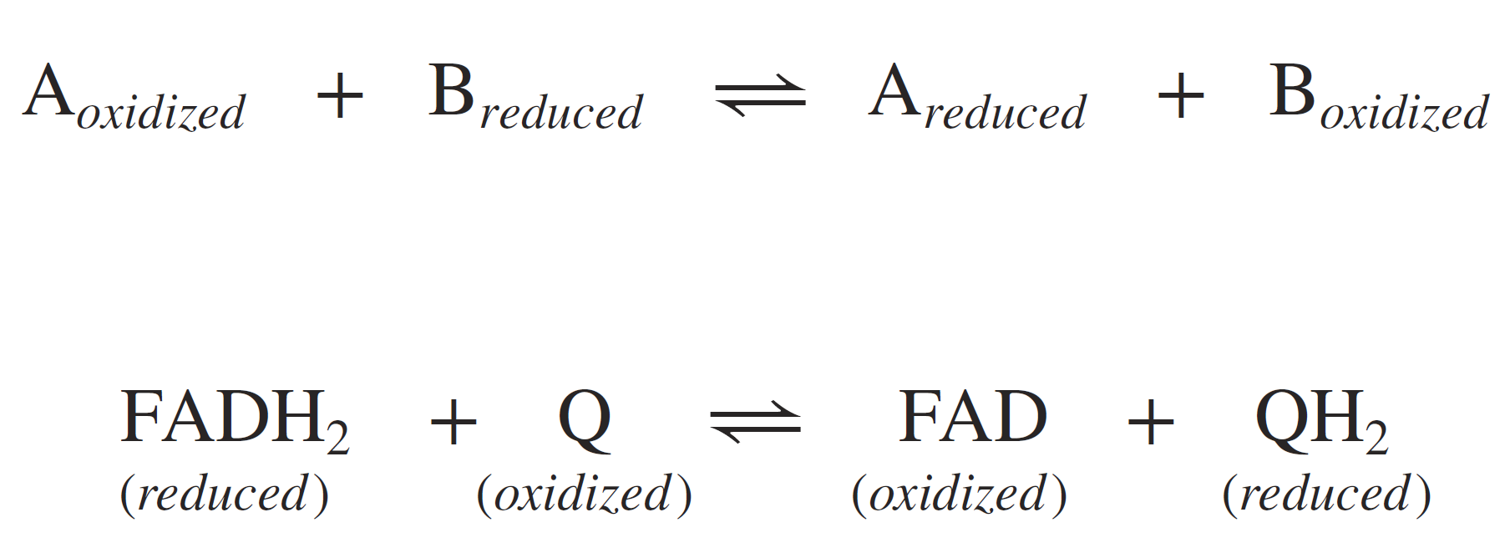
Recap on Oxidation-Reduction

Slide 5
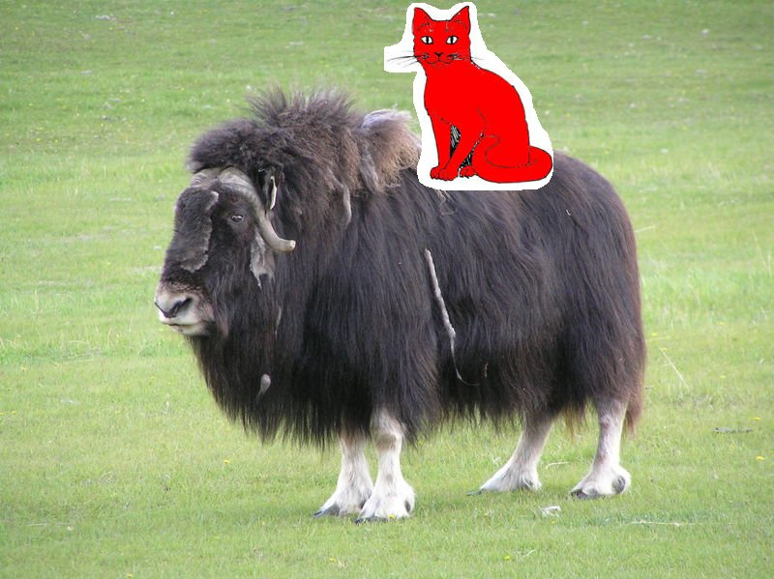
RED Cat on AN Ox

Slide 6
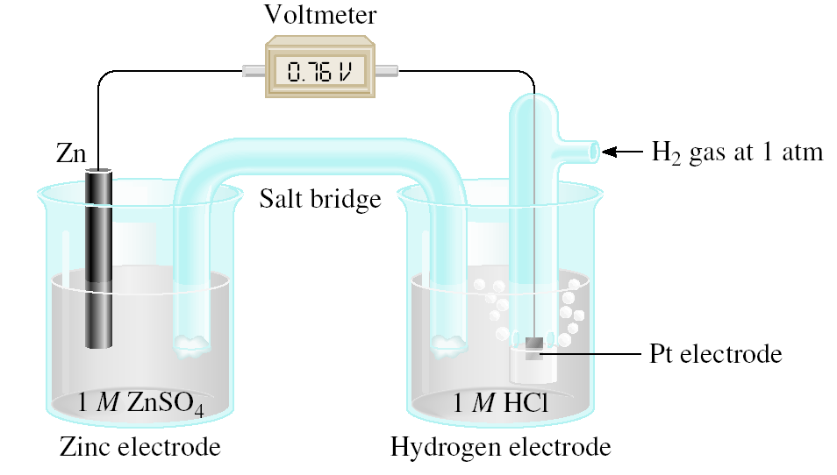
Standard Reduction Potentials
E⁰ = 0.76 V
cell
Standard emf (E⁰ )
cell
E⁰ = E_{cathode} - E_{anode}
0
0
cell
Zn (s) | Zn²⁺ (1 M) || H⁺ (1 M) | H₂ (1 atm) | Pt (s)
E⁰ = E_{H /H} - E_{Zn /Zn}
0
0
cell
+
2
2+
0.76 V = 0 - E_{Zn /Zn}
0
2+
E_{Zn /Zn} = -0.76 V
0
2+
Zn²⁺ (1 M) + 2e⁻ Zn E⁰ = -0.76 V

Slide 7
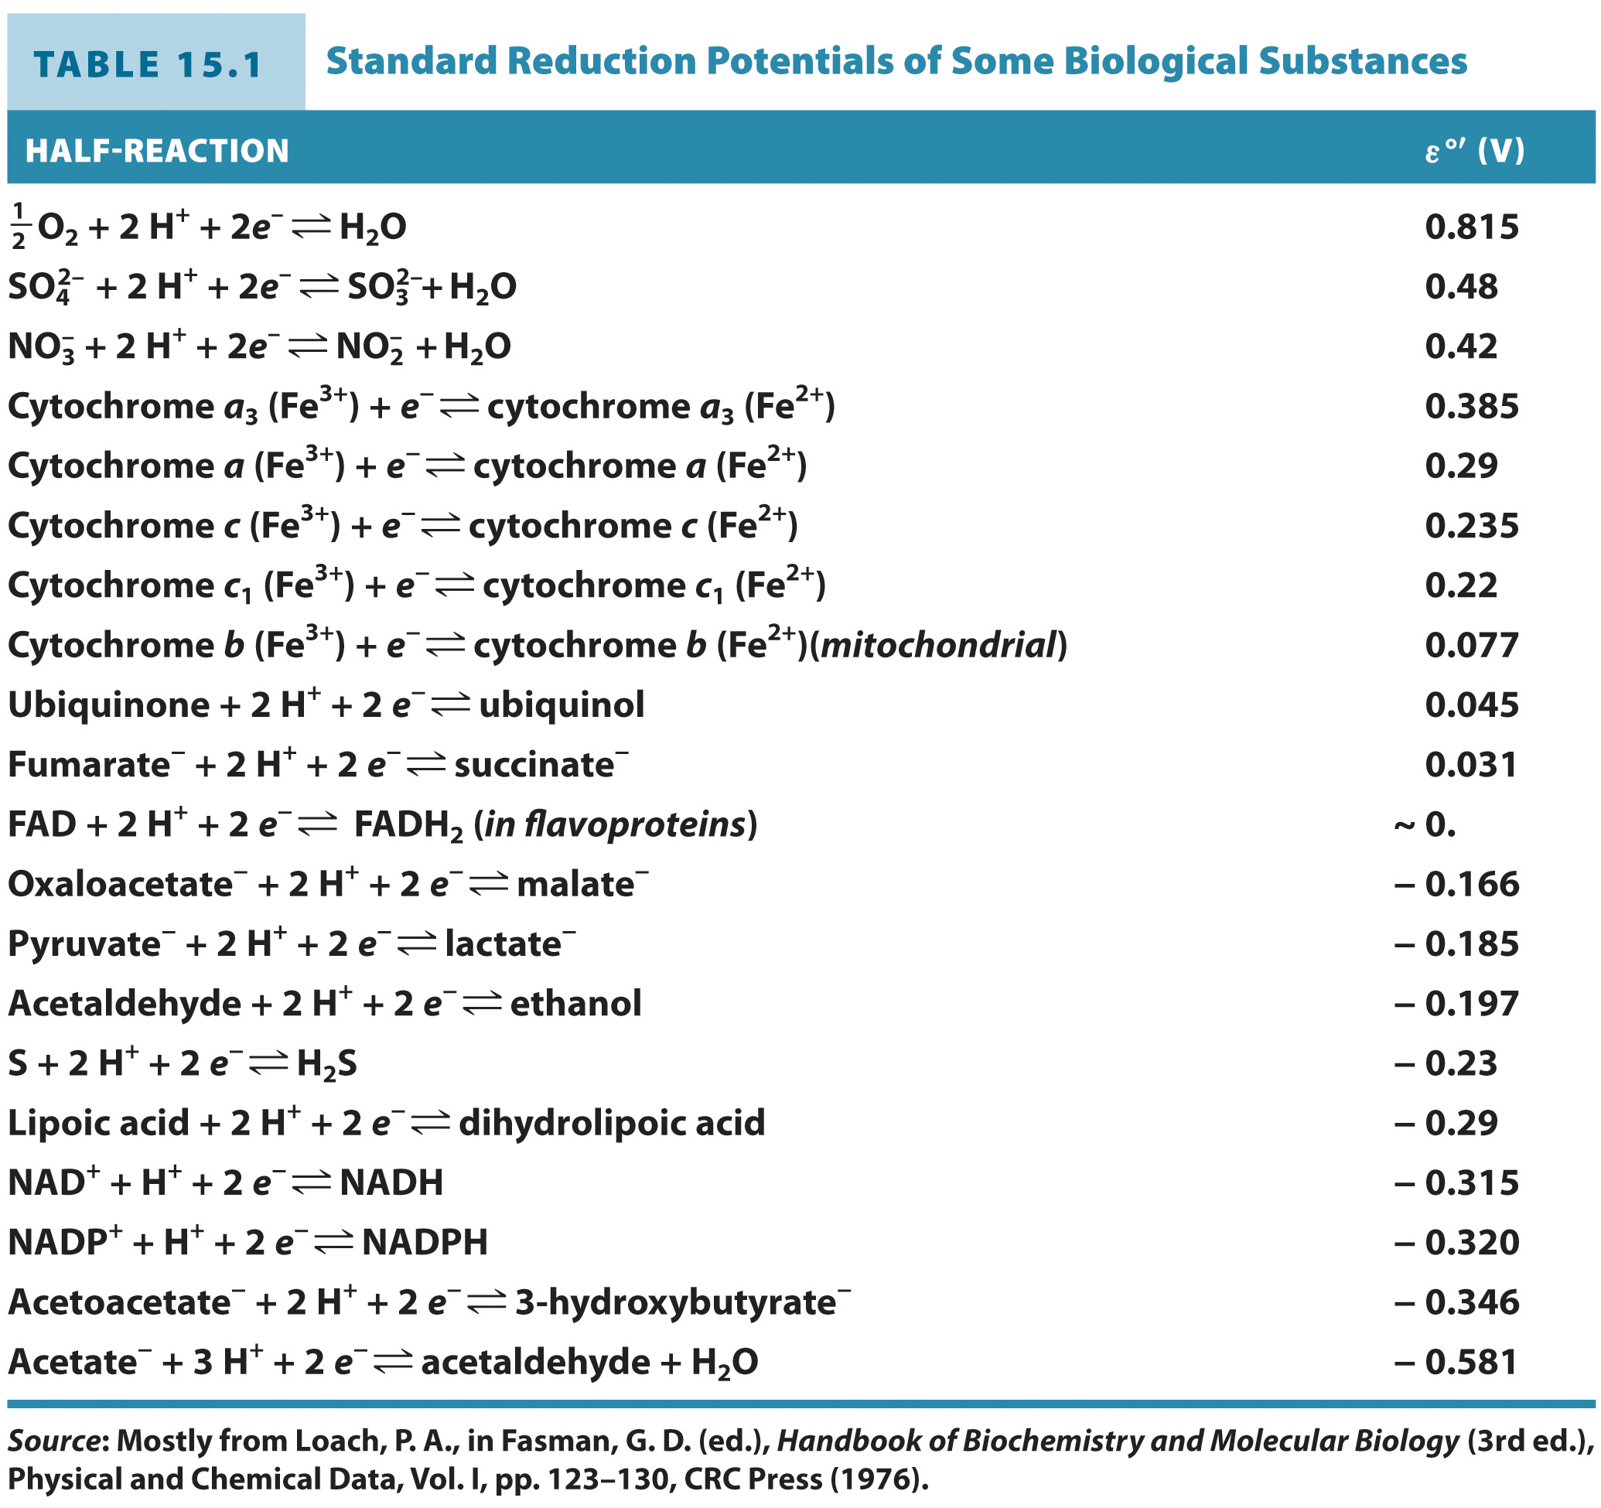
Reduction potential indicates a substance’s tendency to accept electrons

Slide 8
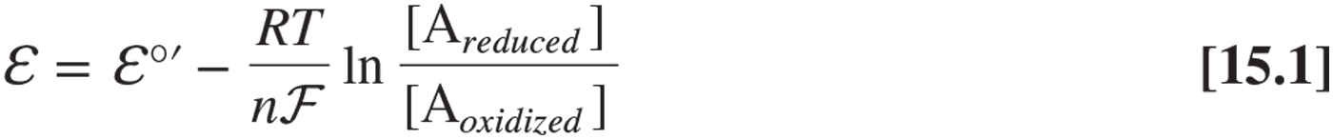
The Nernst Equation
R = Gas Constant = 8.3145 J • mol⁻¹ •K⁻¹
T = temperature in Kelvin
n = # of electrons
F = Faraday’s constant = 96,485 J • V⁻¹ •K⁻¹

Slide 9
The free energy change can be calculated from the change in reduction potential

Slide 10
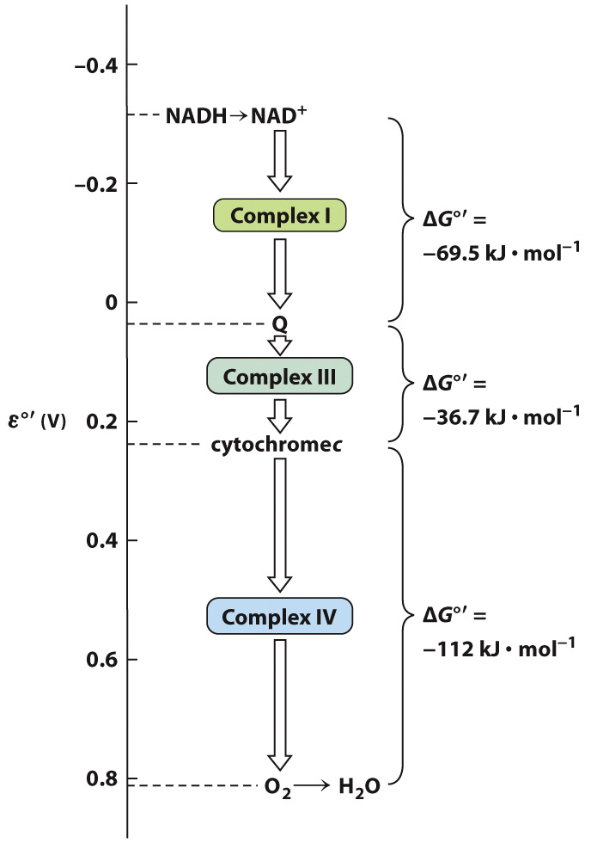
Overview of Mitochondrial Electron Transport

Slide 11
Mitochondrial Electron Transport
Section 15.2
Learning Objective
Map the path of electrons through the redox groups of the electron transport pathway

Slide 12
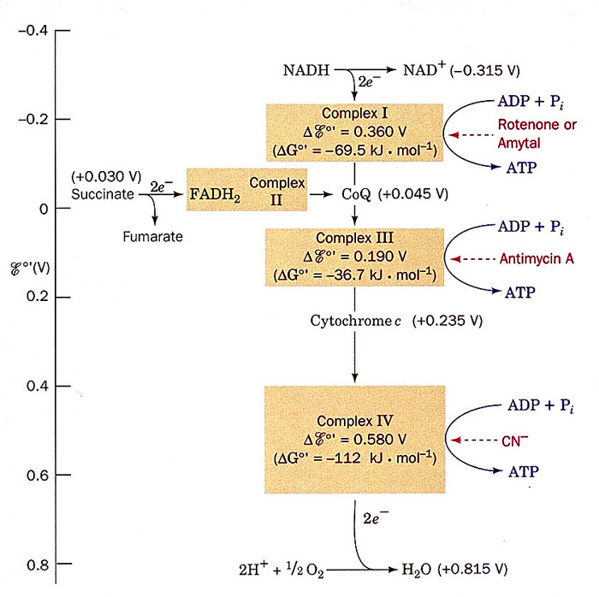

Slide 13
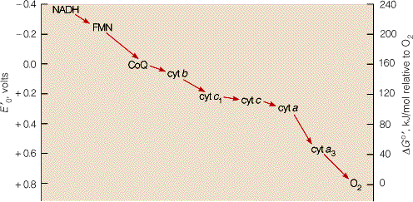

Slide 14
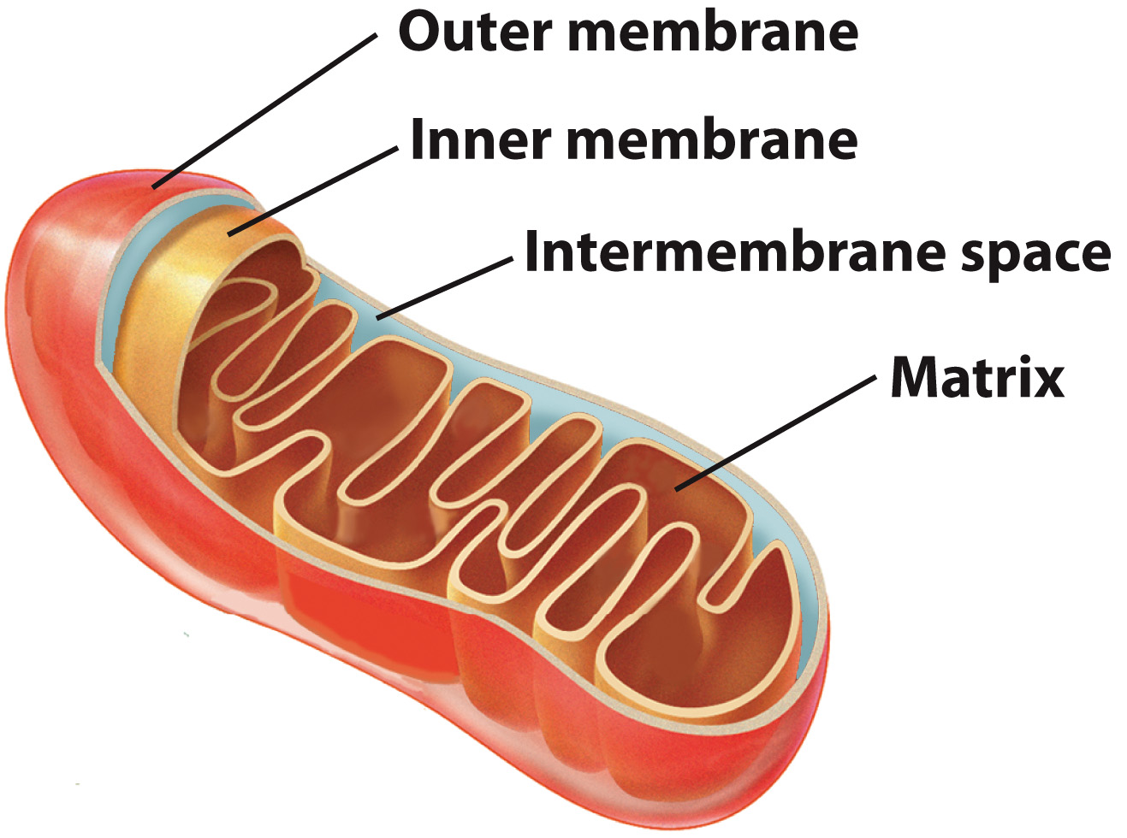
Electron transport takes place in the mitochondrion.

Slide 15
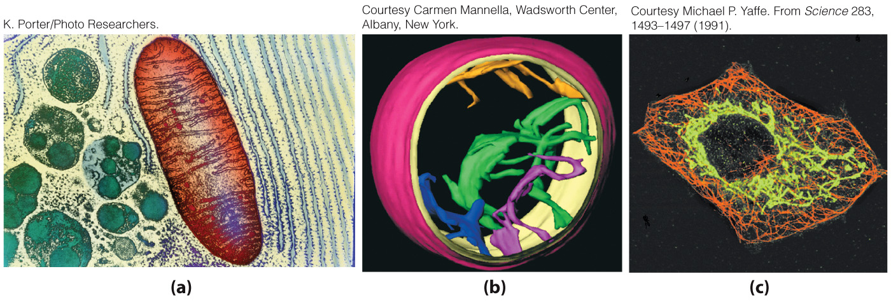
Experimental imaging helps us know what mitochondria look like.
3D Reconstruction by
Electron Tomography
Electron Micrograph
of a Fibroblast
Electron Micrograph
Mitochondria in Green

Slide 16
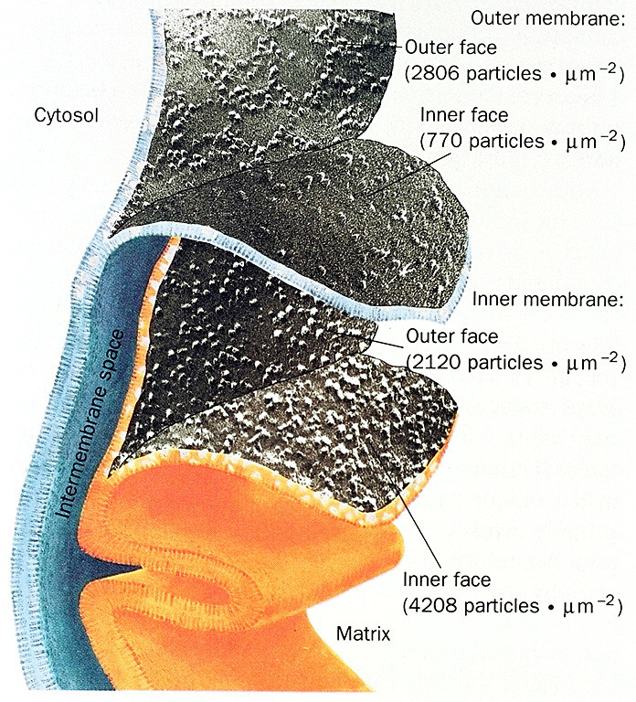

Slide 17
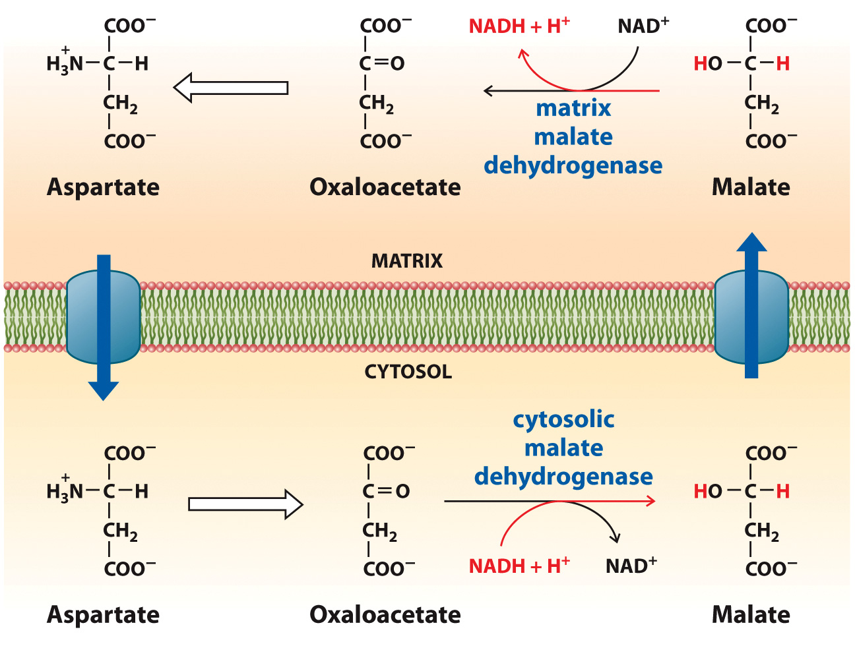
The Malate-Aspartate Shuttle System

Slide 18
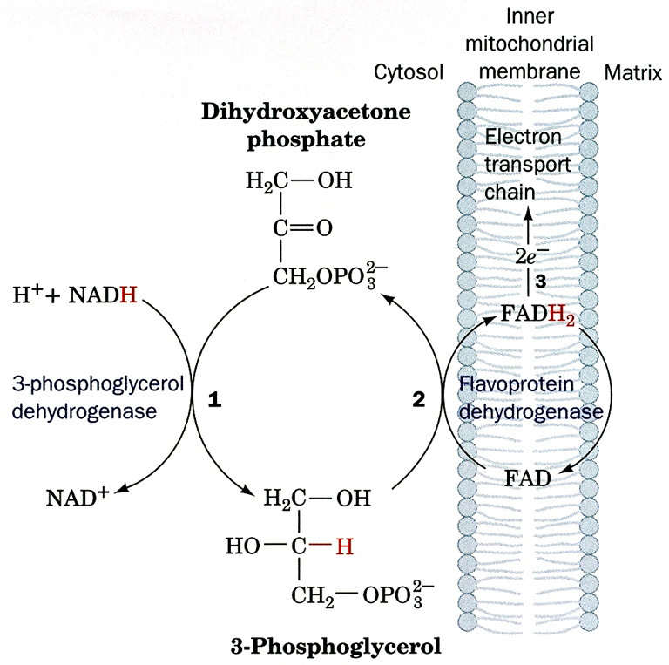

Slide 19
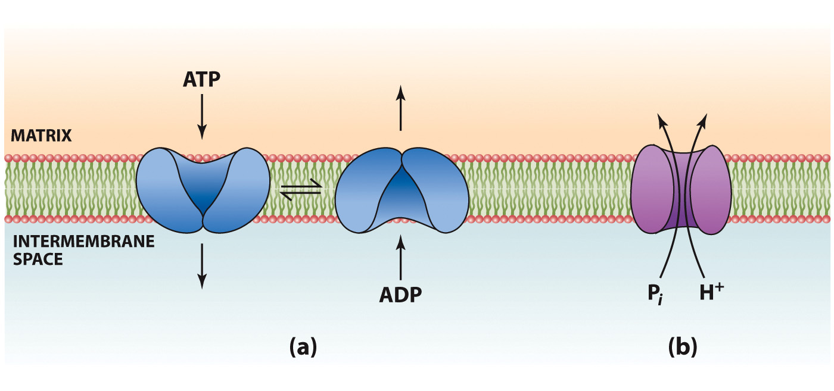
Mitochondrial Transport Systems
ATP translocase protein imports ADP and exports ATP.
A symport protein permits
simultaneous movement of P_{i} and H^{+.}

Slide 20
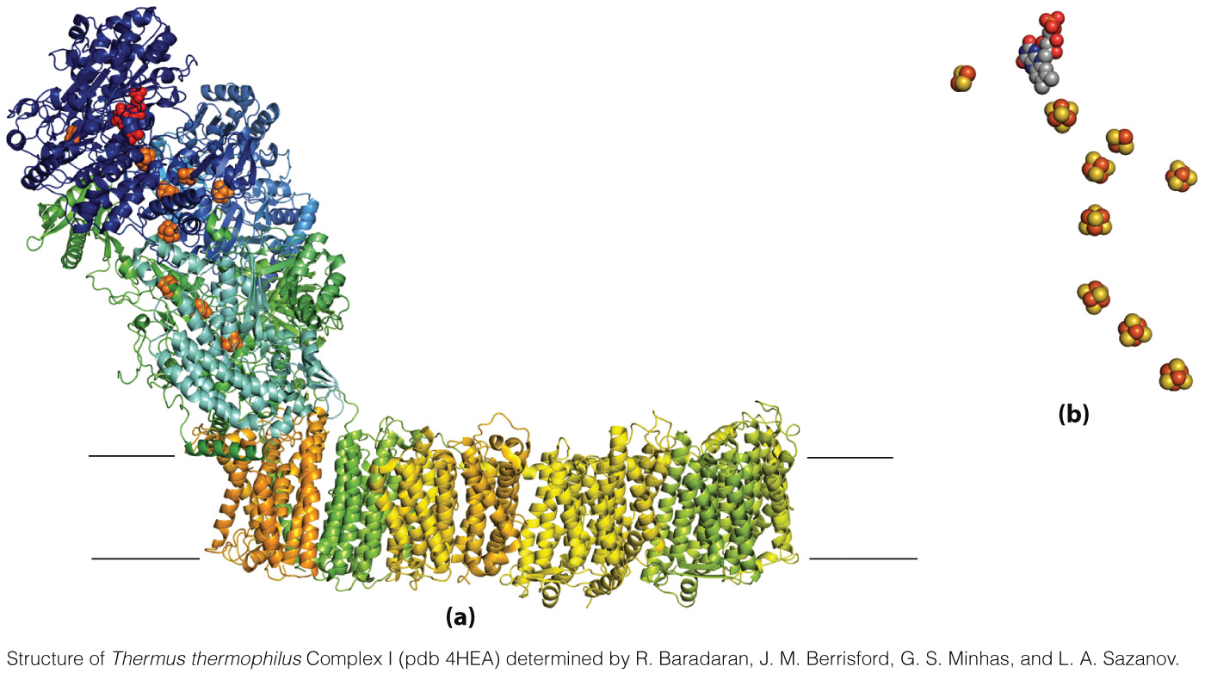
Structure of Bacterial Complex I

Slide 21
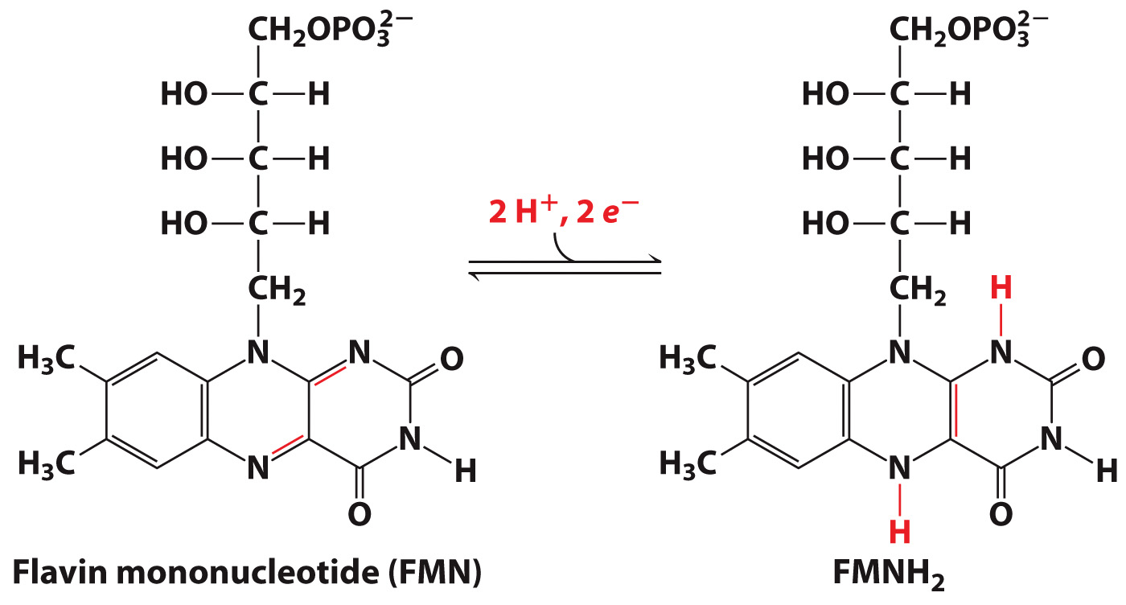
Flavin Mononucleotide (FMN)

Slide 22
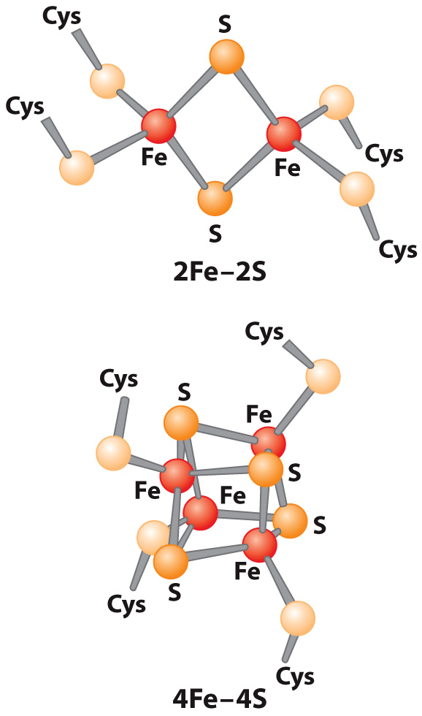
Iron-Sulfur Clusters

Slide 23
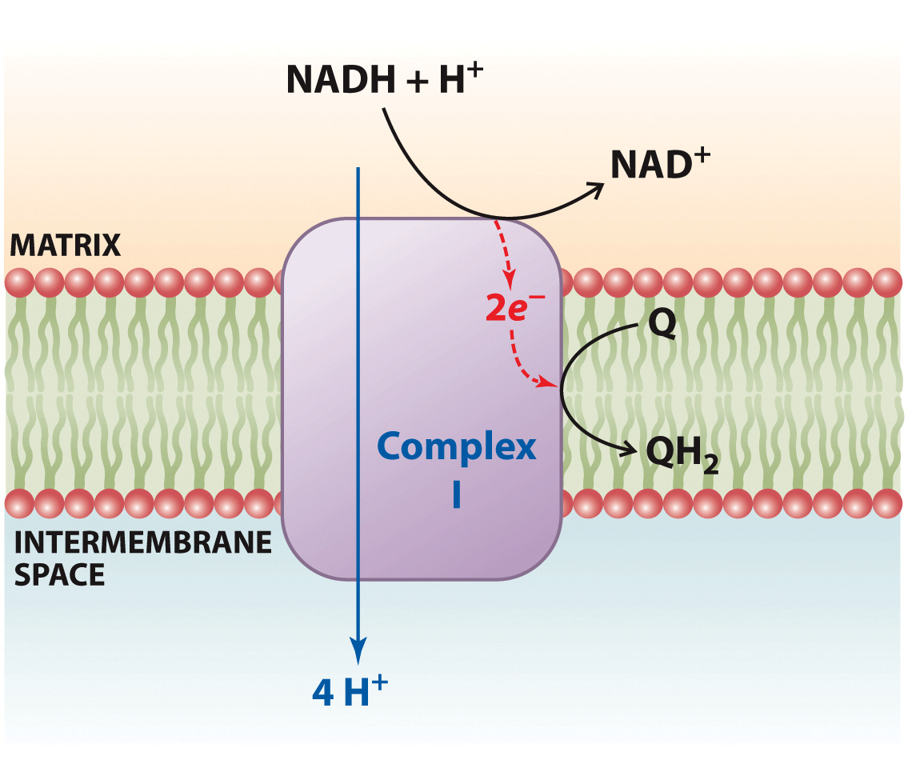
Complex I Function

Slide 24
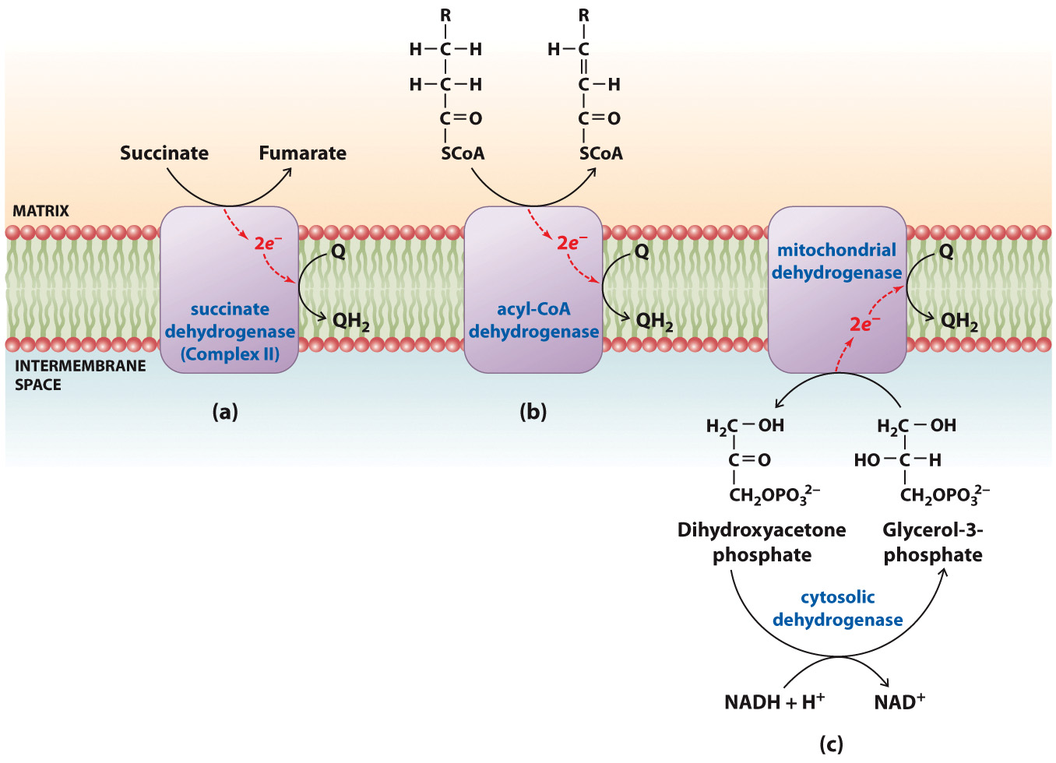
Reactions that Contribute to the Ubiquinol Pool

Slide 25
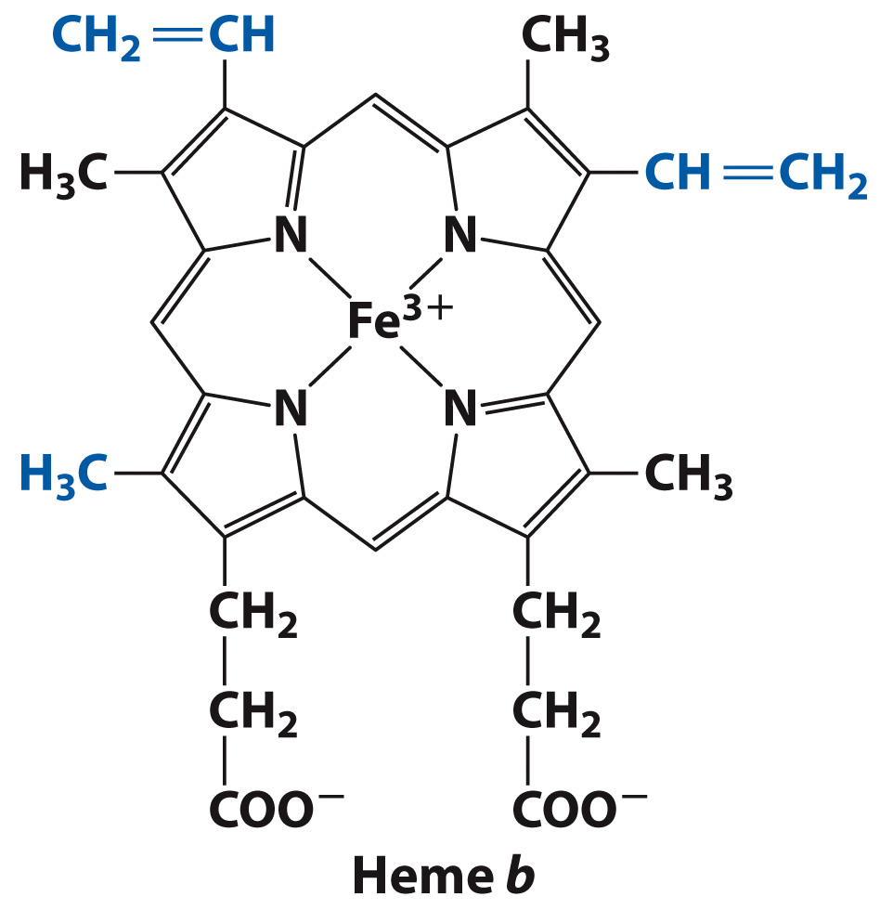
The Heme Group of a b Cytochrome

Slide 26
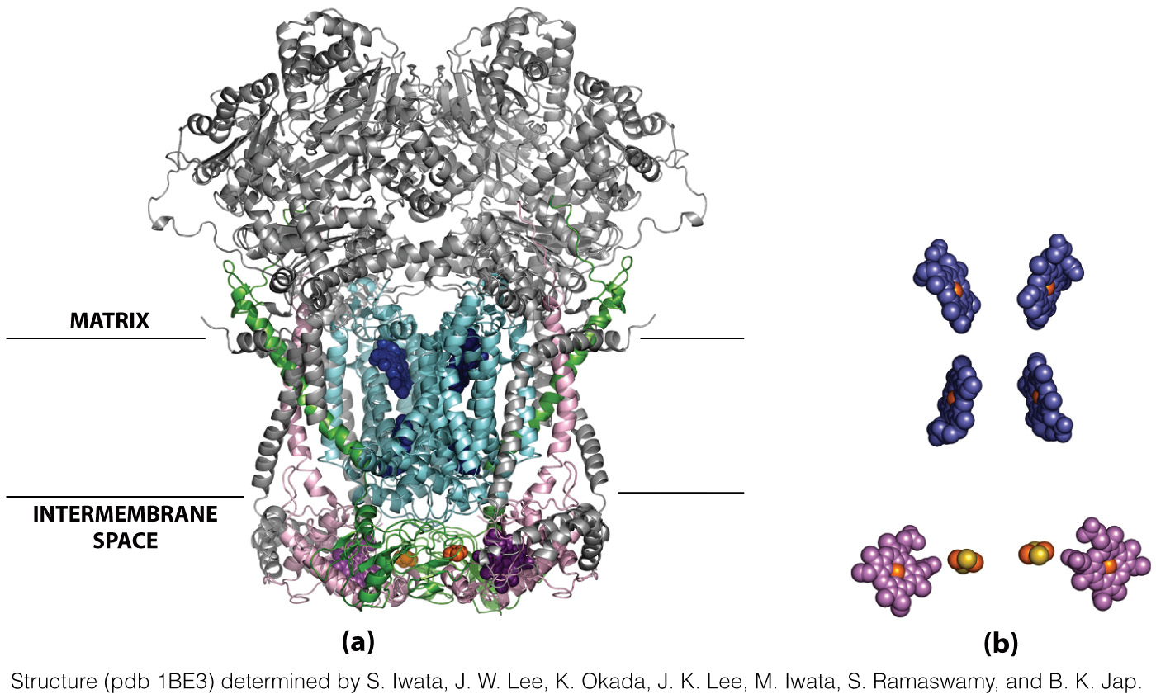
Structure of Mammalian Complex III
Cyt b
Cyt c₁
Arrangement of Prosthetic Groups
Heme groups of Cyt b
Fe-S clusters

Slide 27
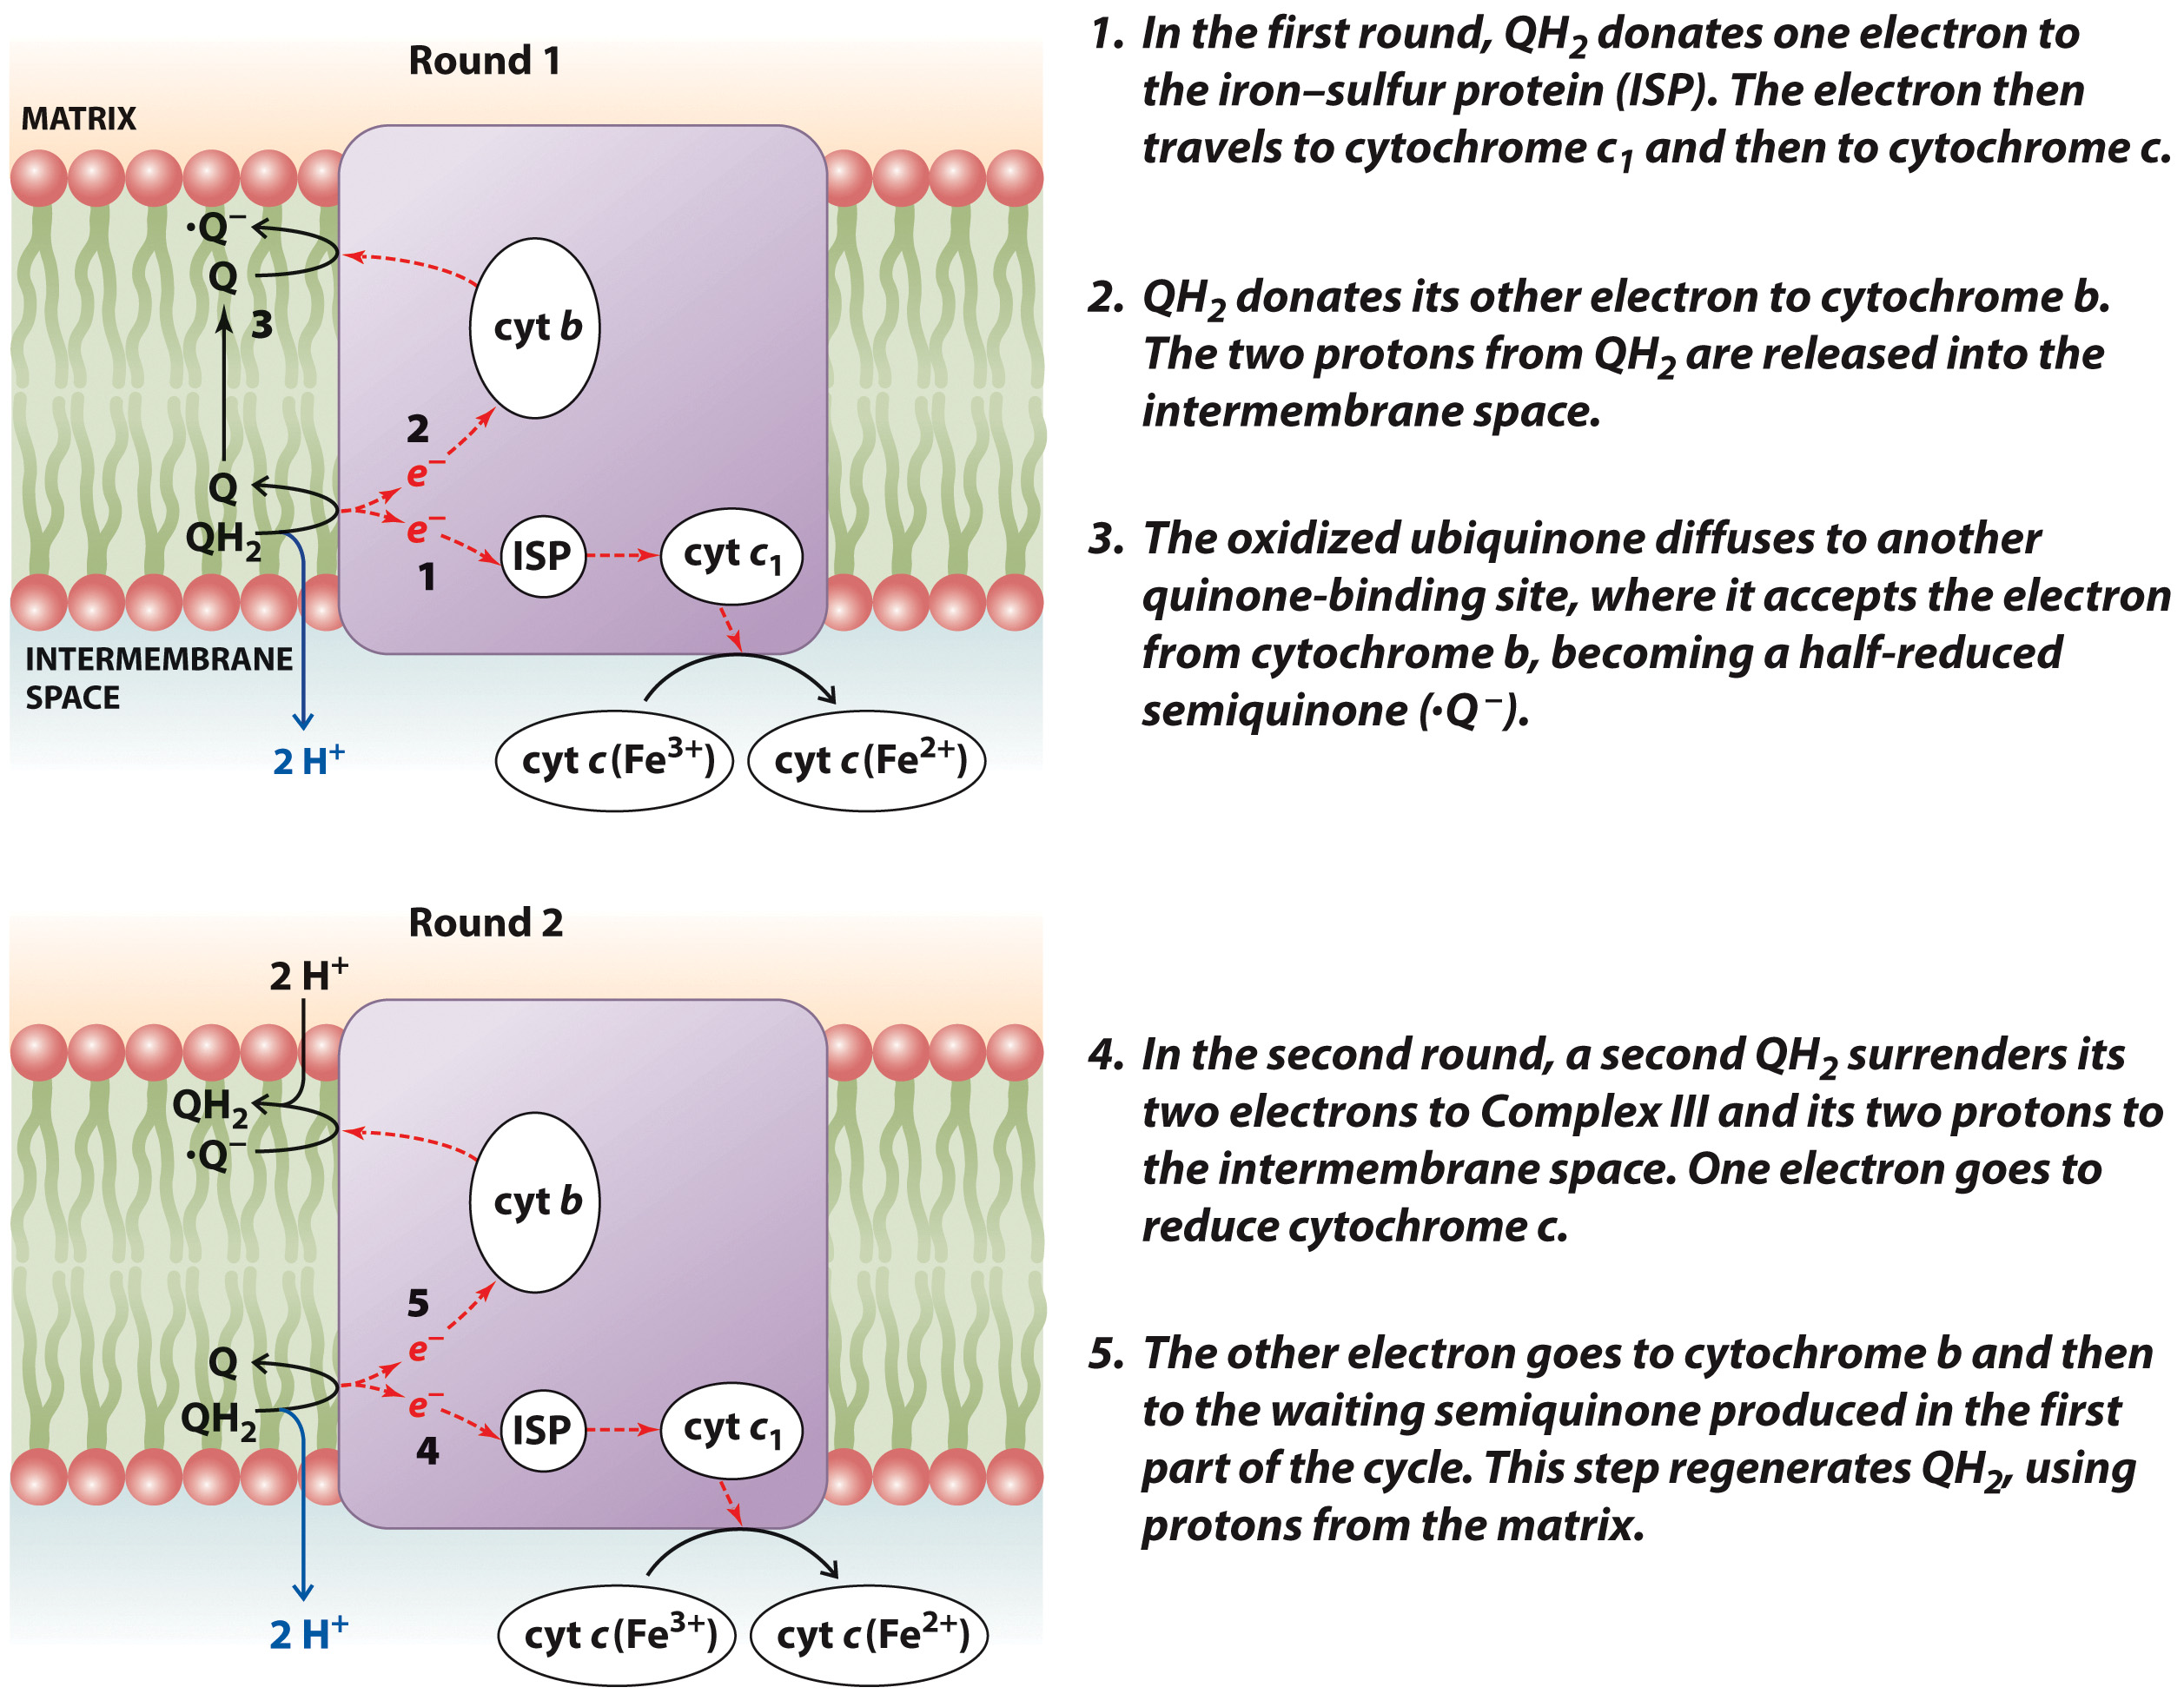
The Q Cycle

Slide 28
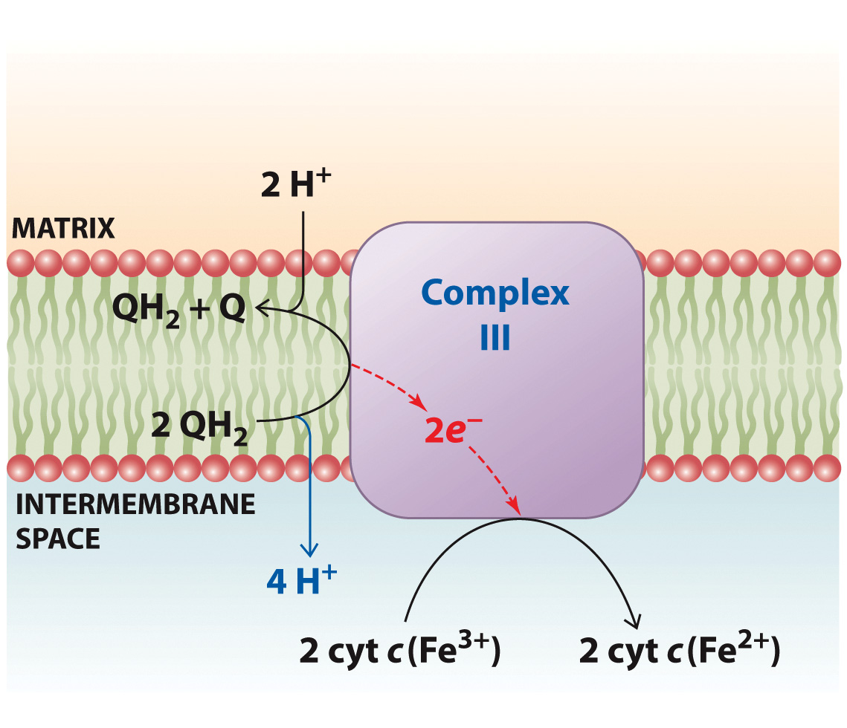
Complex III Function

Slide 29
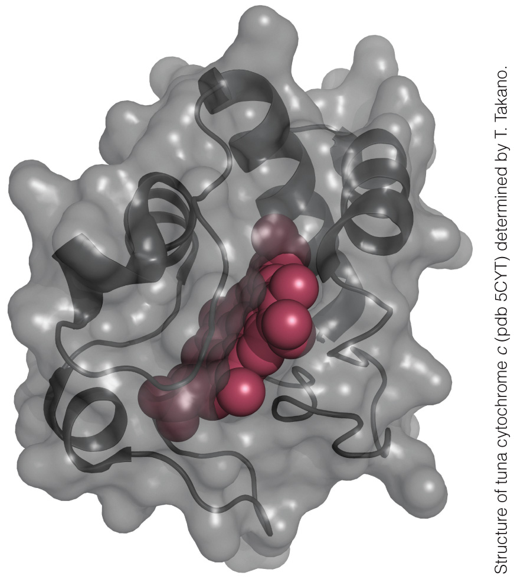
Cytochrome c

Slide 30
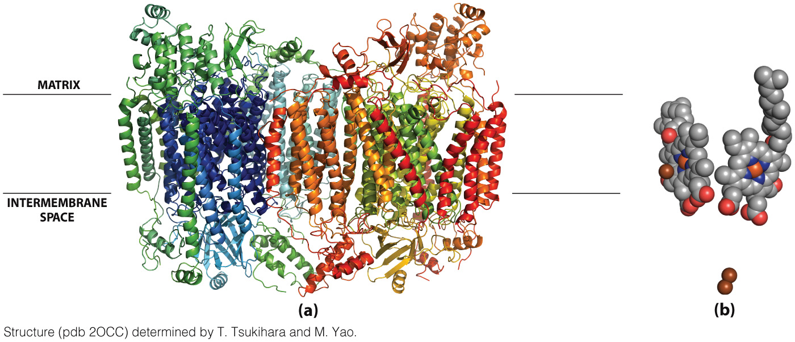
Structure of Cytochrome c Oxidase

Slide 31
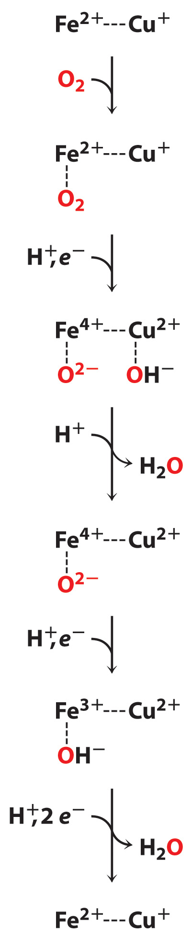
A Proposed Model for Cytochrome c Oxidase Activity

Slide 32
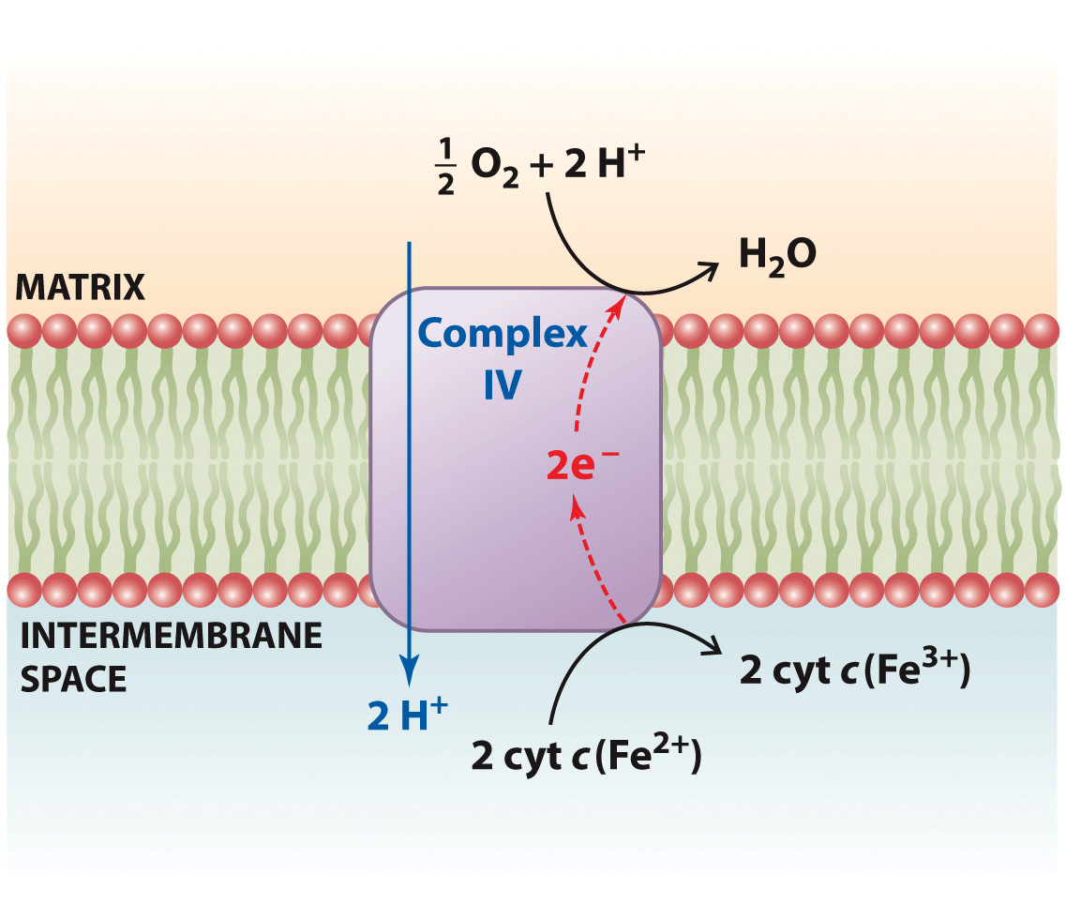
Complex IV Function

Slide 33
Chemiosmosis
Section 15.3
Learning Objective
Explain how the protonmotive force links electron transport and ATP synthesis

Slide 34
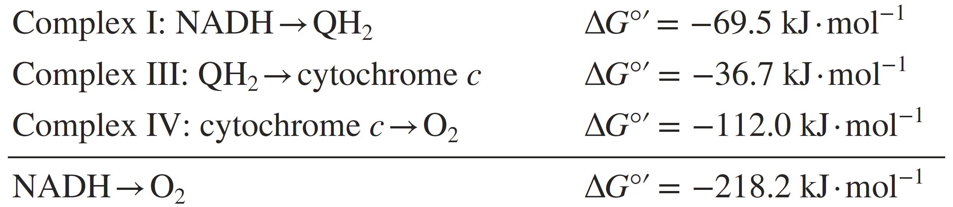
How much energy is available from electron transport?

Slide 35
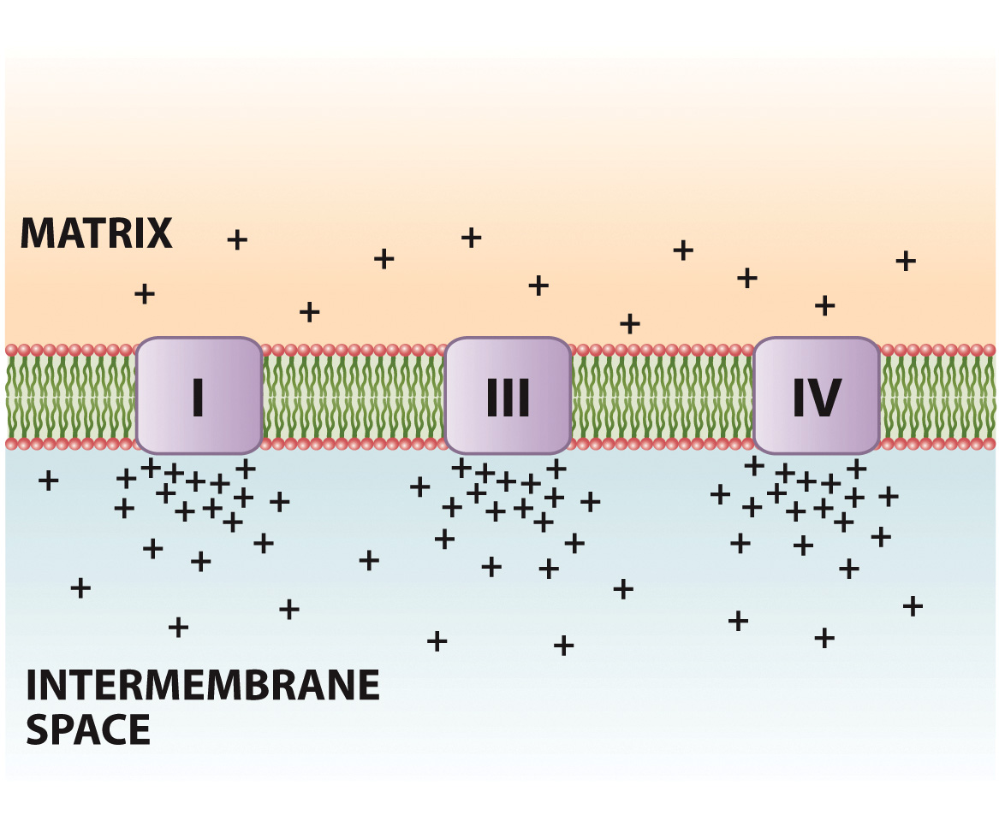
Generation of a Proton Gradient

Slide 36
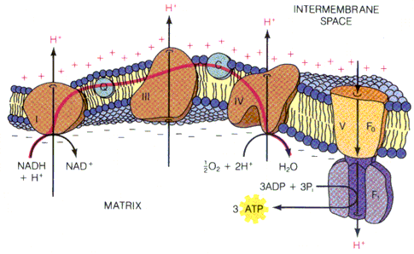
...appears to be a proton gradient
AND a charge separation (capacitor?)

Slide 37

Does the proton gradient explain ATP synthesis entirely? No.
~+0.224V
~+0.14V
~0.084V
(“typical values”)
Therefore, (0.14/0.224)*100% = ~62% contributed by voltage potential.

Slide 38
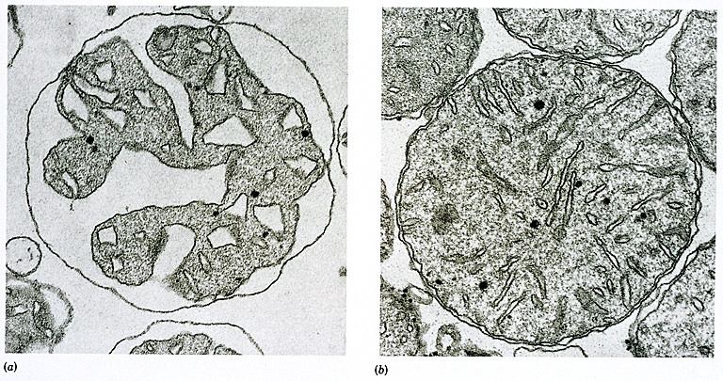
Actively Respiring mouse
liver mitochondria.
Resting mouse liver mitochondria.

Slide 39
ATP Synthase
Section 15.4
Learning Objective
Describe the structure and operation of ATP synthase

Slide 40
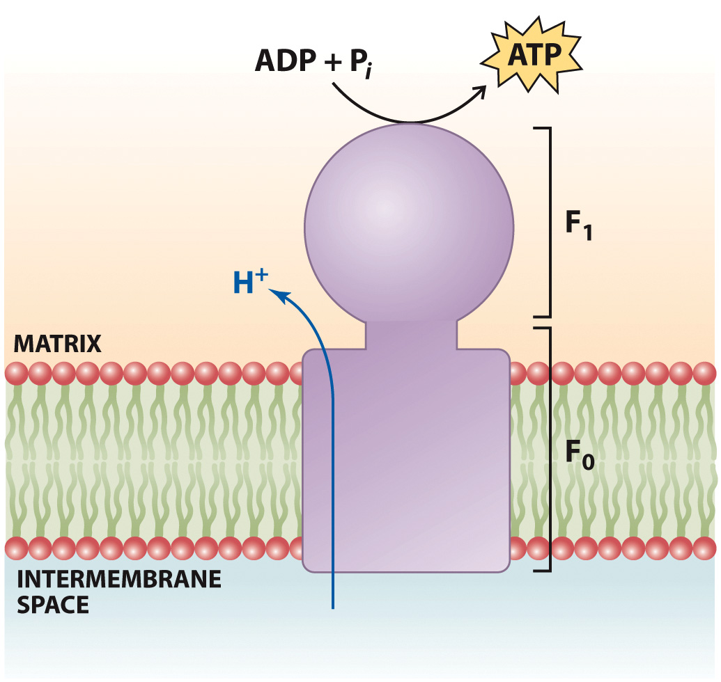
ATP Synthase Function

Slide 41
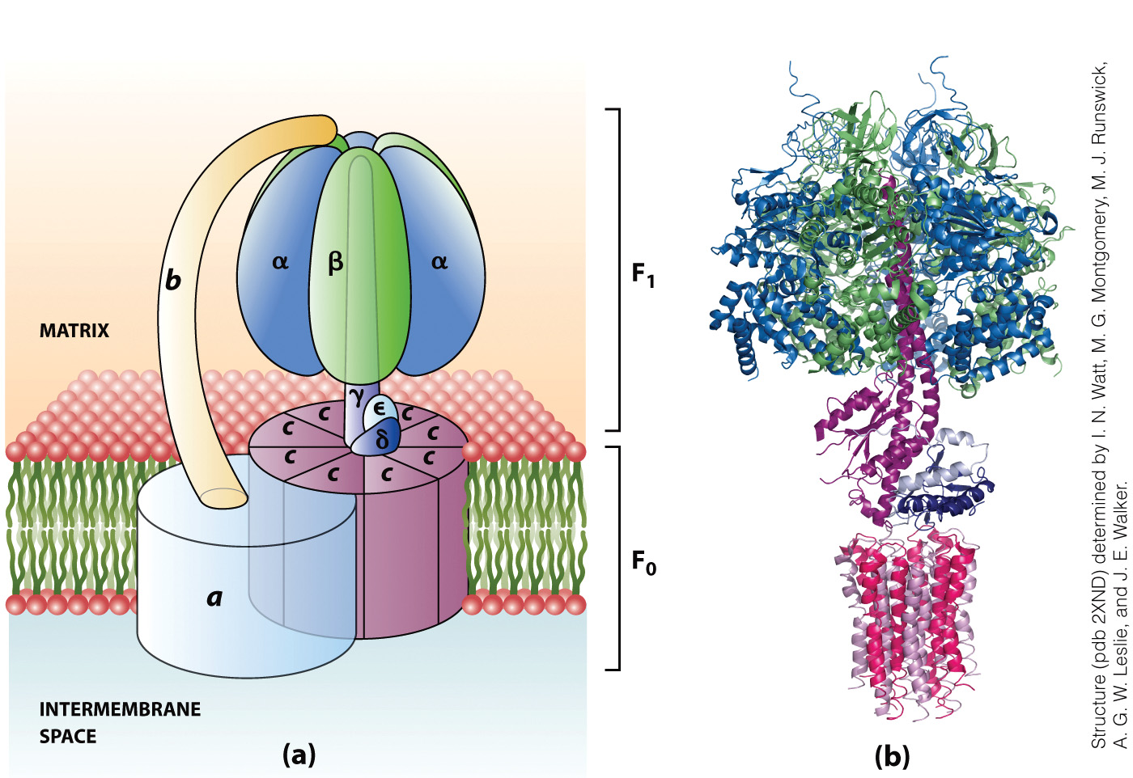
Structure of ATP Synthase

Slide 42
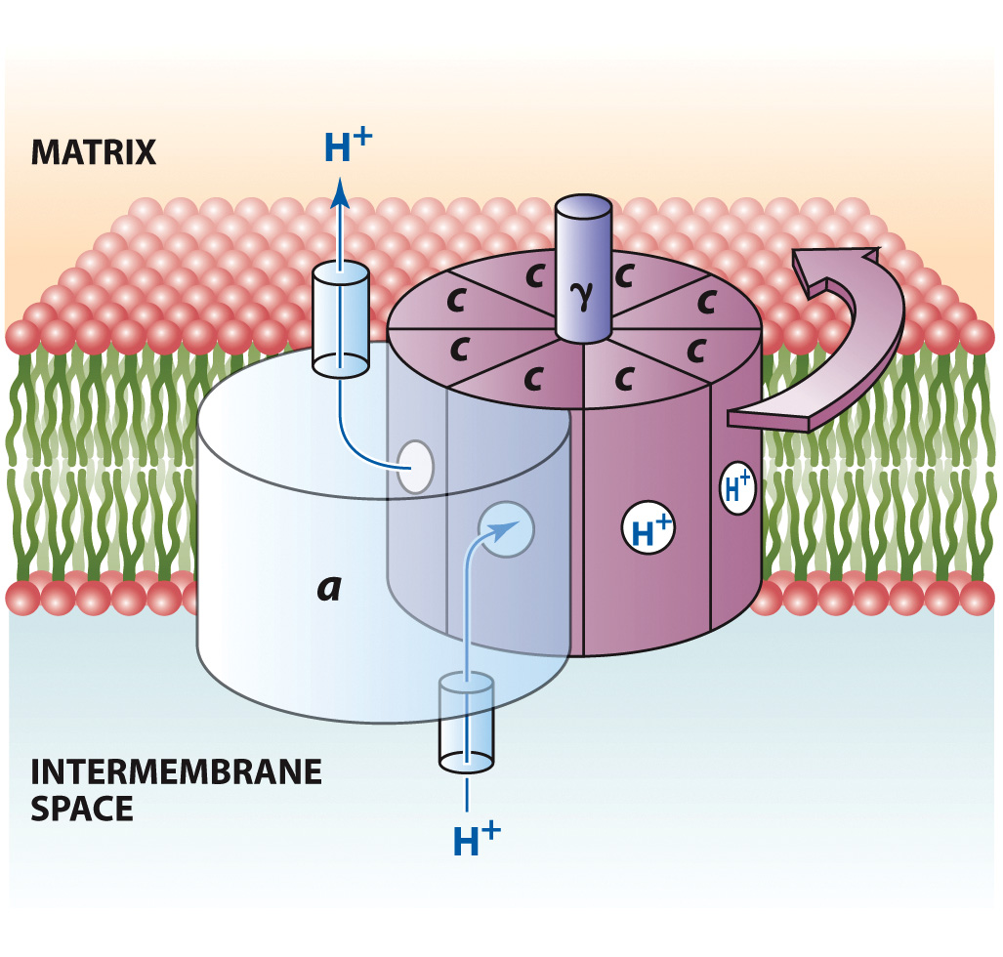
Mechanism of Proton Transport by ATP synthase

Slide 43
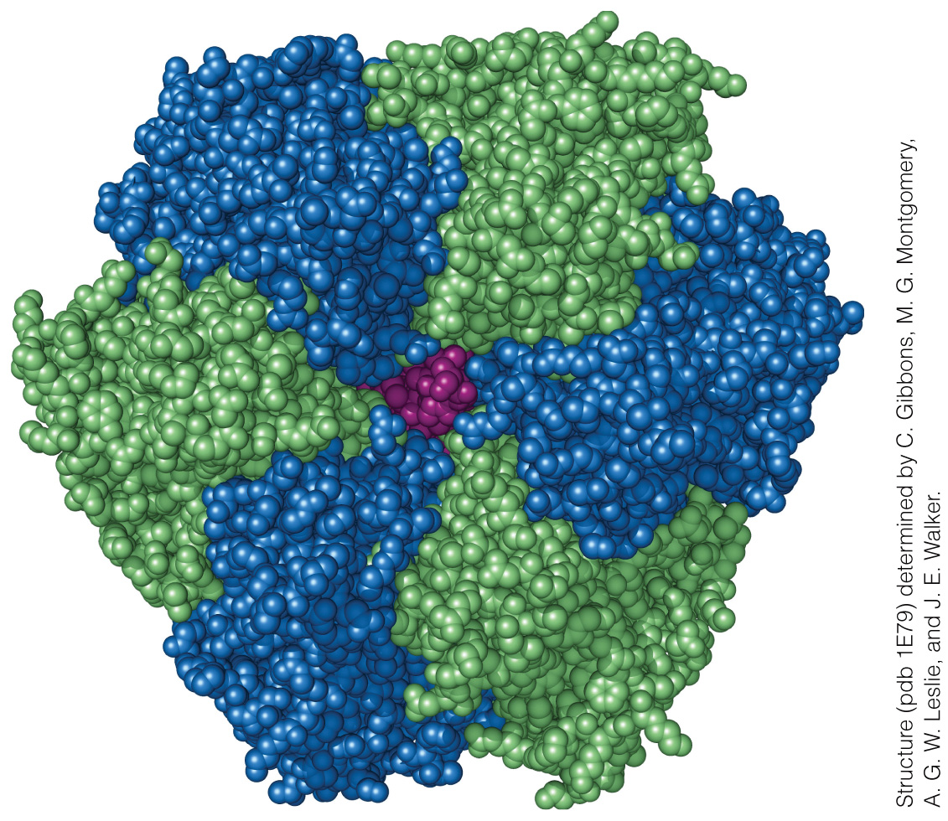
Structure of the F₁ Component of ATP Synthase
α = blue
β = green
γ = purple

Slide 44
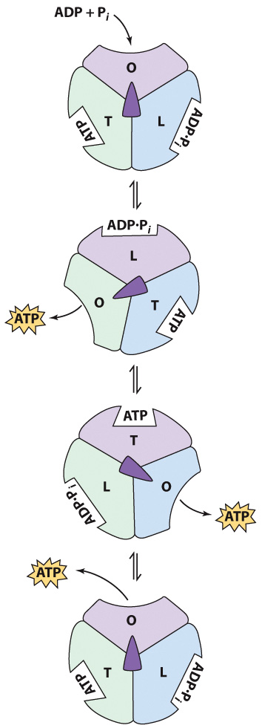
The Binding Change Mechanism

Slide 45
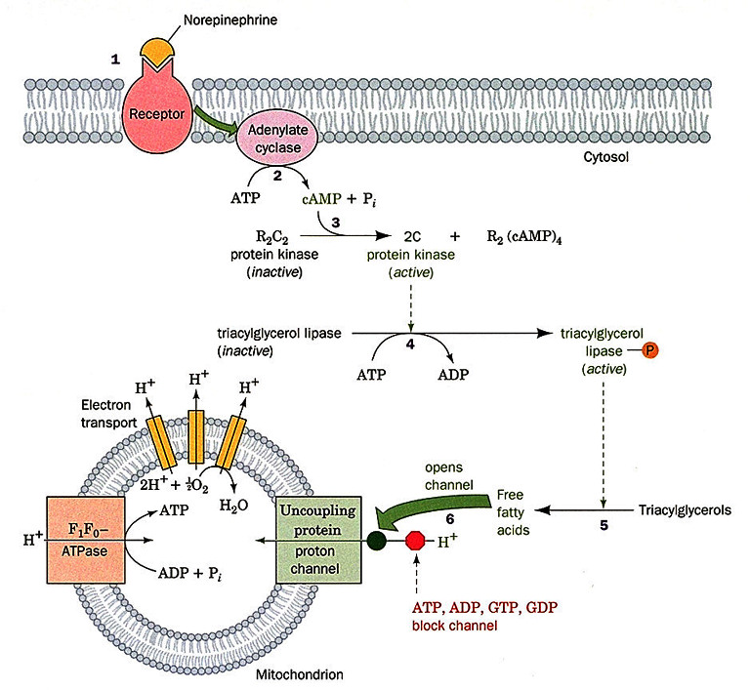

Slide 46
