Slide 1
Essential Biochemistry
Fourth Edition
Charlotte W. Pratt | Kathleen Cornely
Lecture Notes for
Chapter 14
The Citric Acid Cycle

Slide 2
KEY CONCEPTS: Section 14-1
The pyruvate dehydrogenase complex includes three types of enzymes that collectively remove a carboxylate group from pyruvate and produce acetyl-CoA and NADH.

Slide 3
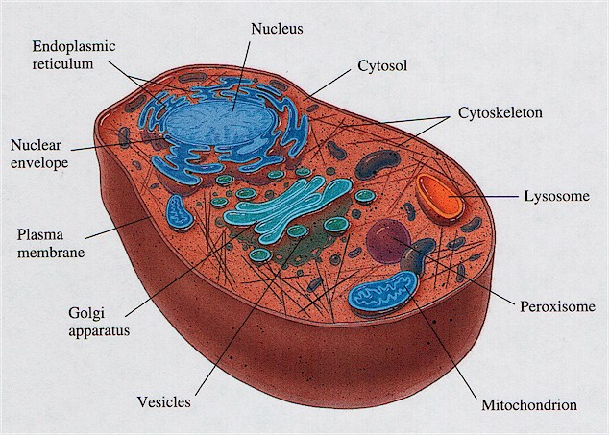

Slide 4
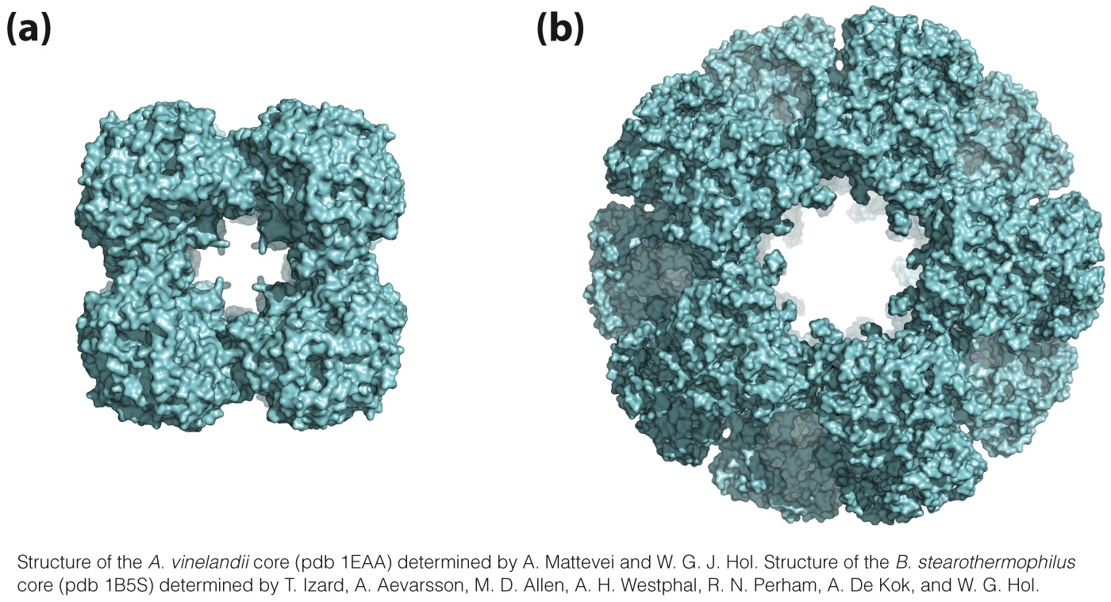
The Pyruvate Dehydrogenase Reaction
Model of the pyruvate dehydrogenase complex from Azotobacter vinelandii and B. stearothermophilus

Slide 5
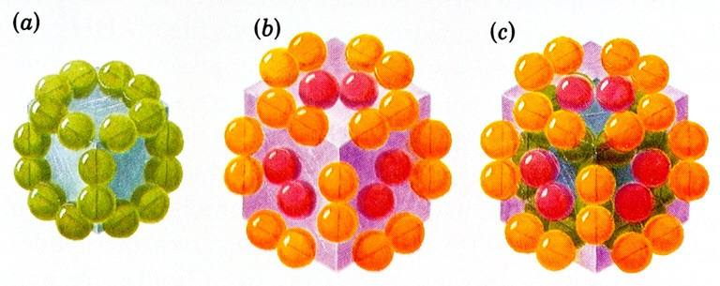
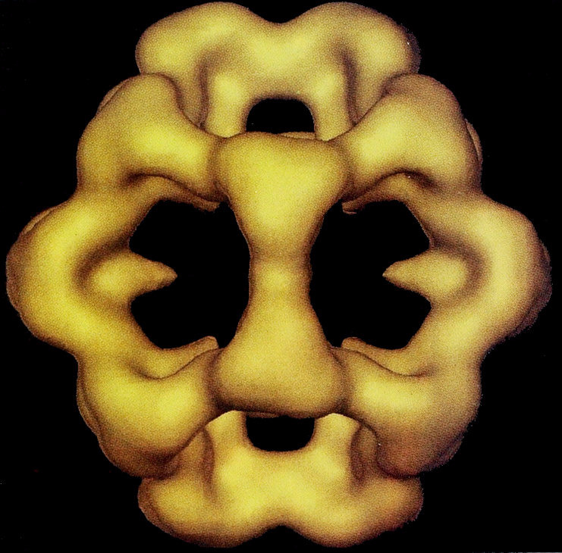
The whole
60 subunit
complex
24 subunit
E2 core
24 E1 (orange)
+ 12 E3 subunits (red)
Pyruvate Dehydrogenase:
Bacterial, 4.6 Megadaltons larger than a ribosome.
Mammalian, ~twice as large
Vitamin rich. (thiamine pyrophosphate (TPP), lipoic acid, NAD, FAD, CoA)

Slide 6
The pyruvate dehydrogenase complex works in 5 steps.
E1 decarboxylates pyruvate; CO₂ is released.
A leftover hydroxyethyl group is transferred to E2.
An acetyl group is transferred to CoA.
E2 is restored.
E3 is restored and NADH is produced.

Slide 7
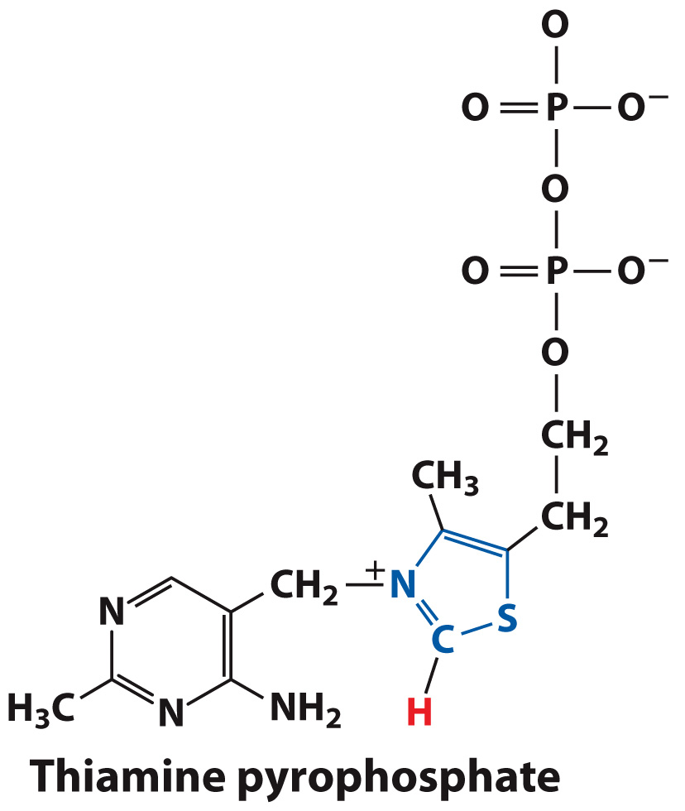
E1 of pyruvate dehydrogenase uses thiamine pyrophosphate.
Thiamin = Vitamin B₁
Cofactor for several decarboxylation reactions

Slide 8
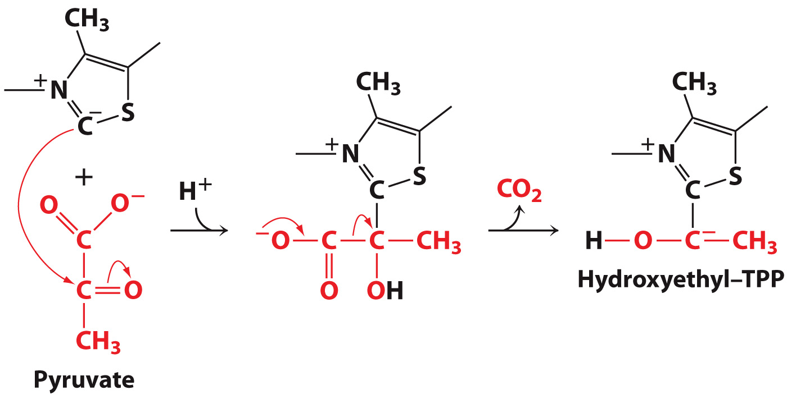
Step 1: Decarboxylation of Pyruvate

Slide 9
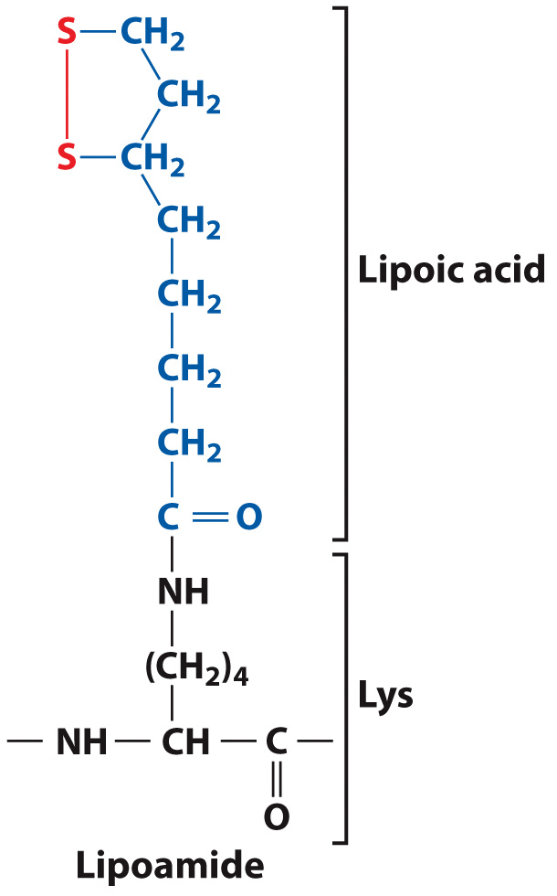
E2 uses a lipoamide cofactor.
Disulfide bond = active portion

Slide 10
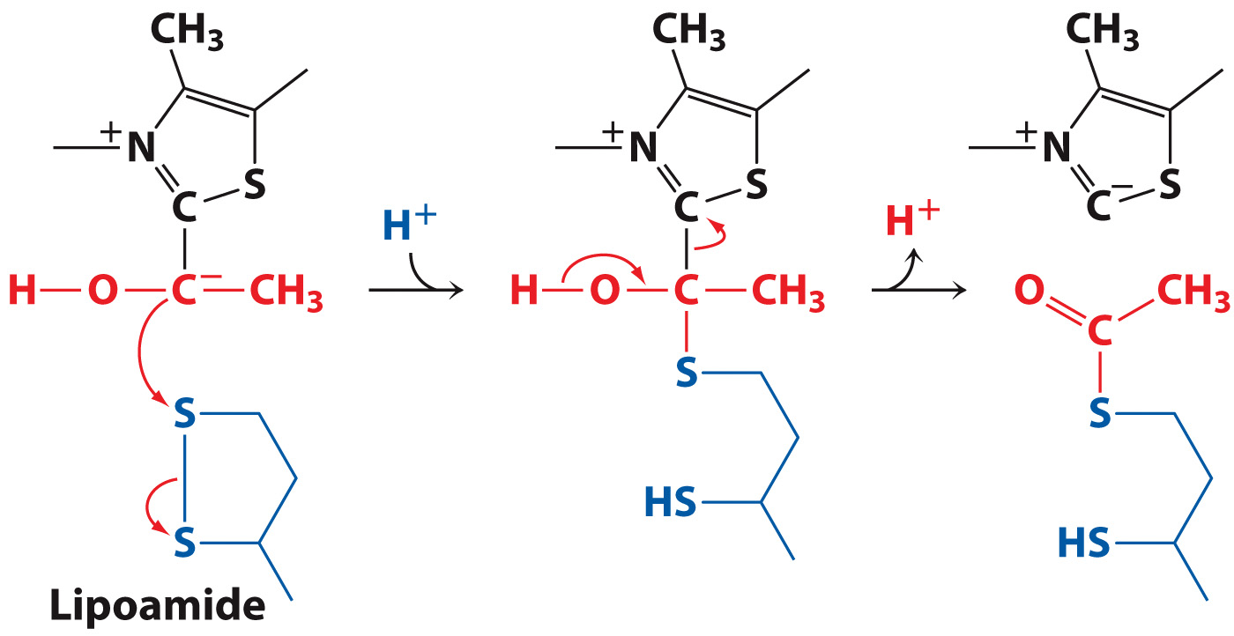
Step 2: Transfer from E1 to E2

Slide 11
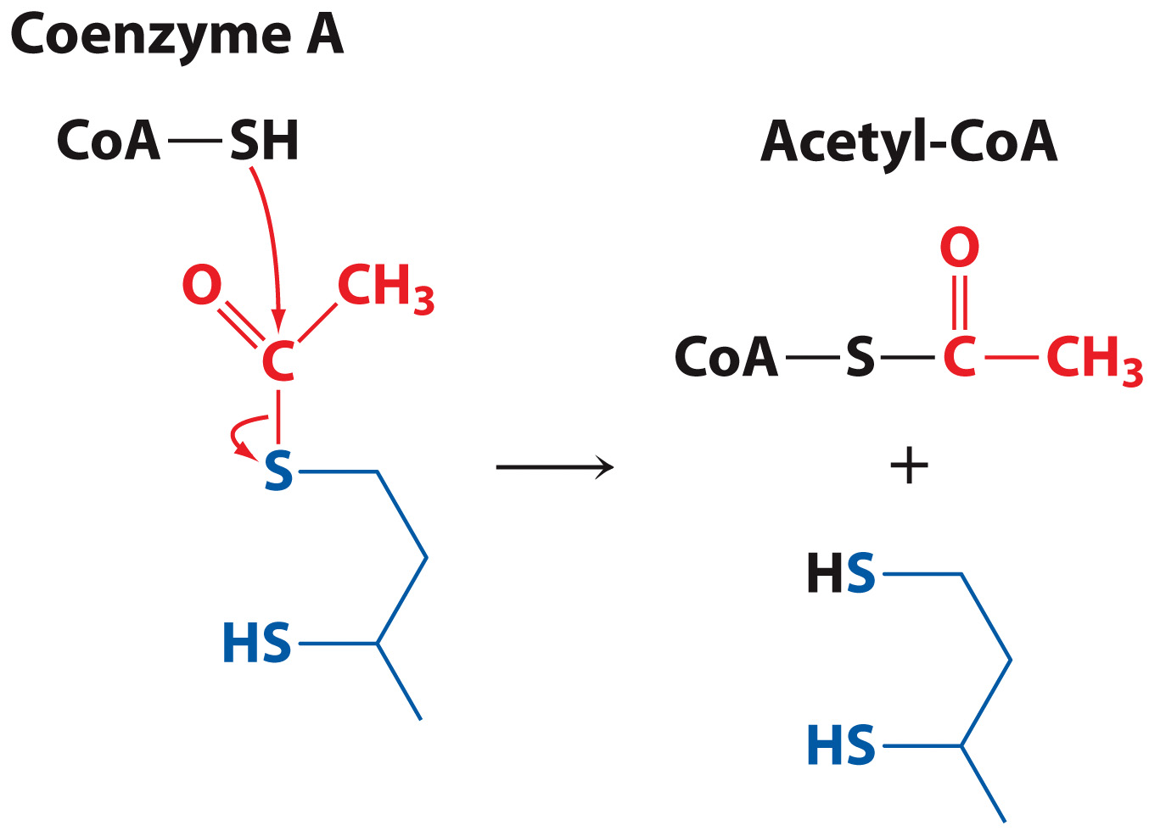
Step 3: Acetyl Transfer to CoA

Slide 12
Step 4: Restoration of E2
E3 uses a disulfide bond and an FAD cofactor
Lipoamide is oxidized by E3’s disulfide

Slide 13
Step 5: Restoration of E3
Electrons move to FAD to form FADH_{2.}
Electrons move from FADH₂ to NAD⁺ to form NADH and H^{+.}
E3 is restored to its oxidized state.

Slide 14
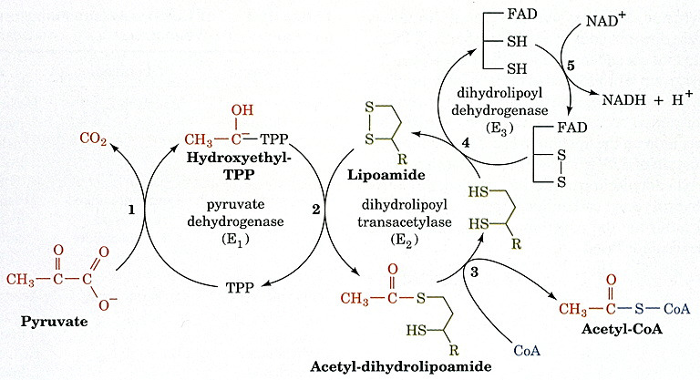
Summary of the Pyruvate Dehydrogenase Reactions

Slide 15
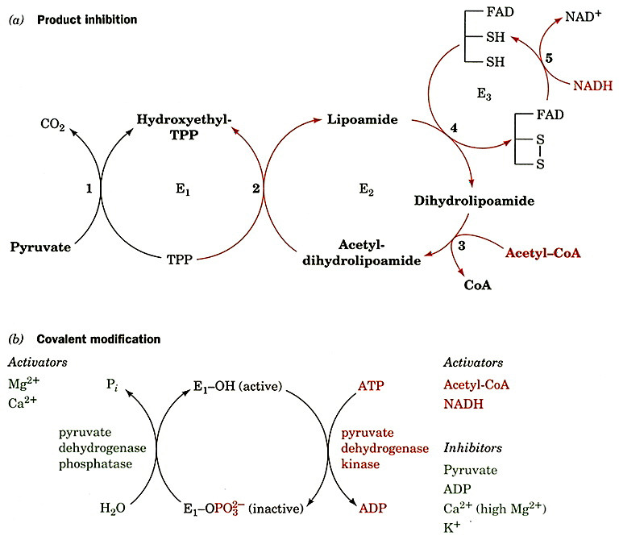

Slide 16
ΔG° ~ -30kJ/mol for hydrolysis of
acetyl-CoA, so net reaction is about zero.

Slide 17
KEY CONCEPTS: Section 14-2
The citric acid cycle is a set of eight reactions in which an acetyl group is condensed with oxaloacetate, two CO₂ are lost, and oxaloacetate is regenerated.
Each round of the citric acid cycle generates three NADH, one QH₂, and one GTP or ATP.
Flux through the citric acid cycle is regulated primarily by feedback inhibition at three steps.
The citric acid cycle likely evolved by the combination of oxidative and reductive pathways.

Slide 18
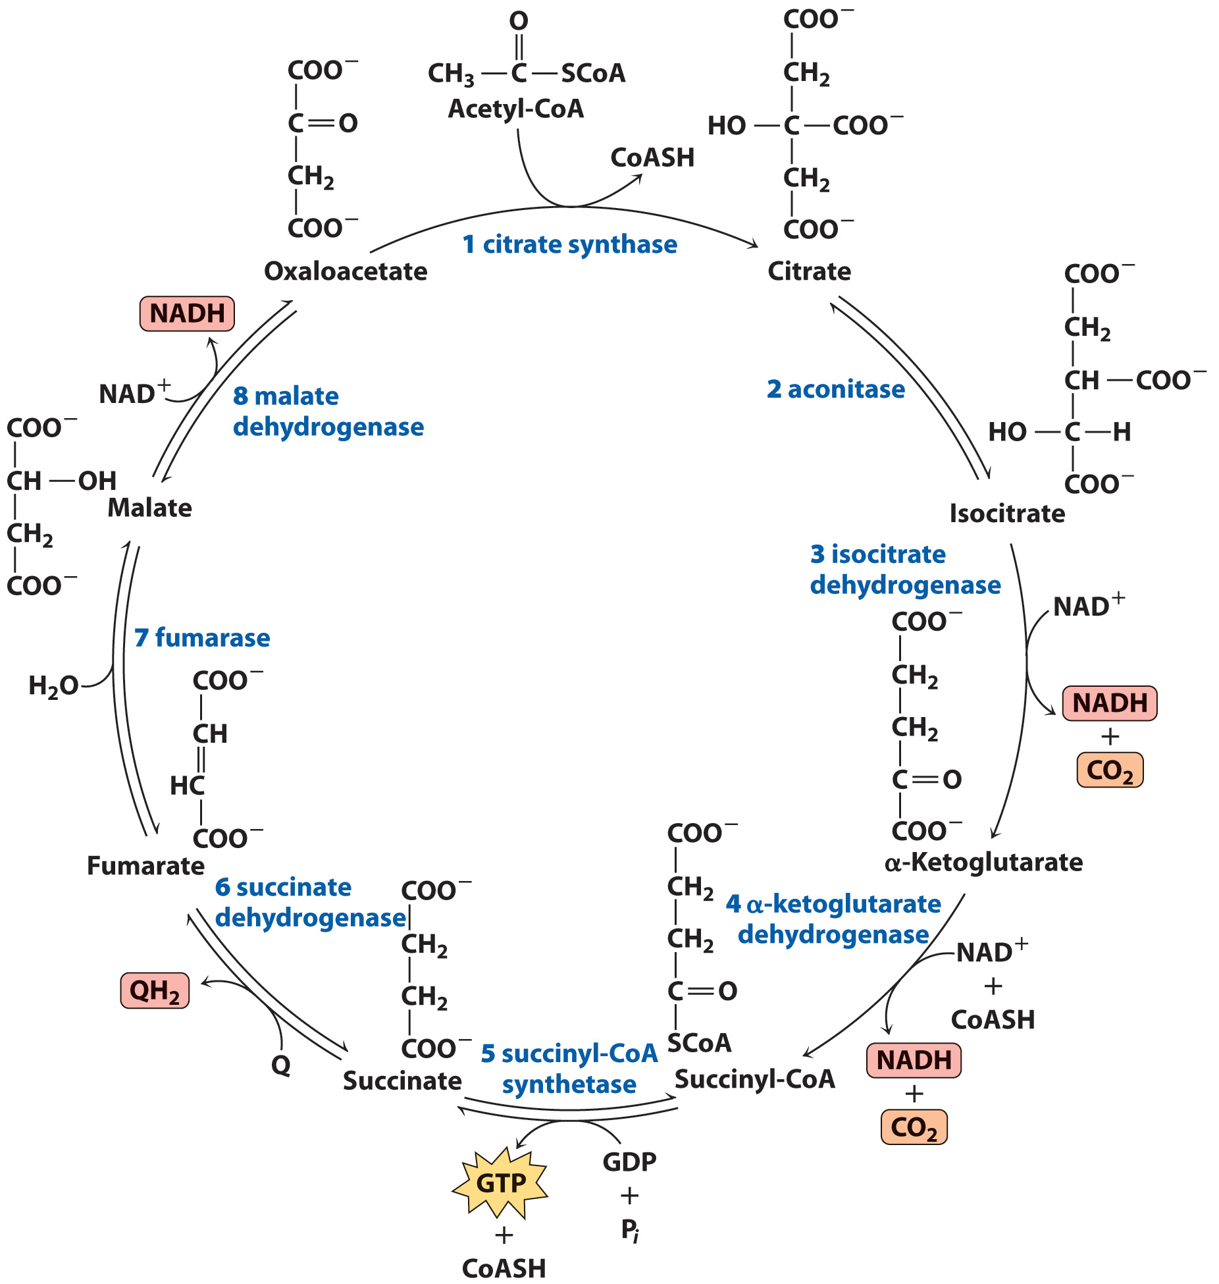
Overview of the Citric Acid Cycle

Slide 19
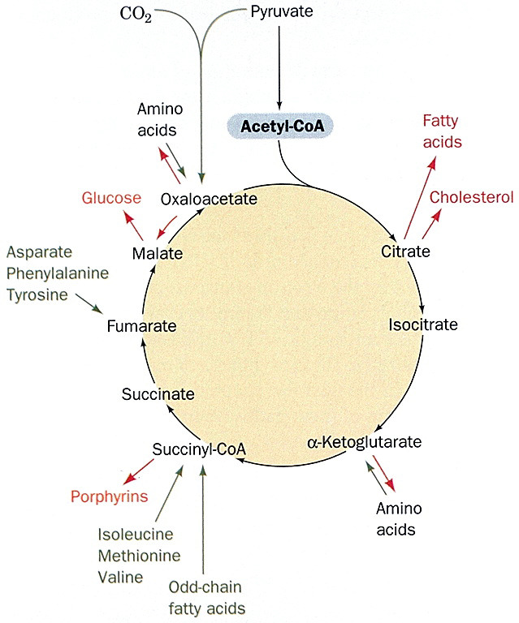

Slide 20
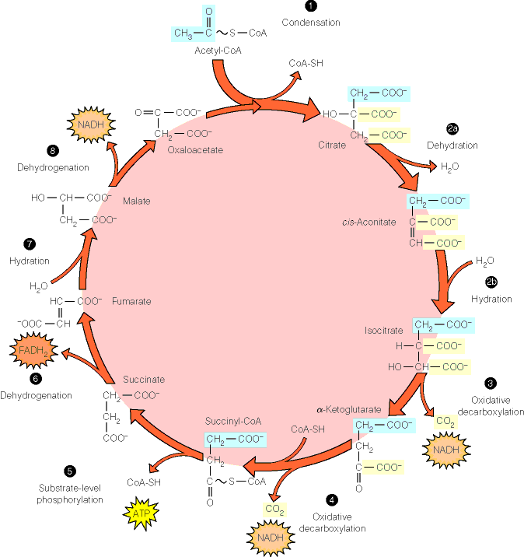

Slide 21
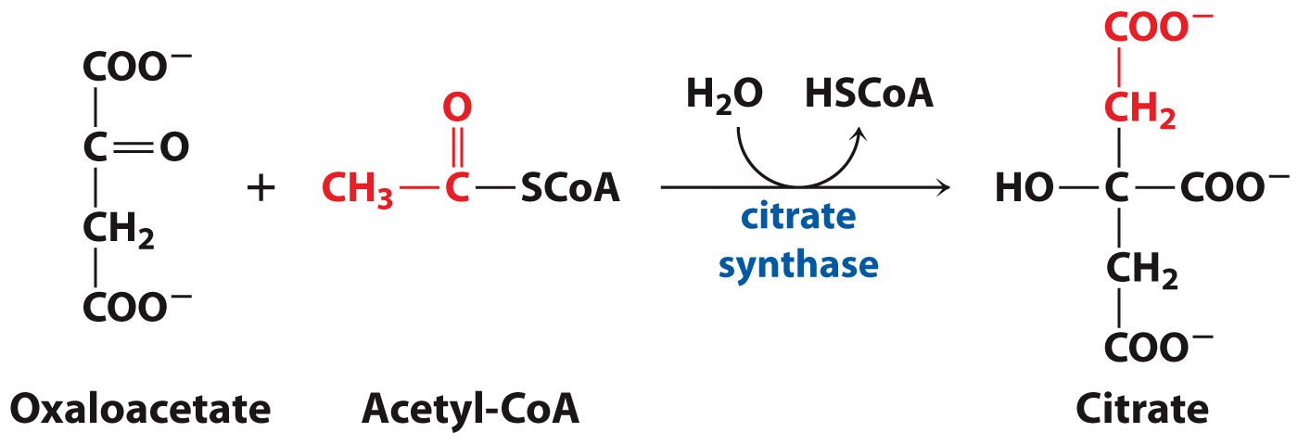
Reaction 1: Citrate Synthase Adds an Acetyl Group to Oxaloacetate

Slide 22
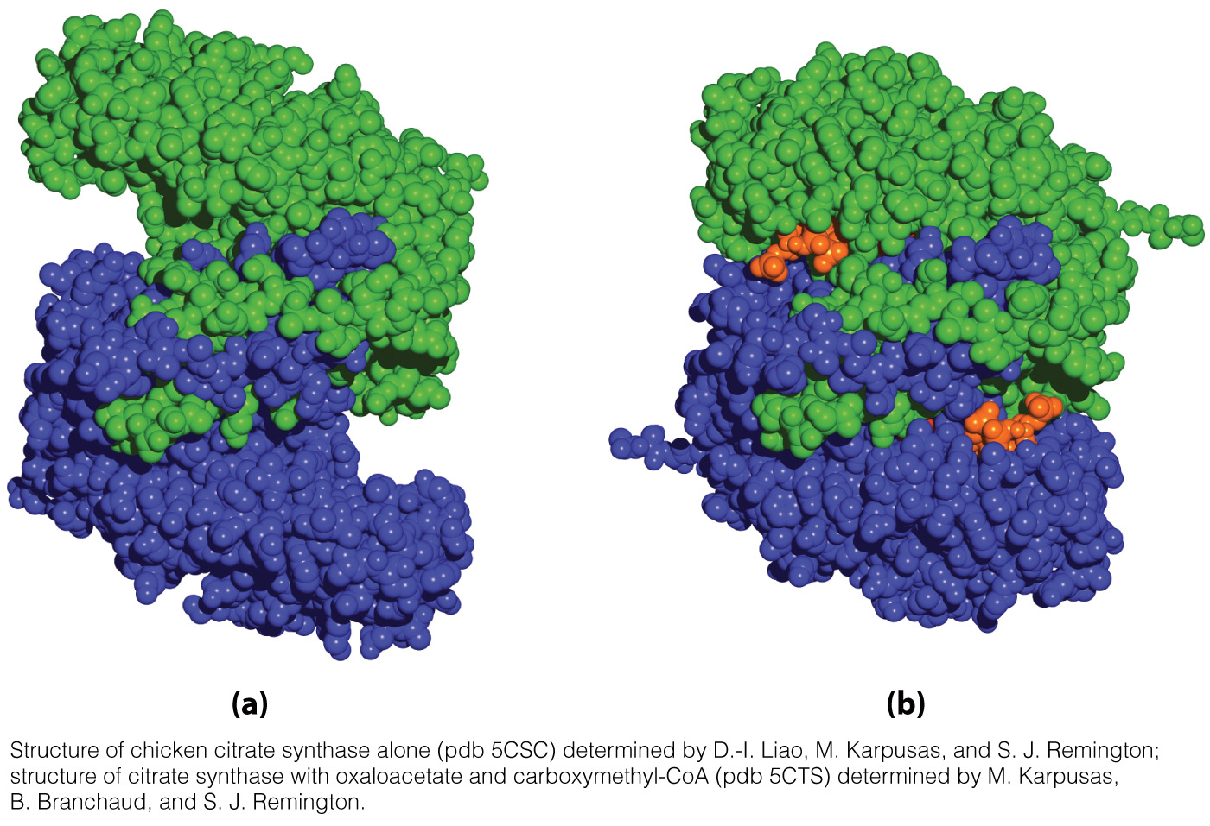
Citrate synthase undergoes a conformational change upon binding oxaloacetate, allowing for binding of acetyl-CoA.
No Substrates Bound
Substrates Bound

Slide 23
Citrate synthase is one of a few enzymes that can synthesize a C-C bond without a metal ion cofactor.
Let’s look at the mechanism of citrate synthase…

Slide 24
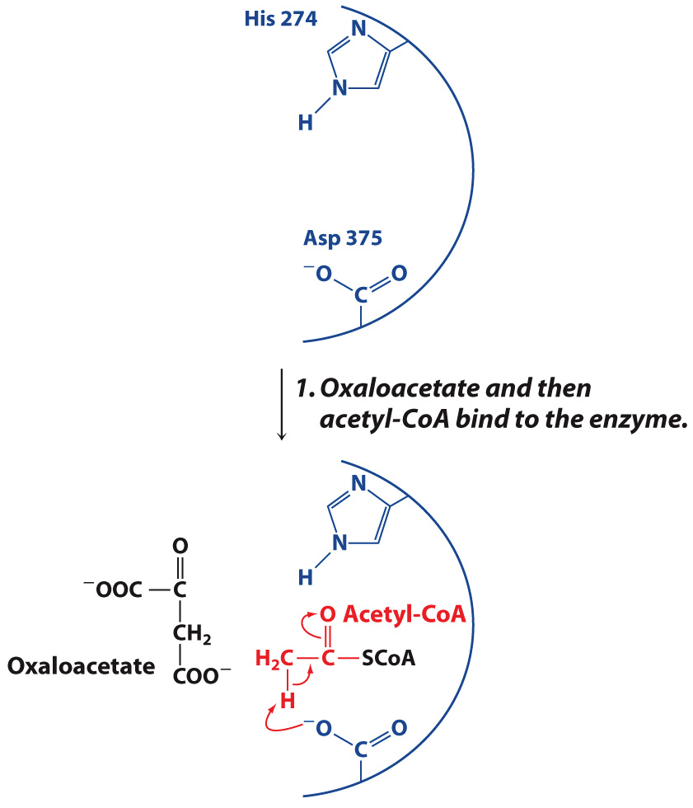
Citrate Synthase Mechanism

Slide 25
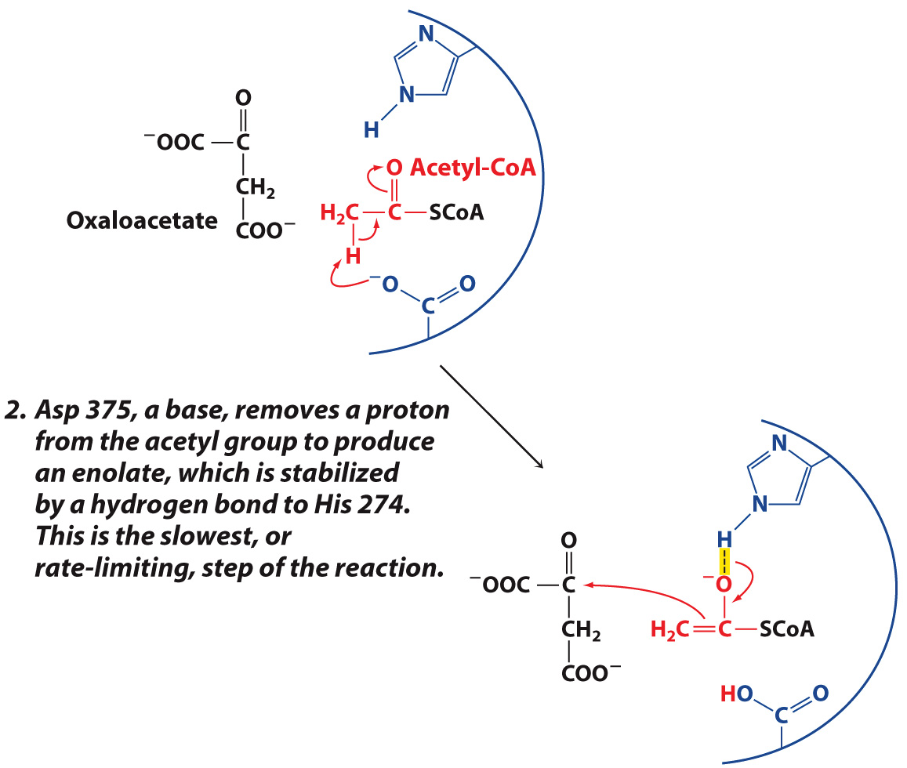
Citrate Synthase Mechanism

Slide 26
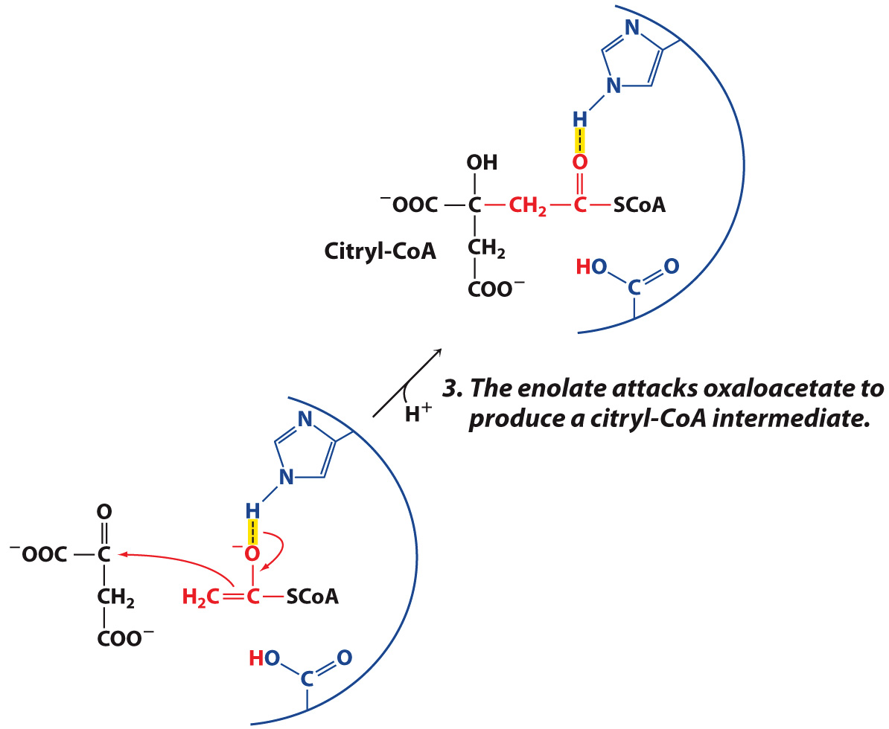
Citrate Synthase Mechanism

Slide 27
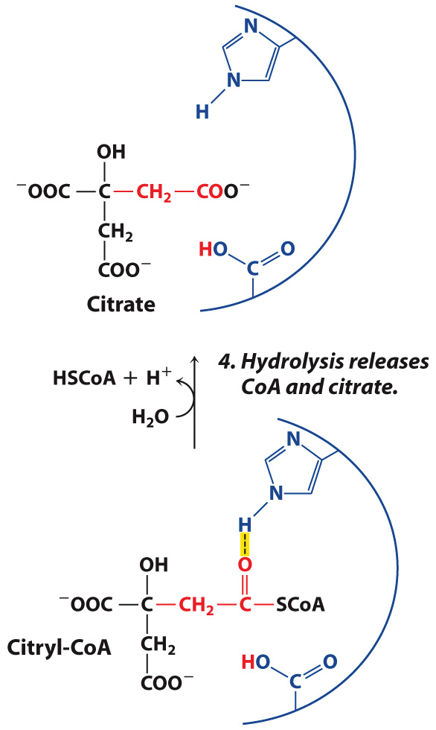
Citrate Synthase Mechanism

Slide 28
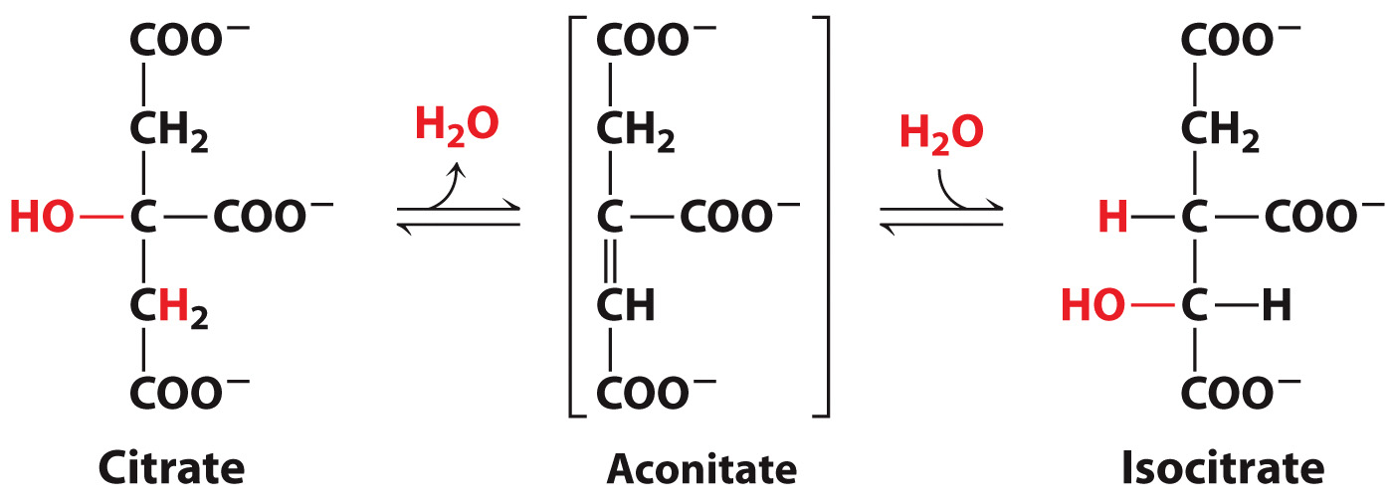
Reaction 2: Aconitase Isomerizes Citrate to Isocitrate

Slide 29
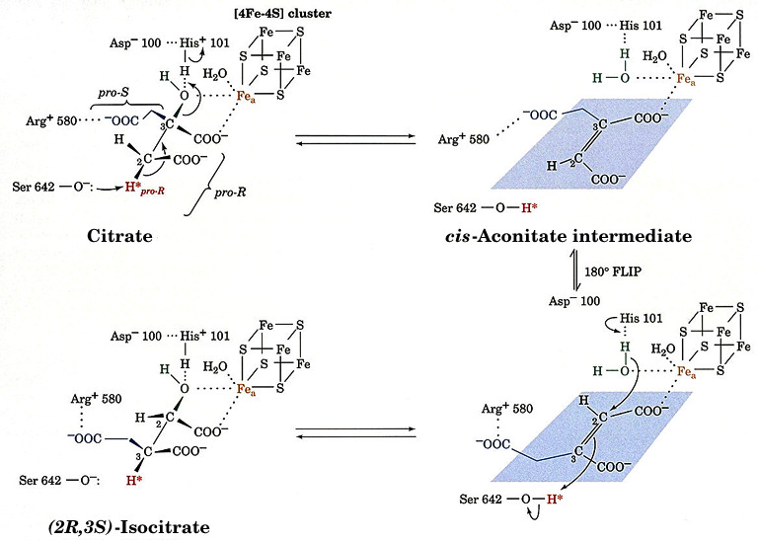
Aconitase

Slide 30
Reaction 3: Isocitrate Dehydrogenase Releases the First CO₂

Slide 31
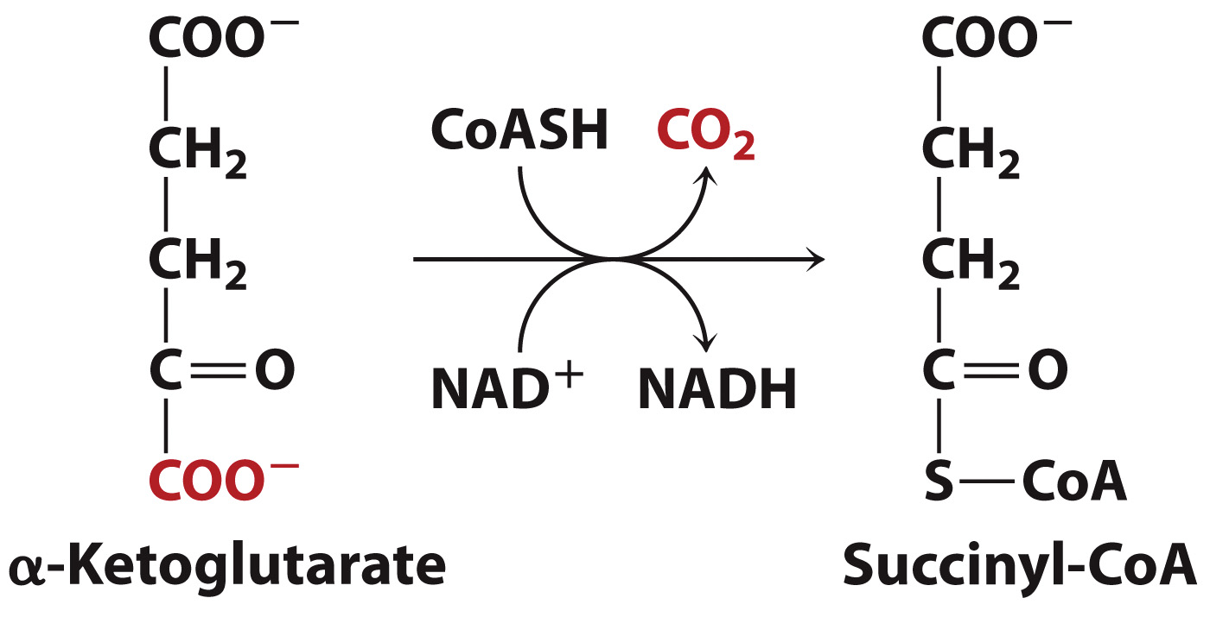
Reaction 4: α-Ketoglutarate Dehydrogenase Releases the Second CO₂

Slide 32
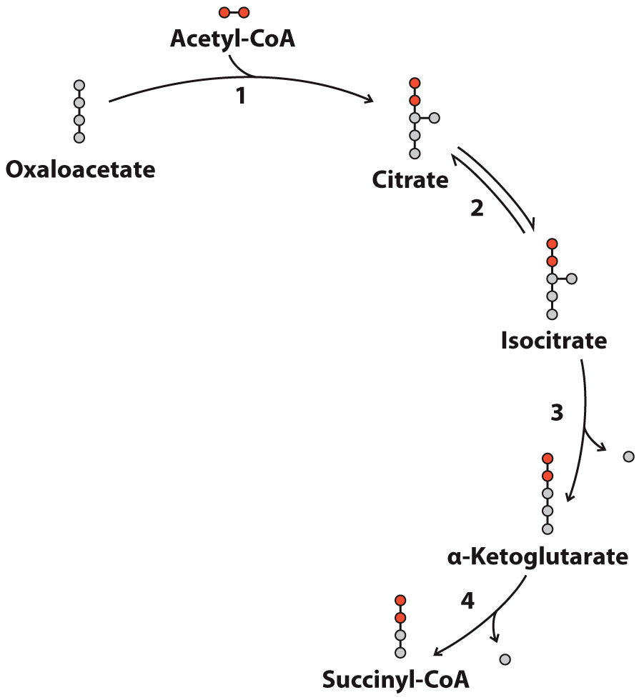
Fates of Carbons in the Citric Acid Cycle
Carbon
The two carbons released in the 1st round of the citric acid cycle did not come from acetyl-CoA.
Carbon from Acetyl-CoA

Slide 33
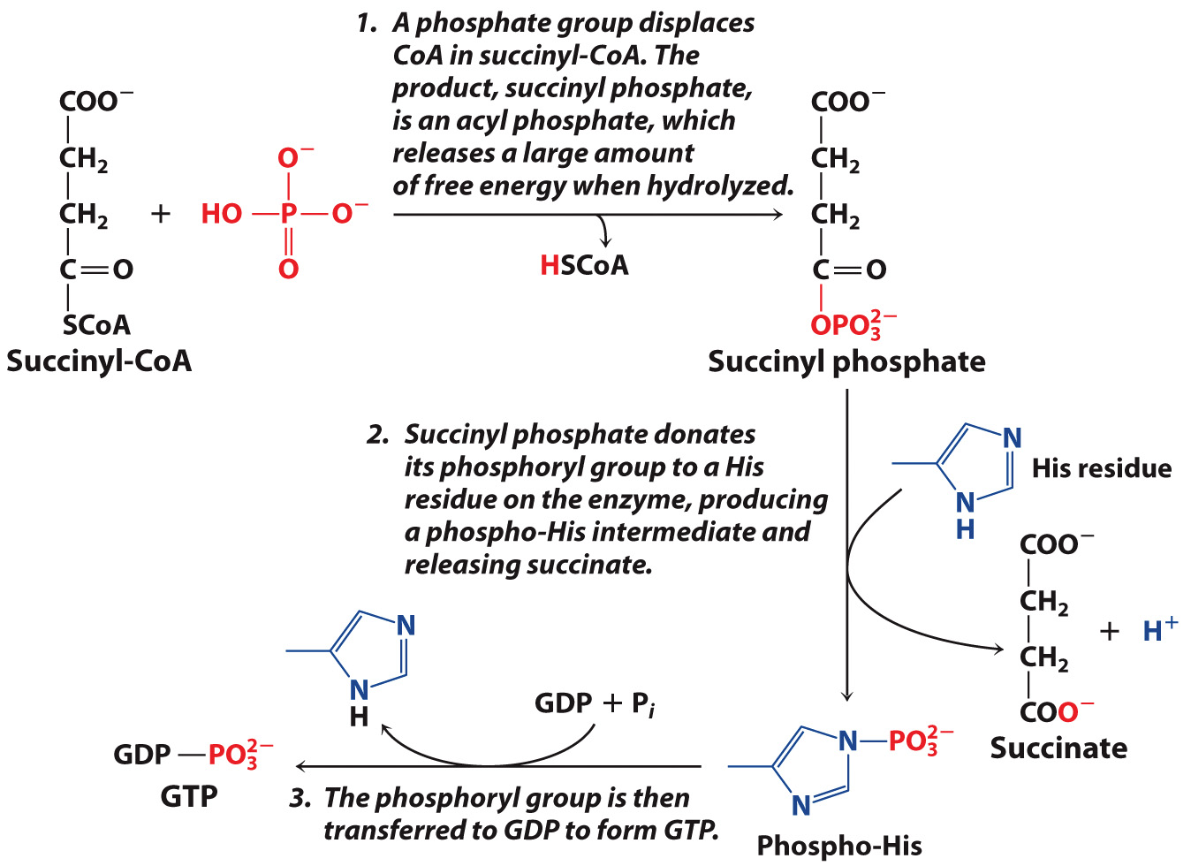
Reaction 5: Succinyl-CoA Synthetase Catalyzes Substrate Level Phosphorylation

Slide 34
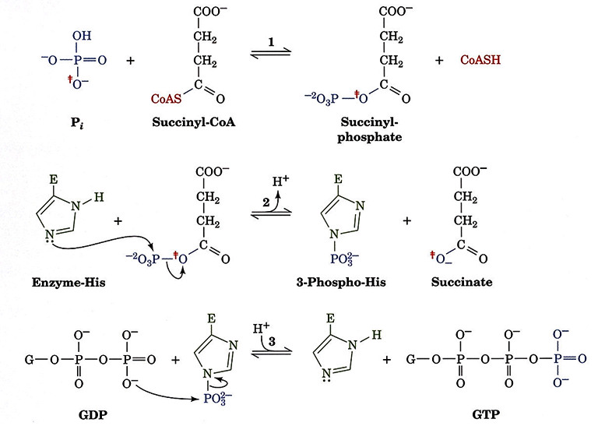
Succinyl-CoA Synthetase

Slide 35
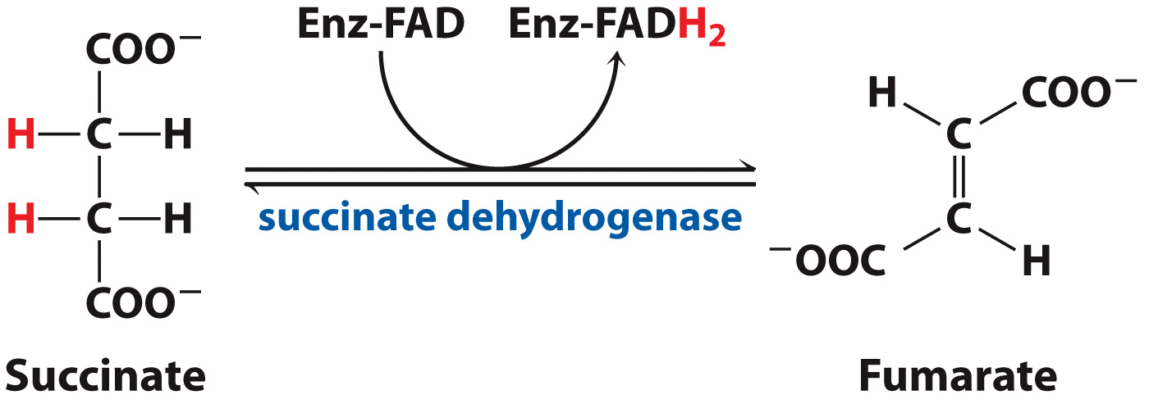
Reaction 6: Succinate Dehydrogenase Generates Ubiquinol

Slide 36
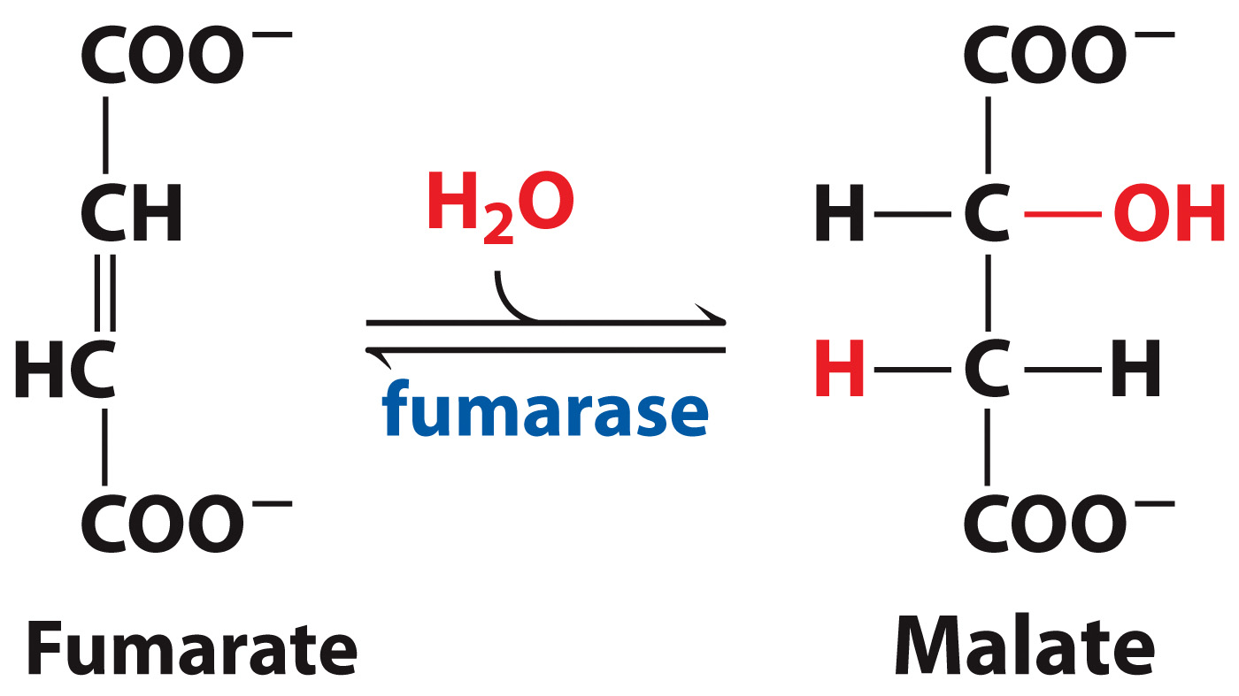
Reaction 7: Fumarase Catalyzes a Hydration Reaction

Slide 37
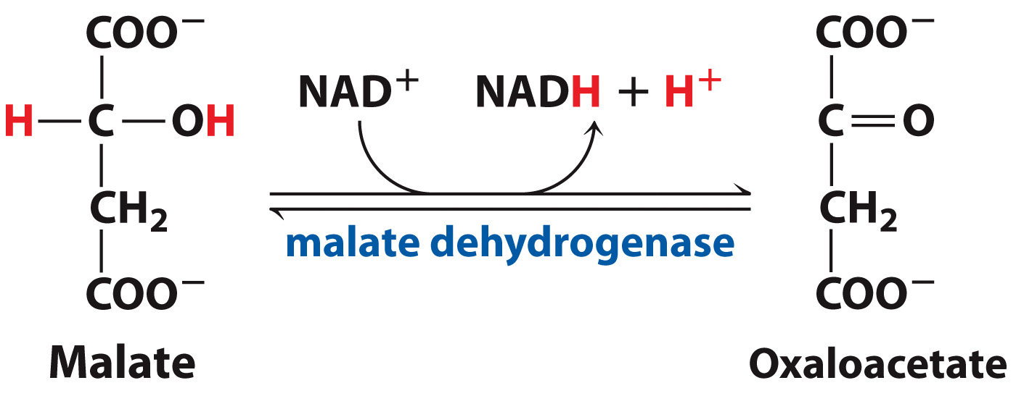
Reaction 8: Malate Dehydrogenase Regenerates Oxaloacetate

Slide 38
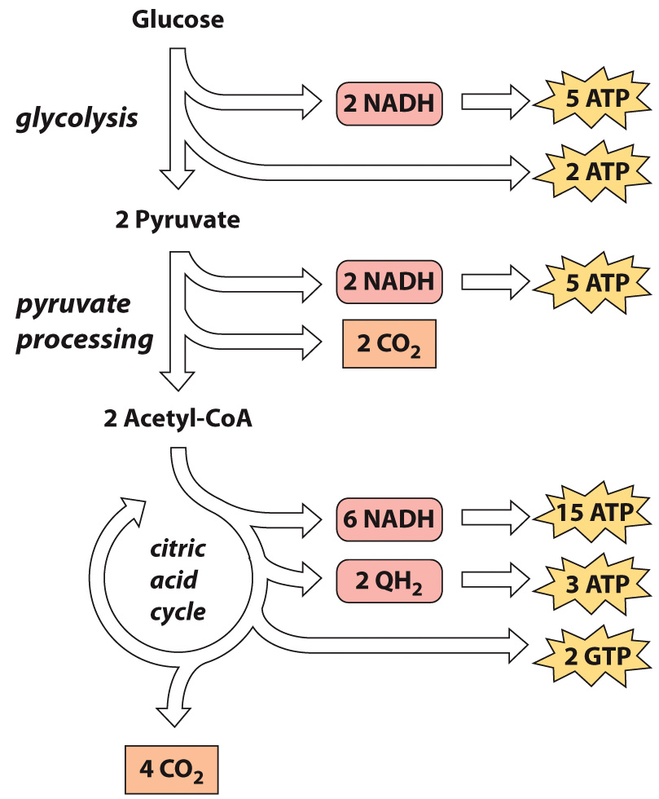
The citric acid cycle is an energy-generating cycle.
1 NADH = 2.5 ATP
1 QH₂ = 1.5 ATP

Slide 39
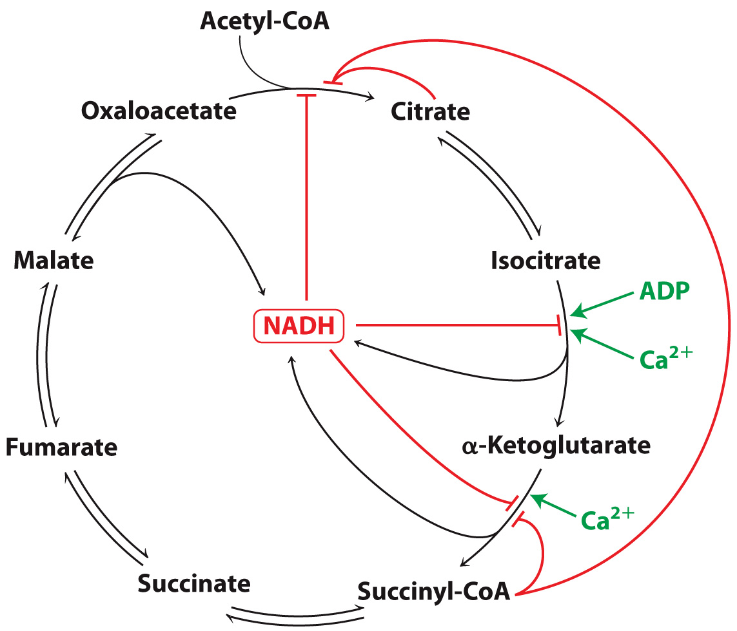
Regulation occurs at the three irreversible steps.

Slide 40
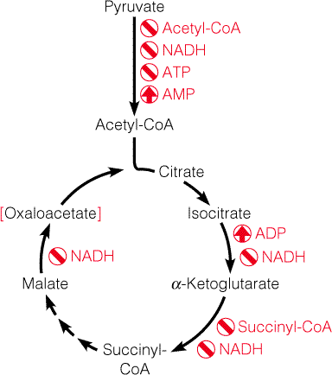

Slide 41
KEY CONCEPTS: Section 14-3
The citric acid cycle supplies precursors for the synthesis of other compounds.
Citric acid cycle intermediates can be replenished.

Slide 42
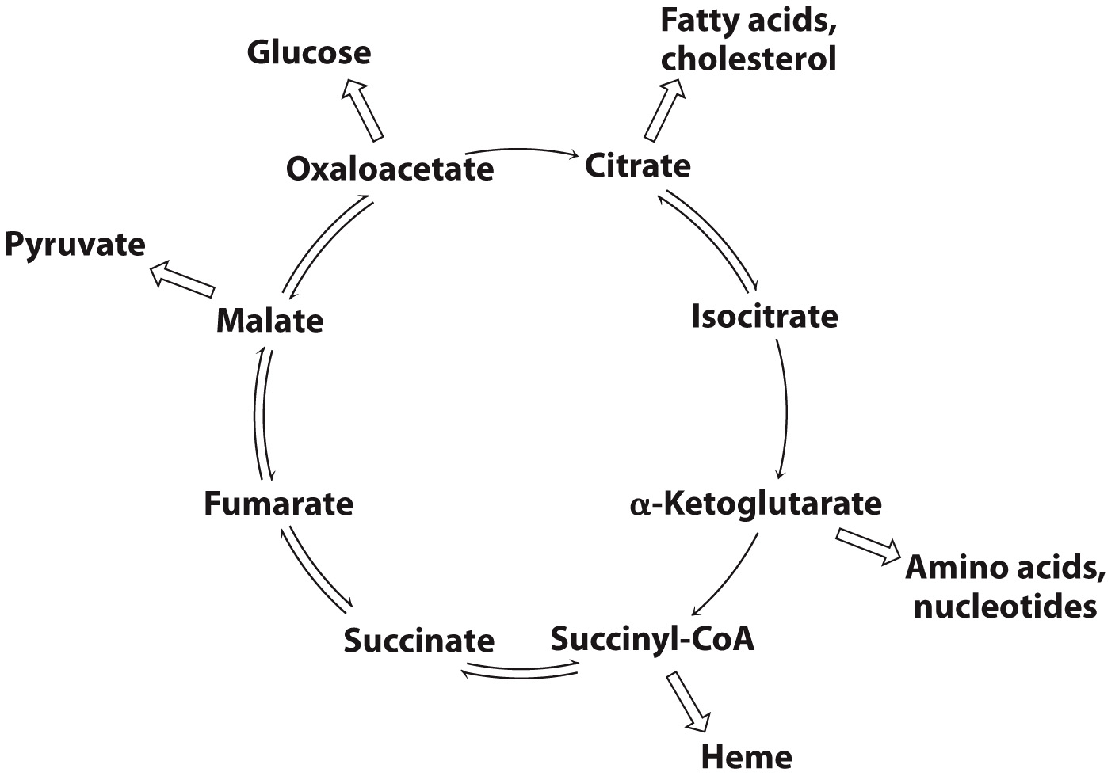
Citric acid cycle intermediates are precursors of other molecules.

Slide 43
An Example of Amino Acid Formation from a Citric Acid Cycle Intermediate

Slide 44
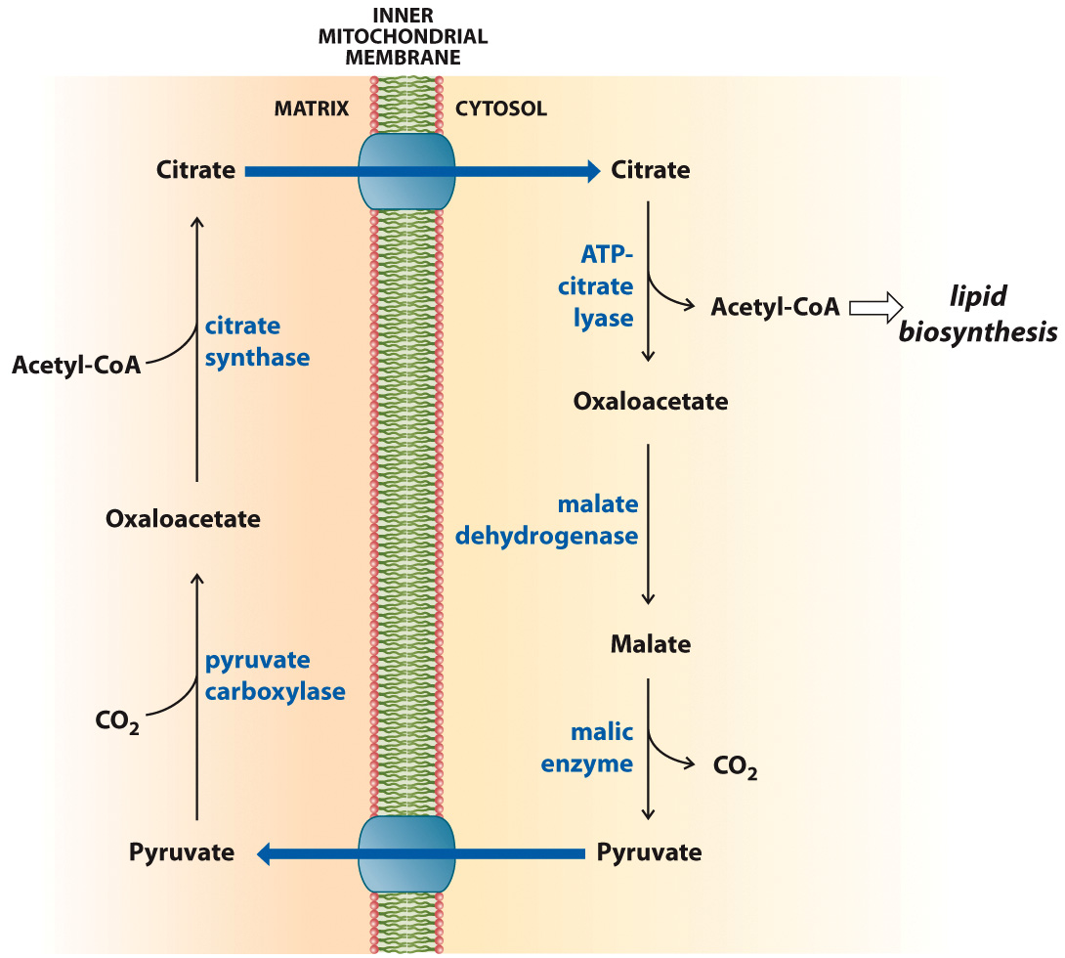
Citrate Transport System
Citrate and pyruvate can cross the mitochondrial membrane via specific transport proteins.

Slide 45
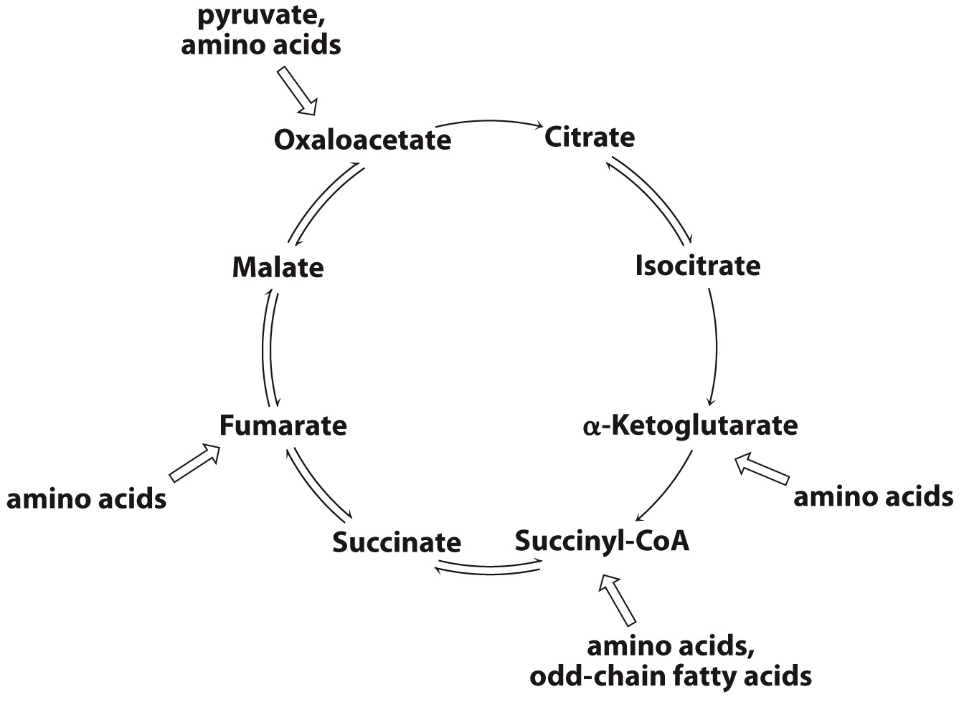
Intermediates that are diverted to other pathways can be replenished.

Slide 46
Anaplerotic reactions replenish citric acid cycle intermediates.
pyruvate + CO₂ + ATP + H₂O → oxaloacetate + ADP + P_{i}

Slide 47
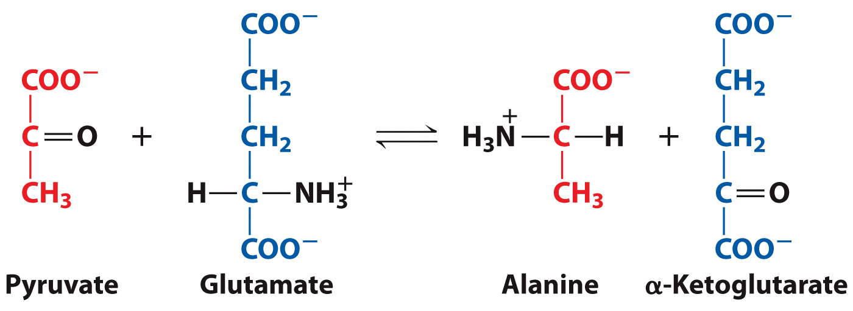
During exercise, some pyruvate can be converted to α-ketoglutarate to boost the activity of the citric acid cycle.

Slide 48
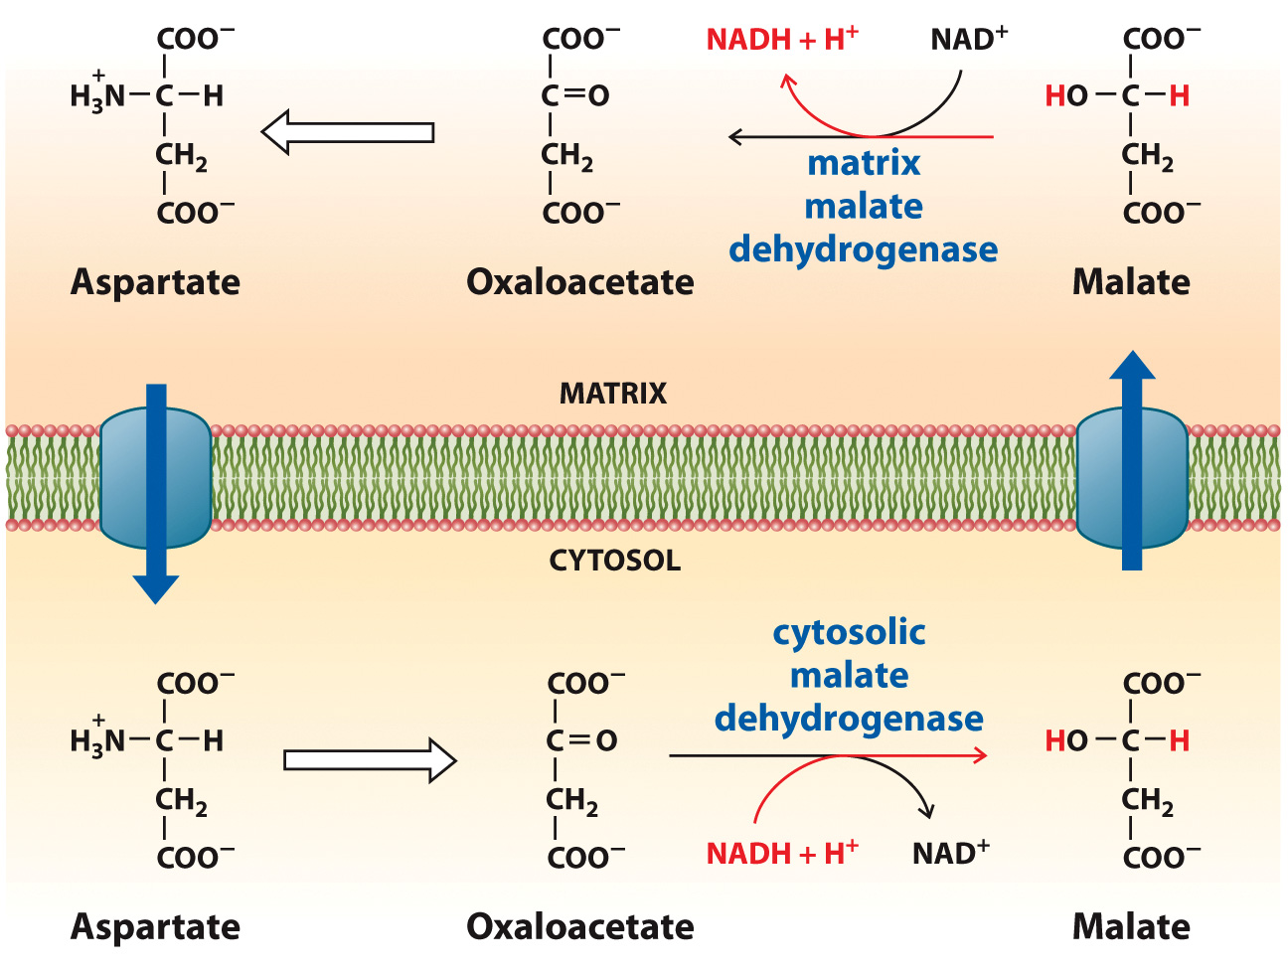
The Malate-Aspartate Shuttle System

