Slide 1
Essential Biochemistry
Fourth Edition
Charlotte W. Pratt | Kathleen Cornely
Lecture Notes for
Chapter 13
Glucose Metabolism

Slide 2
Glycolysis
Section 13.1
Learning Objective
Describe the substrates, products, and chemical reaction for each step of glycolysis

Slide 3
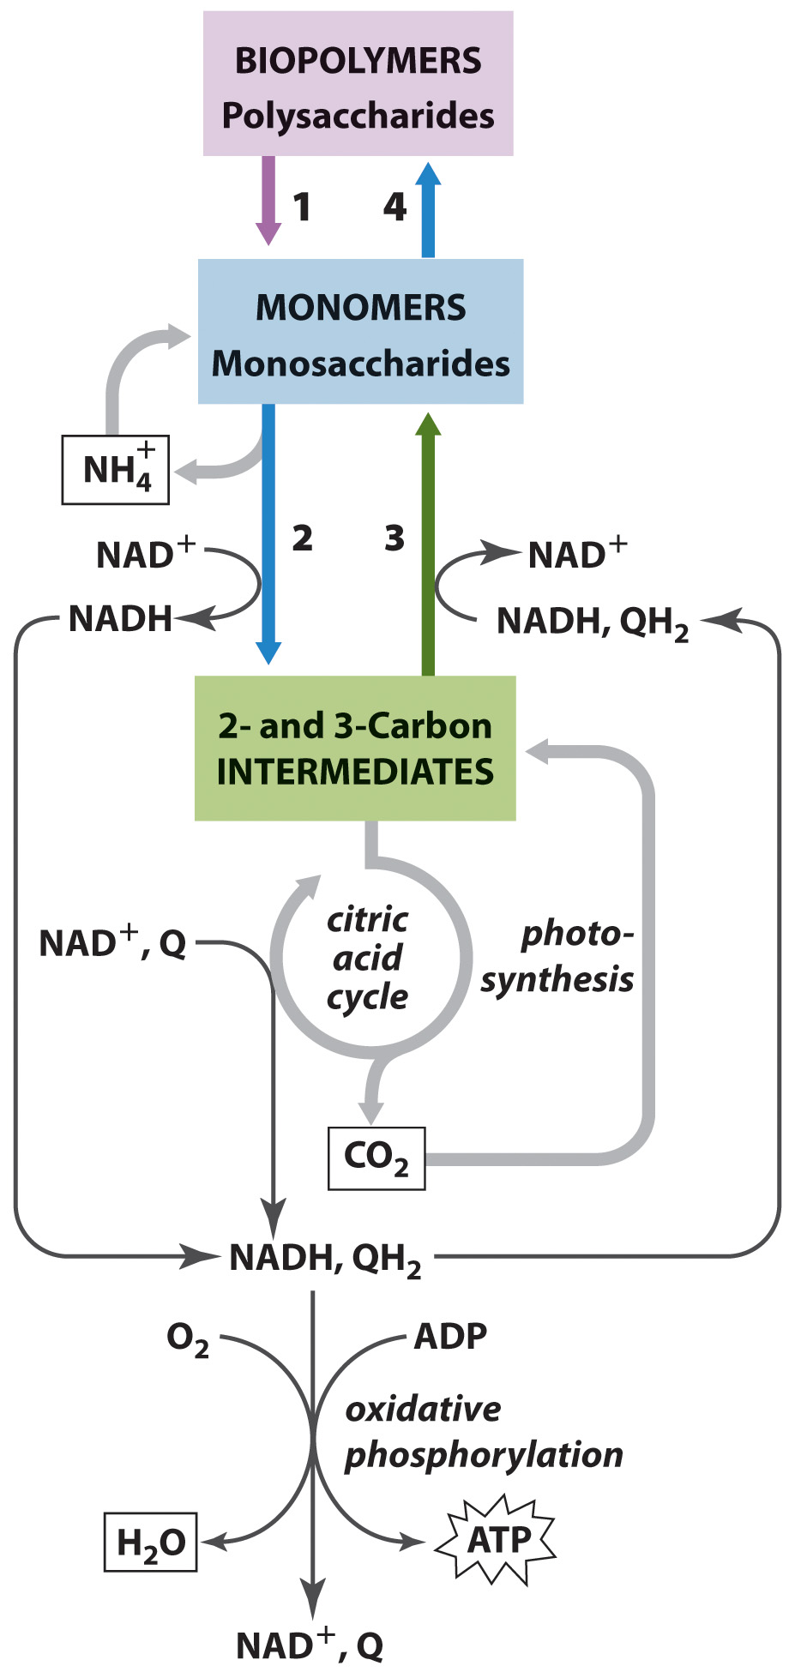
Glucose Metabolism in Context

Slide 4
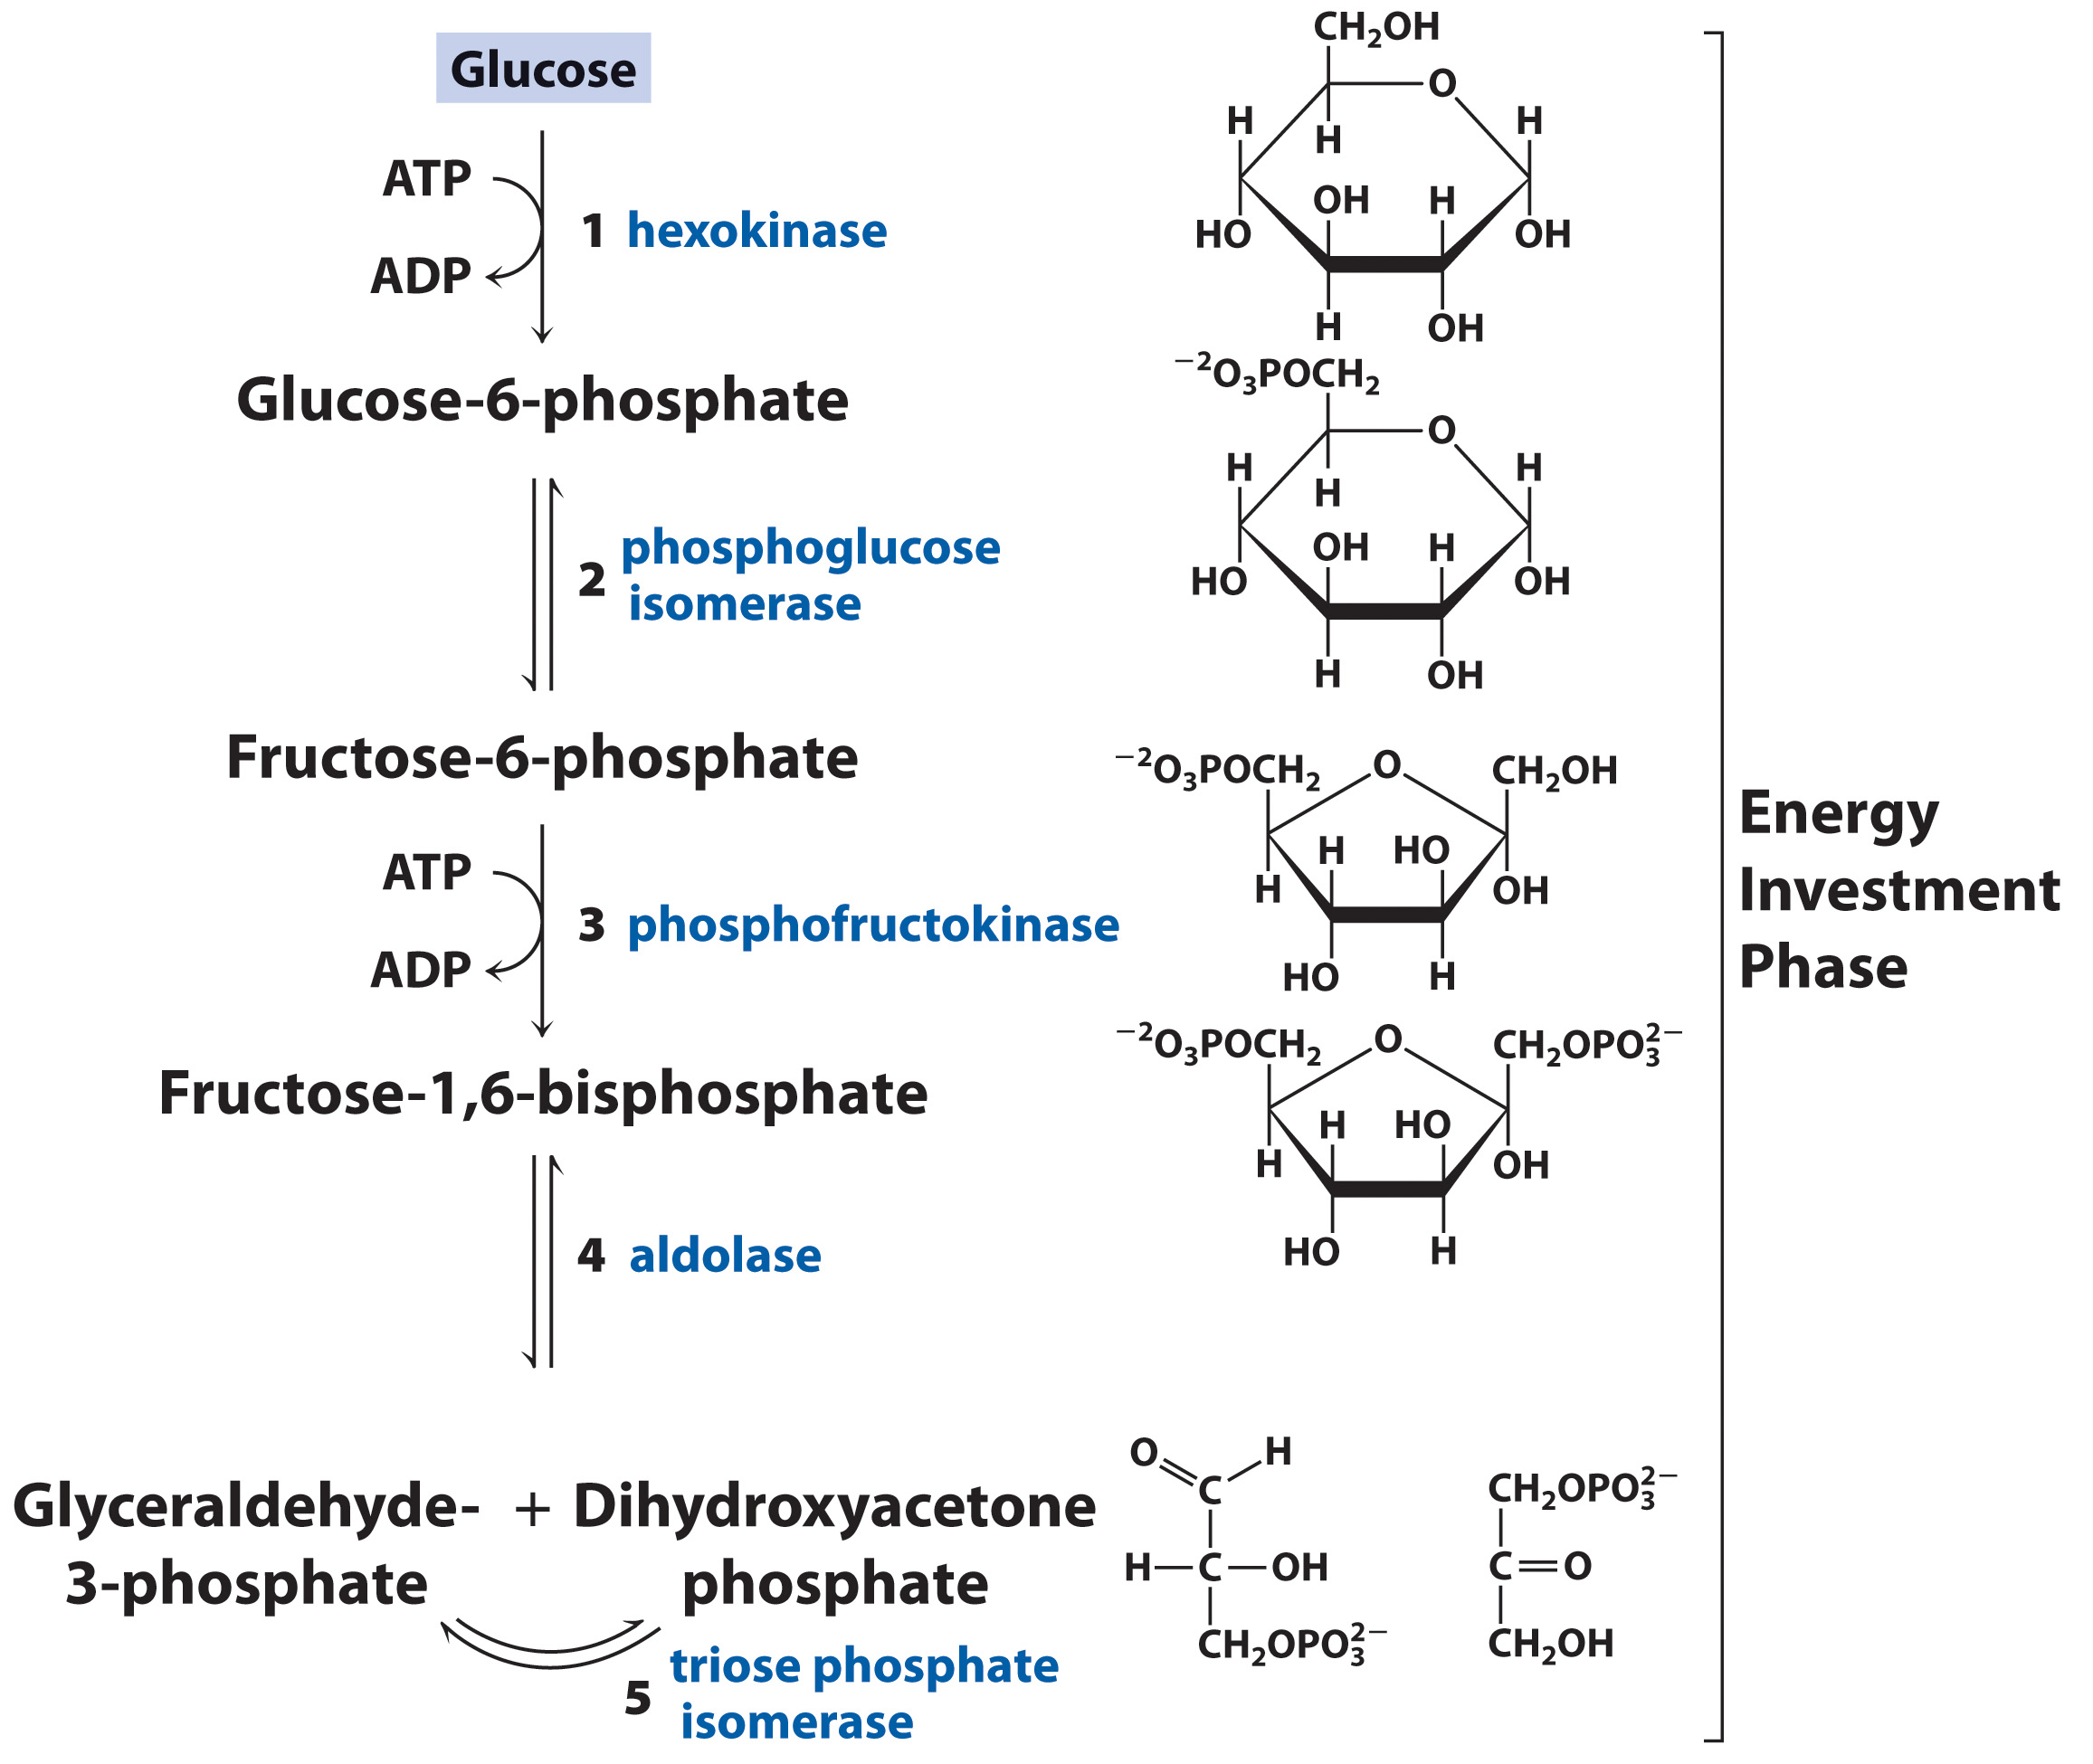
First 5 Steps of Glycolysis

Slide 5
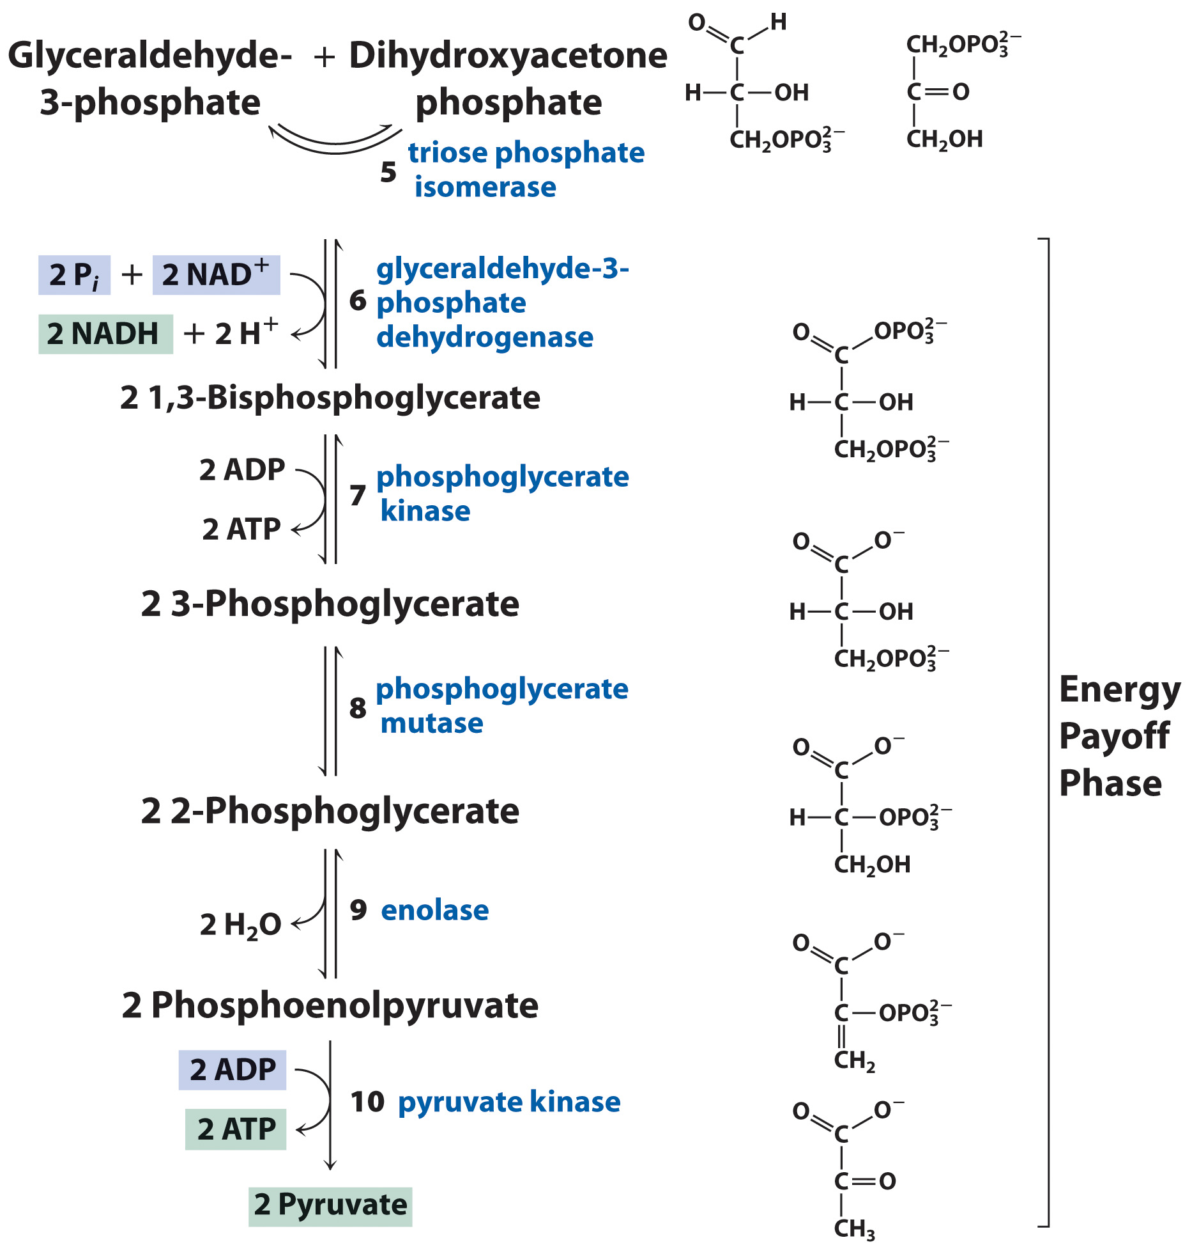
Last 5 Steps of Glycolysis

Slide 6
Step 1: Hexokinase Reaction

Slide 7
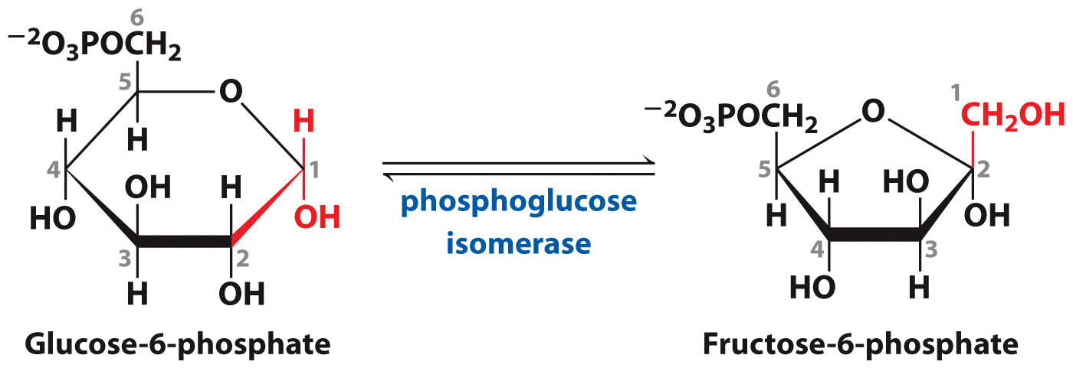
Step 2: Phosphoglucose Isomerase Reaction

Slide 8
Step 3: Phosphofructokinase Reaction

Slide 9
Fructose-2,6-bisphosphate is the most potent activator of phosphofructokinase in mammals

Slide 10
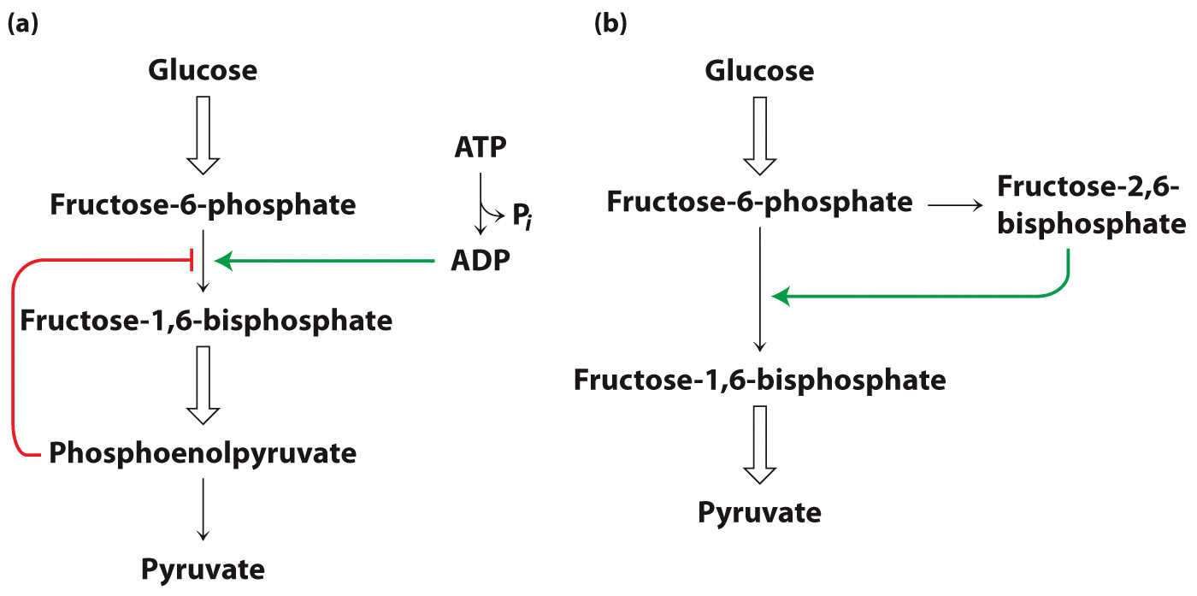
Other molecules activate or inhibit phosphofructokinase

Slide 11
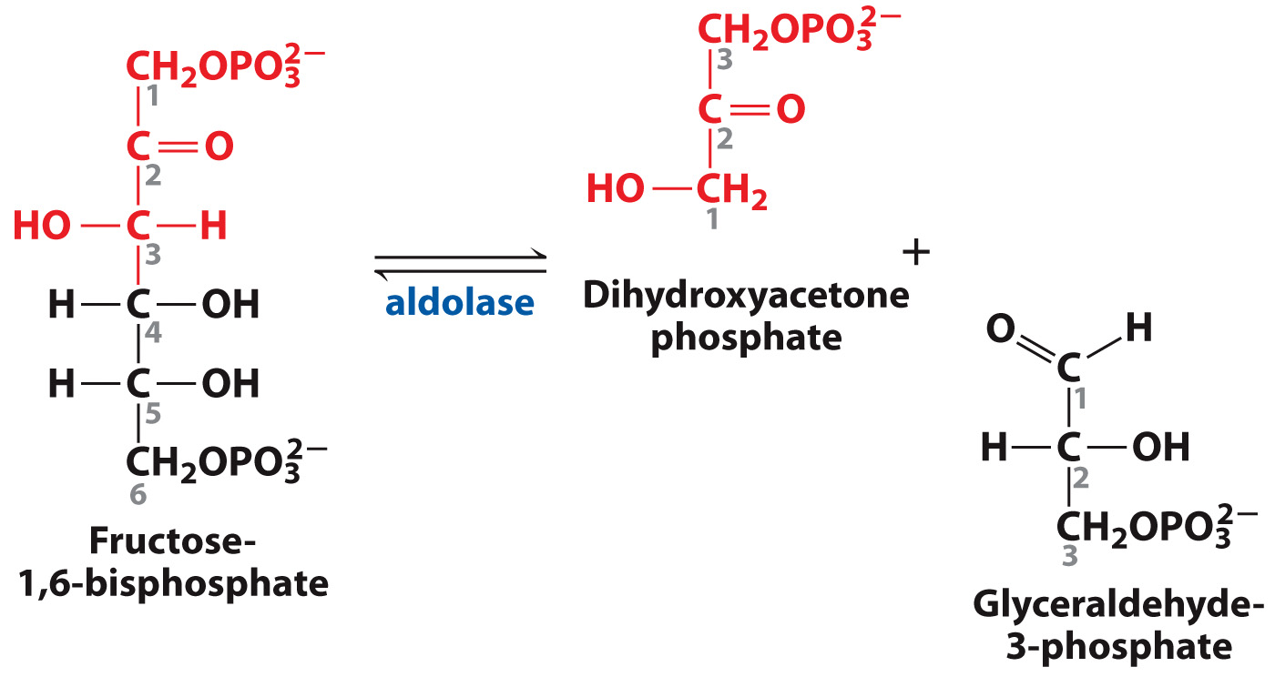
Step 4: Aldolase Reaction

Slide 12
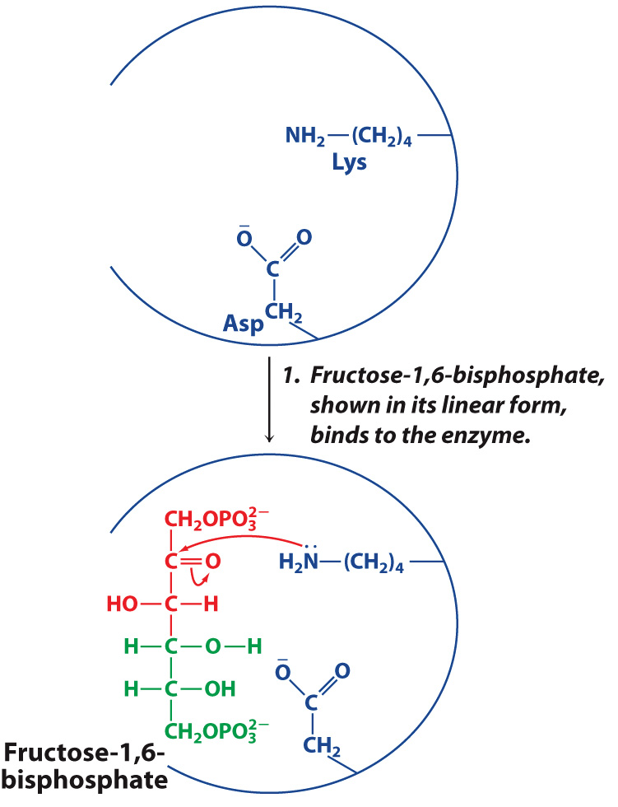
Aldolase Mechanism in Detail

Slide 13
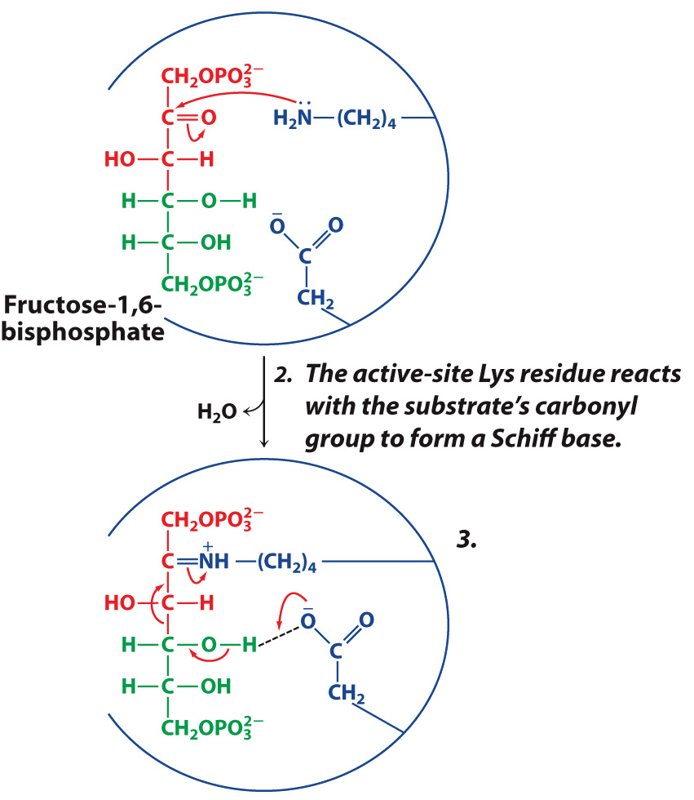
Aldolase Mechanism in Detail

Slide 14
Aldolase Mechanism in Detail

Slide 15
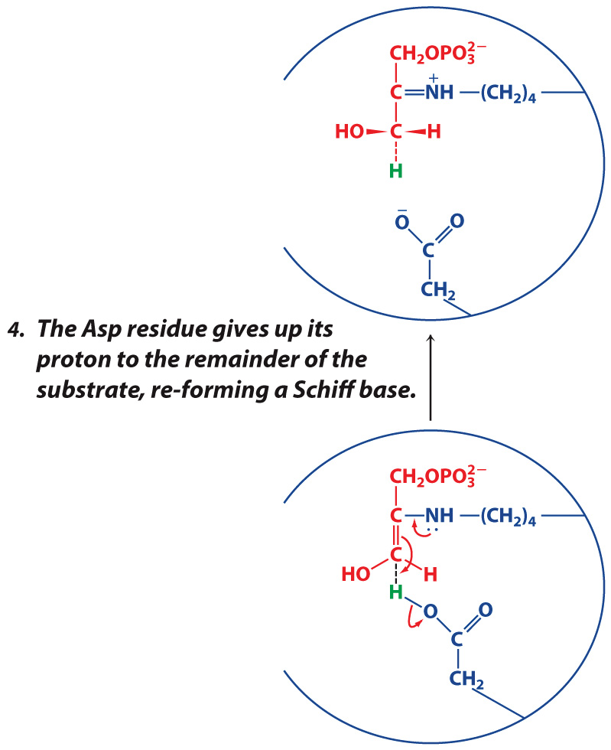
Aldolase Mechanism in Detail

Slide 16
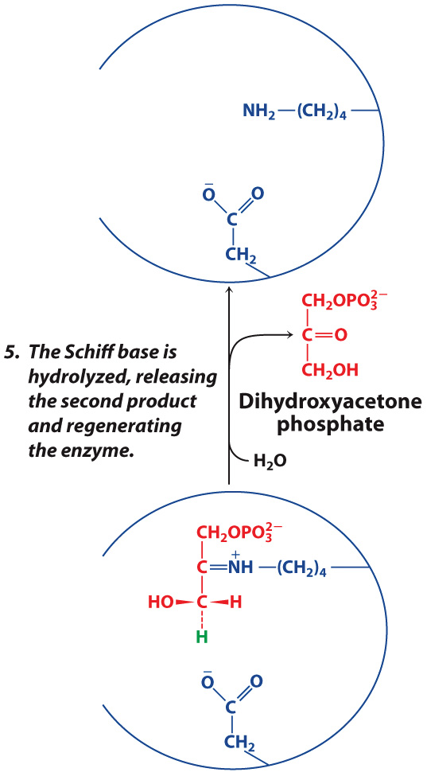
Aldolase Mechanism in Detail

Slide 17
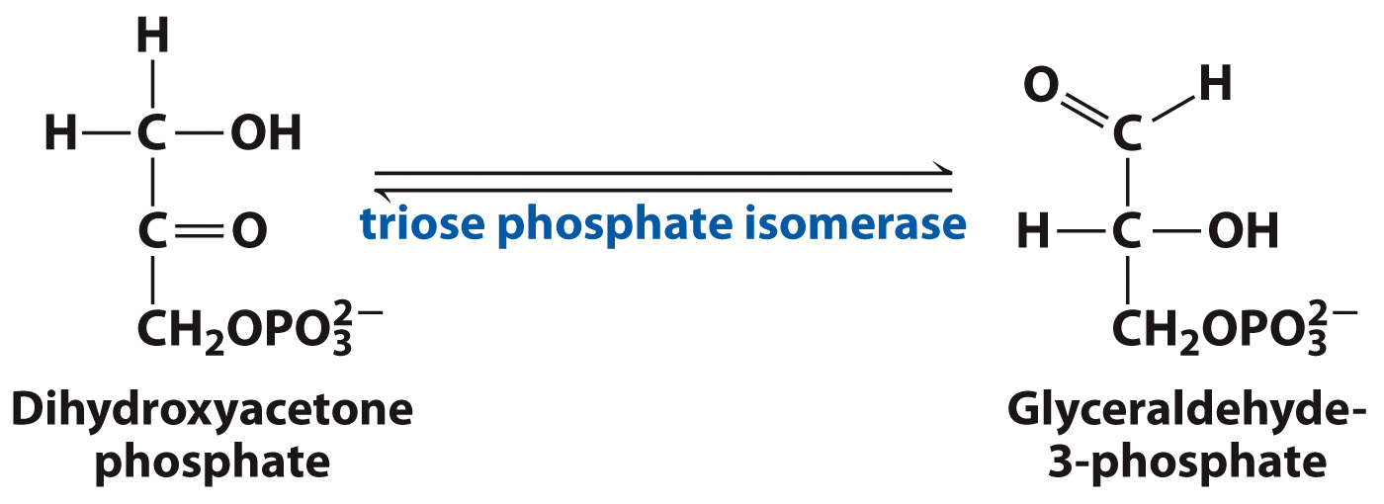
Step 5: Triose Phosphate Isomerase Reaction

Slide 18
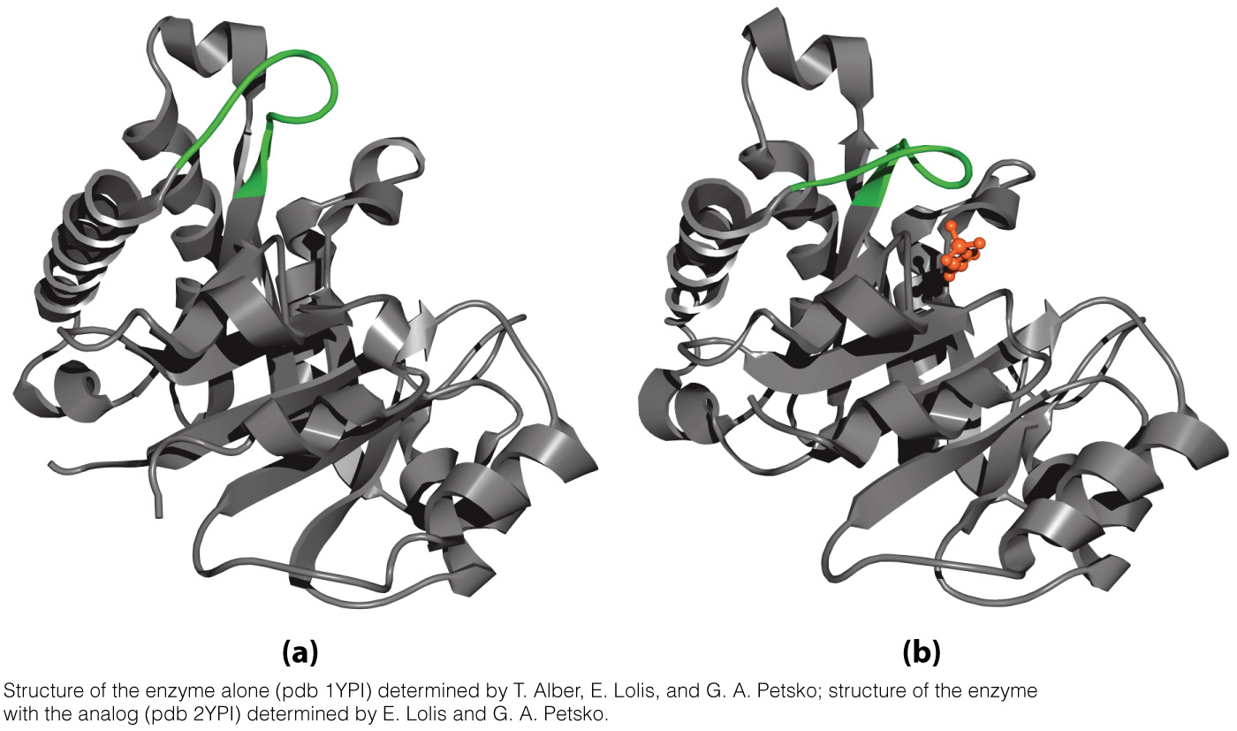
Triose phosphate isomerase is a catalytically “perfect” enzyme

Slide 19
Step 6: GAP Dehydrogenase Reaction

Slide 20
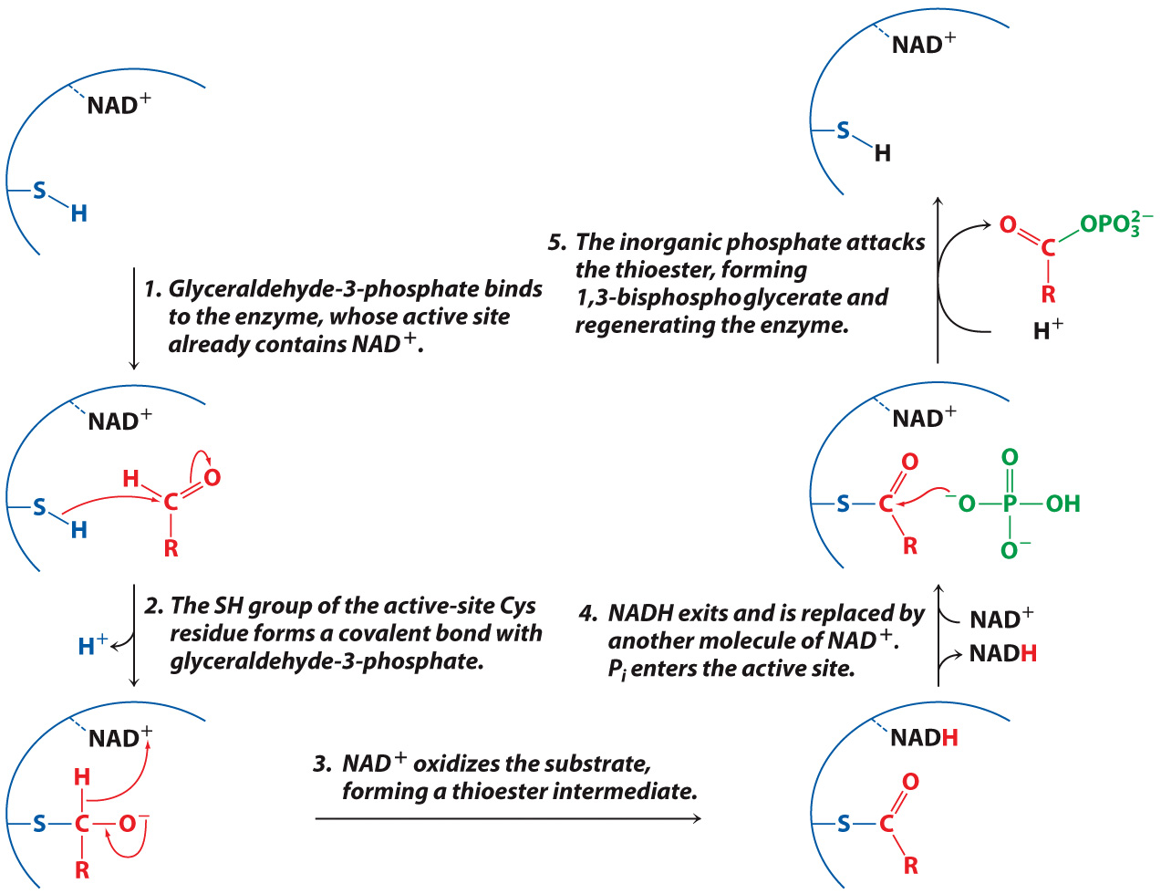
GAP Dehydrogenase Mechanism

Slide 21
Step 7: Phosphoglycerate Kinase Reaction

Slide 22
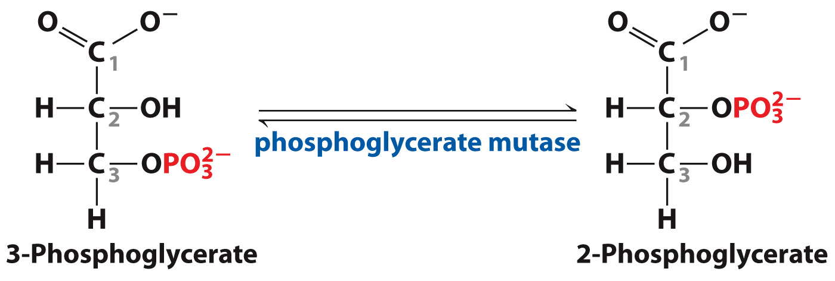
Step 8: Phosphoglycerate Mutase Reaction

Slide 23
Isomerization of 3-phosphoglycerate occurs via an active site His residue

Slide 24
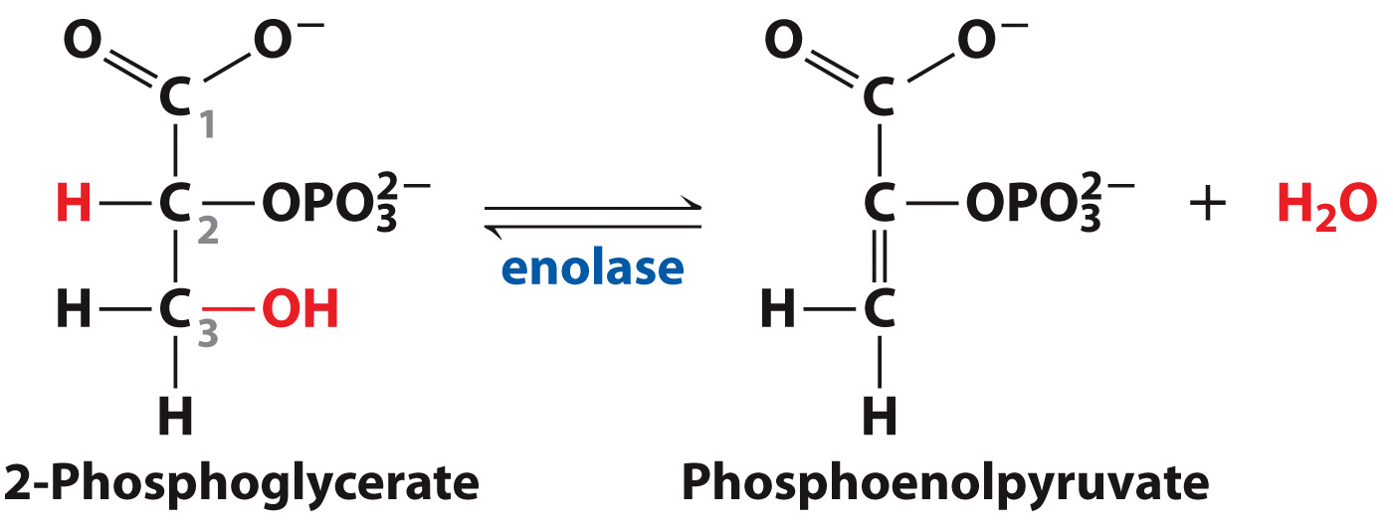
Step 9: Enolase Reaction

Slide 25
Step 10: Pyruvate Kinase Reaction

Slide 26
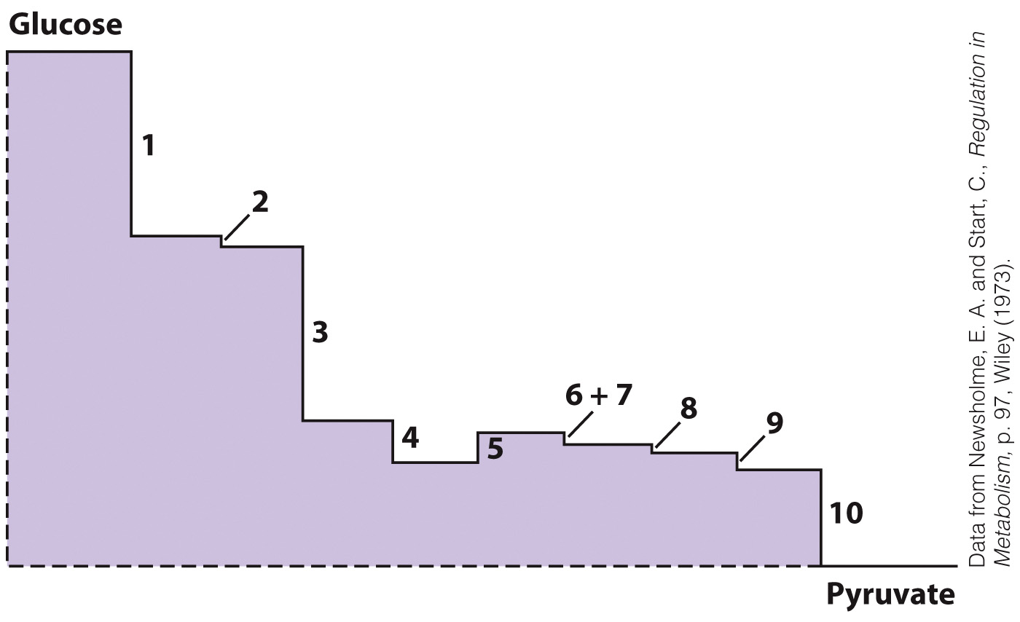
Graphical Representation of the Free Energy Changes of Glycolysis

Slide 27
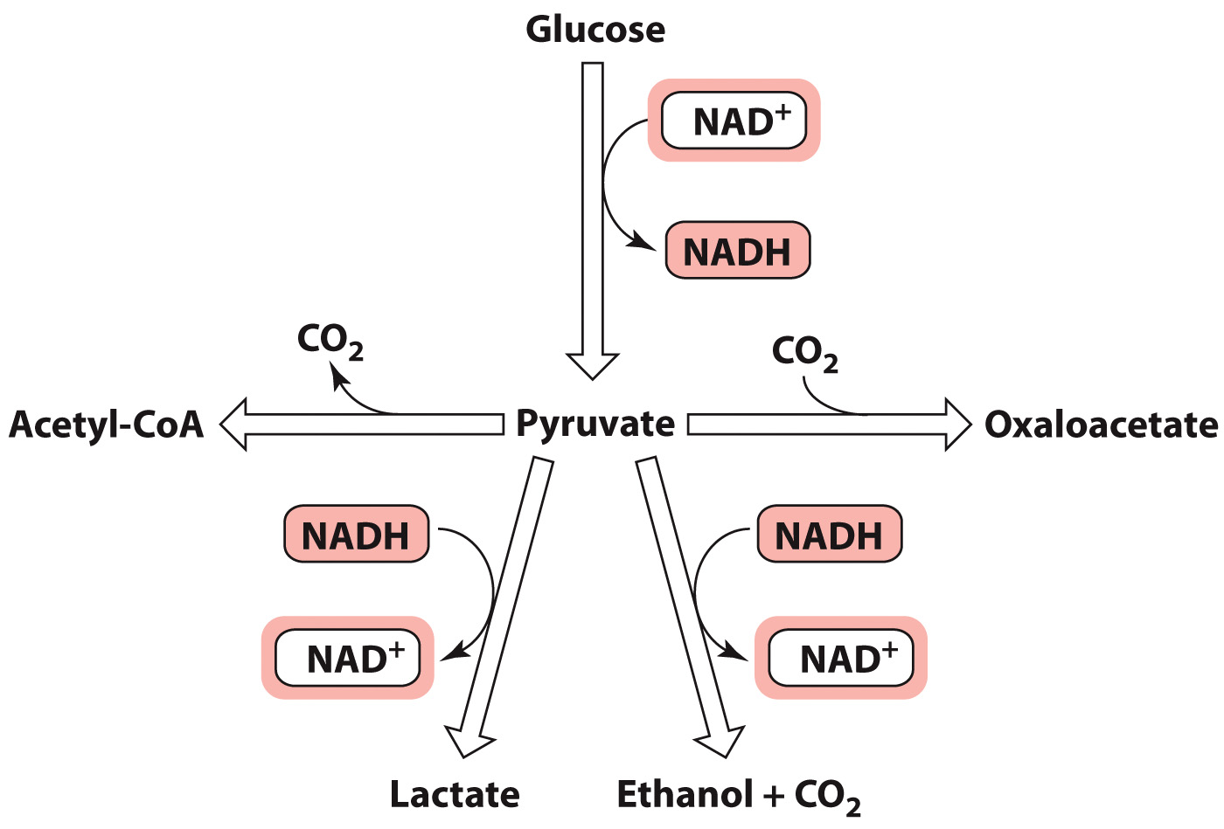
What happens to pyruvate?

Slide 28
During exercise pyruvate can be temporarily converted to lactate

Slide 29
Regeneration of NAD⁺ in Yeast

Slide 30
Pyruvate can be further oxidized

Slide 31
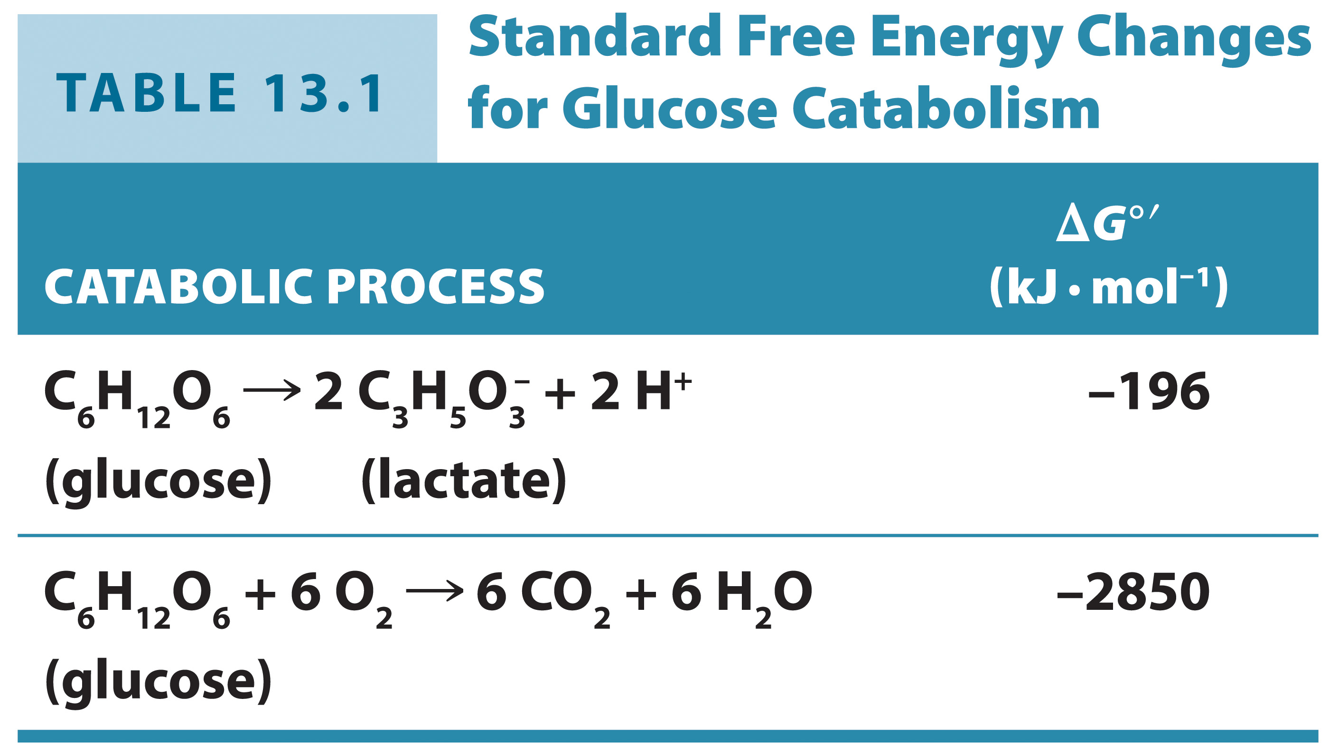
Standard Free Energy Changes for Glucose Metabolism

Slide 32
Pyruvate is a precursor of oxaloacetate

Slide 33
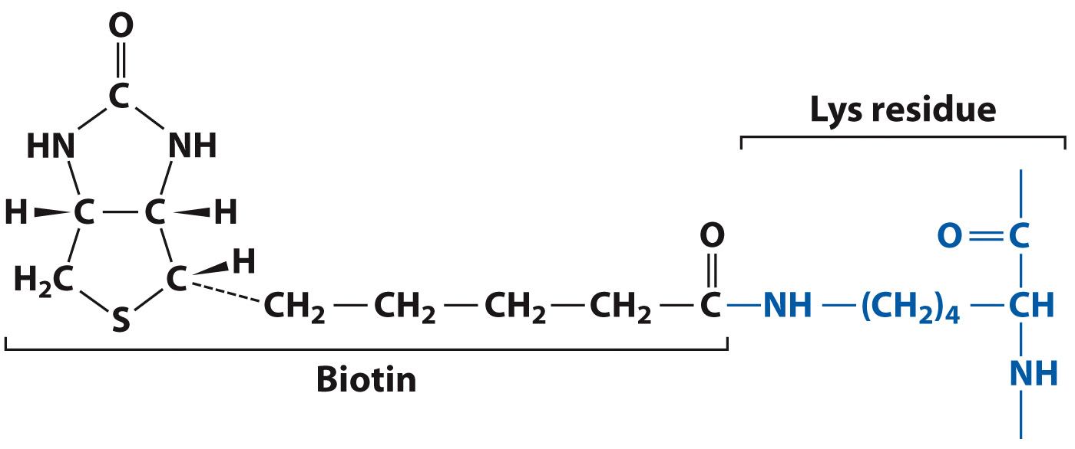
Pyruvate carboxylase uses biotin as a cofactor

Slide 34
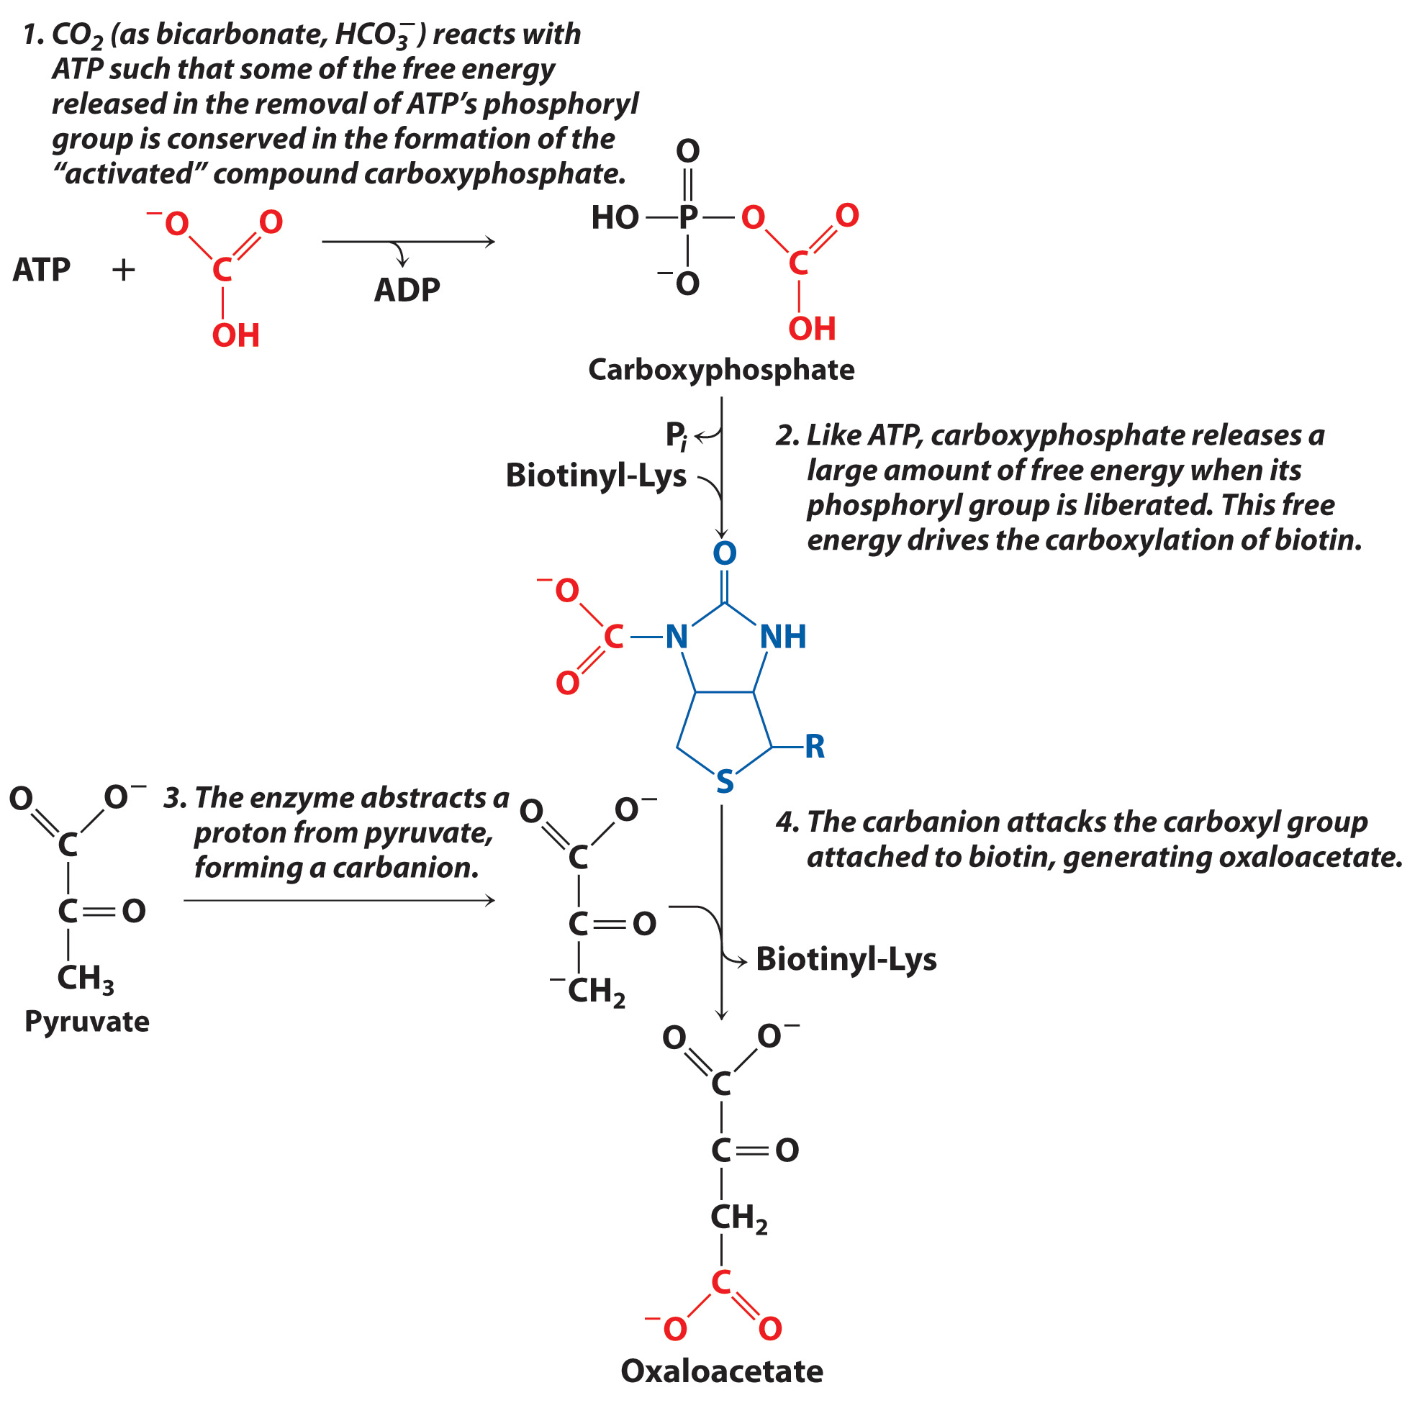
Pyruvate Carboxylase Mechanism

Slide 35
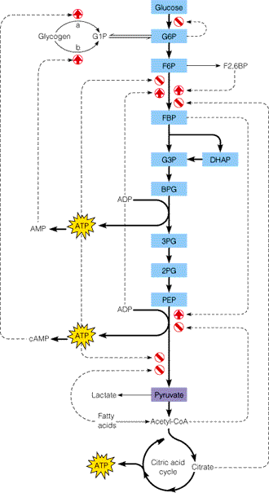

Slide 36
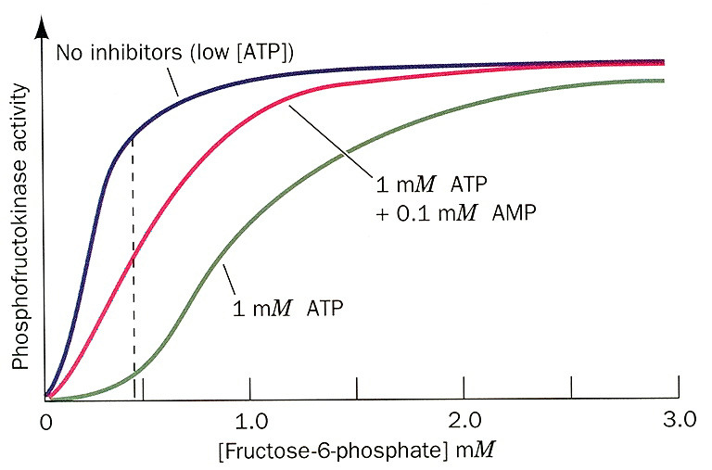

Slide 39
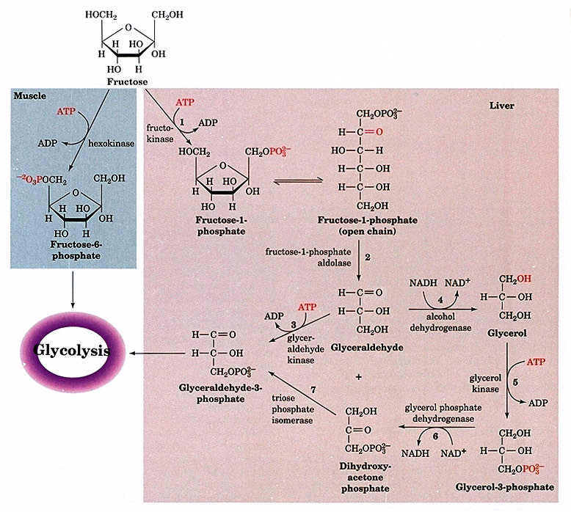
Fructose use

Slide 40
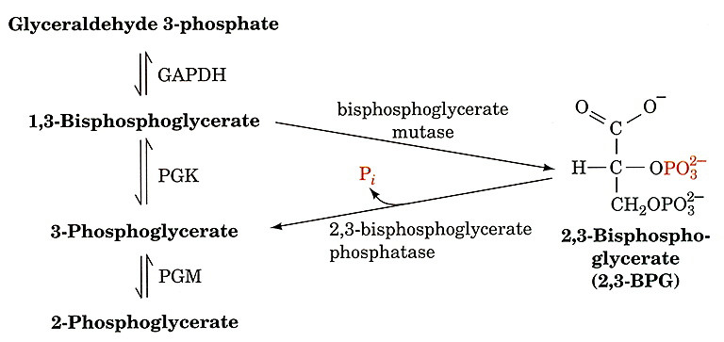
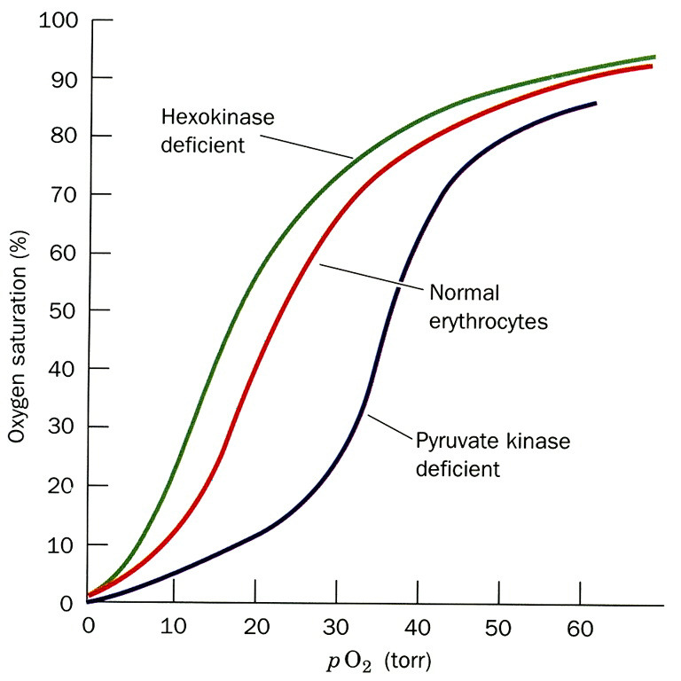

Slide 41
Gluconeogenesis
Section 13.2
Learning Objective
Describe the substrates, products, and reactions of gluconeogenesis

Slide 42
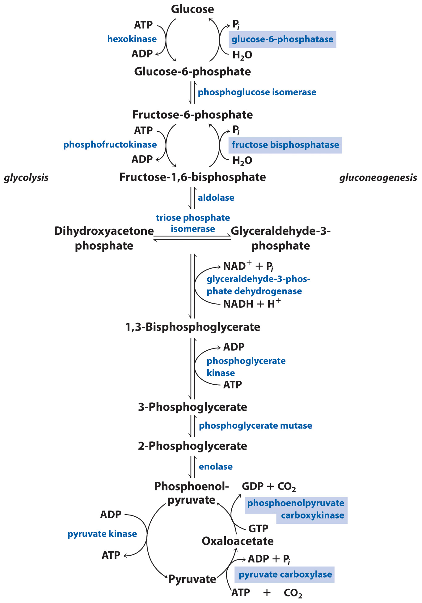
Overview of Gluconeogenesis

Slide 43
Pyruvate is converted to phosphoenolpyruvate in 2 steps

Slide 44
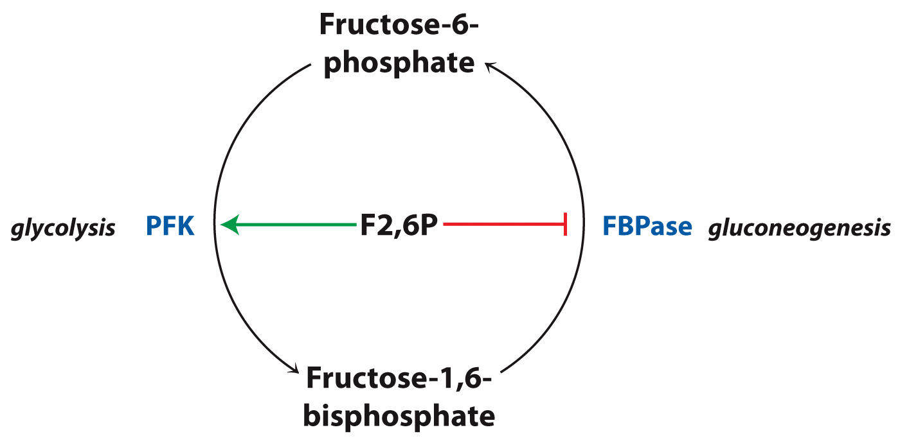
Gluconeogenesis is regulated at the fructose bisphosphatase step

Slide 45
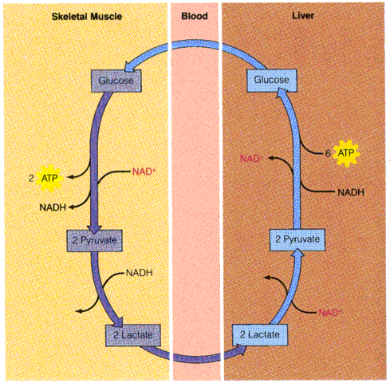

Slide 46
Glycogen Synthesis and Degradation
Section 13.3
Learning Objective
Compare the processes of glycogen synthesis and degradation

Slide 47
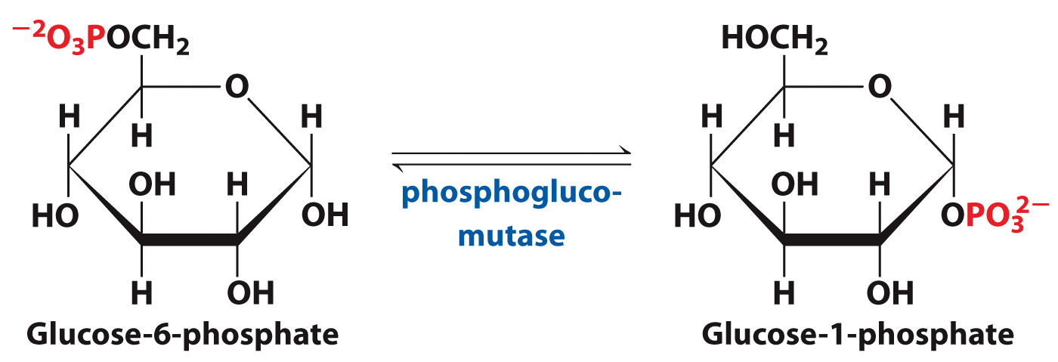
Glycogen is a polymer of glucose-1-phosphate monomers

Slide 48
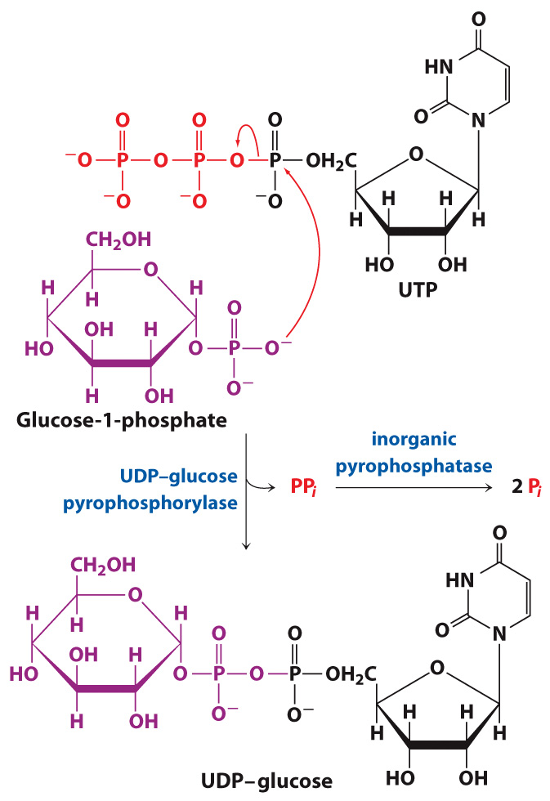
Glycogen synthesis consumes the free energy of UTP

Slide 49
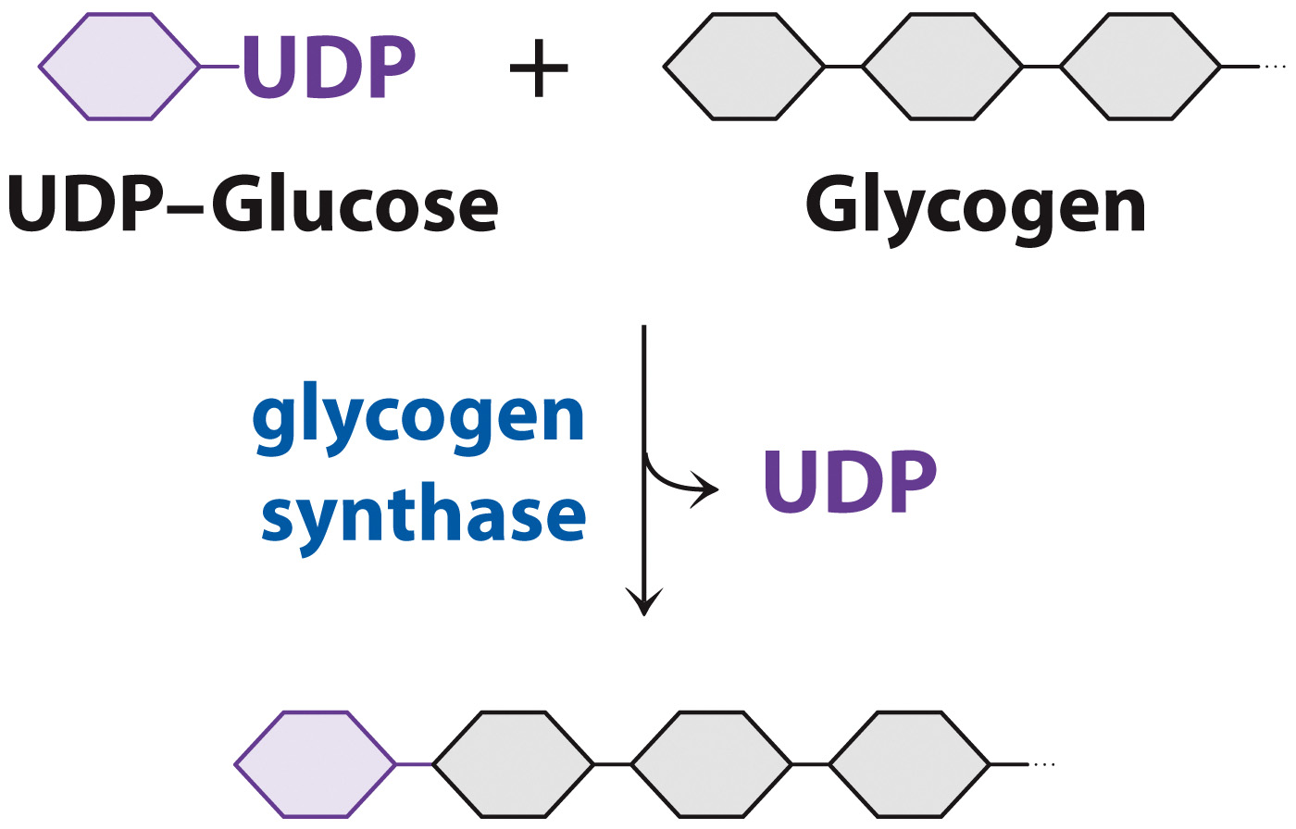
Glycogen synthase adds glucose to extend the glycogen polymer

Slide 50
Glycogenolysis

Slide 51
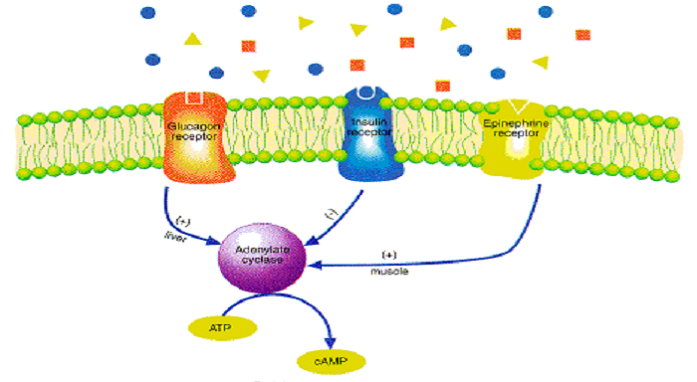

Slide 52
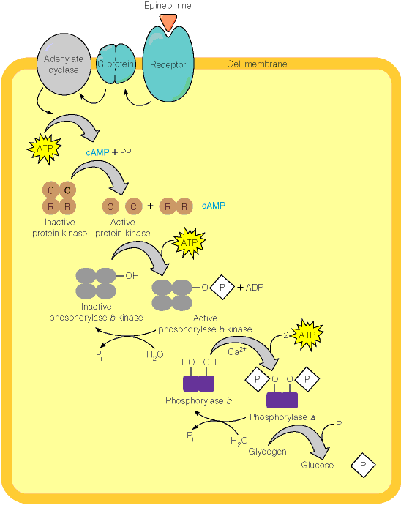
Protein
Kinase A
(AKA
cAMP-
dependent
kinase)
Ca+2
required
for calmodulin,
a subunit of
phosphorylase b

Slide 53
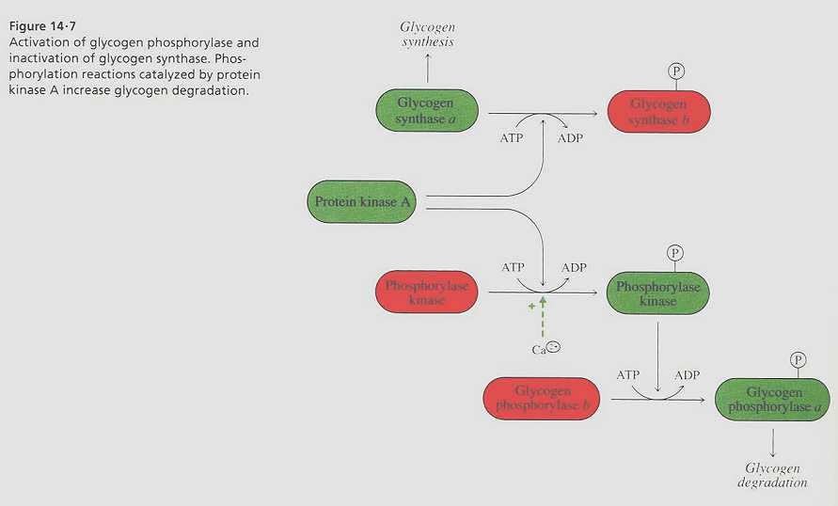
Green=on
Red=off

Slide 54
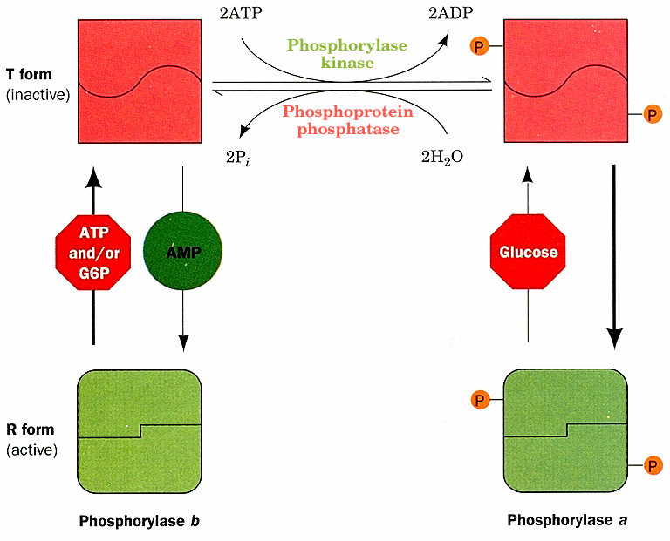
AMP & Phosphorylation
accomplish same thing;
T to R (active).

Slide 55
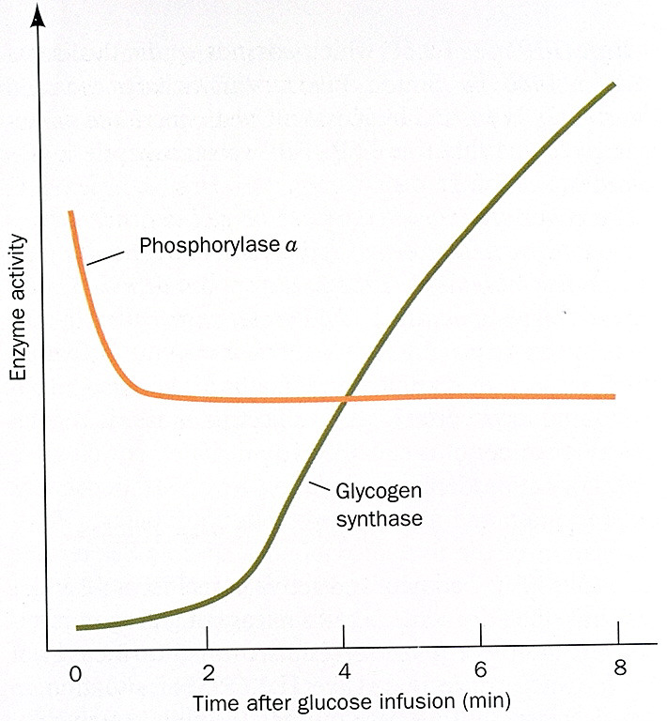

Slide 56
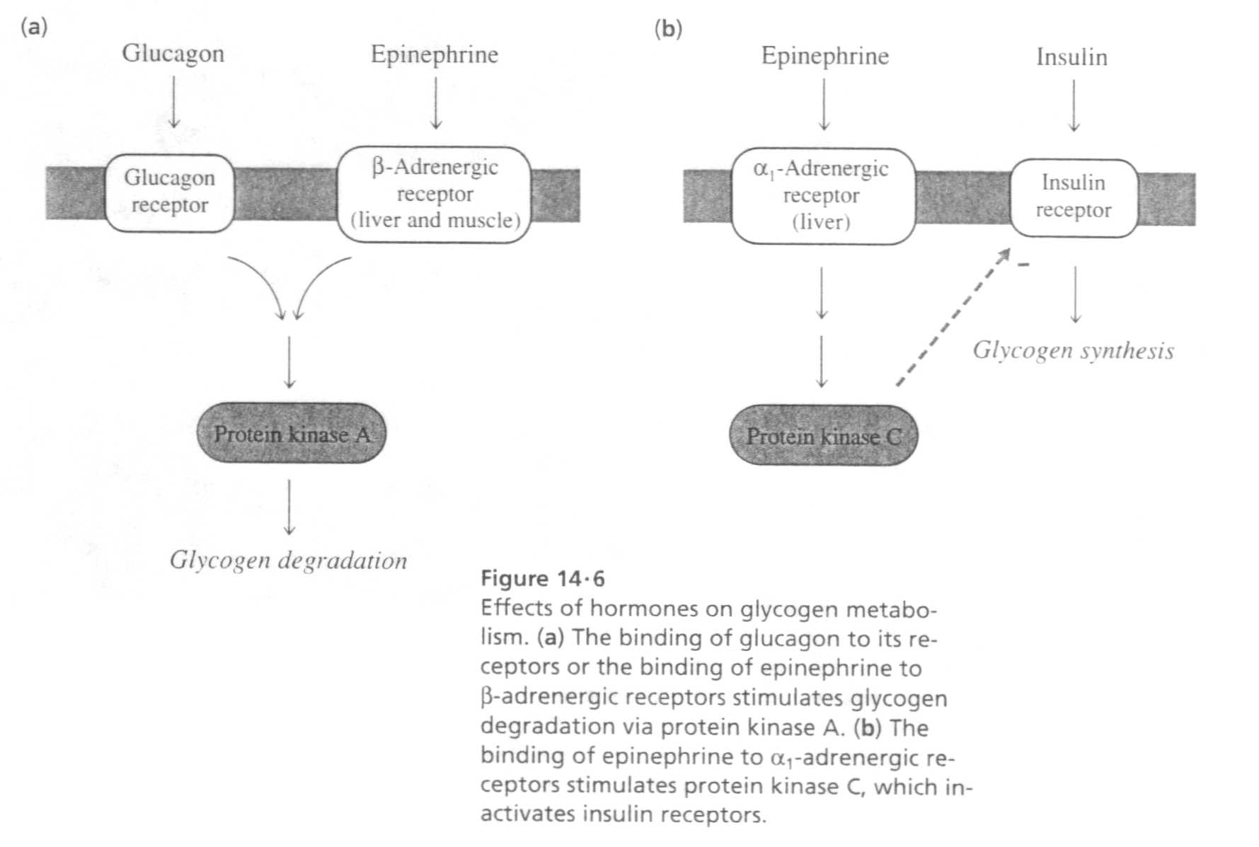

Slide 57
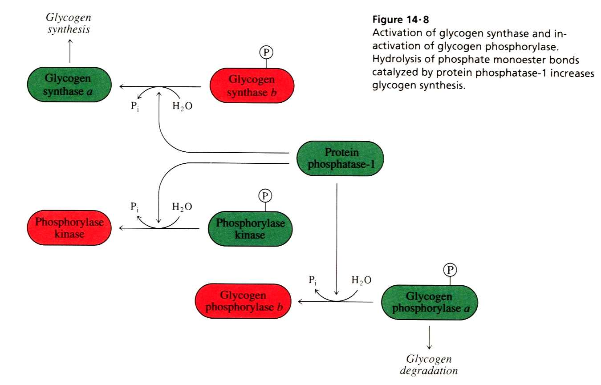
Green=on
Red=off

Slide 58
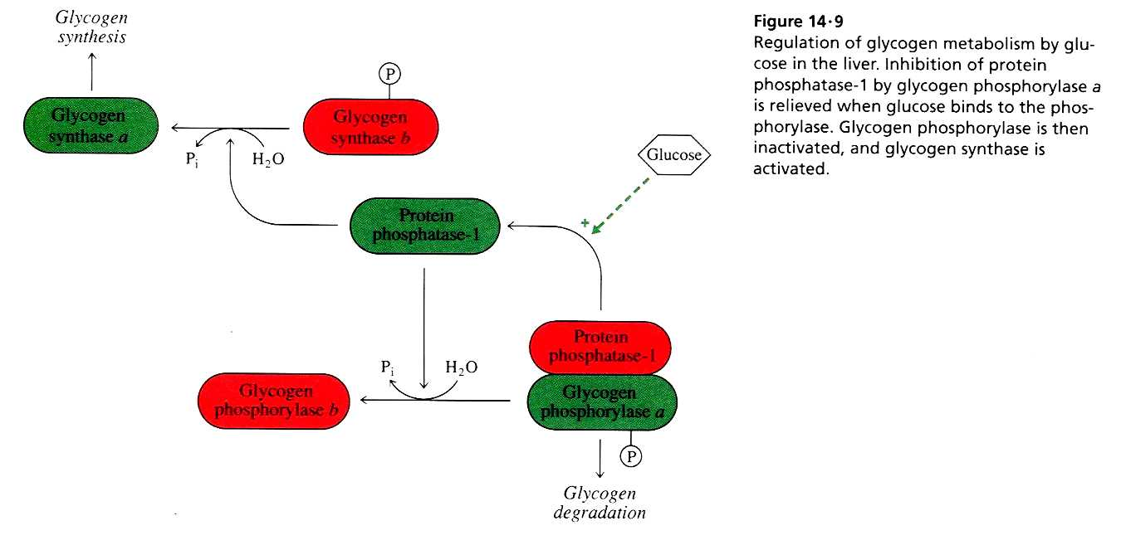
Green=on
Red=off

Slide 59
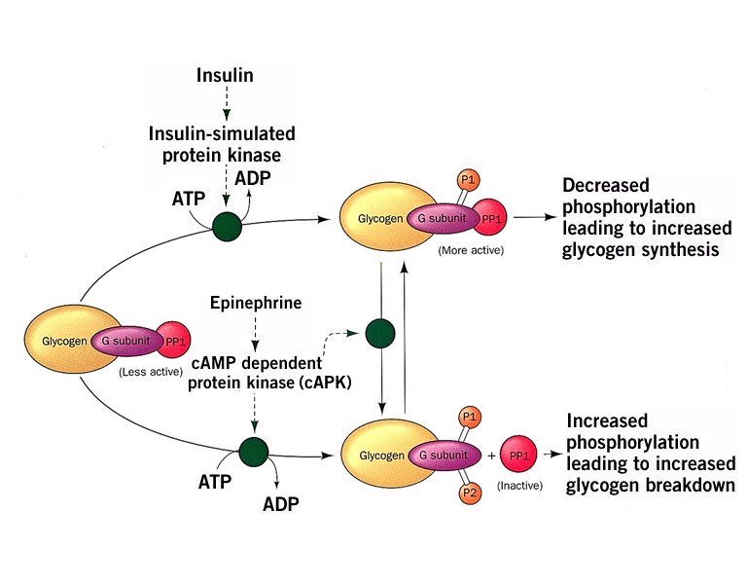
In Muscle, G_{M}
In Liver, G_{L}
G subunit=glycogen binding domain of PP1.
PP1=protein phosphatase-1
P1=phosphorylation of site”1”
P2= phosphorylation of site”2”

Slide 60
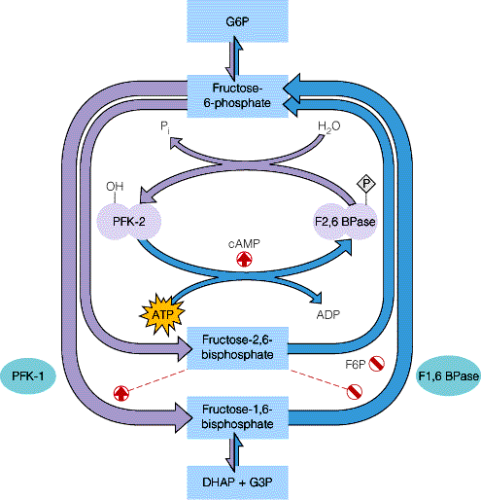

Slide 61
The Pentose Phosphate Pathway
Section 13.4
Learning Objective
Describe the substrates, products, and reactions of the pentose phosphate pathway

Slide 62
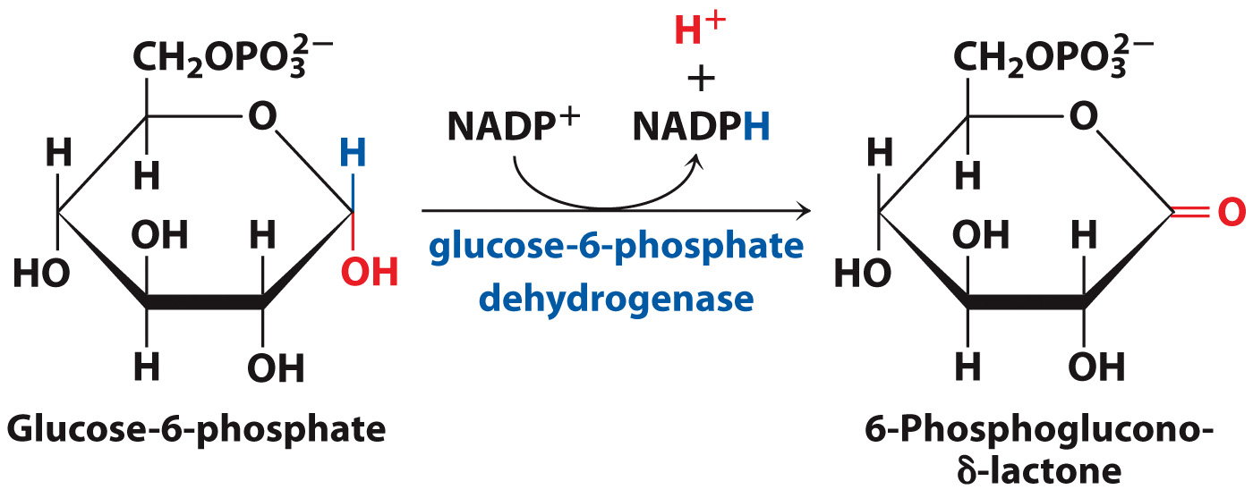
Oxidative reactions of the pentose phosphate pathway produce NADPH

Slide 63
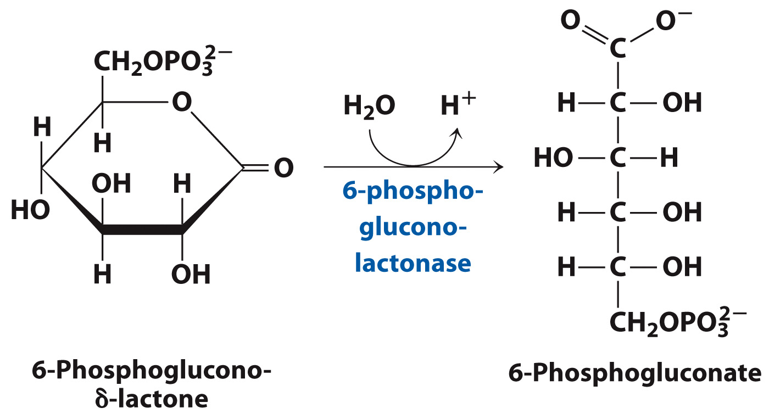
6-Phosphogluconate Production

Slide 64
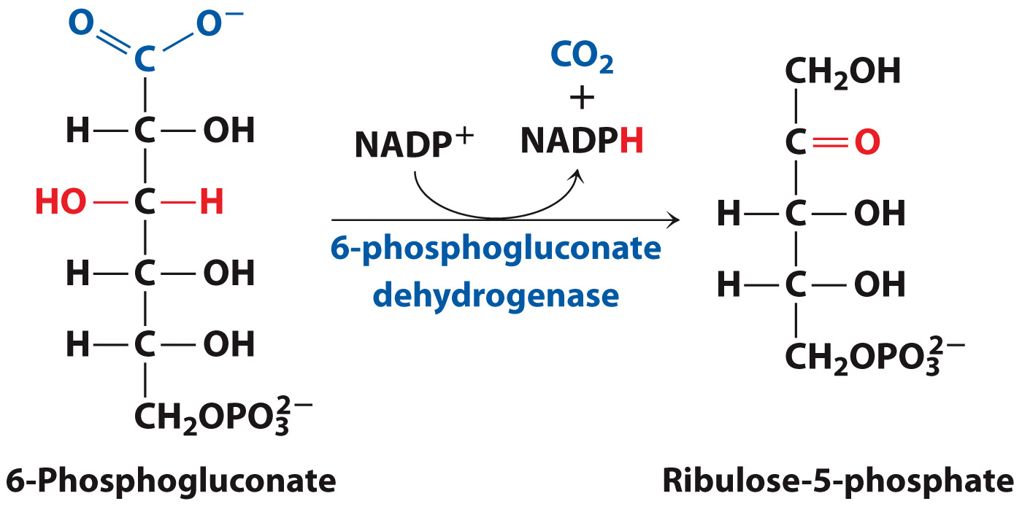
The third step of the pentose phosphate pathway involves oxidative decarboxylation

Slide 65
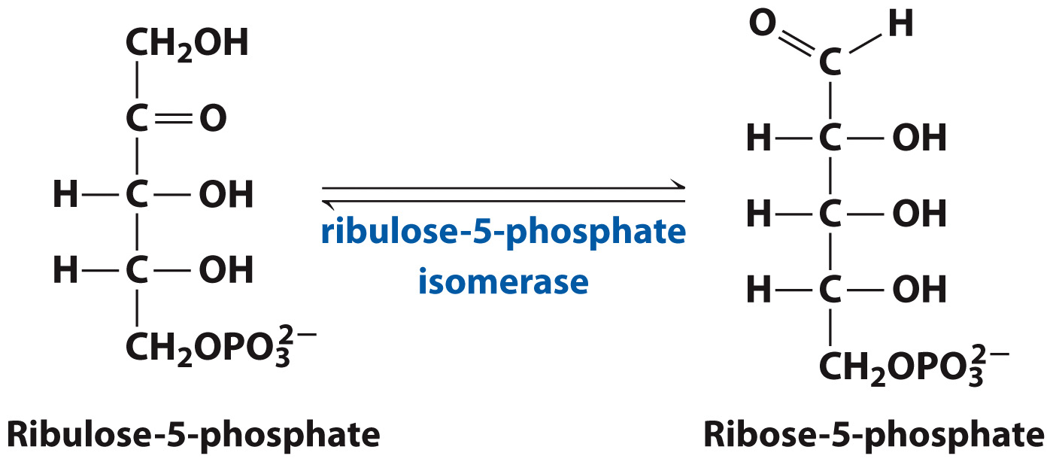
Ribose-5-phospate is a precursor of the ribose unit of nucleotides

Slide 66
Ribonucleotide reductase converts ribose to deoxyribose

Slide 67
Rearrangements of the Products in the Pentose Phosphate Pathway

Slide 68
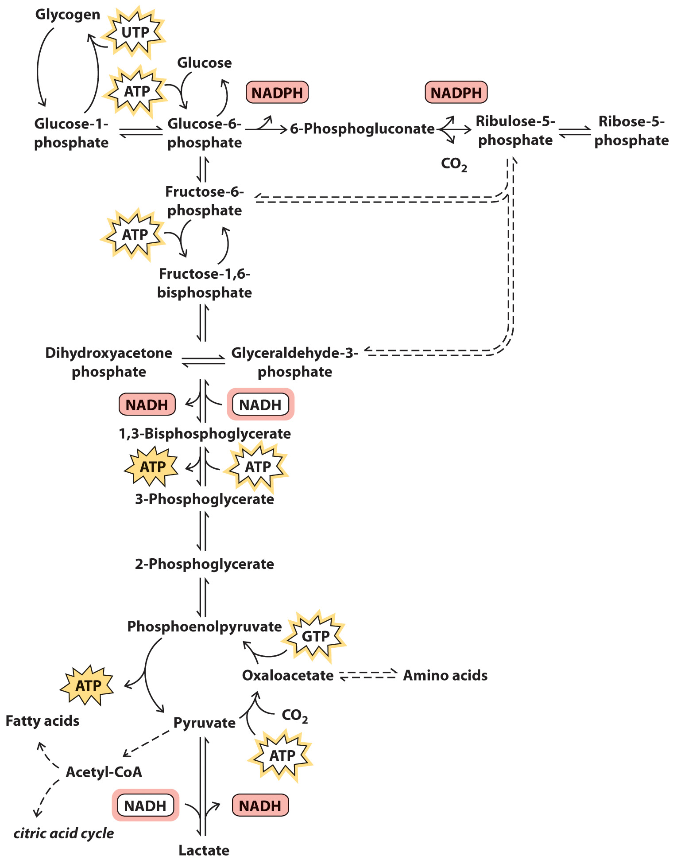
Summary of Glucose Metabolism

Slide 69
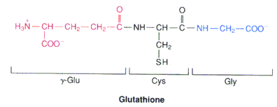

Slide 70
Glutathione Reductase
(requires FAD also)
(maintains GSH/GSSG at about 500:1)

Slide 71
Clinical Connection: Disorders of Carbohydrate Metabolism
Section 13.5
Learning Objective
Relate enzyme deficiencies to defects in carbohydrate metabolism

Slide 72
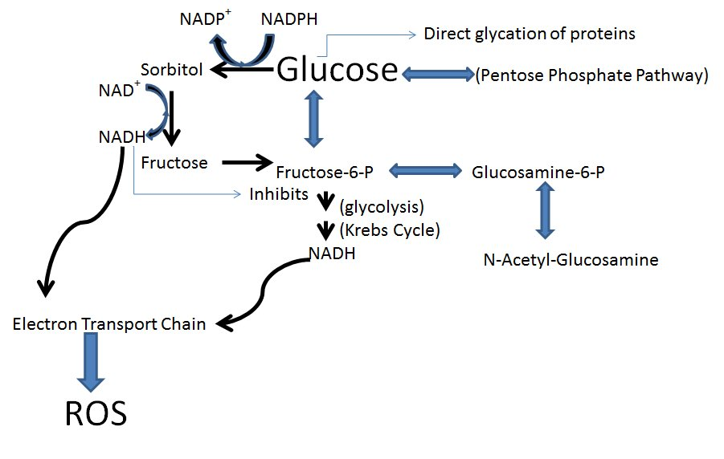

Slide 73
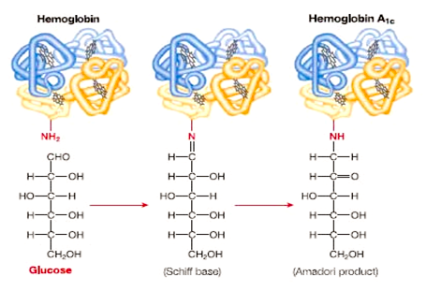

Slide 74
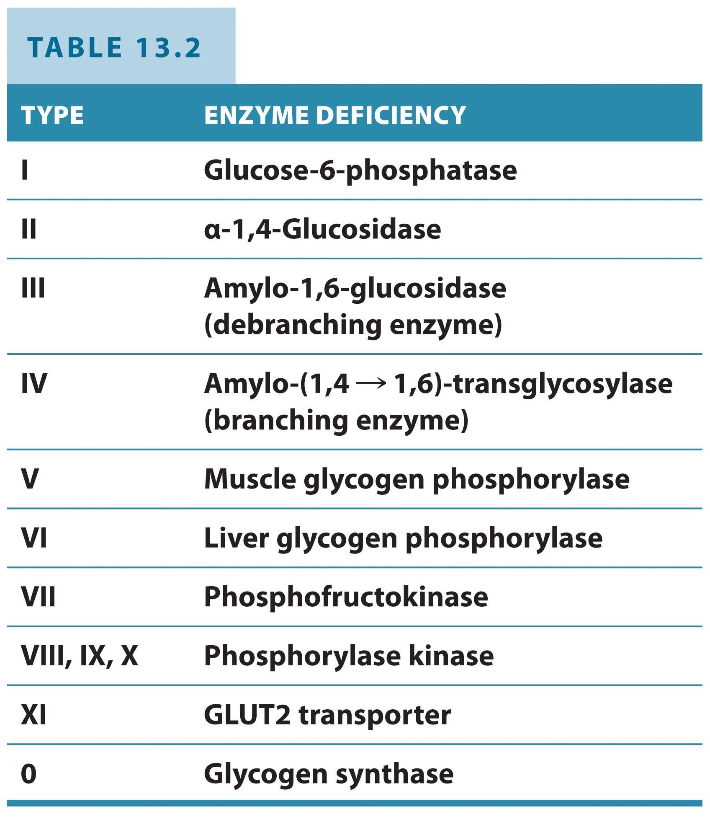
Enzyme Deficiency

