Slide 1
Essential Biochemistry
Fourth Edition
Charlotte W. Pratt | Kathleen Cornely
Lecture Notes for
Chapter 12
Metabolism and Bioenergetics

Slide 2
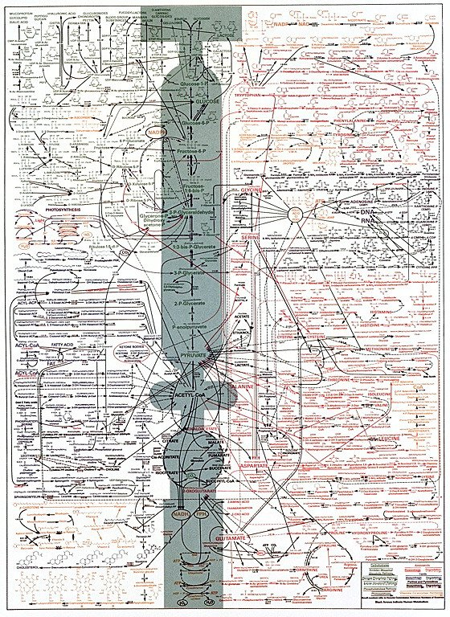

Slide 3
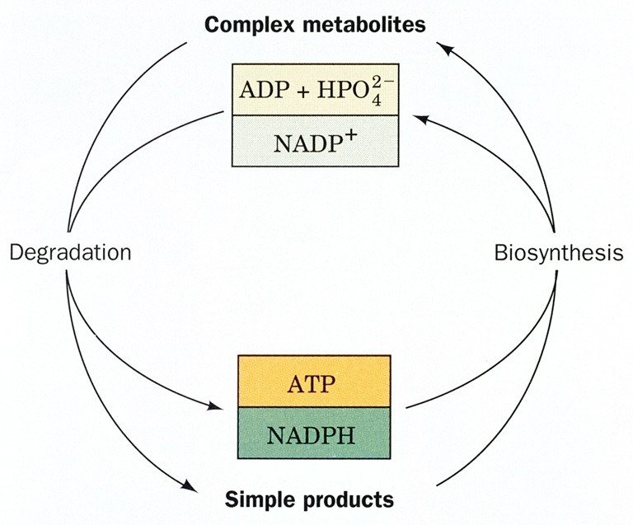

Slide 4
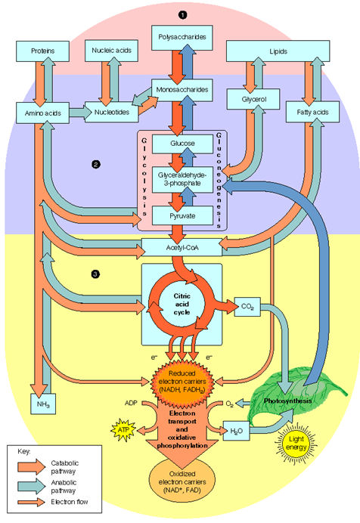

Slide 5
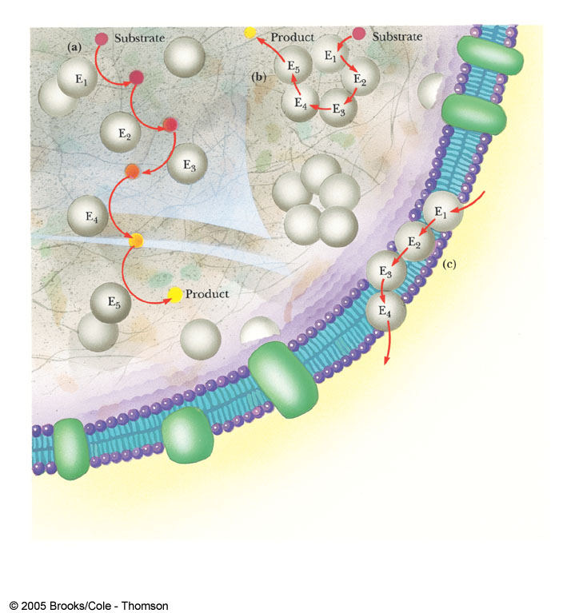
Metabolons

Slide 6
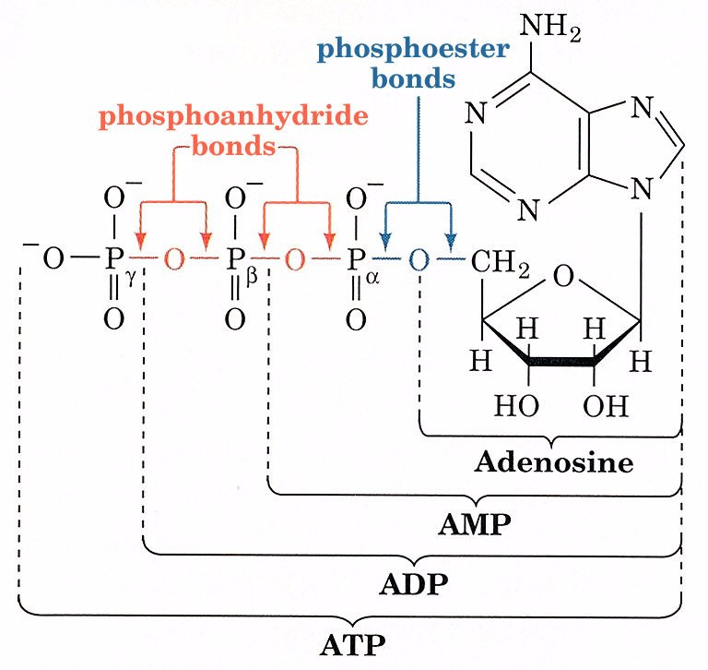

Slide 7
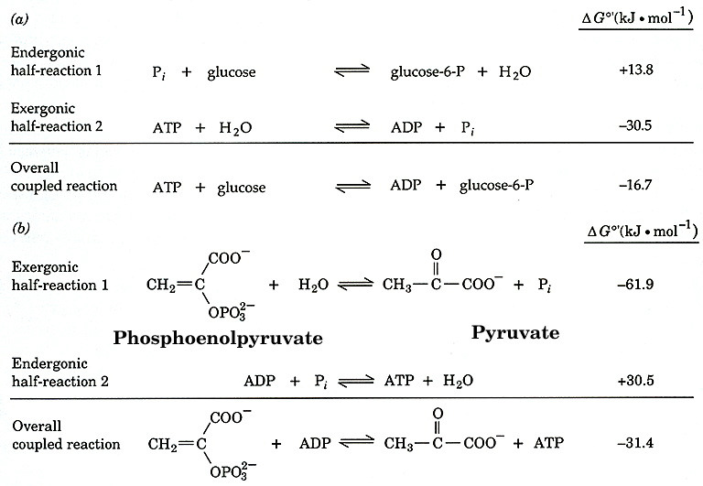

Slide 8
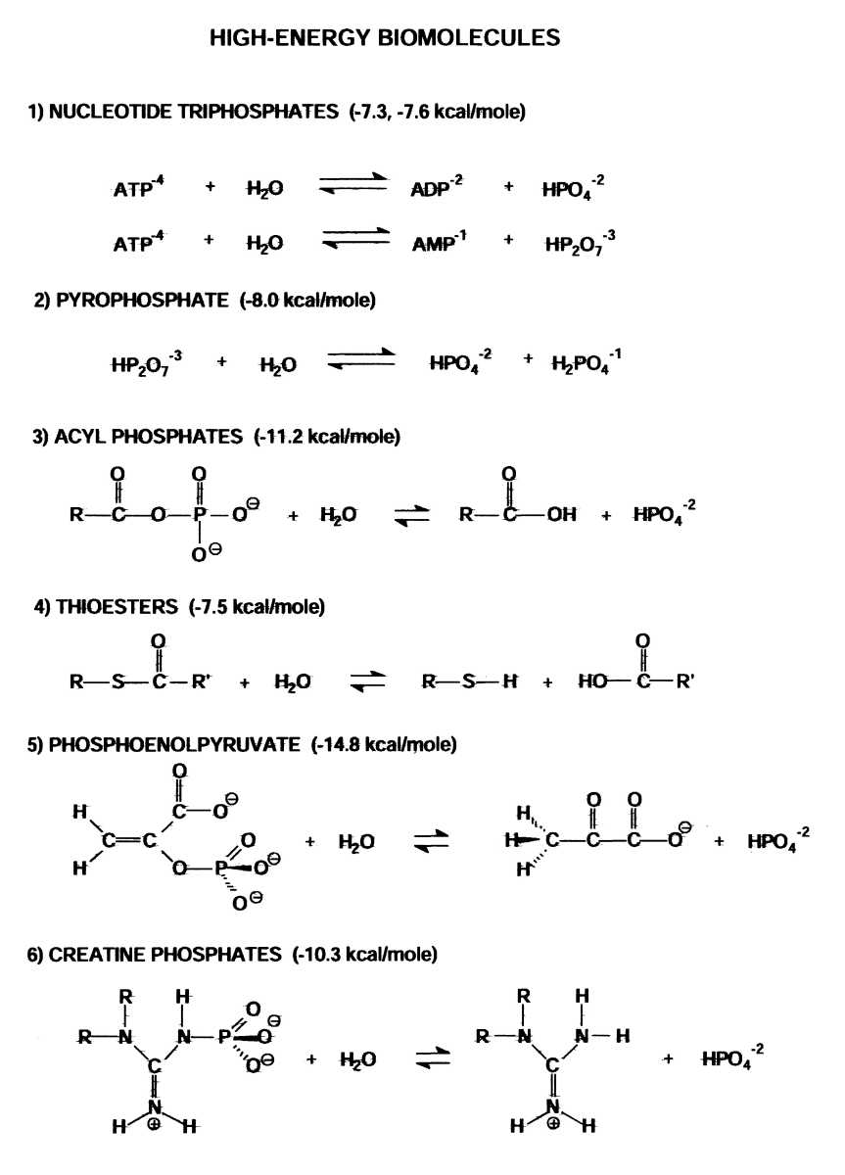

Slide 9
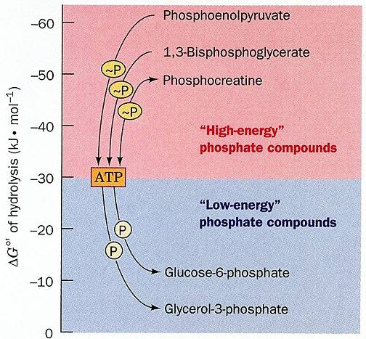

Slide 10
Food and Fuel
Section 12.1
Learning Objective
Summarize the pathways for digesting and mobilizing metabolic fuels

Slide 11
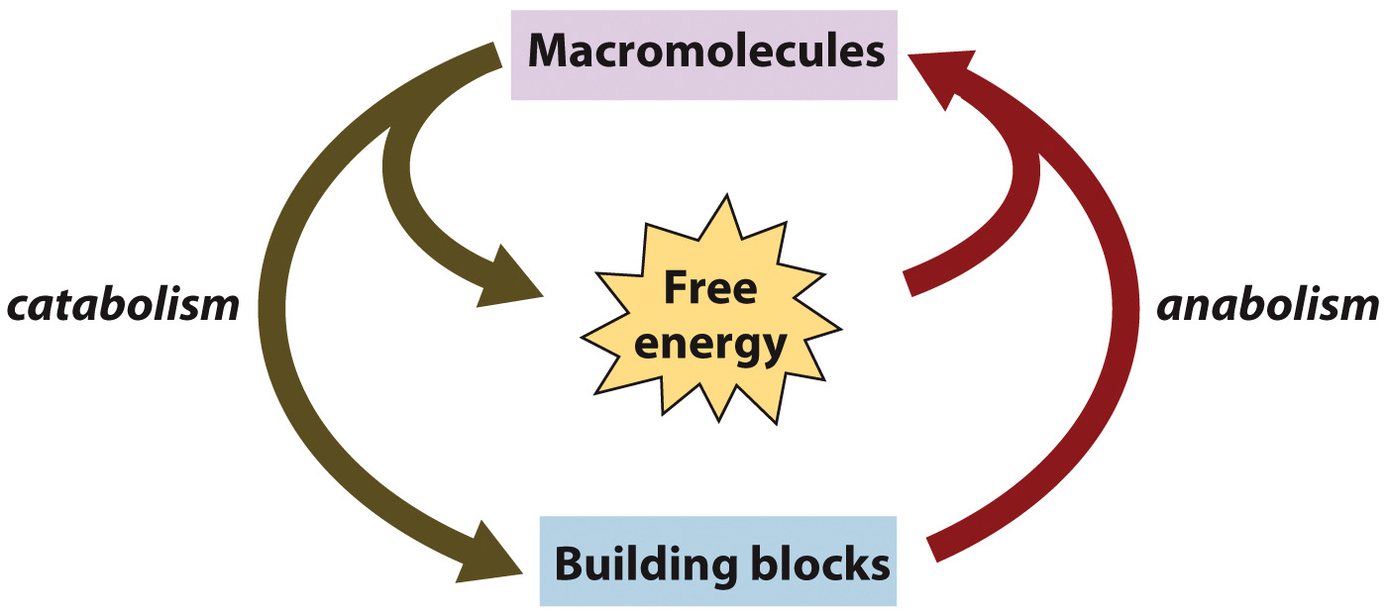
Overview of Metabolism

Slide 12
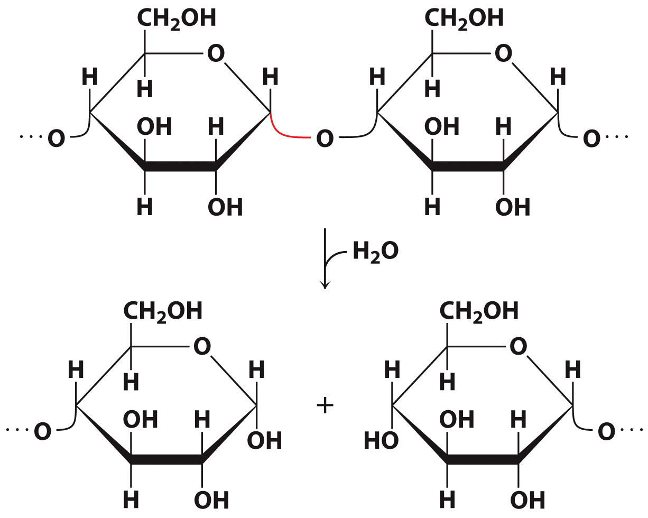
Starchy foods are hydrolyzed by amylases

Slide 13
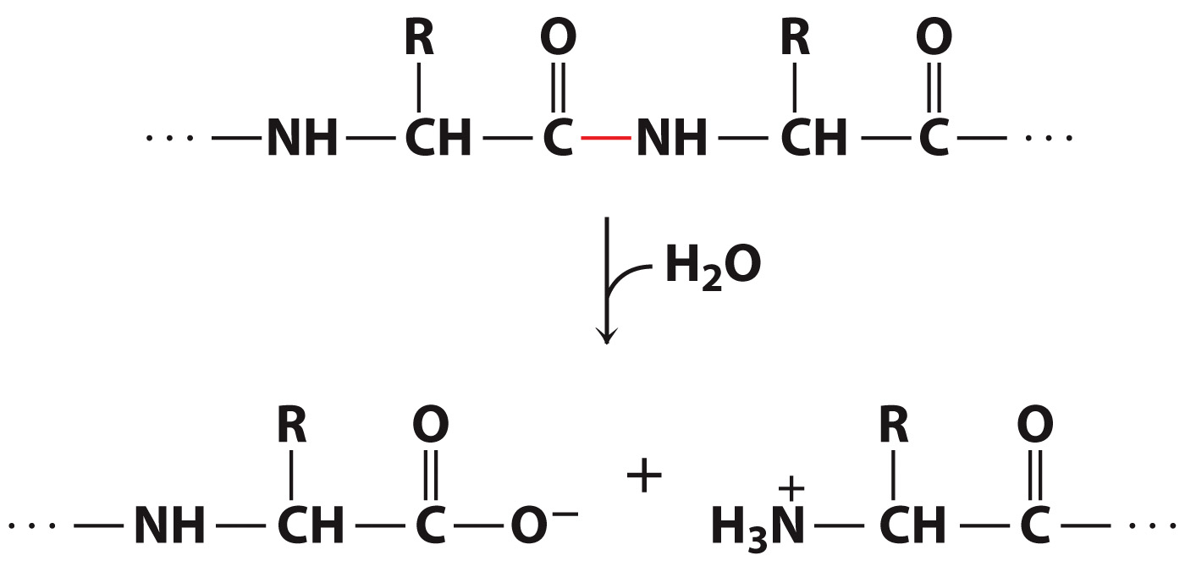
Proteins are hydrolyzed by proteases

Slide 14
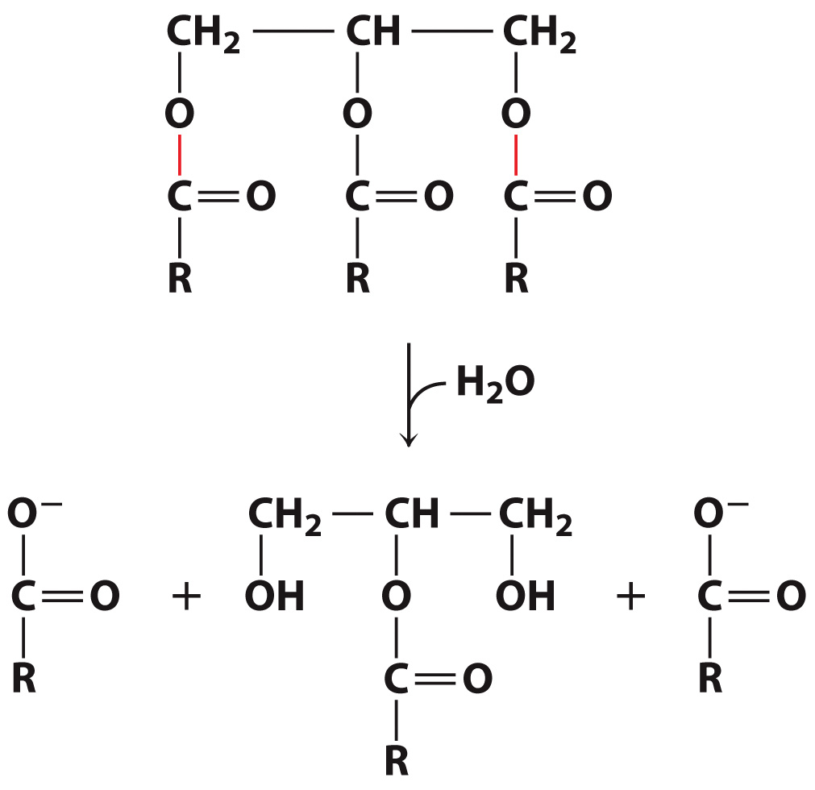
Fatty acids are hydrolyzed by lipases

Slide 15
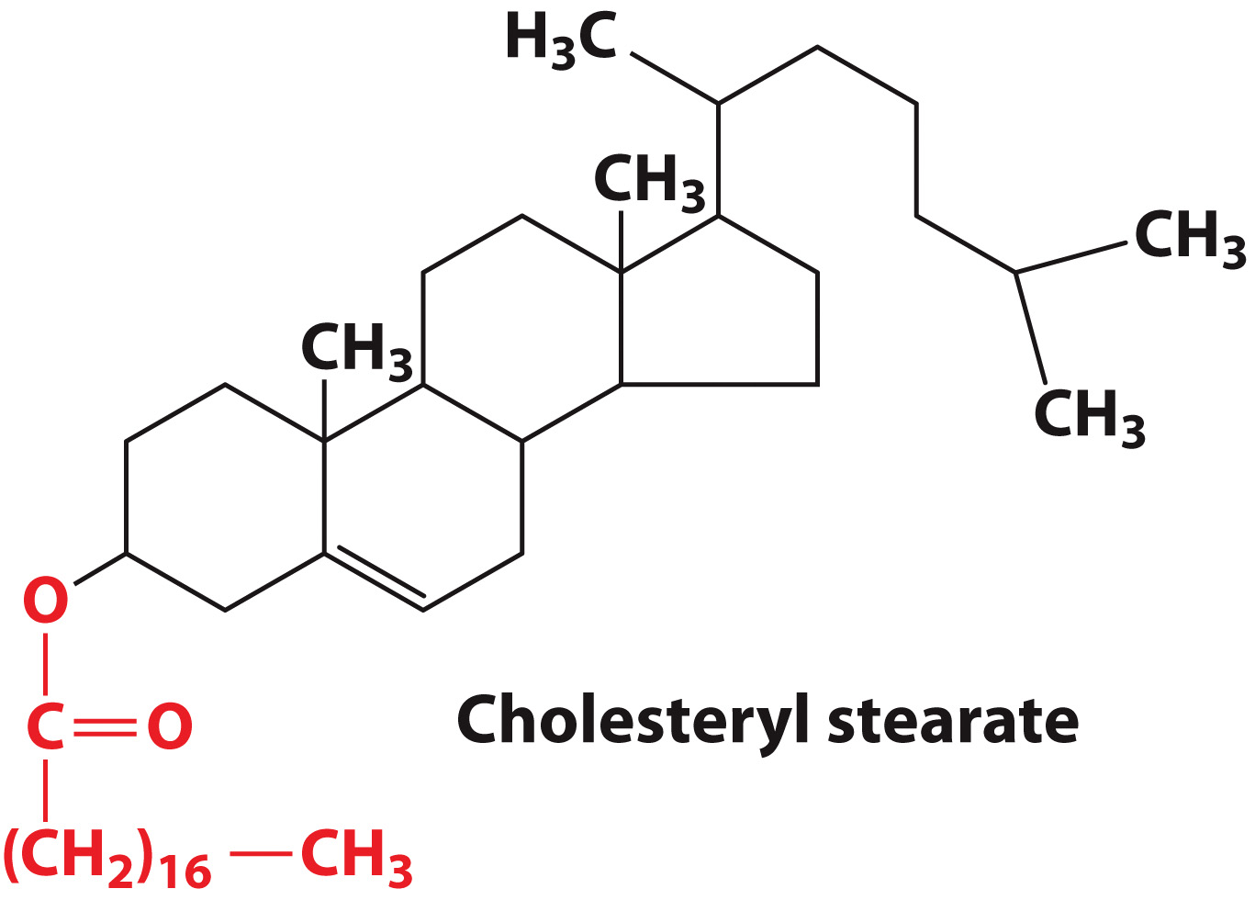
For transport, some fatty acids are linked to cholesterol

Slide 16
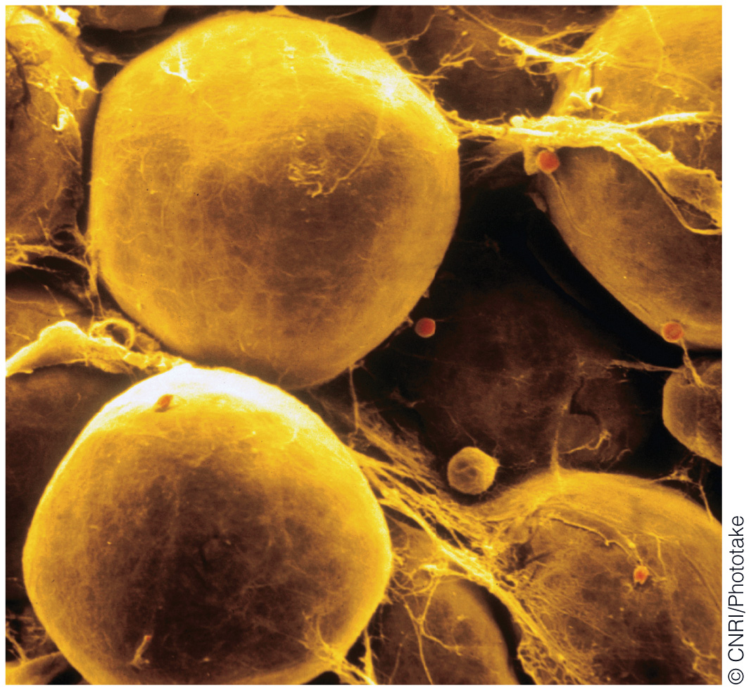
Adipocytes hold triacylglycerols

Slide 17
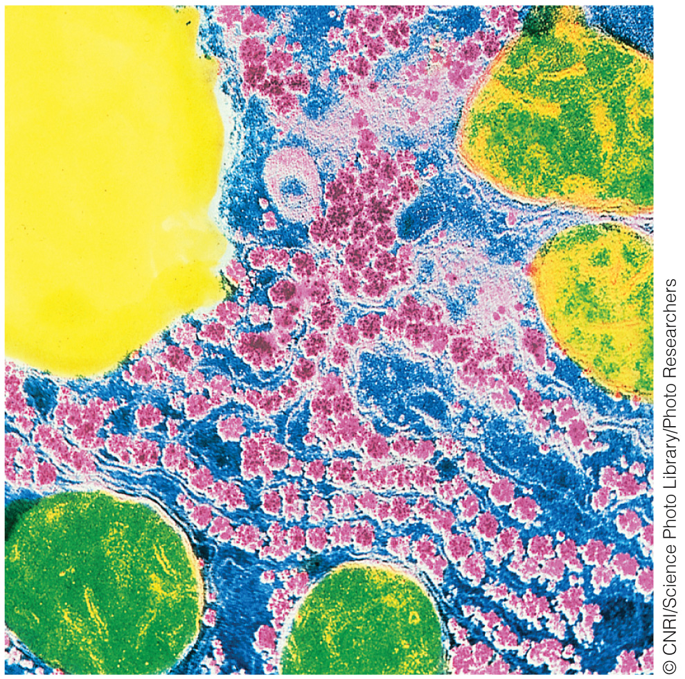
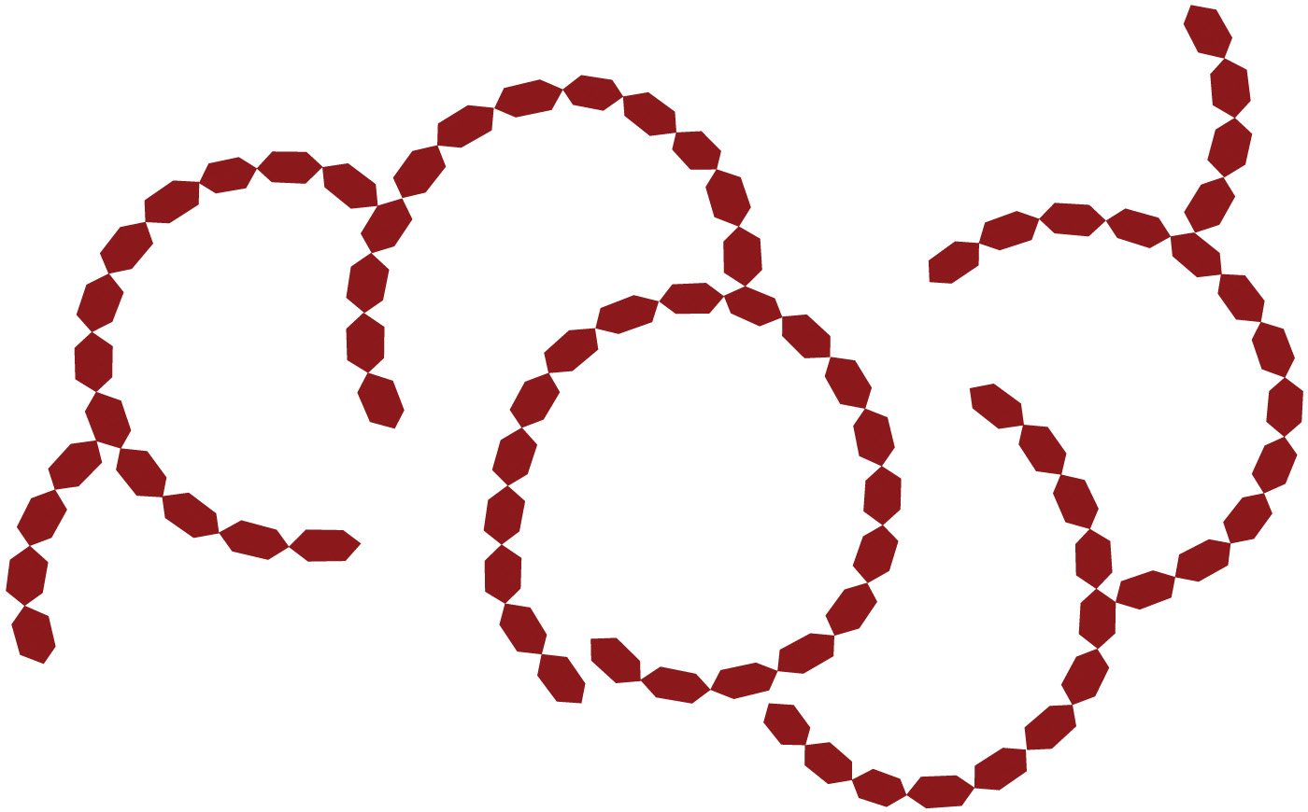
Glycogen Structure
Electron Micrograph of a Liver Cell
Schematic of Glycogen

Slide 18
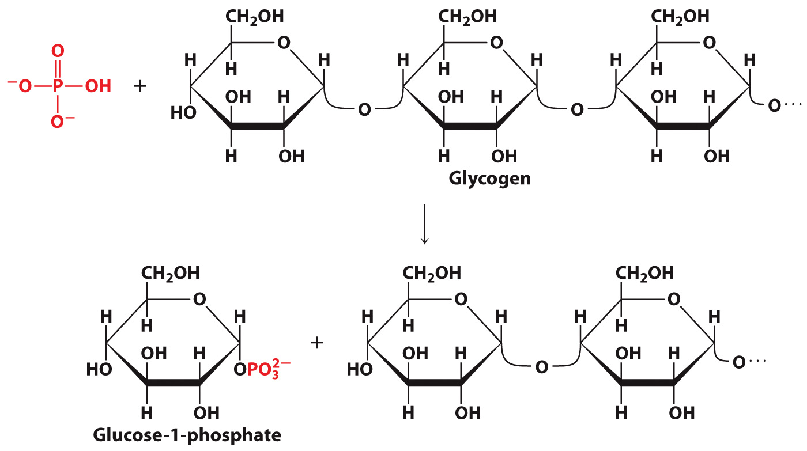
Glycogen breakdown occurs via phosphorolysis

Slide 19
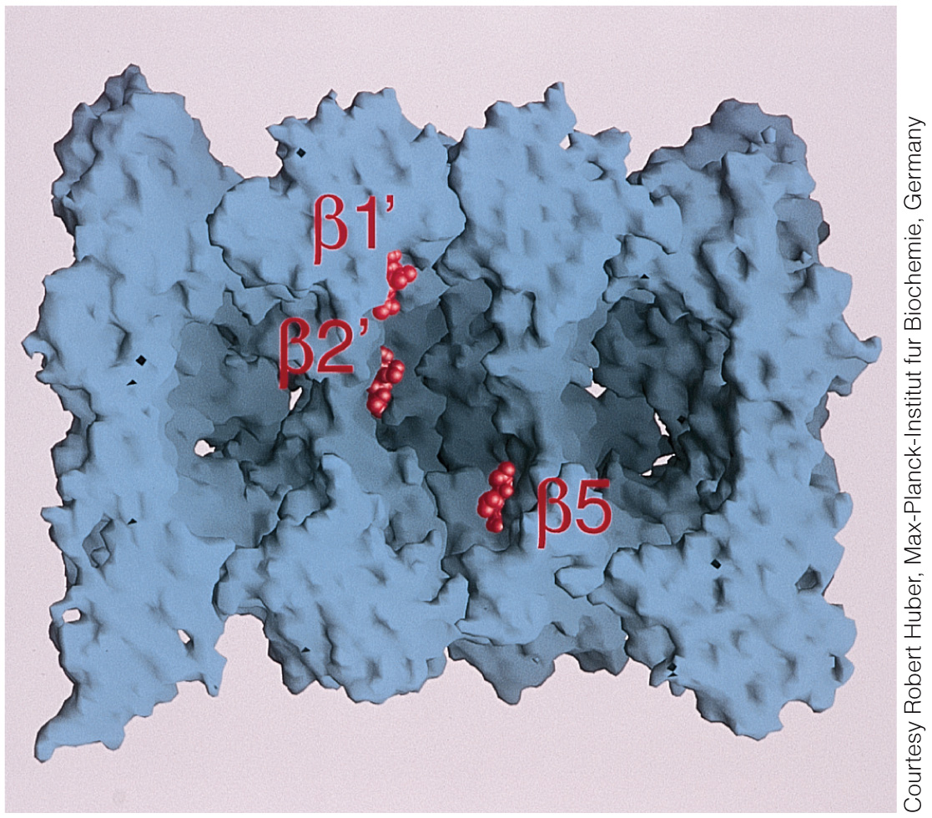
Structure of the Yeast Proteasome Core

Slide 20
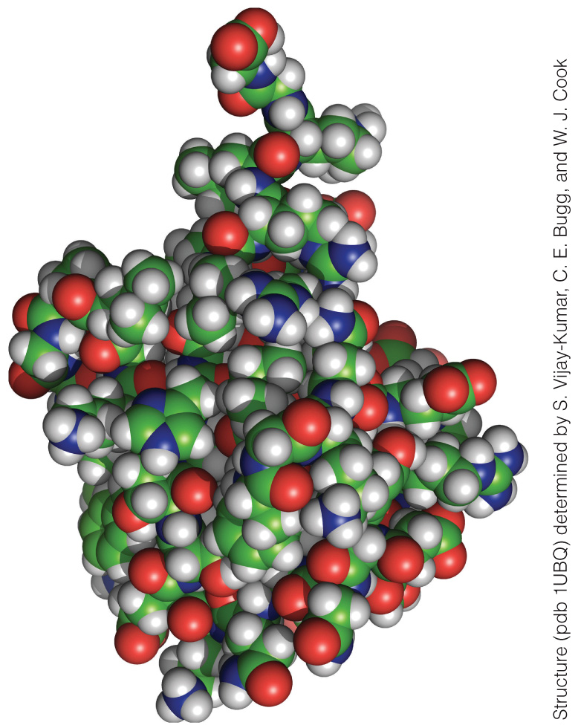
Ubiquitin

Slide 21
Metabolic Pathways
Section 12.2
Learning Objective
Recognize the common chemical features of metabolic pathways

Slide 22
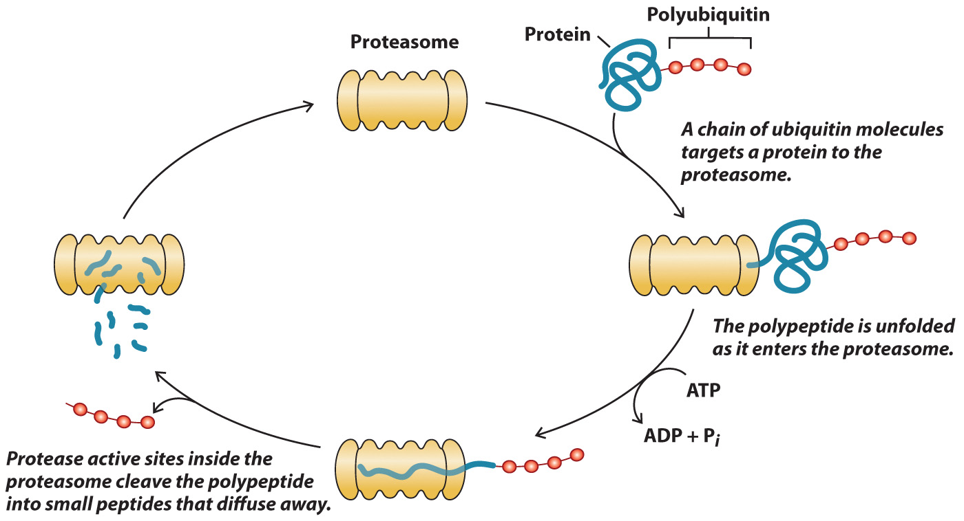
Protein Degradation by the Proteasome

Slide 23
Some Intermediates of Glucose Metabolism

Slide 24
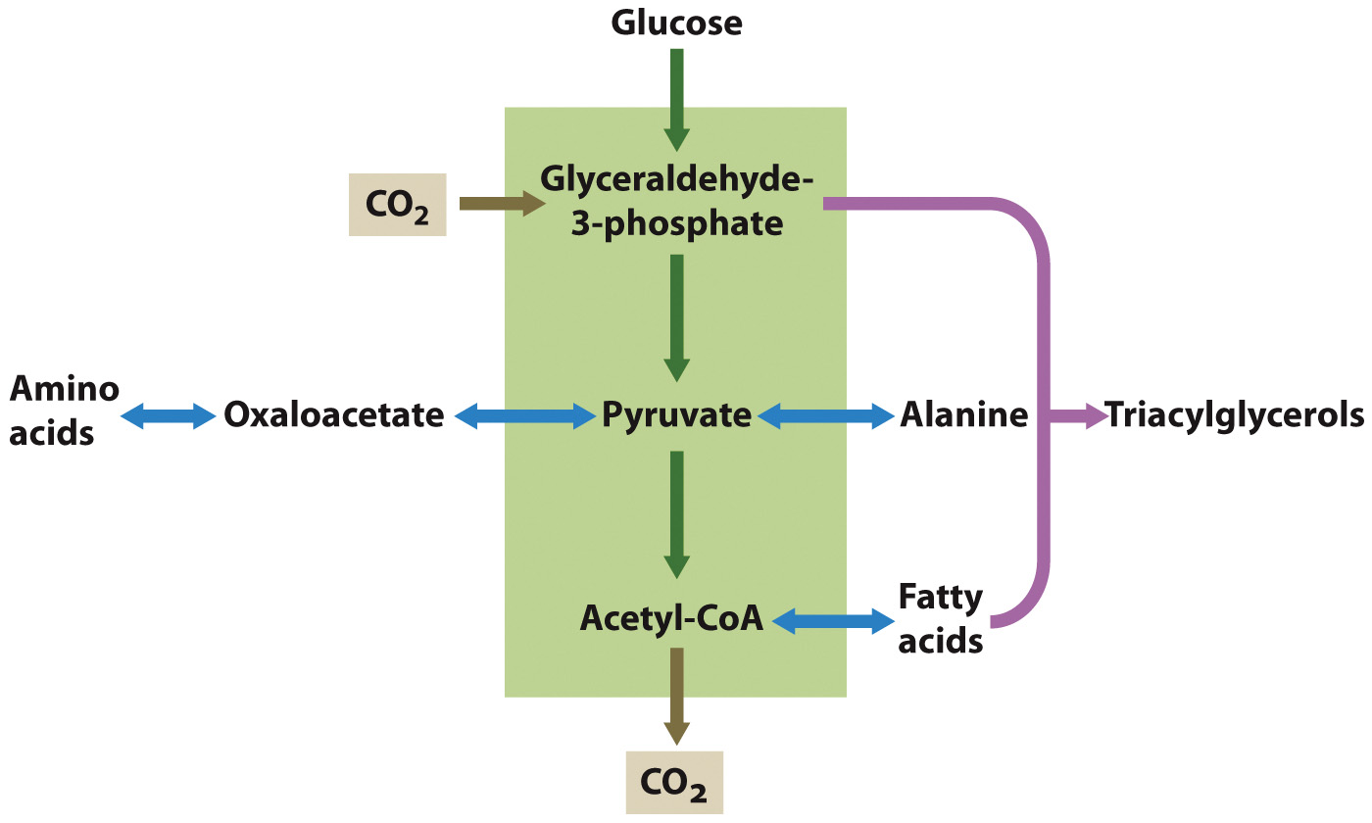
Some major metabolic pathways share a few common intermediates

Slide 25
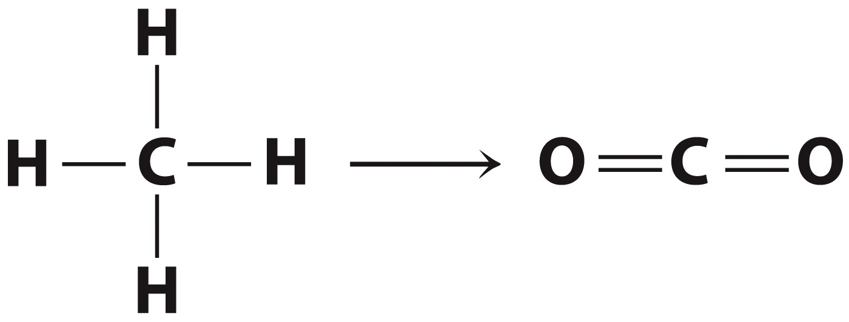
Many metabolic pathways include oxidation-reduction reactions

Slide 26
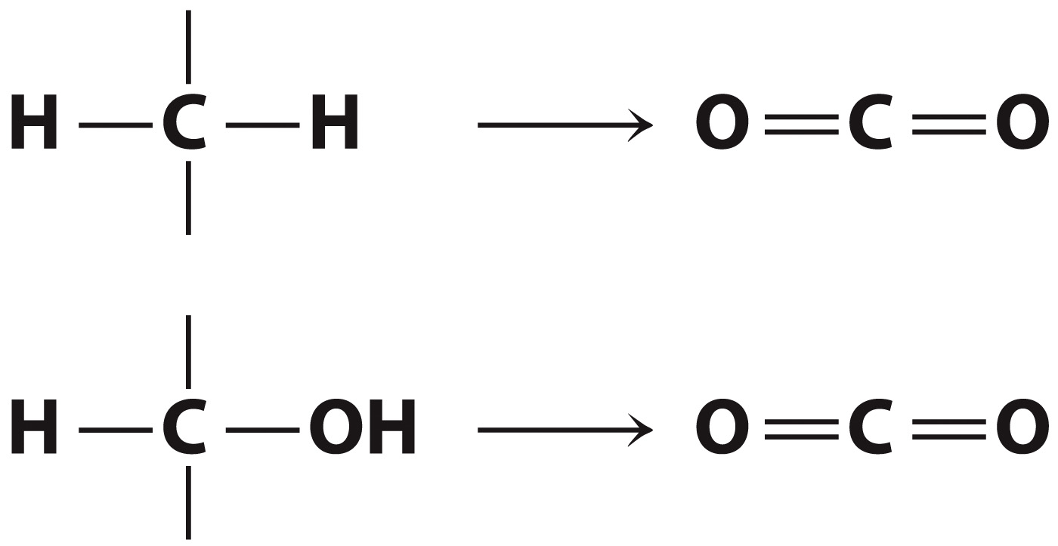
Carbons in fatty acids and carbohydrates are oxidized to CO₂

Slide 27
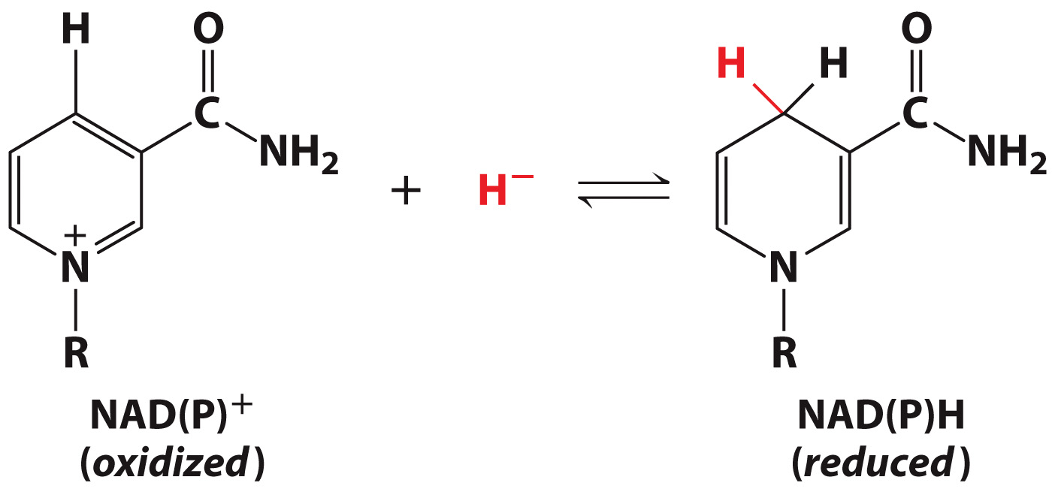
Some cofactors undergo oxidation-reduction

Slide 28
Reduction of ubiquinone to ubiquinol is stepwise

Slide 29
Cofactors are recycled through oxidative phosphorylation

Slide 30
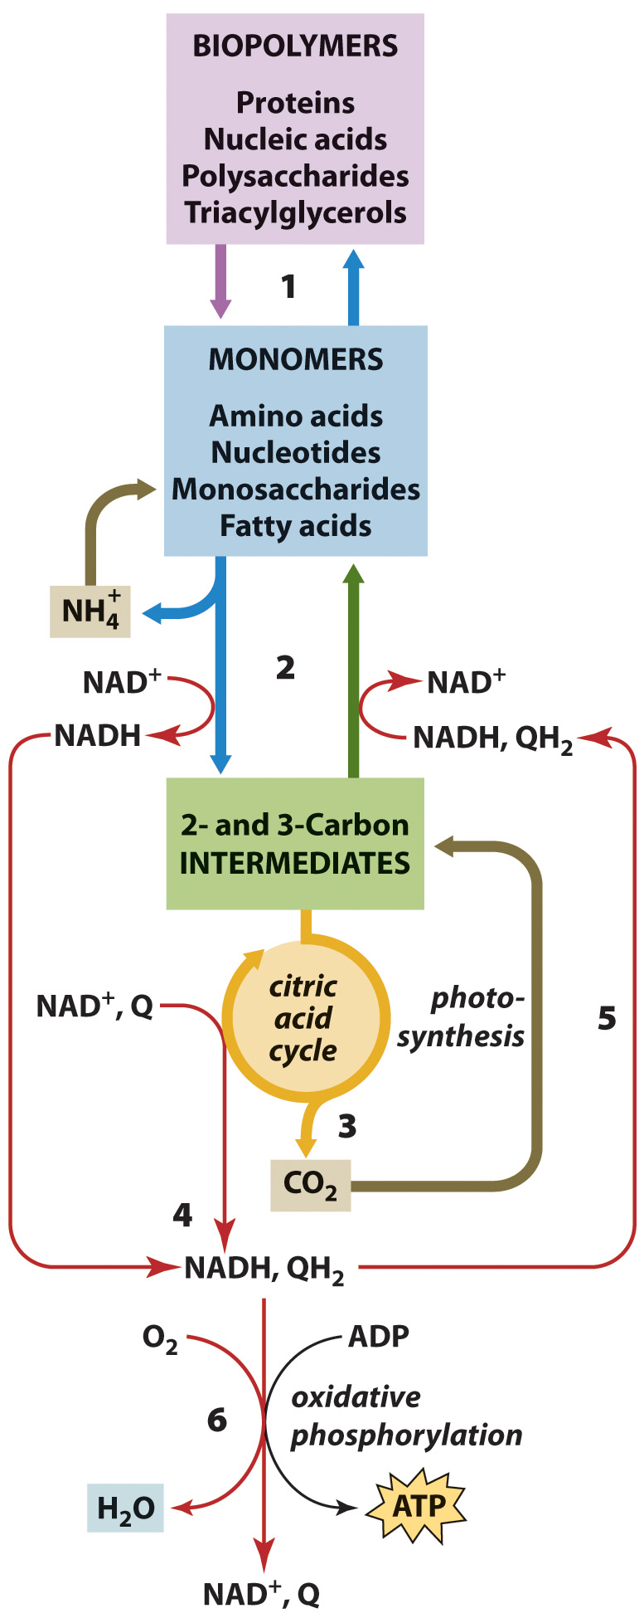
Outline of Metabolism

Slide 31
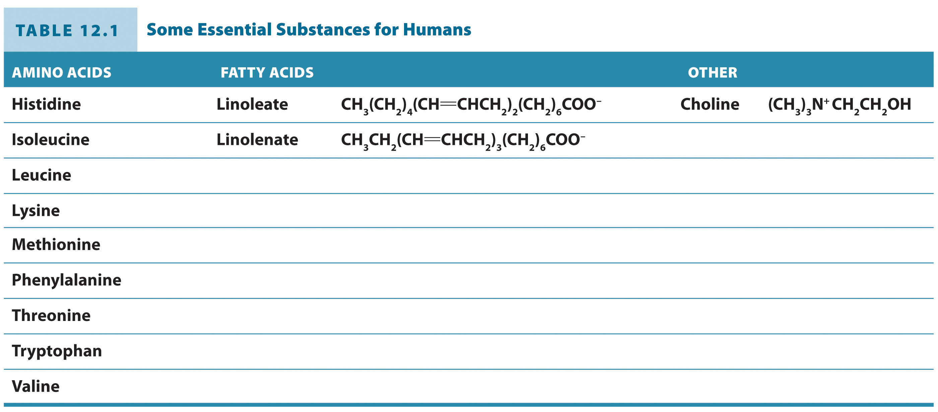
Humans do not synthesize some important biomolecules

Slide 32
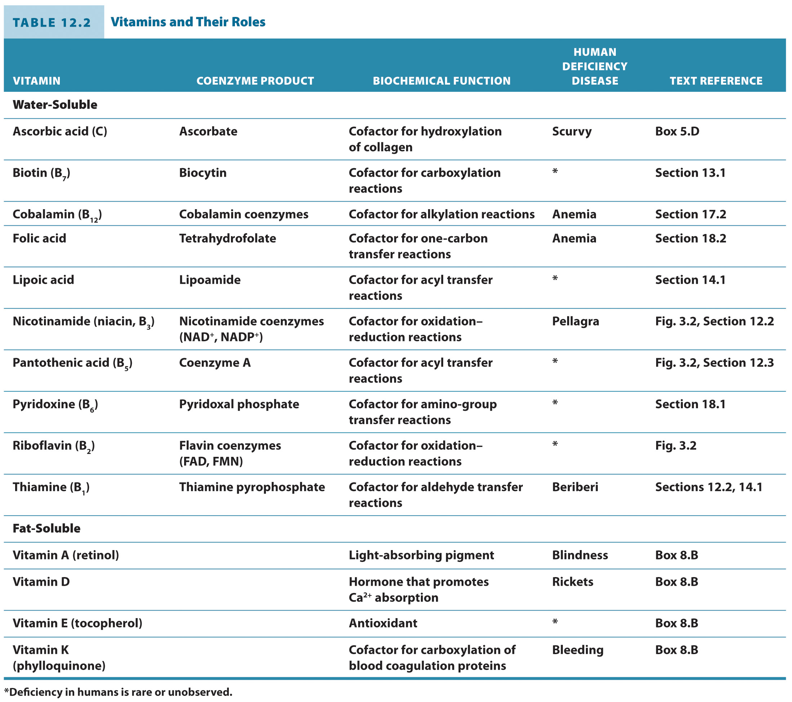
Humans do not synthesize vitamins

Slide 33
Free Energy Changes in Metabolic Reactions
Section 12.3
Learning Objective
Analyze the free energy changes that occur during metabolic reactions

Slide 34
The free energy change depends on reactant concentrations
Standard Free Energy Change

Slide 35
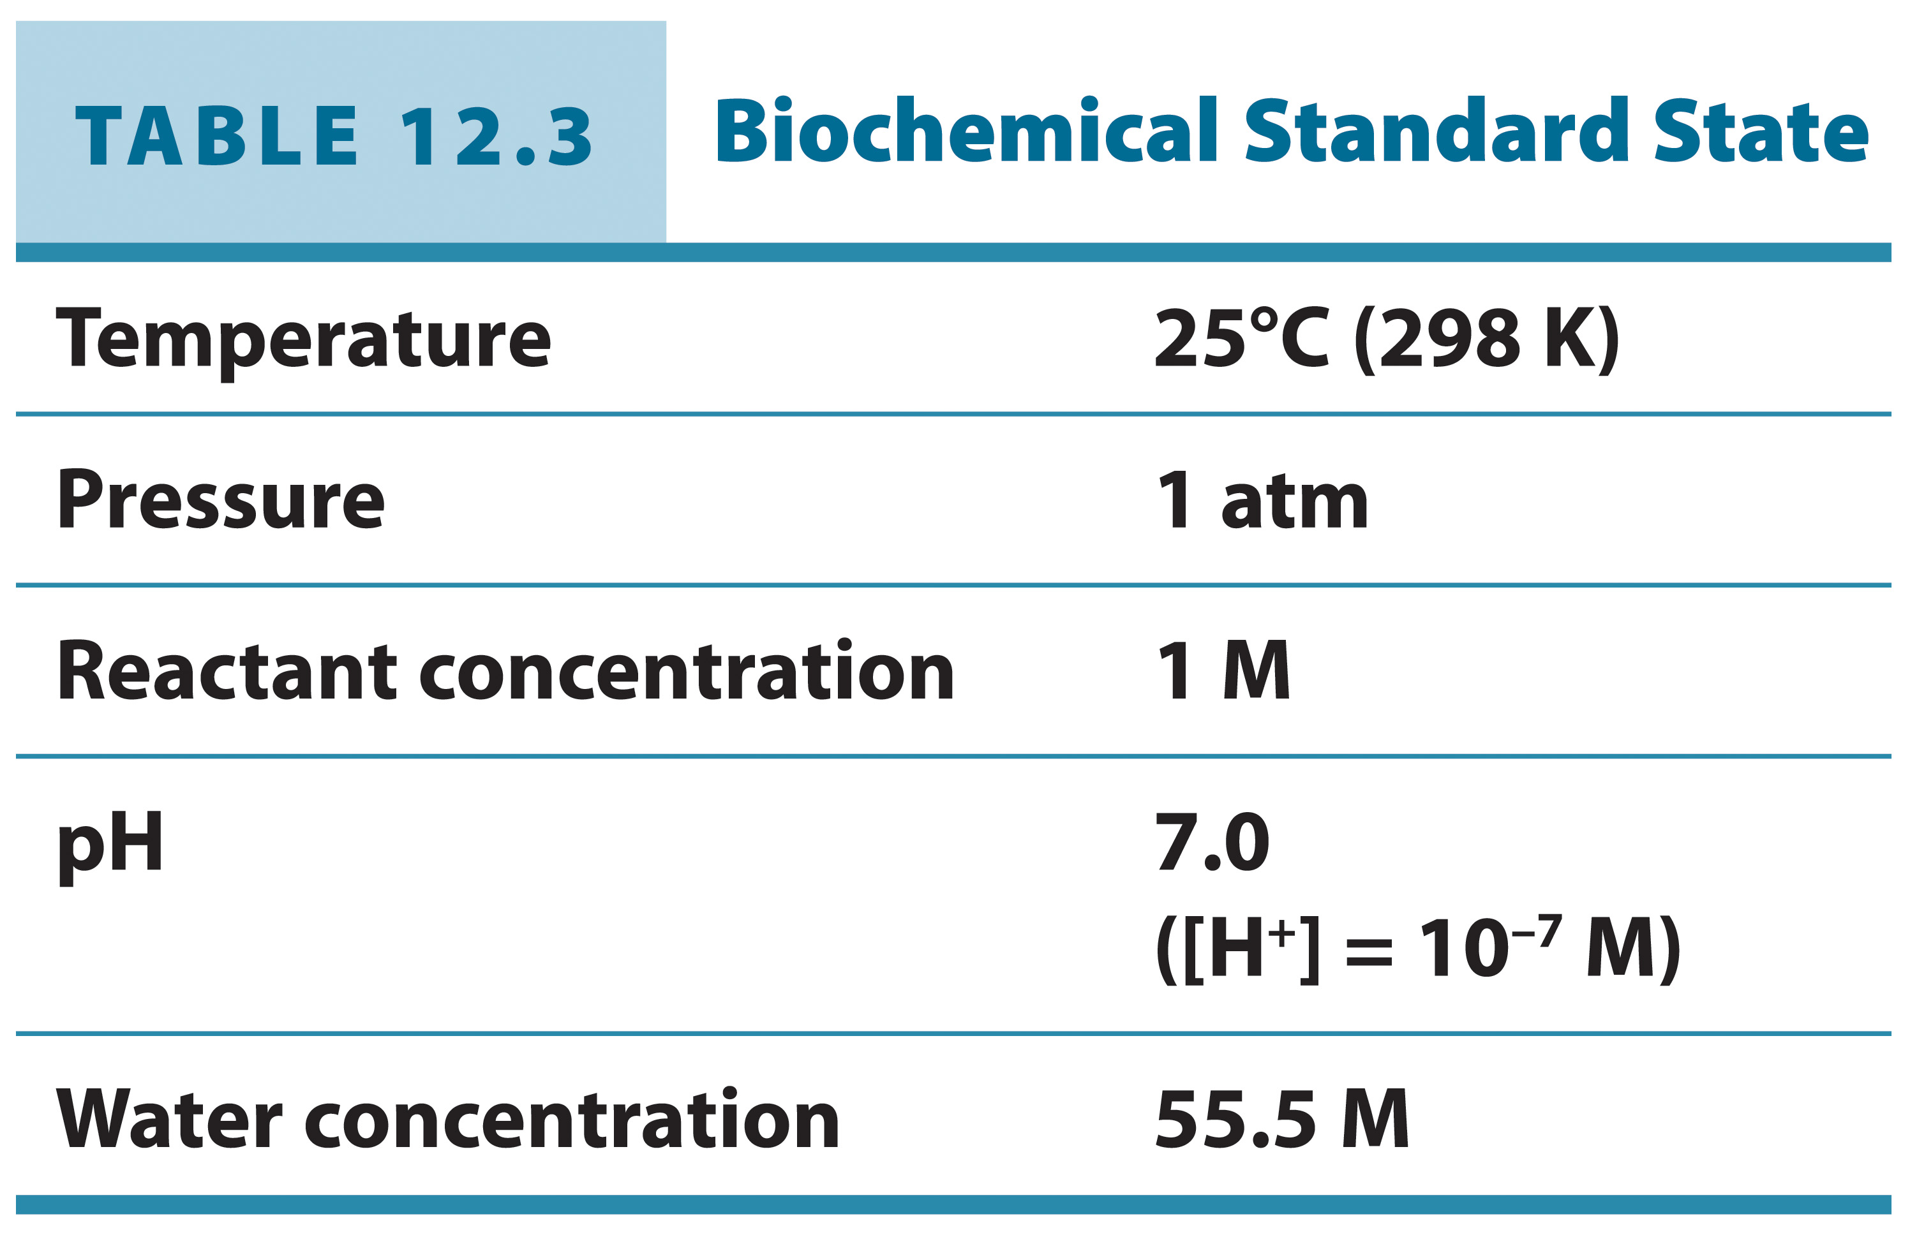
Biochemical Standard State

Slide 36
Calculating Actual Free Energy Changes

Slide 37
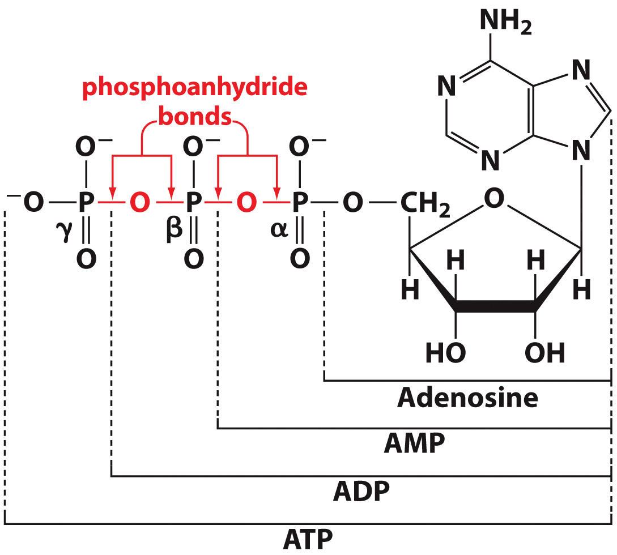
ATP is often involved in coupled processes

Slide 38
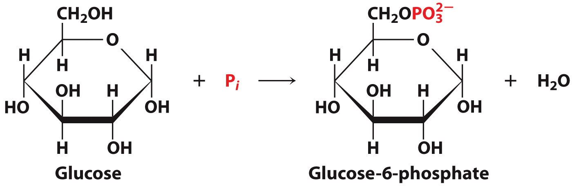
Consider the following reactions
A highly favorable reaction
A highly unfavorable reaction

Slide 39
ATP hydrolysis provides the energy for glucose phosphorylation

Slide 40
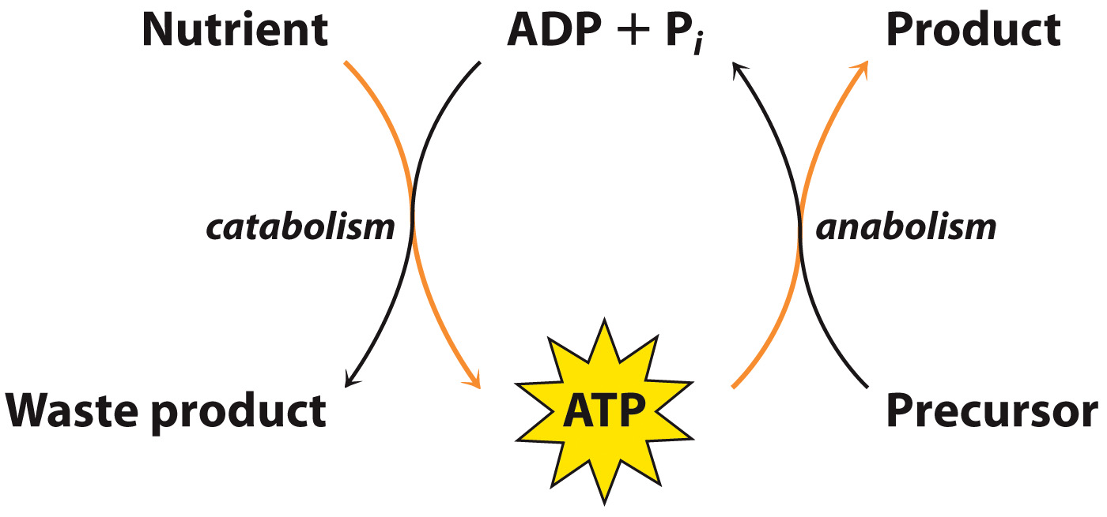
What’s so special about ATP?

Slide 41
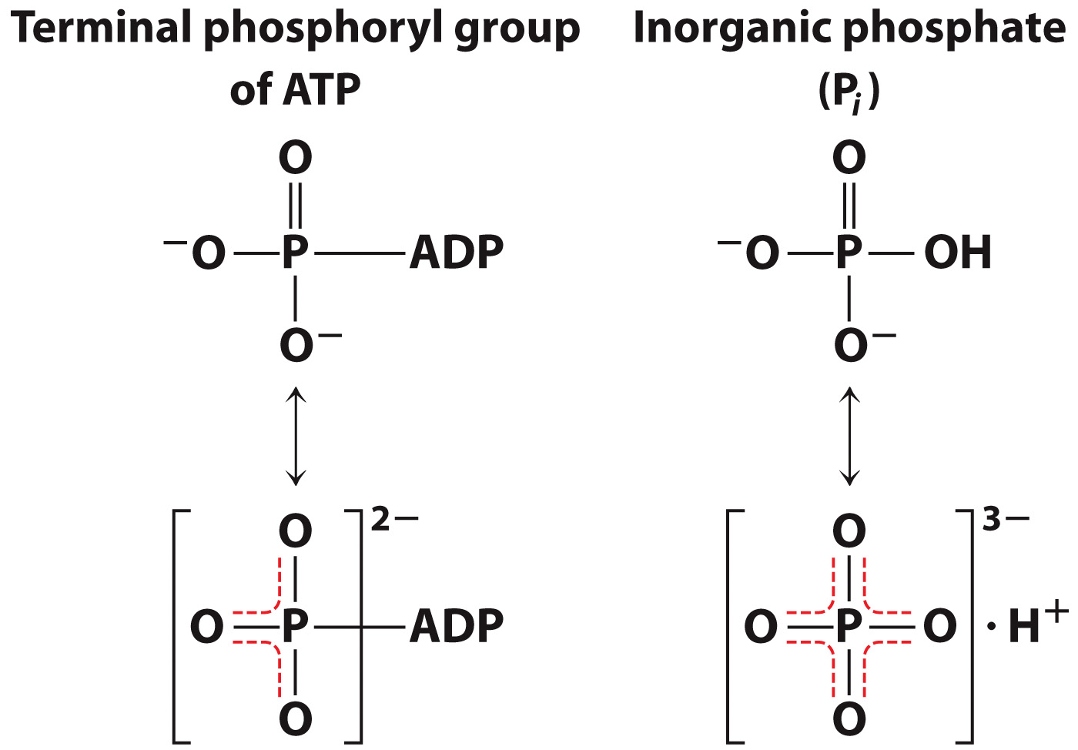
Why does ATP hydrolysis release so much energy?

Slide 42
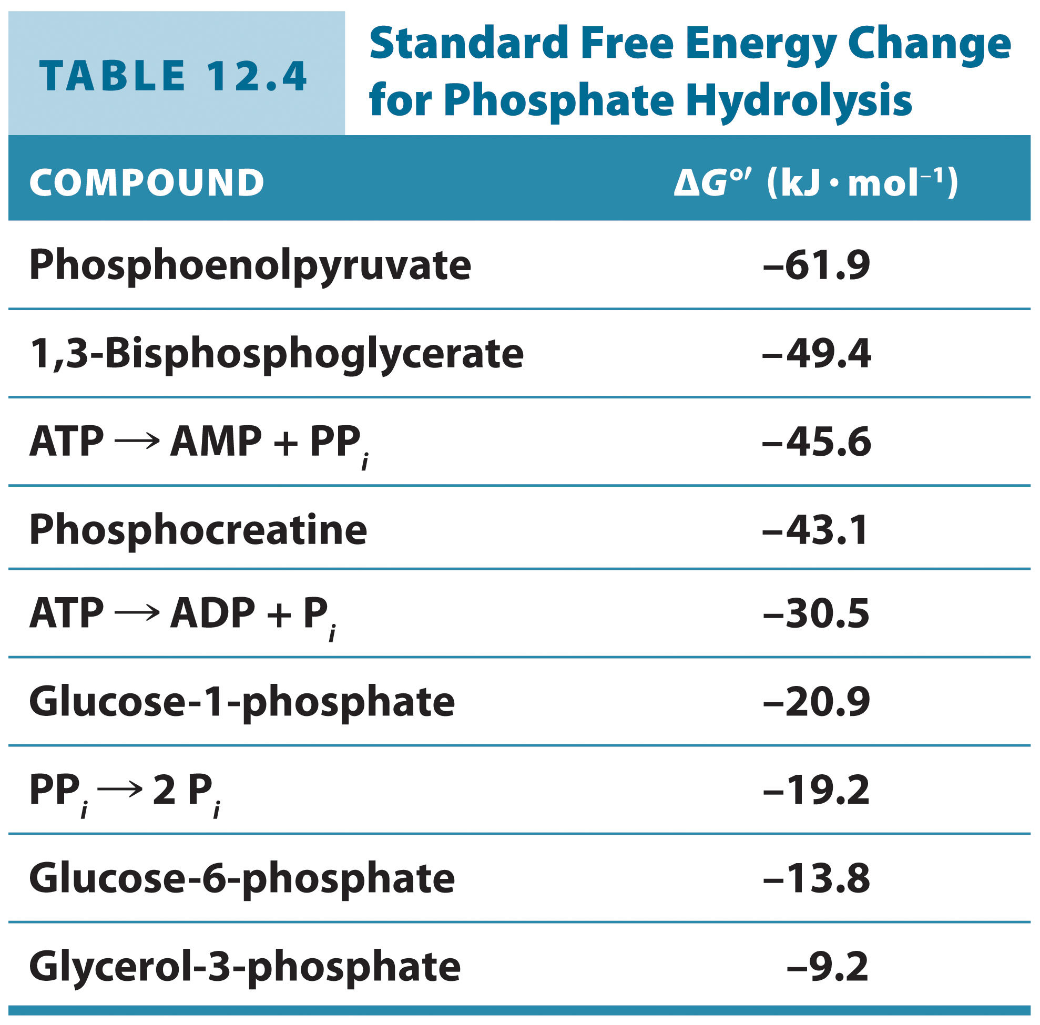
Several different molecules can serve as energy currency within a cell

Slide 43
Thioester hydrolysis also releases a large amount of free energy

Slide 44
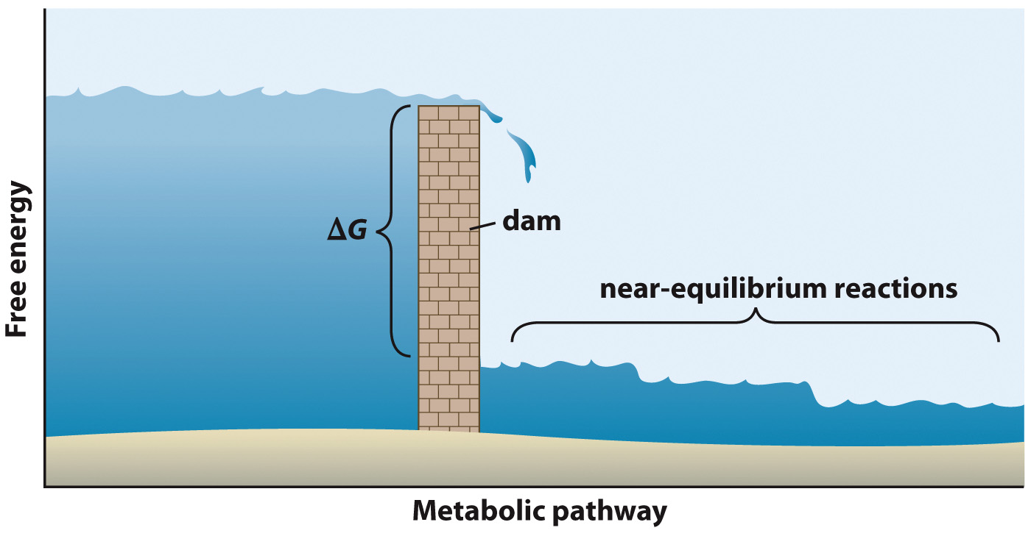
Regulation occurs at steps with the largest free energy changes

