Slide 1
Essential Biochemistry
Fourth Edition
Charlotte W. Pratt | Kathleen Cornely
Lecture Notes for
Chapter 11
Carbohydrates

Slide 2
Monosaccharides
Section 11.1
Learning Objective
Recognize monosaccharides and their derivatives

Slide 3
Monosaccharides made from aldehydes form aldoses

Slide 4
Monosaccharides made from ketones form ketoses

Slide 5
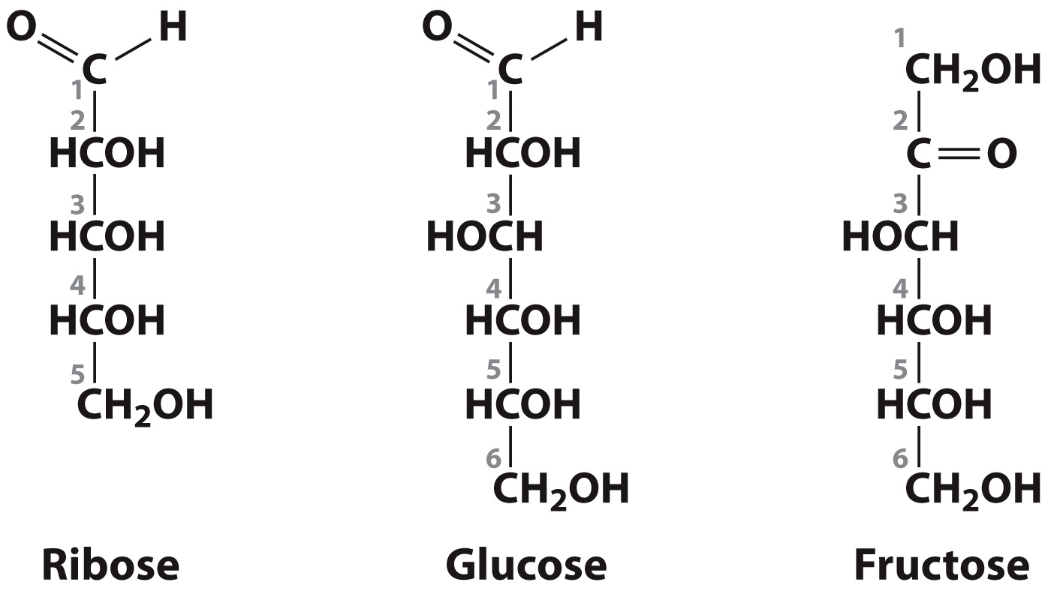
Some Common Monosaccharides

Slide 6
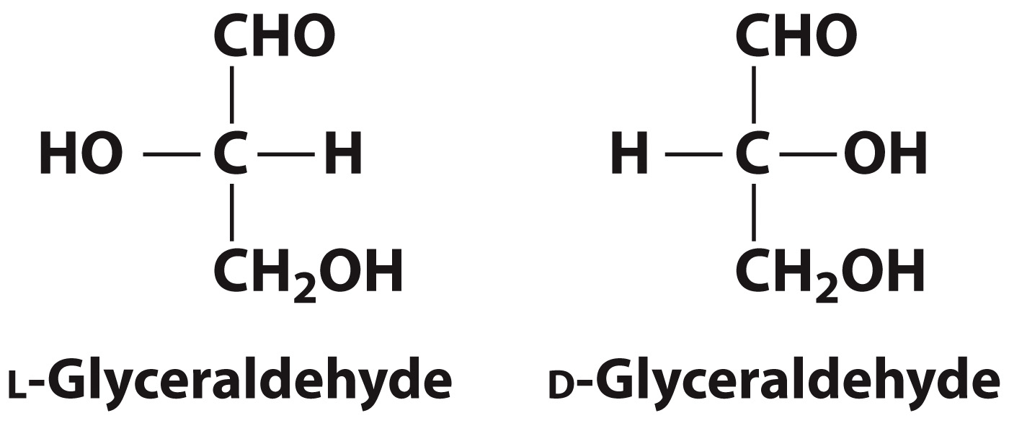
Most carbohydrates are chiral

Slide 7
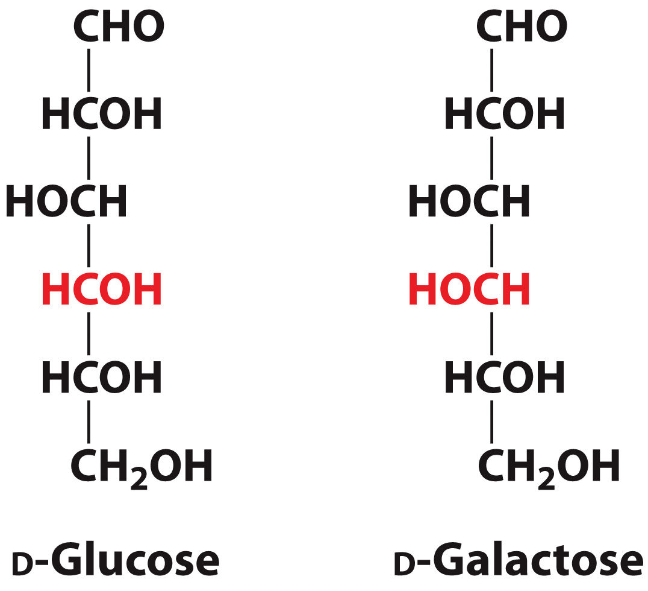
Epimers differ only by the configuration around one carbon atom

Slide 8
Cyclization generates α and β anomers

Slide 9
Monosaccharides can be derivatized in many different ways

Slide 10
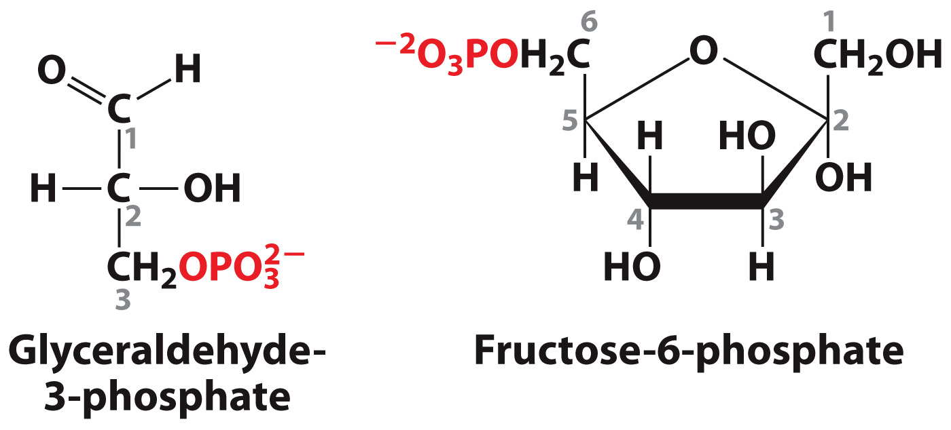
Some Phosphorylated Monosaccharides

Slide 11
Nucleic Acid Monosaccharides

Slide 12
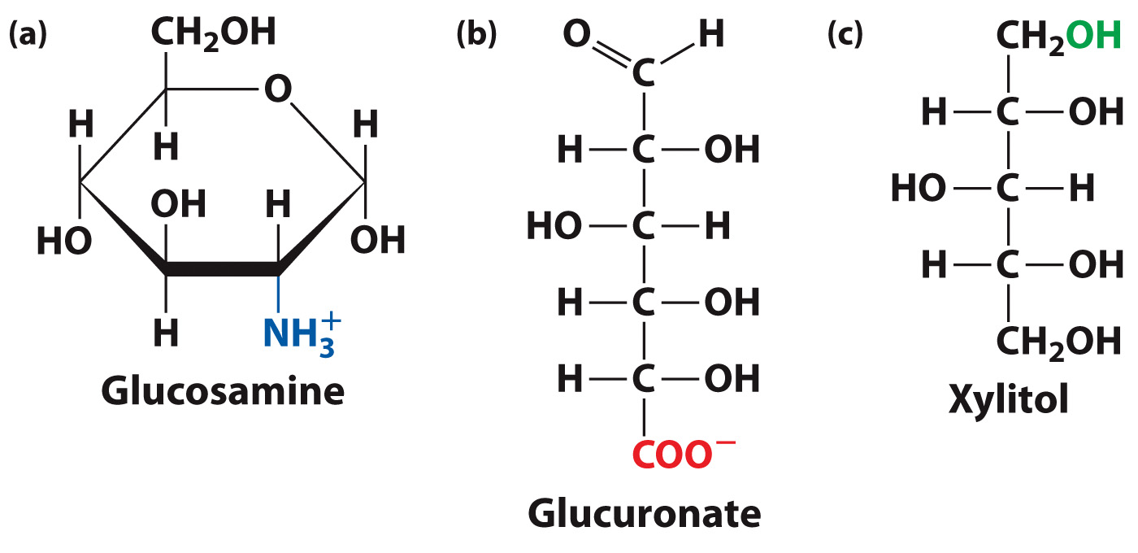
Monosaccharides Derivatives

Slide 13
Polysaccharides
Section 11.2
Learning Objective
Relate the structures of polysaccharides to their biological functions

Slide 14
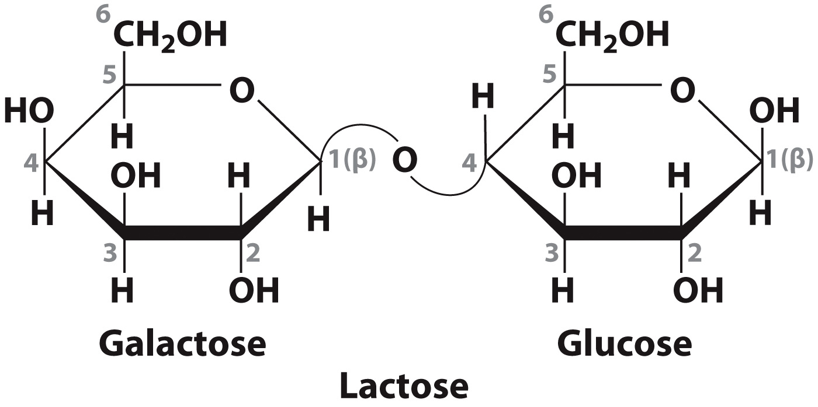
Lactose Structure

Slide 15
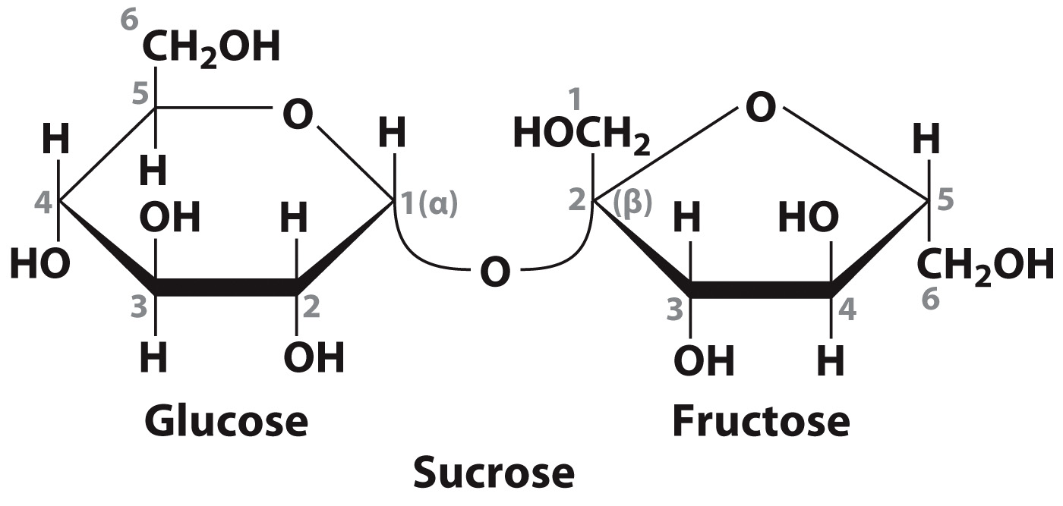
Sucrose Structure

Slide 16
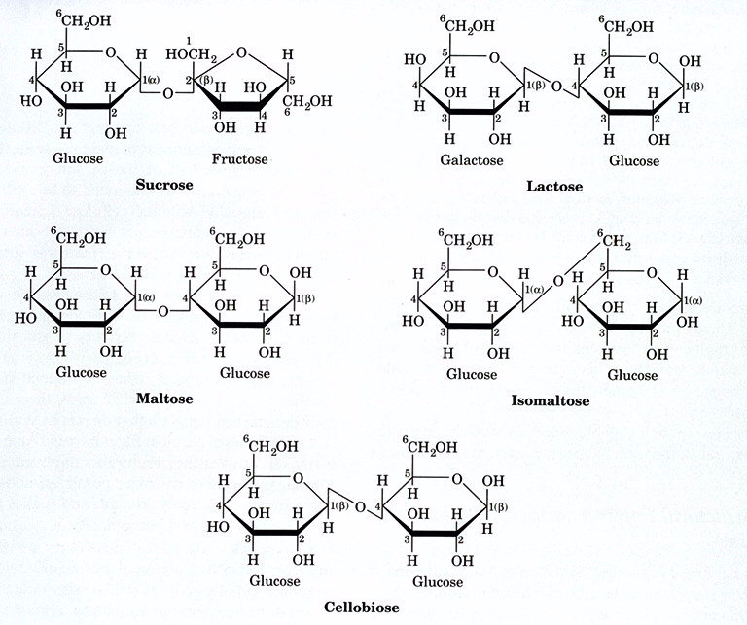

Slide 17
Sugar | Relative Sweetness
Lactose | 0.16
Galactose | 0.32
Maltose | 0.33
Sucrose | 1.00
Fructose | 1.73
High Fructose Corn Syrup | 1.2-1.6
Aspartame | 180
Saccharin | 450
sucralose | 600

Slide 18
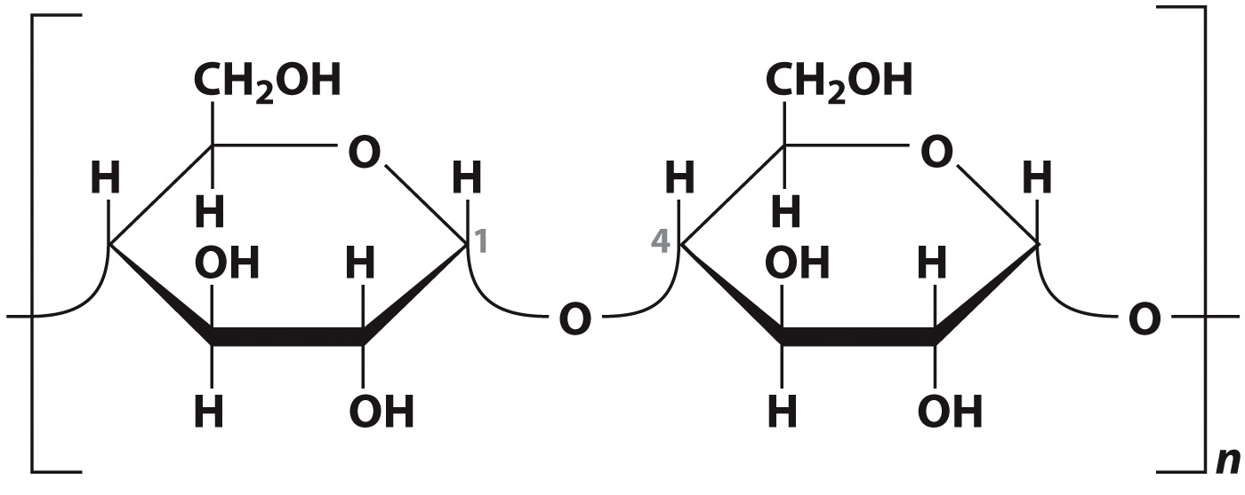
Starch and glycogen are storage forms of glucose

Slide 19
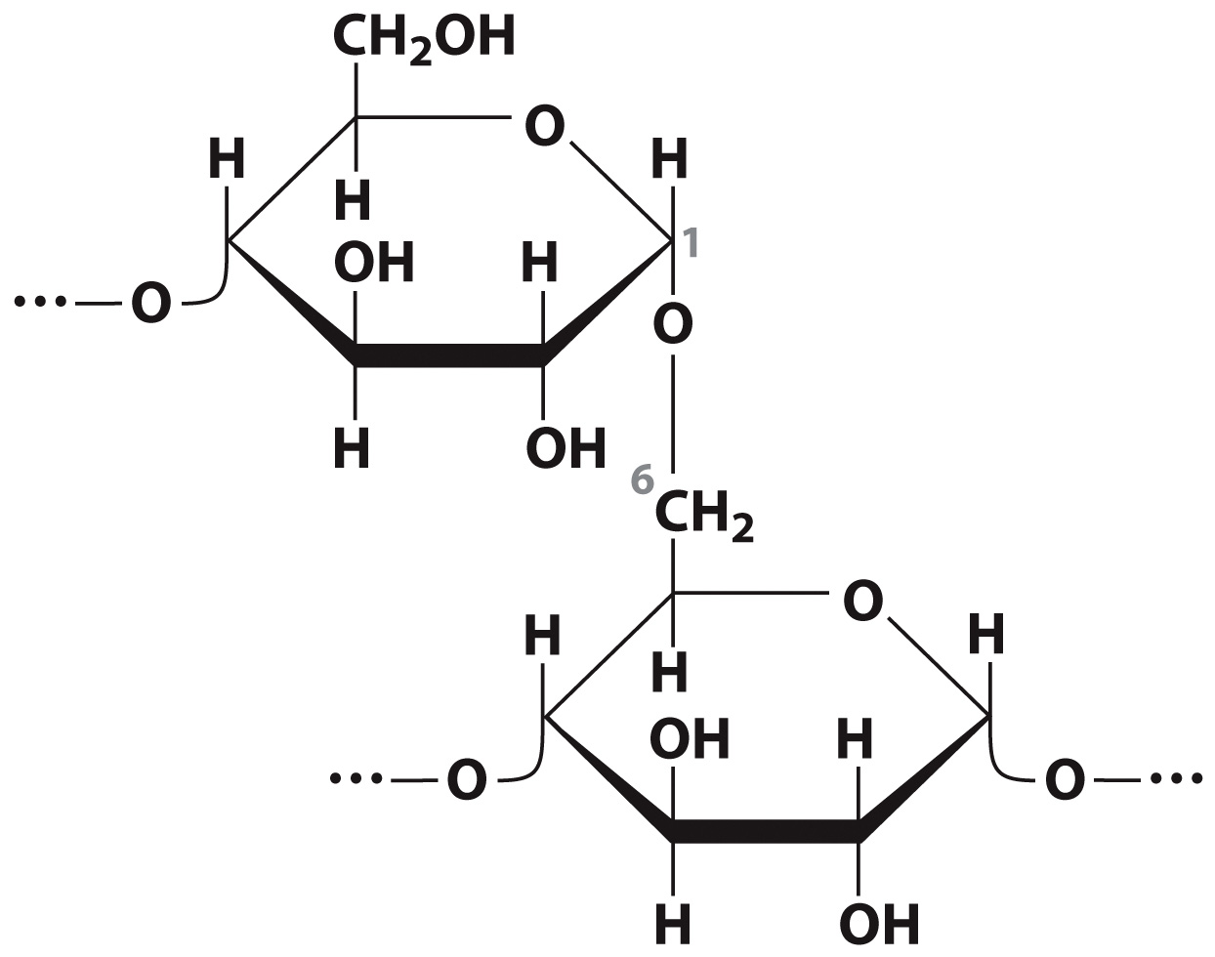
Branching of Starch in Plants Amylopectin Structure

Slide 20
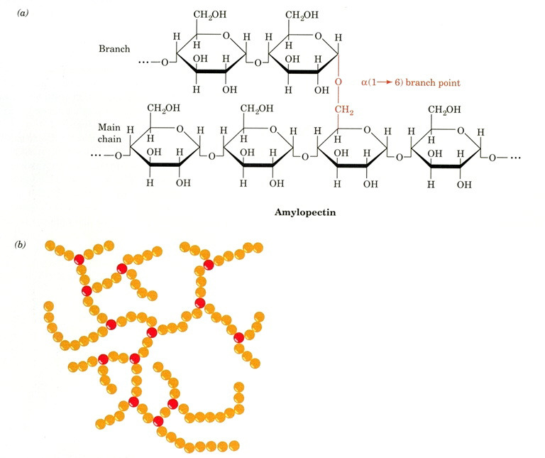

Slide 21
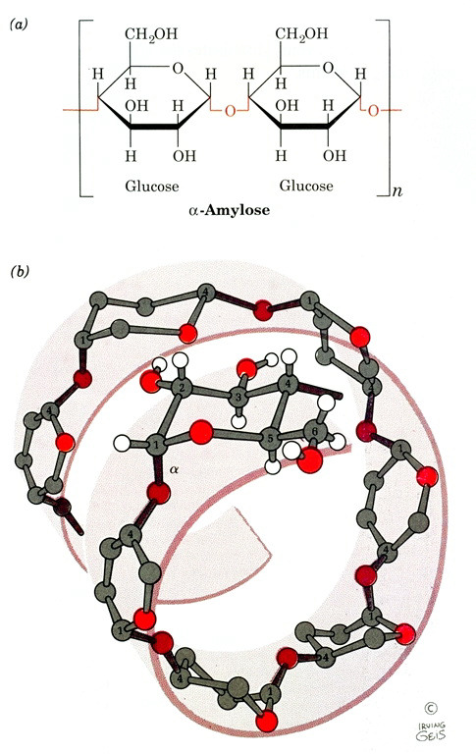

Slide 22
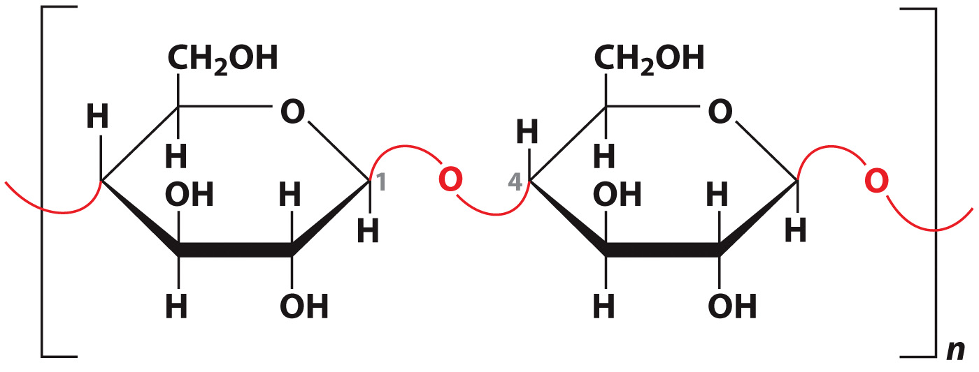
Cellulose is composed of glucose in β(1→4) linkages

Slide 23
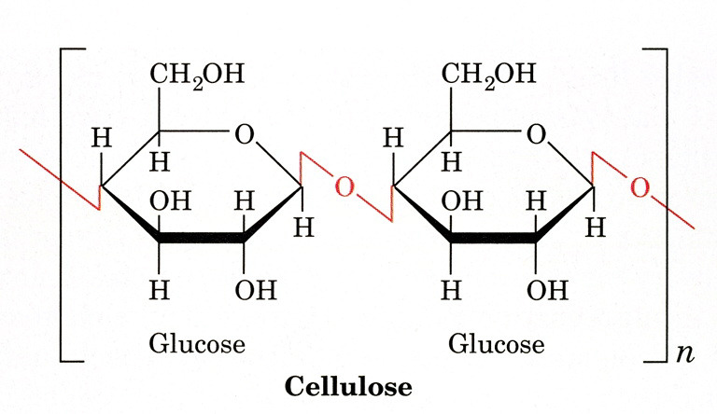
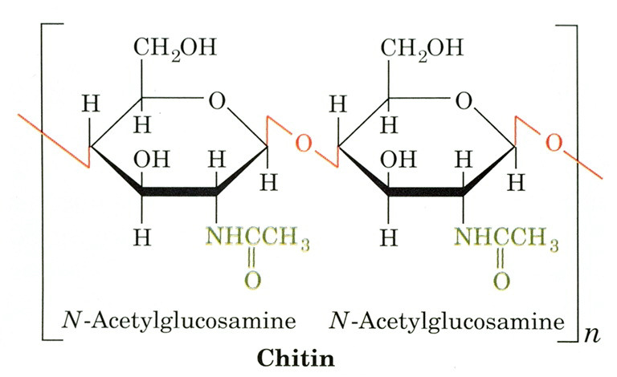

Slide 24
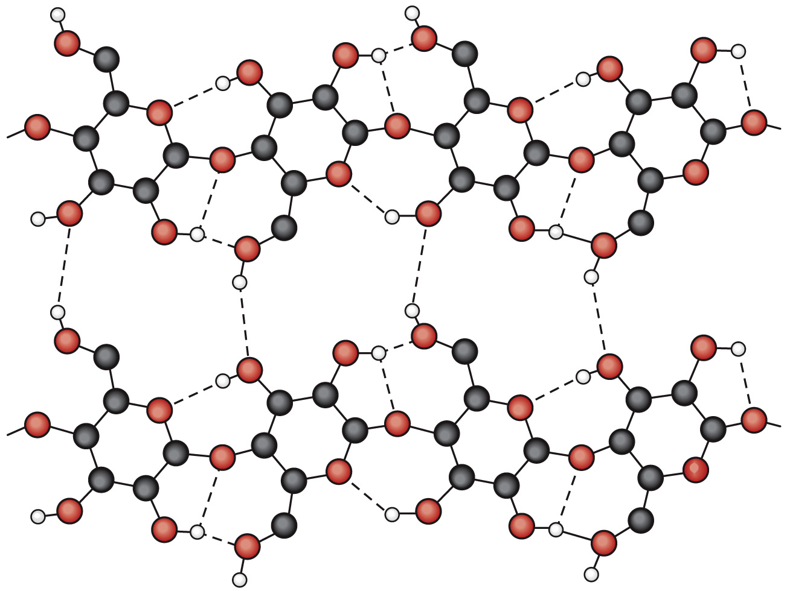
Cellulose Structure

Slide 25
Glycoproteins
Section 11.3
Learning Objective
Describe the structures and functions of glycoproteins

Slide 26
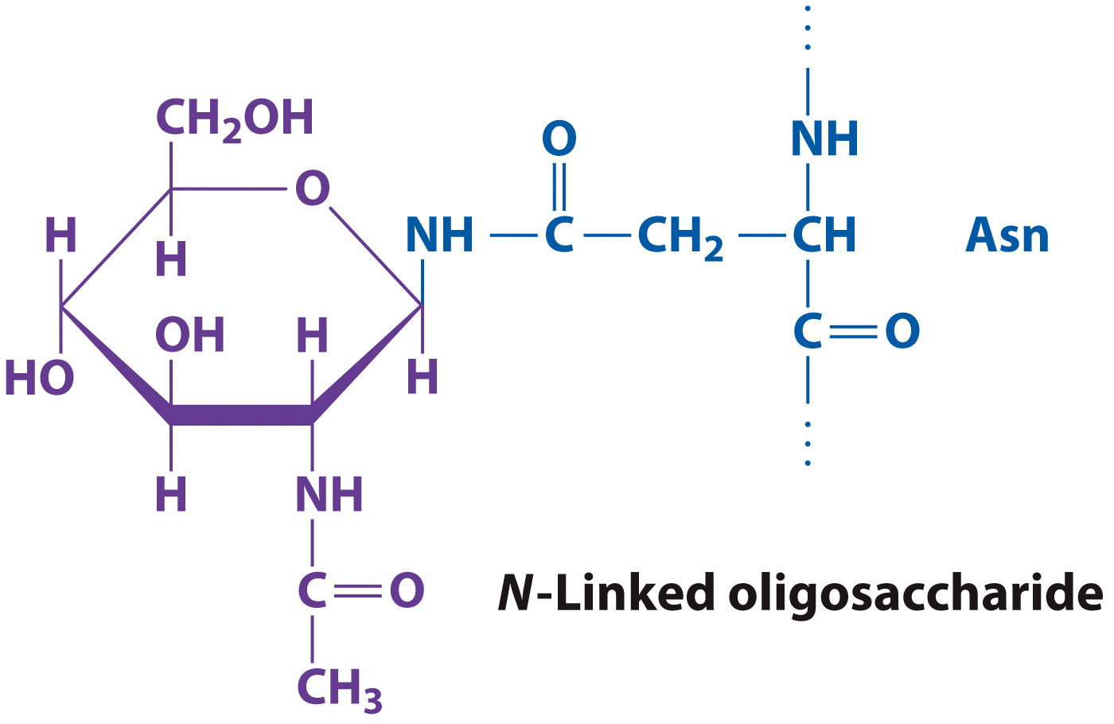
Glycoproteins are N-linked via Asn

Slide 27
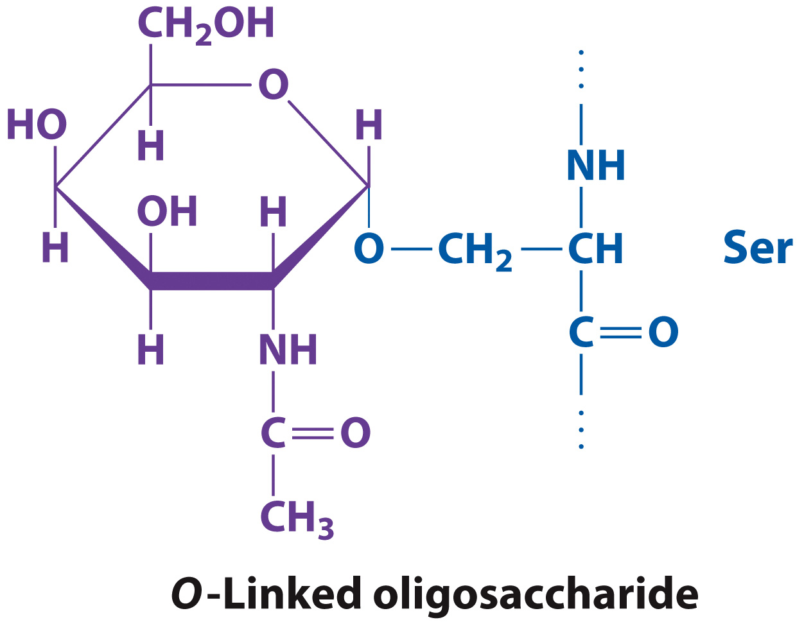
Glycoproteins are O-linked via Ser or Thr

Slide 28
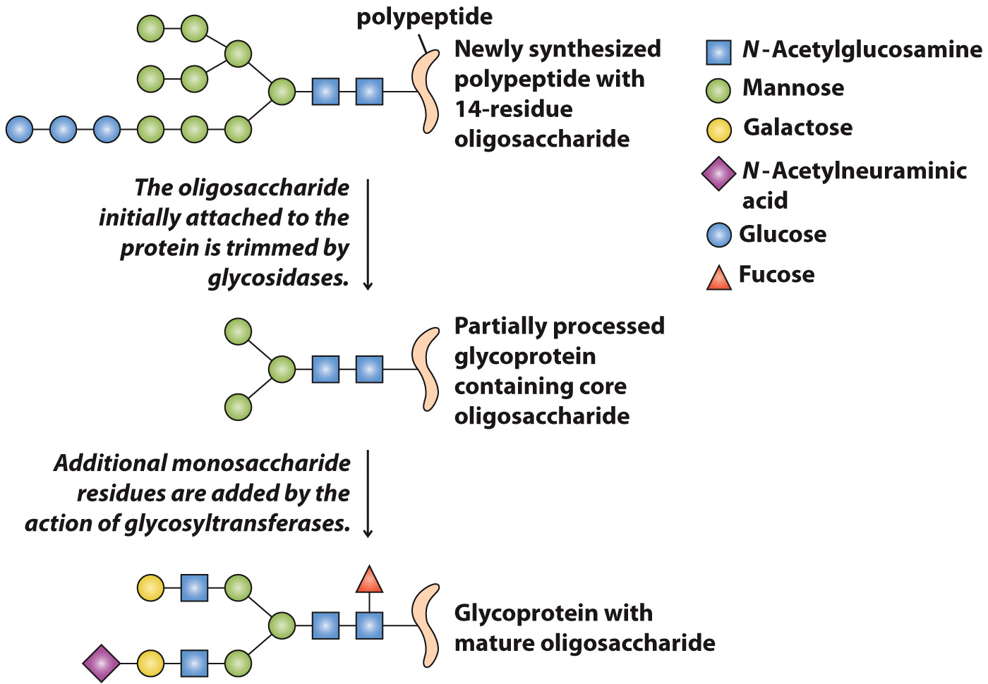
Glycosylation occurs during protein synthesis

Slide 29
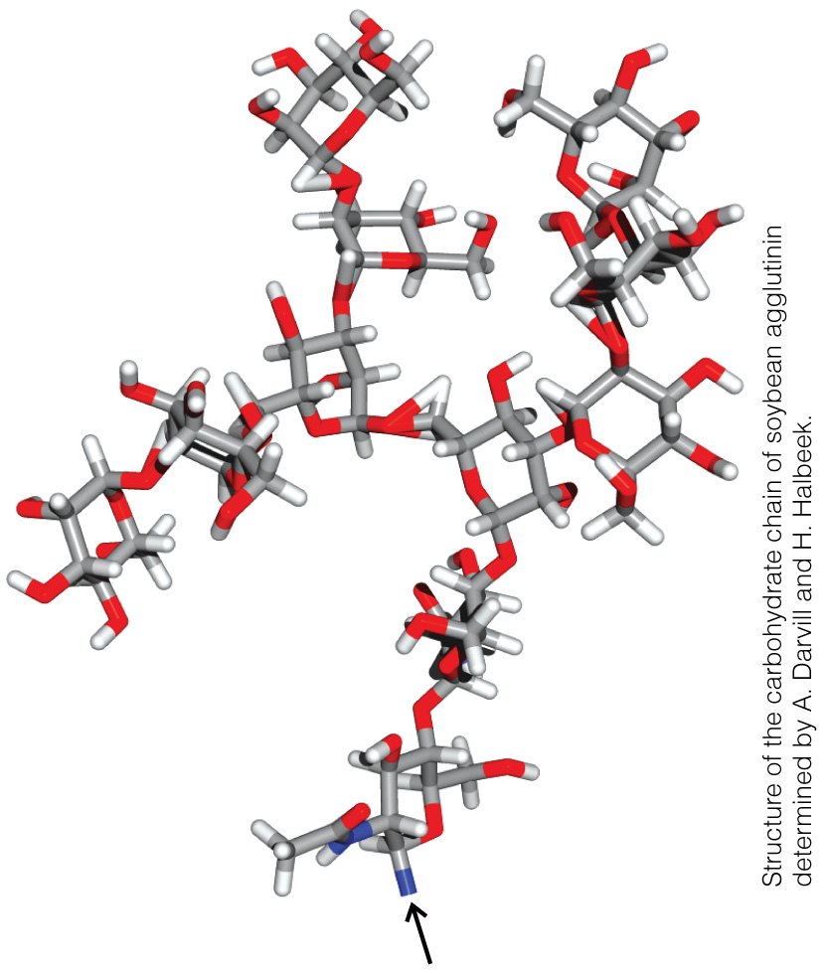
Structure of an N-linked Oligosaccharide

Slide 30
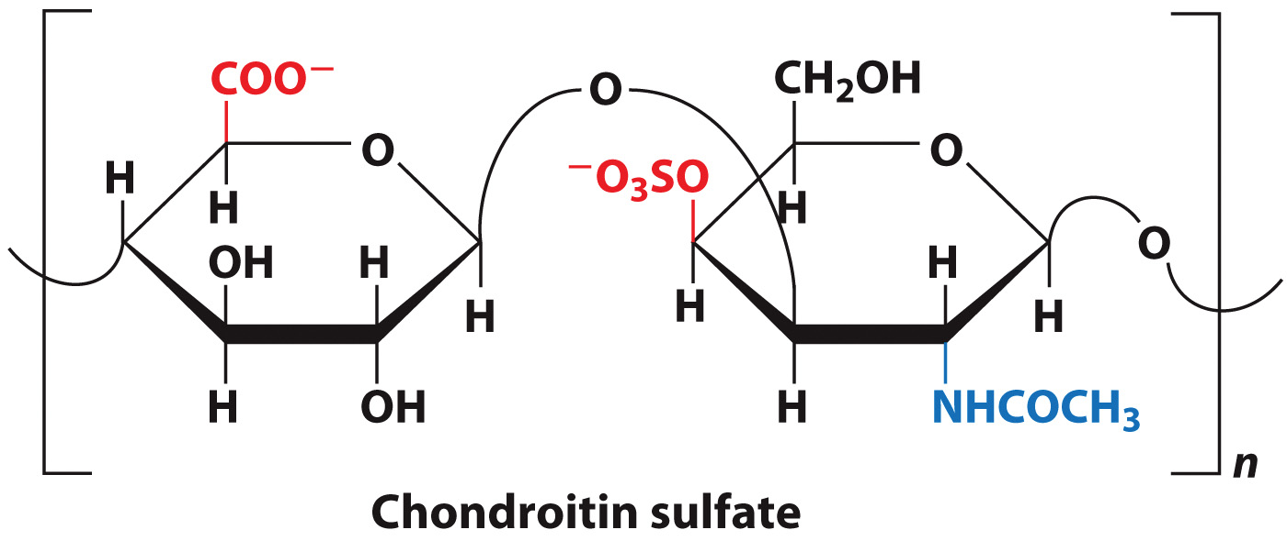
Proteoglycans contain repeating units of chondroitin sulfate

Slide 31
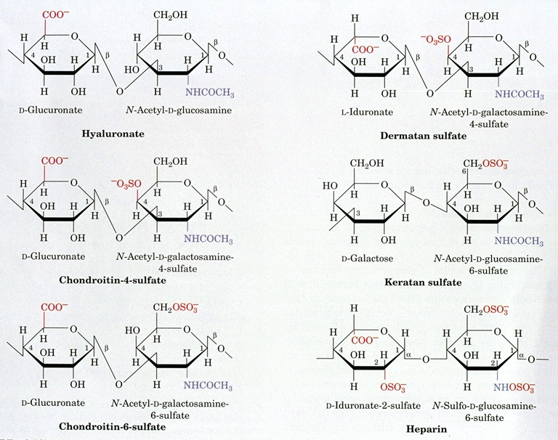

Slide 32
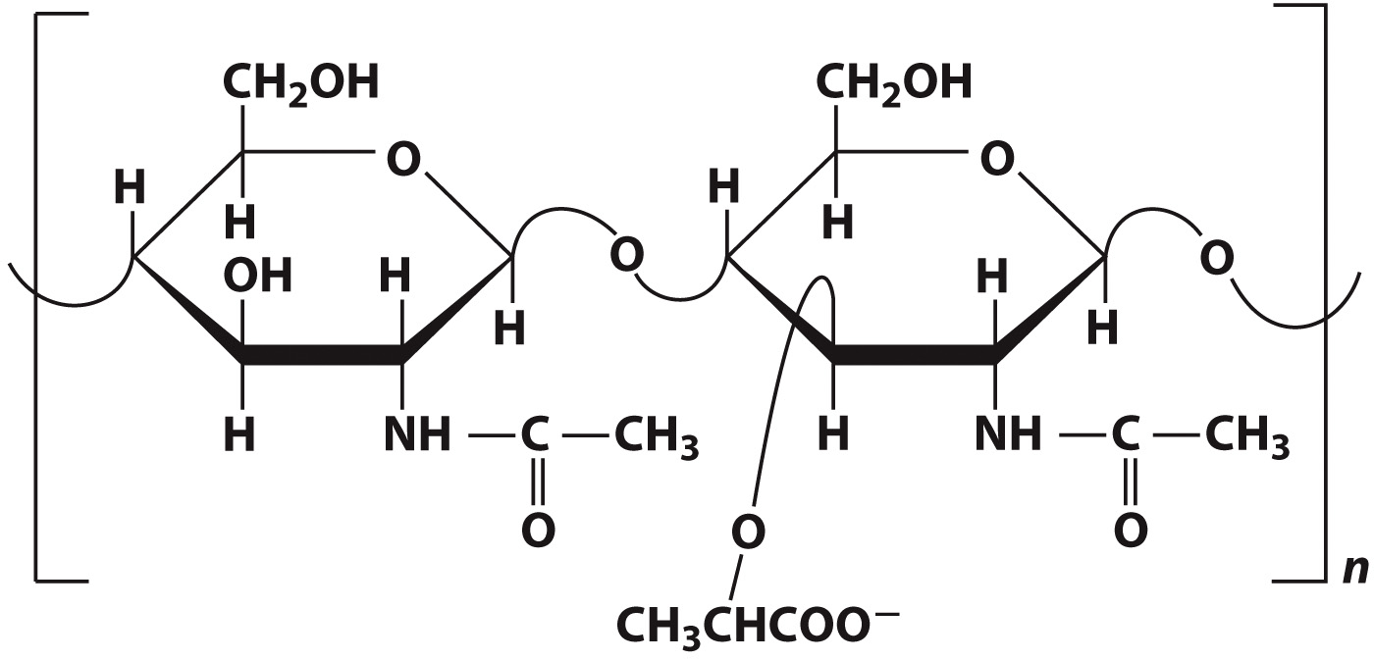
Bacterial walls are made of peptidoglycan

Slide 33
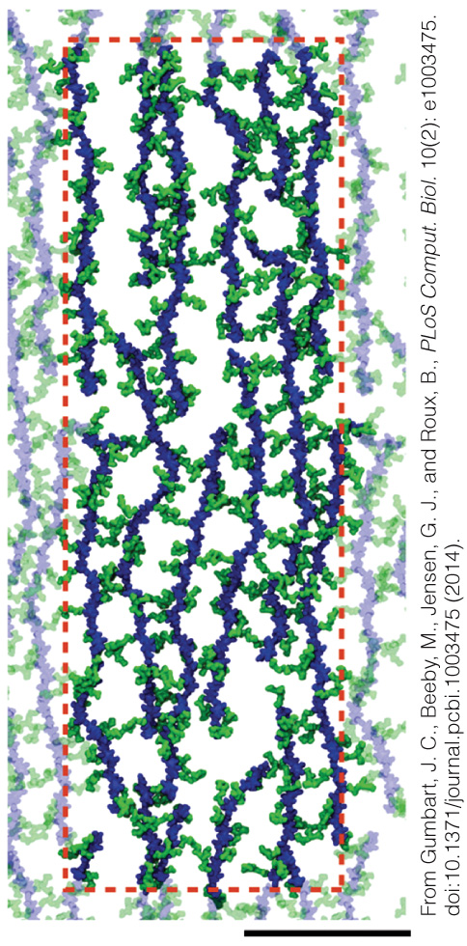
Model of E. coli Peptidoglycan

Slide 34
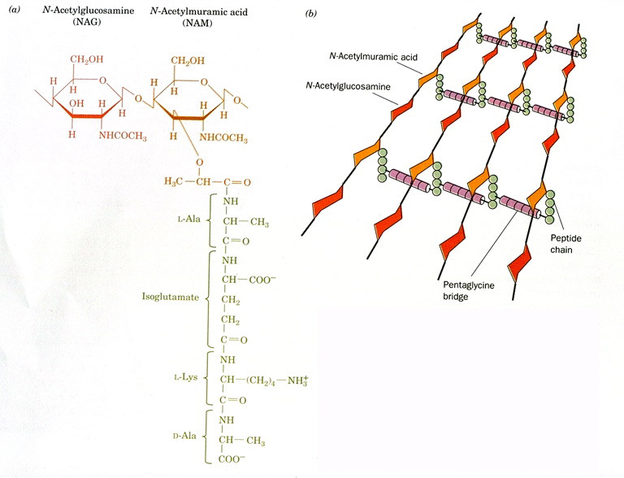

Slide 35
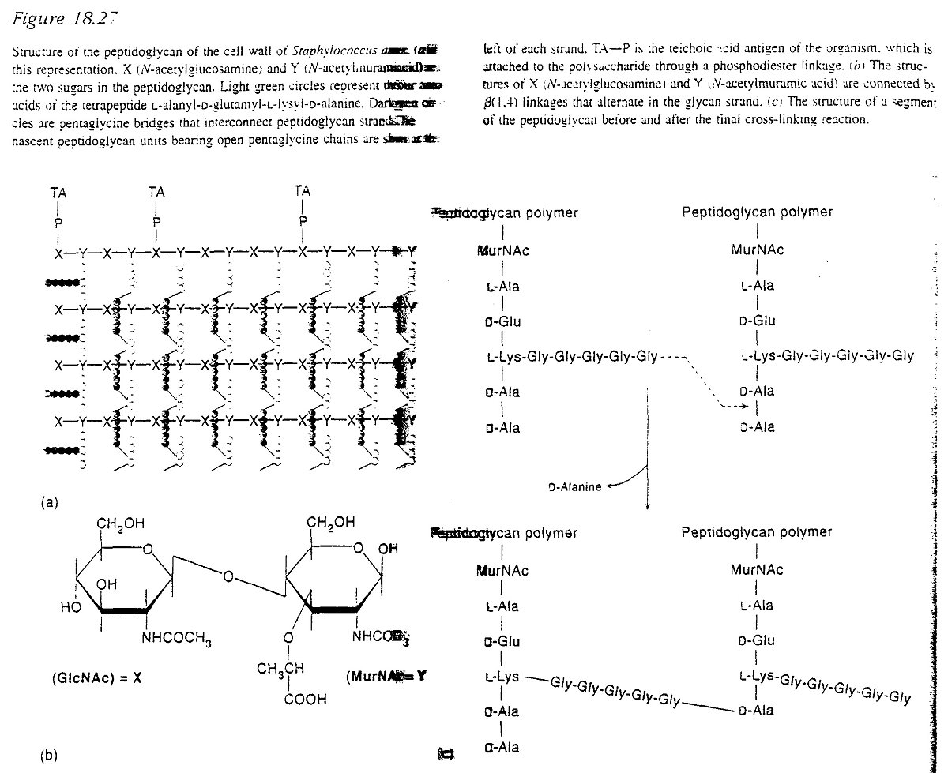

Slide 36
