Slide 1
Essential Biochemistry
Fourth Edition
Charlotte W. Pratt | Kathleen Cornely
Lecture Notes for
Chapter 9
Membrane Transport

Slide 2
The Thermodynamics of Membrane Transport
Section 9.1
Learning Objective
Explain how ion movements affect membrane potential

Slide 3
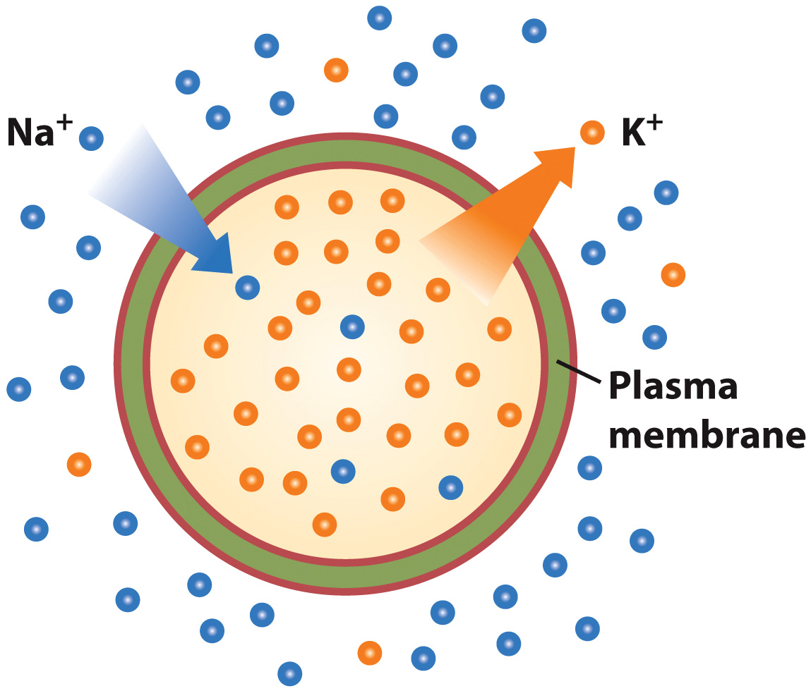
Na⁺ and K⁺ concentrations are inversely proportional in cells

Slide 4
Passive Transport
Section 9.2
Learning Objective
Describe the operation of passive transport systems

Slide 6
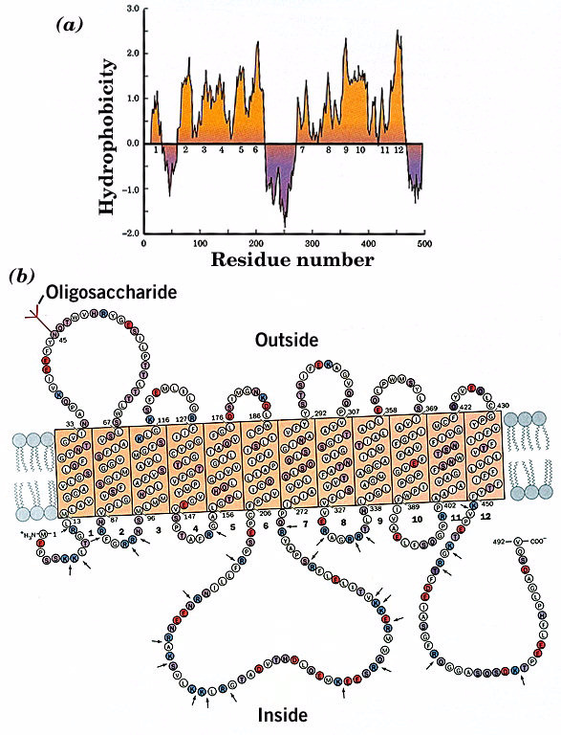

Slide 7
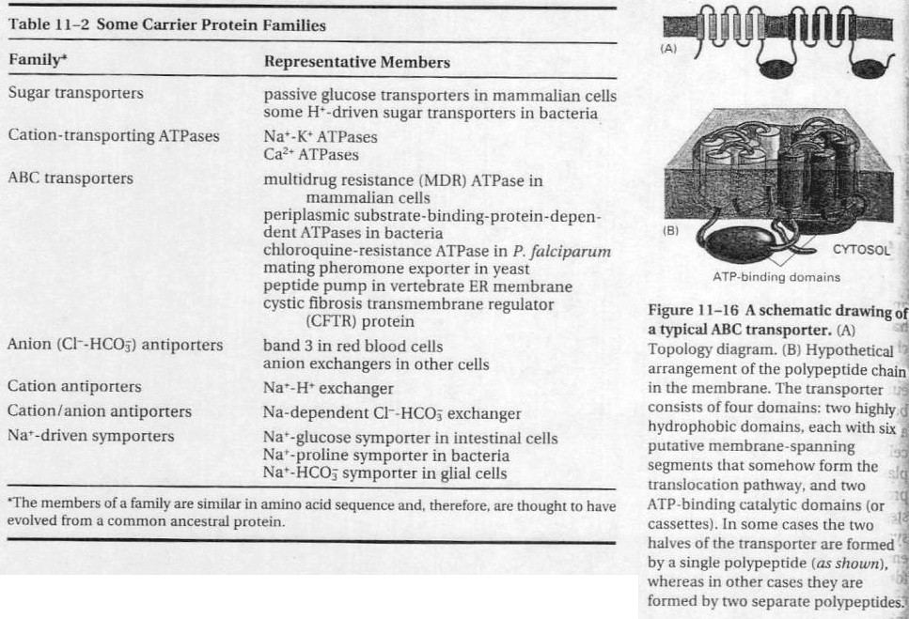

Slide 8
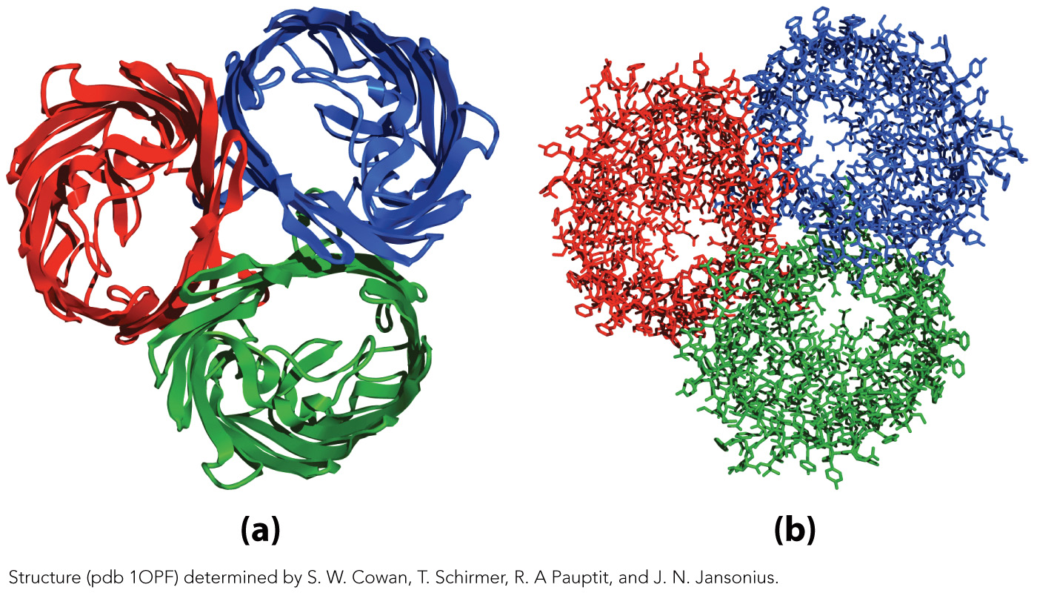
The E. coli OmpF Porin
Ribbon Model
Stick Model

Slide 9
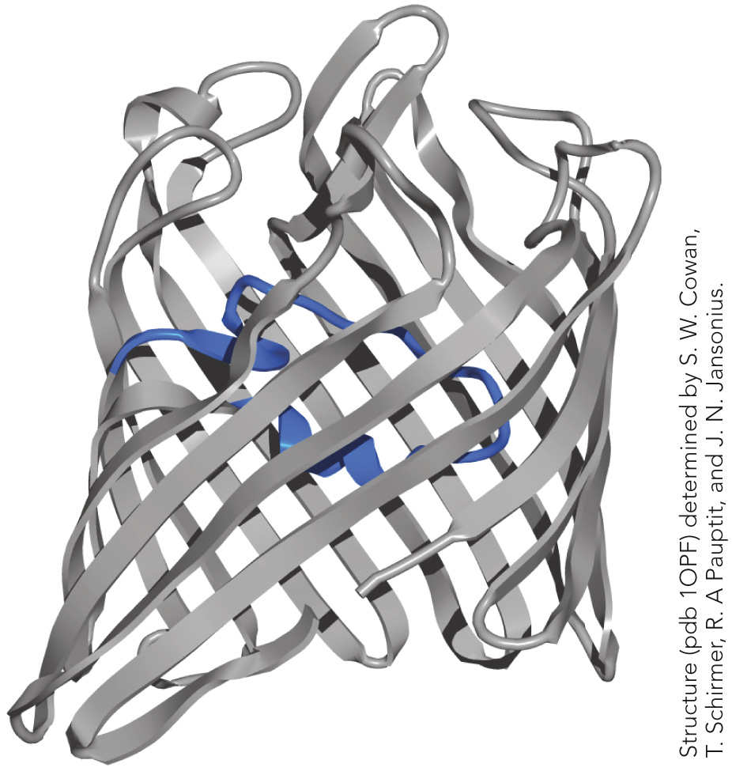
One loop makes the porin specific for small cationic solutes

Slide 10
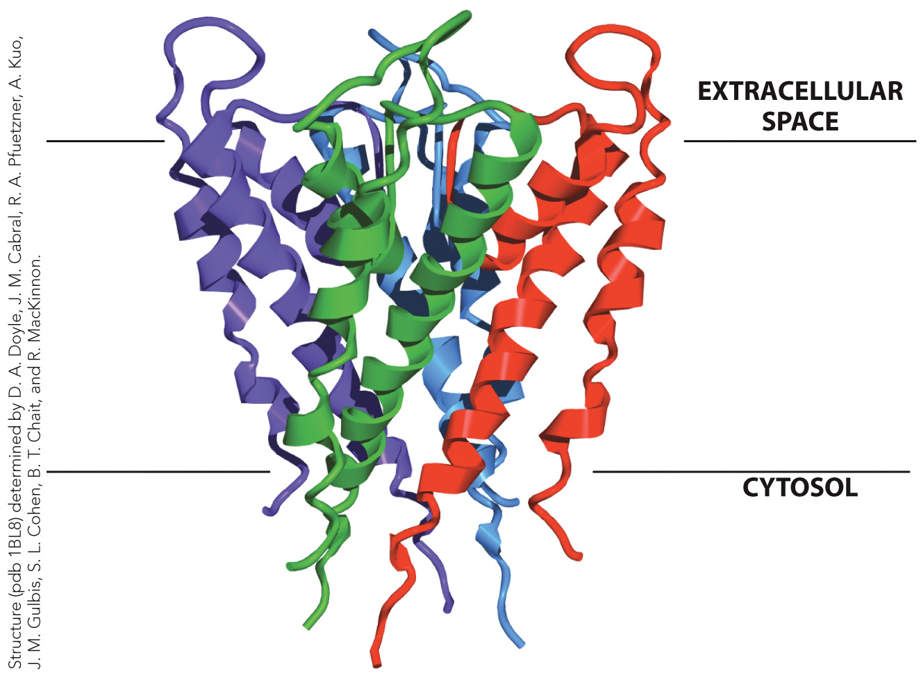
Structure of the K⁺ Channel from S. lividans

Slide 11
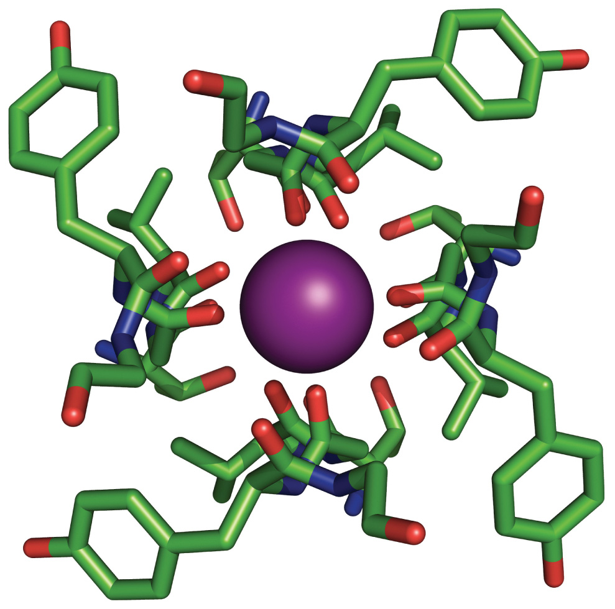
The K⁺ Channel Selectivity Filter

Slide 12
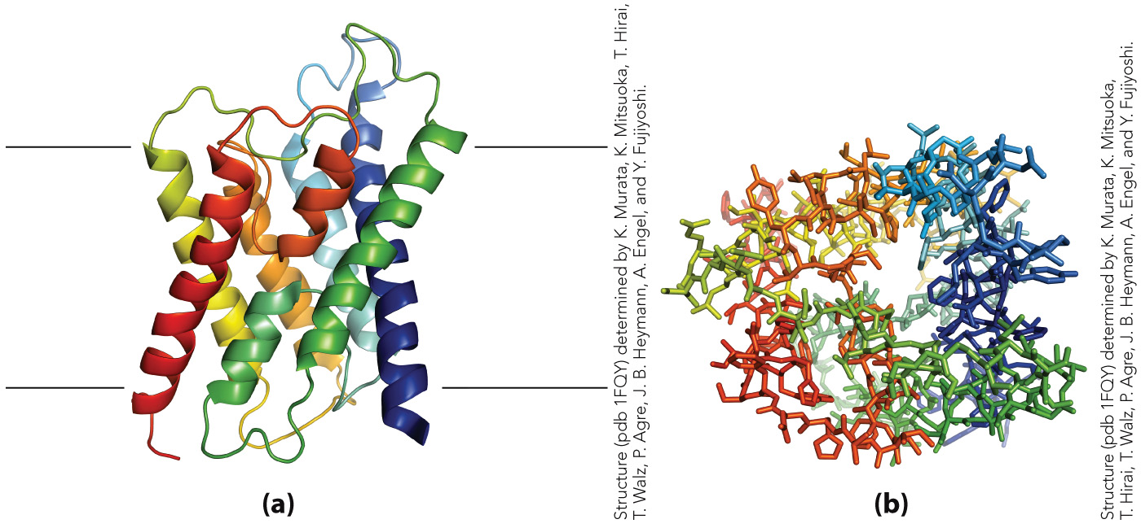
Structure of an Aquaporin Subunit

Slide 13
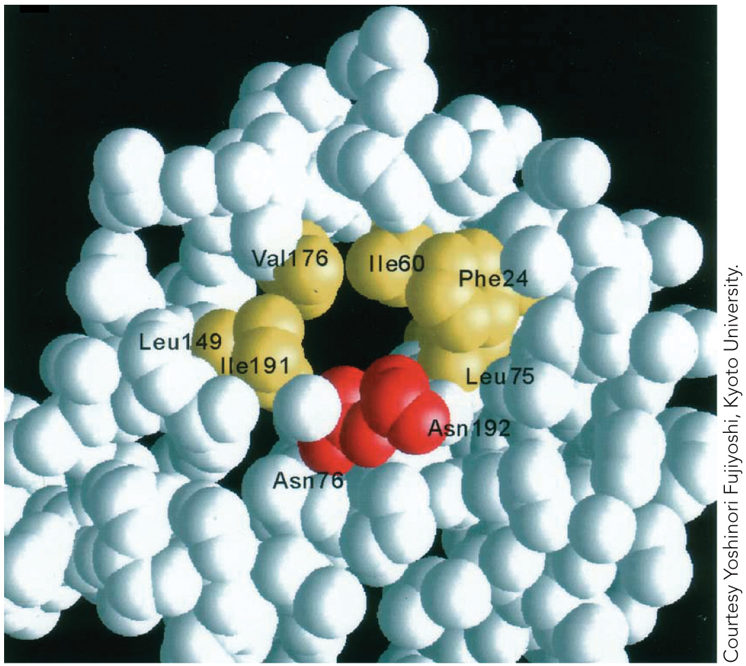
View of an Aquaporin Pore

Slide 14
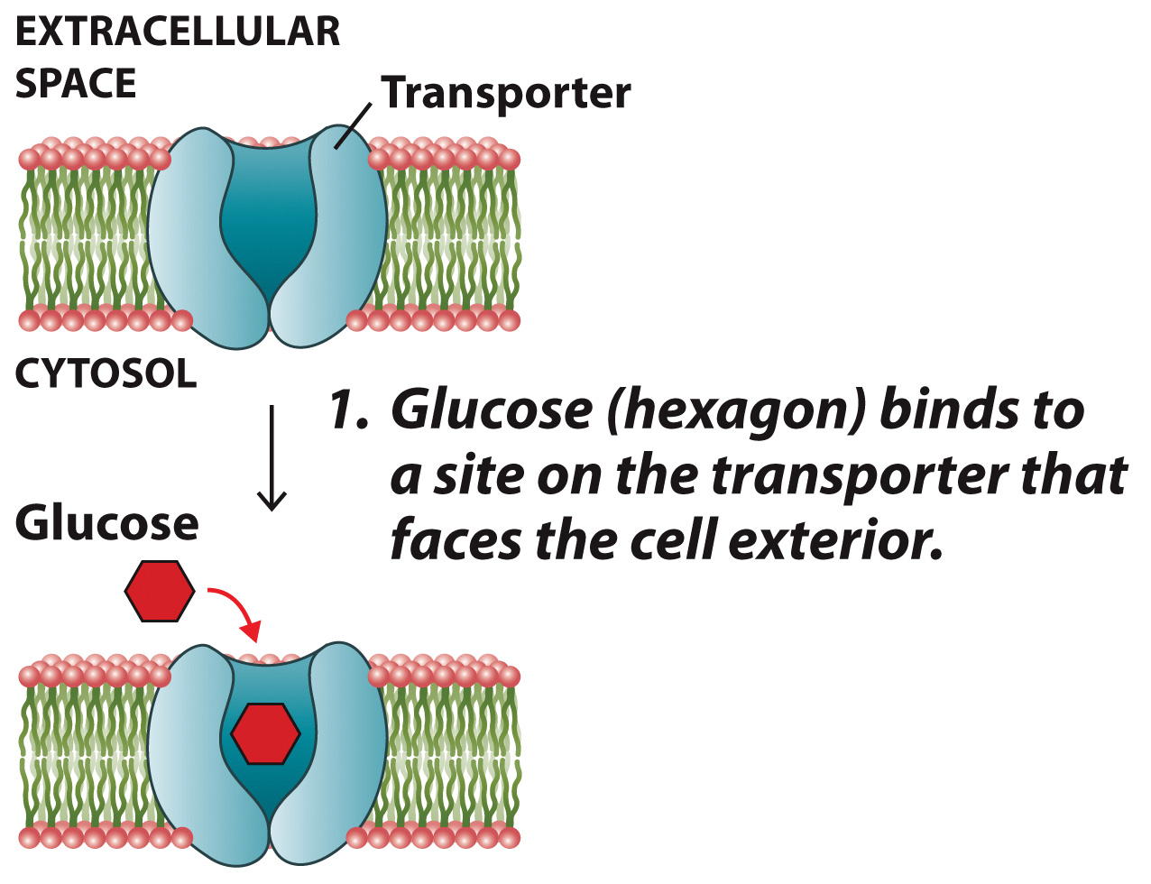
Operation of the Red Blood Cell Glucose Transporter

Slide 15
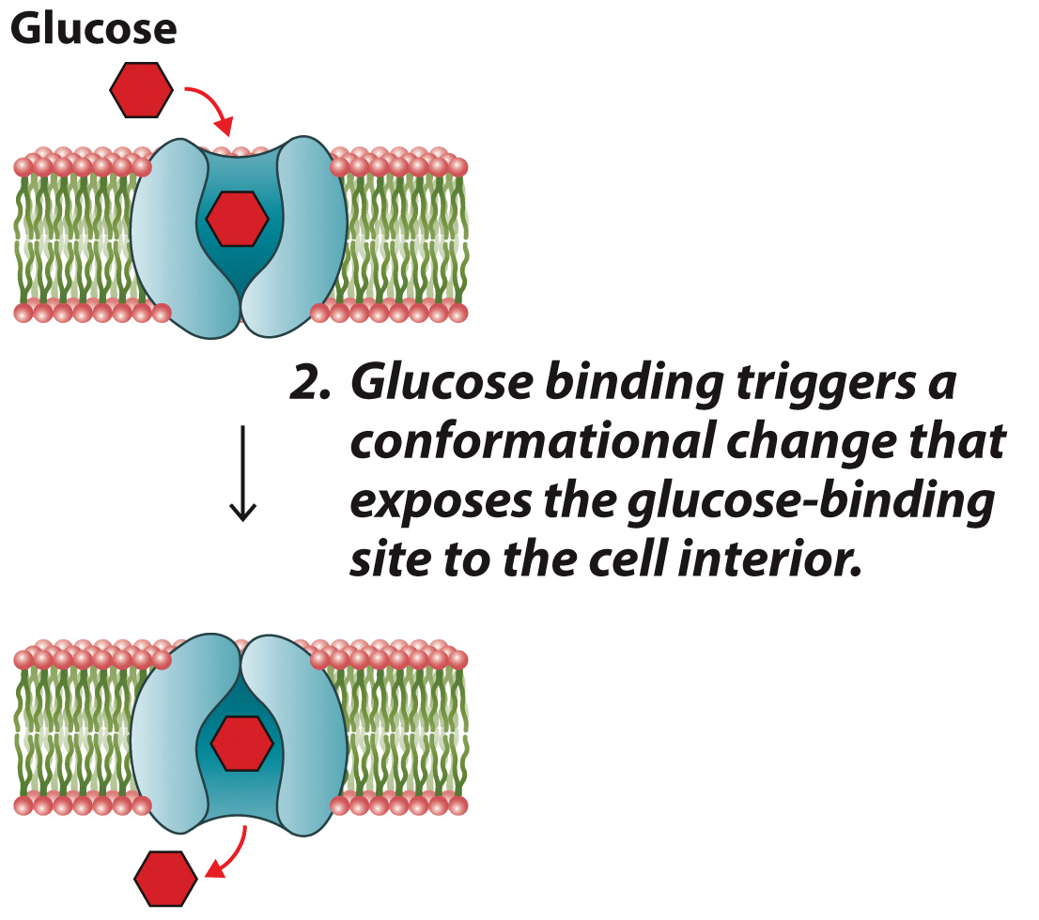
Operation of the Red Blood Cell Glucose Transporter

Slide 16
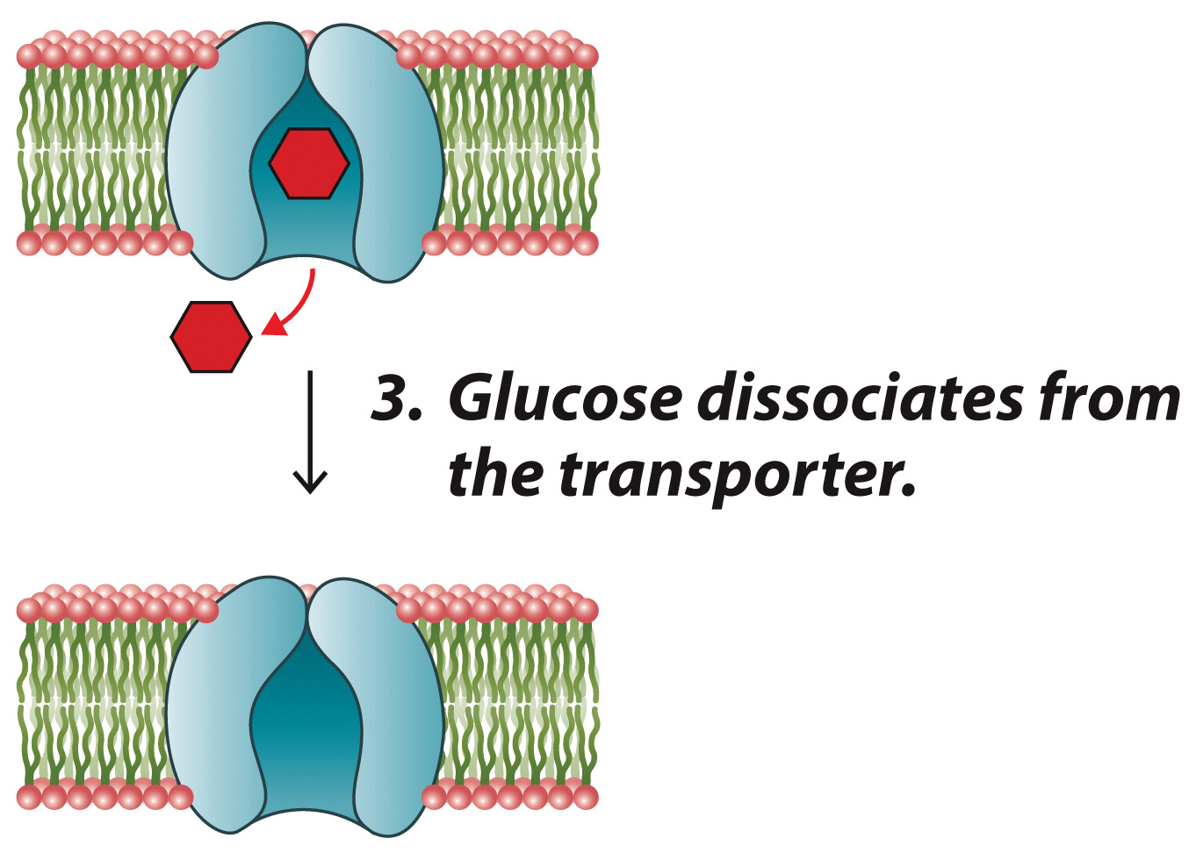
Operation of the Red Blood Cell Glucose Transporter

Slide 17
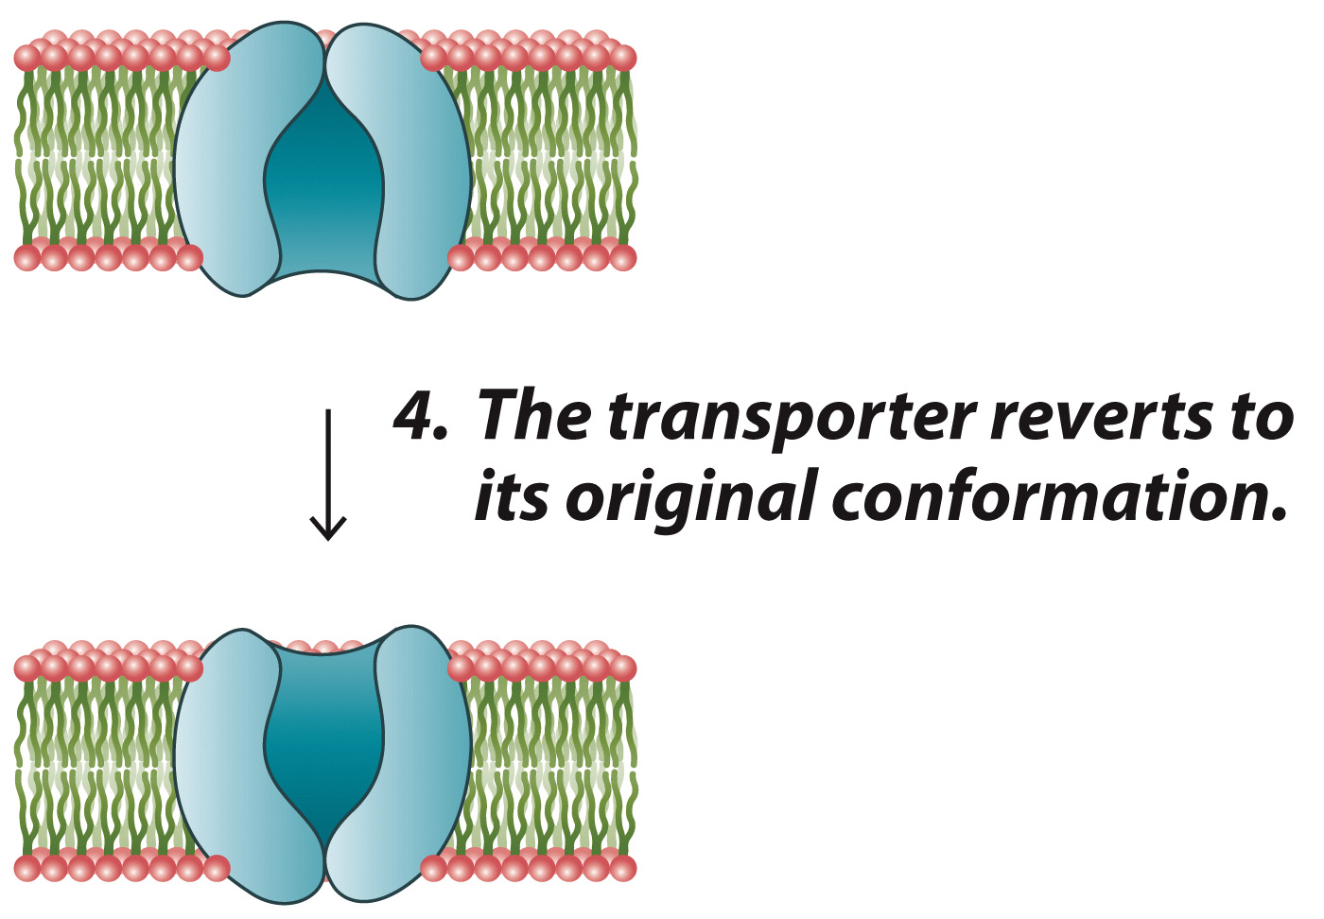
Operation of the Red Blood Cell Glucose Transporter

Slide 18
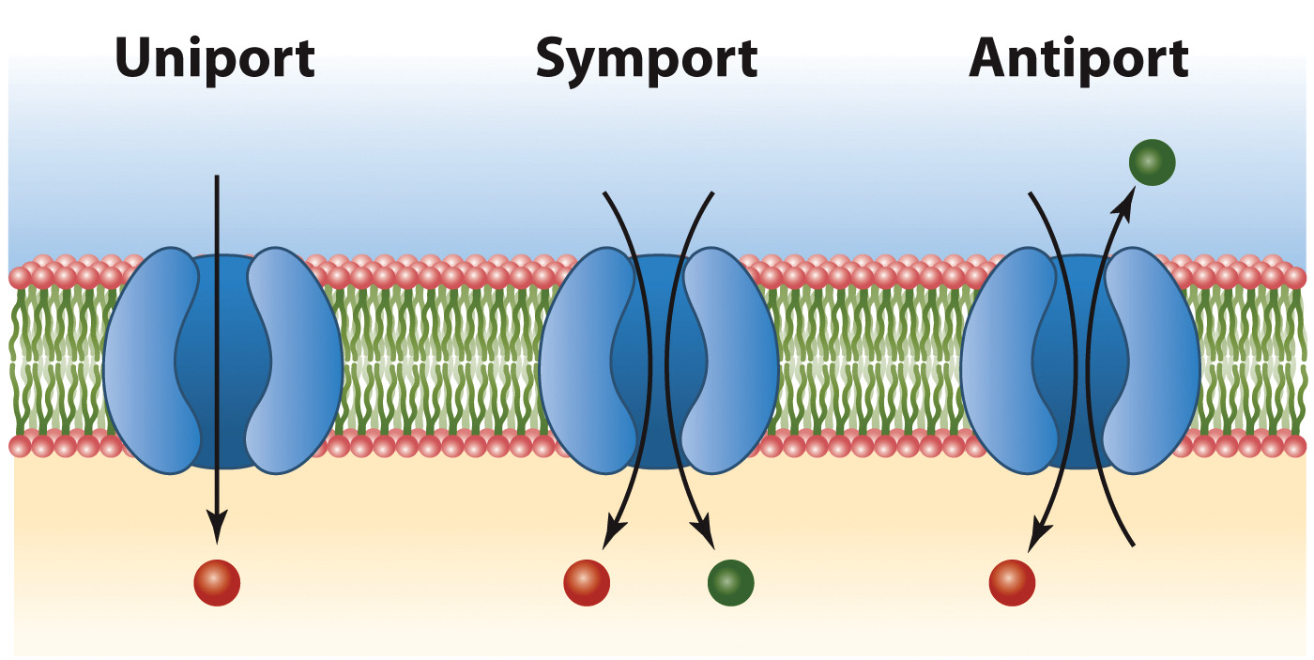
Some Types of Membrane Transport Systems

Slide 19
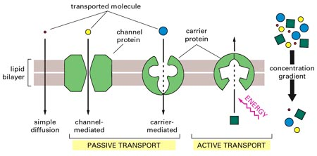

Slide 20
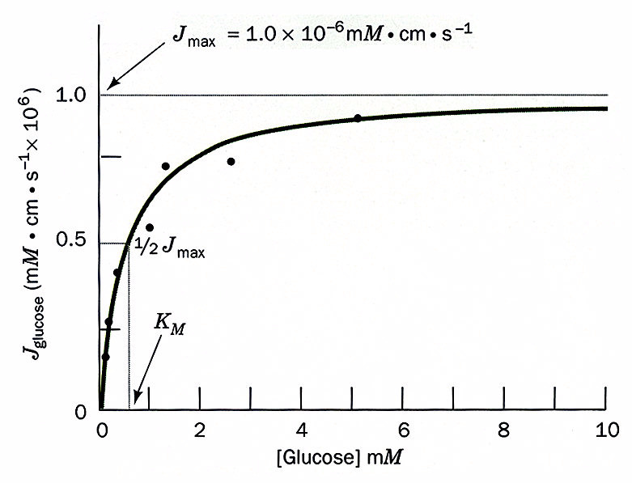

Slide 21
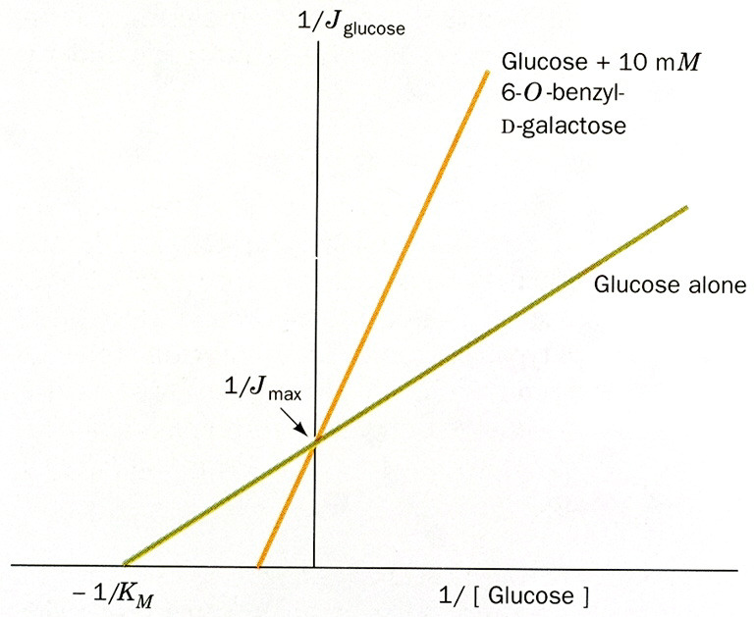

Slide 22
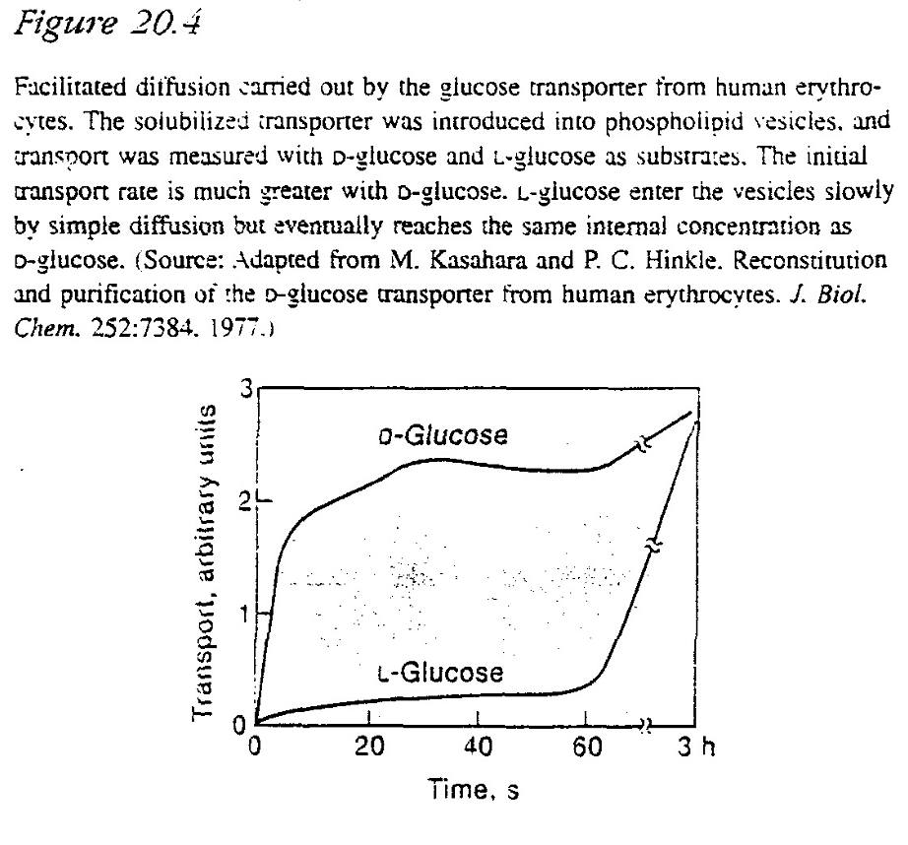

Slide 23
Active Transport
Section 9.3
Learning Objective
Describe the operation of active transport systems

Slide 24
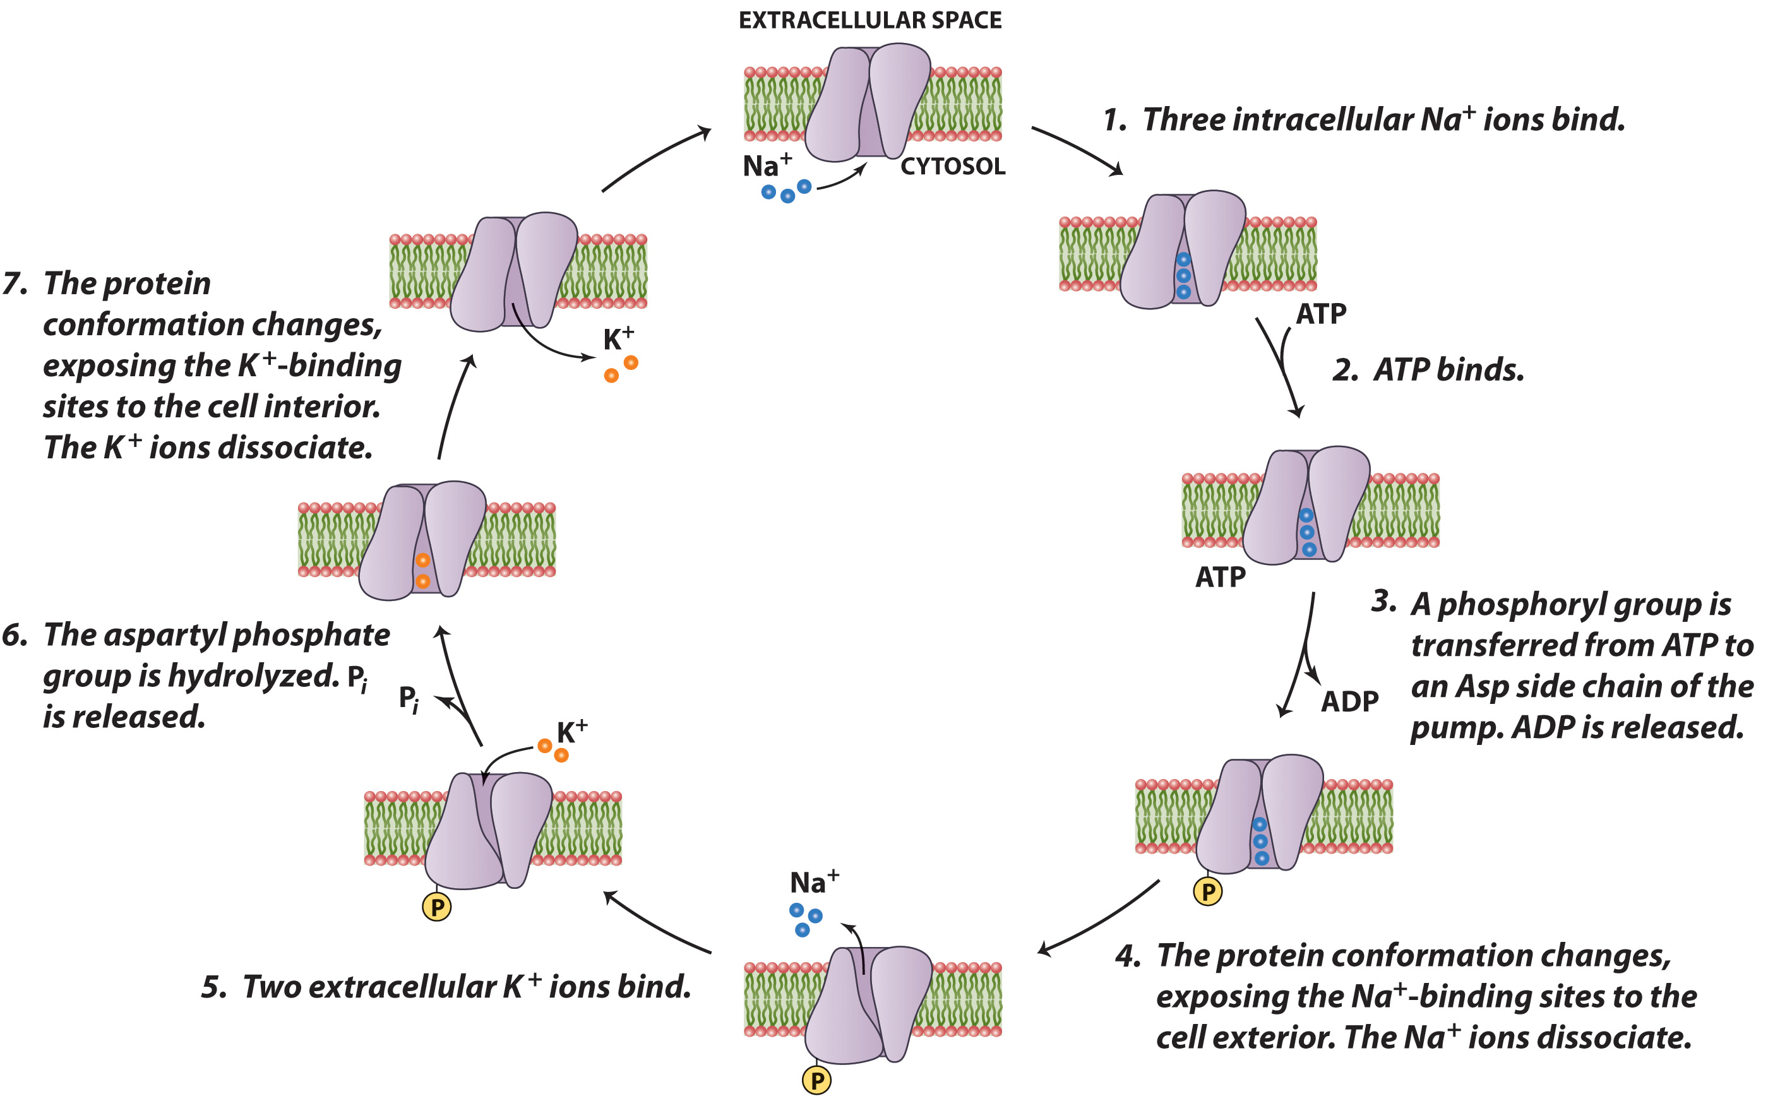
The Reaction Cycle of Na,K-ATPase

Slide 25
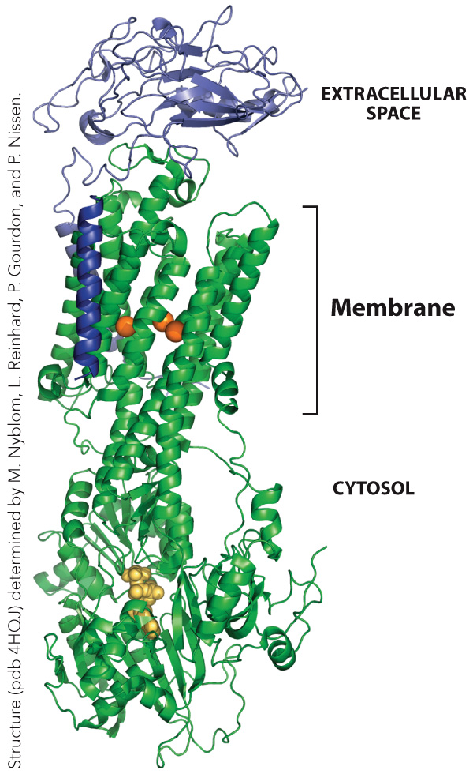
The Structure of the Na,K-ATPase

Slide 26
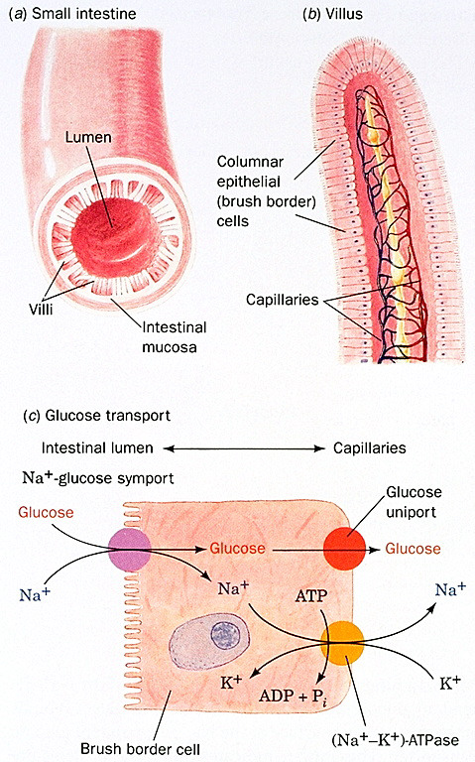

Slide 27
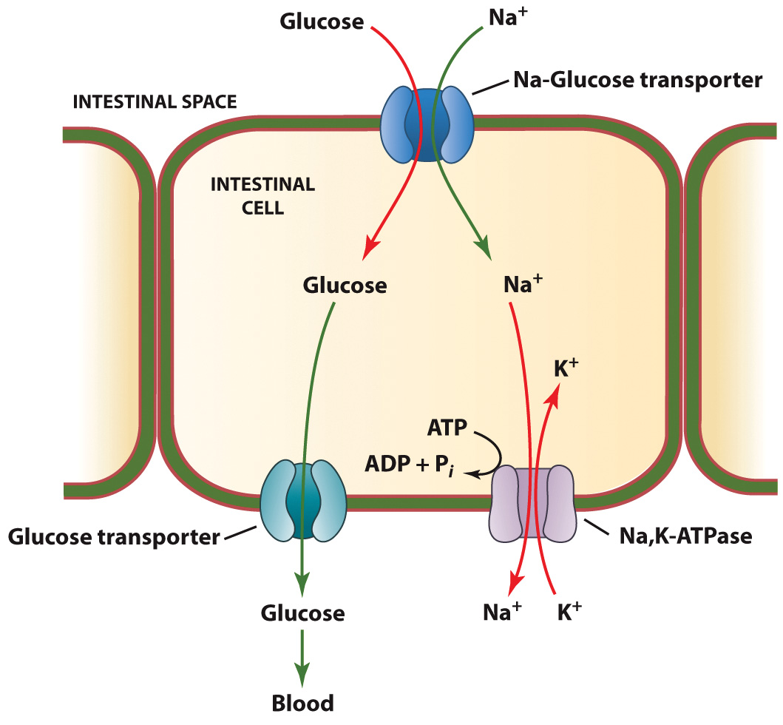
Glucose Transport into Intestinal Cells

Slide 28
Membrane Fusion
Section 9.4
Learning Objective
Describe the process of membrane fusion

Slide 29
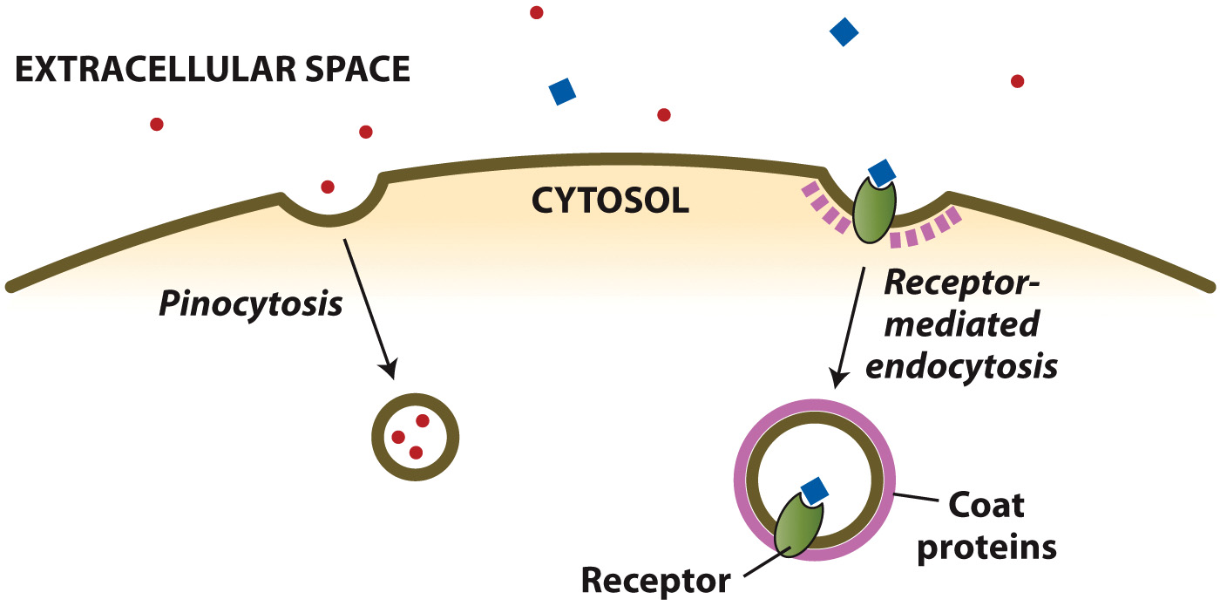
Endocytosis

Slide 30
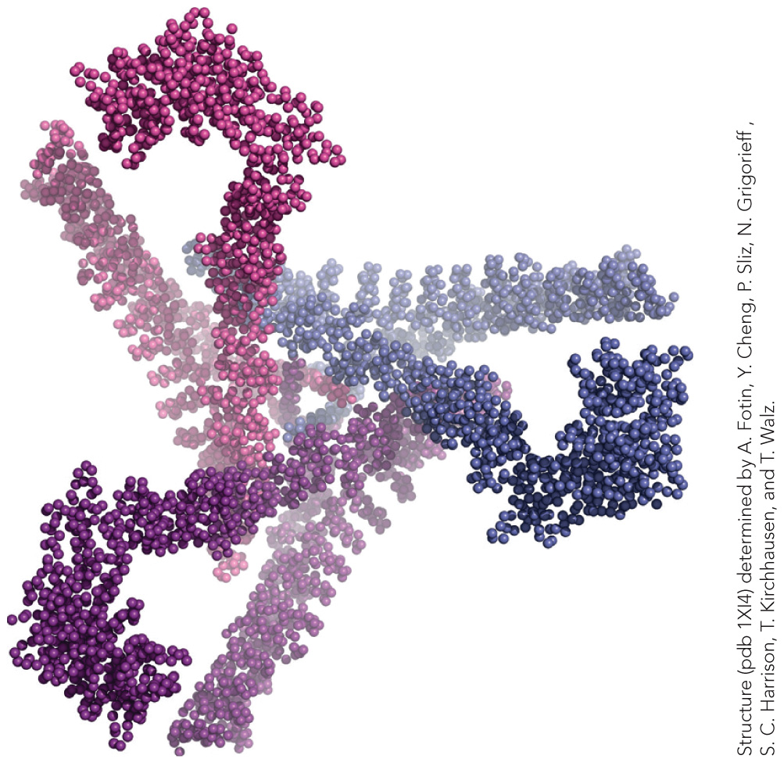
Clathrin Assembly

