Slide 1
Essential Biochemistry
Fourth Edition
Charlotte W. Pratt | Kathleen Cornely
Lecture Notes for
Chapter 8
Lipids and Membranes

Slide 2
Lipids
Section 8.1
Learning Objective
Recognize the physical characteristics of lipids

Slide 3
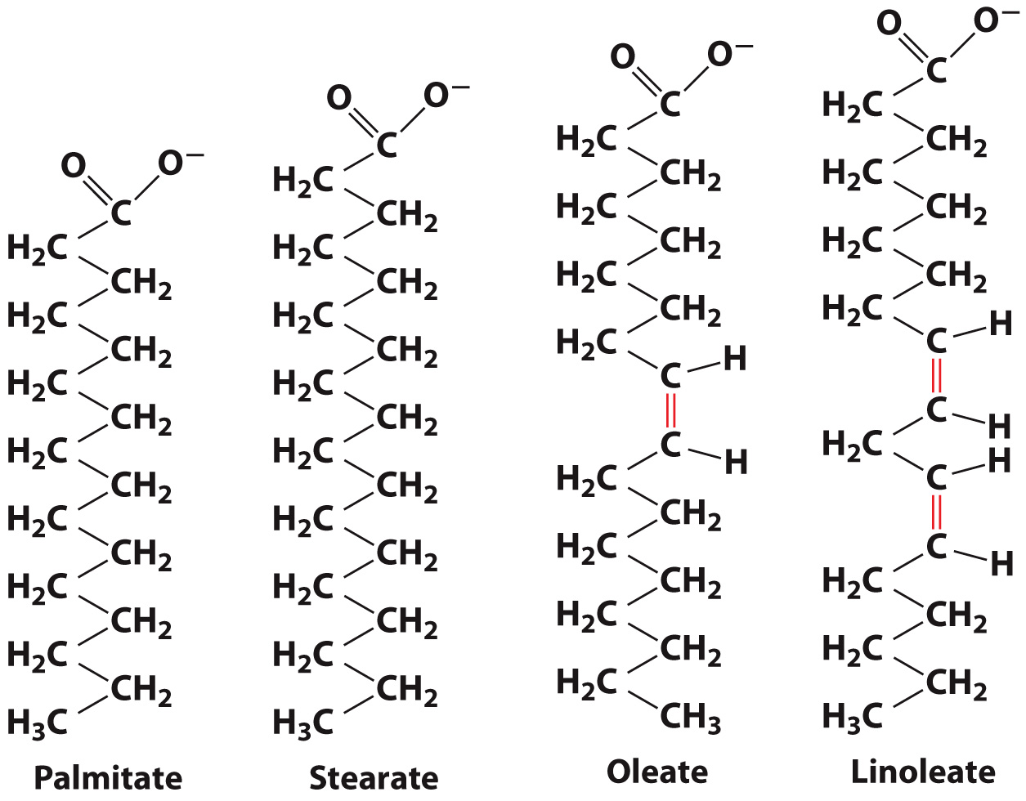
Fatty acids are long-chain hydrocarbons

Slide 4
Fatty acids can be saturated with hydrogens

Slide 5
Fatty acids can be unsaturated or polyunsaturated
Double bonds are usually in the cis conformation

Slide 6
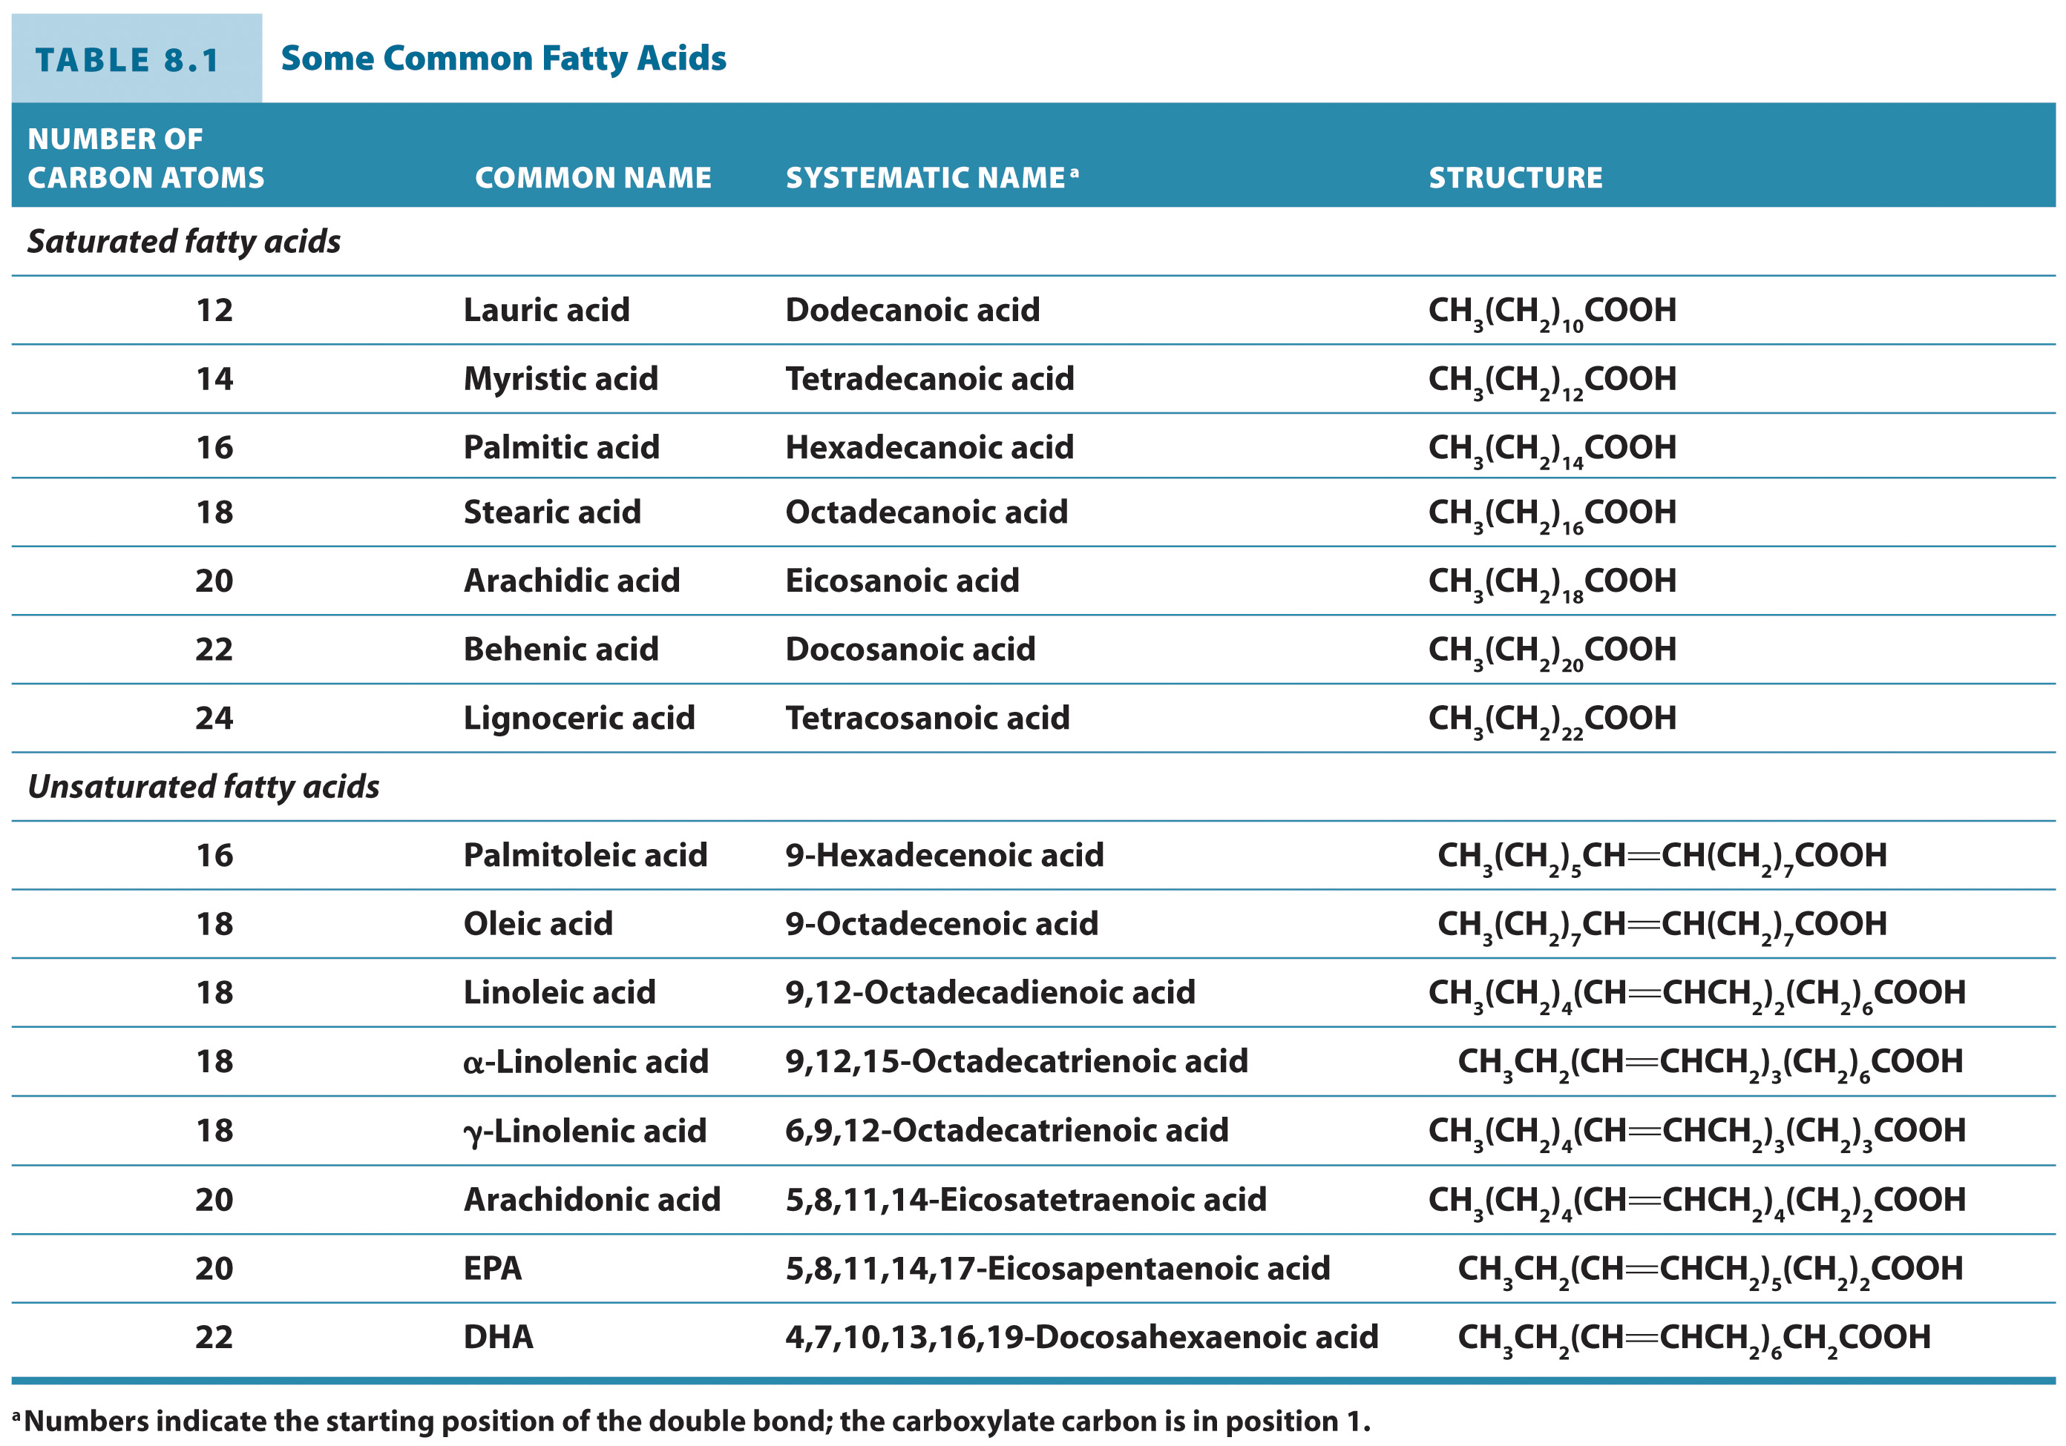
Some Common Fatty Acids

Slide 7
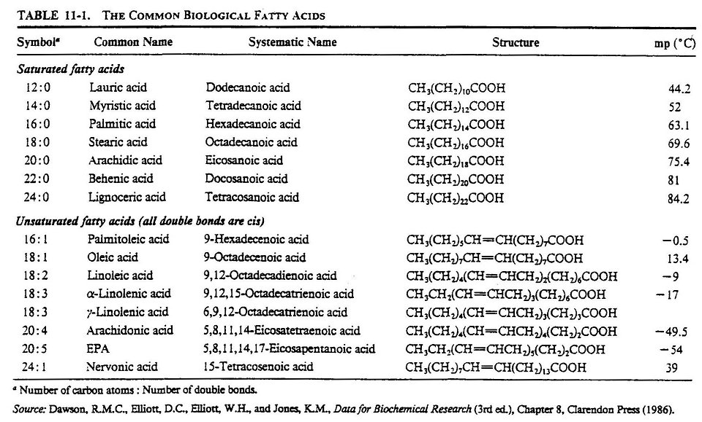

Slide 8
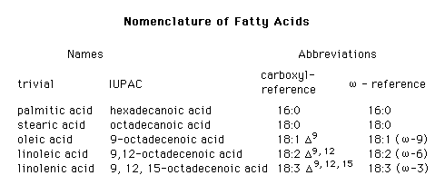

Slide 9
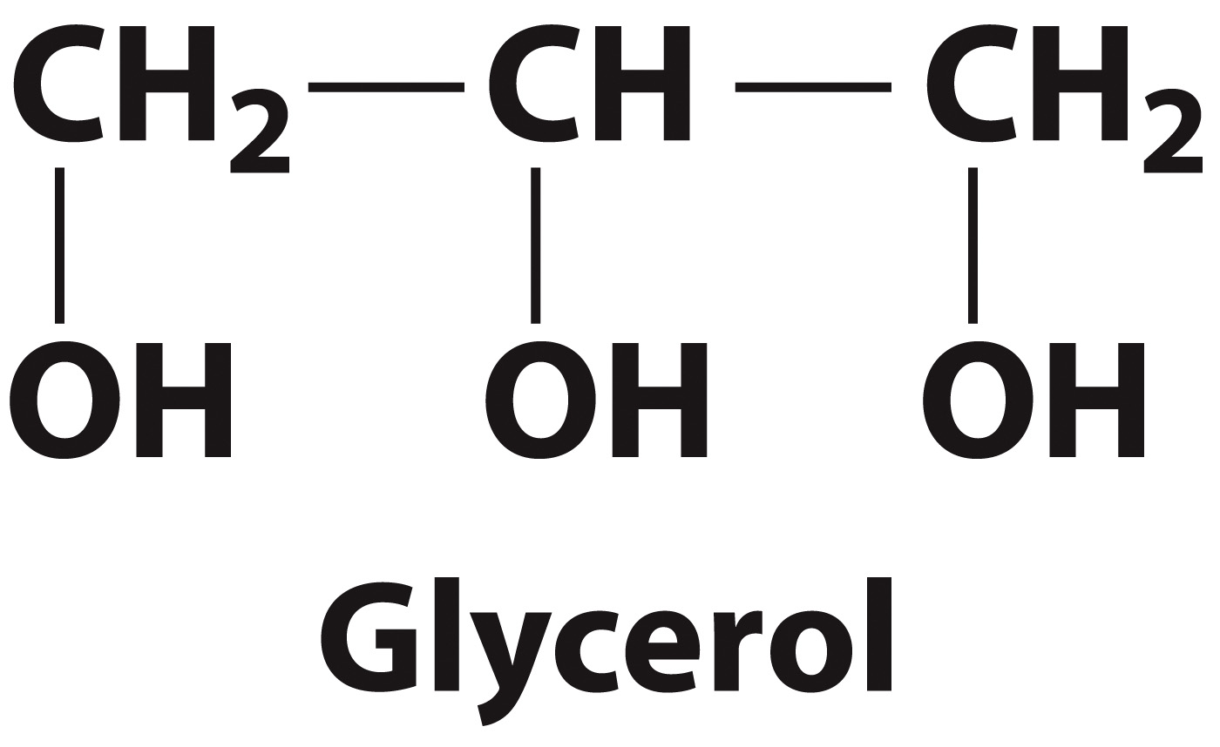
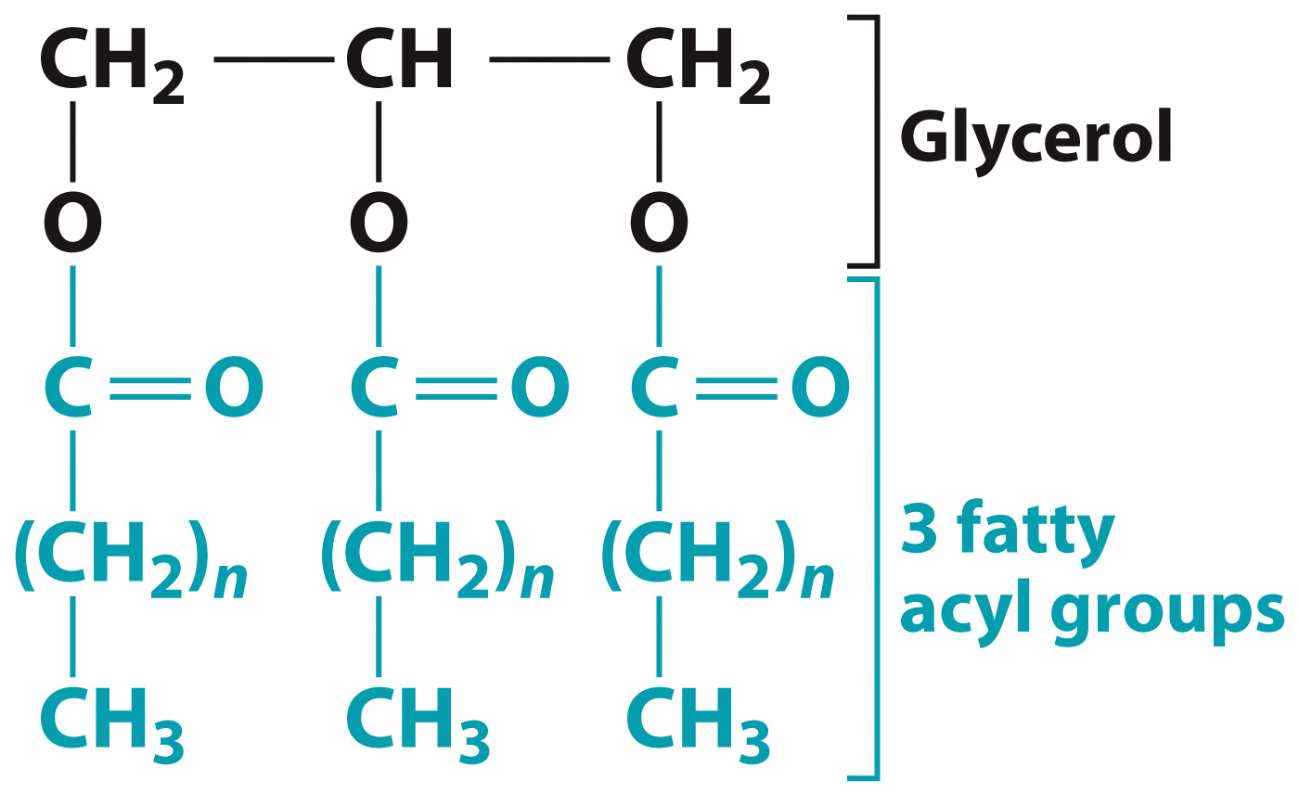
Fatty acids are usually found as part of triacylglycerols

Slide 10
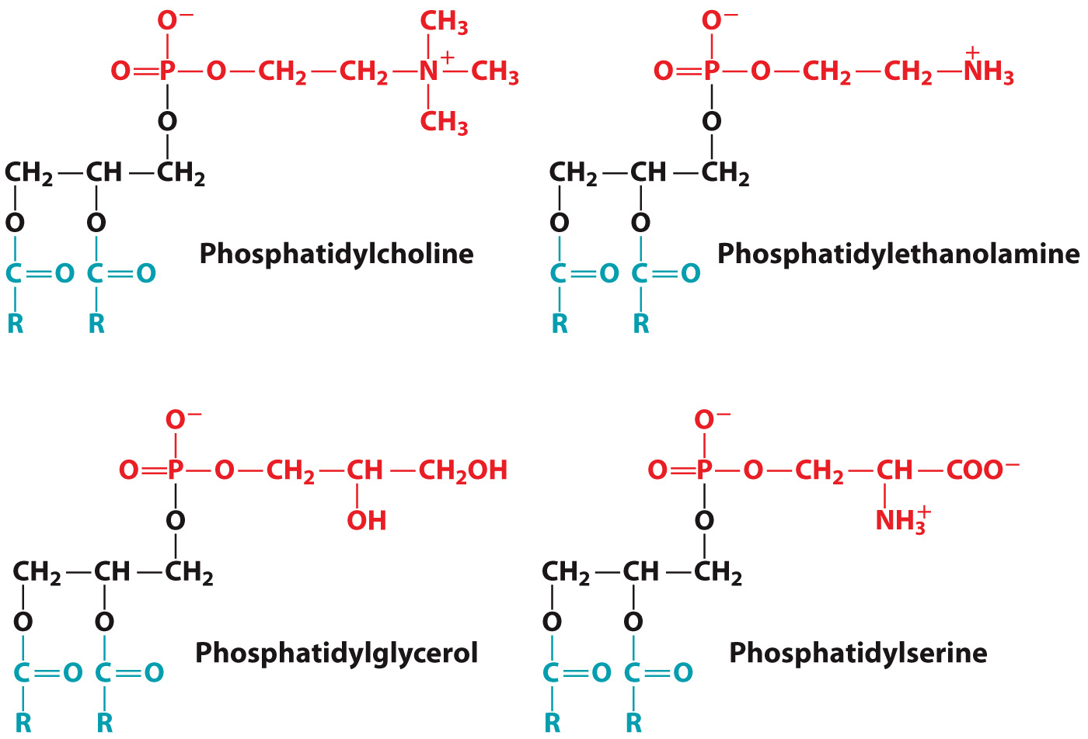
Glycerophospholipids often have unique head groups

Slide 11
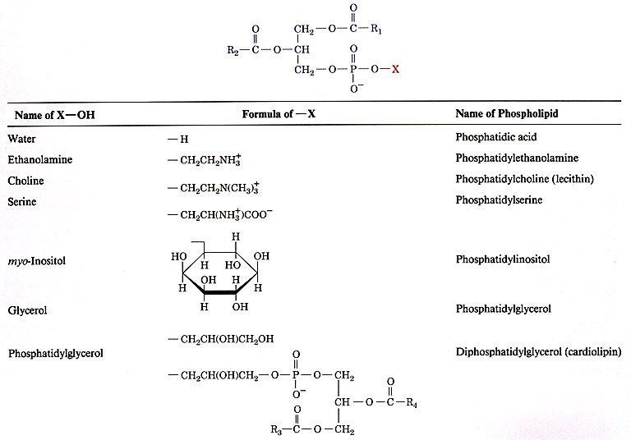

Slide 12
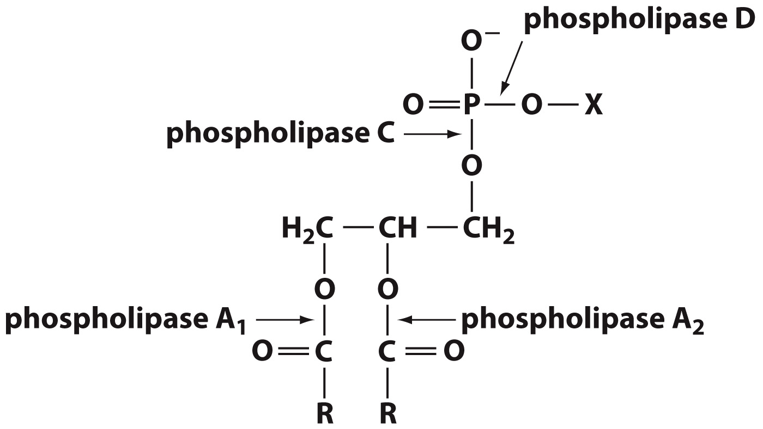
Phospholipases cleave glycerophospholipids at specific sites

Slide 13
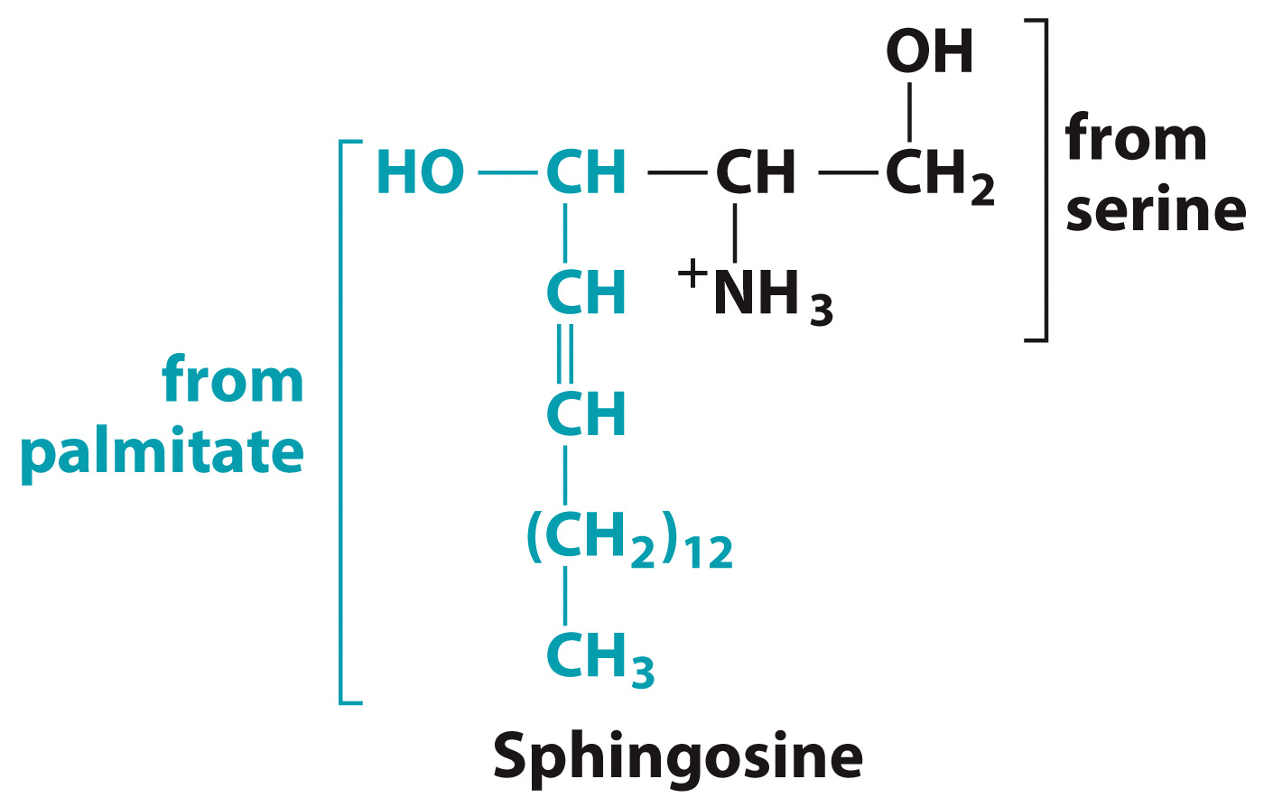
Sphingosine is derived from palmitate and serine

Slide 14
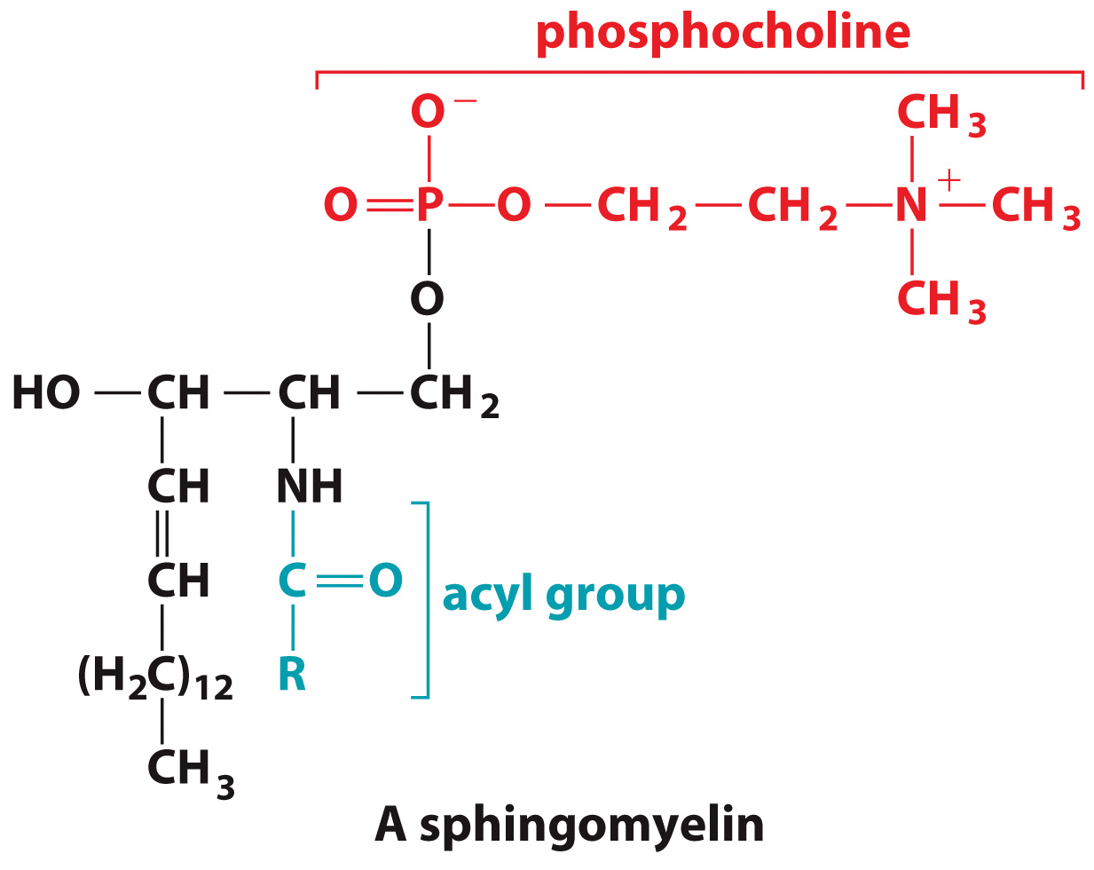
Sphingomyelin has a phosphocholine or phophoethanolamine head group
Notes:
PICK UP HERE….

Slide 15
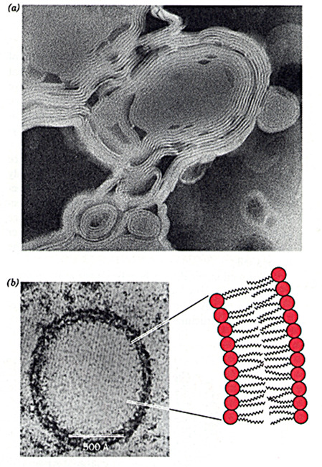

Slide 16
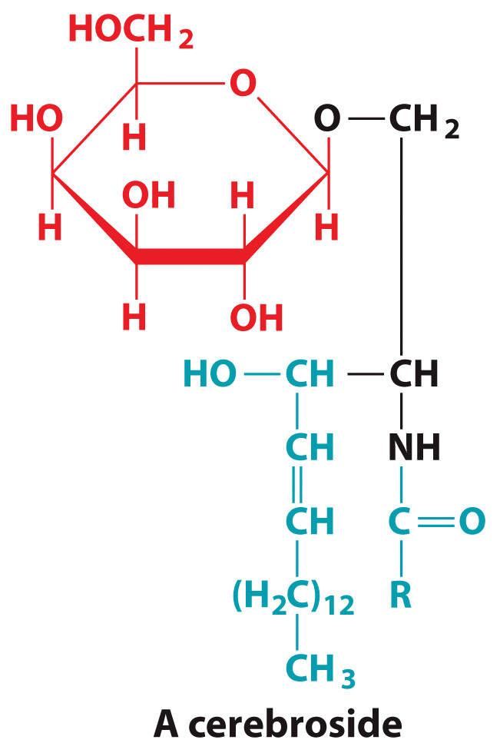
Some sphingolipids have monosaccharides as head groups

Slide 17
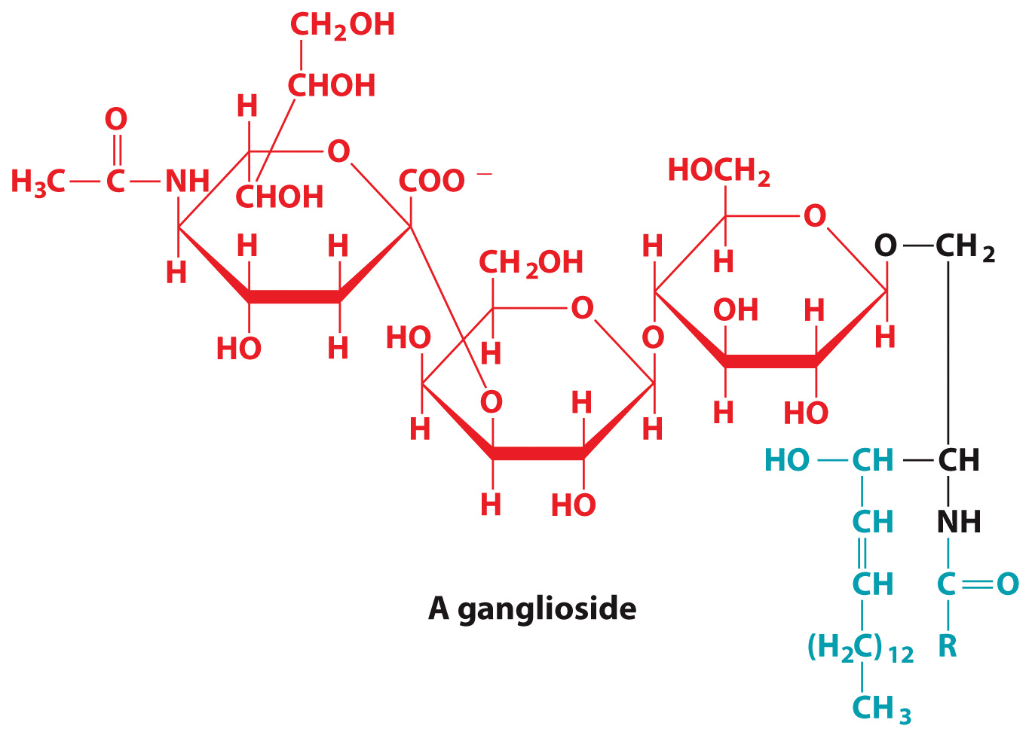
Some sphingolipids have oligosaccharides as head groups

Slide 18
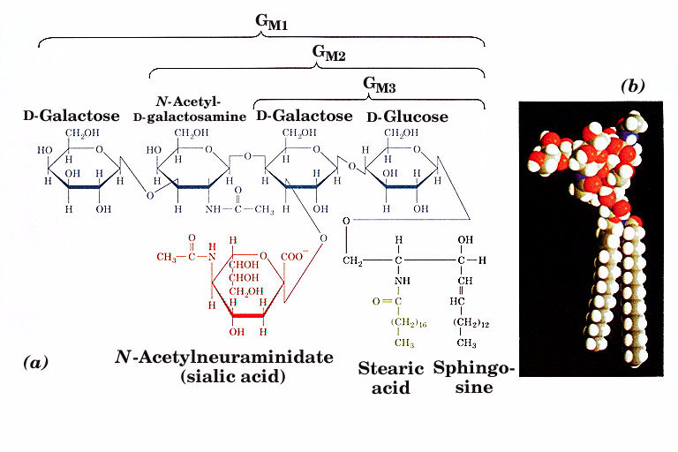

Slide 19
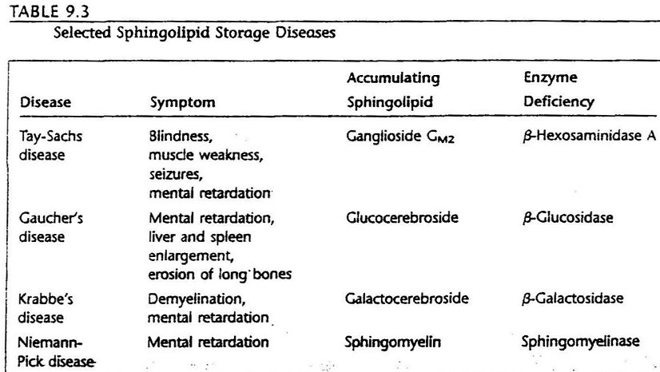

Slide 20
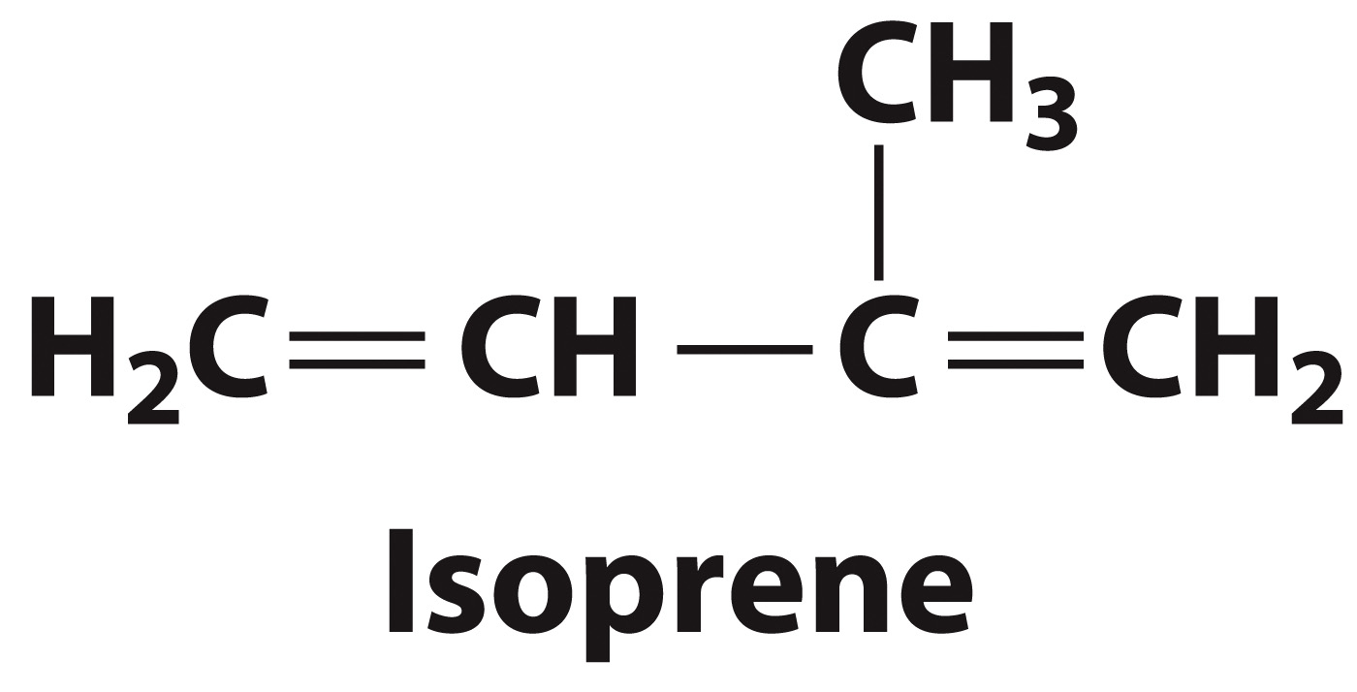
Some lipids are derivatives of isoprene

Slide 21
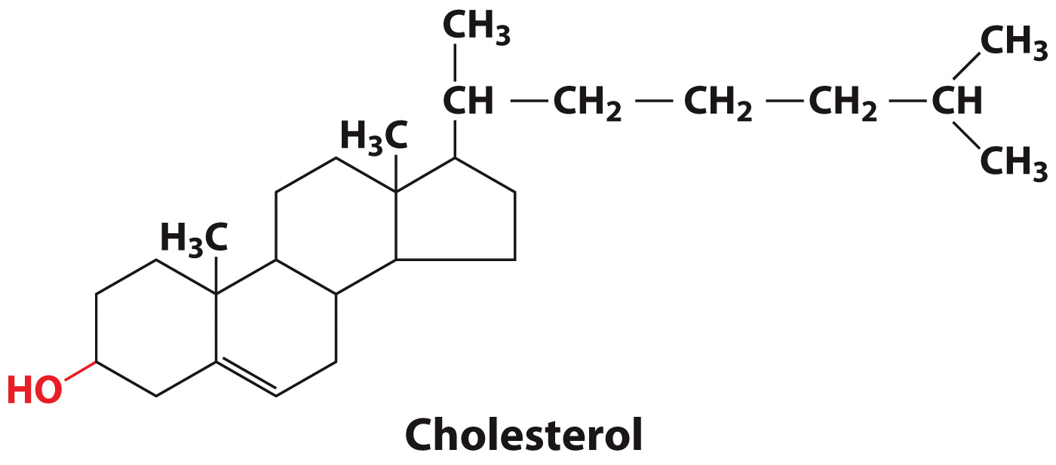
Cholesterol is an amphiphilic isoprenoid

Slide 22
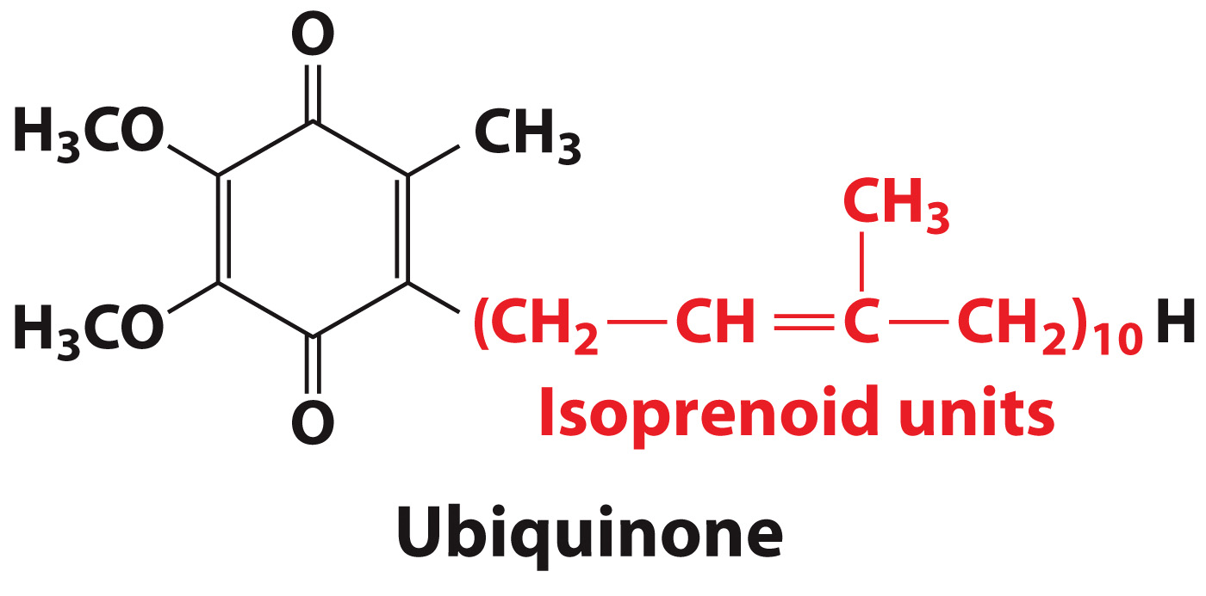
Ubiquinone is an isoprenoid derivative

Slide 23
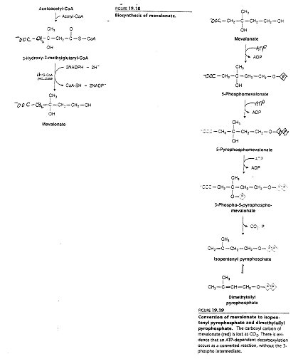

Slide 24
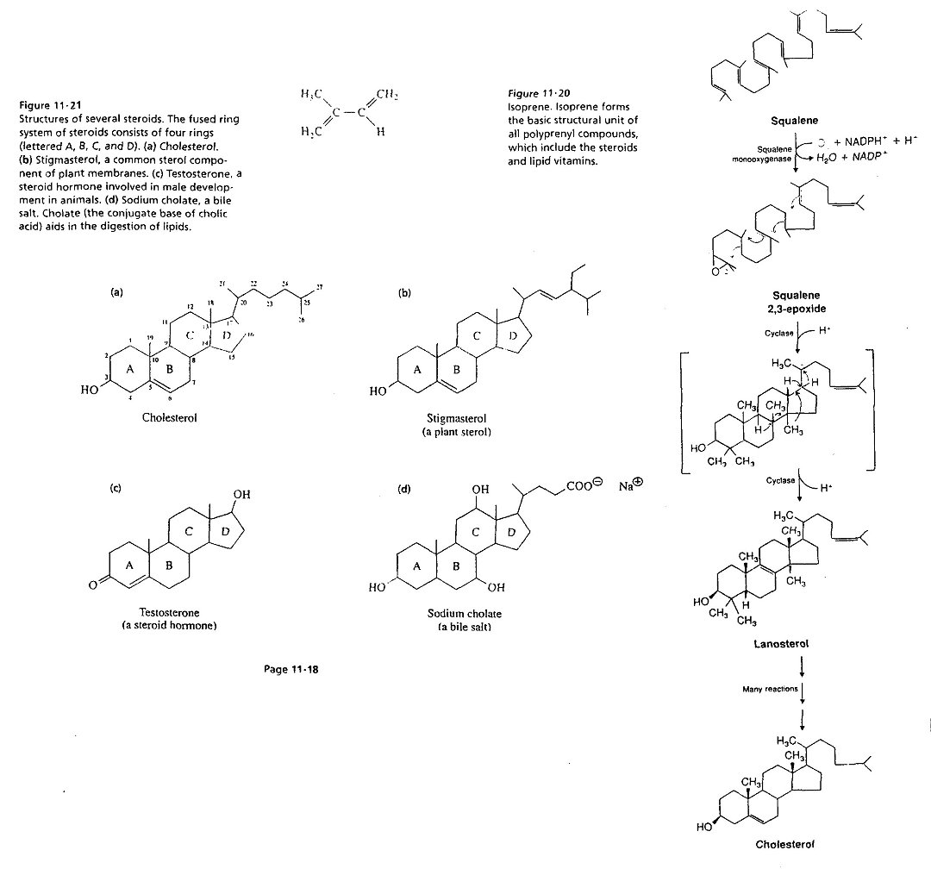

Slide 25
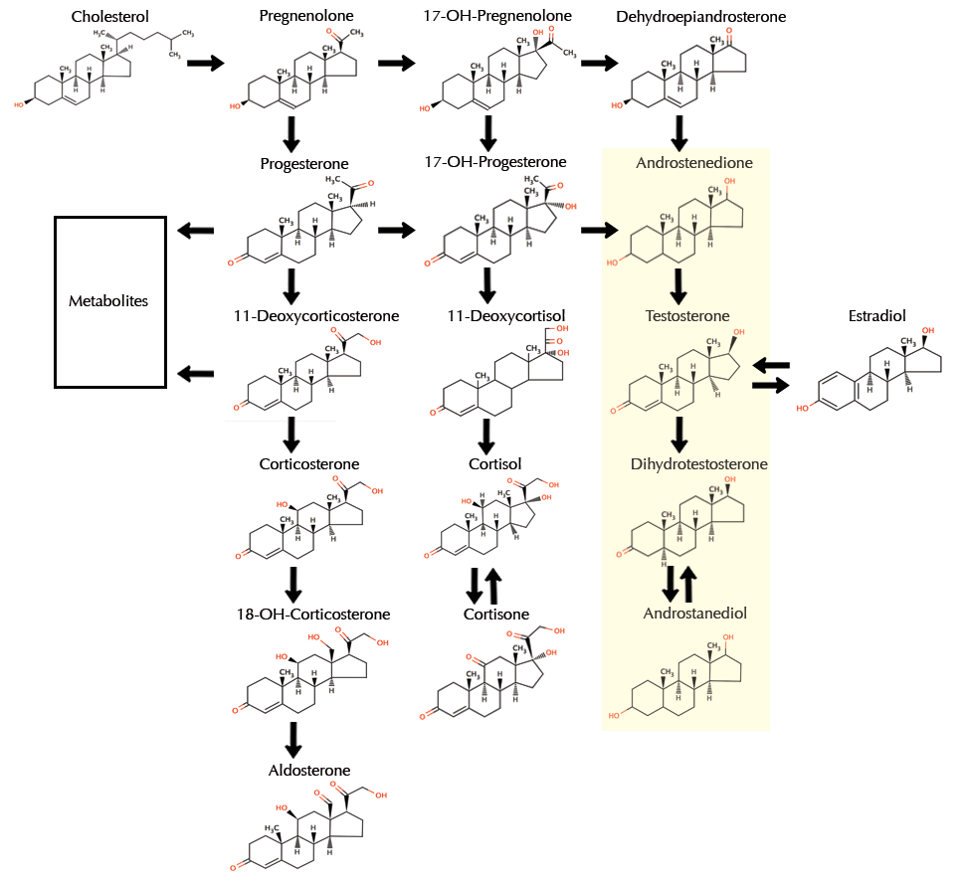

Slide 26
Geraniol is a plant lipid that functions as an attractant

Slide 27
Limonene gives citrus fruits their characteristic odor

Slide 28
Capsaicin gives chili peppers their “hot” taste

Slide 29
The Lipid Bilayer
Section 8.2
Learning Objective
Describe the physical properties of the lipid bilayer

Slide 30
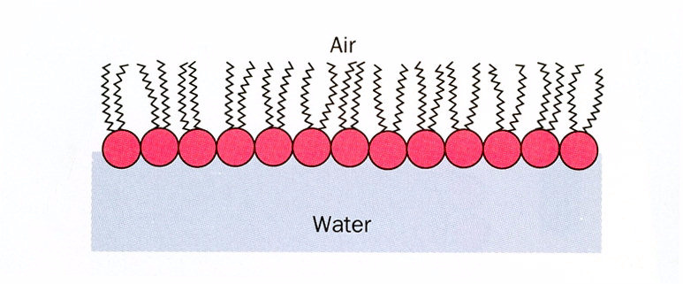

Slide 31
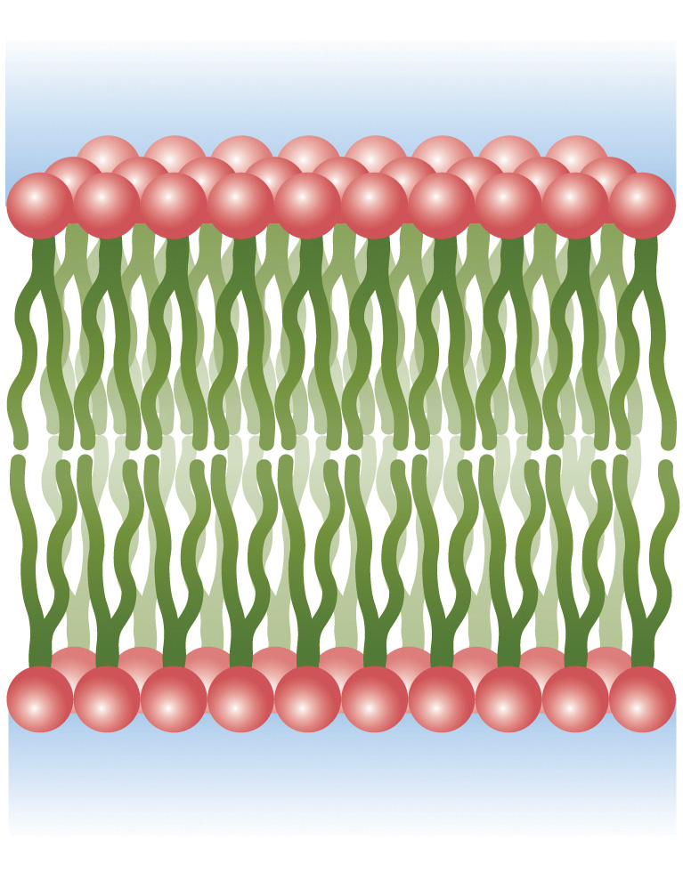
A Lipid Bilayer

Slide 32
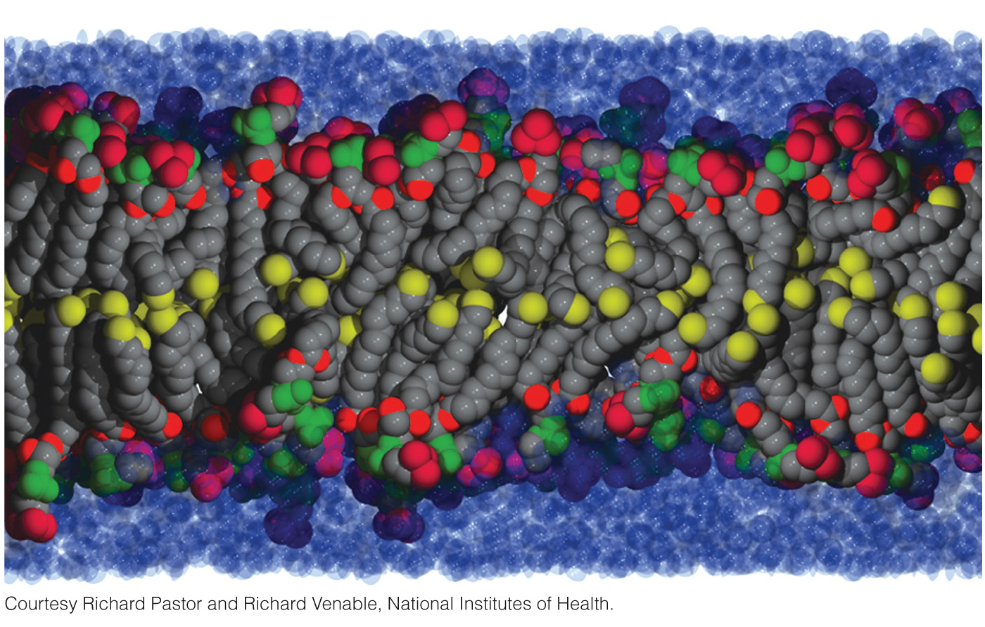
Simulation of a Lipid Bilayer

Slide 33
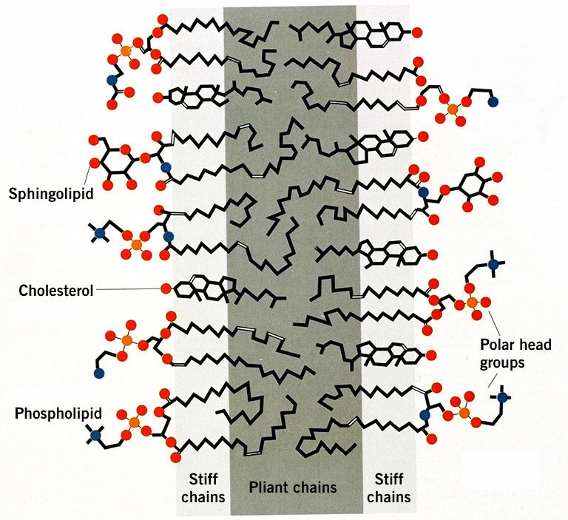

Slide 34
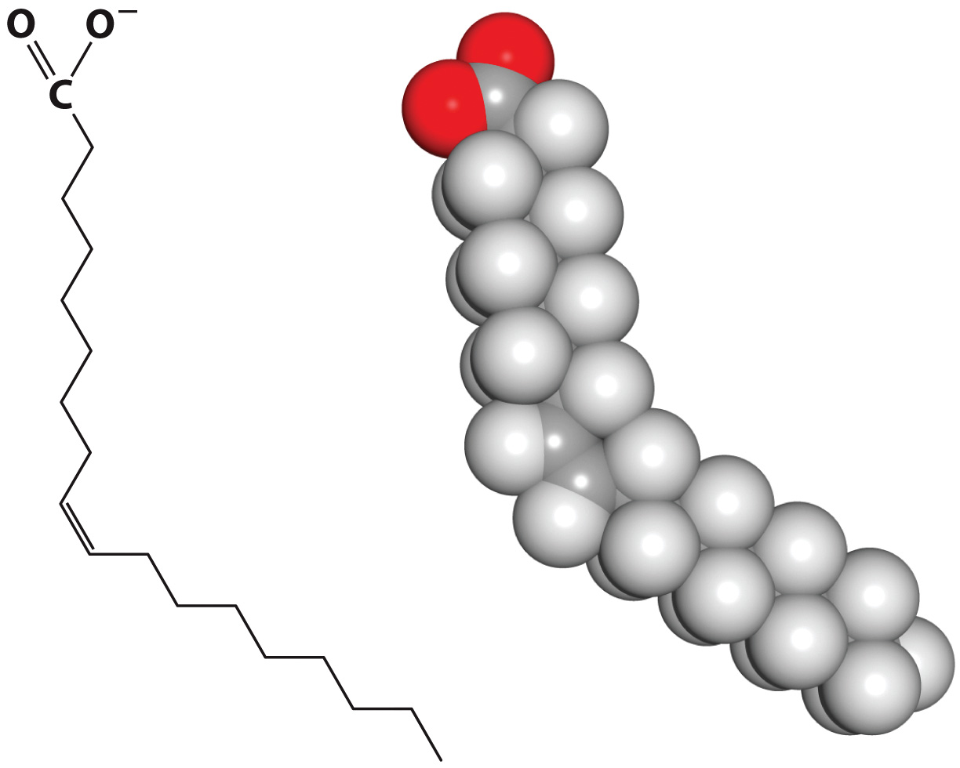
Double bonds kink the acyl chain in lipids

Slide 35
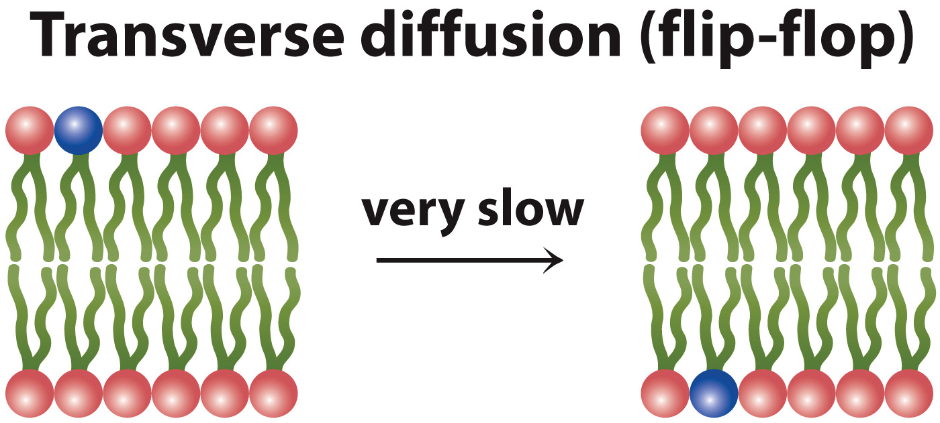
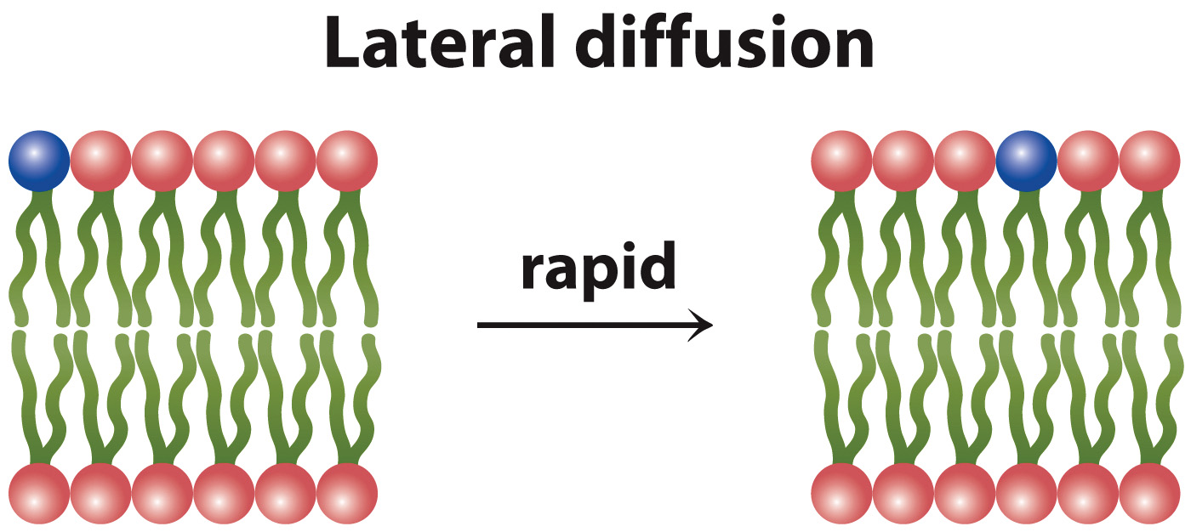
Diffusion in membranes differs according to direction

Slide 36
Membrane Proteins
Section 8.3
Learning Objective
Explain how proteins associate with membranes

Slide 37
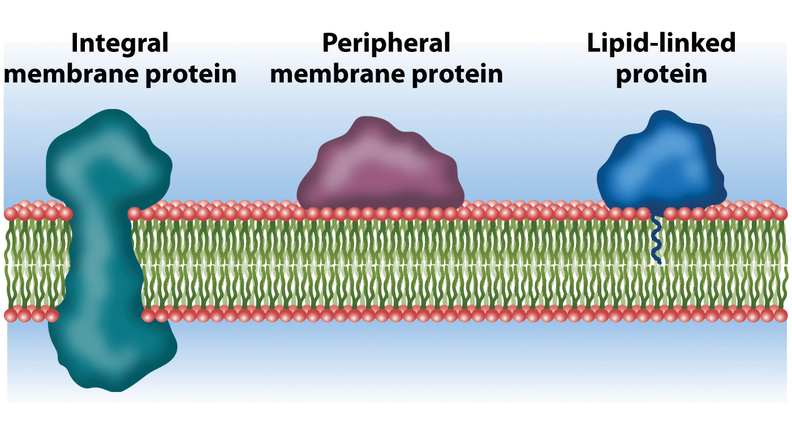
Proteins associate with membranes in different ways

Slide 38
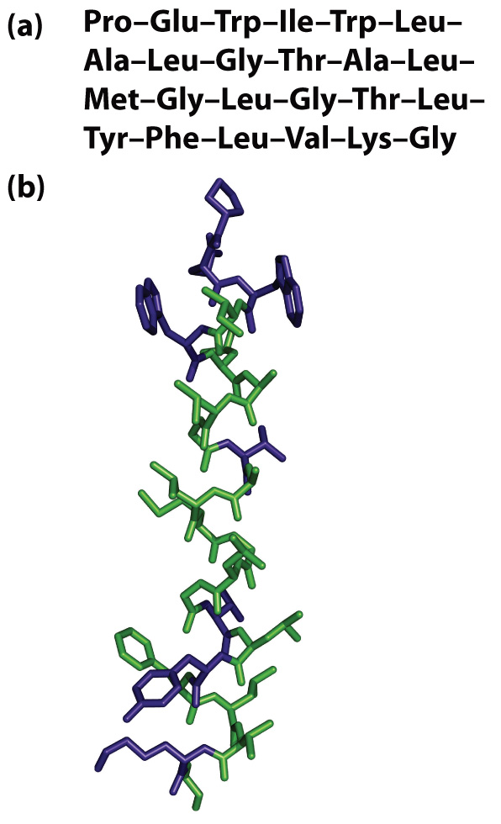
A Membrane-Spanning α Helix

Slide 39
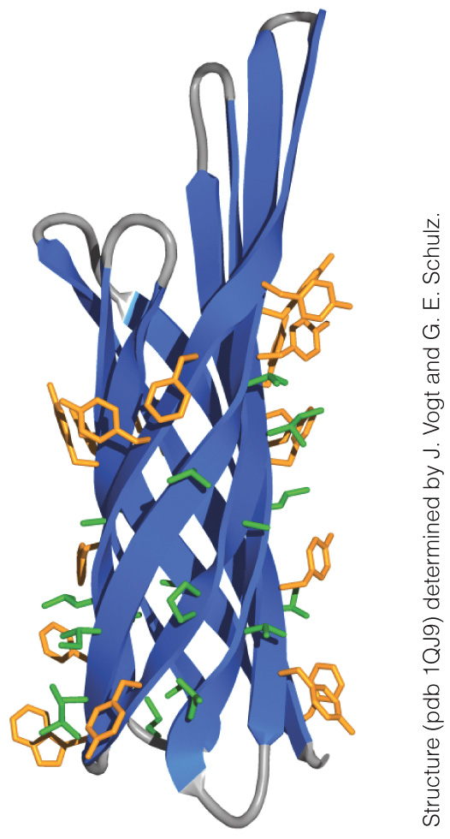
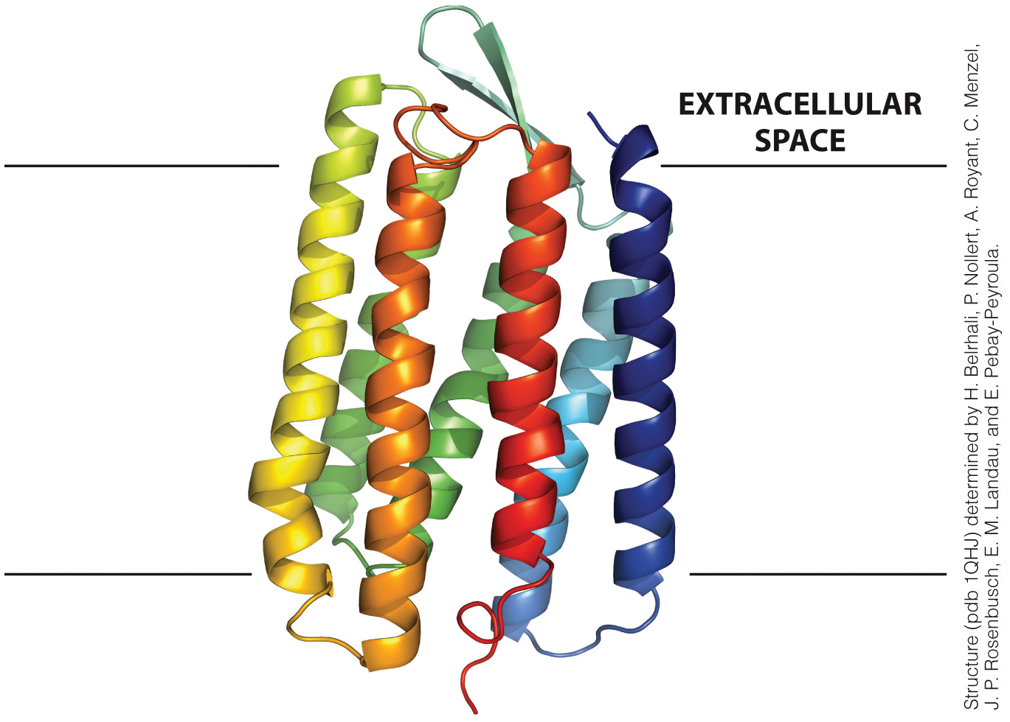
Membrane proteins can span the bilayer
Bacteriorhodopsin
Beta Barrel

Slide 40
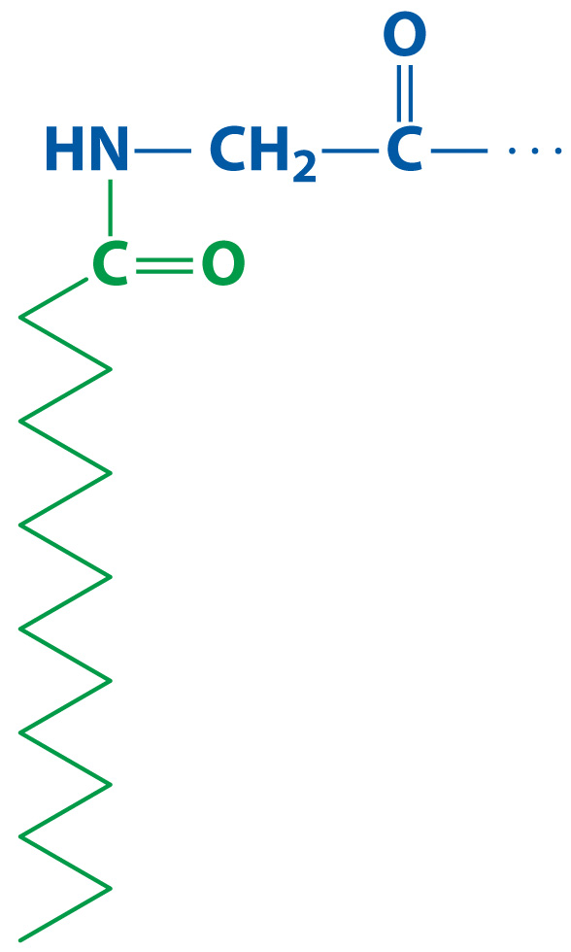
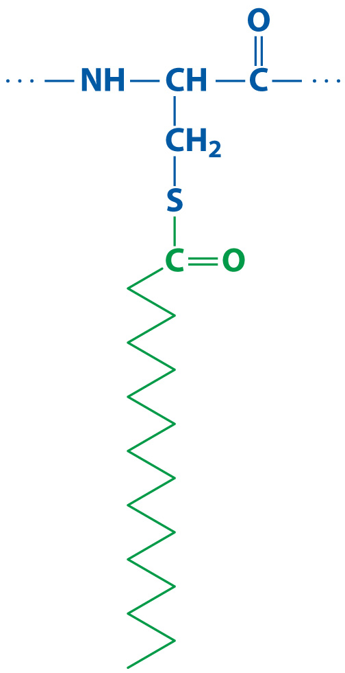
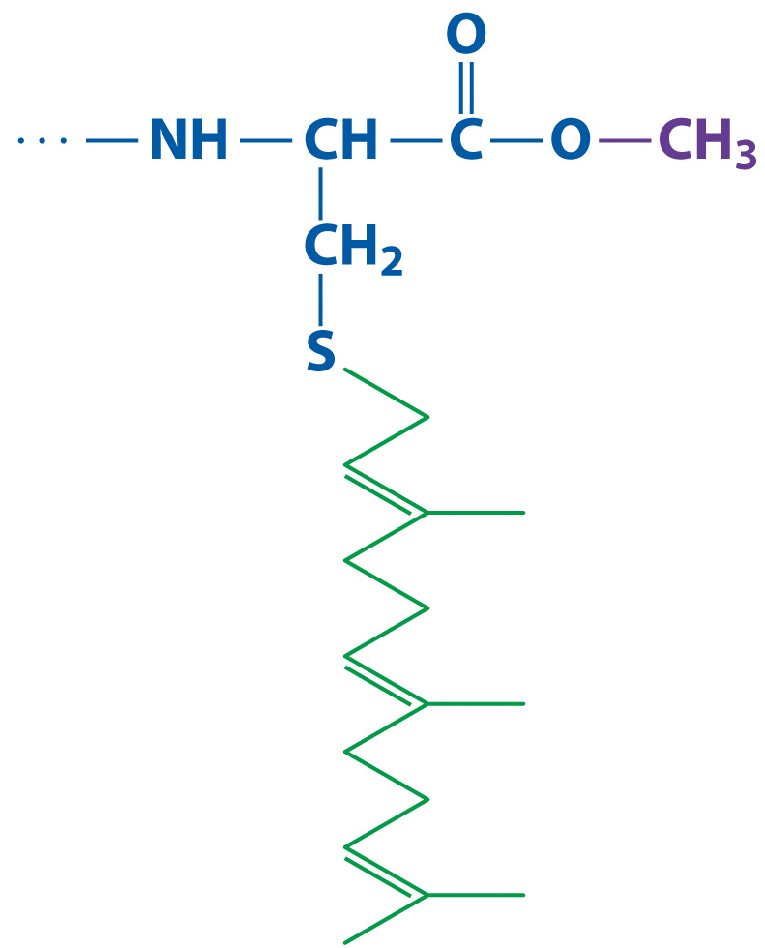
Lipids can be covalently linked to proteins in a variety of ways
Myristoylation
Palmitoylation
Prenylation

Slide 41
The Fluid Mosaic Model
Section 8.4
Learning Objective
Summarize the features of the fluid mosaic model

Slide 42
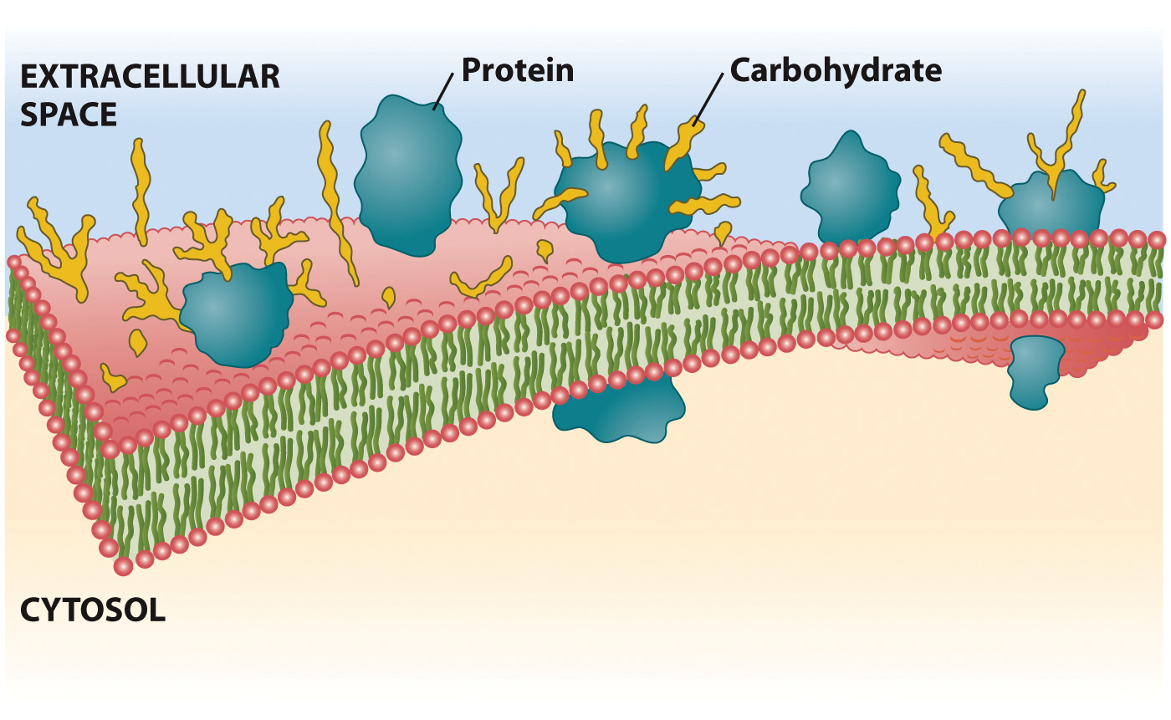
The Fluid Mosaic Model

Slide 43
