Slide 1
Essential Biochemistry
Fourth Edition
Charlotte W. Pratt | Kathleen Cornely
Lecture Notes for
Chapter 7
Enzyme Kinetics and Inhibition

Slide 2
Introduction to Enzyme Kinetics
Section 7.1
Learning Objective
Explain why an enzyme’s activity varies with the substrate concentration

Slide 3
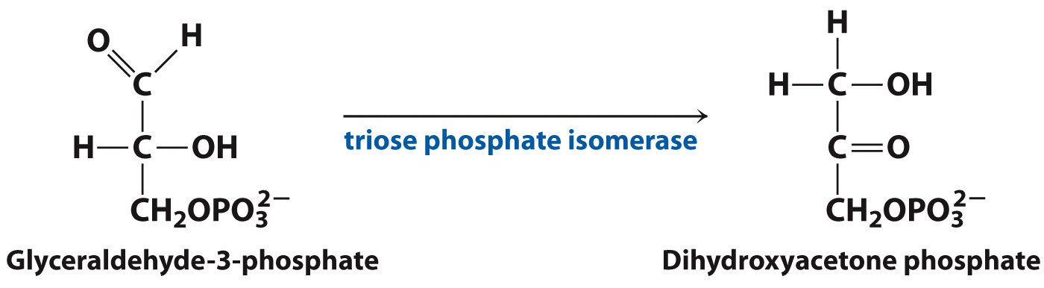
Consider the reaction catalyzed by triose phosphate isomerase

Slide 4
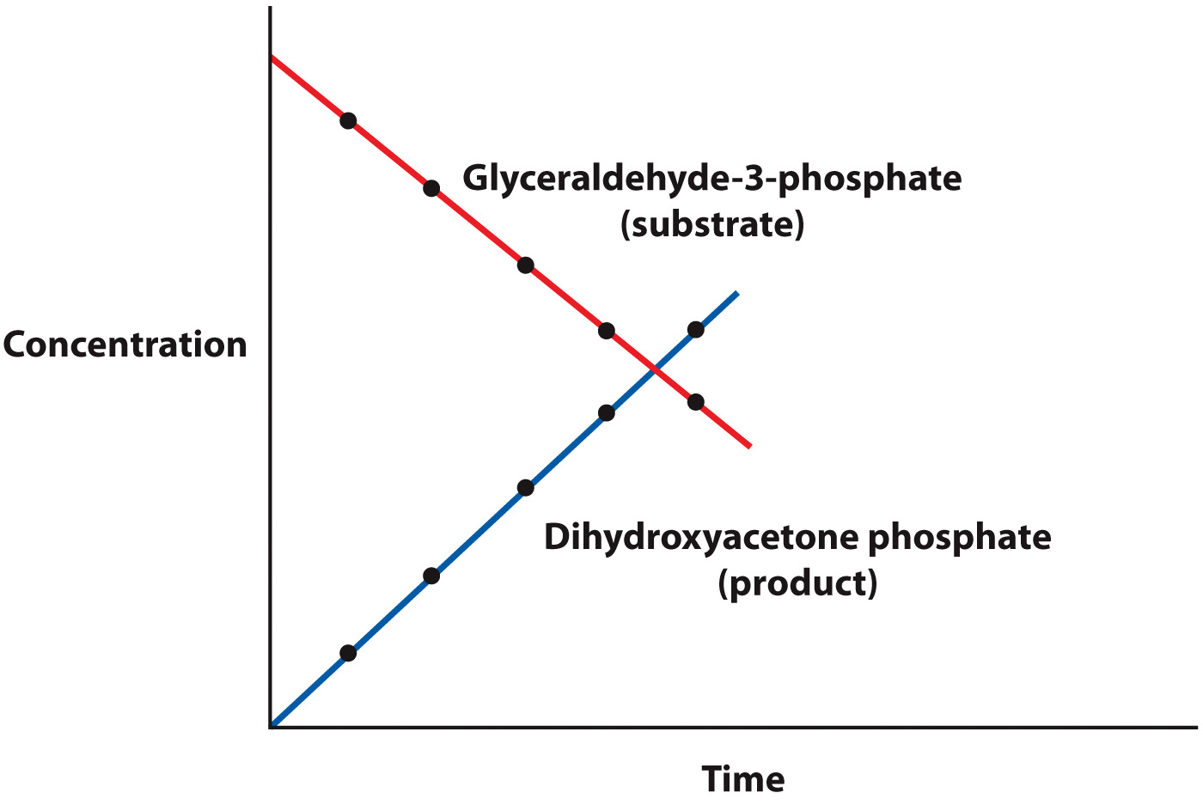
Reaction velocity can be thought of as concentration vs. time

Slide 5
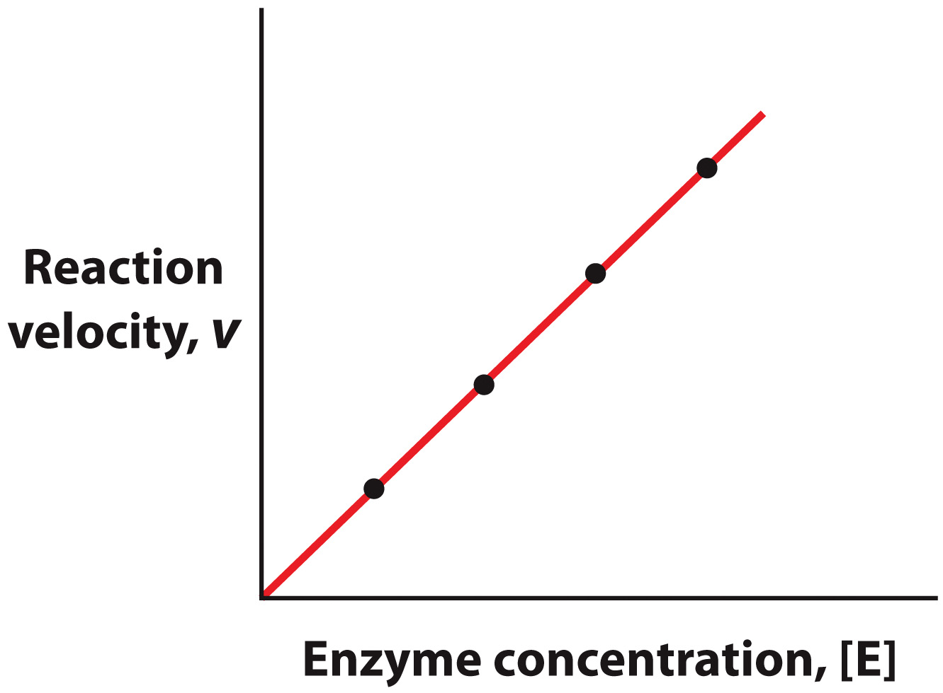
Progress of the Triose Phosphate Isomerase Reaction

Slide 6
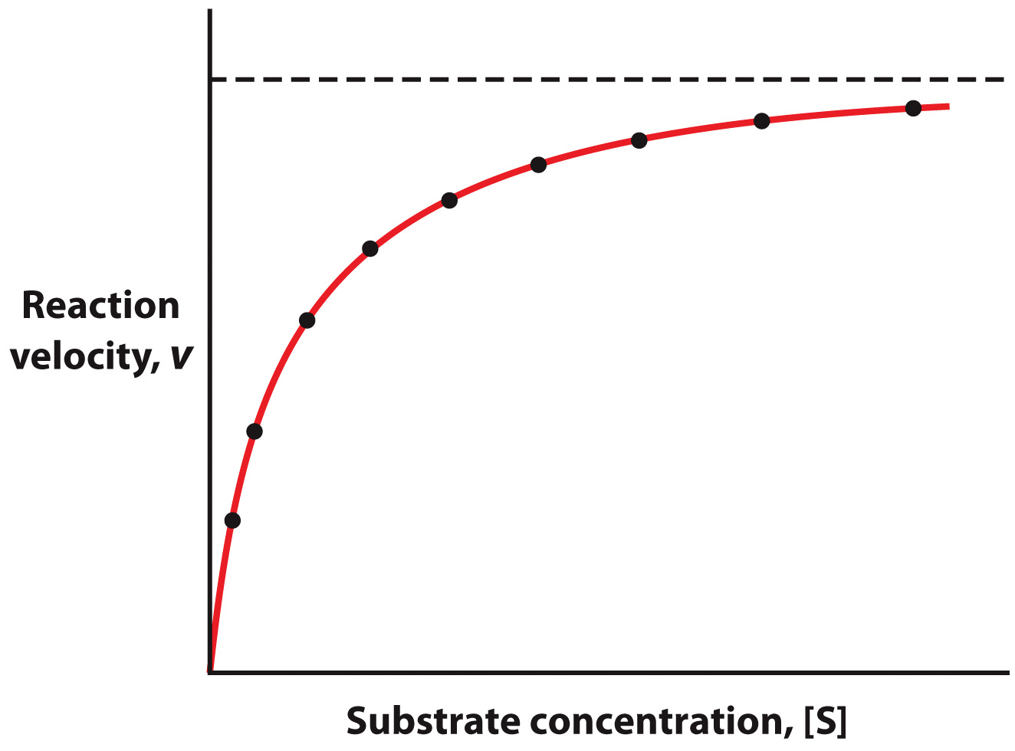
Many enzymes react with substrates in a nonlinear fashion

Slide 7
Derivation and Meaning of the Michaelis-Menten Equation
Section 7.2
Learning Objective
Use the Michaelis-Menten equation to describe enzyme behavior

Slide 8
Rate equations describe chemical processes
A unimolecular reaction has a velocity (rate) that is dependent on the concentration of only one substrate.
v = k [A], where k has units of sec⁻¹
k
v = A P

Slide 9
Rate equations describe chemical processes
A bimolecular (second order) reaction has a velocity (rate) that is dependent on two substrate concentrations.
v = k [A] [B] (or k [A]² or k [B]²)
where k has units of M⁻¹ • sec⁻¹
k
v = A + B P

Slide 10
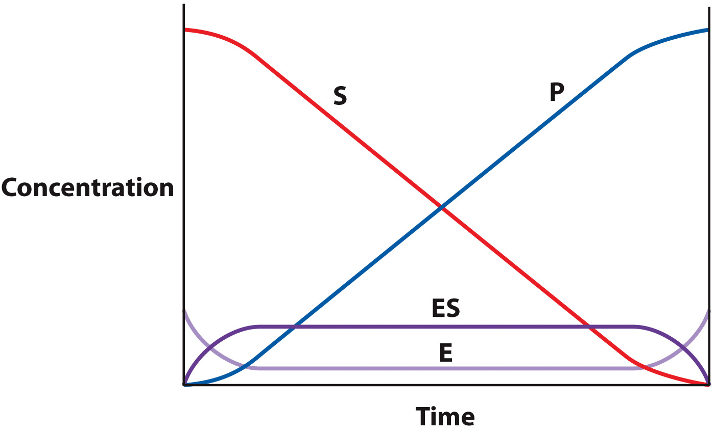
Assume steady state equilibrium

Slide 11
Many enzymes obey Michaelis-Menten kinetics
k₁
k₂
E + S ES E + P
k₋₁
Rate limiting step

Slide 12
Try to re-express the rate
k₁
k₂
E + S ES E + P
k₋₁
One point that helps:
k₁ [E] [S] - k₋₁ [ES] - k₂ [ES]
Formation
of ES
Depletion of ES

Slide 13
Michaelis-Menten Equation
k₁
k₂
E + S ES E + P
k₋₁
= k₁ [E] [S] - k₋₁ [ES] - k₂ [ES]

Slide 14
Derivation of the
Michaelis-Menten Equation
= k₁ [E] [S] - k₋₁ [ES] - k₂ [ES]
Thus:
k₁ [E] [S] = [ES] (k₋₁ + k₂ )
Since…
[E]_{total} = [ES] + [E]
[E] = [E]_{total} - [ES]
Substitute
here

Slide 15
Derivation of the
Michaelis-Menten Equation
k₁ ([E]_{total} [S] - [ES] [S]) = [ES] (k₋₁ + k₂ )
K_{M}
Divide both sides by k₁
[E]_{total} [S] - [ES] [S] = [ES] (k₋₁ + k₂ )
k₁
[E]_{total} [S] - [ES] [S] = [ES] K_{M}

Slide 16
Derivation of the
Michaelis-Menten Equation
[E]_{total} [S] - [ES] [S] = [ES] K_{M}
Rearrange:
[E]_{total} [S] = [ES] (K_{M} + [S])
[ES] = [E]_{total} [S]
K_{M} + [S]

Slide 17
Derivation of the
Michaelis-Menten Equation
V_{max}
k₂ [E]_{total} [S]
v =
K_{M} + [S]
The Michaelis-Menten Equation
V_{max} [S]
v =
K_{M} + [S]

Slide 18
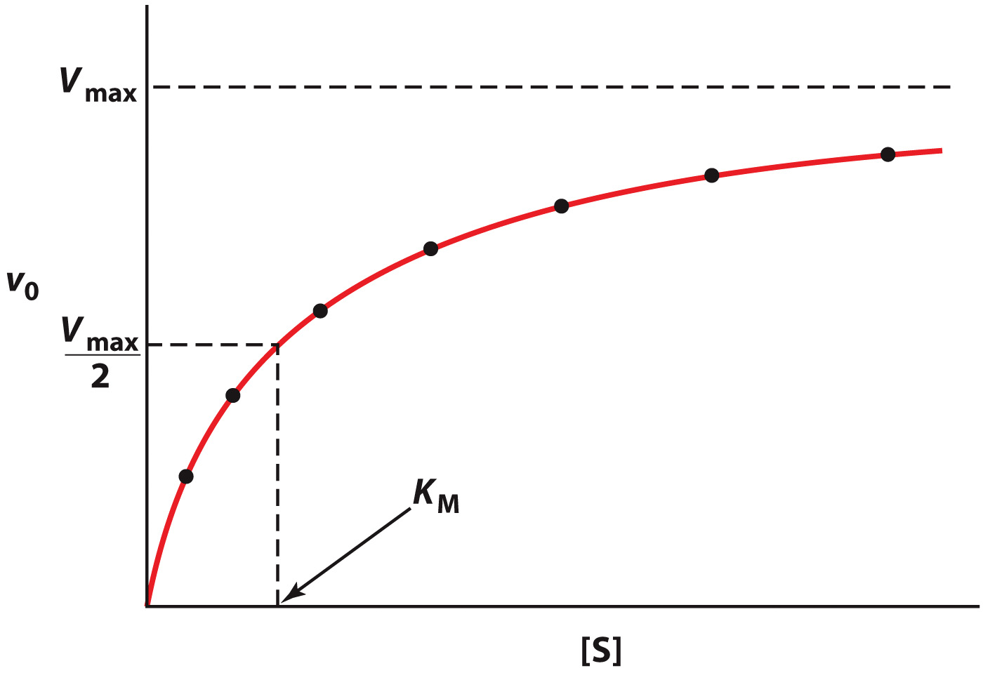
The Michaelis-Menten equation is hyperbolic

Slide 19
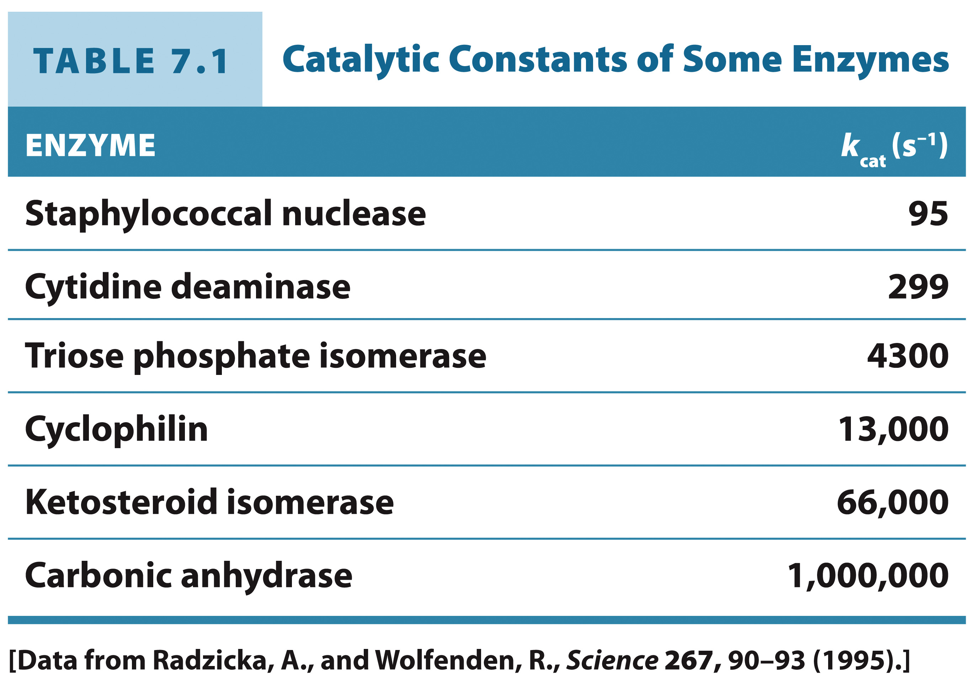
Catalytic Constants of Some Enzymes

Slide 20
k_{cat}/K_{M} indicates catalytic efficiency
k_{cat} [E]_{T} [S]
v₀ =
K_{M} + [S]
Overall ability to convert substrate to product

Slide 21
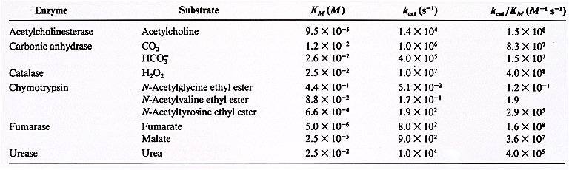

Slide 22
The Lineweaver-Burk plot linearizes Michaelis-Menten kinetics data
V_{max} [S]
v =
K_{M} + [S]
Take the reciprocal of both sides:
1
K_{M}
1
1
=
+
v
[S]
V_{max}
V_{max}

Slide 23
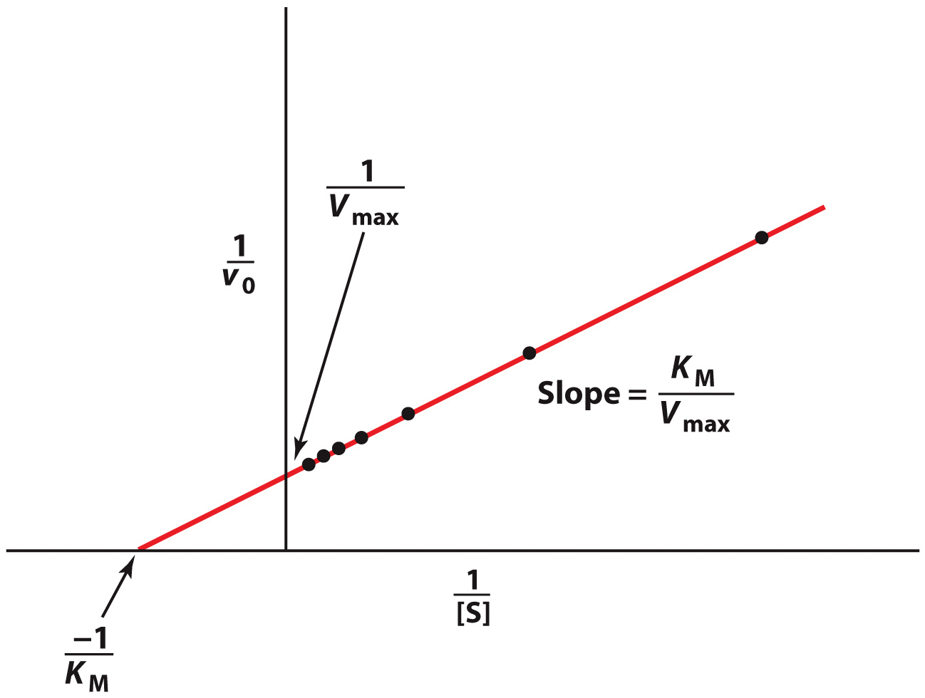
The Lineweaver-Burk plot linearizes Michaelis-Menten kinetics data

Slide 24
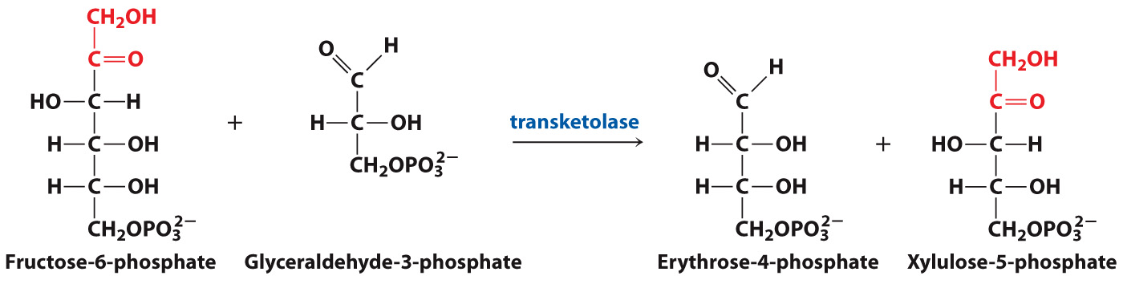
Not all enzymes fit the Michaelis-Menten model
Some enzymes have multiple substrates

Slide 25
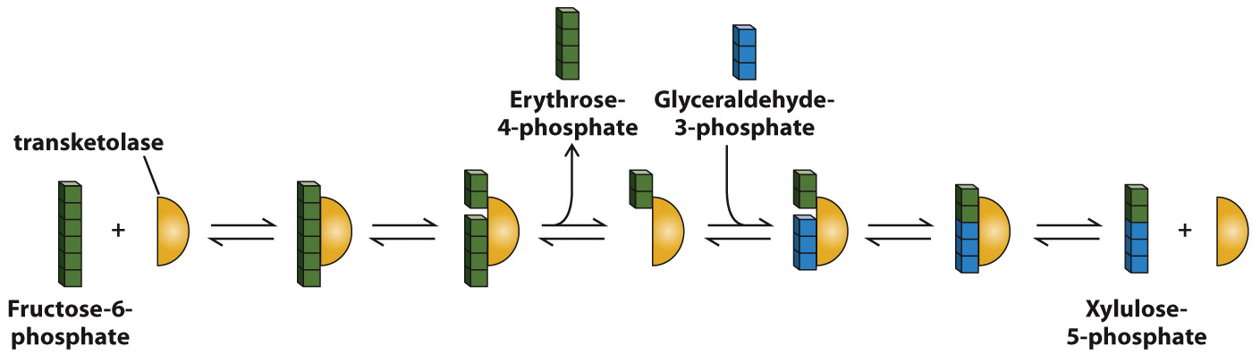
Not all enzymes fit the Michaelis-Menten model
Some enzyme-catalyzed reactions have many steps

Slide 26
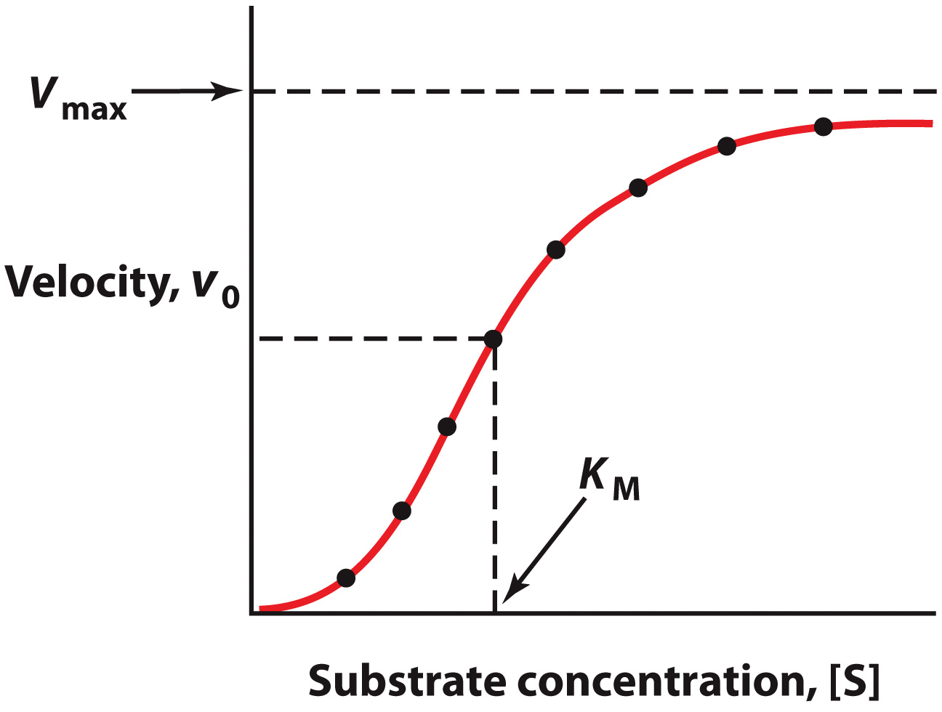
Not all enzymes fit the Michaelis-Menten model

Slide 27
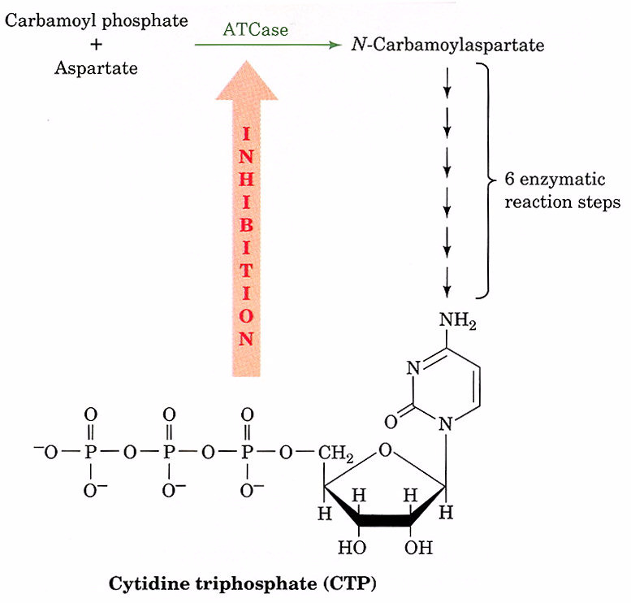

Slide 28
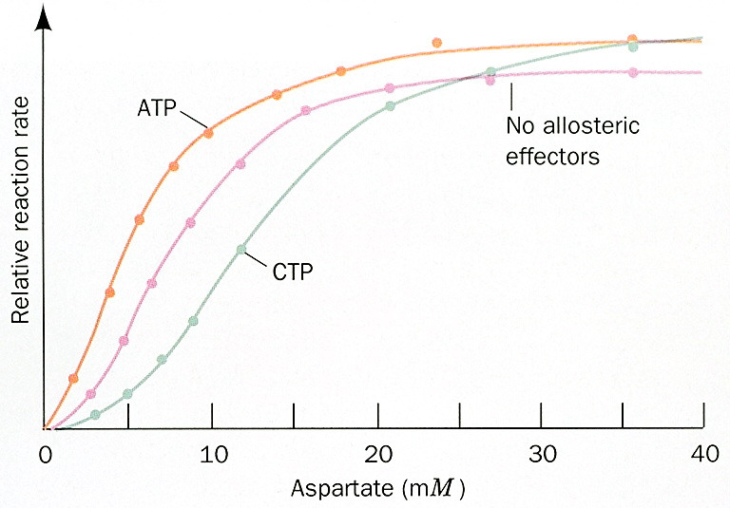

Slide 29
Enzyme Inhibition
Section 7.3
Learning Objective
Distinguish the effects of different types of enzyme inhibitors

Slide 30
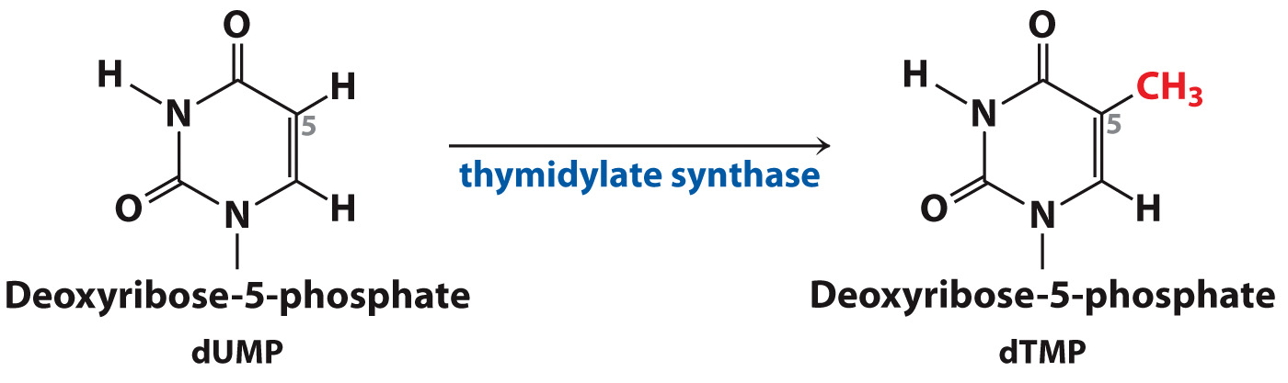
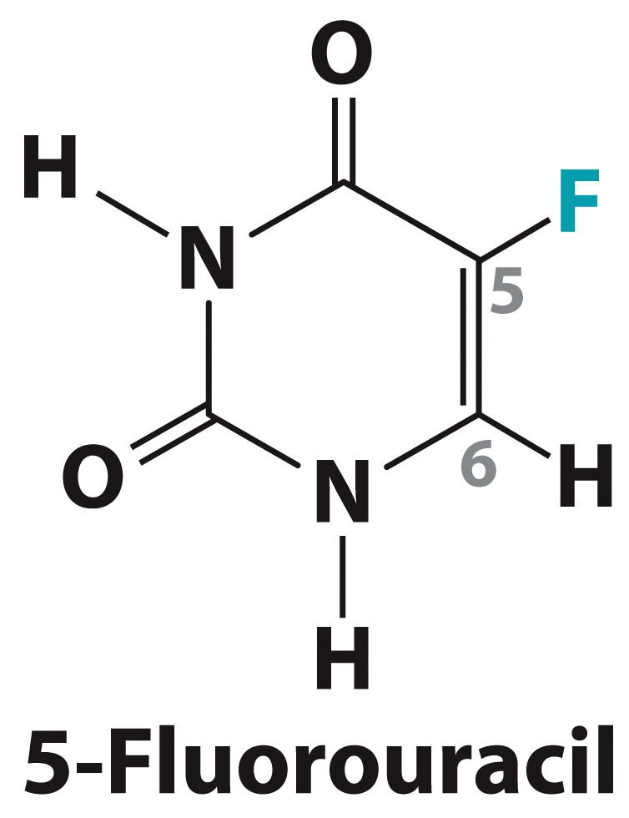
Some inhibitors act irreversibly
A “suicide inhibitor”

Slide 31
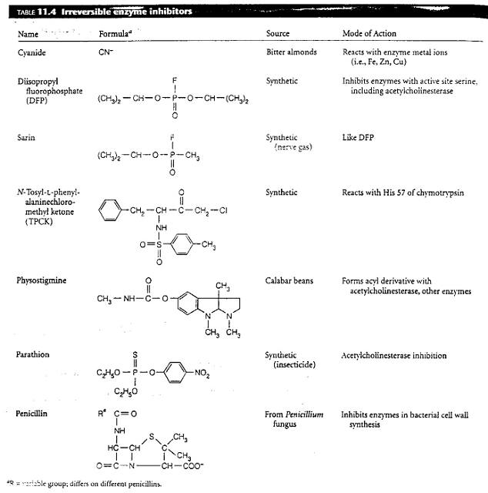

Slide 32
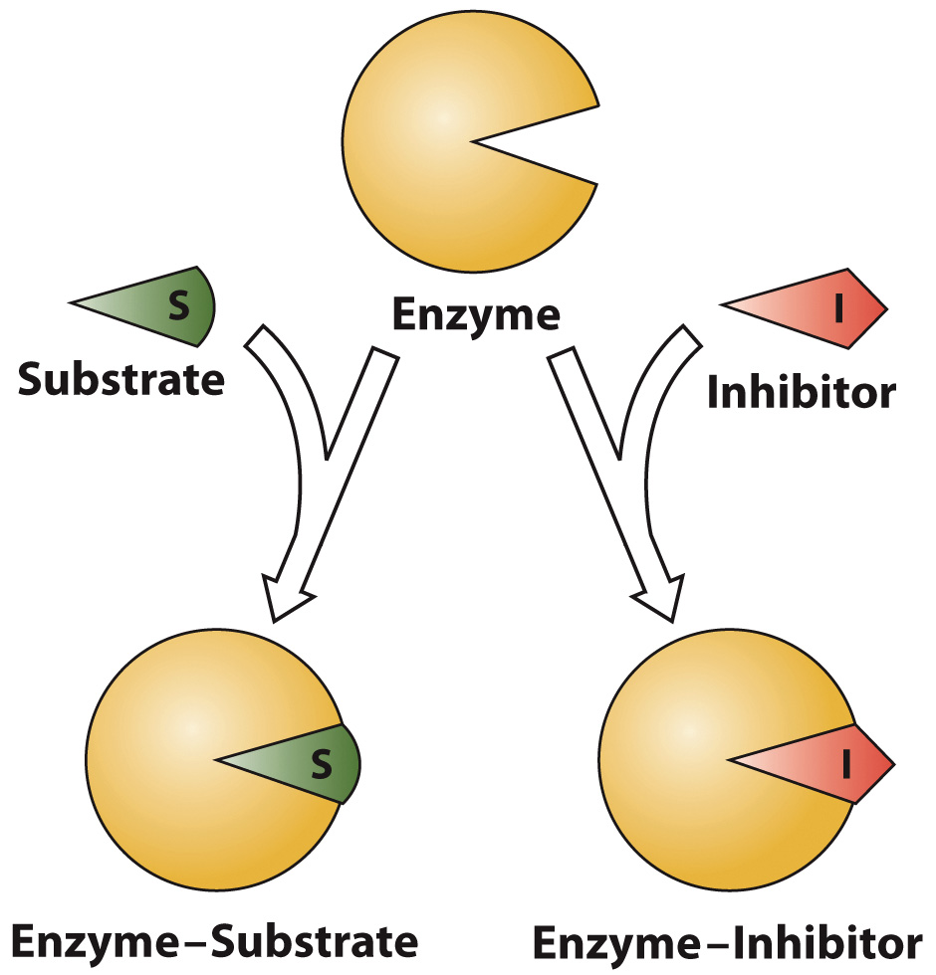
Competitive inhibitors bind to the same site as the substrate

Slide 33
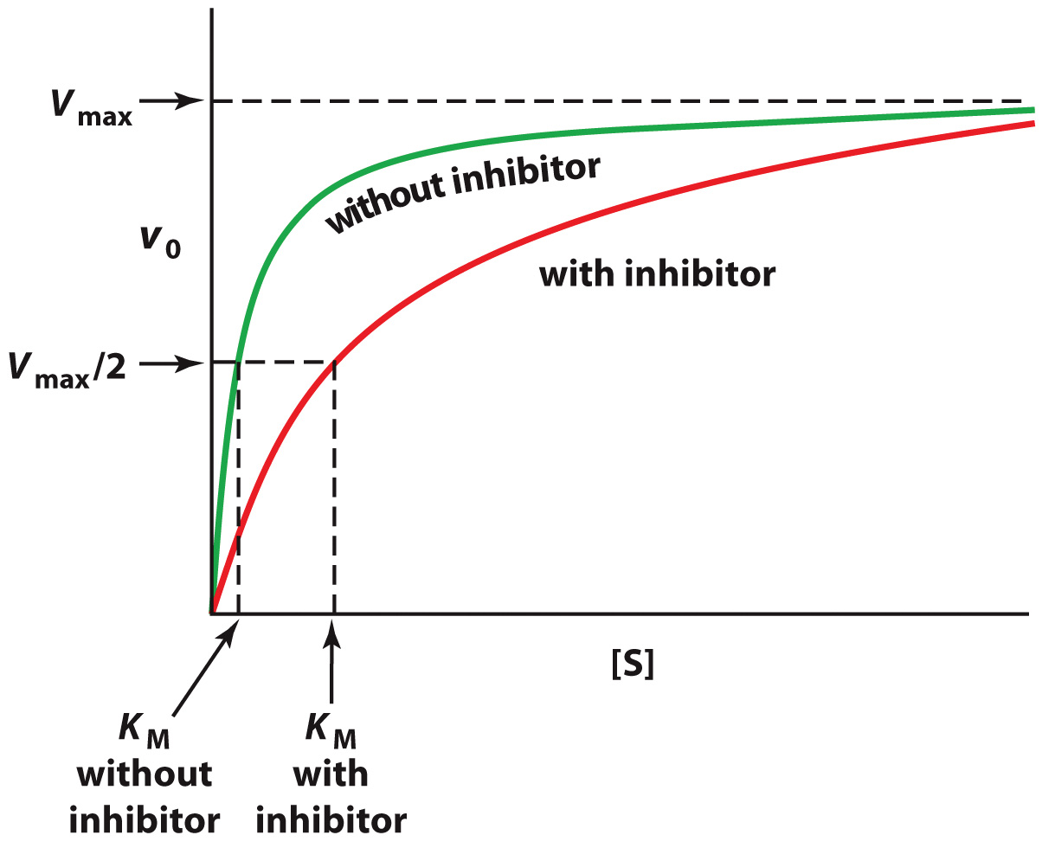
Competitive inhibitors increase K_{M}, but do not affect V_{max}

Slide 34
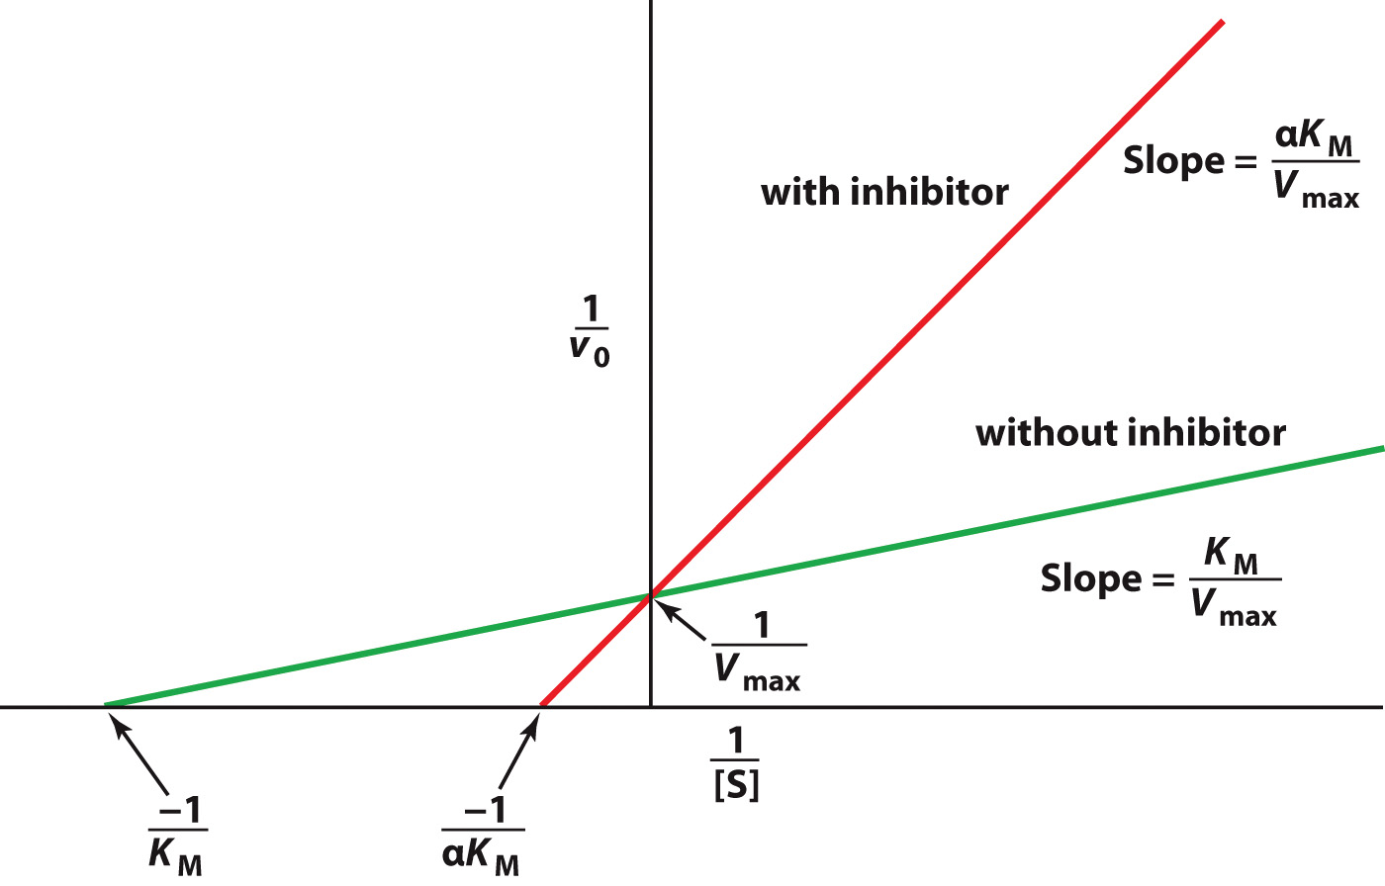
A Lineweaver-Burk plot for Competitive Inhibition

Slide 35
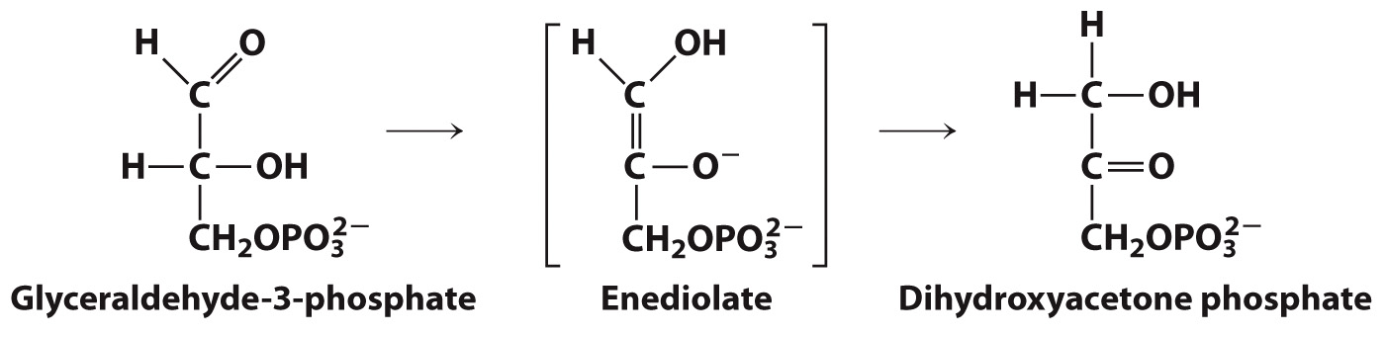
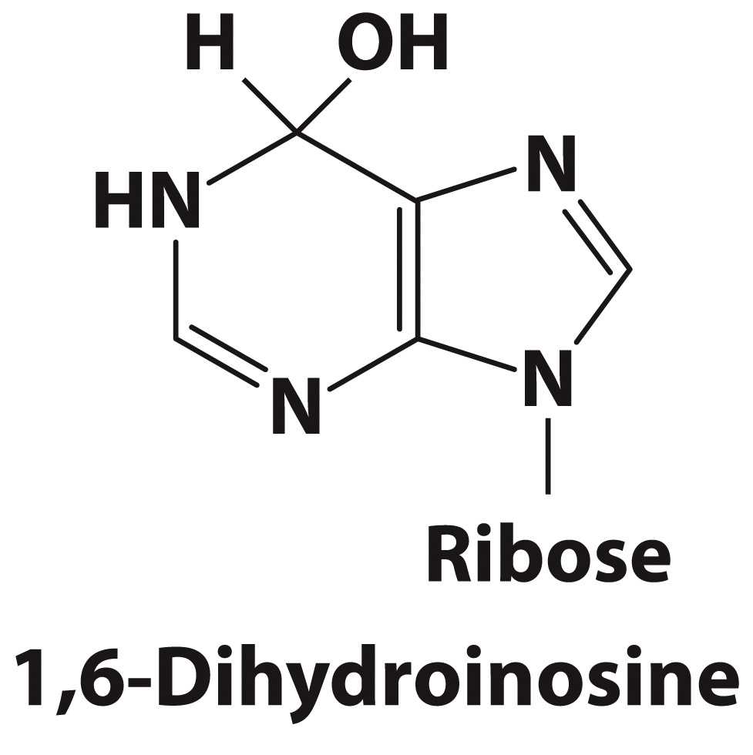
Transition state analogs often make better inhibitors than substrate analogs

Slide 36
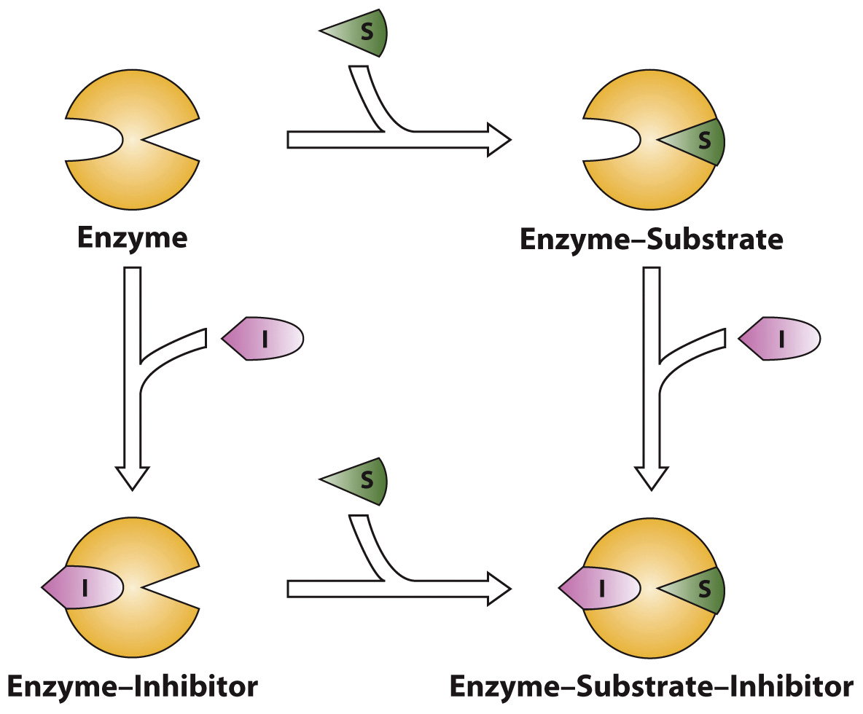
Noncompetitive inhibitors appear to decrease V_{max}

Slide 37
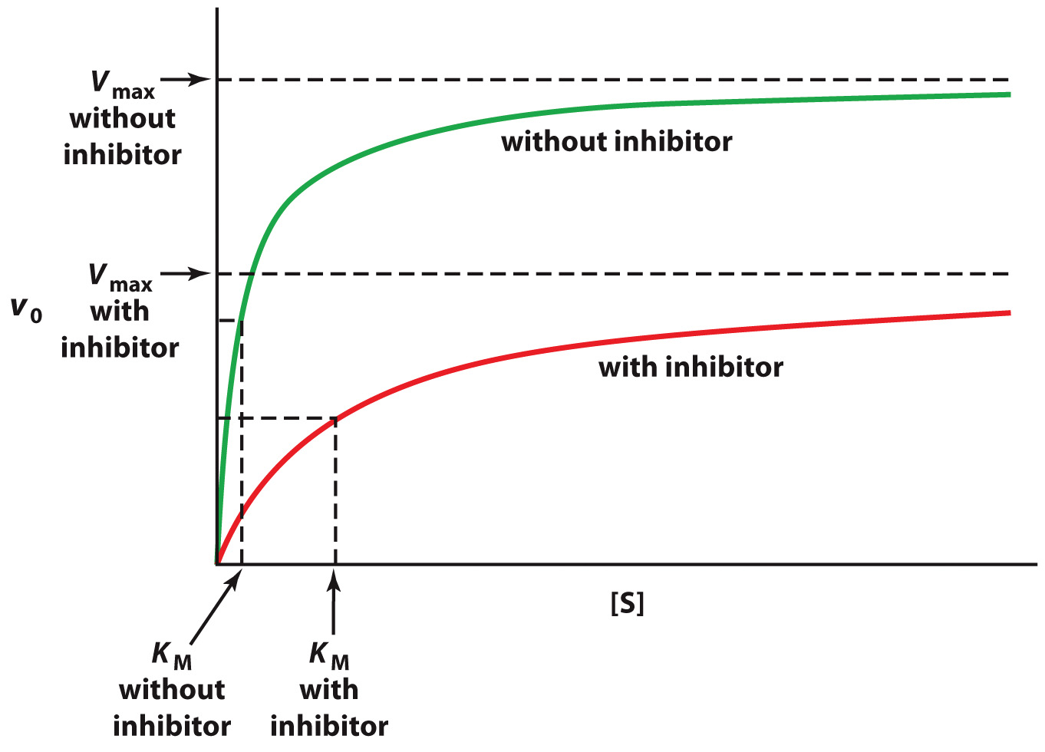
Mixed inhibitors affect both V_{max} and K_{M}

Slide 38
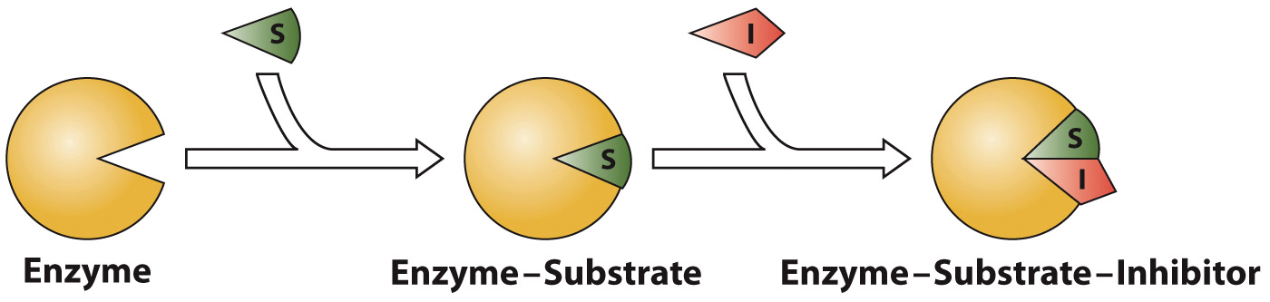
Uncompetitive inhibitors reduce V_{max} and K_{M} by roughly the same amount

Slide 39
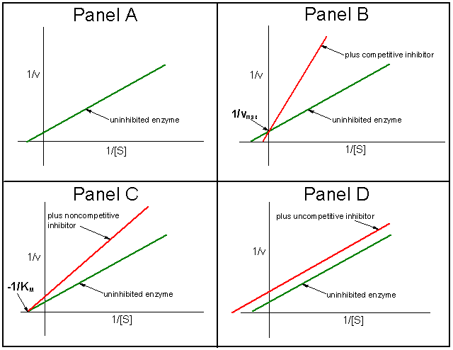

Slide 40
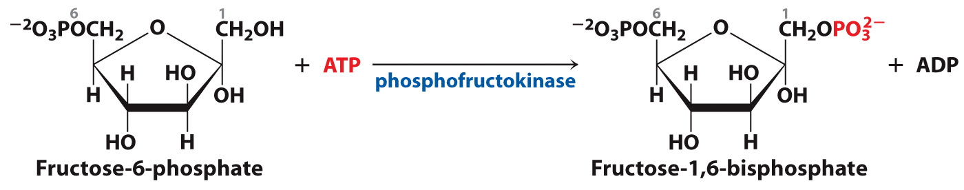
Allosteric regulation can inhibit or enhance enzyme activity

Slide 41
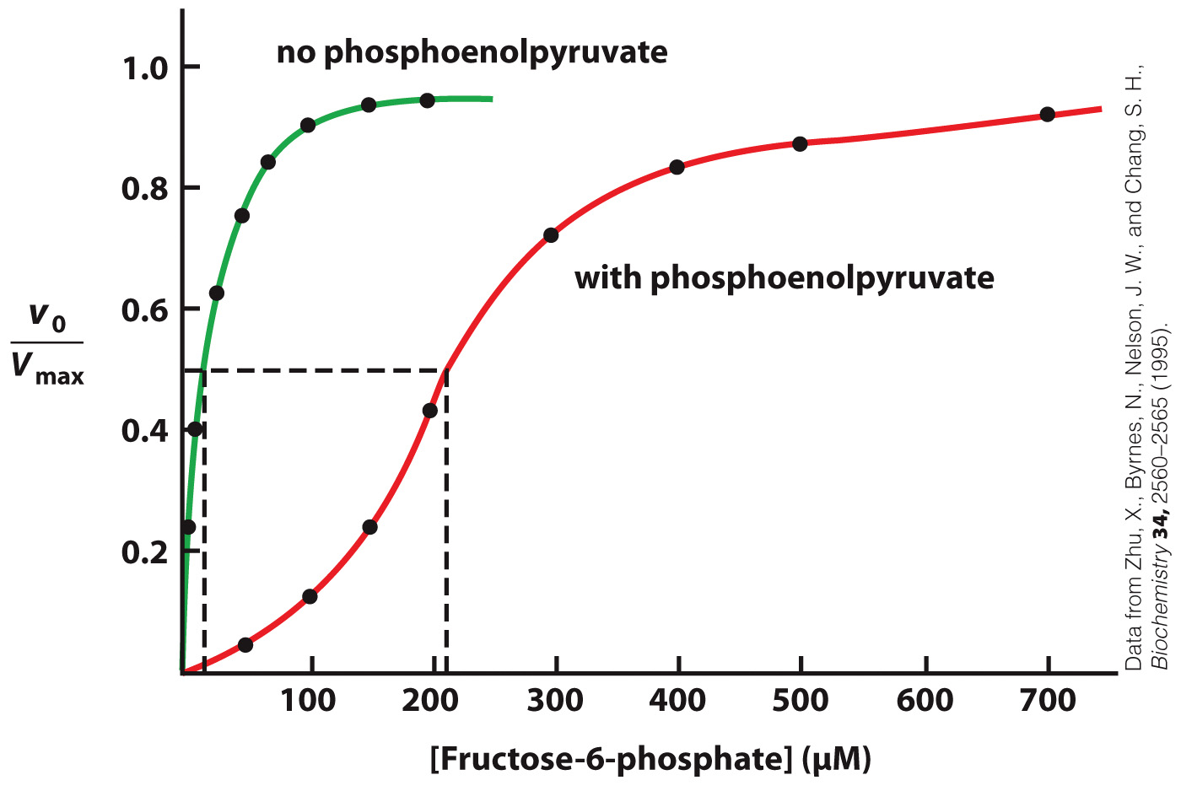
Phosphoenolpyruvate inhibits PFK by an allosteric feedback mechanism

Slide 42
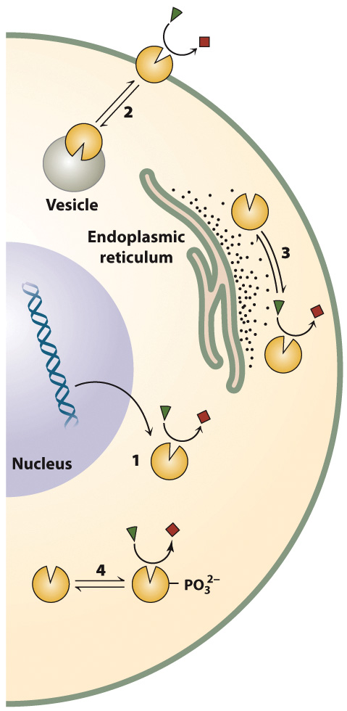
Some Mechanisms for Regulating Enzyme Activity

Slide 43
Clinical Connection: Drug Development
Section 7.4
Learning Objective
Describe the process of drug development

Slide 44
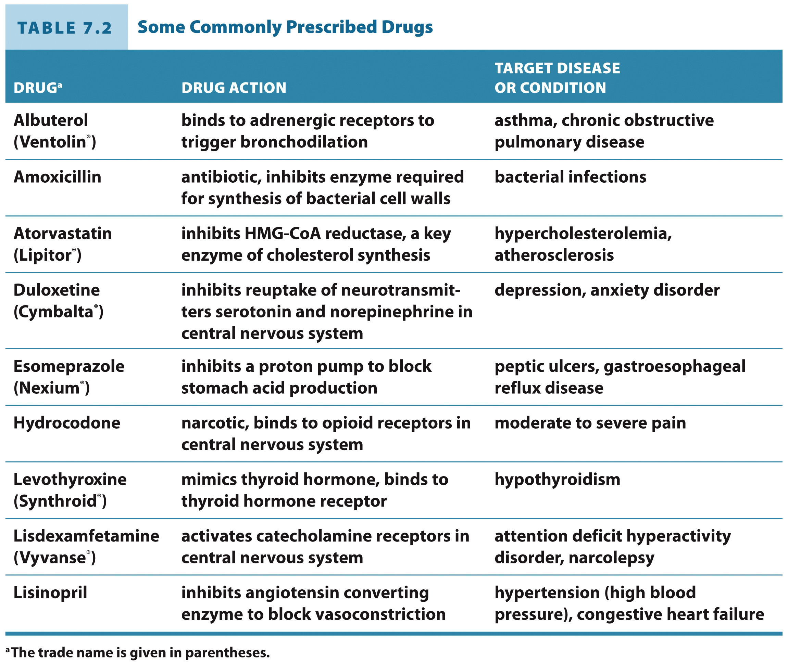
Some Commonly Prescribed Drugs

