Slide 1
Essential Biochemistry
Fourth Edition
Charlotte W. Pratt | Kathleen Cornely
Lecture Notes for
Chapter 6
How Enzymes Work

Slide 2
What Is an Enzyme?
Section 6.1
Learning Objective
Describe how enzymes differ from other catalysts

Slide 3
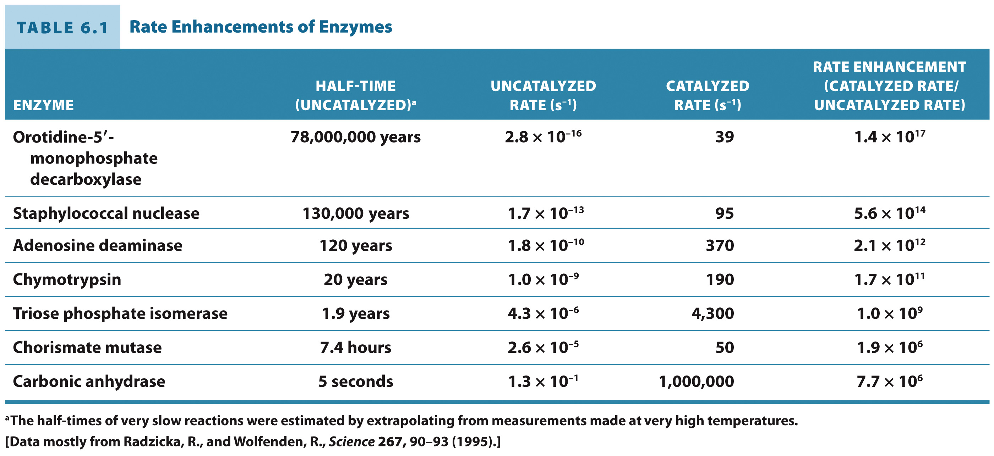
Enzymes speed up biochemical reactions
Rate enhancements of 10⁸ to 10¹² are typical of enzymes.

Slide 4
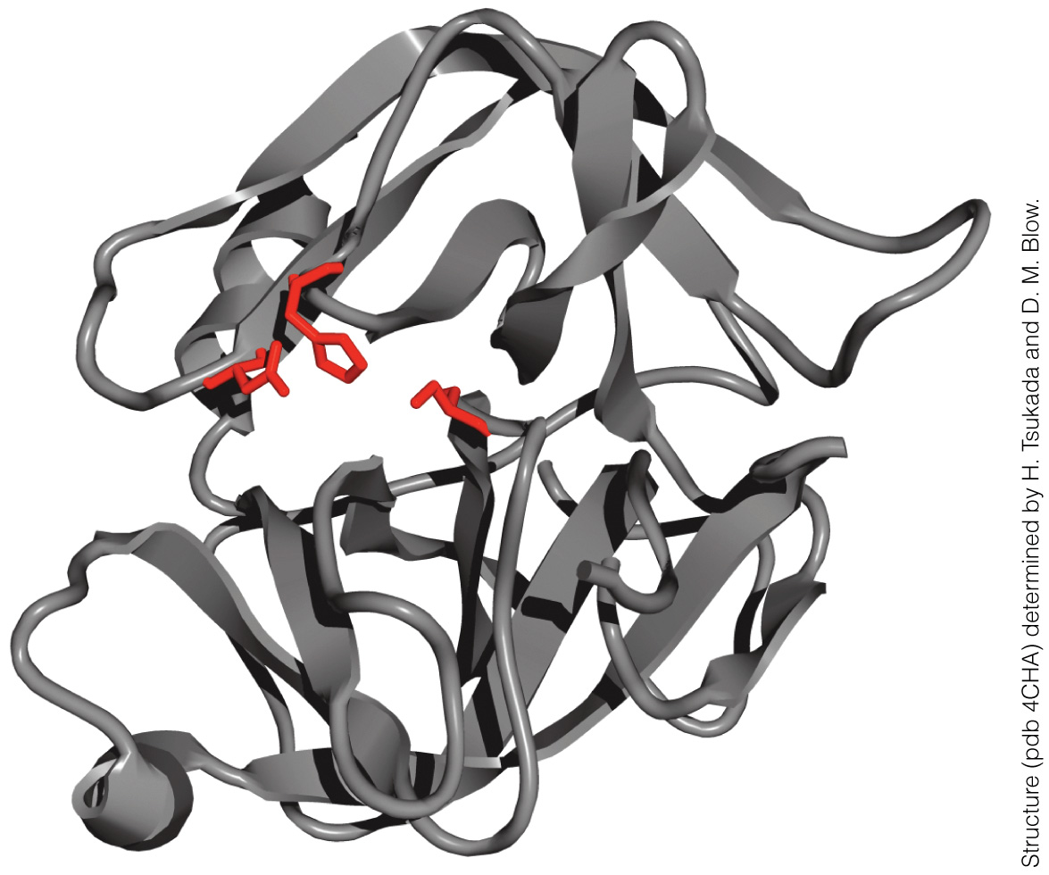
Enzymes have an active site

Slide 5
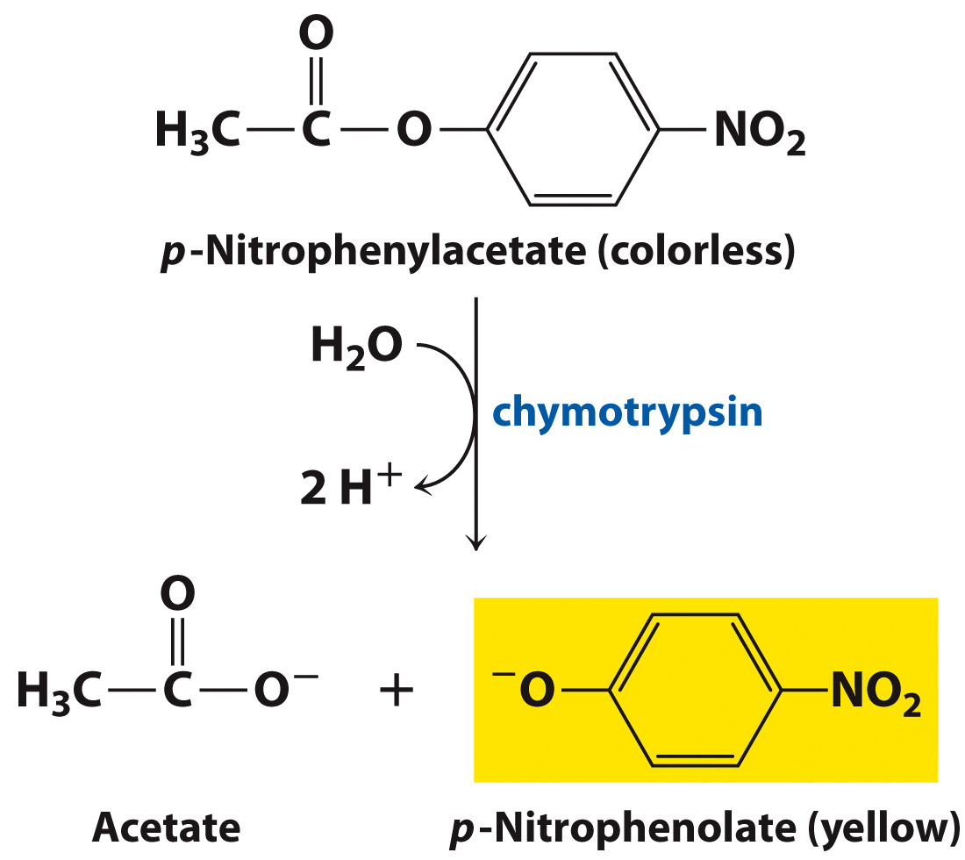
Most enzymes are highly specific for their substrates

Slide 6
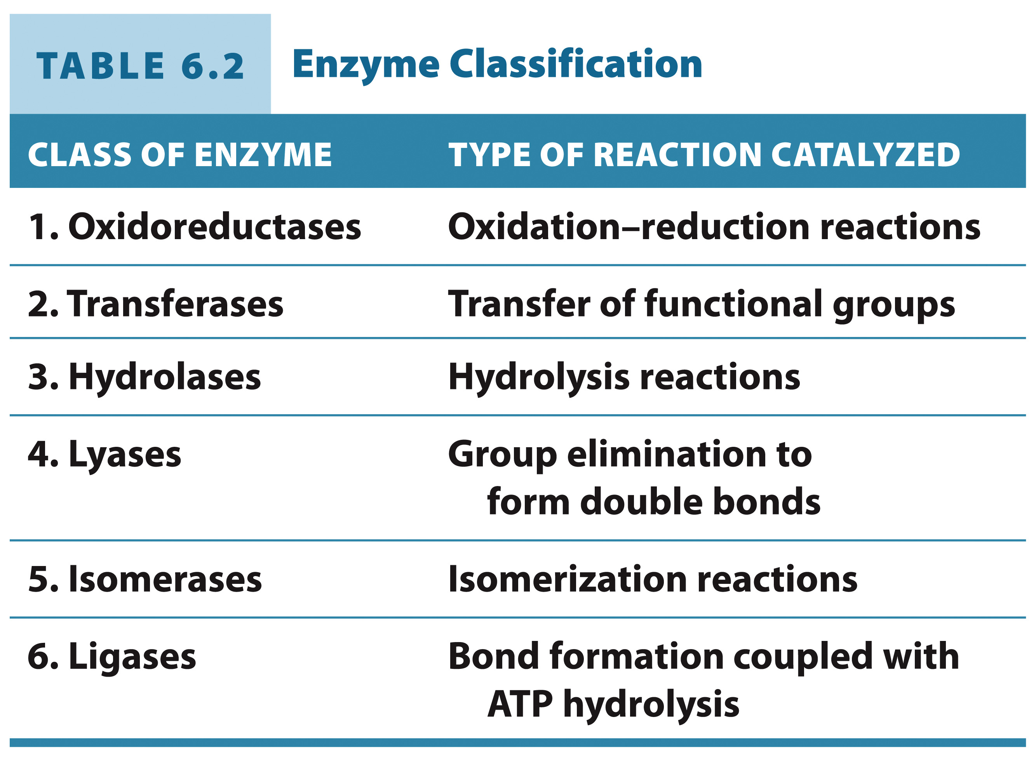
There are six major classifications of enzymes

Slide 7
E.C. Classes
1. Oxidoreductases: Alcohol Dehydrogenase
2. Transferases: Hexokinase

Slide 8
3. Hydrolase: alkaline phosphatase
4. Lyases: Citrate Lyase

Slide 9
5. Isomerases: Phosphoglycermutase
6. Ligases: Pyruvate carboxylase

Slide 10
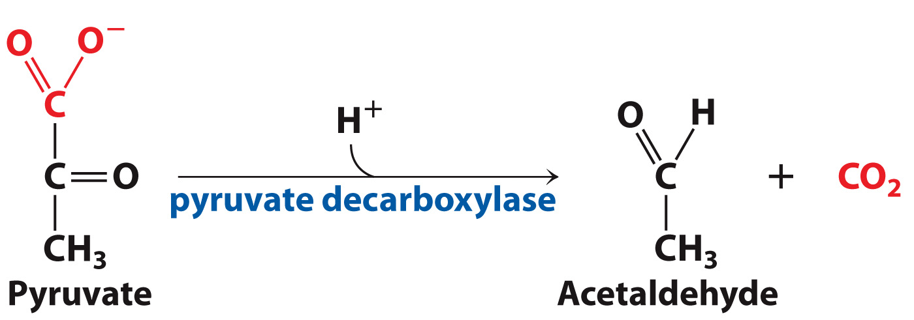
Enzymes are usually named after the reaction they catalyze

Slide 11
Chemical Catalytic Mechanisms
Section 6.2
Learning Objective
Describe the chemical mechanisms enzymes use to accelerate reactions

Slide 12
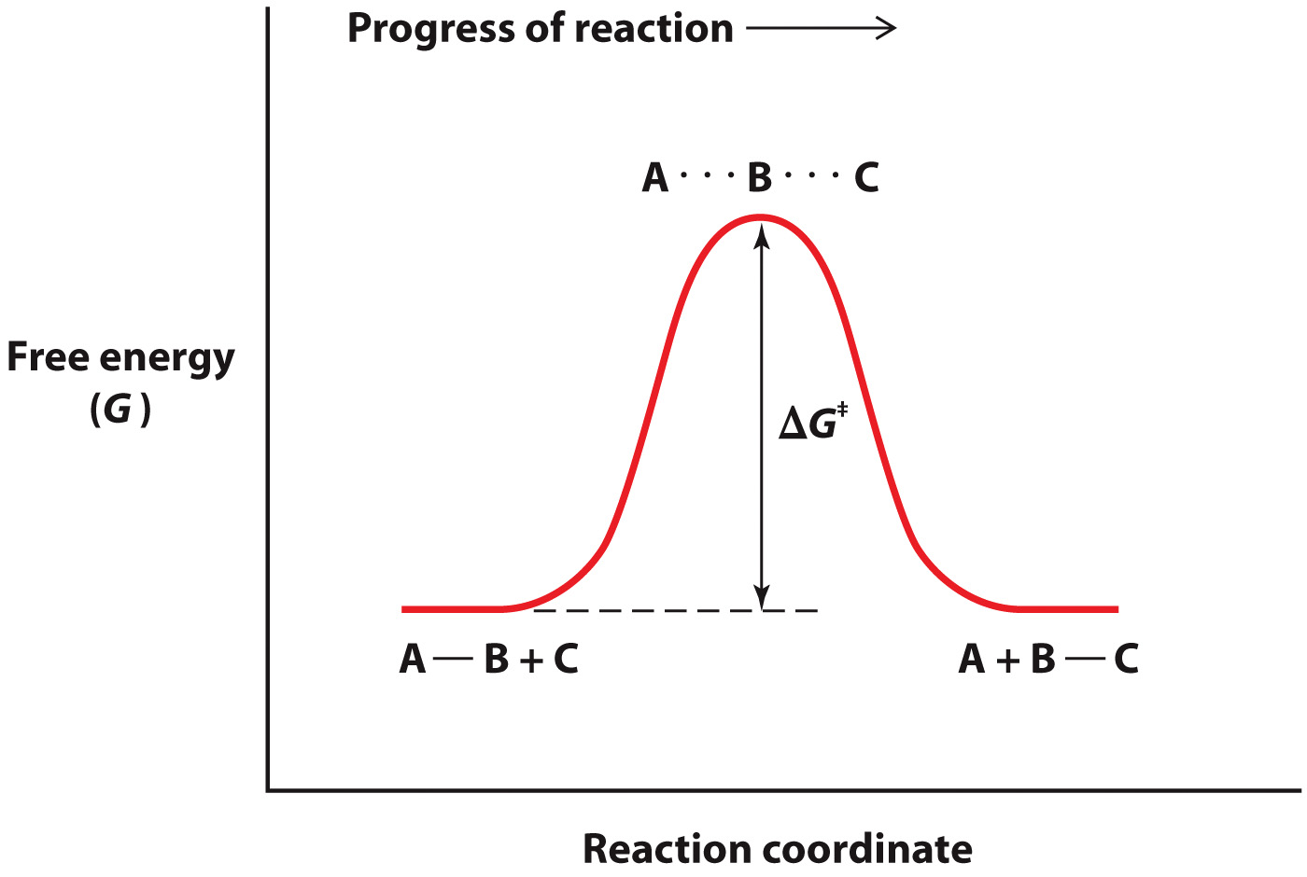
The height of the activation energy barrier determines the rate of a reaction

Slide 13
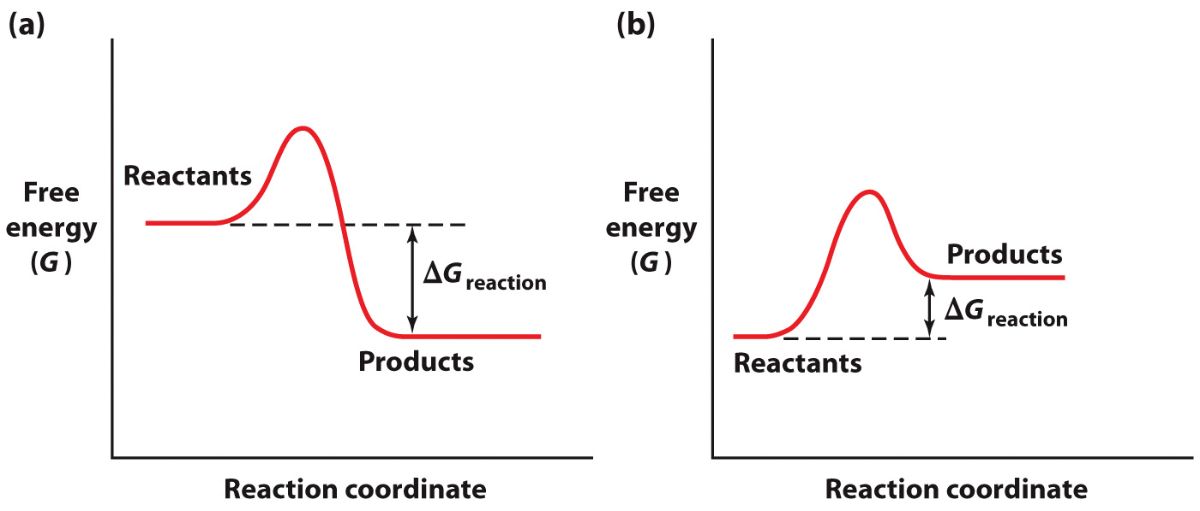
The sign of ΔG indicates the spontaneity of a reaction
ΔG<0 spontaneous reaction
ΔG>0 non-spontaneous reaction

Slide 14
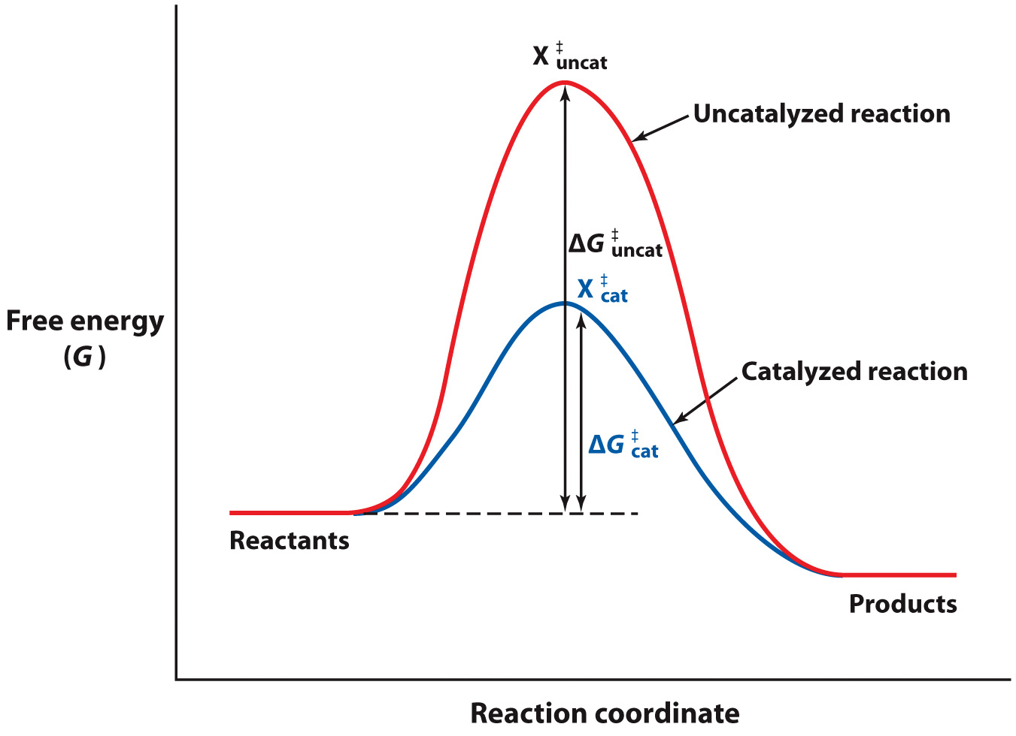
Enzymes lower the activation energy for a reaction

Slide 15
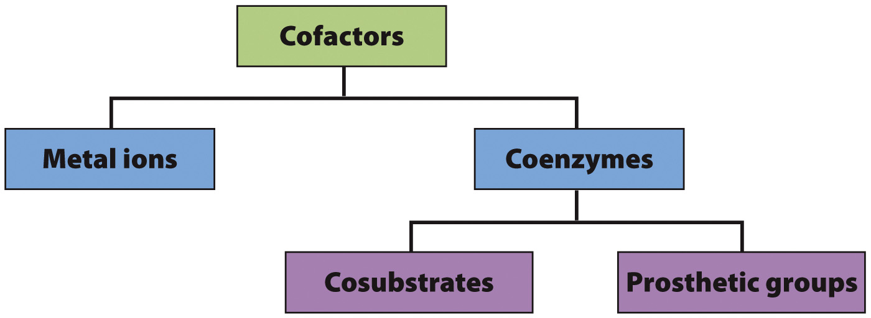
Enzymes often use cofactors to aid in catalysis

Slide 17
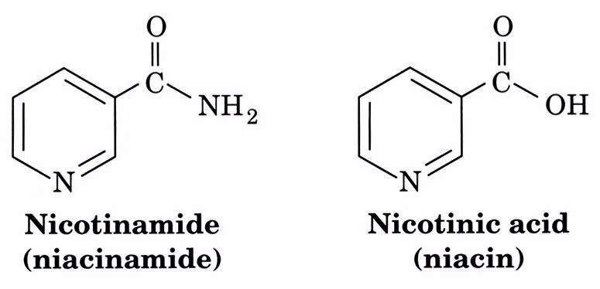

Slide 18
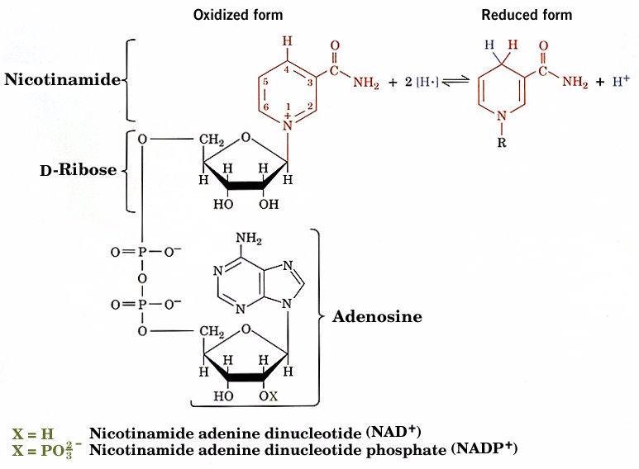

Slide 19
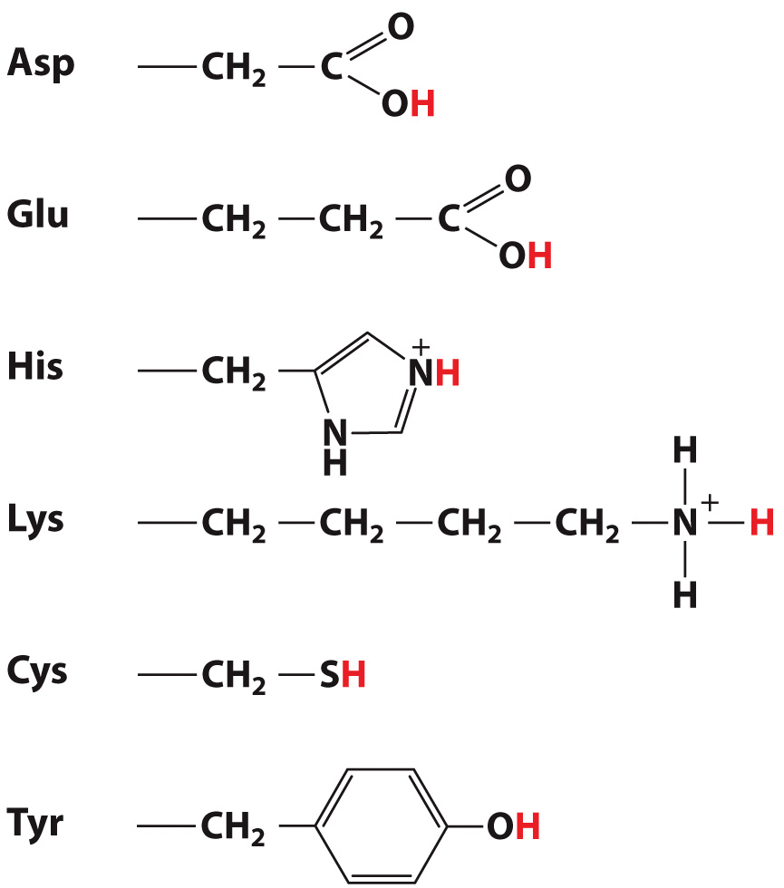
Some amino acids can play a role in acid-base catalysis

Slide 20
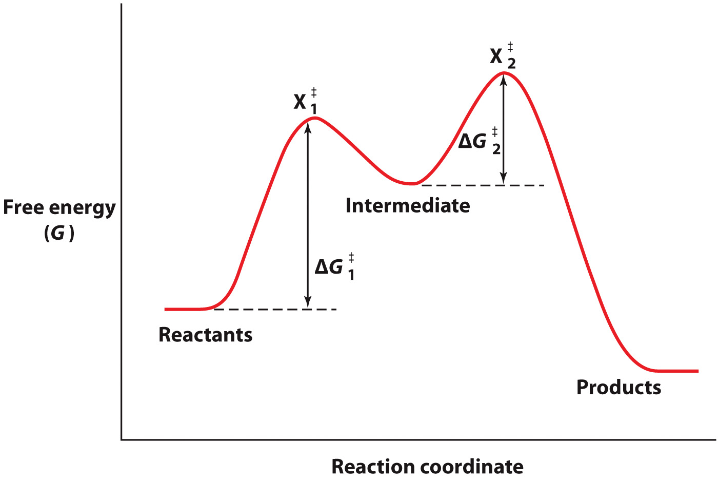
Covalent Catalysis

Slide 21
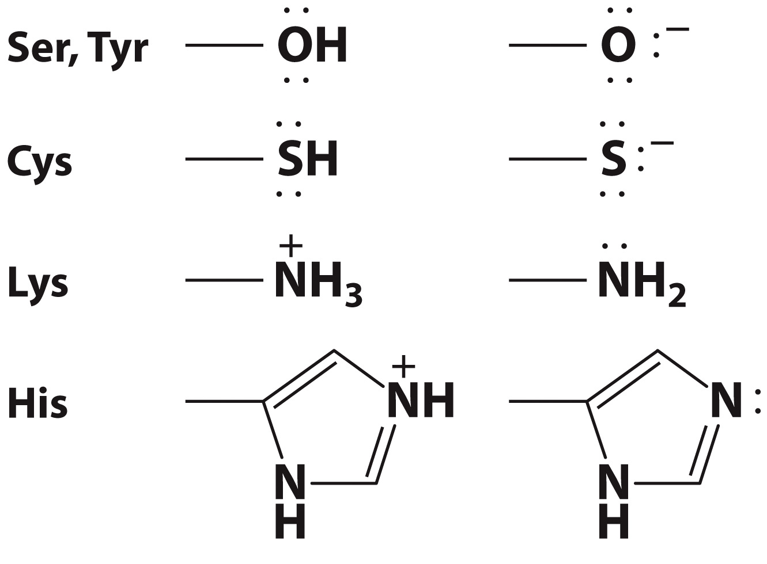
Amino Acids that Act as Covalent Catalysts

Slide 22
Metal Ions as Catalysts
Example: Alcohol Dehydrogenase

Slide 23
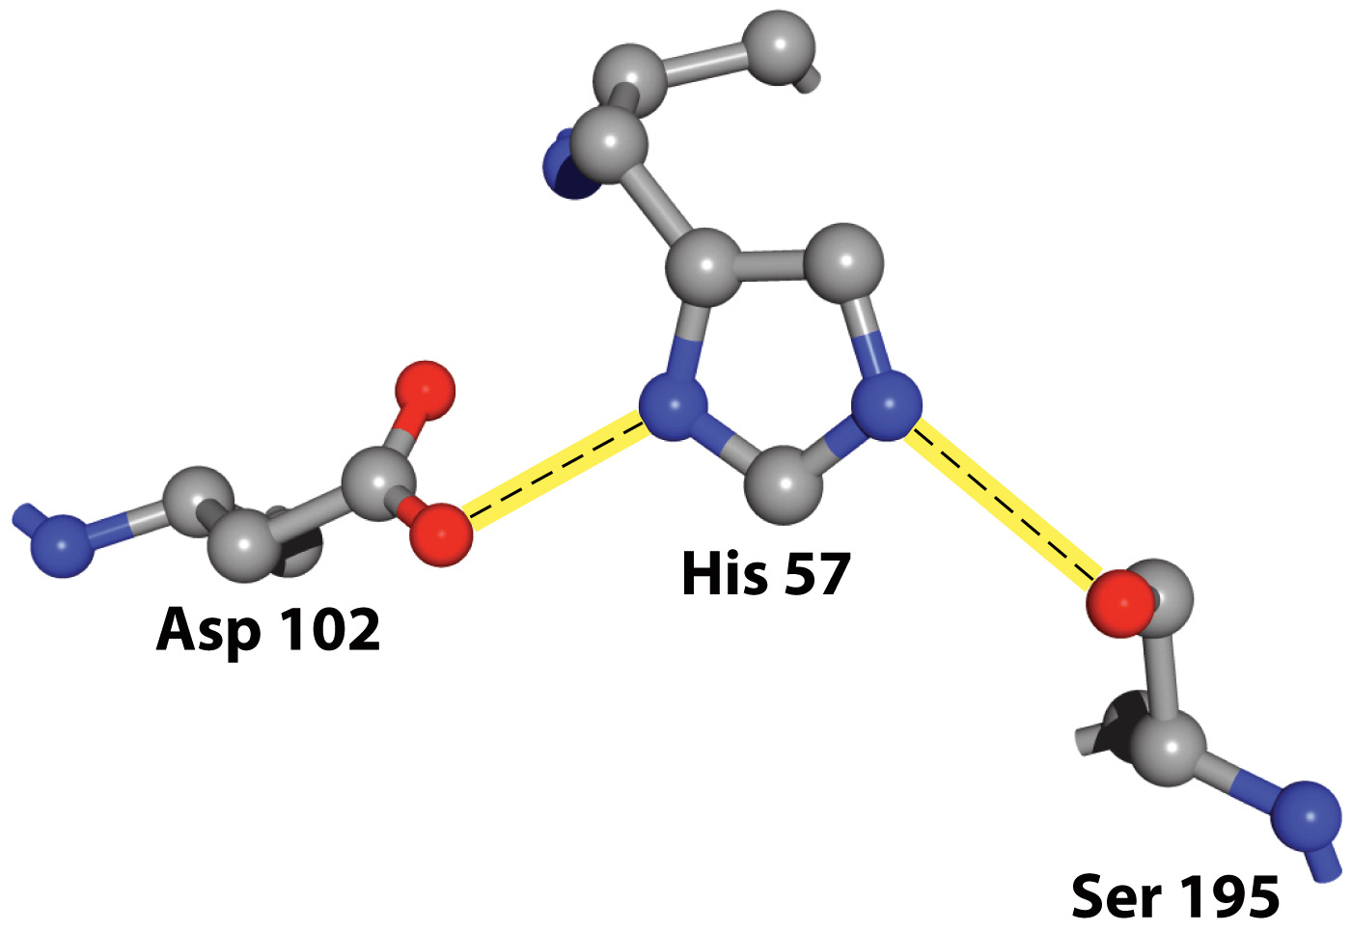
The Catalytic Triad of Chymotrypsin

Slide 24
Unique Properties of Enzyme Catalysts
Section 6.3
Learning Objective
Explain how active site structure contributes to catalysis

Slide 25
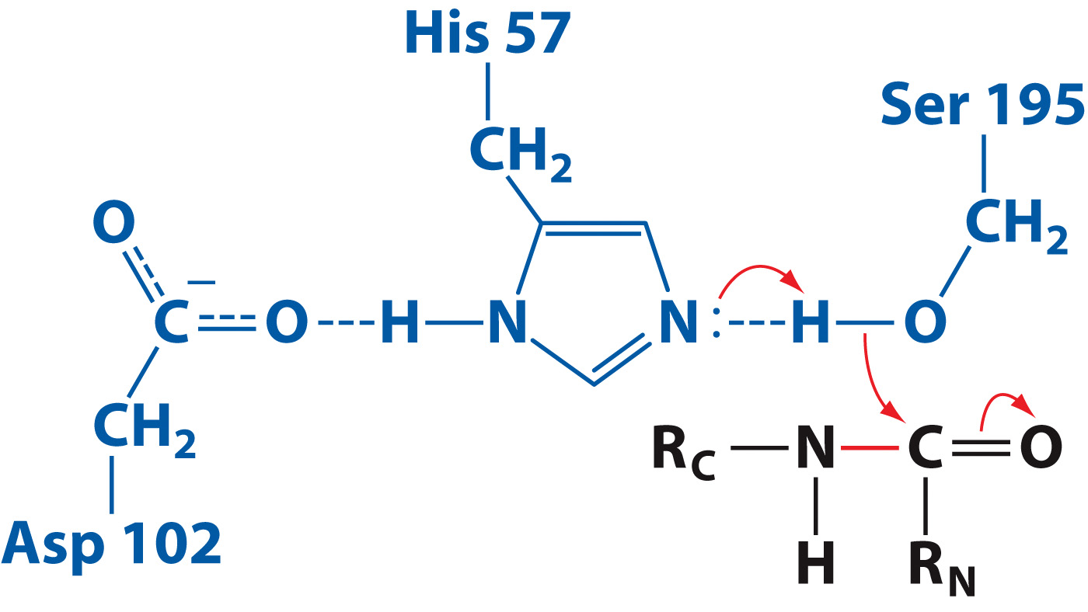
Features of Ser Protease Mechanism

Slide 26
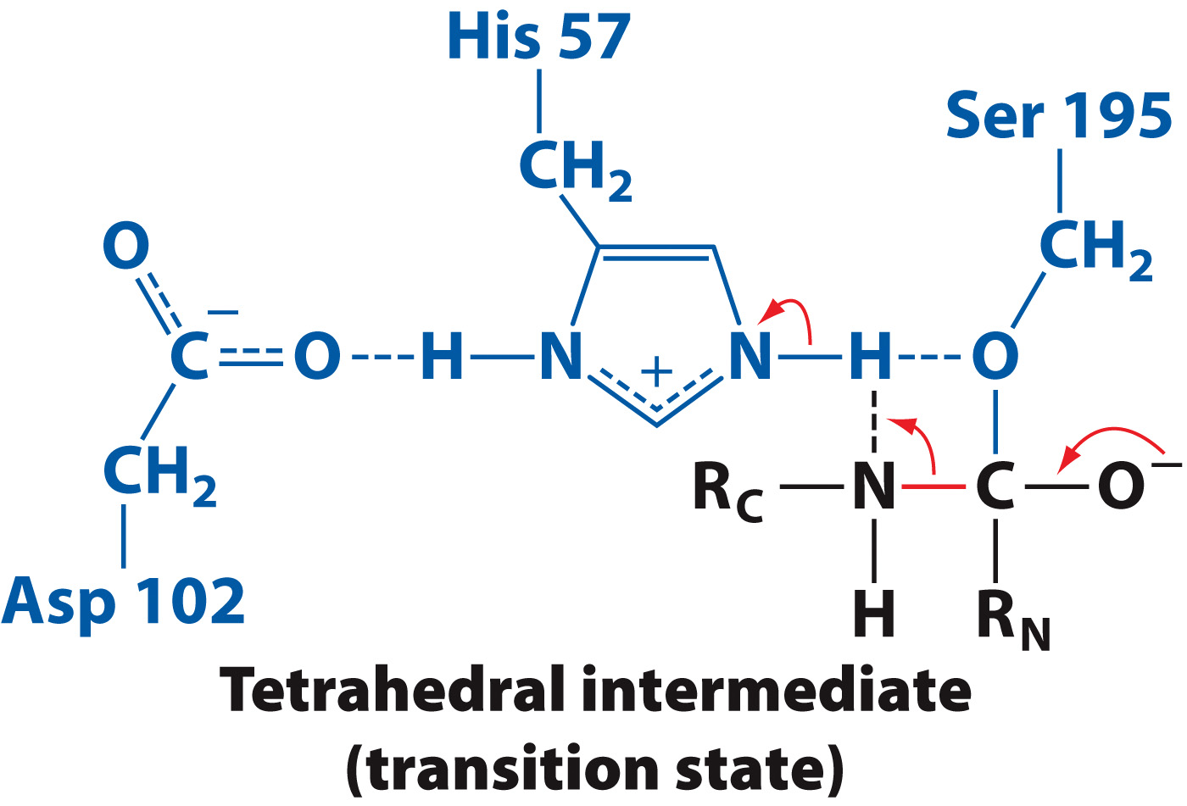
Features of Ser Protease Mechanism

Slide 27
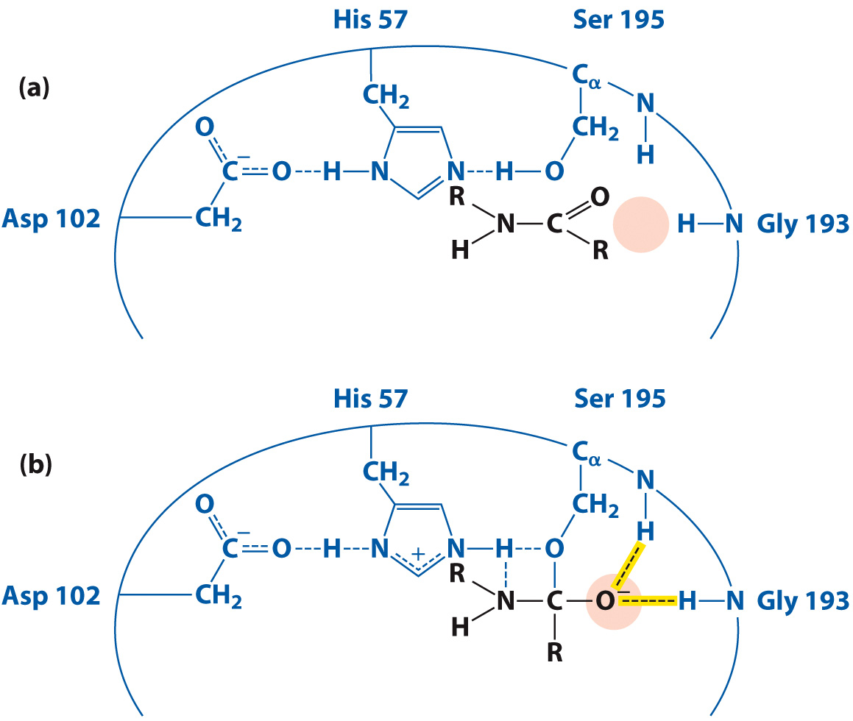
Enzymes stabilize the transition state

Slide 28
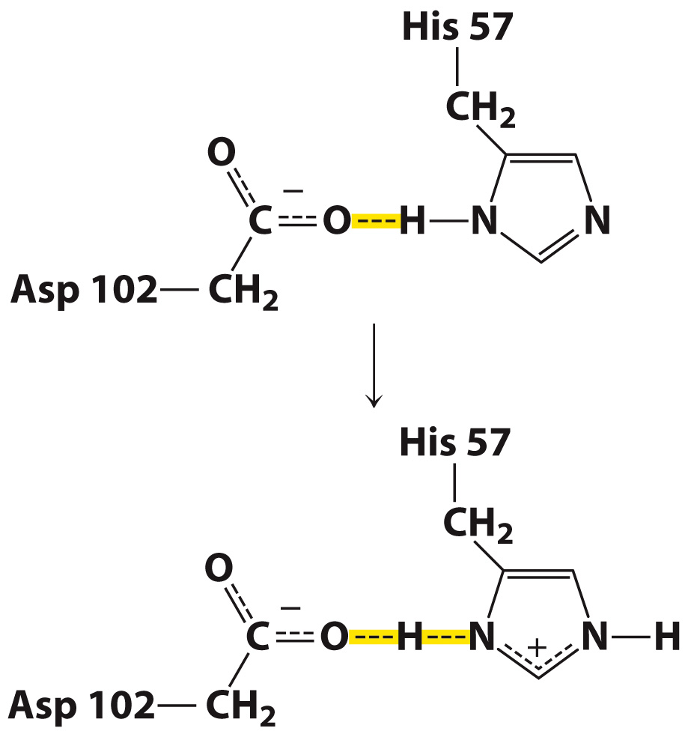
Formation of a Low-Barrier Hydrogen Bond During Catalysis by Chymoptrypsin

Slide 29
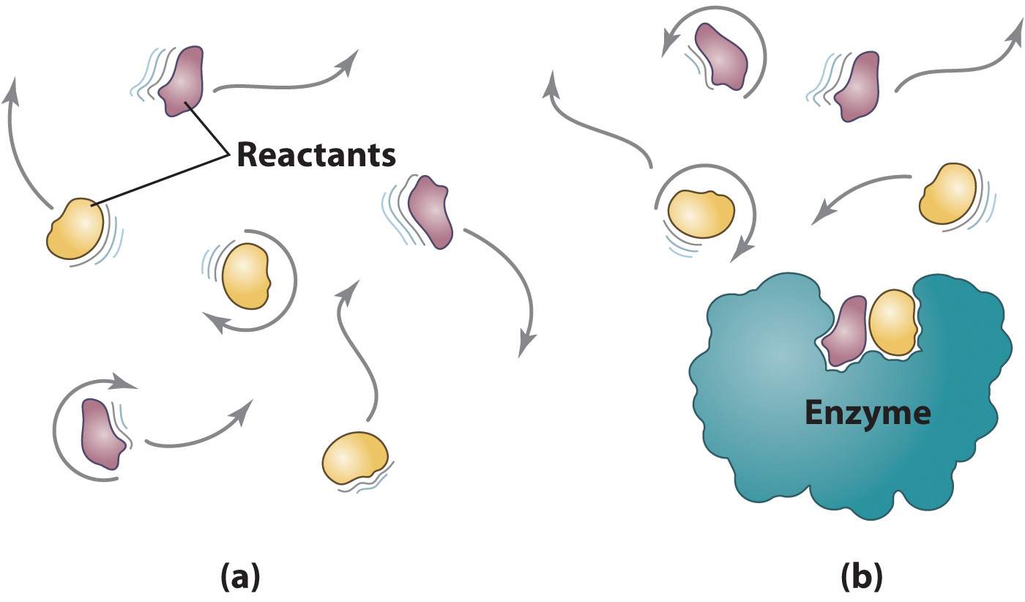
Proximity and Orientation Effects

Slide 30
Hexokinase catalyzes the phosphorylation of glucose by ATP

Slide 31
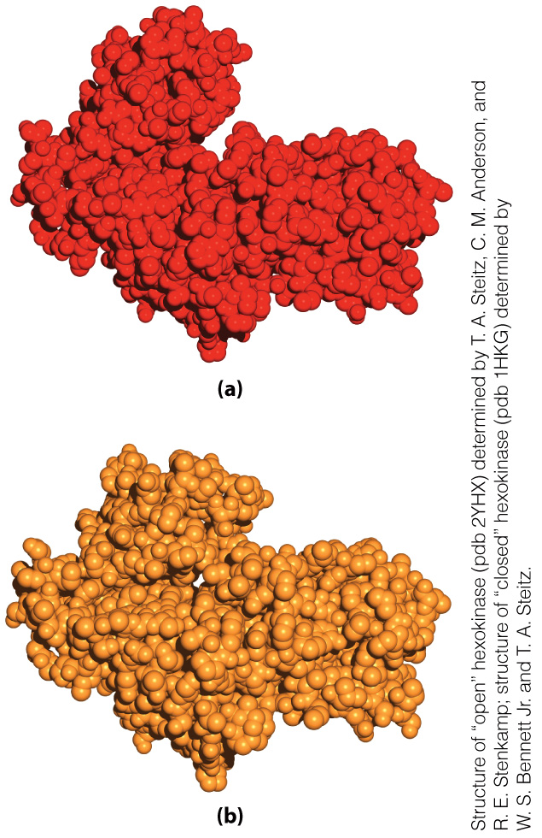
Induced Fit

Slide 32
Chymotrypsin in Context
Section 6.4
Learning Objective
Recognize that chymotrypsin illustrates general features of enzyme evolution and physiology

Slide 33
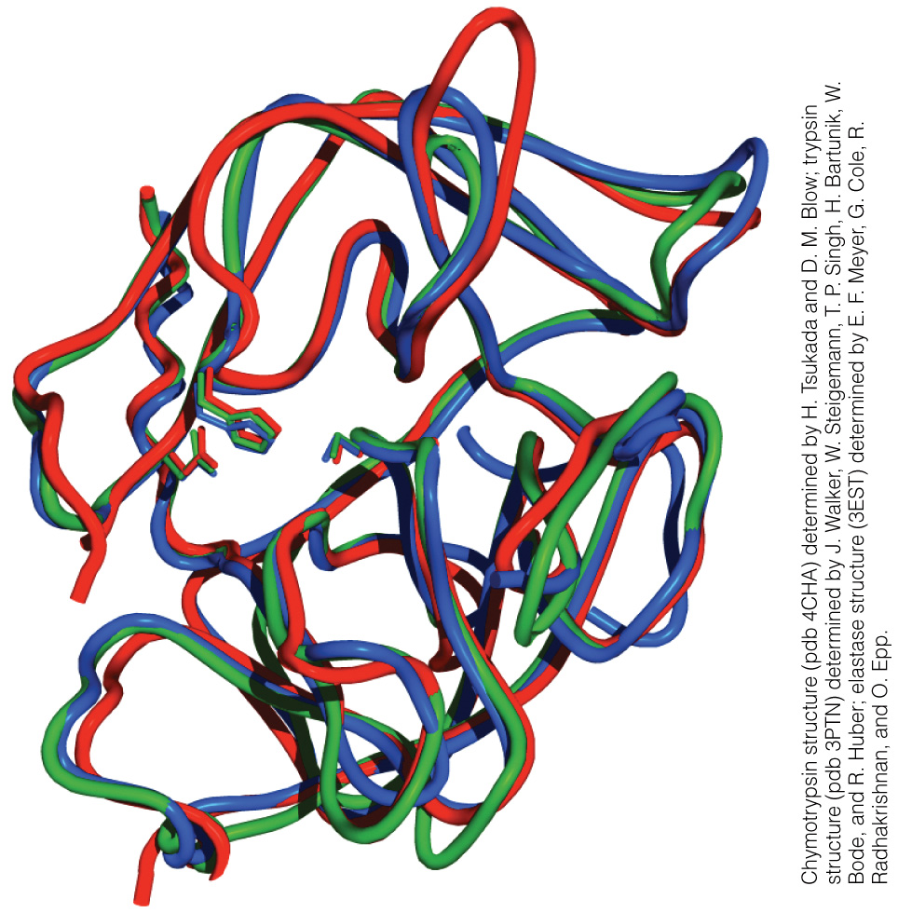
Chymotrypsin, trypsin and elastase have very similar structures
Chymotrypsin
Trypsin
Elastase

Slide 34
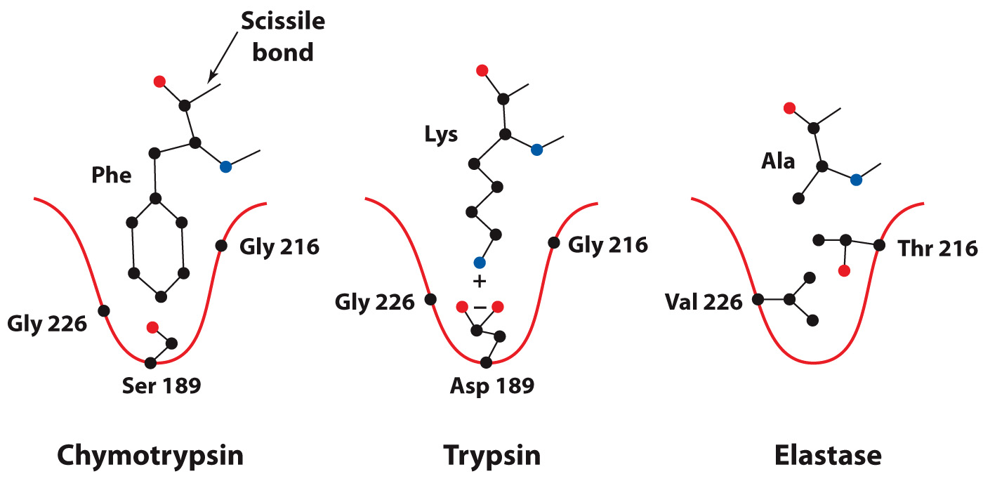
Specificity pockets of serine proteases

Slide 35
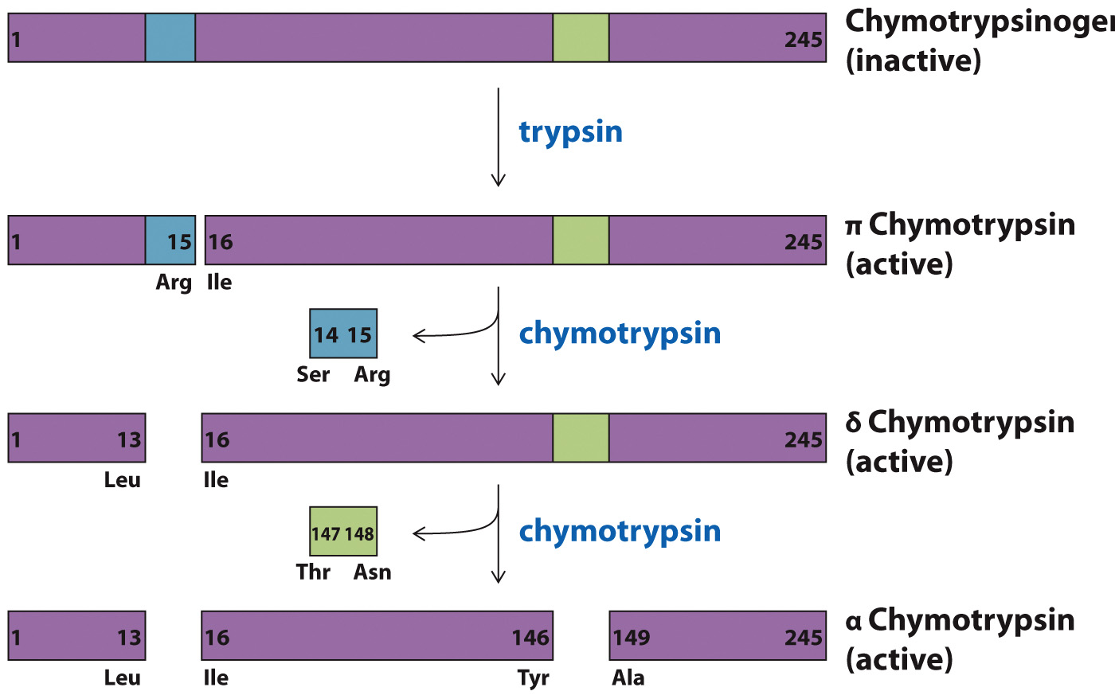
Activation of Chymotrypsinogen

Slide 36
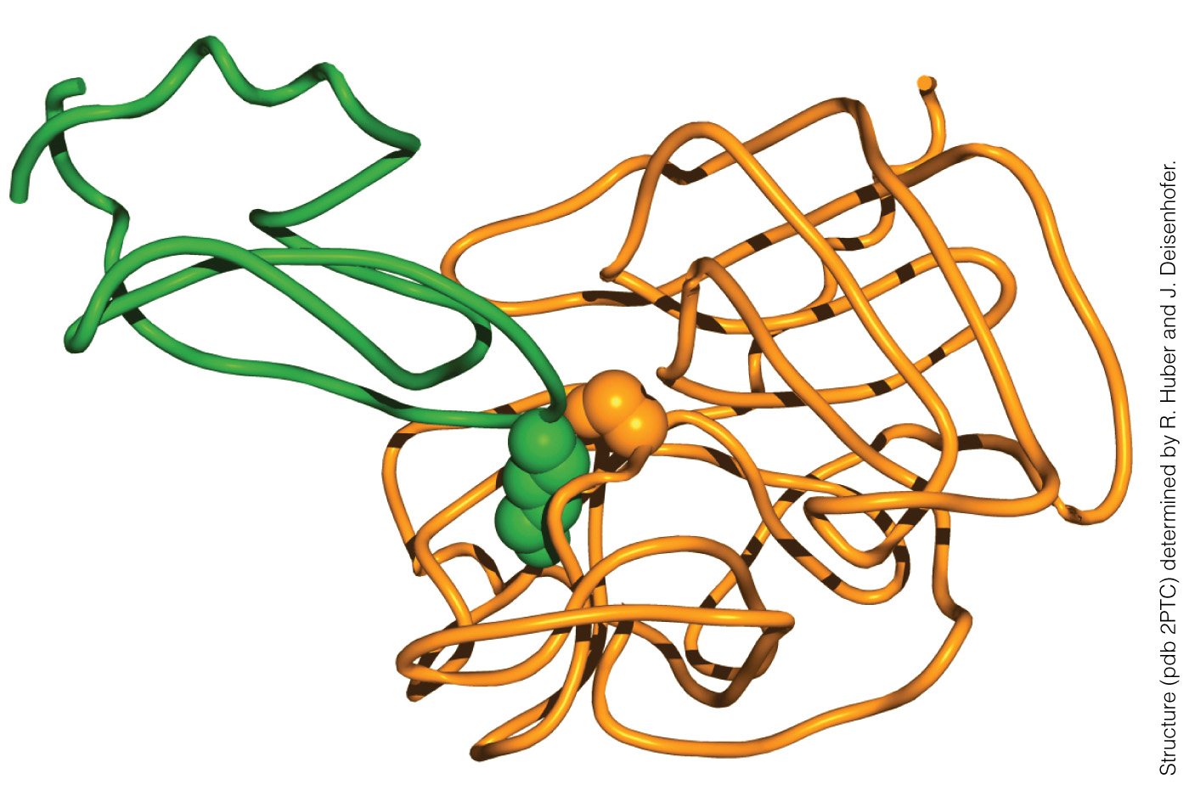
Protease inhibitors limit protease activity
Trypsin
Bovine Pancreatic Trypsin Inhibitor (BPTI)

Slide 37
Clinical Connection: Blood Coagulation
Section 6.5
Learning Objective
Describe blood coagulation as a protease cascade

Slide 38
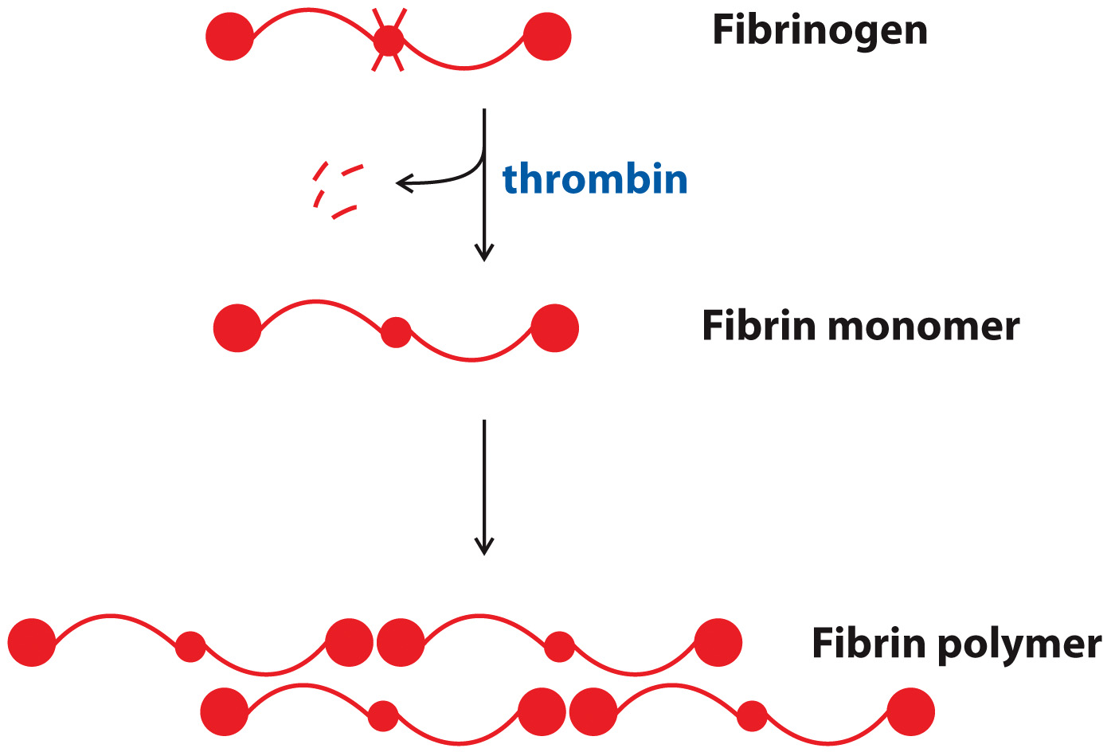
Fibrin traps red blood cells to form blood clots

Slide 39
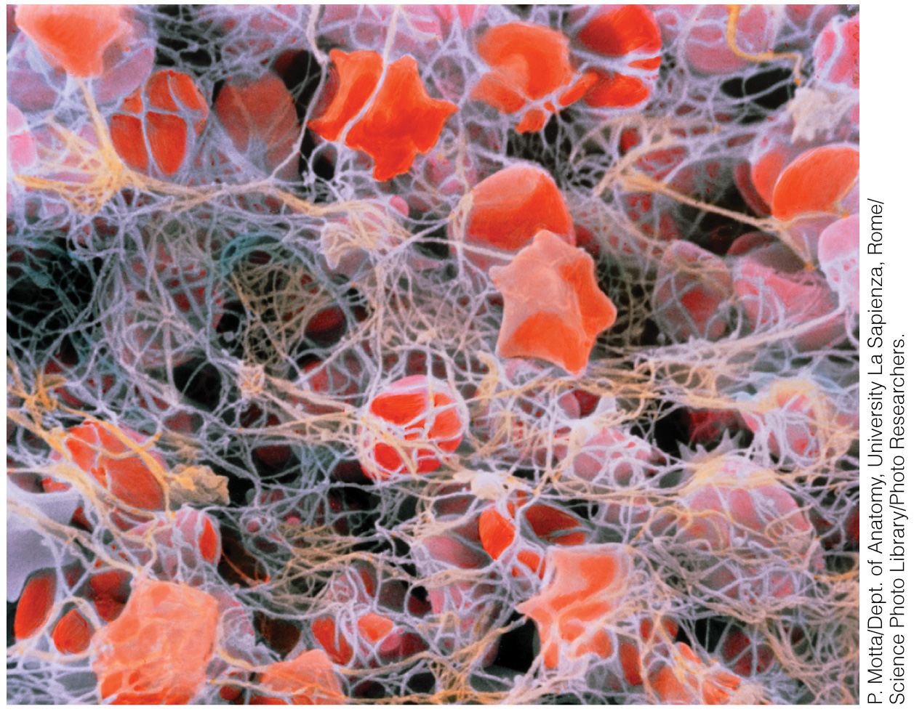
A Blood Clot

Slide 40
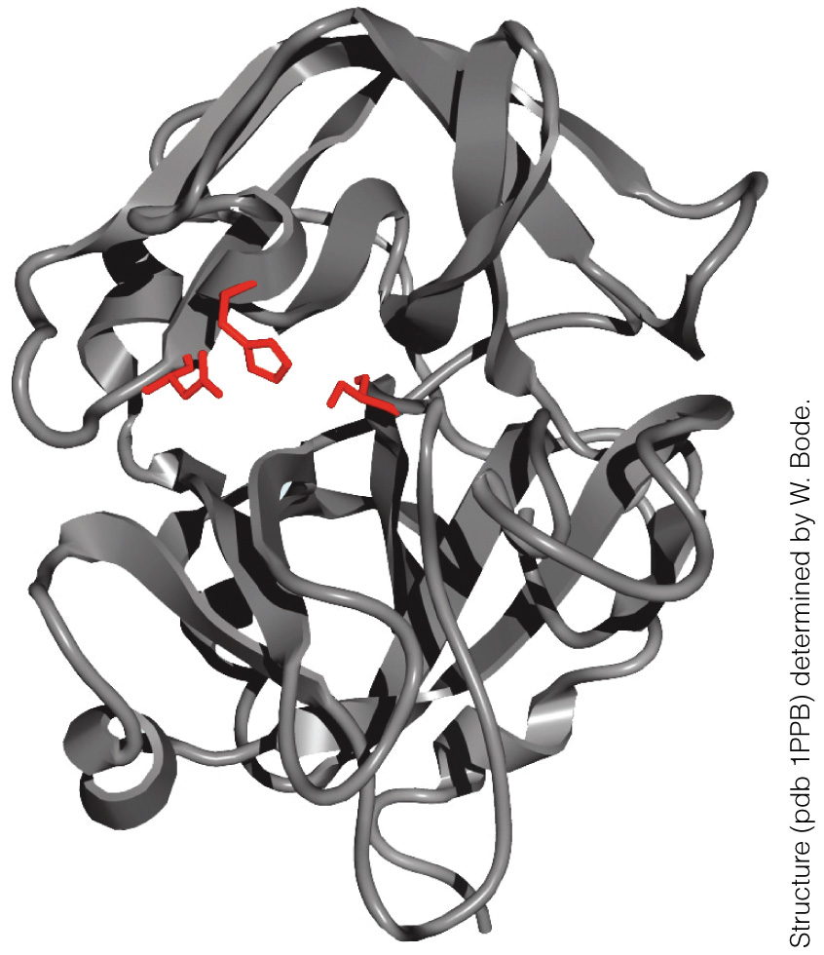
Thrombin Structure

Slide 41
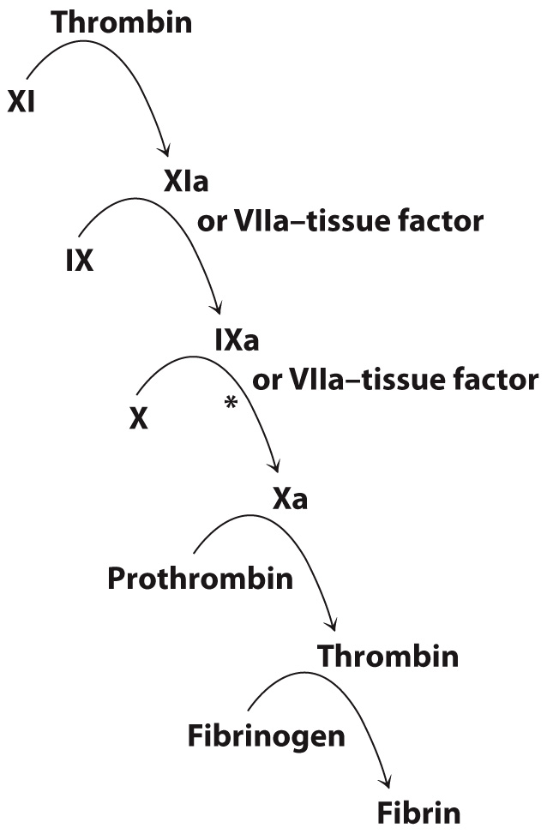
The Coagulation Cascade

Slide 42
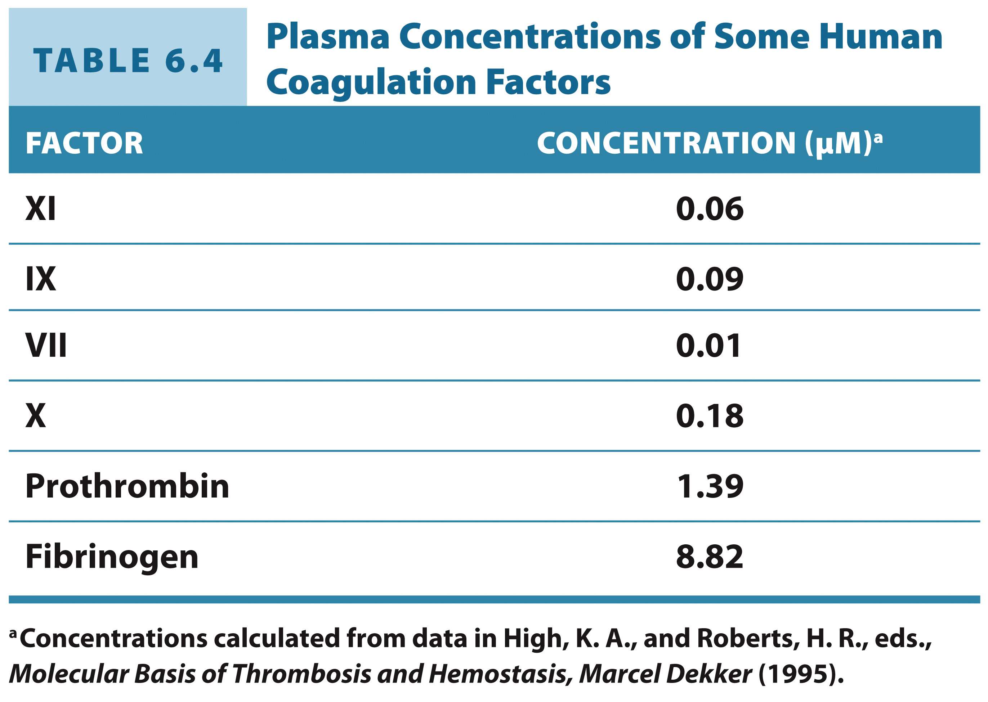
Human Coagulation Factors

Slide 43
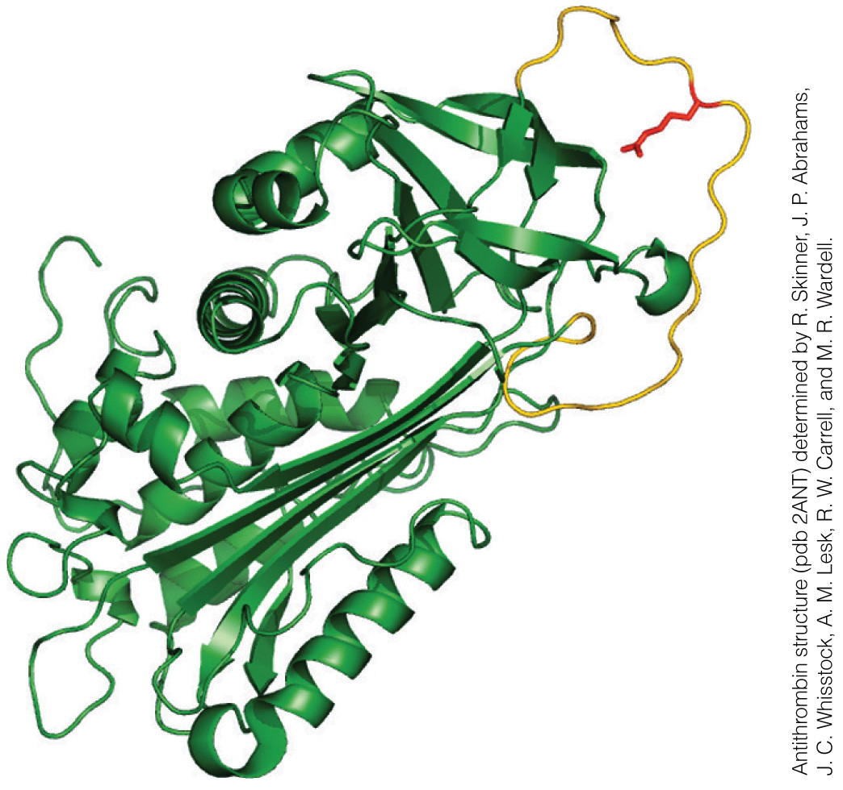
Antithrombin

