Slide 1
Essential Biochemistry
Fourth Edition
Charlotte W. Pratt | Kathleen Cornely
Lecture Notes for
Chapter 5
Protein Function

Slide 2
Myoglobin and Hemoglobin: Oxygen-Binding Proteins
Section 5.1
Learning Objective
Compare the structures and functions of myoglobin and hemoglobin

Slide 3
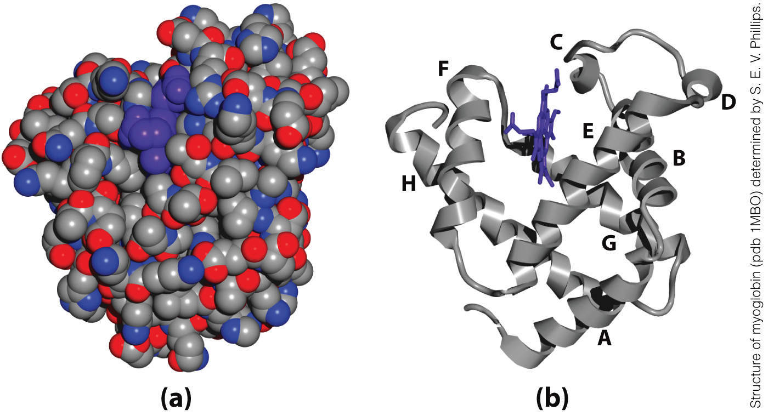
Myoglobin is a classical globular protein
Space-filling representation
Ribbon diagram with heme in purple

Slide 4
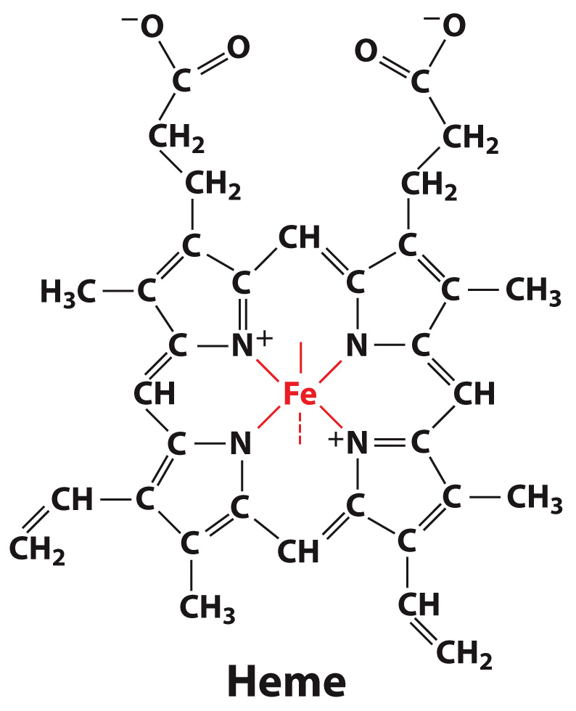
Heme is a prosthetic group found in myoglobin and hemoglobin

Slide 5
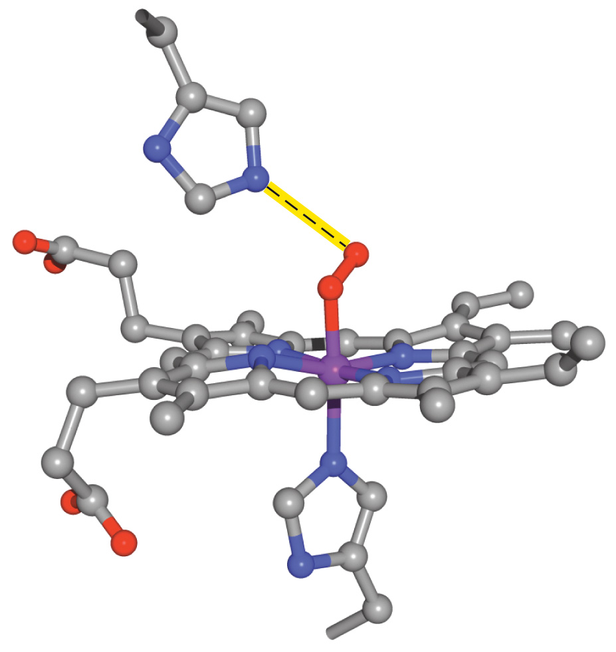
Myoglobin transports O₂ via the Fe in heme
O₂

Slide 6
How can binding of O₂ to myoglobin be described?
Mb + O₂ MbO₂
[Mb]
[MbO₂]
K =
[MbO₂]

Slide 7
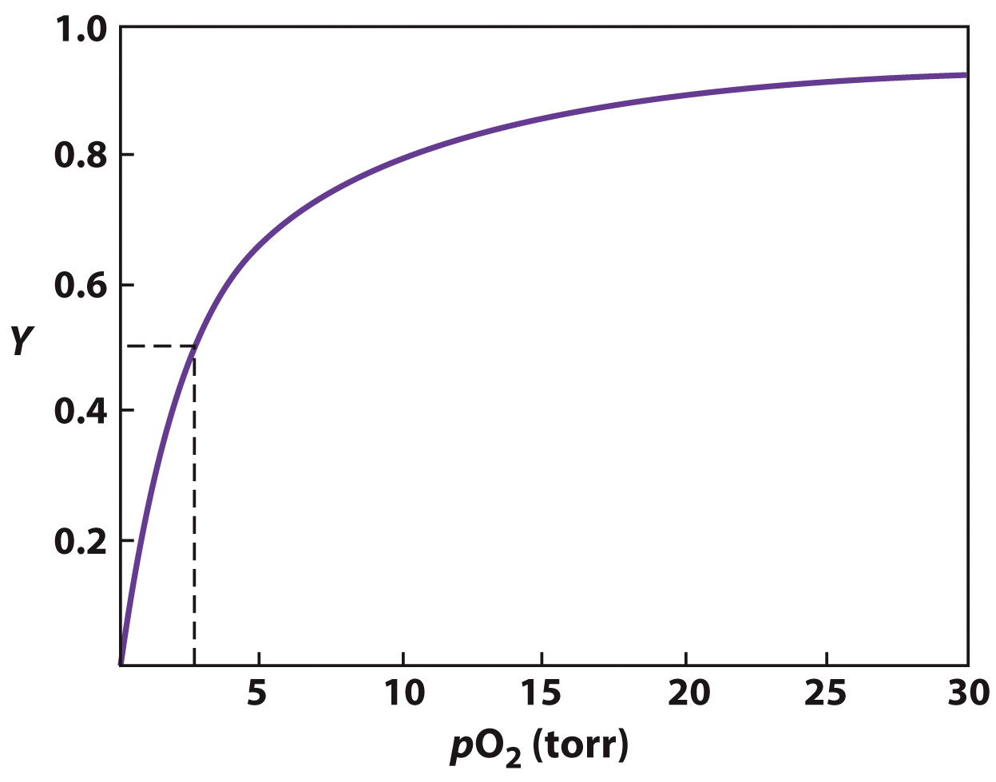
Myoglobin binds to O₂ in a hyperbolic trend
Fractional Saturation (Y):
the proportion of myoglobin
molecules that have bound O₂
Bound Mb
Y =
Total Mb
[MbO₂]
Y =
[Mb] +
[MbO₂]
pO₂
Y =
K +
pO₂
Equation of a hyperbolic curve

Slide 8
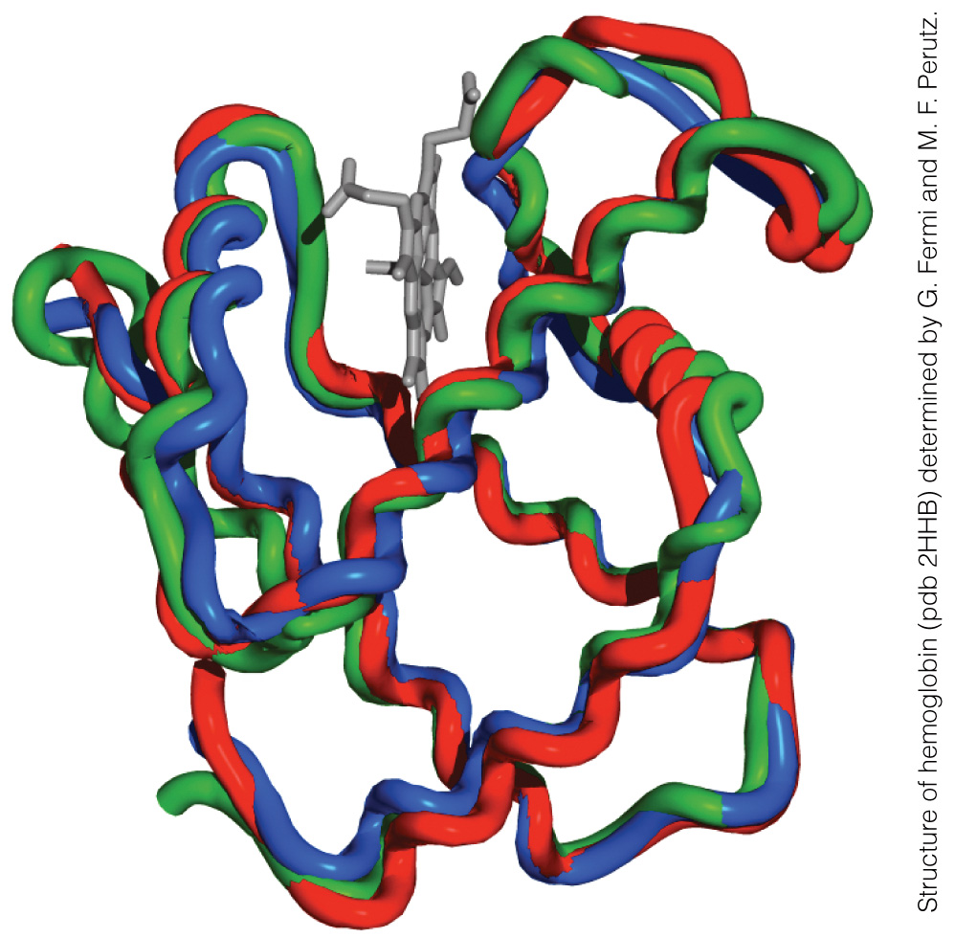
Mb and Hb are similar in their secondary and tertiary structures
Heme
Myoglobin
α-Subunit of Hemoglobin
β-Subunit of Hemoglobin

Slide 9
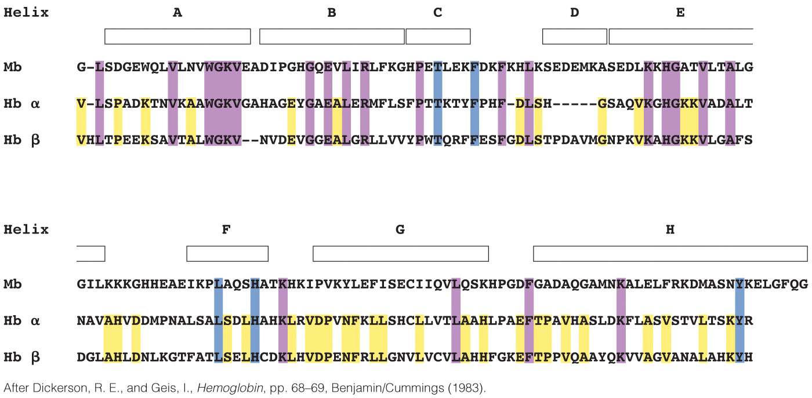
Mb and Hb are only ~18% identical in primary sequence
Invariant
Identical in all
Identical in Hb

Slide 10
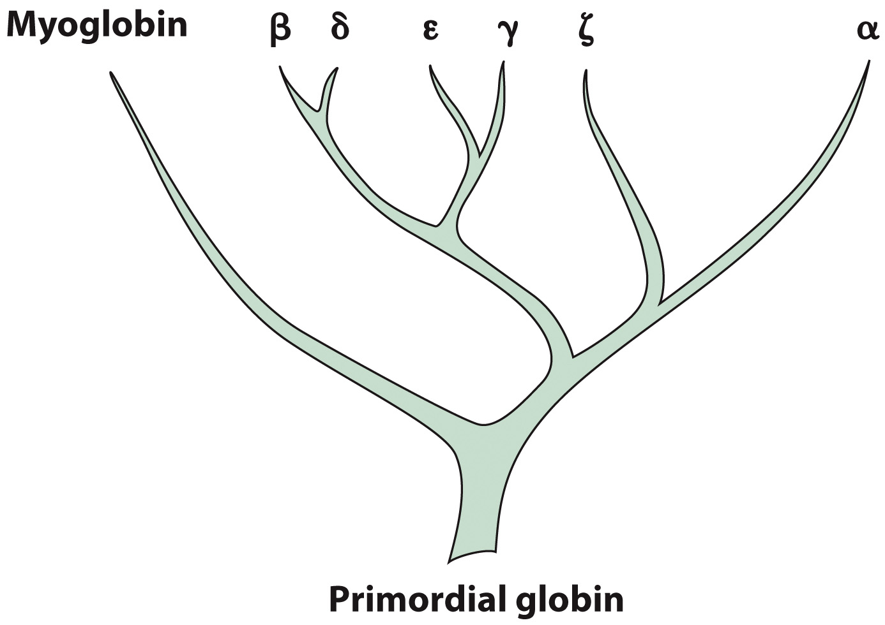
The similarities in structure and sequence between myoglobin and hemoglobin indicate a common evolutionary origin

Slide 11
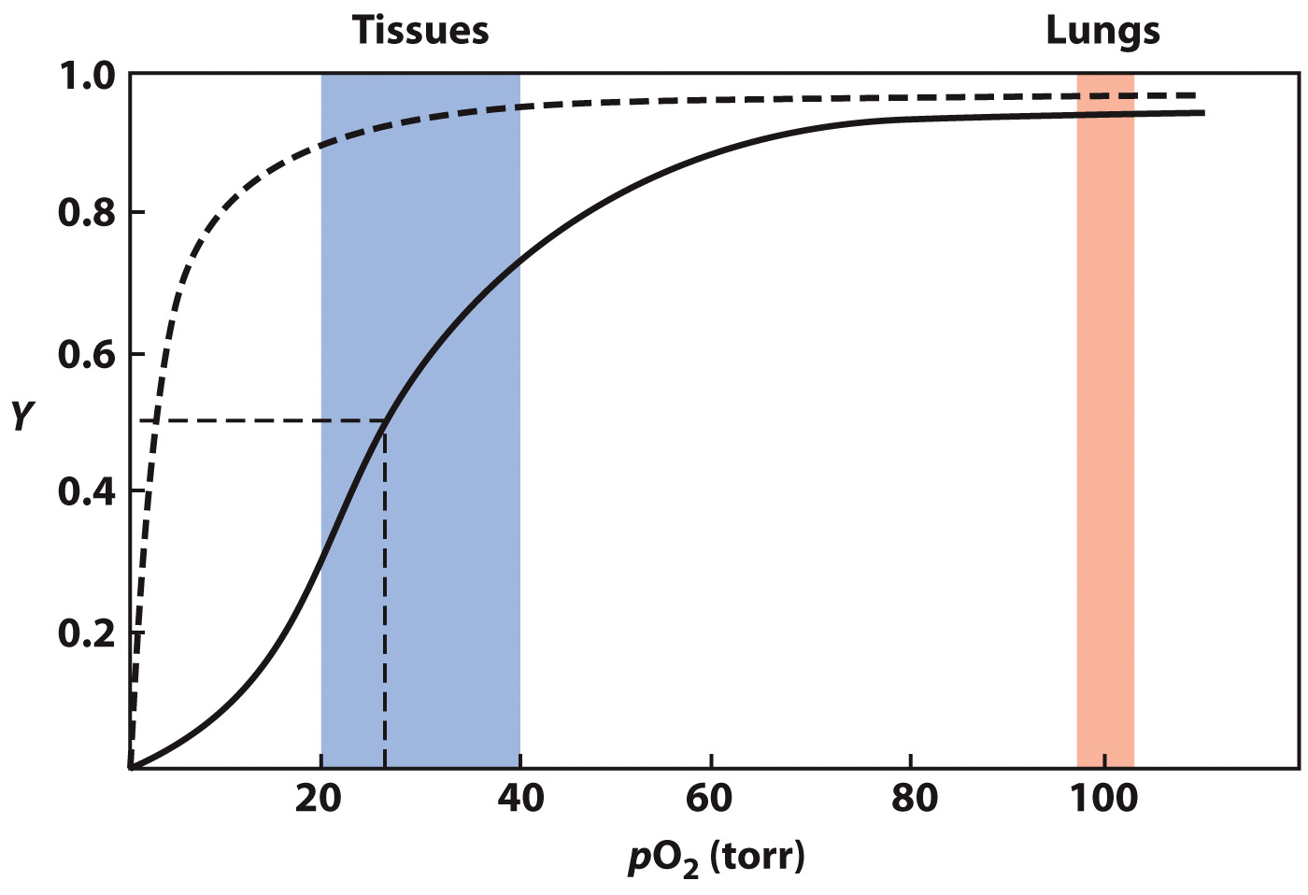
Oxygen binds cooperatively to Hemoglobin
Solid line: Hemoglobin + O₂
(sigmoid)
Dotted line: Myoglobin + O₂
(hyperbola)

Slide 12
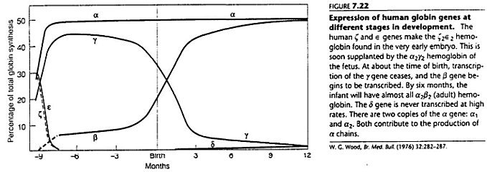

Slide 13
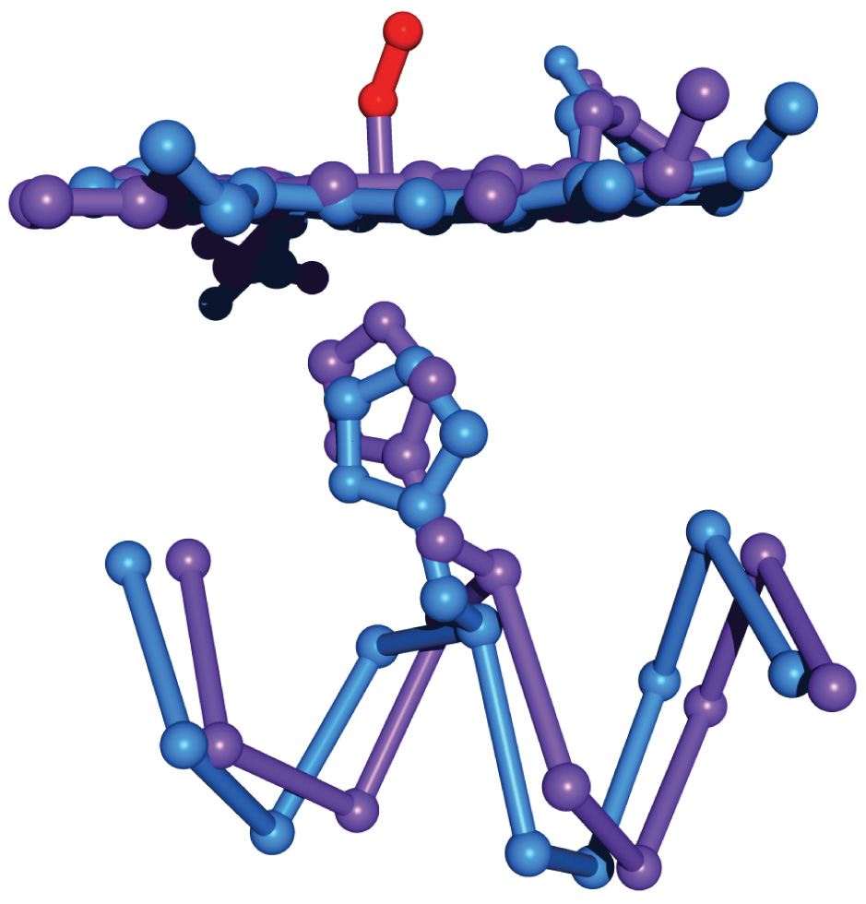
Hemoglobin undergoes conformational changes upon binding O₂

Slide 14
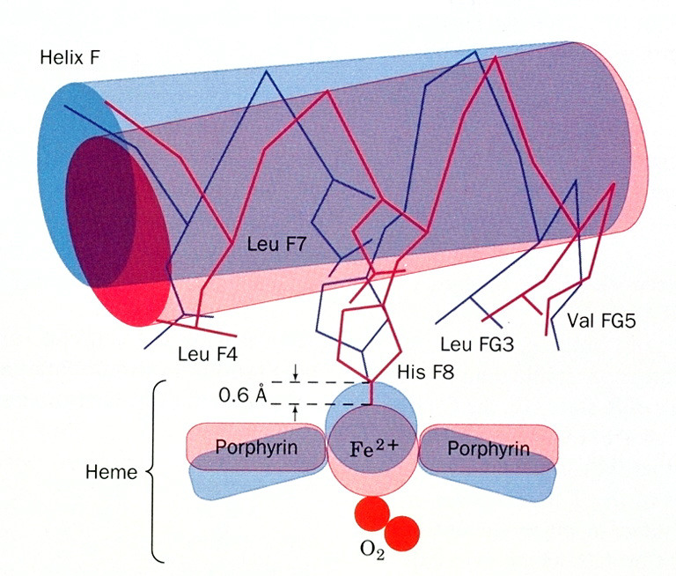

Slide 15
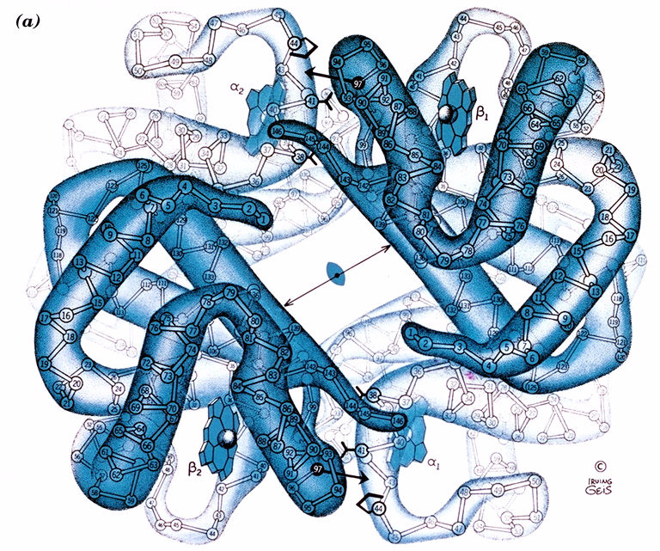

Slide 16
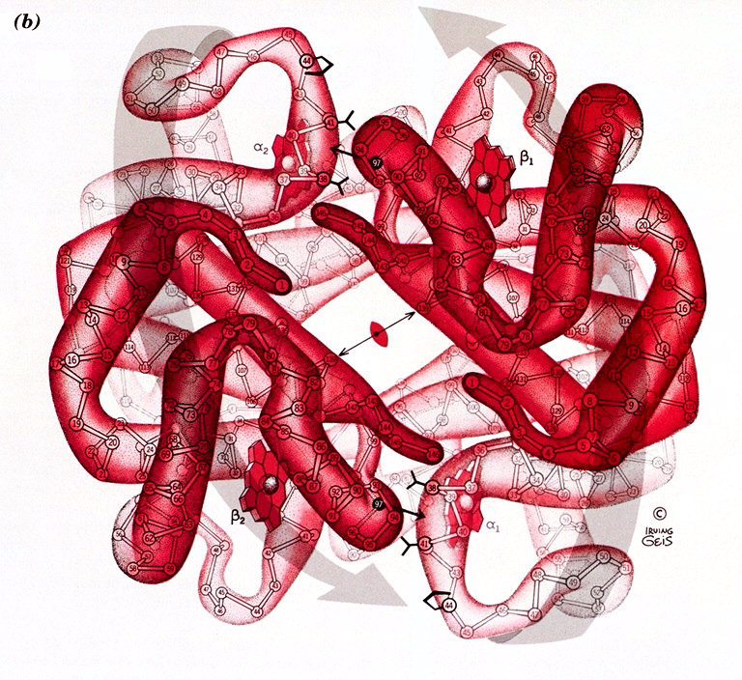

Slide 17
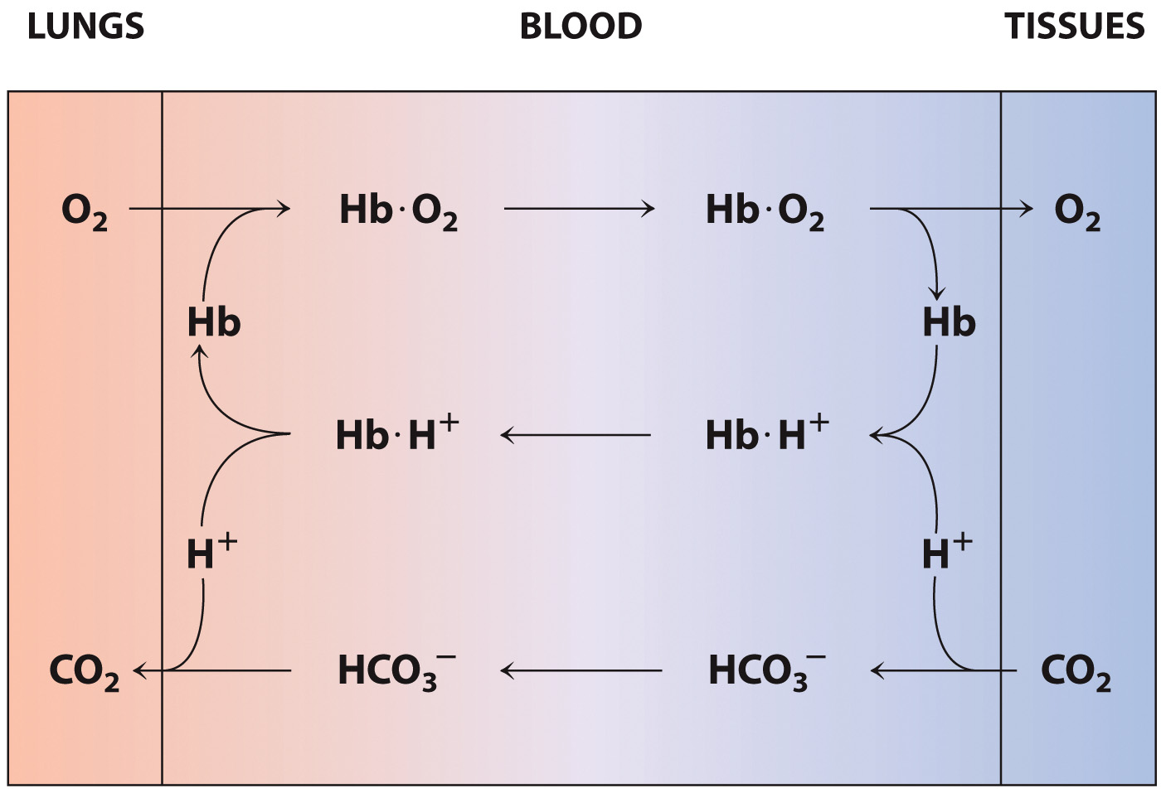
Bohr Effect and O₂ Transport
What is happening biochemically when you breathe?

Slide 18
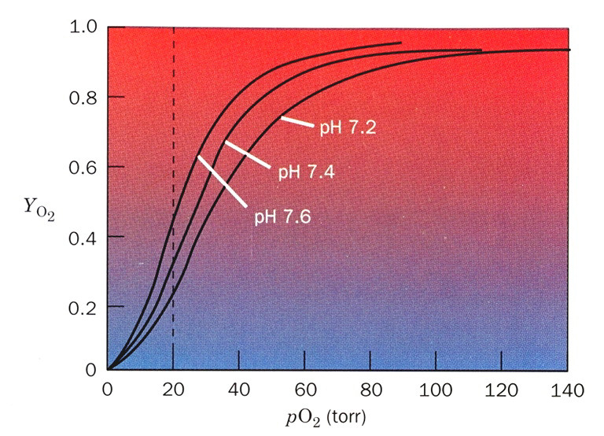

Slide 19
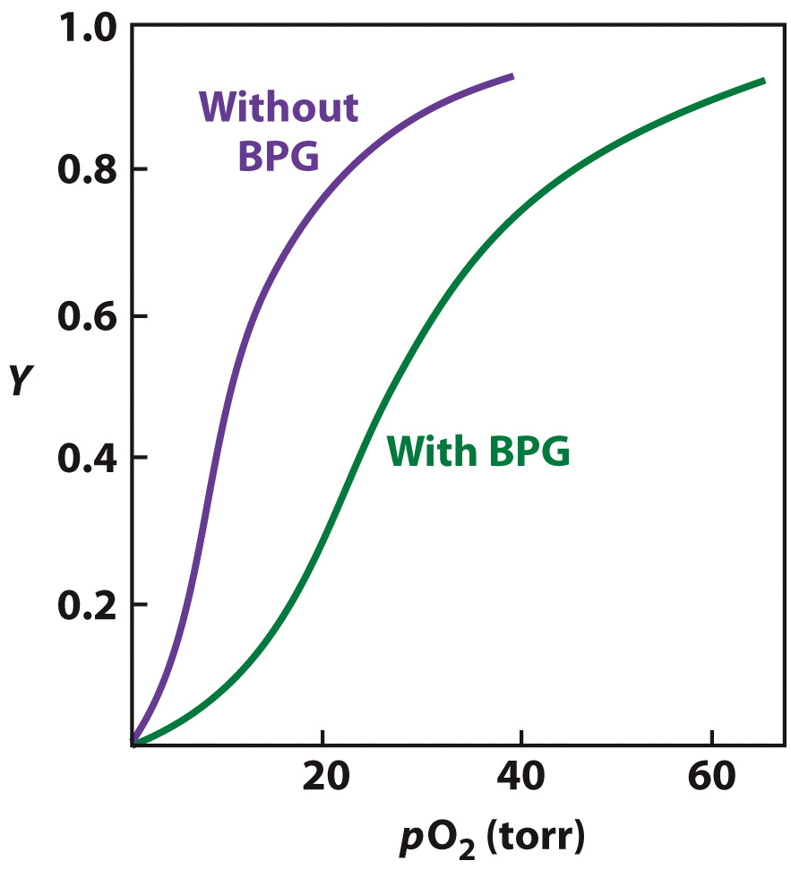
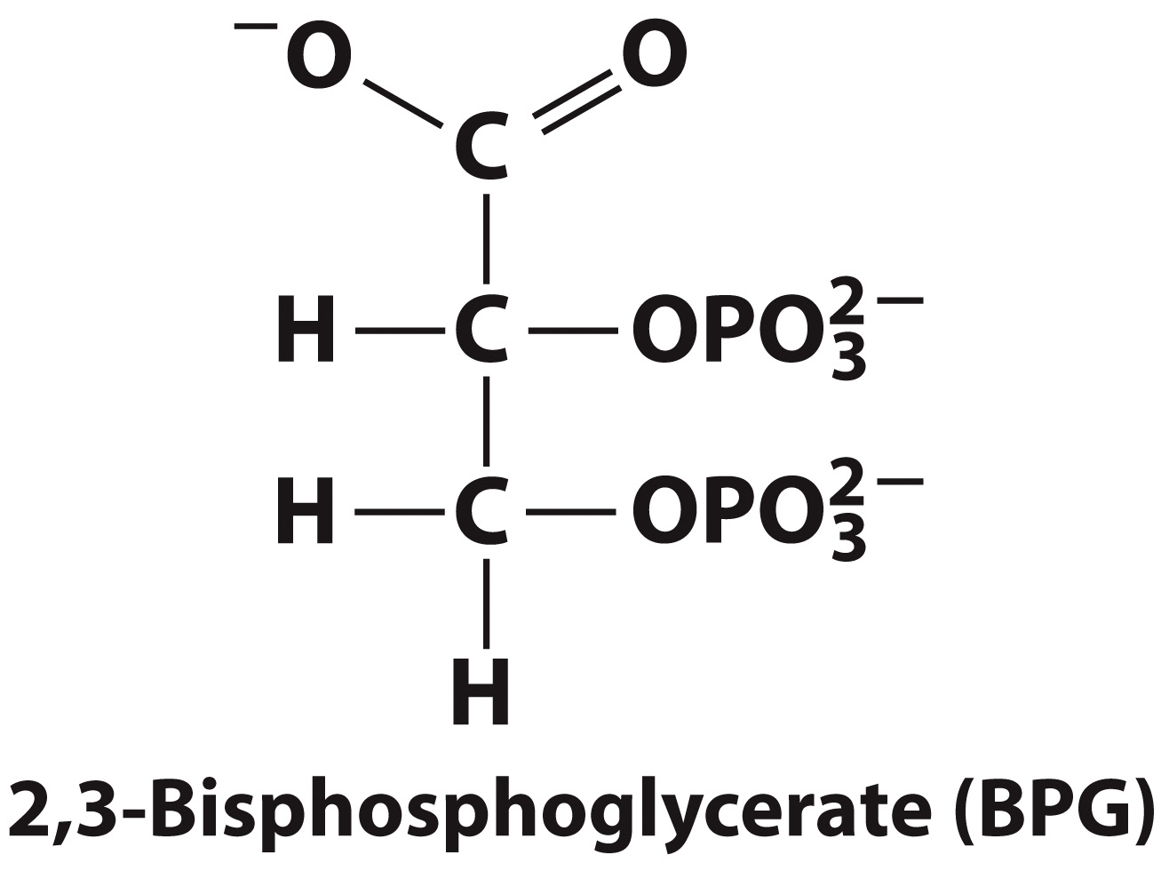
BPG decreases Hemoglobin’s O₂ affinity
BPG binds only to the
tense (deoxy)
conformation of Hb

Slide 20
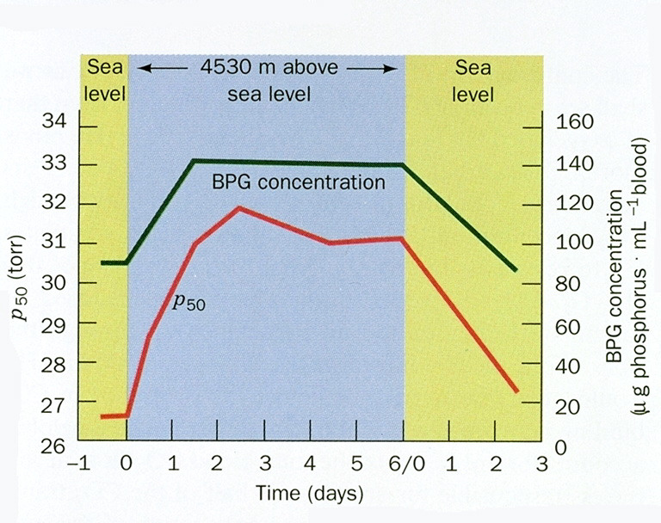

Slide 21
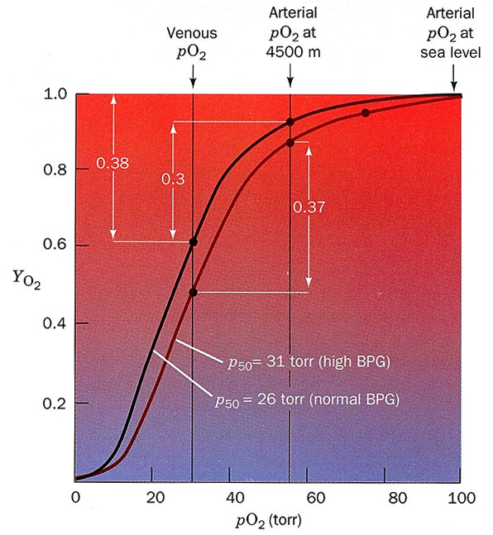

Slide 22
Clinical Connection: Hemoglobin Variants
Section 5.2
Learning Objective
Relate genetic variations to changes in protein function

Slide 23
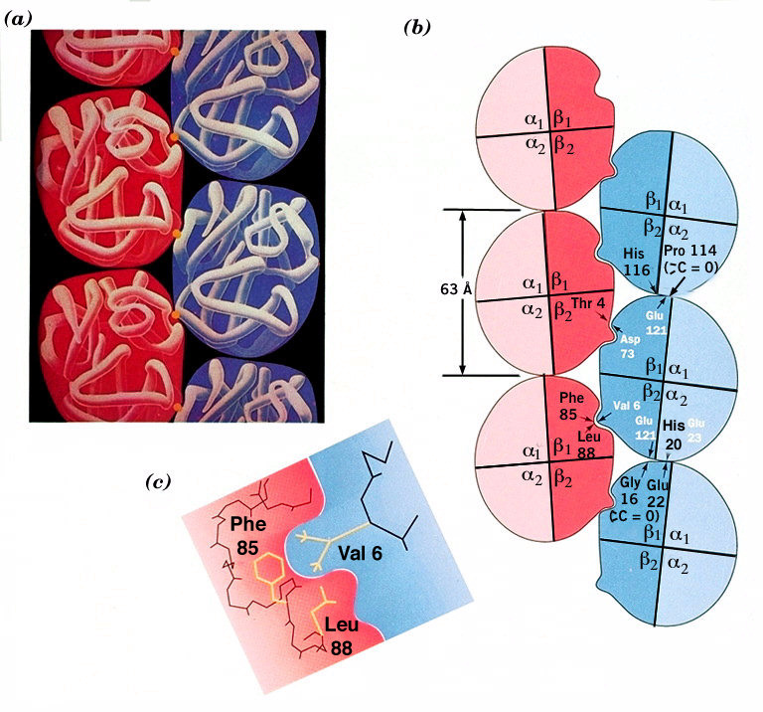

Slide 24
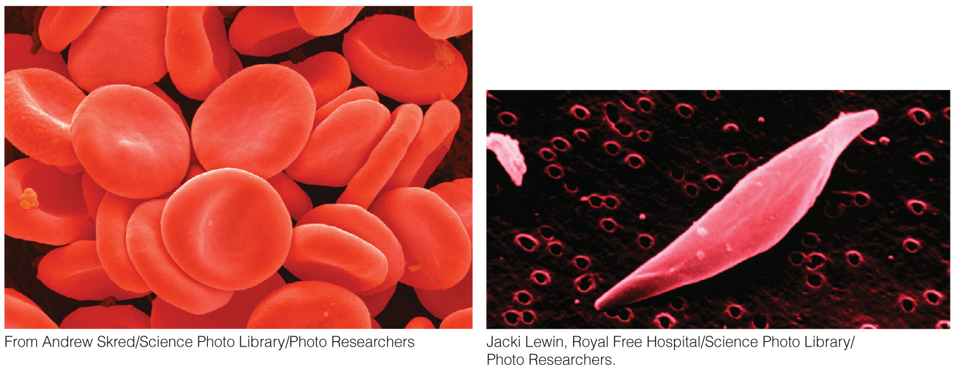
Normal vs. Sickled Red Blood Cells

Slide 25
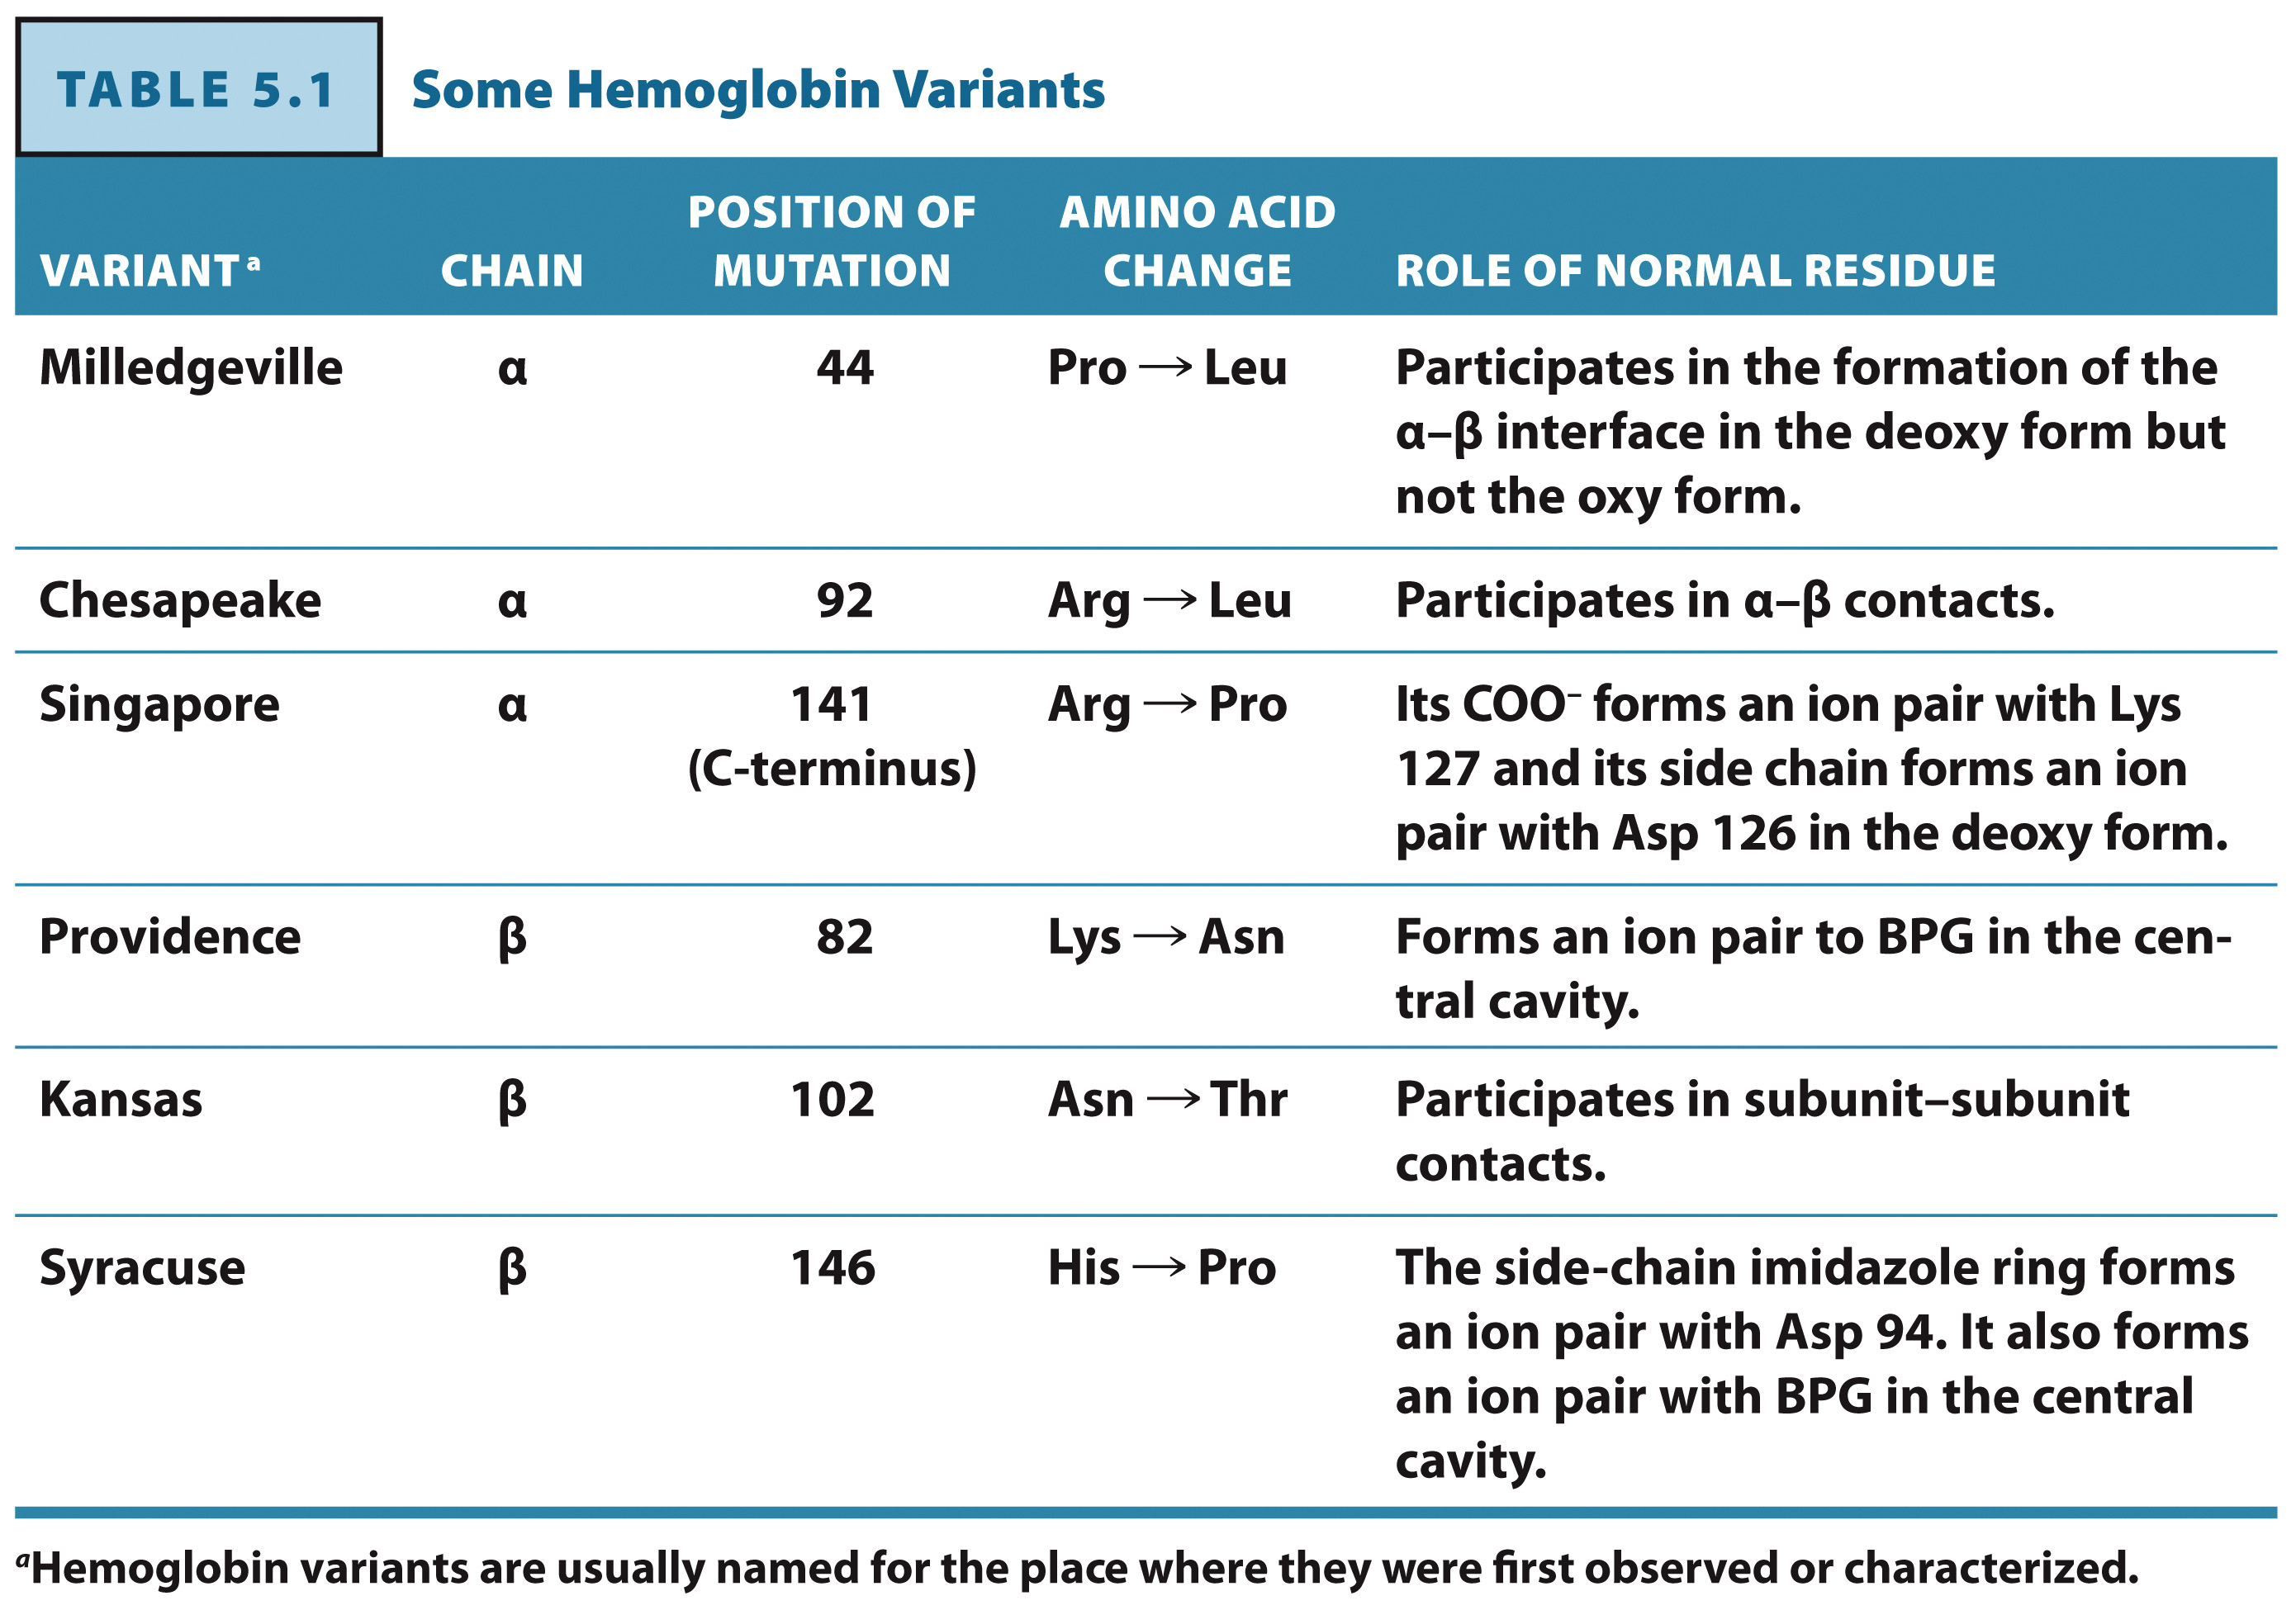
Some Hemoglobin Variants

Slide 26
Structural Proteins
Section 5.3
Learning Objective
Compare the structures and functions of structural proteins

Slide 27
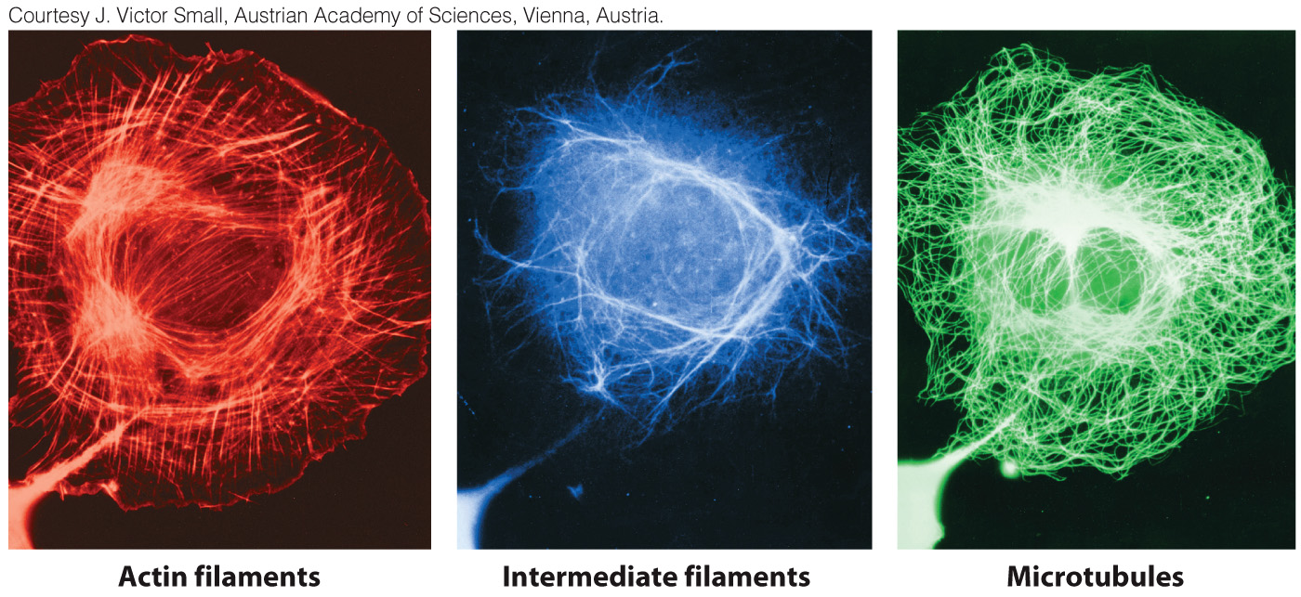
Microfilaments are polymers of actin

Slide 28
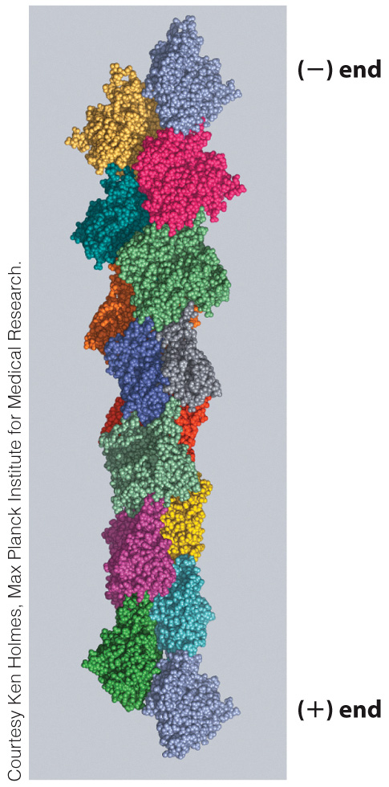
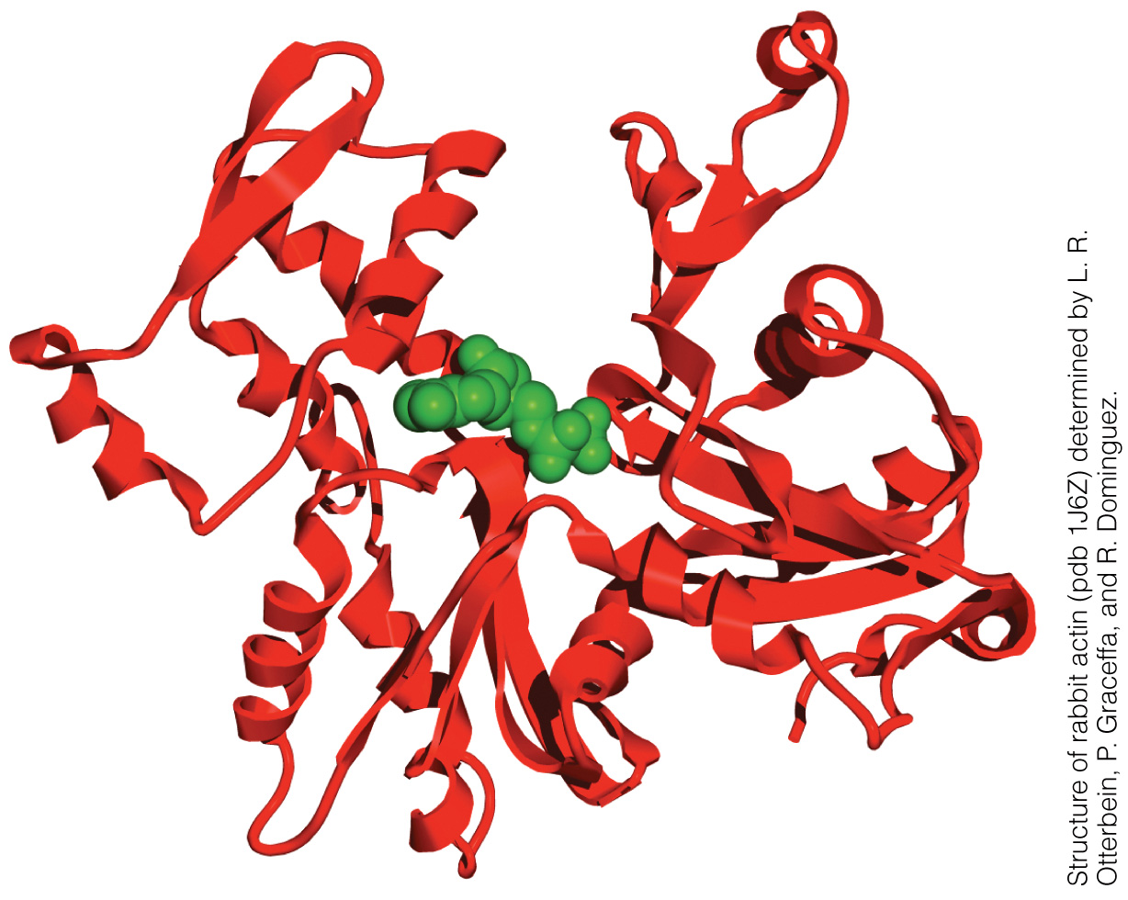
Globular actin subunits associate in a double chain to form a microfilament
Polymerization
Actin monomer

Slide 29
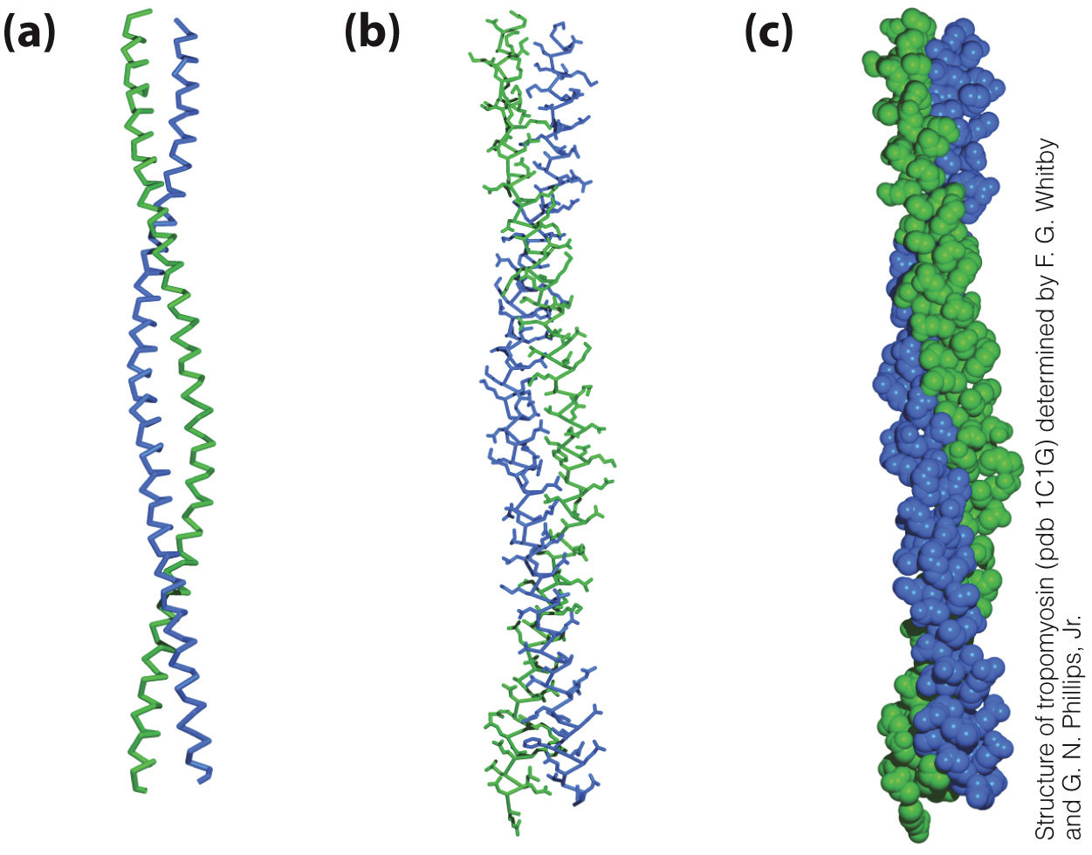
Keratin is an intermediate filament

Slide 30
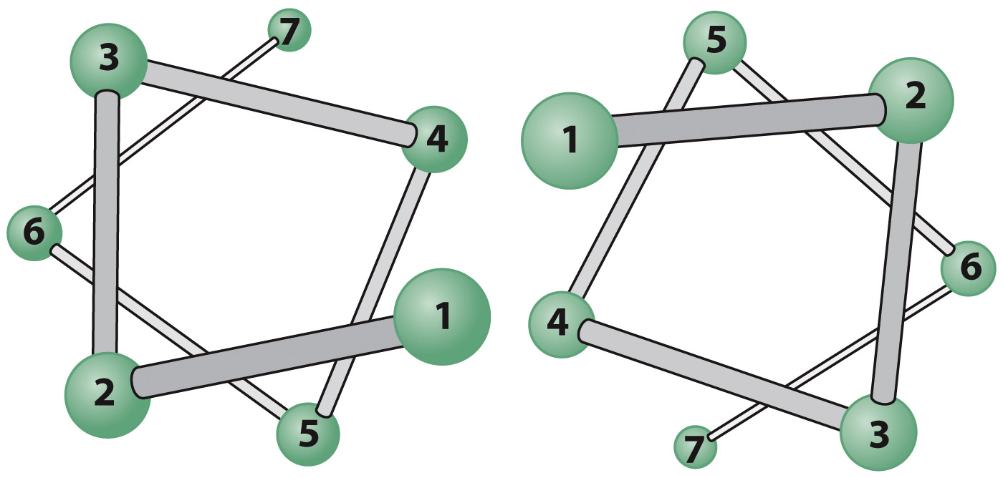
Arrangement of Residues in a Coiled Coil

Slide 31
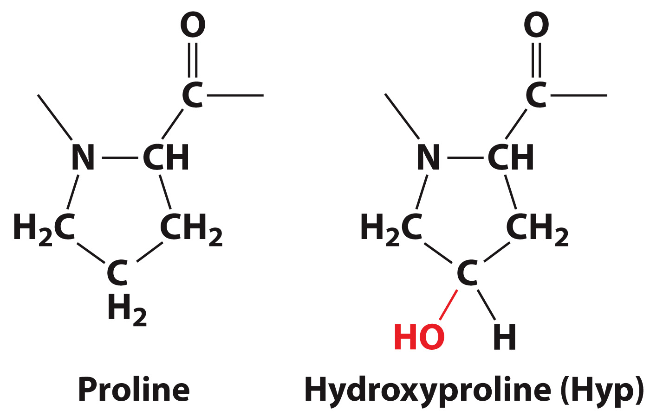
Collagen has a unique amino acid composition

Slide 32
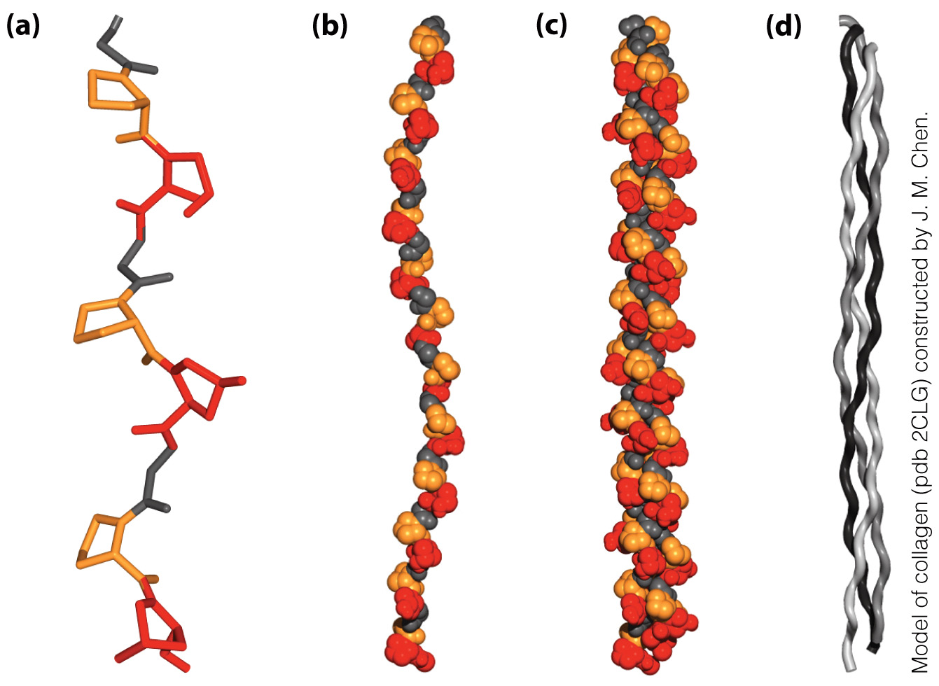
Collagen forms a triple helix

Slide 33
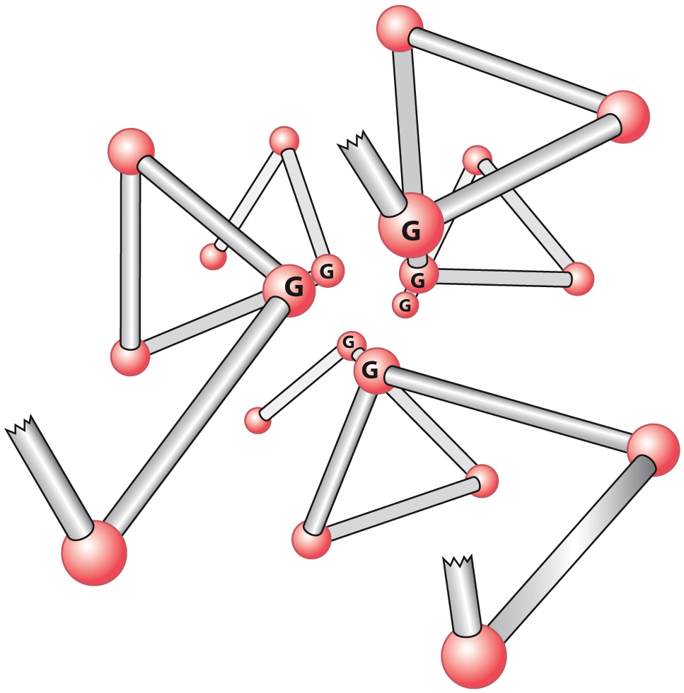
Cross-section of the Collagen Triple Helix

Slide 34
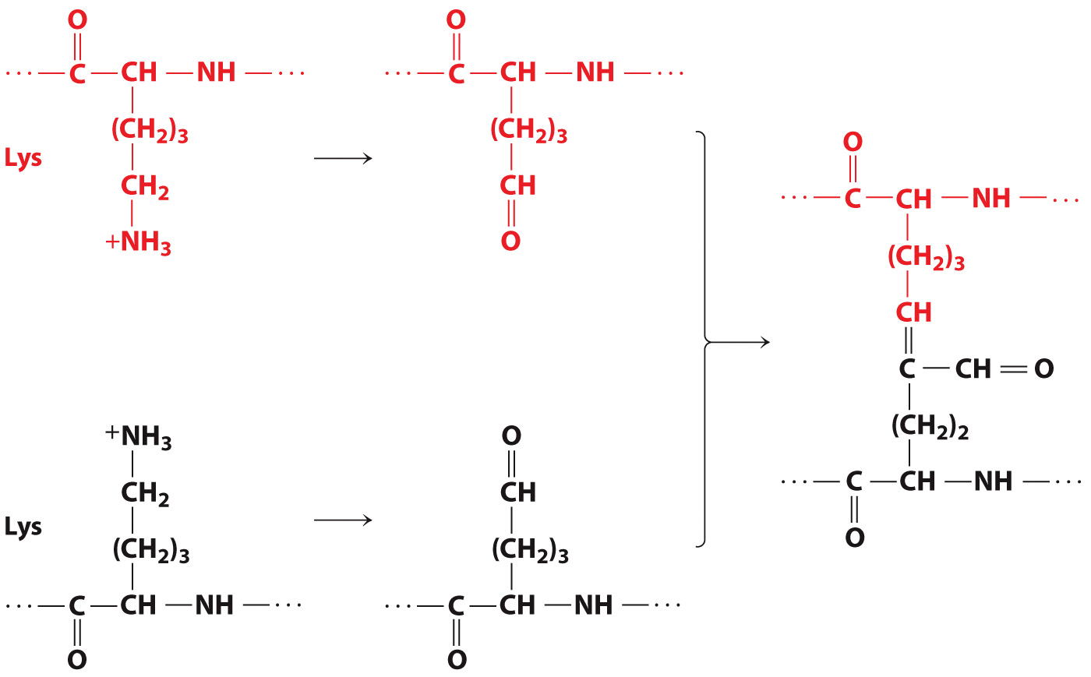
Collagen is covalently cross-linked

Slide 35
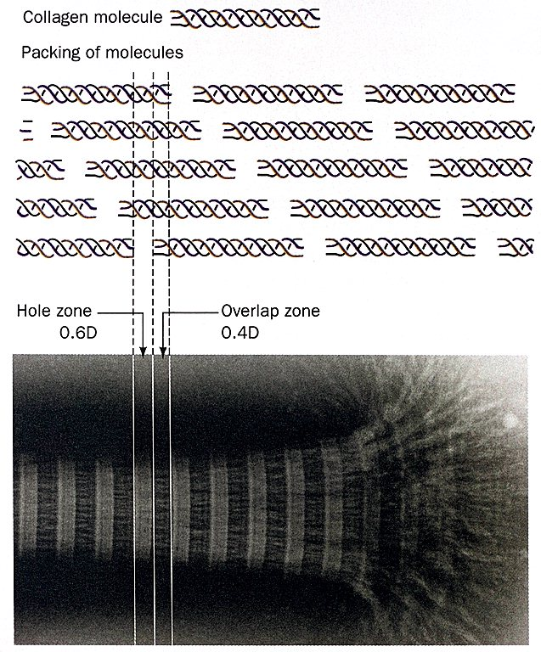
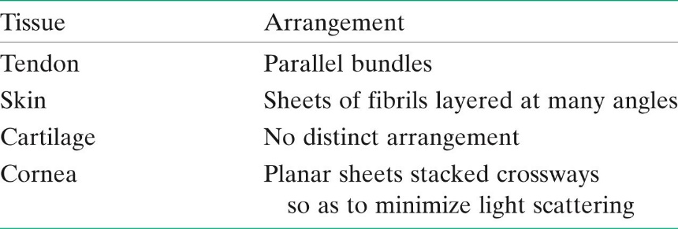
The Arrangement of Collagen Fibrils in Various Tissues.

