Slide 1
Essential Biochemistry
Fourth Edition
Charlotte W. Pratt | Kathleen Cornely
Lecture Notes for
Chapter 4
Protein Structure

Slide 2
Amino Acids, the Building Blocks of Proteins
Section 4.1
Learning Objective
Identify the 20 amino acids that occur in proteins

Slide 3
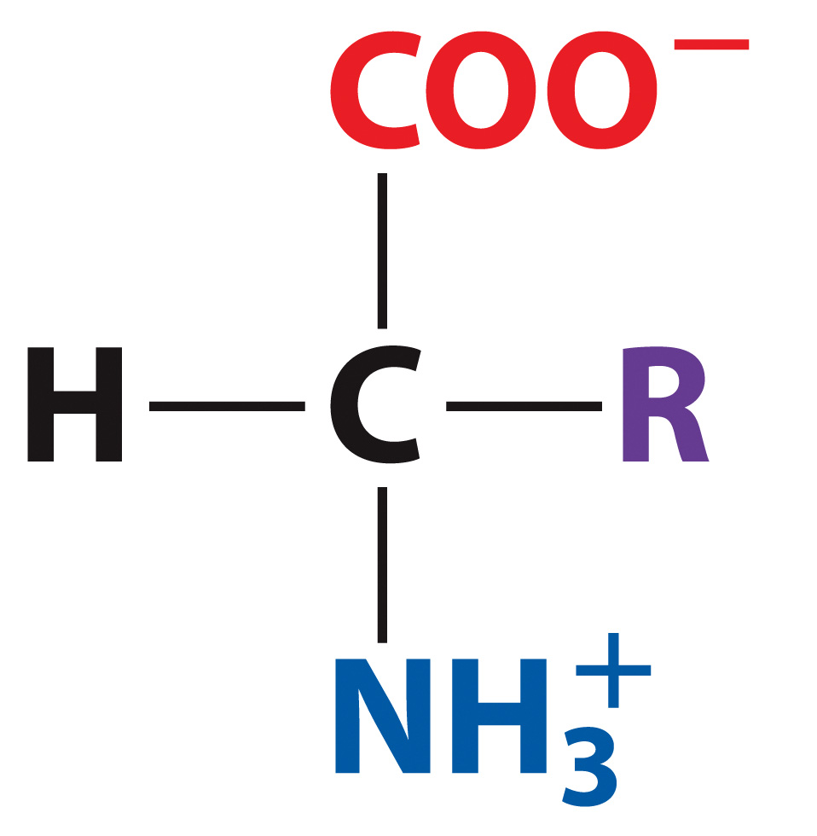
Proteins are polymers of amino acids
Generic structure of an amino acid

Slide 4
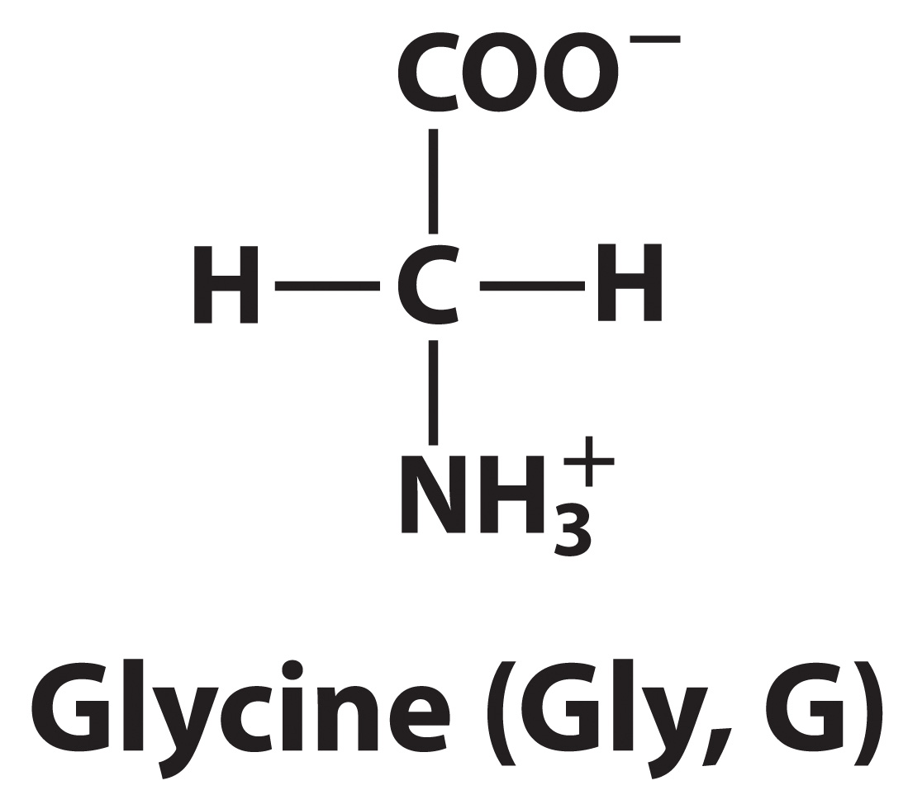
Glycine is the simplest amino acid

Slide 5
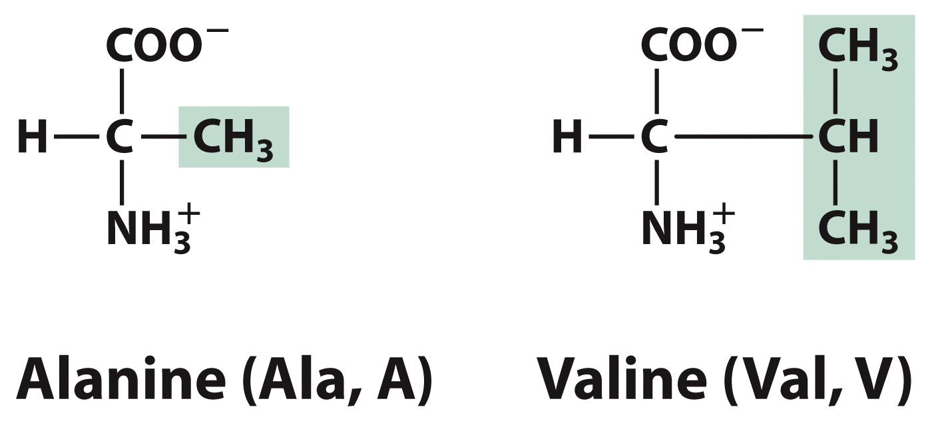
Some amino acids have hydrophobic R groups

Slide 6
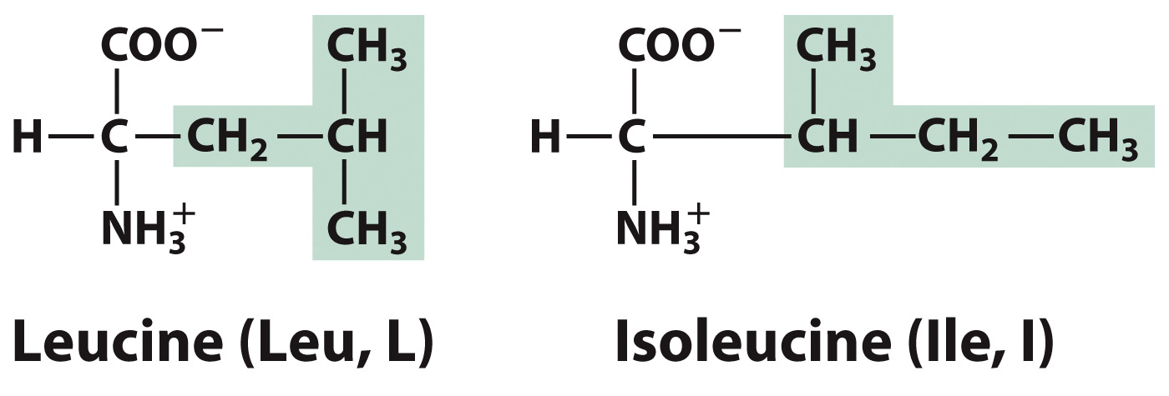
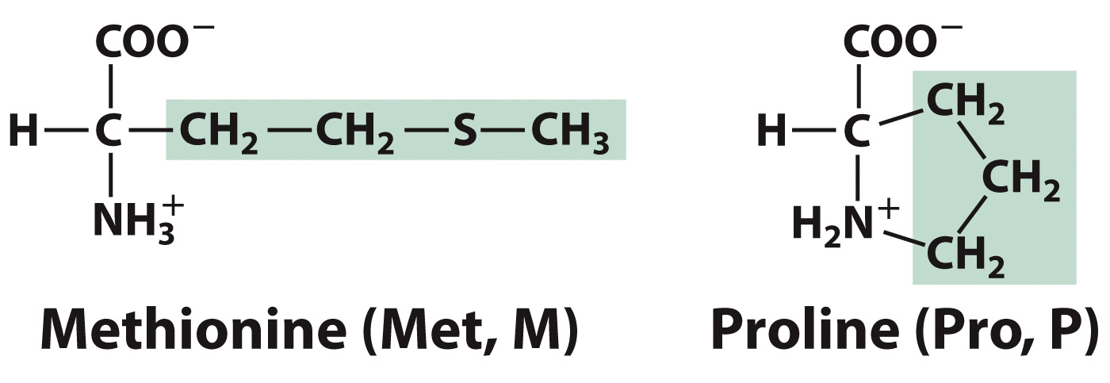
Some amino acids have hydrophobic R groups

Slide 7
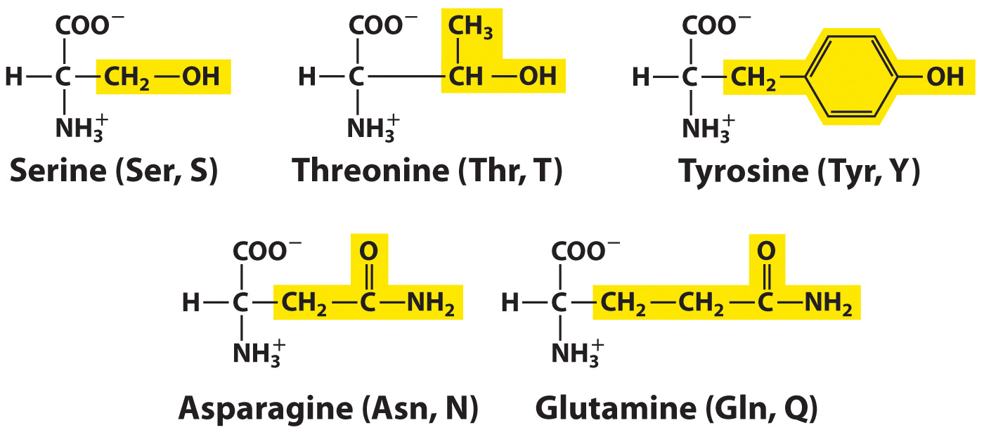
Some amino acids have polar R groups

Slide 8
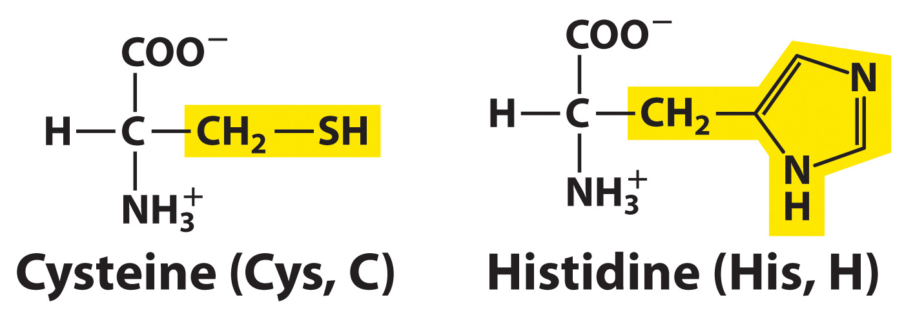
Some amino acids have polar R groups

Slide 9
Some amino acids have positively charged, polar R groups.

Slide 10
Asp and Glu have negatively charged, polar R groups.

Slide 11
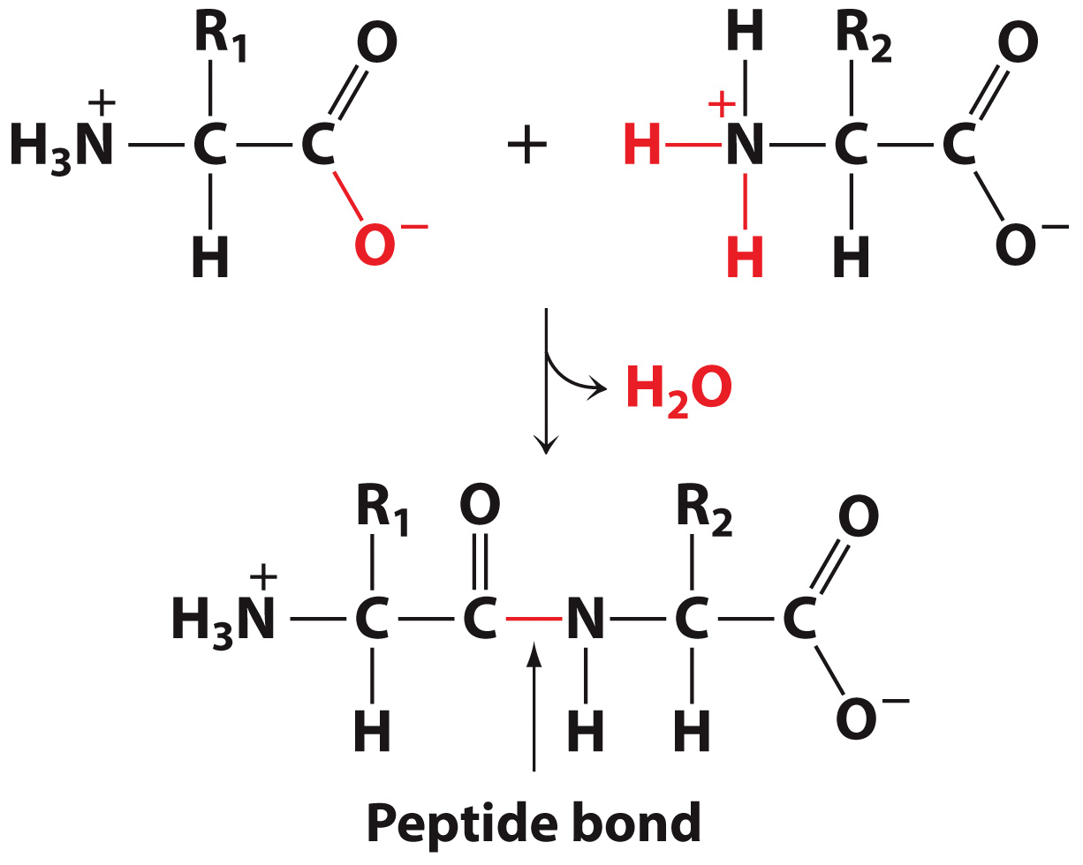
Amino acids are linked via a condensation reaction.
Here amino acids within the peptide are called “amino acid residues” because only the residual atoms remain.

Slide 12
Amino acids are linked by peptide bonds to form a polypeptide

Slide 13
PROBLEM: How can one predict the chemical structure of an amino acid or peptide since the ionization states can change?

Slide 14
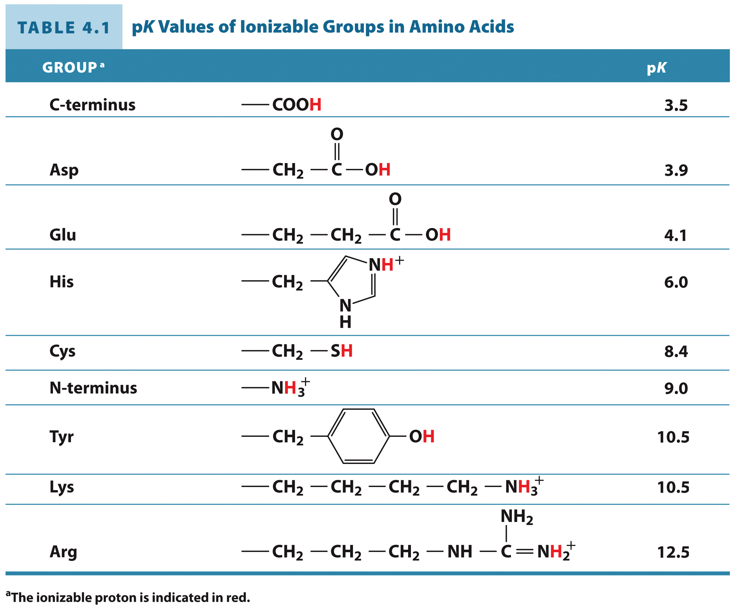
Look up the pK values for the ionization states.

Slide 15
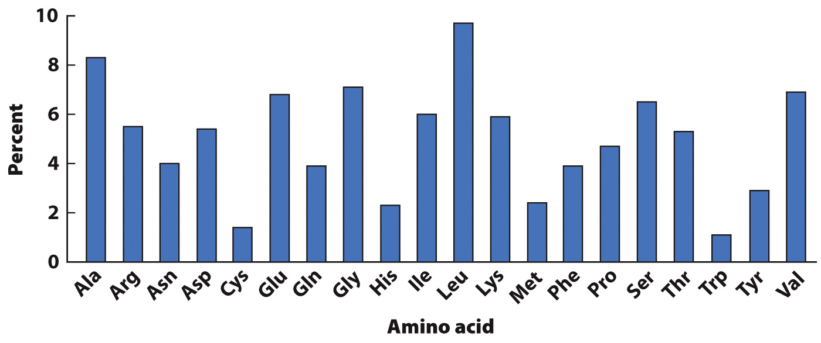
Most proteins contain all 20 amino acids

Slide 16
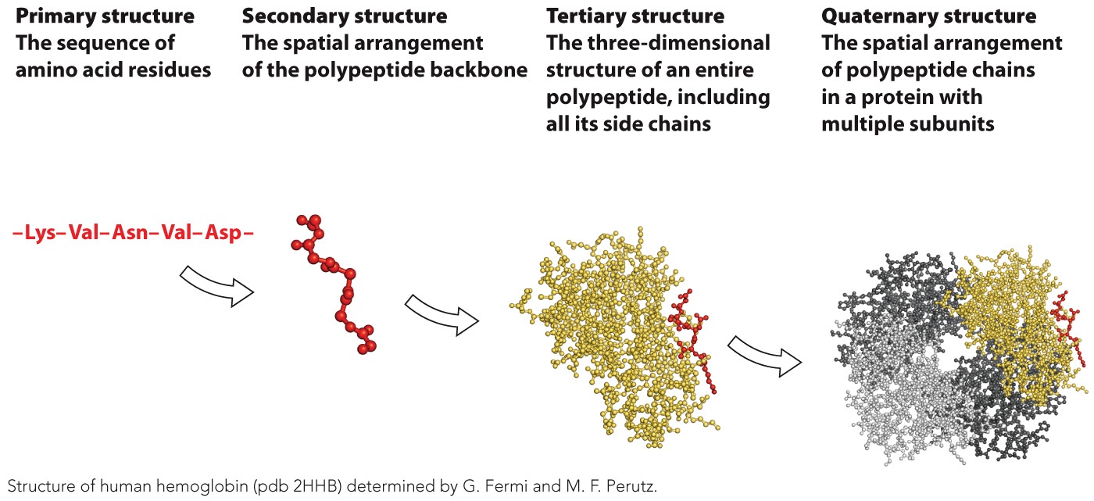
There are four levels of protein structure

Slide 17
Secondary Structure: the Conformation of the Peptide Group
Section 4.2
Learning Objective
Recognize the common types of regular secondary structure

Slide 18
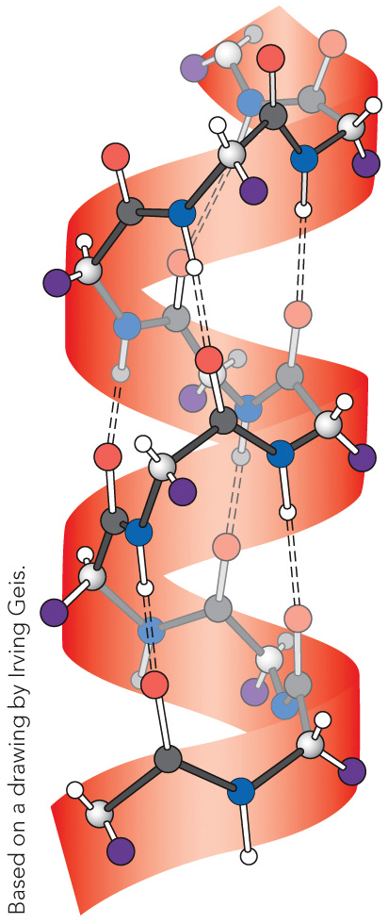
The α helix
Hydrogen bonds along the helical axis stabilize this structure.

Slide 19
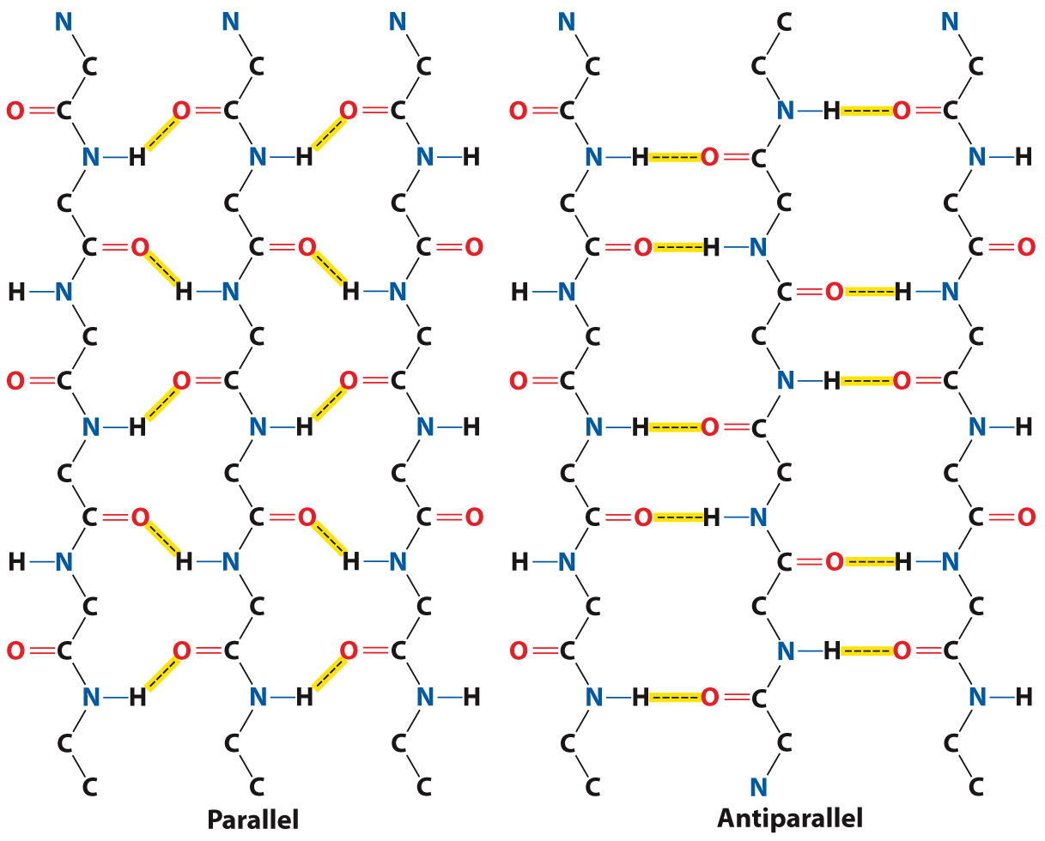
Hydrogen Bonding β Sheets

Slide 20
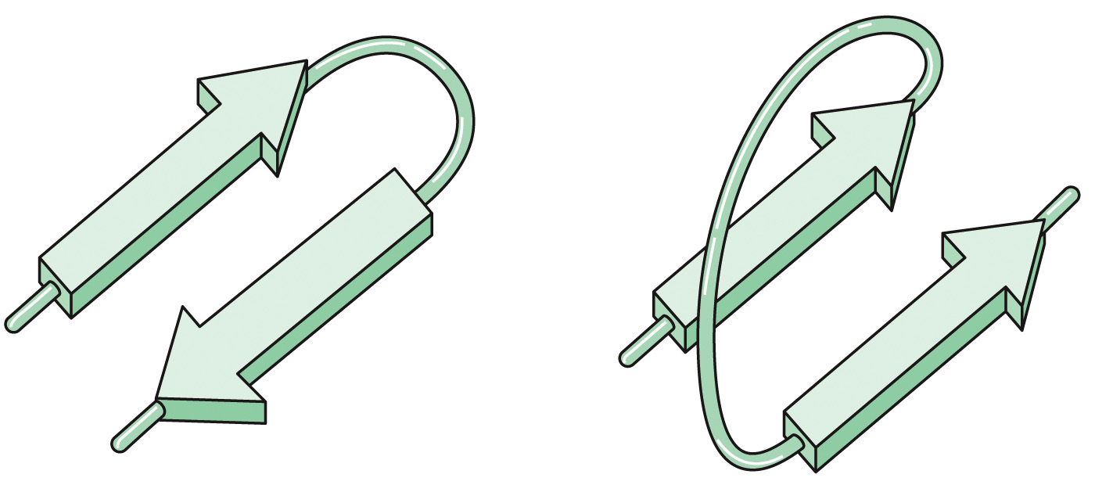
Some polypeptide chains align in regions with directionality.
Antiparallel β sheets align in opposite directions.
Parallel β sheets align in the same direction.

Slide 21
Tertiary Structure and Protein Stability
Section 4.3
Learning Objective
Describe the forces that stabilize protein structure

Slide 22
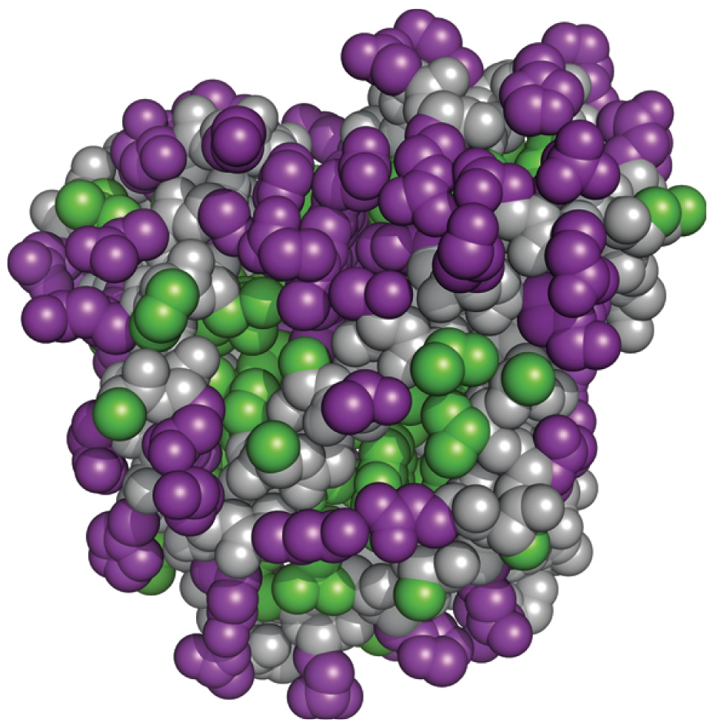
Hydrophobic and Hydrophilic Residues in Myoglobin

Slide 23
Protein folding and protein stabilization depend on noncovalent forces.
Key example: the hydrophobic effect

Slide 24
Quaternary Structure
Section 4.4
Learning Objective
List the advantages of having a protein with quaternary structure

Slide 25
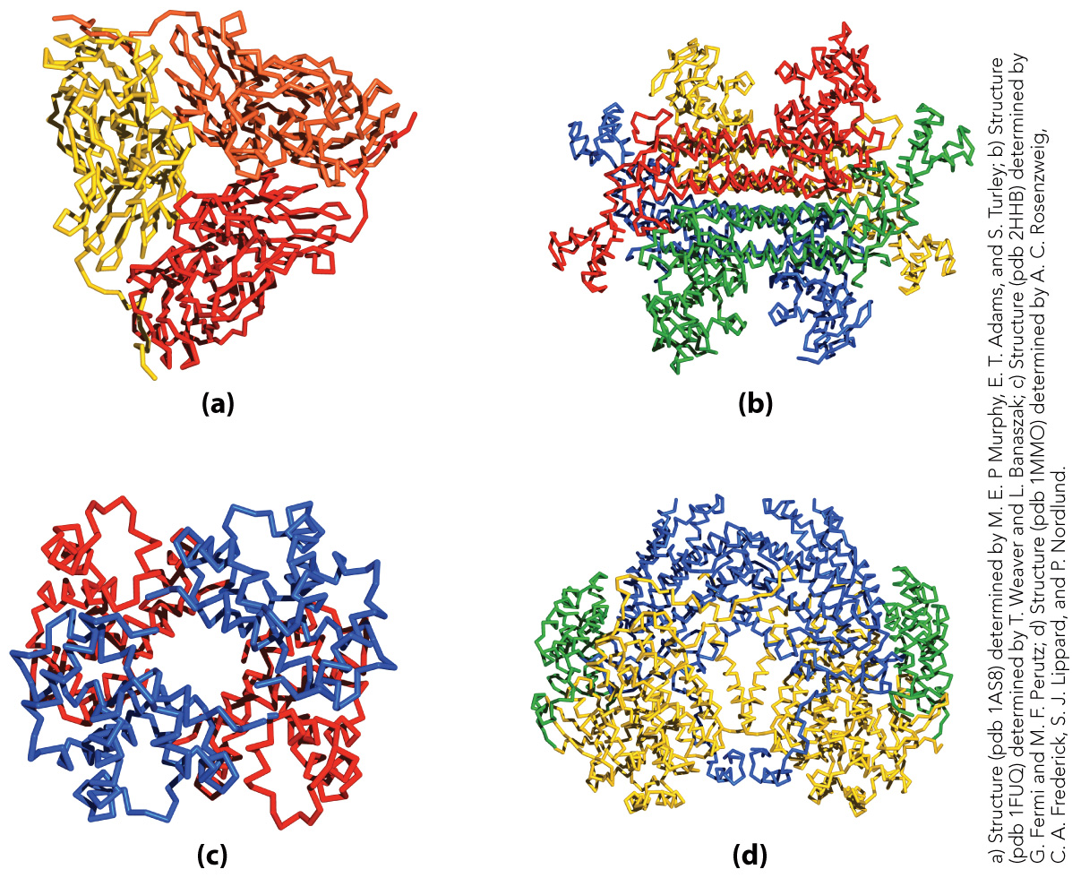
Some proteins have quaternary structure

Slide 26
Clinical Connection: Protein Misfolding and Disease
Section 4.5
Learning Objective
Explain how misfolded proteins cause disease

Slide 27
Tools and Techniques: Analyzing Protein Structure
Section 4.6
Learning Objective
Describe the techniques for purifying and analyzing proteins

Slide 28
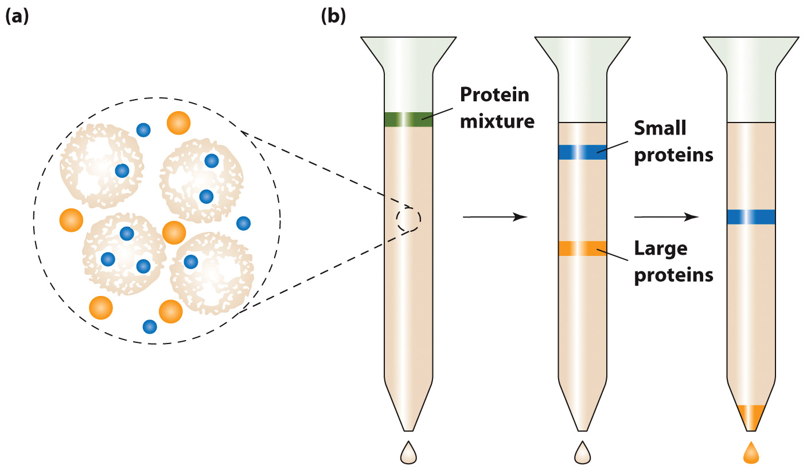
Size Exclusion Chromatography
Separation based on size

Slide 29
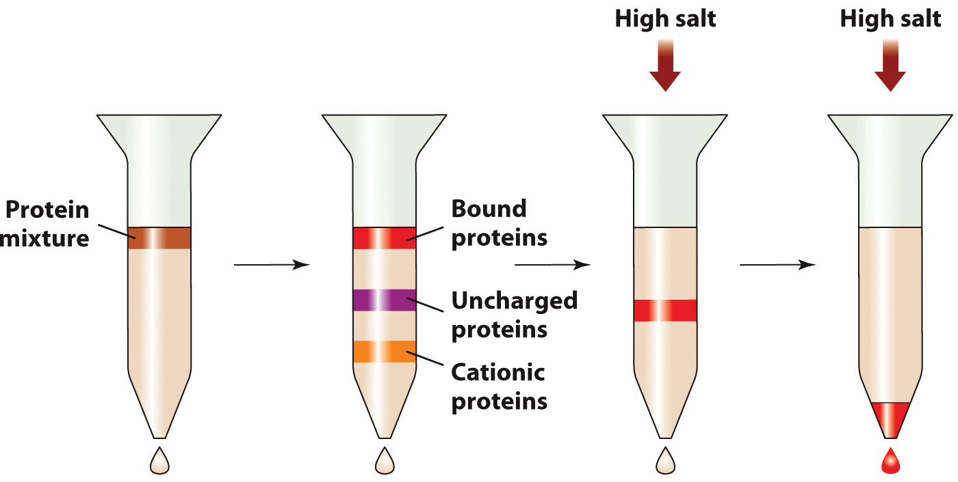
Ion Exchange Chromatography
Separation based on charge

Slide 30
Other Common Modes of Chromatography
Affinity Chromatography
Separation based on molecular interactions
High Performance Liquid Chromatography (HPLC)
Analytical rather than preparative separation

Slide 31
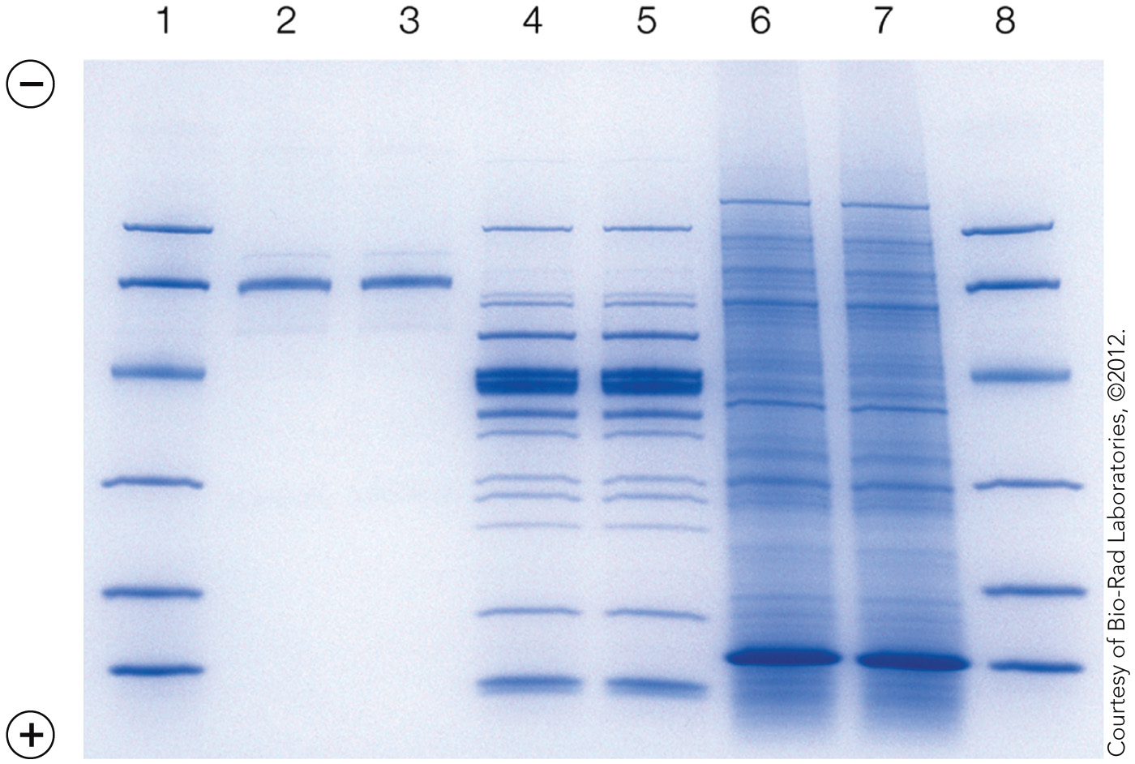
SDS-PAGE

Slide 32
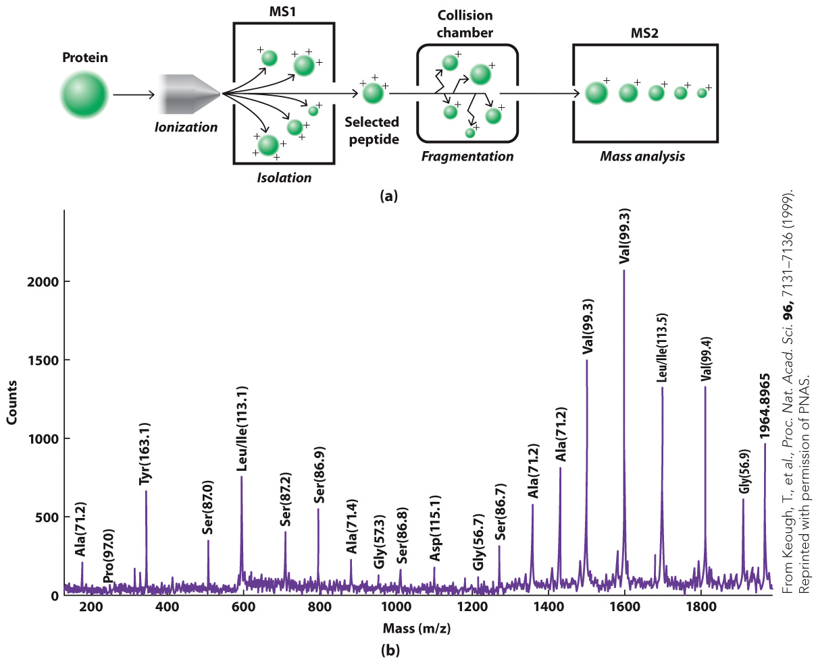
Mass Spectrometry

Slide 33
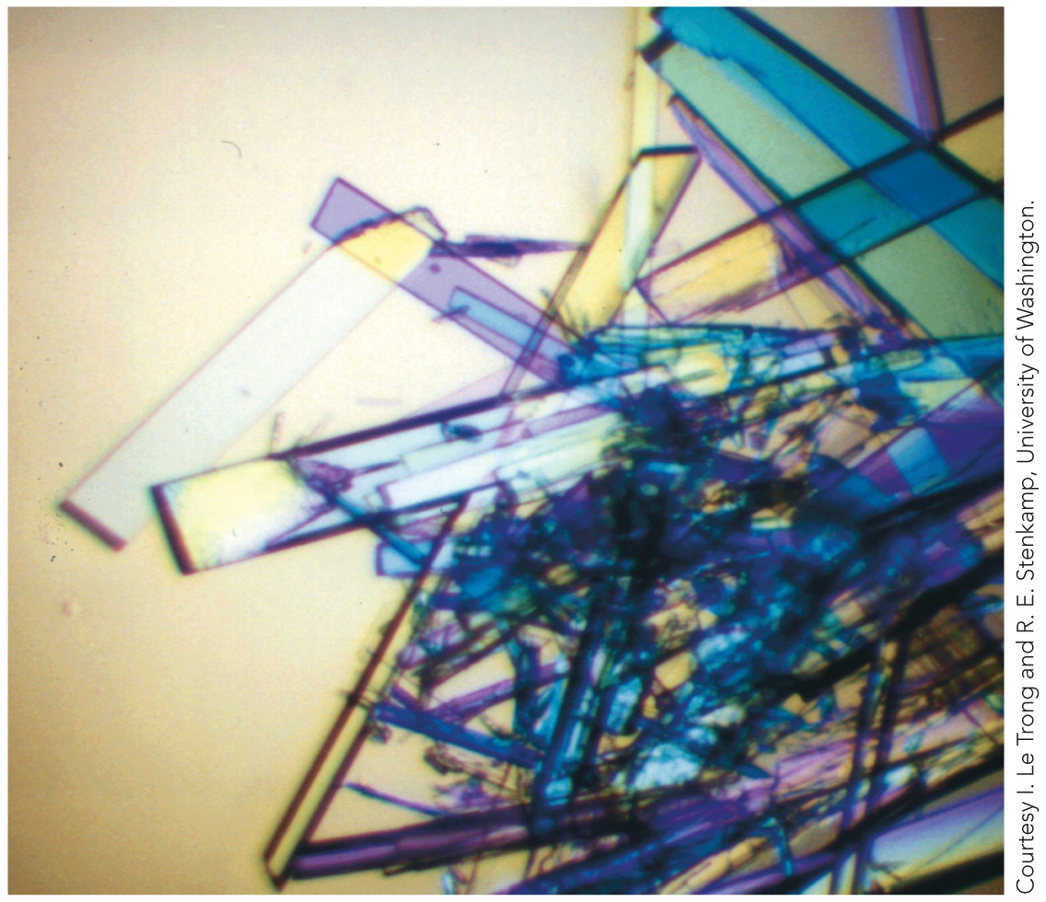
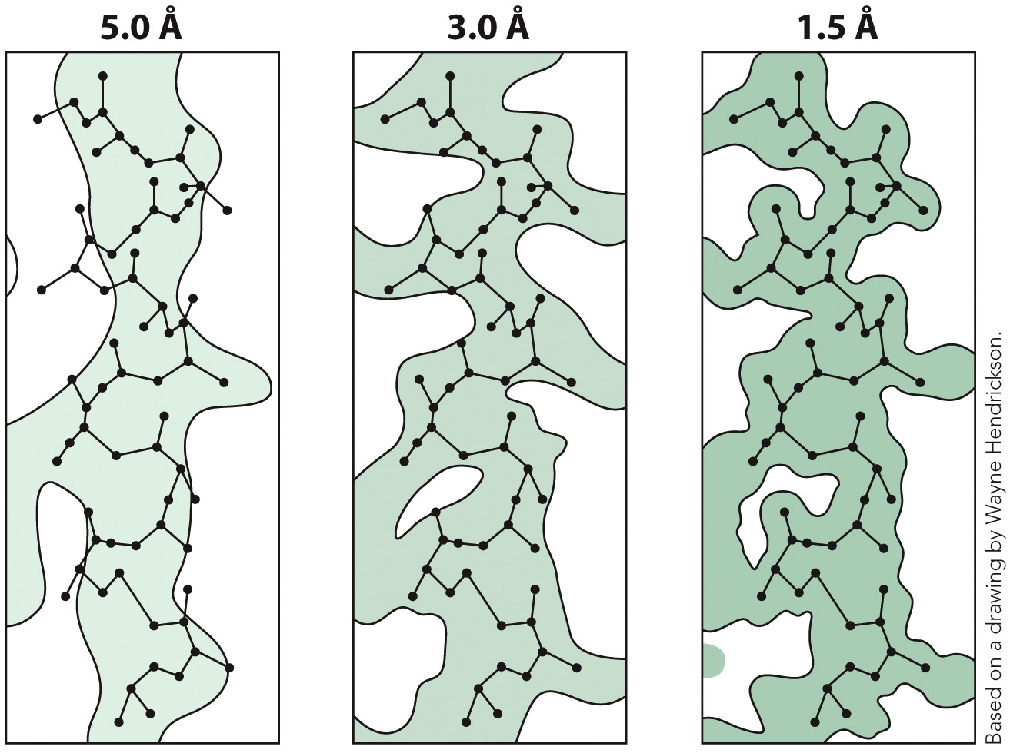
X-ray Crystallography

Slide 34
Crystals of the Protein Streptavidin
The 3D arrangement of atoms in a protein can be deduced by measuring the diffraction of X-rays or by analyzing NMR.
With X-ray crystallography, the protein must first be crystallized.

Slide 35
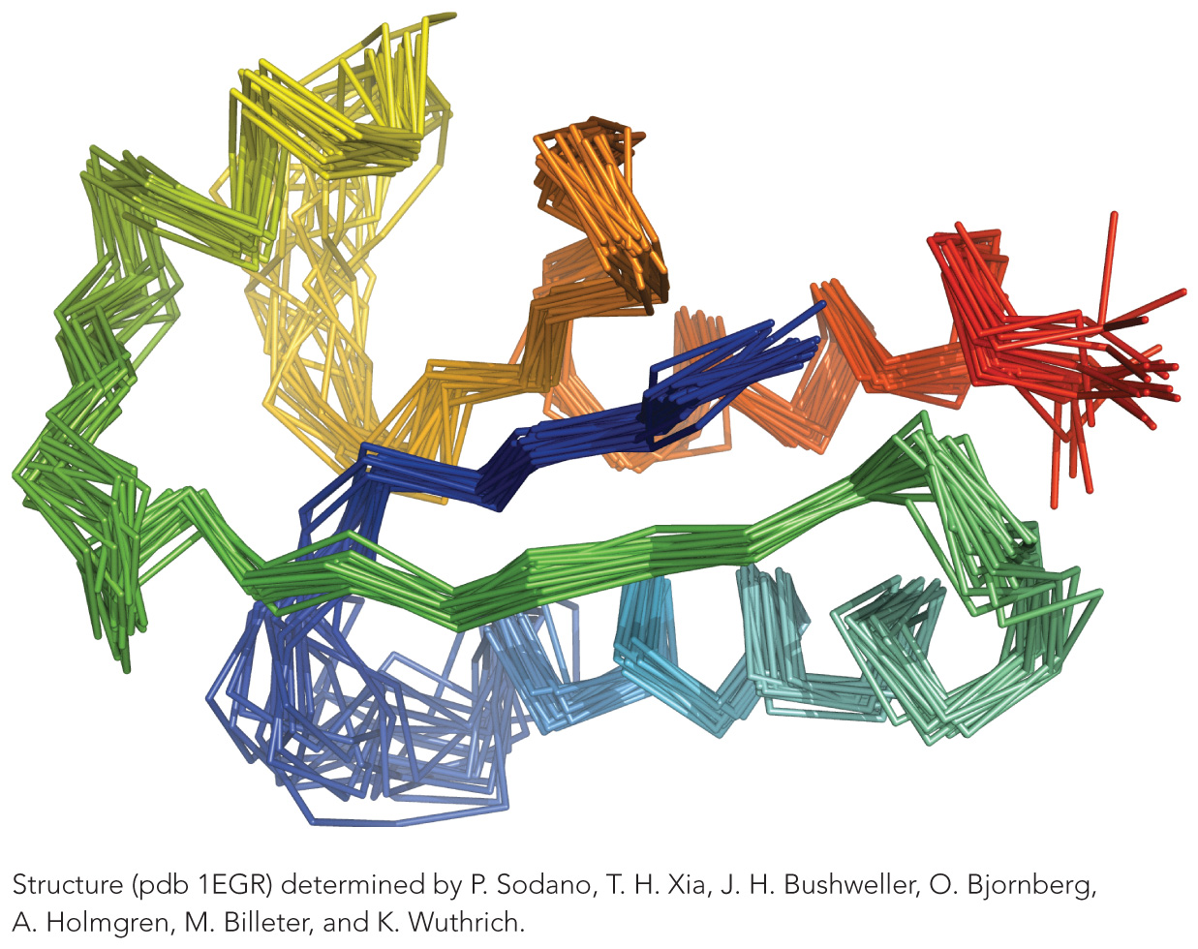
The NMR Structure of Glutaredoxin
The 3D arrangement of atoms in a protein can be deduced by measuring the diffraction of X-rays or by analyzing NMR.
With NMR spectroscopy, a family of structures is obtained.

