Slide 1
Essential Biochemistry
Fourth Edition
Charlotte W. Pratt | Kathleen Cornely
Lecture Notes for
Chapter 3
From Genes to Proteins

Slide 2
Nucleotides
Section 3.1
Learning Objective
Recognize the structures of nucleotides

Slide 3
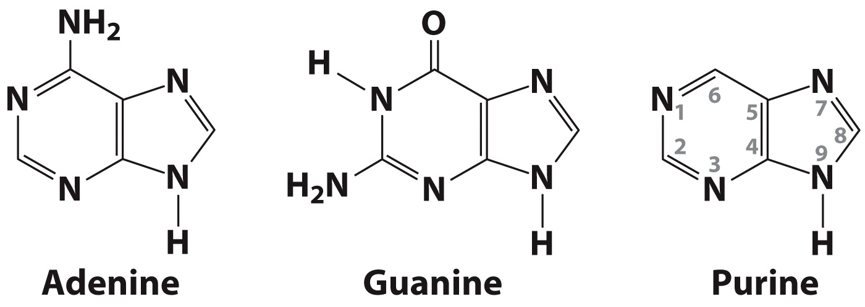
Nucleic acids are polymers of nucleotides

Slide 4
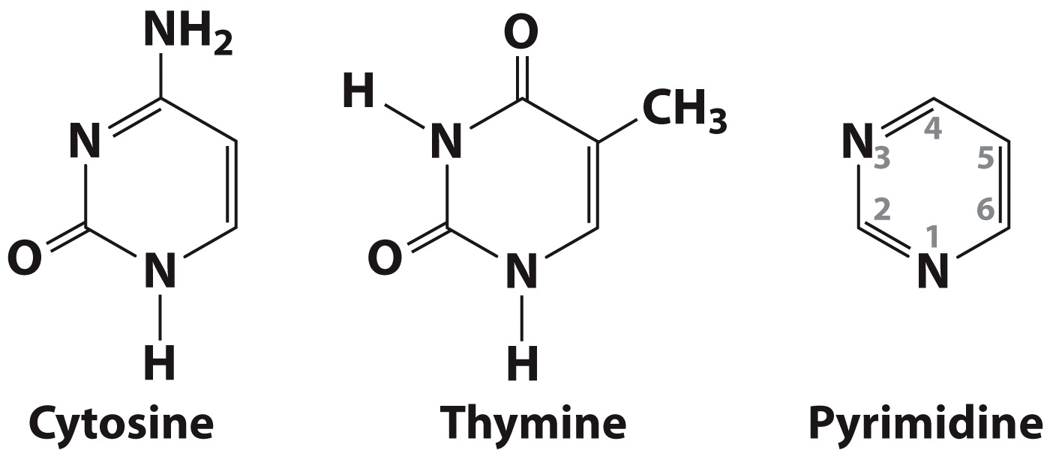
Nucleic acids are polymers of nucleotides

Slide 5
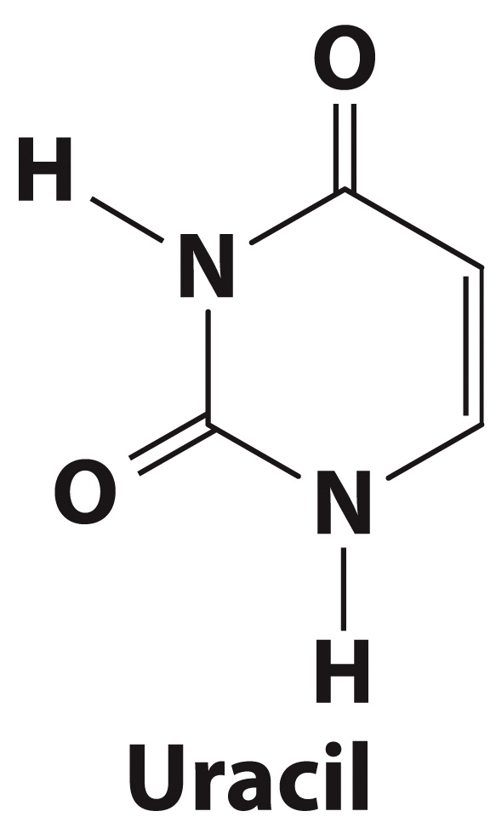
RNA contains Uracil rather than Thymine

Slide 6
DNA and RNA contain sugar groups

Slide 7
Phosphates can attach to the sugar of the nucleotide

Slide 8
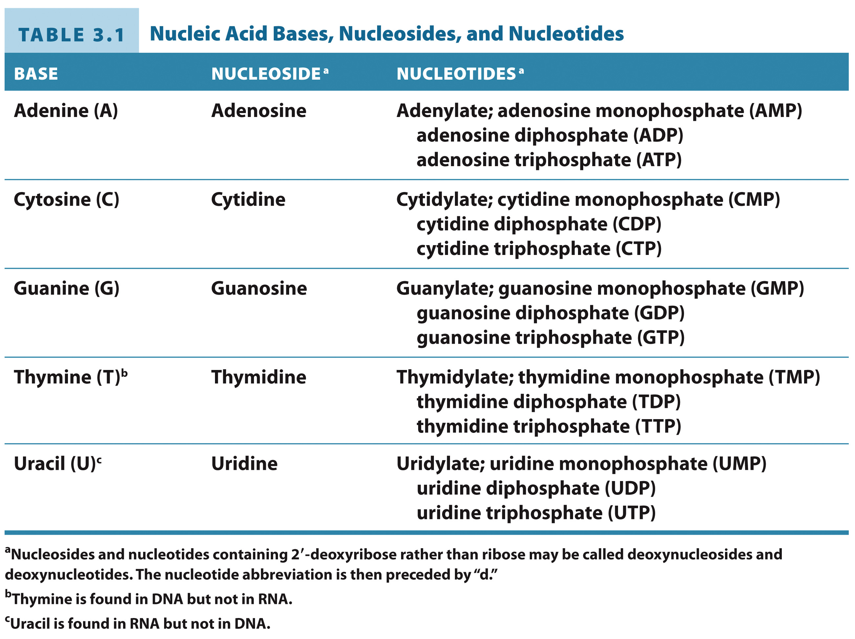
Nucleoside/nucleotide nomenclature is distinct from that of bases.

Slide 9
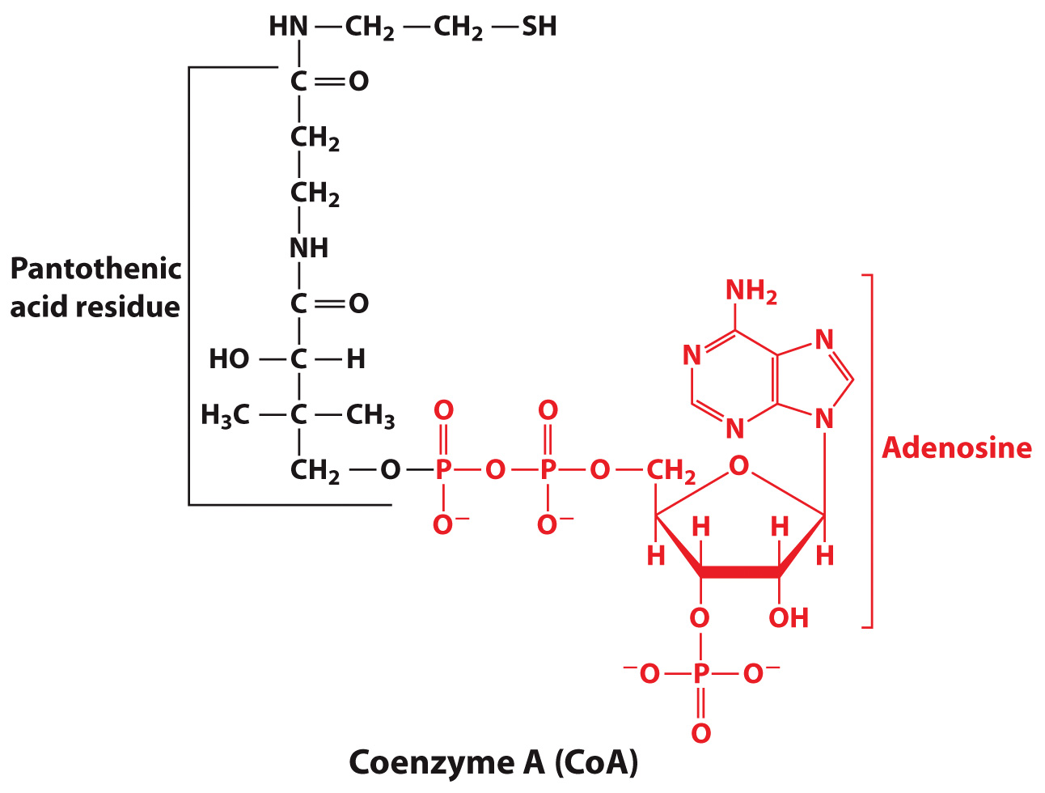
Coenzyme A contains Adenosine

Slide 10
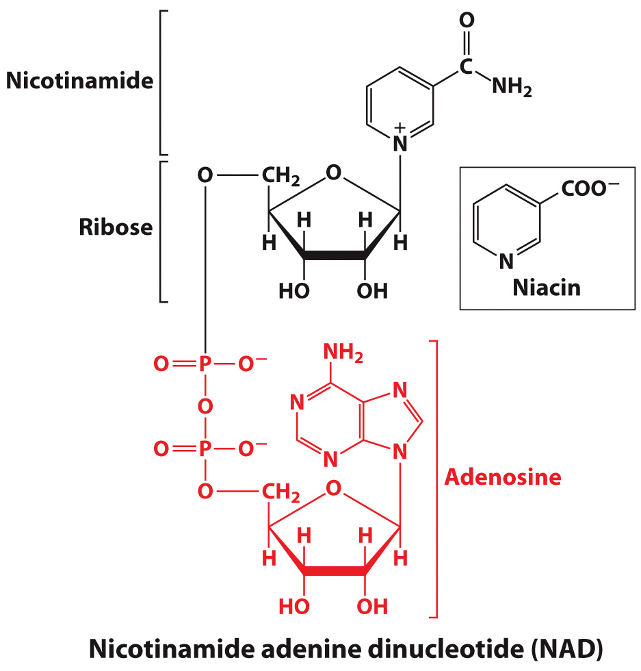
NAD contains Adenosine

Slide 11
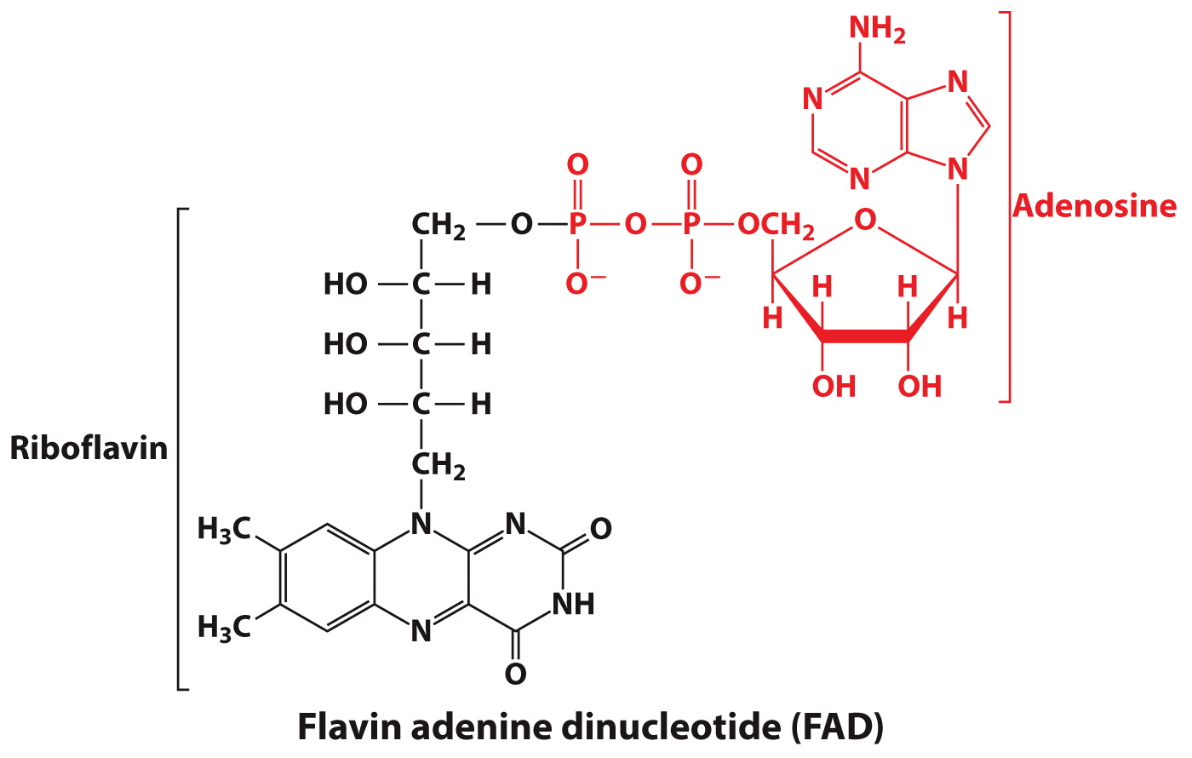
FAD contains Adenosine

Slide 12
Nucleotide Structure
Section 3.2
Learning Objective
Describe the structure and stabilizing forces in DNA

Slide 13
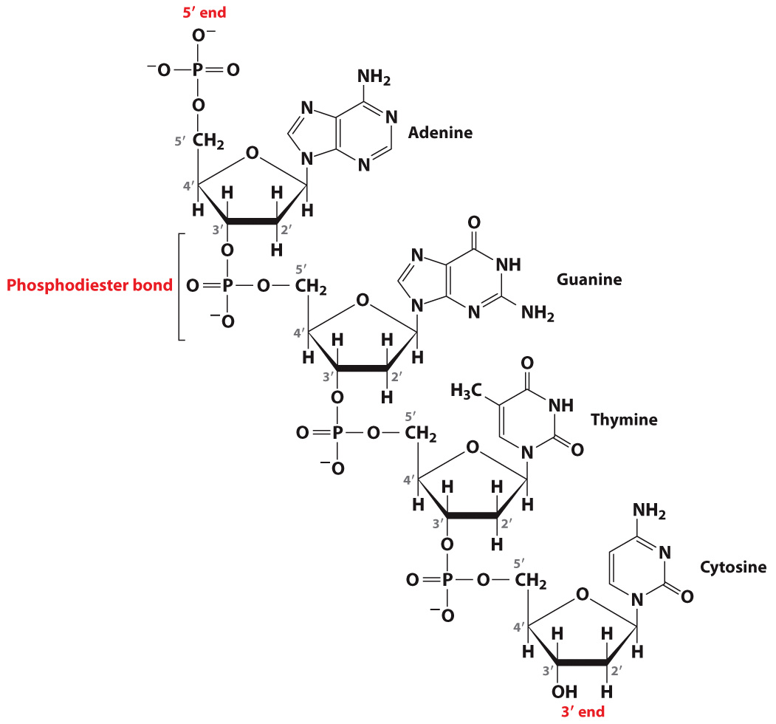
How do nucleotides link?
Via sugar in phosphodiester backbone
Read sequence of bases from 5’→ 3’
Nucleotides are connected via phosphodiester bonds

Slide 14
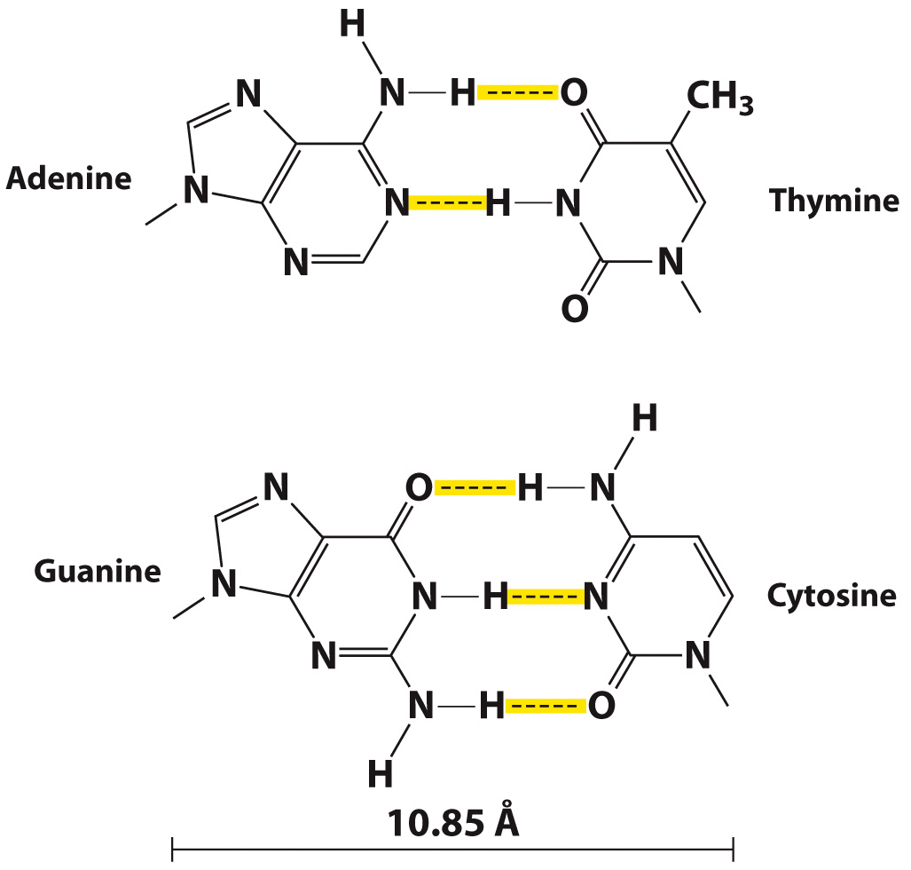
Nucleotides form specific base pairs

Slide 15
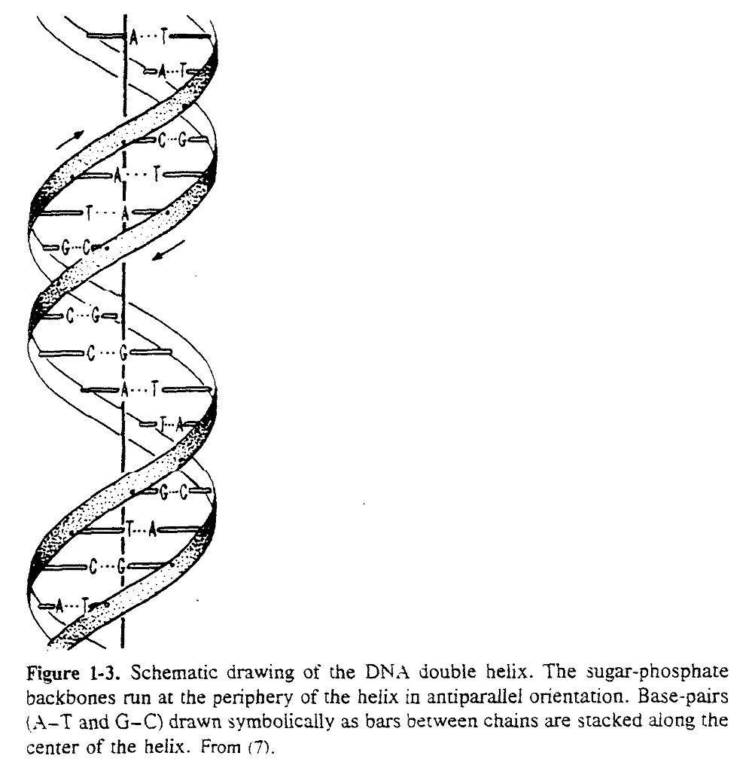

Slide 16
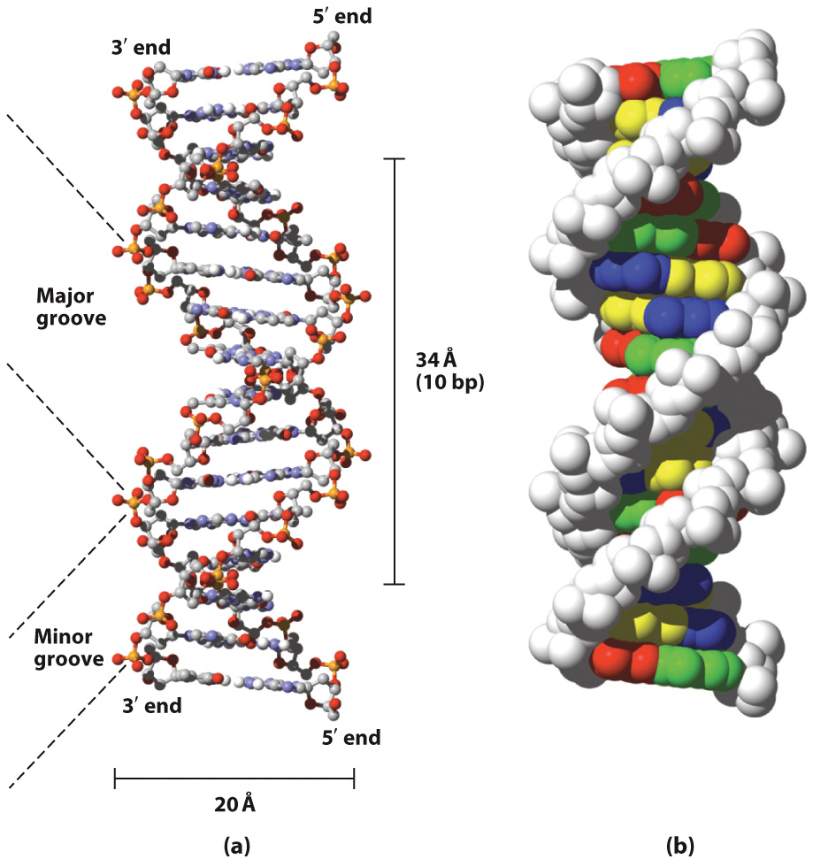
DNA forms a double helix

Slide 17
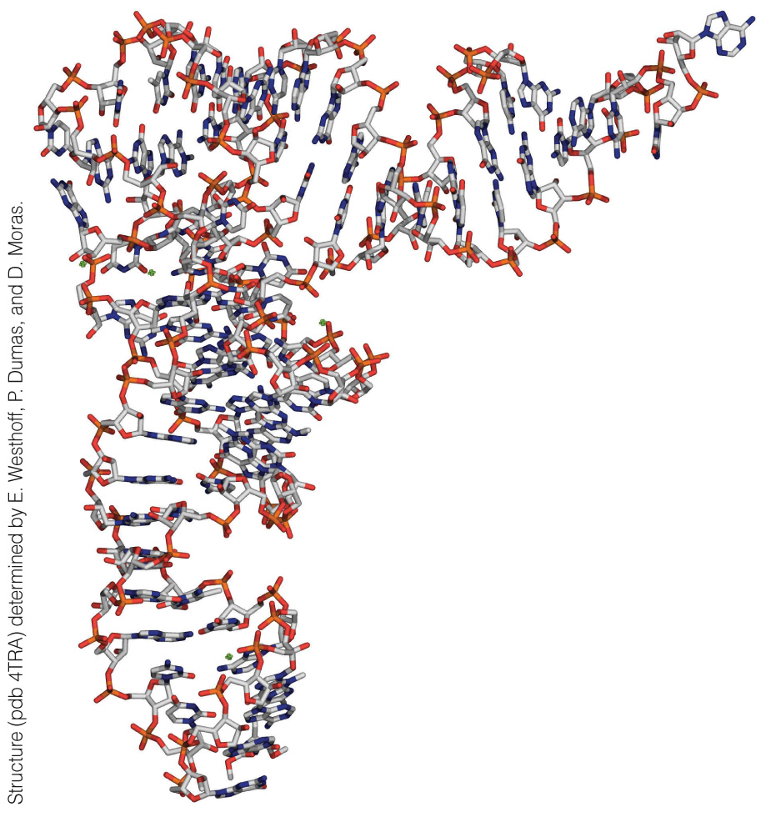
RNA is single stranded
Transfer RNA

Slide 18
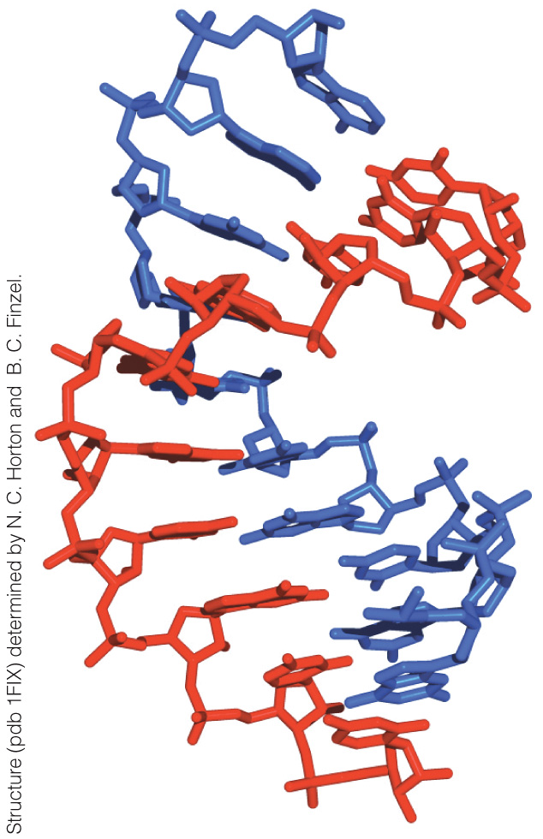
An RNA-DNA Hybrid Helix

Slide 19
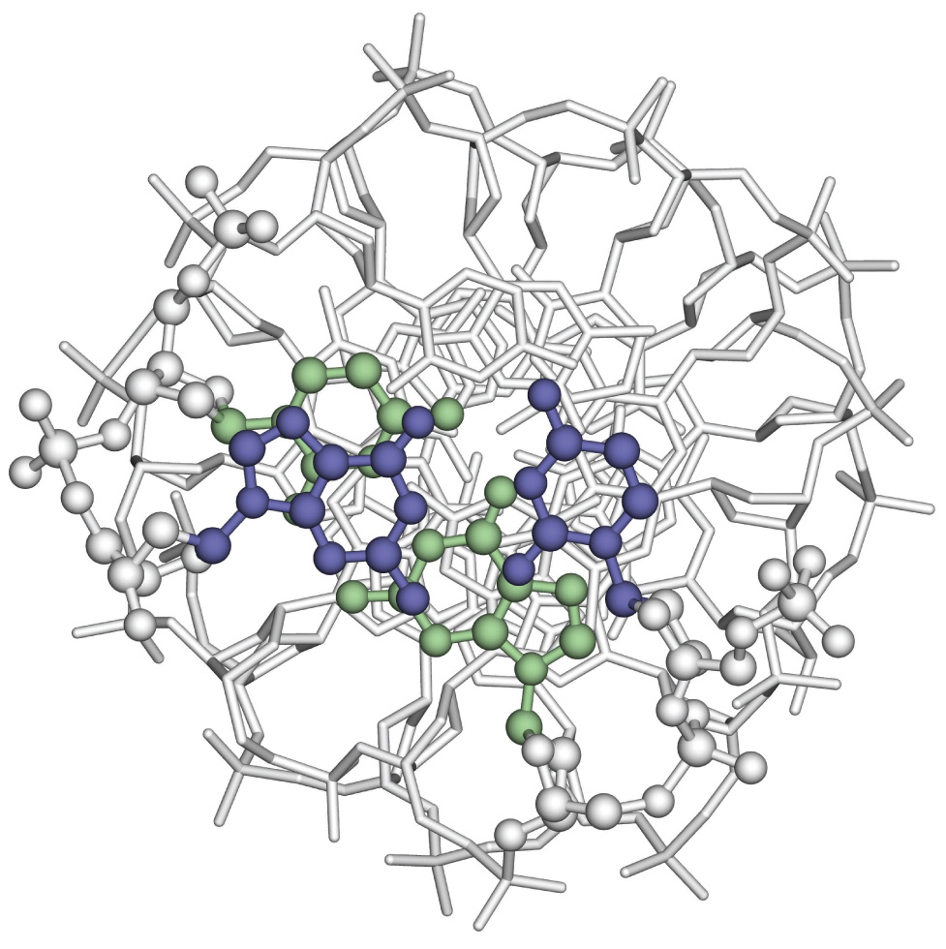
The stability of a DNA double helix depends mostly on stacking interactions
An Axial View of DNA Base Pairs

Slide 20
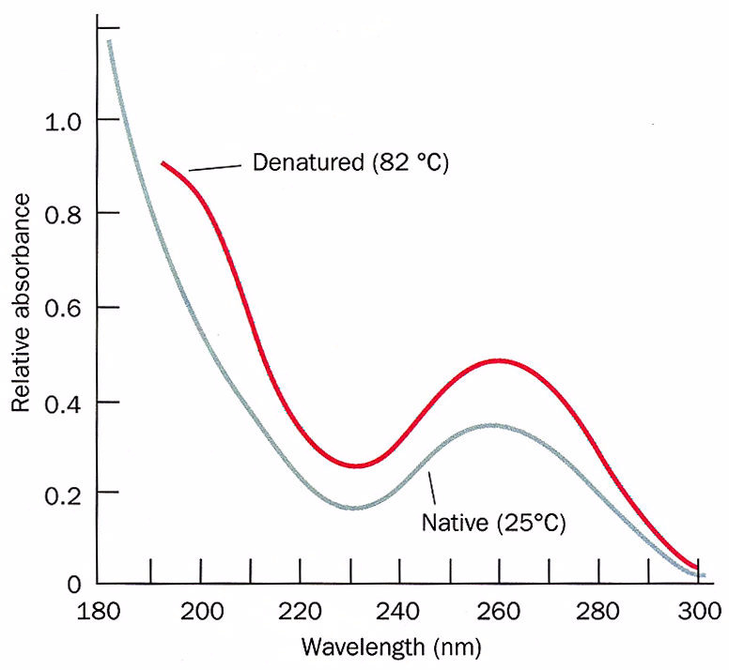

Slide 21
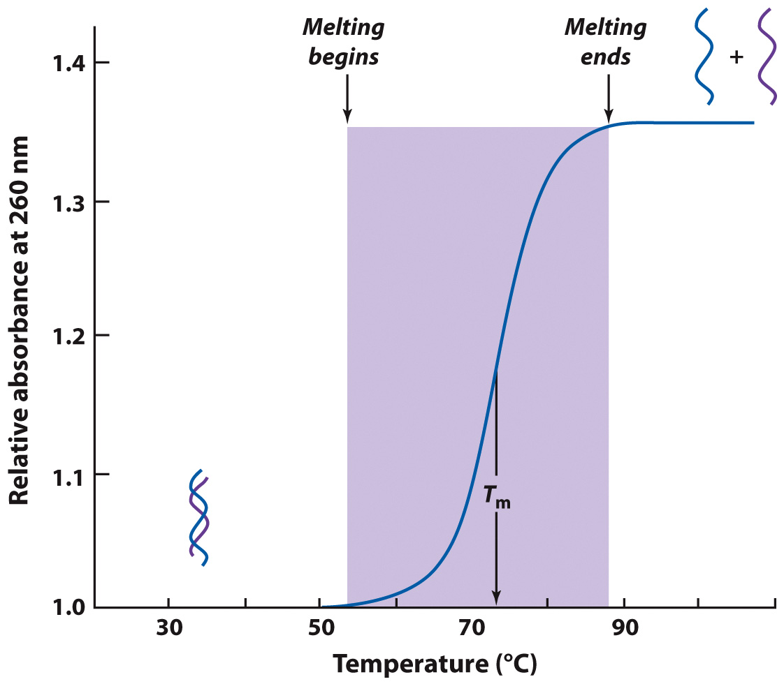
DNA can denature (unfold)

Slide 22
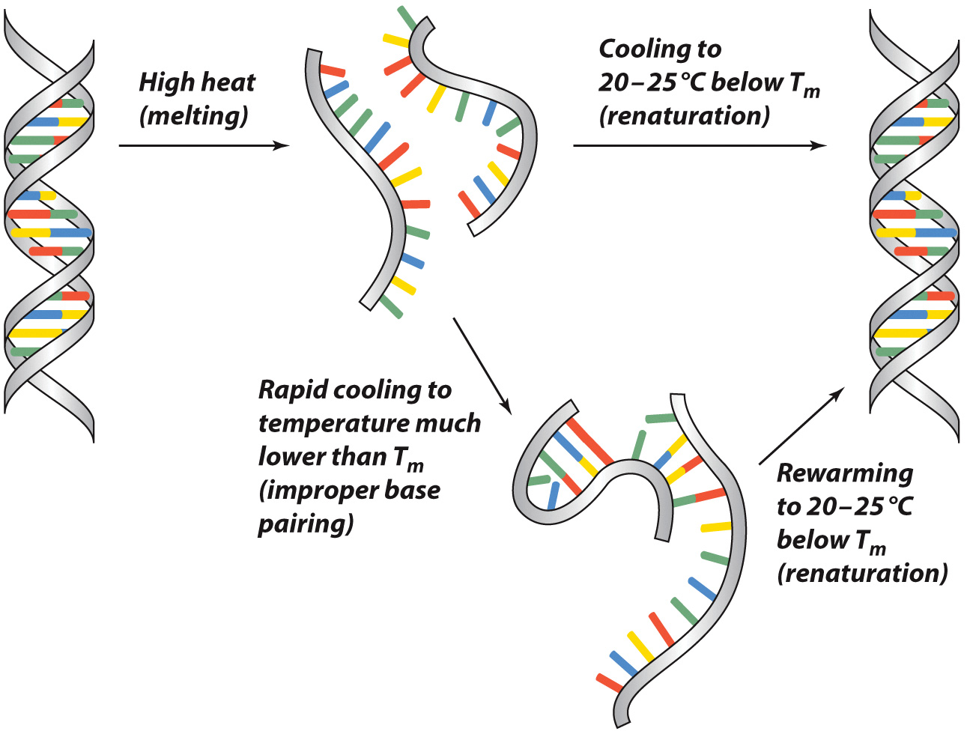
DNA can renature (refold, anneal)
Notes:
STOPPED HERE…

Slide 23
The Central Dogma
Section 3.3
Learning Objective
Summarize the biological roles of DNA and RNA

Slide 24
What does it mean to go from genes to proteins?

Slide 25
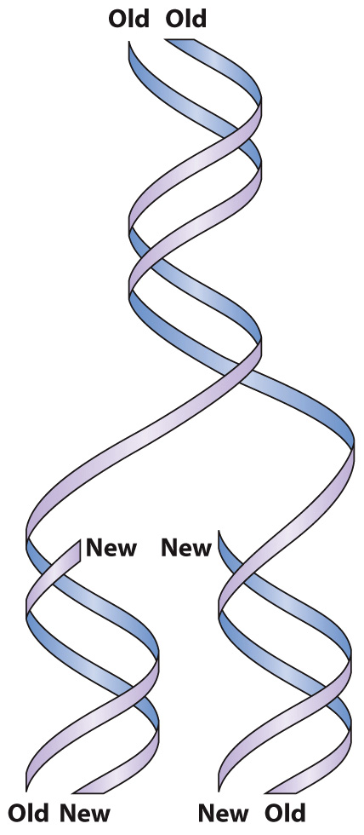
DNA Replication

Slide 26
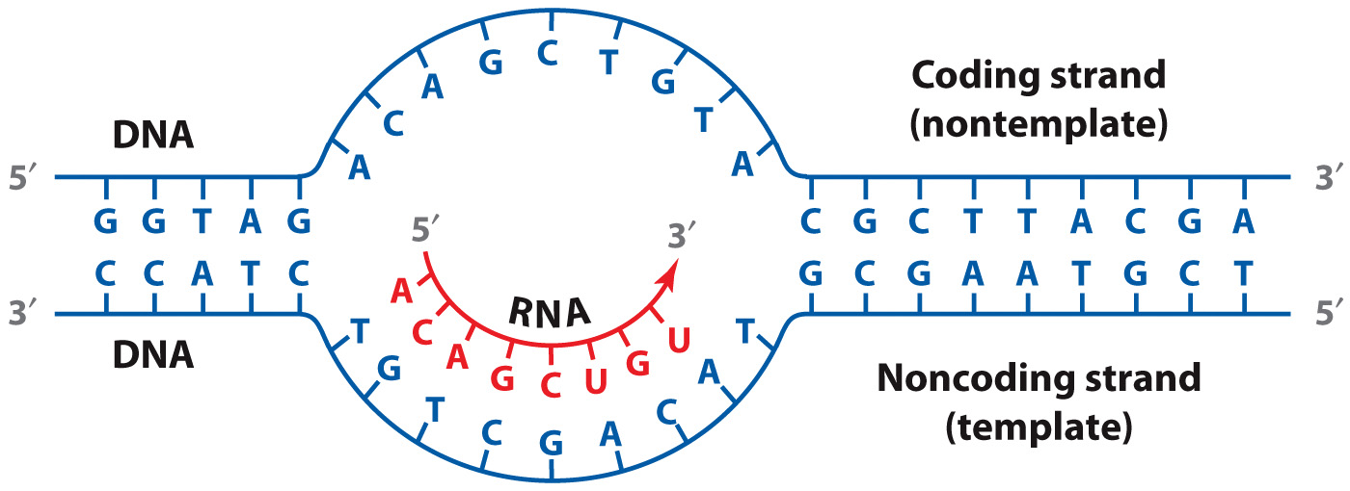
Transcription = RNA Synthesis
Notice that the RNA transcript is complementary to the template (noncoding strand)!

Slide 27
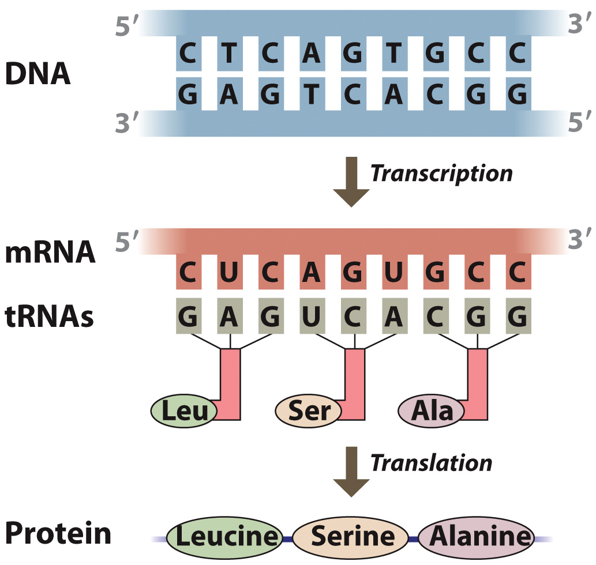
Translation = Protein Synthesis

Slide 28
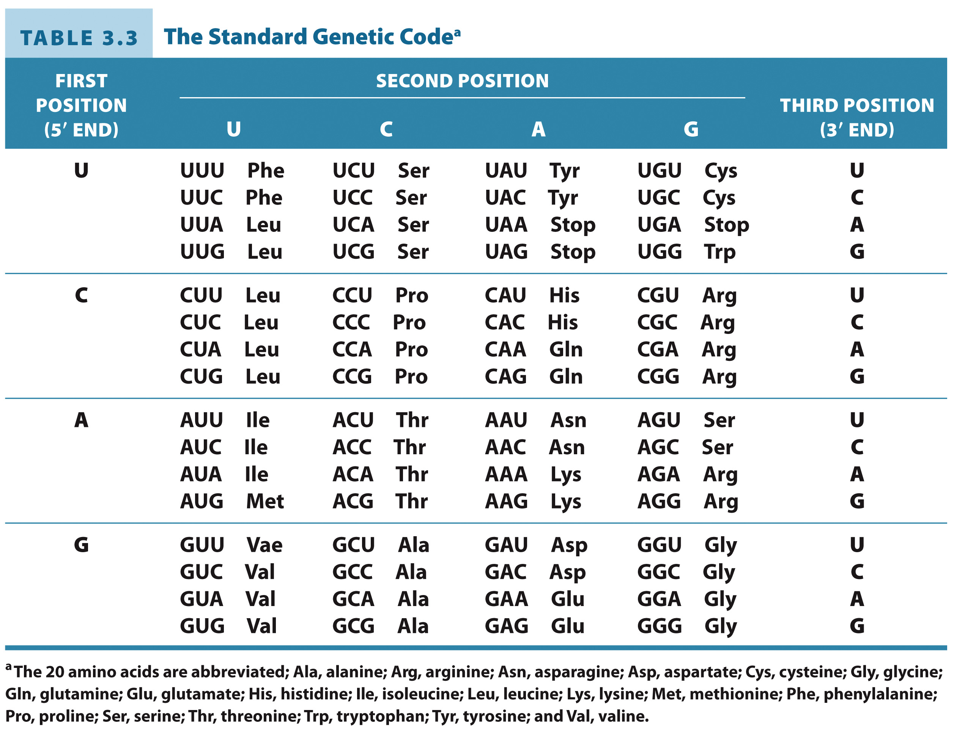
The Standard Genetic Code

Slide 29
A mutated gene can cause disease

Slide 30
Stop Here for CH431 The following slides are very informative, but not within the scope of this class.

Slide 31
Genomics
Section 3.4
Learning Objective
Identify the types of information provided by genomic analysis

Slide 32
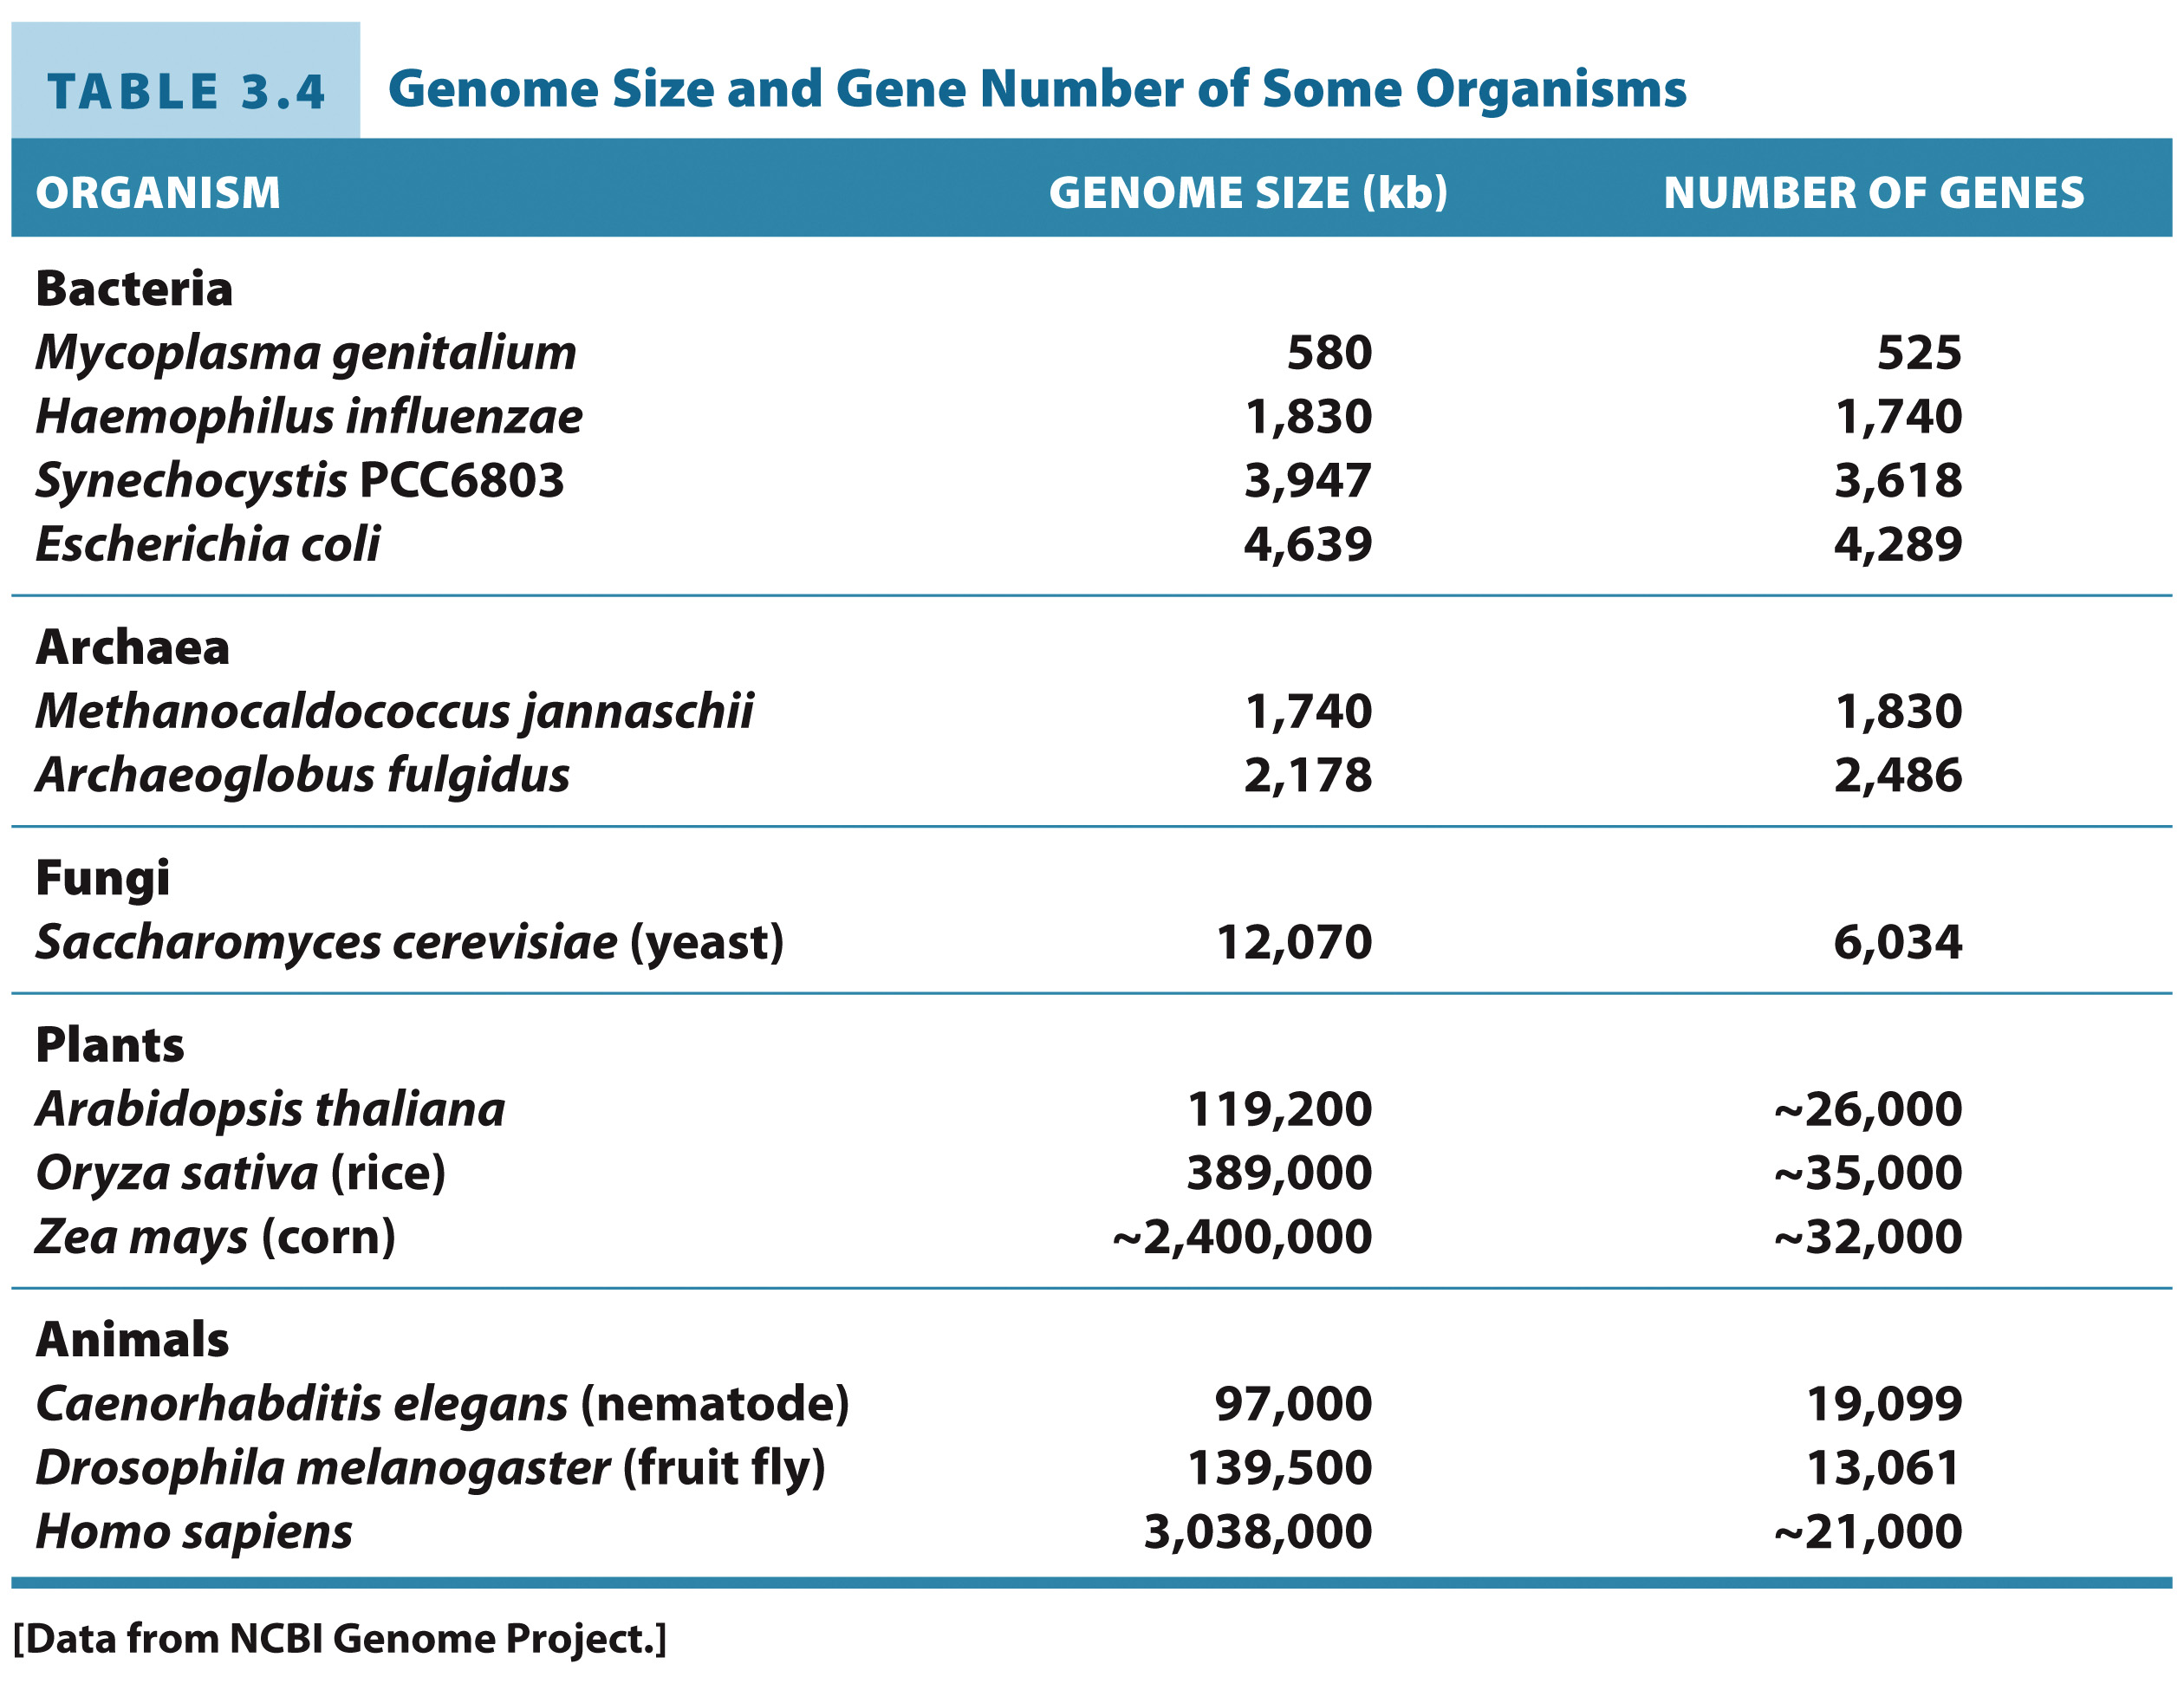
Gene size is roughly correlated with organismal complexity

Slide 33
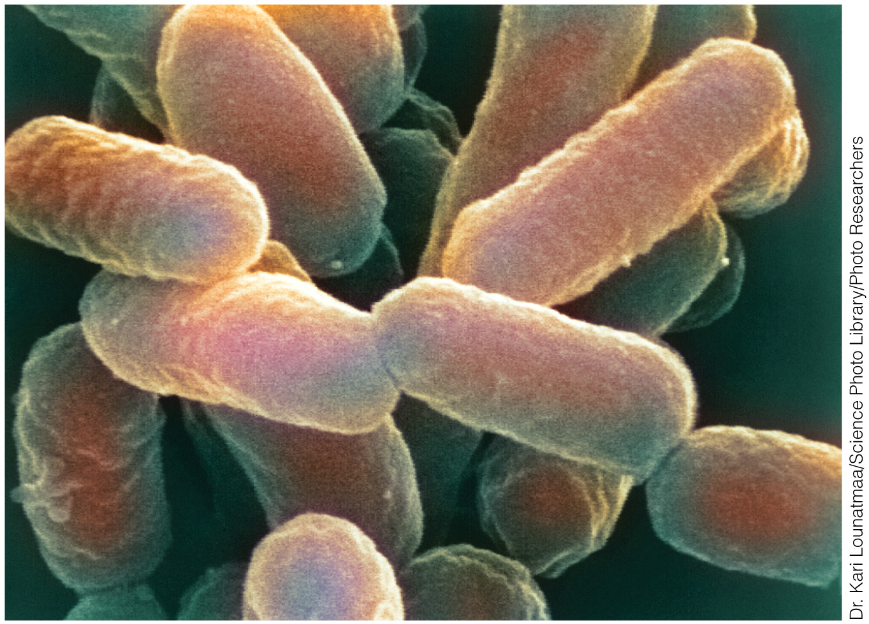
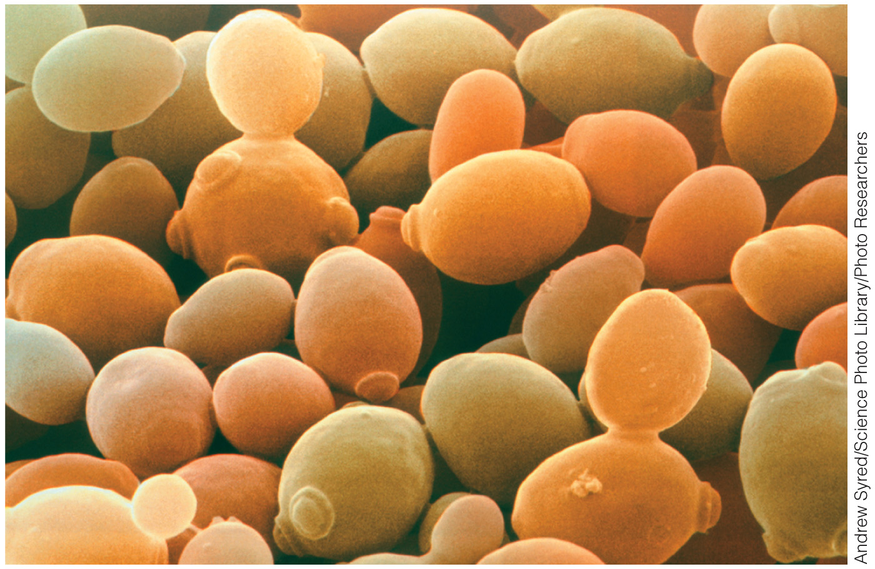
Some model organisms for genomic studies
Escherichia coli, a normal inhabitant of the mammalian digestive tract, is a metabolically versatile bacterium that tolerates both aerobic and anaerobic conditions.
Baker’s yeast, Saccharomyces cerevisiae, is one of the simplest eukaryotic organisms, with just over 6000 genes.

Slide 34
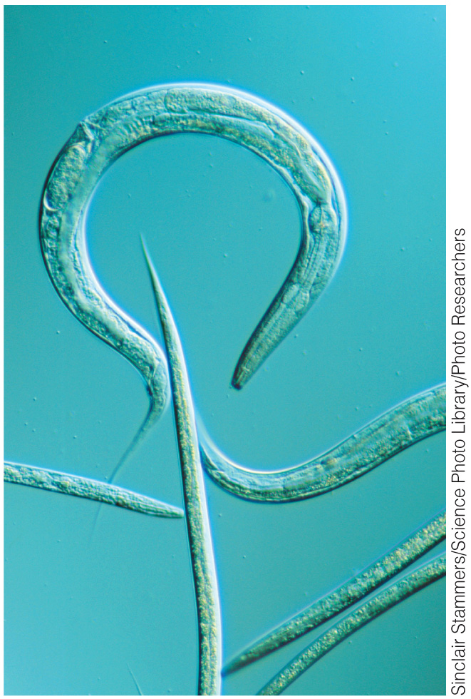
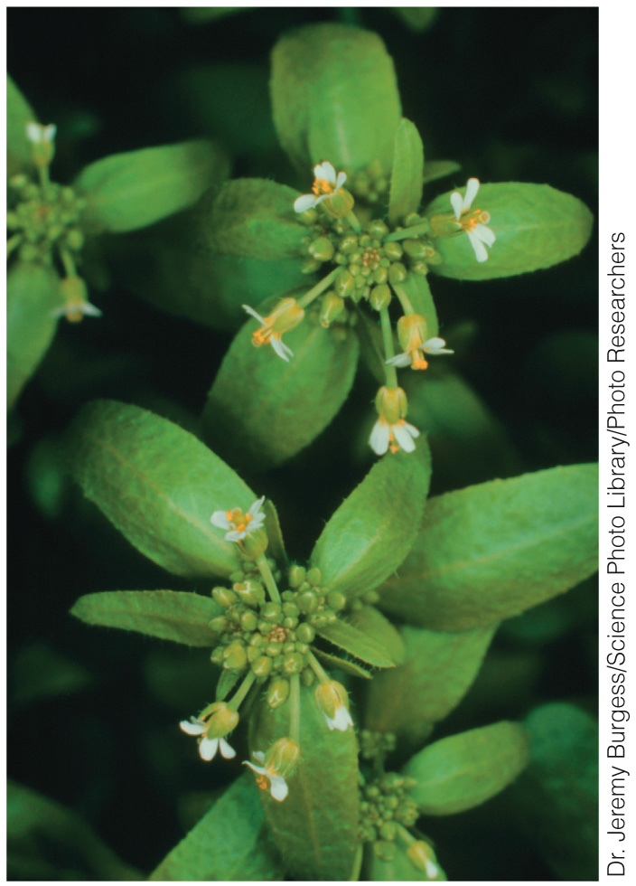
Some model organisms for genomic studies
Caenorhabditis elegans is a small (1-mm) and transparent roundworm. As a multicellular organism, it bears genes not found in unicellular organisms.
The plant kingdom is represented by Arabidopsis thaliana, which has a short generation time and readily takes up foreign DNA.

Slide 35
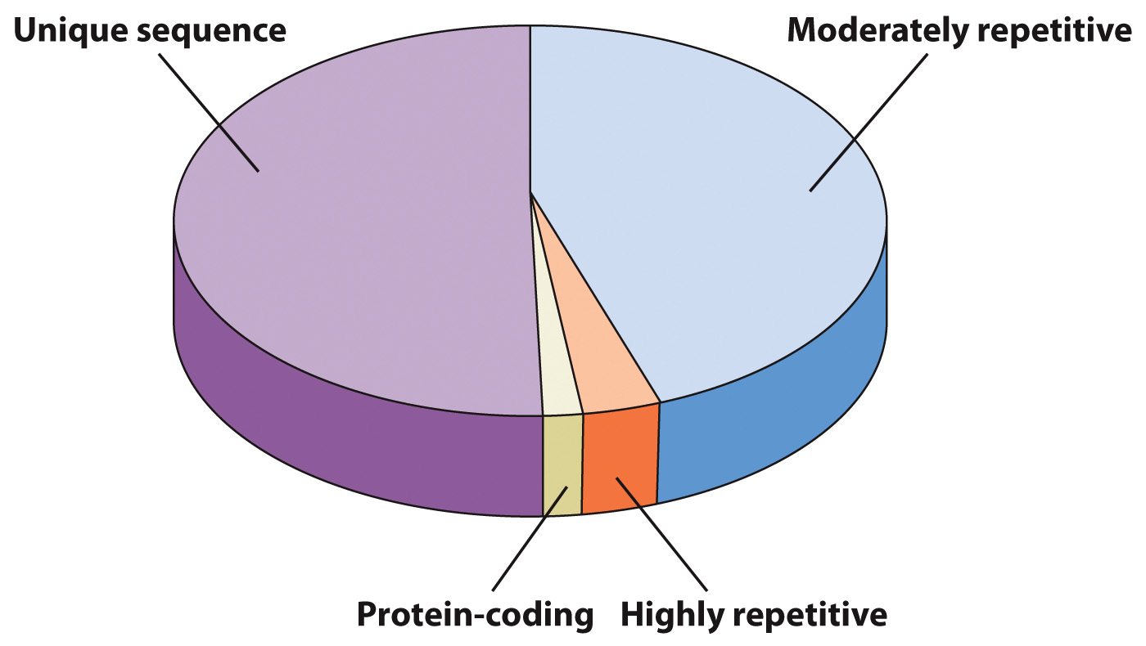
Coding and Noncoding Portions of the Human Genome

Slide 36
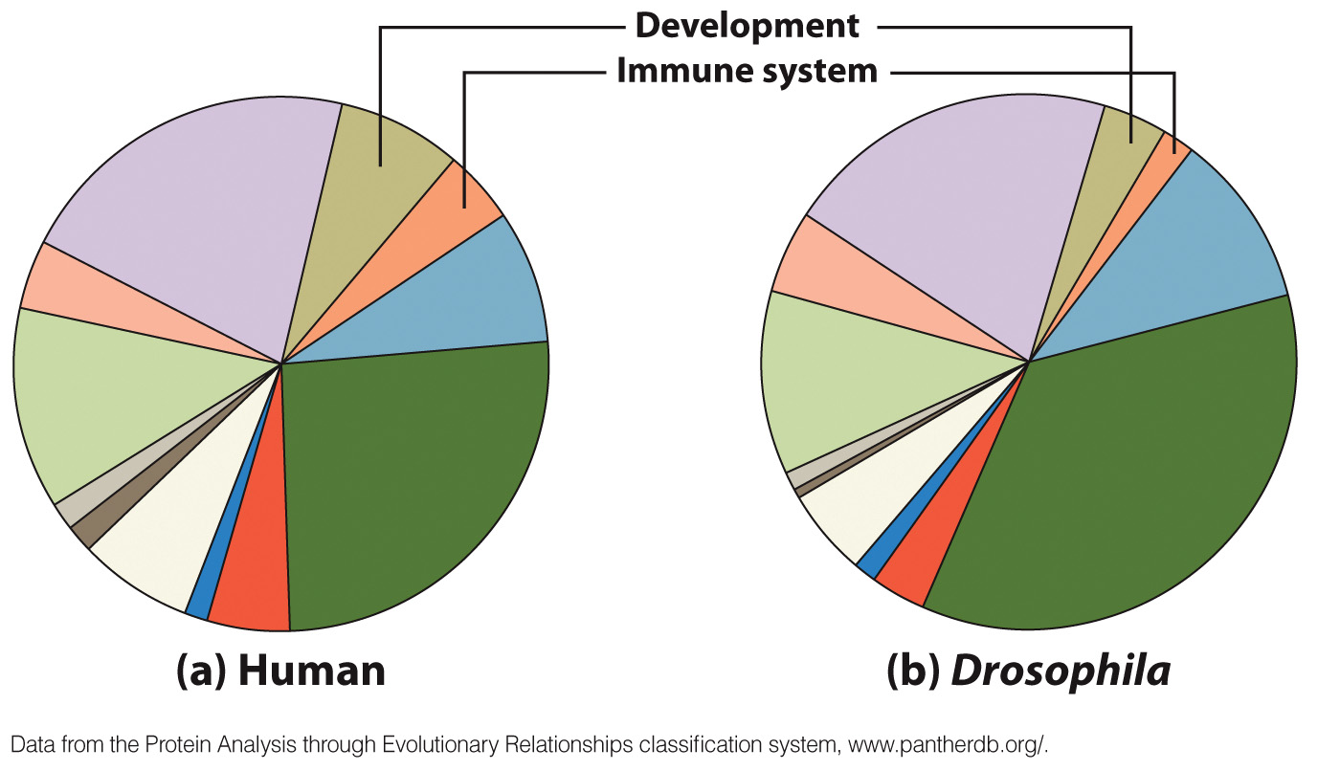
Functional Classification of Genes

Slide 37
Tools and Techniques: Manipulating DNA
Section 3.5
Learning Objective
Describe how researchers manipulate DNA in vitro and in vivo

Slide 38
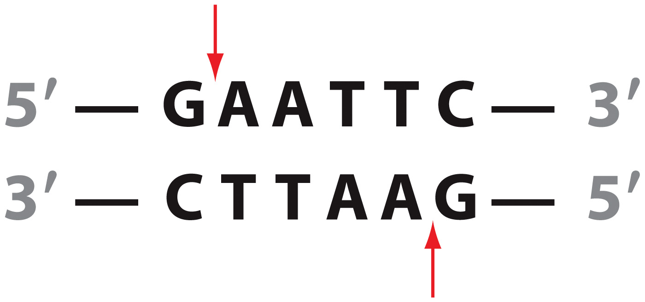
Restriction enzymes cut DNA
Recognition sequences tend to be palindromic.

Slide 39
Restriction enzymes form sticky or blunt ends
STICKY ENDS
BLUNT ENDS

Slide 40
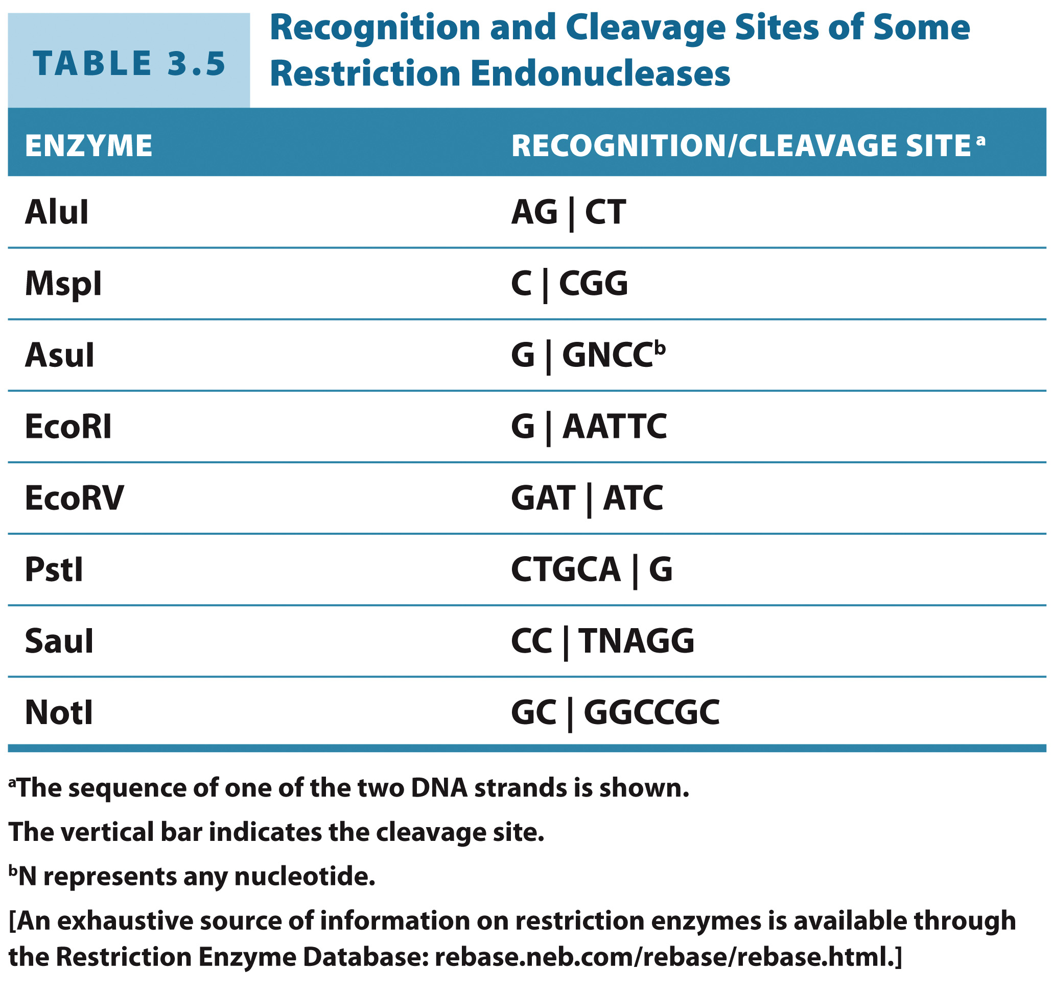
Different restriction enzymes recognize different DNA sequences

Slide 41
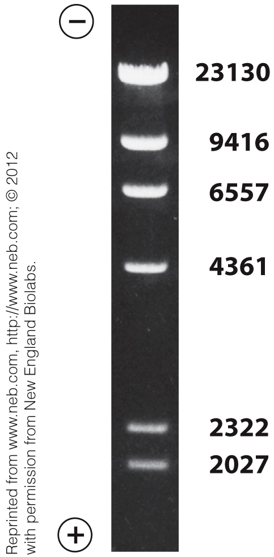
DNA fragment sizes can be quantified from gel images
Digestion of the Bacteriophage λ DNA by HindIII

Slide 42
Production of a Recombinant DNA Molecule

Slide 43
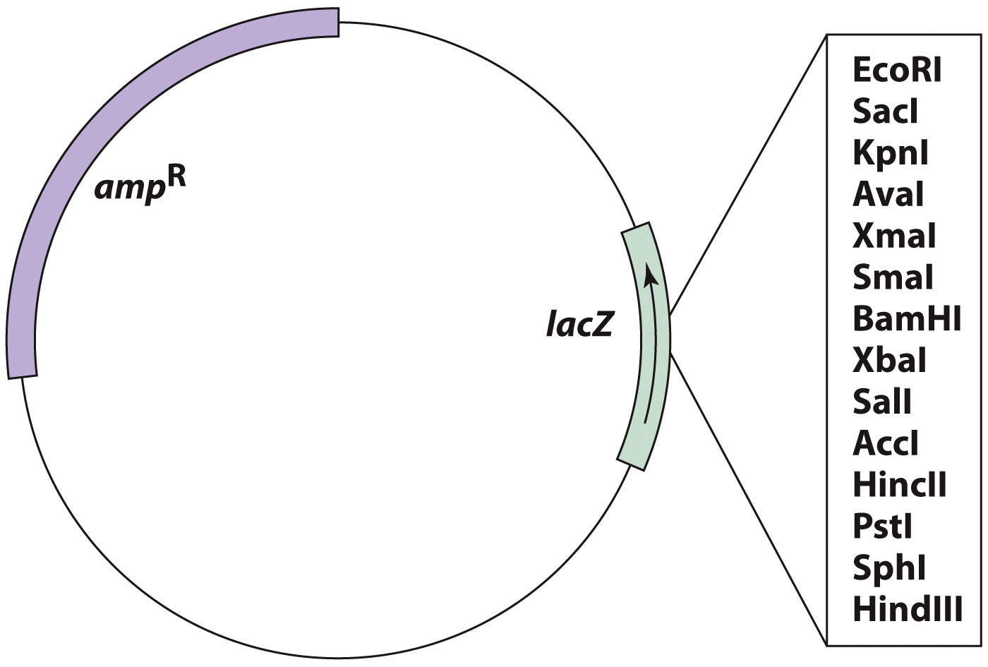
Map of a Cloning Vector

Slide 44
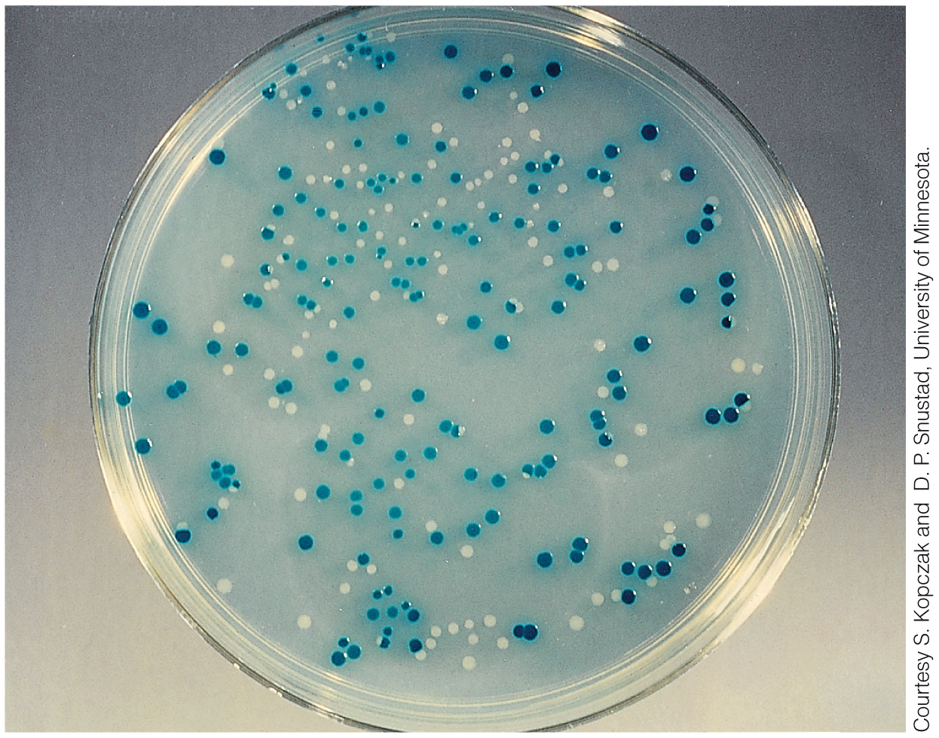
Culture Dish with Recombinant Bacteria

Slide 45
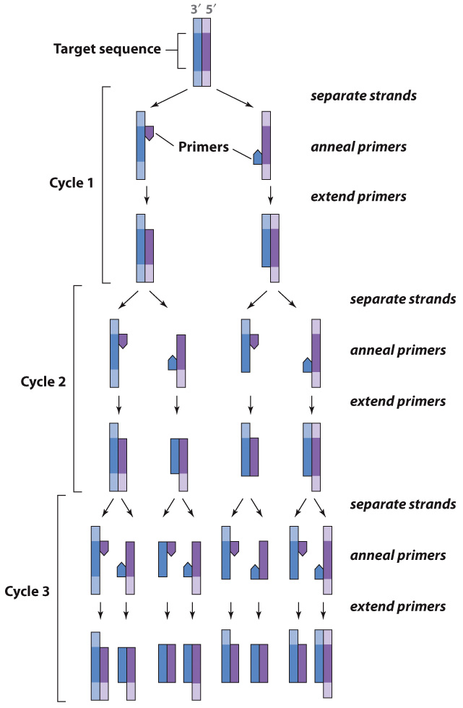
The Polymerase Chain Reaction (PCR) amplifies DNA

Slide 46
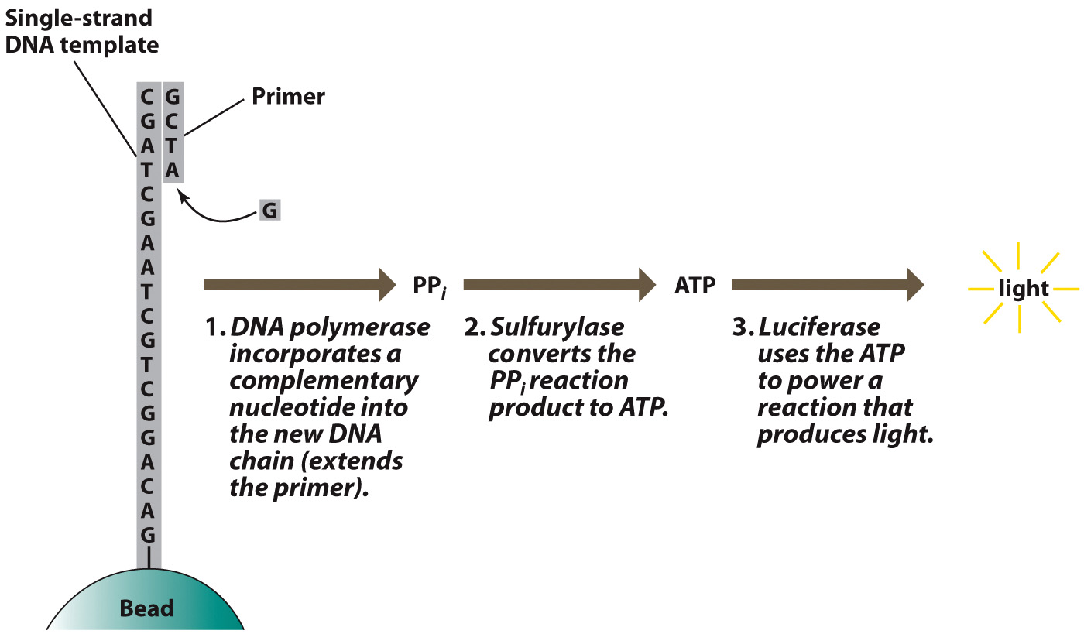
Pyrosequencing

Slide 47
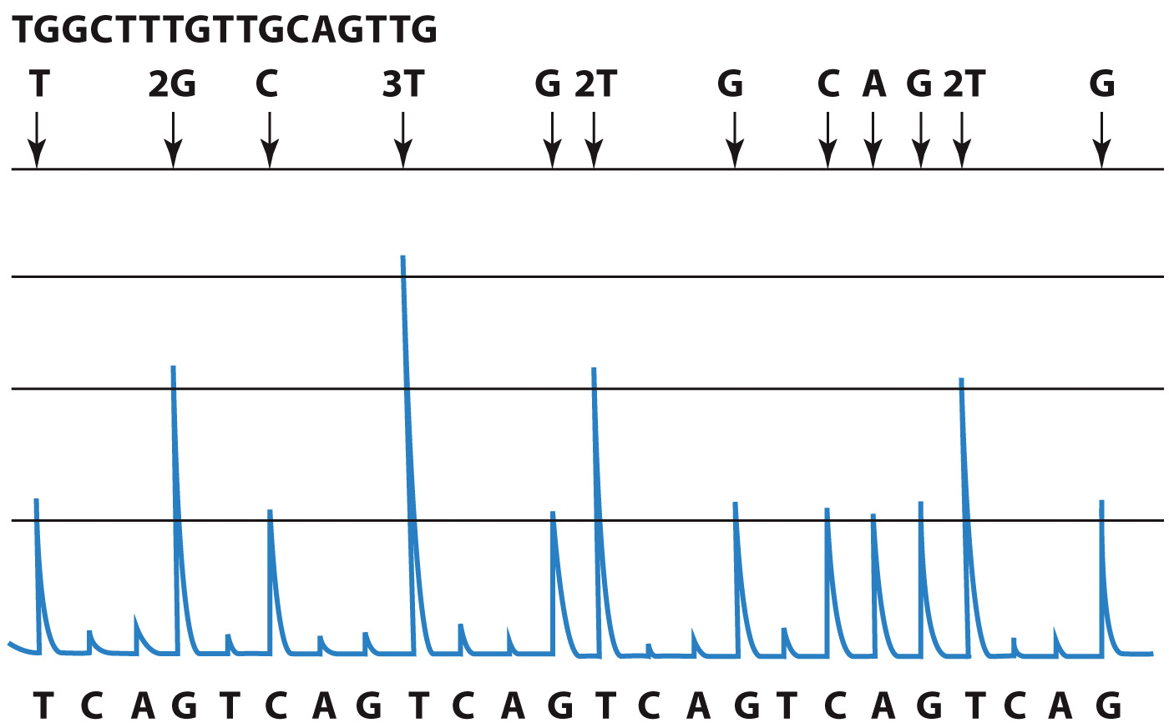
Results of Pyrosequencing

Slide 48
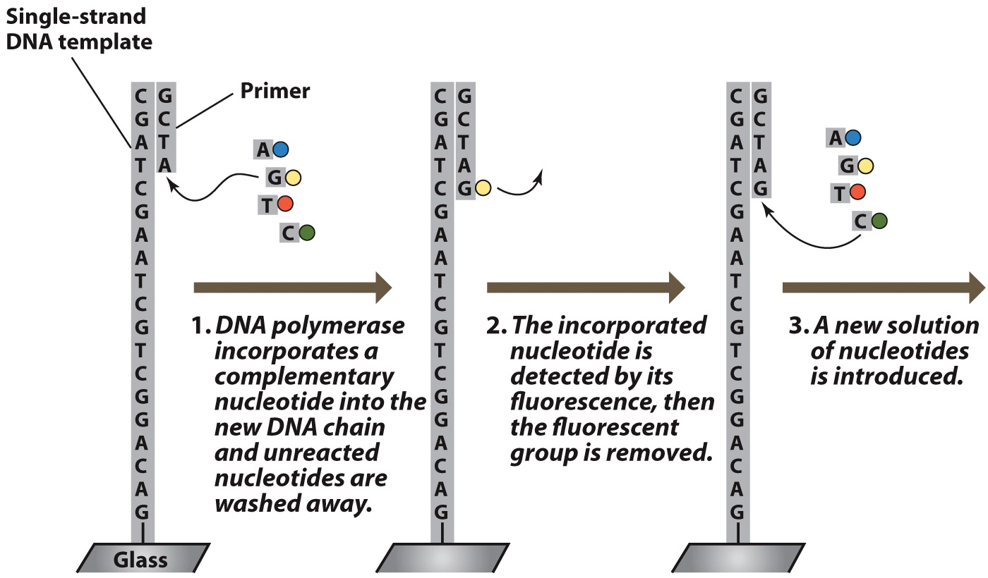
Illumina Sequencing

Slide 49
DNA can be altered via site-directed mutagenesis or CRISPR analysis
Clustered Regularly Interspersed Short Palindromic Repeats CRISPRs

Slide 50
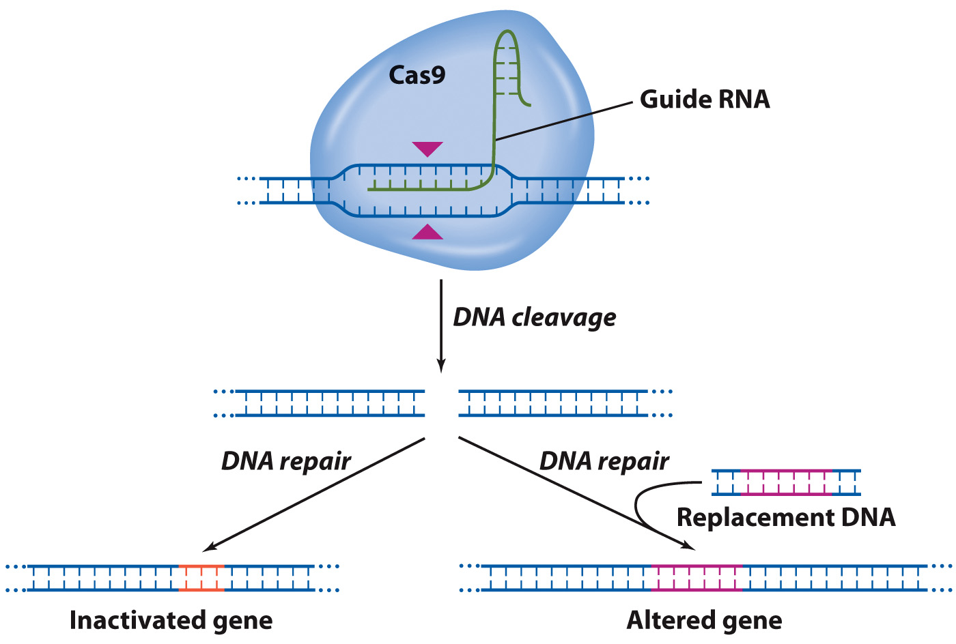
The CRISPR-Cas9 Gene-Editing System

Slide 51
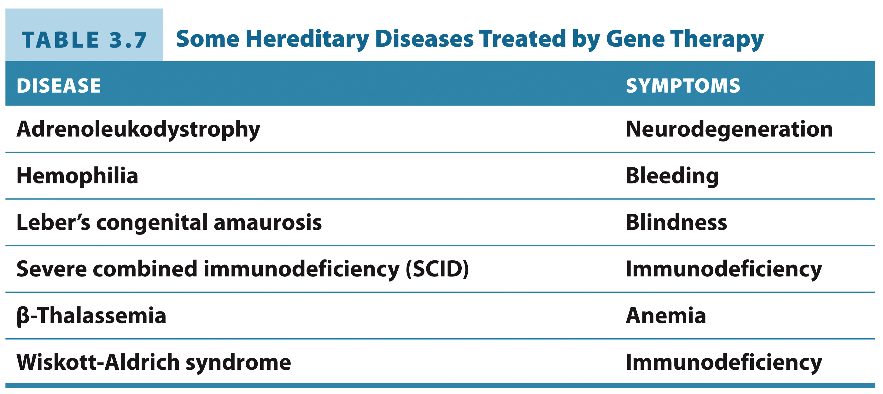
Some Hereditary Diseases Treated by Gene Therapy

