Slide 1
Essential Biochemistry
Fourth Edition
Charlotte W. Pratt | Kathleen Cornely
Lecture Notes for
Chapter 2
Aqueous Chemistry

Slide 2
Water Molecules and Hydrogen Bonds
Section 2.1
Learning Objective
Explain water’s properties in terms of its ability to form hydrogen bonds

Slide 3
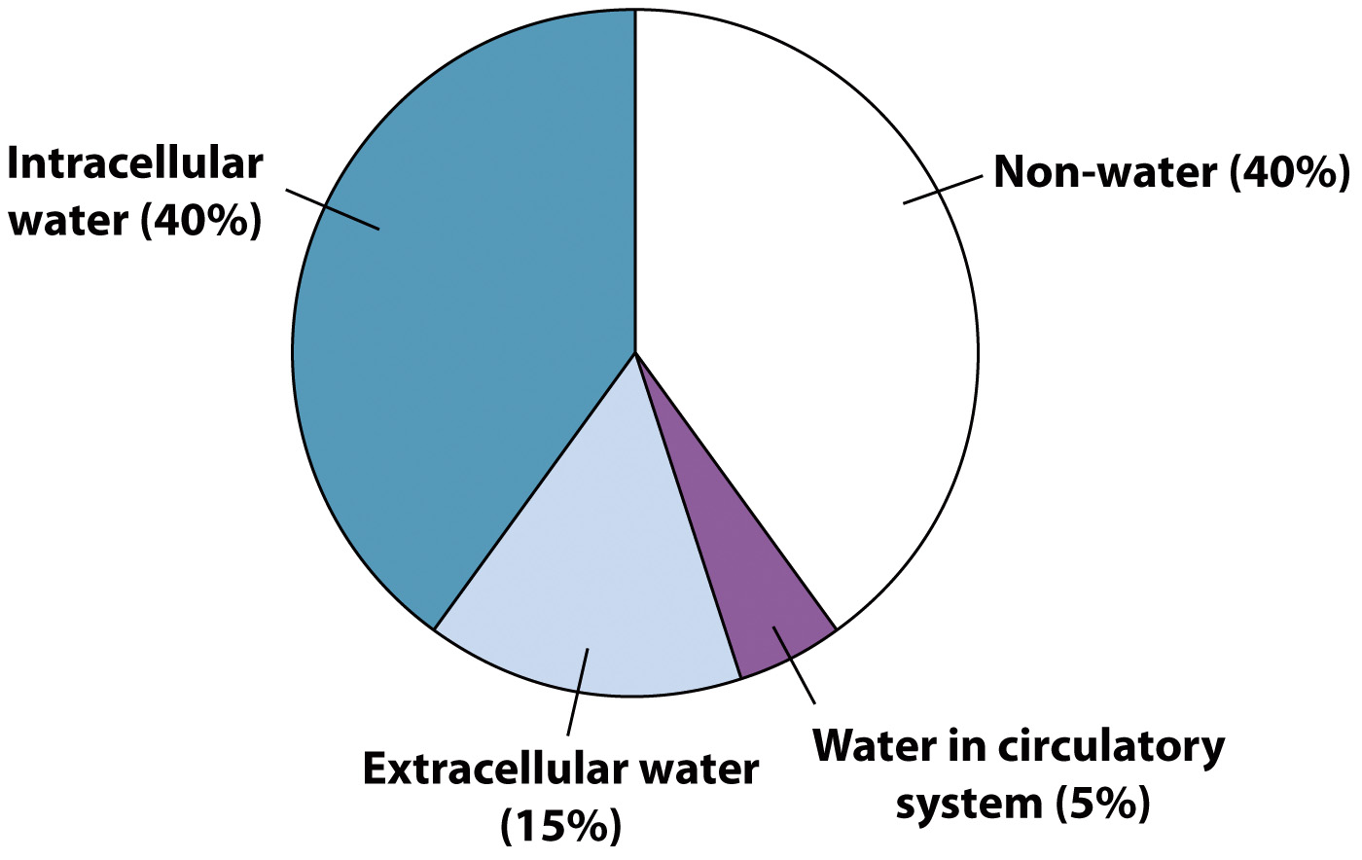
The human body is ~60% water by weight

Slide 4
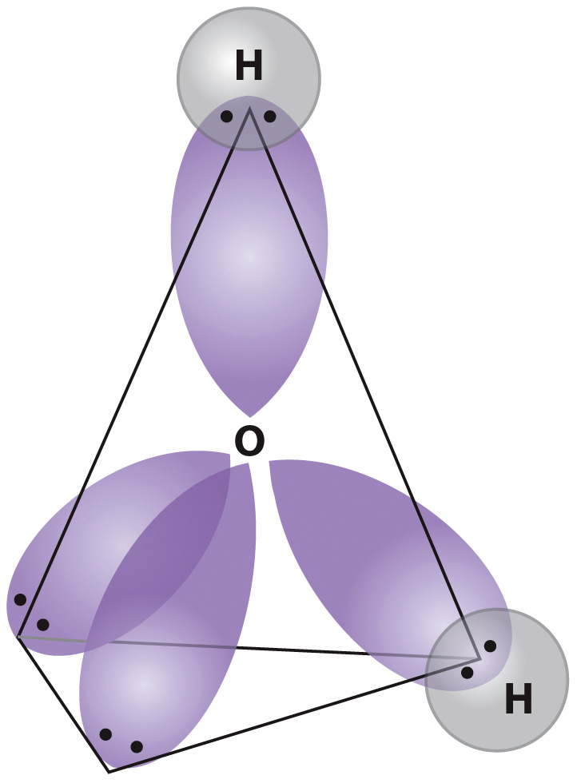
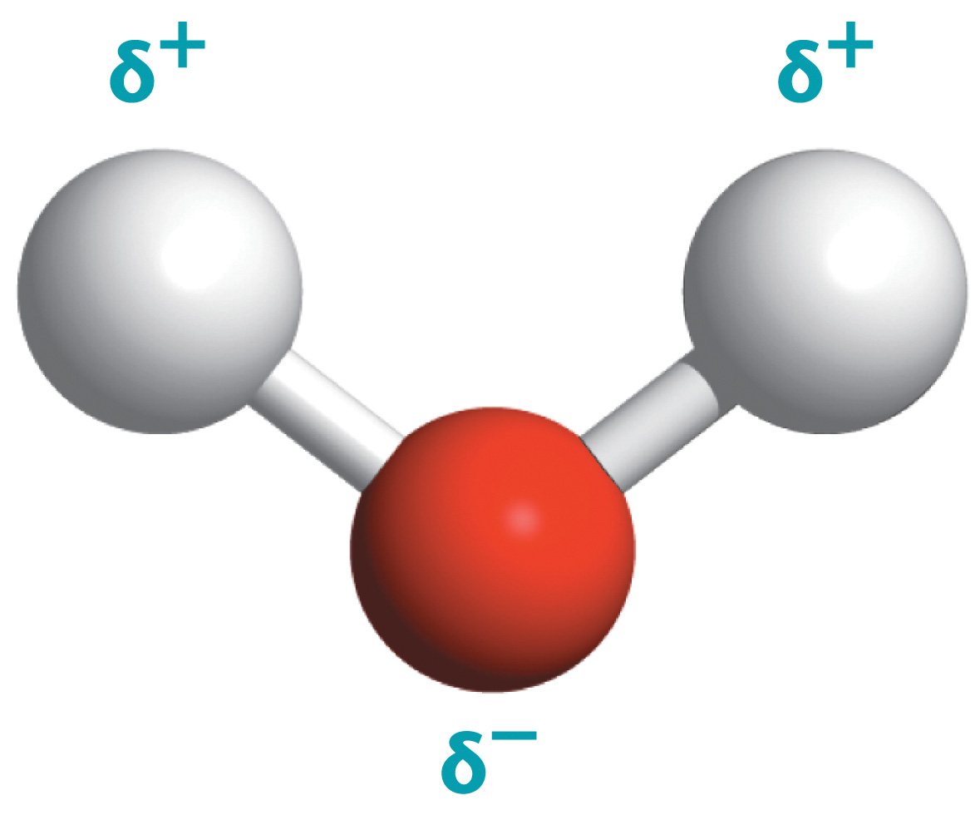
Water is an effective polar solvent
Water has tetrahedral geometry because of its electronic structure.
Water is polar.

Slide 5
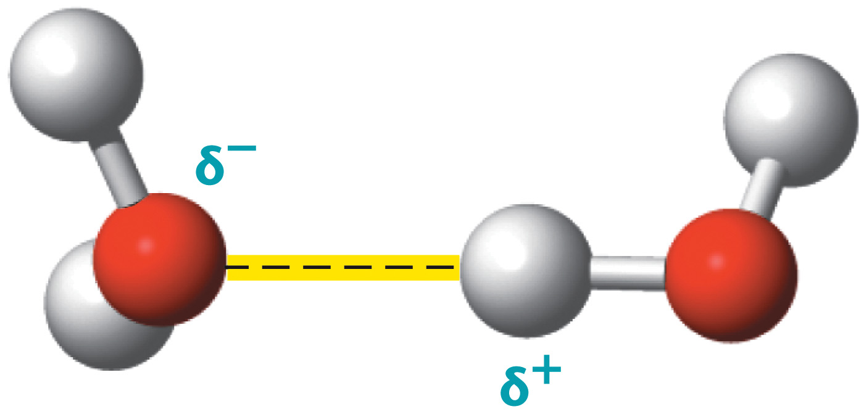
Opposite charges attract
Hydrogen bond in yellow

Slide 6
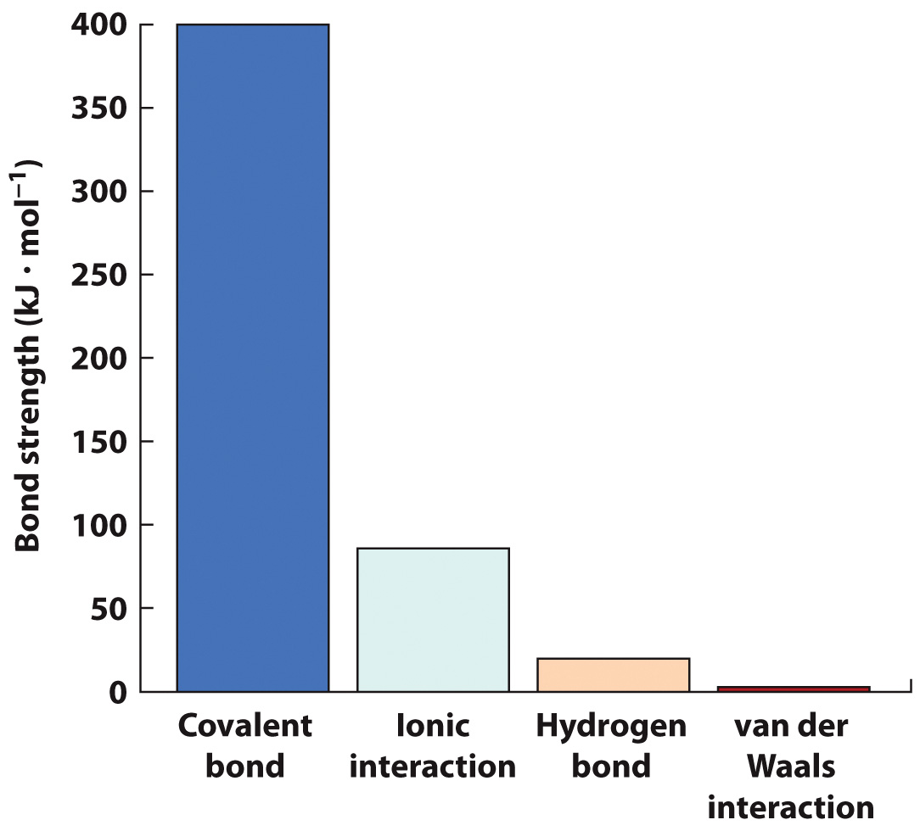
Noncovalent “bonds” are weaker than covalent bonds

Slide 7
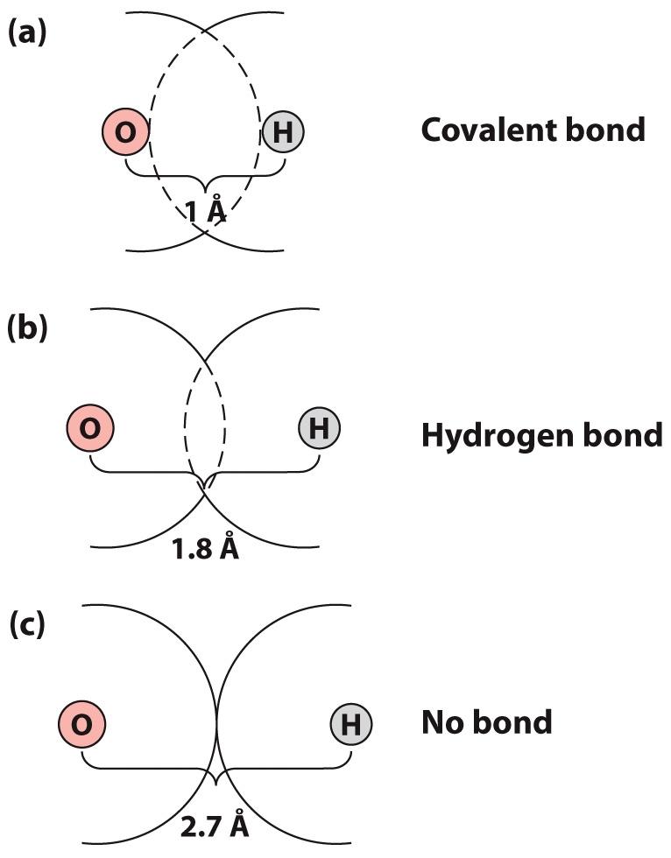
Hydrogen bonds are one type of electrostatic force

Slide 8
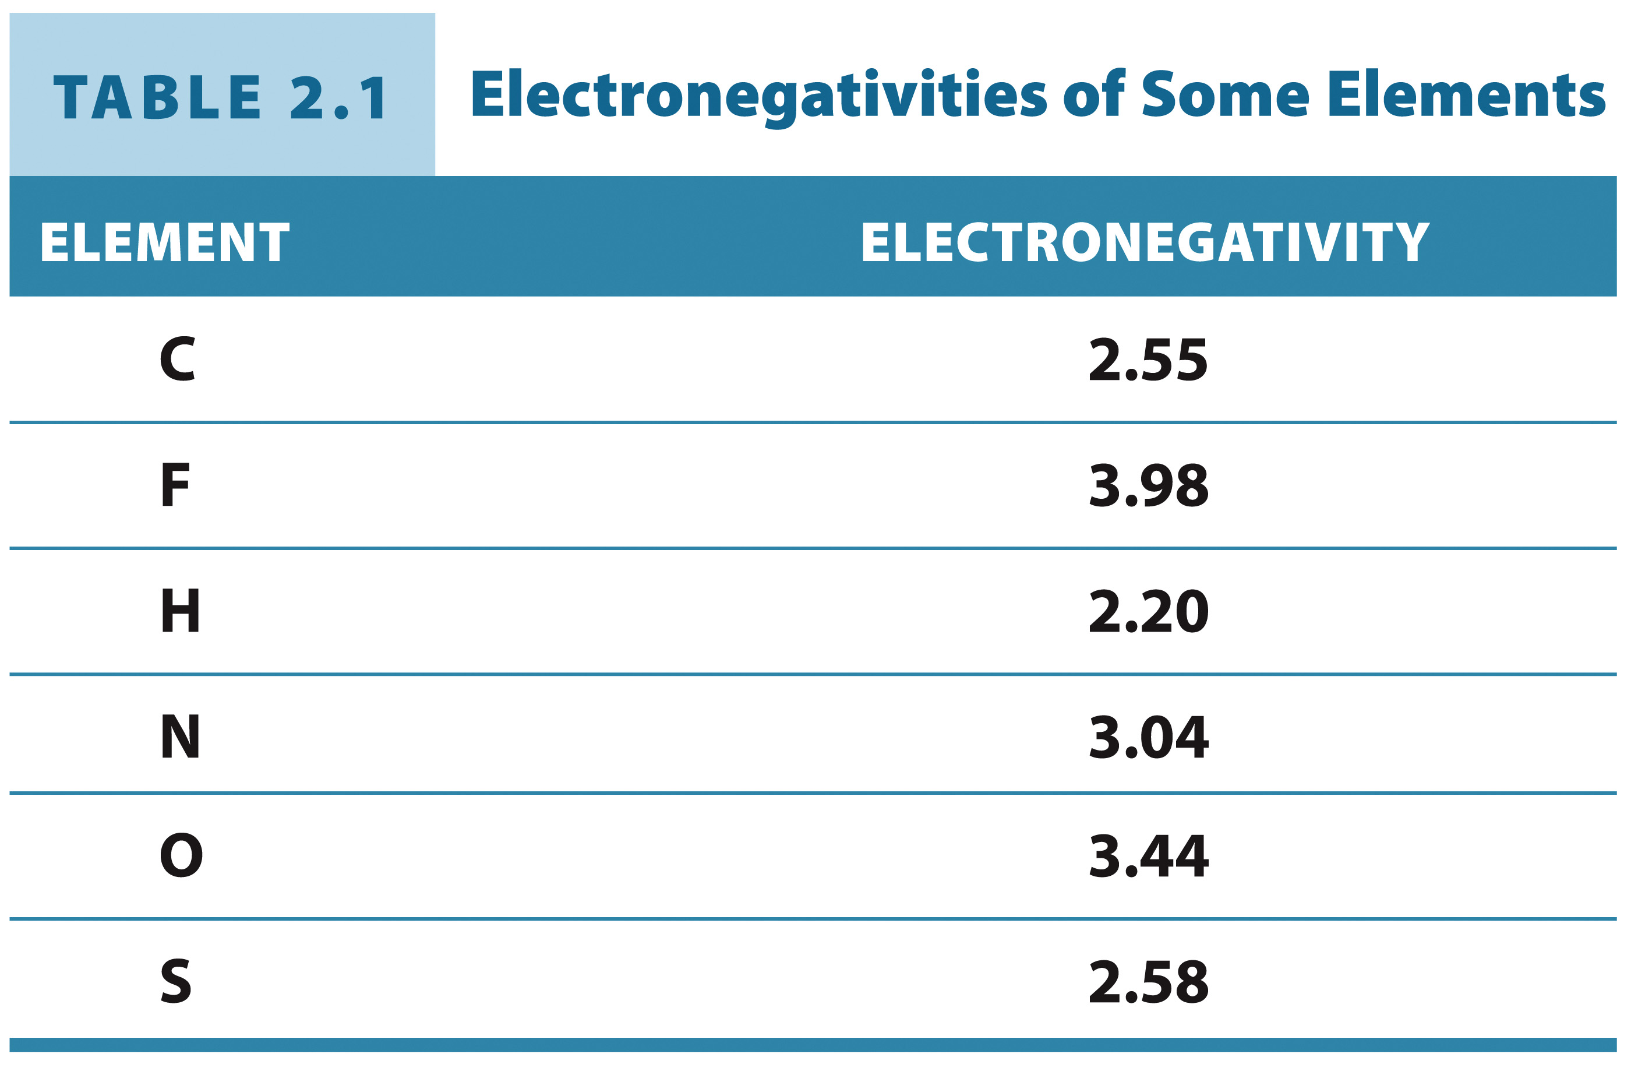
Hydrogen bonding capability is based on electronegativity

Slide 9
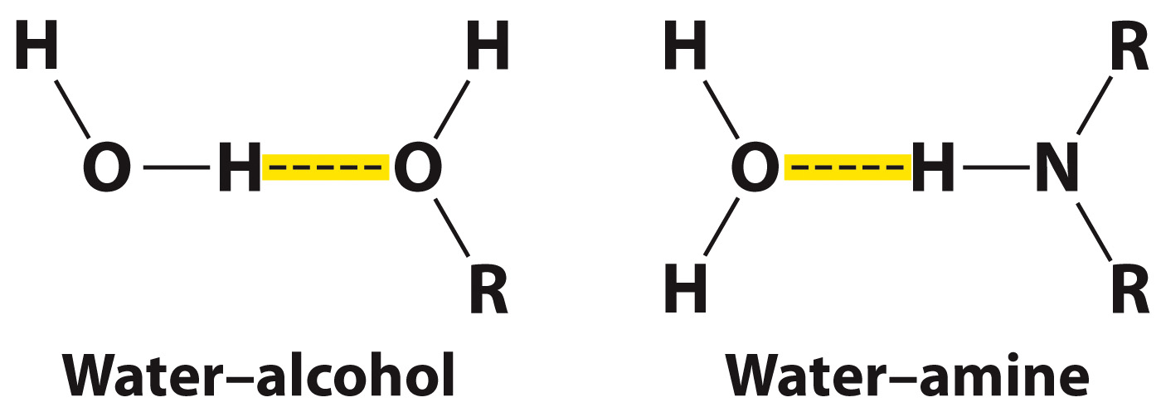
Hydrogen bonds can form between molecules other than two waters
Important Observation:
Hydroxyl groups and amine groups
are key players in hydrogen bonding in biomolecules.

Slide 10
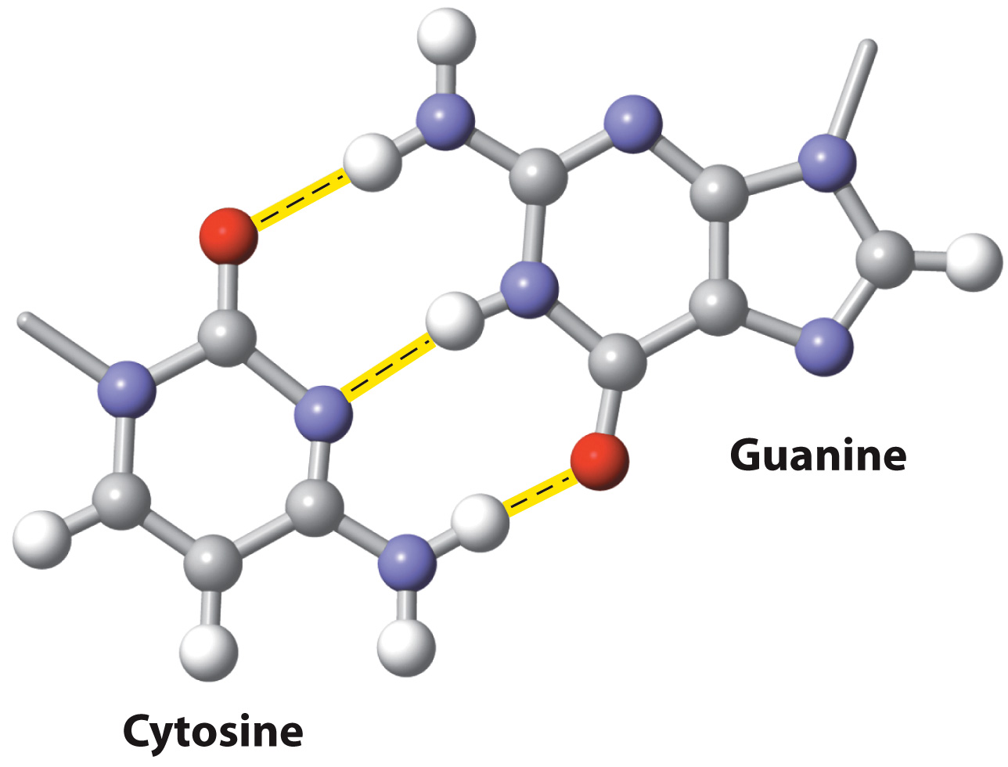
Example: Hydrogen Bonds in DNA
Oxygen
Nitrogen
Hydrogen

Slide 11
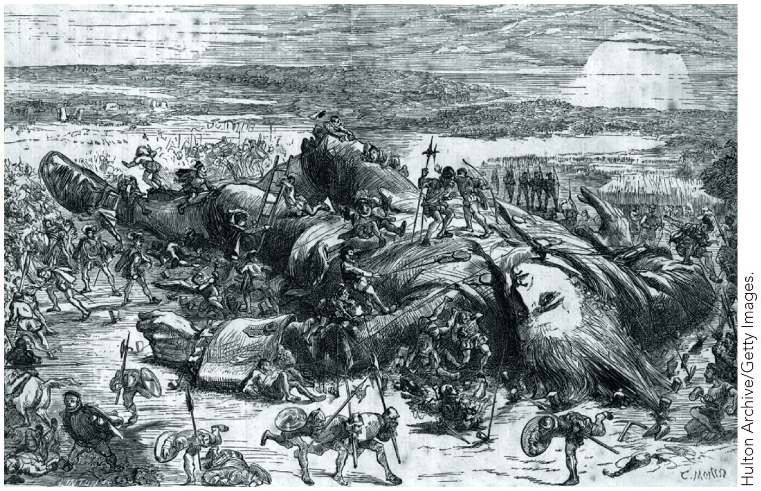
The Cumulative Effect of Small Forces

Slide 12
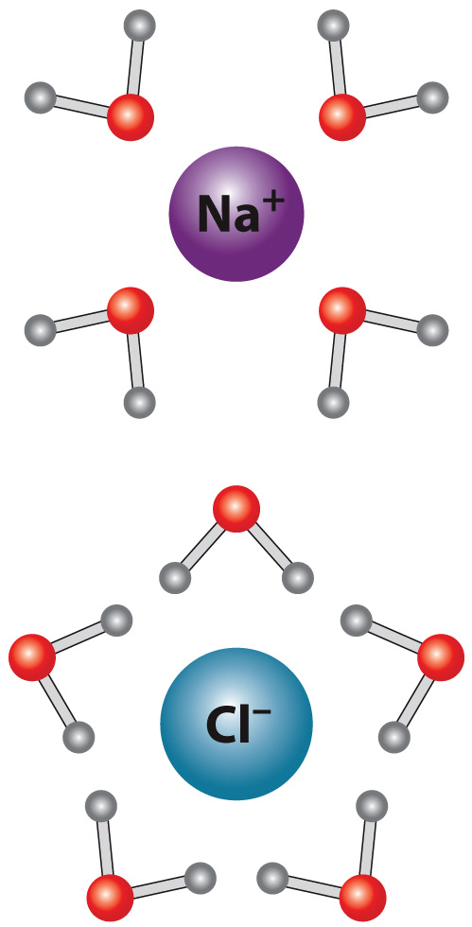
Water dissolves many compounds

Slide 13
The Hydrophobic Effect
Section 2.2
Learning Objective
Relate the solubility of substances to the hydrophobic effect

Slide 14
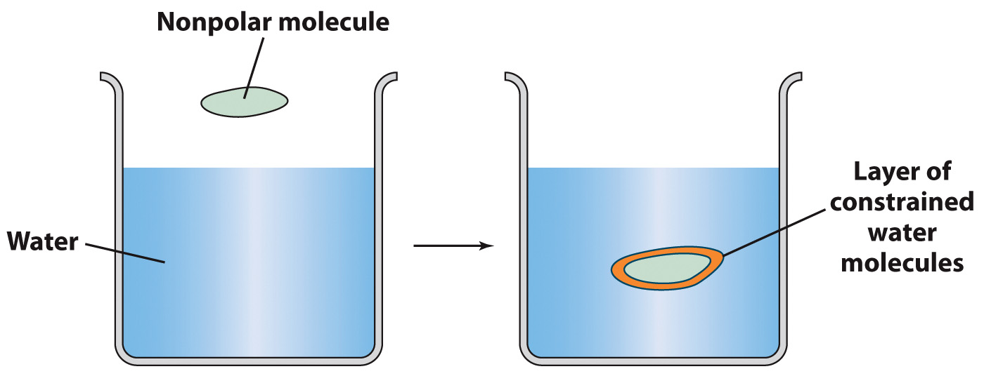
What happens when oil and water mix?
Nonpolar molecules are hydrated by water

Slide 15
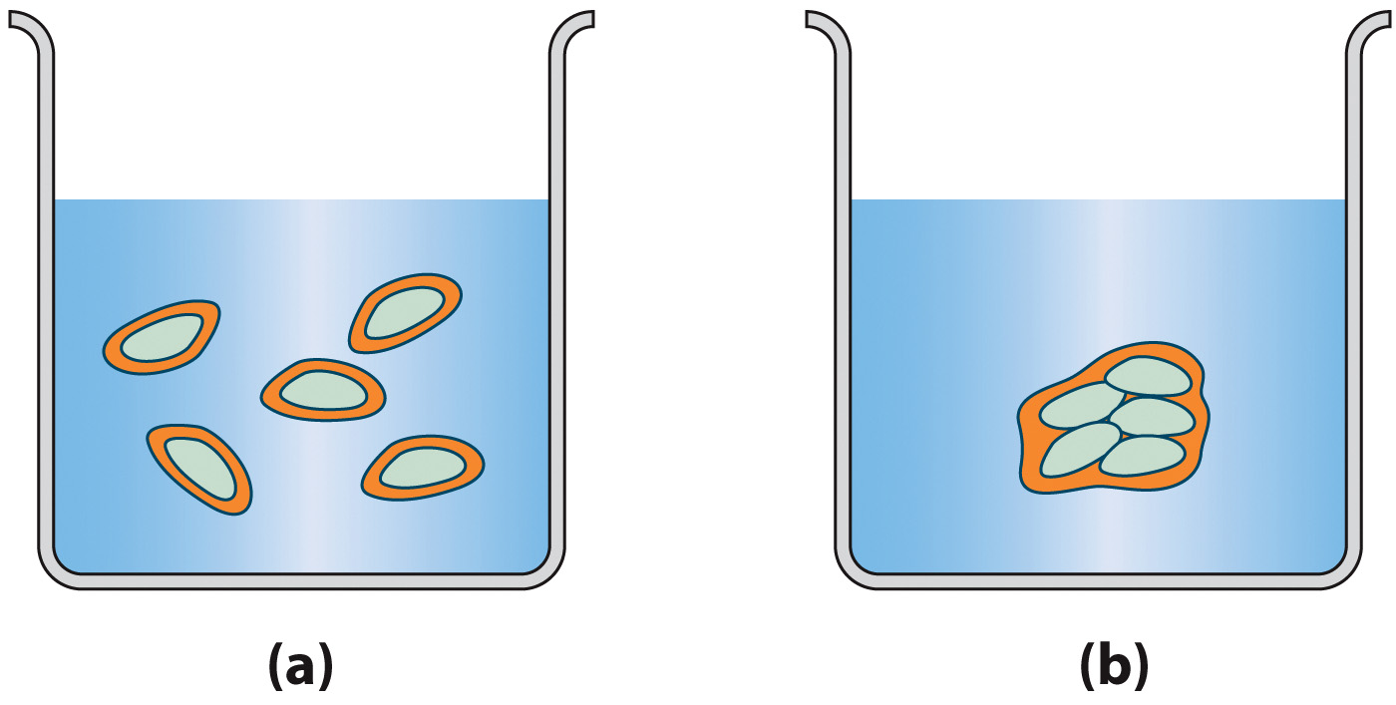
Nonpolar molecules tend to aggregate in polar solvents
The hydrophobic effect is the phenomenon by which nonpolar molecules aggregate to avoid contact with hydrophilic molecules, particularly water.

Slide 16
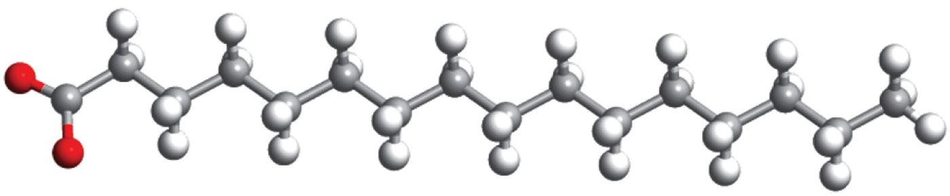
Most lipids are amphiphilic
Amphiphilic molecules experience both hydrophilic interactions and the
hydrophobic effect

Slide 17
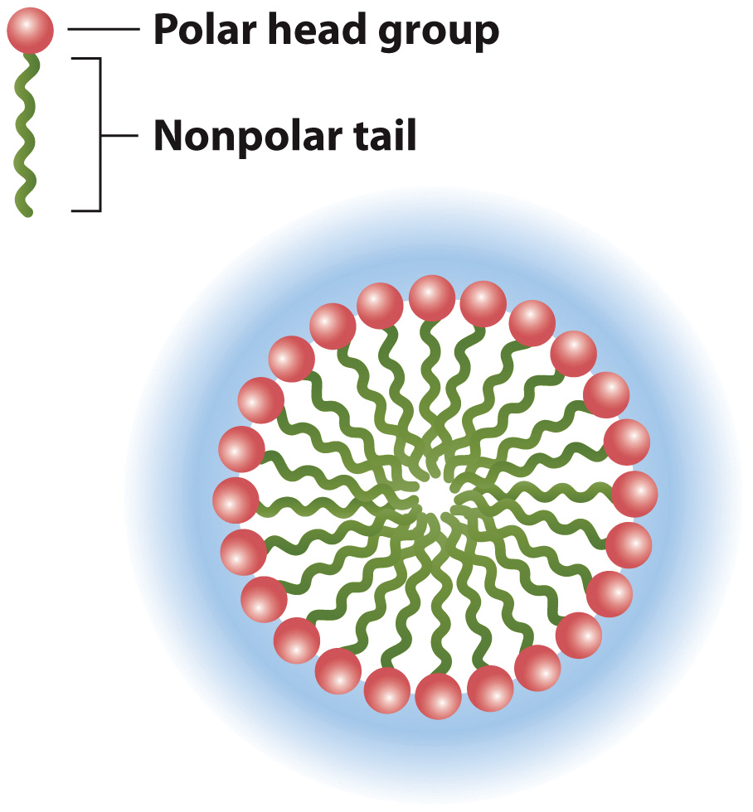
Amphiphilic molecules form micelles in aqueous solutions
Cross section of a micelle formed by amphiphilic molecules

Slide 18
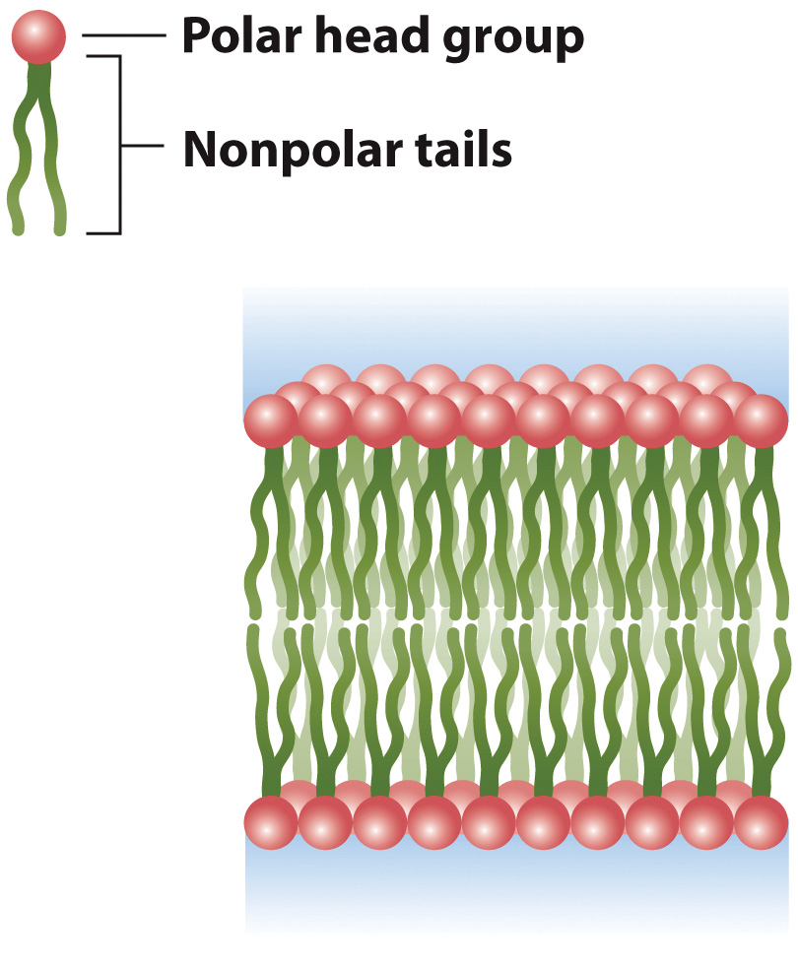
A Lipid Bilayer

Slide 19
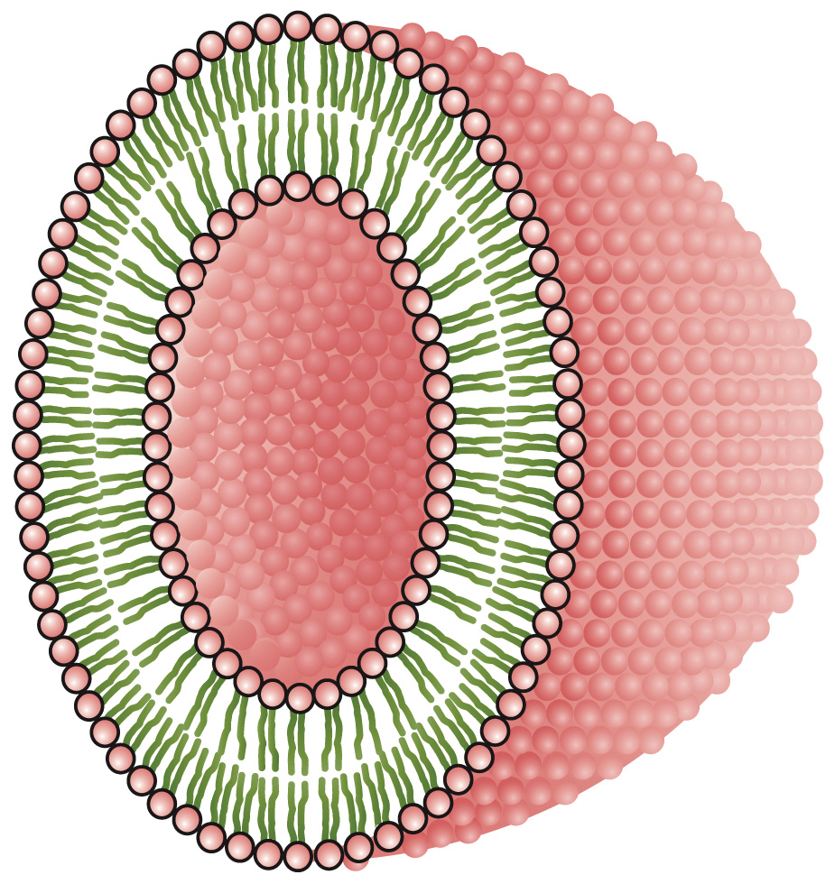
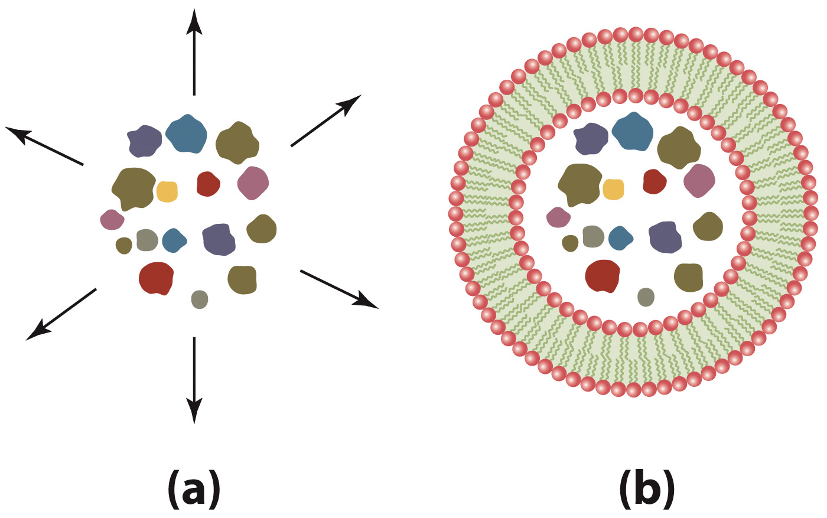
The hydrophobic core of a lipid bilayer is a barrier to diffusion

Slide 20
Acid-Base Chemistry
Section 2.3
Learning Objective
Determine the effect of acids and bases on a solution’s pH

Slide 21
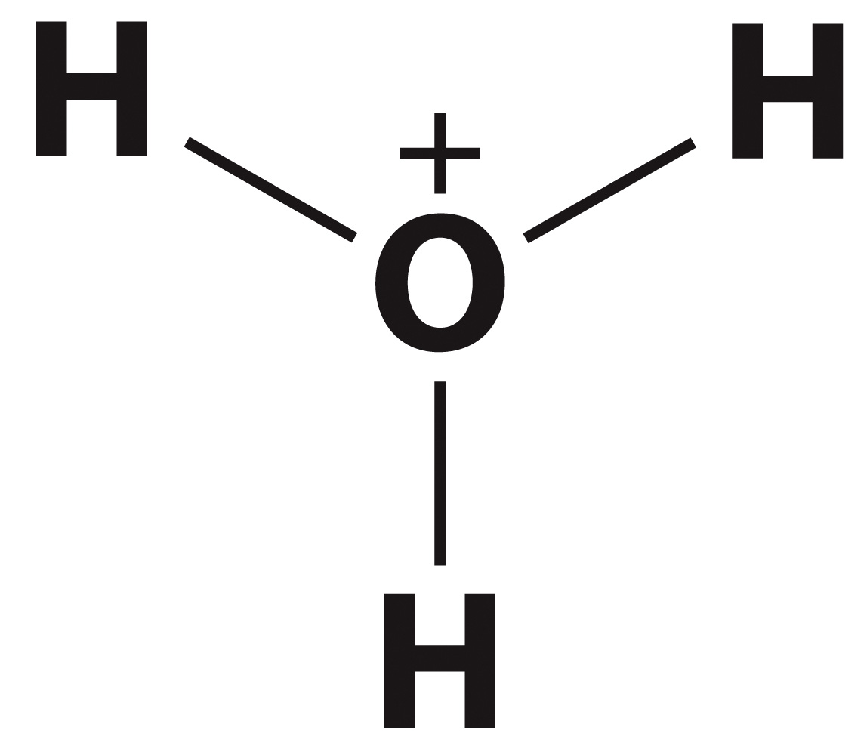
Ionization of water produces hydronium ion
2 H₂O
H₃O⁺
+
OH–
Hydronium
ion
Hydroxide
ion

Slide 22
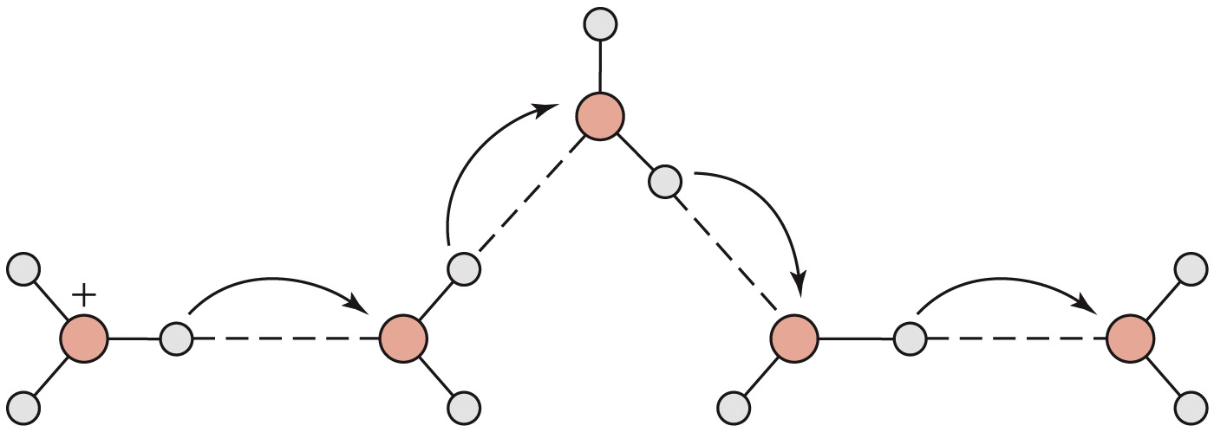
Proton Jumping

Slide 23
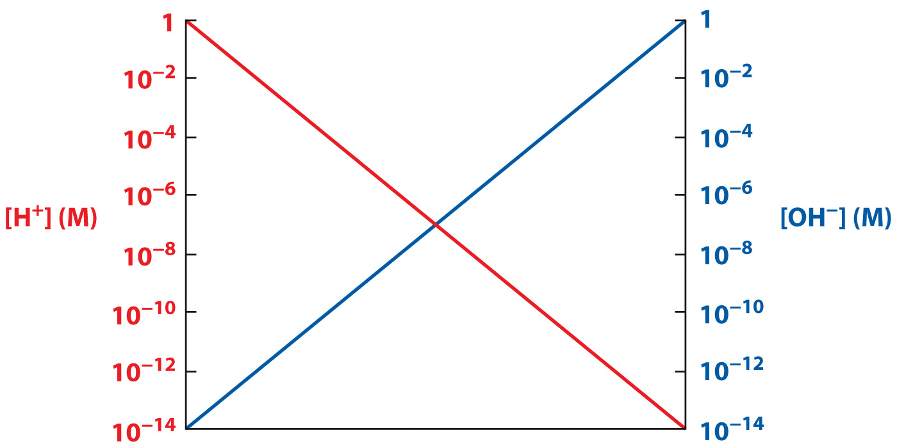
[H⁺] and [OH⁻] are inversely related

Slide 24
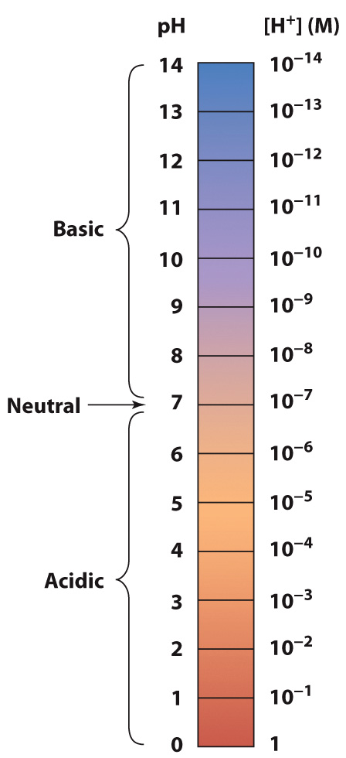
The pH scale is logarithmic pH = –log [H⁺]

Slide 25
pK describes an acid’s tendency to ionize
Example: acetic acid
CH₃COOH
CH₃COO– + H₃O⁺
[CH₃COO–] ✕ [H₃O⁺]
K =
= 1.74 ✕ 10^{–5}
[CH₃COOH]
pK = –log (1.74 ✕ 10^{–5}) = 4.76

Slide 26
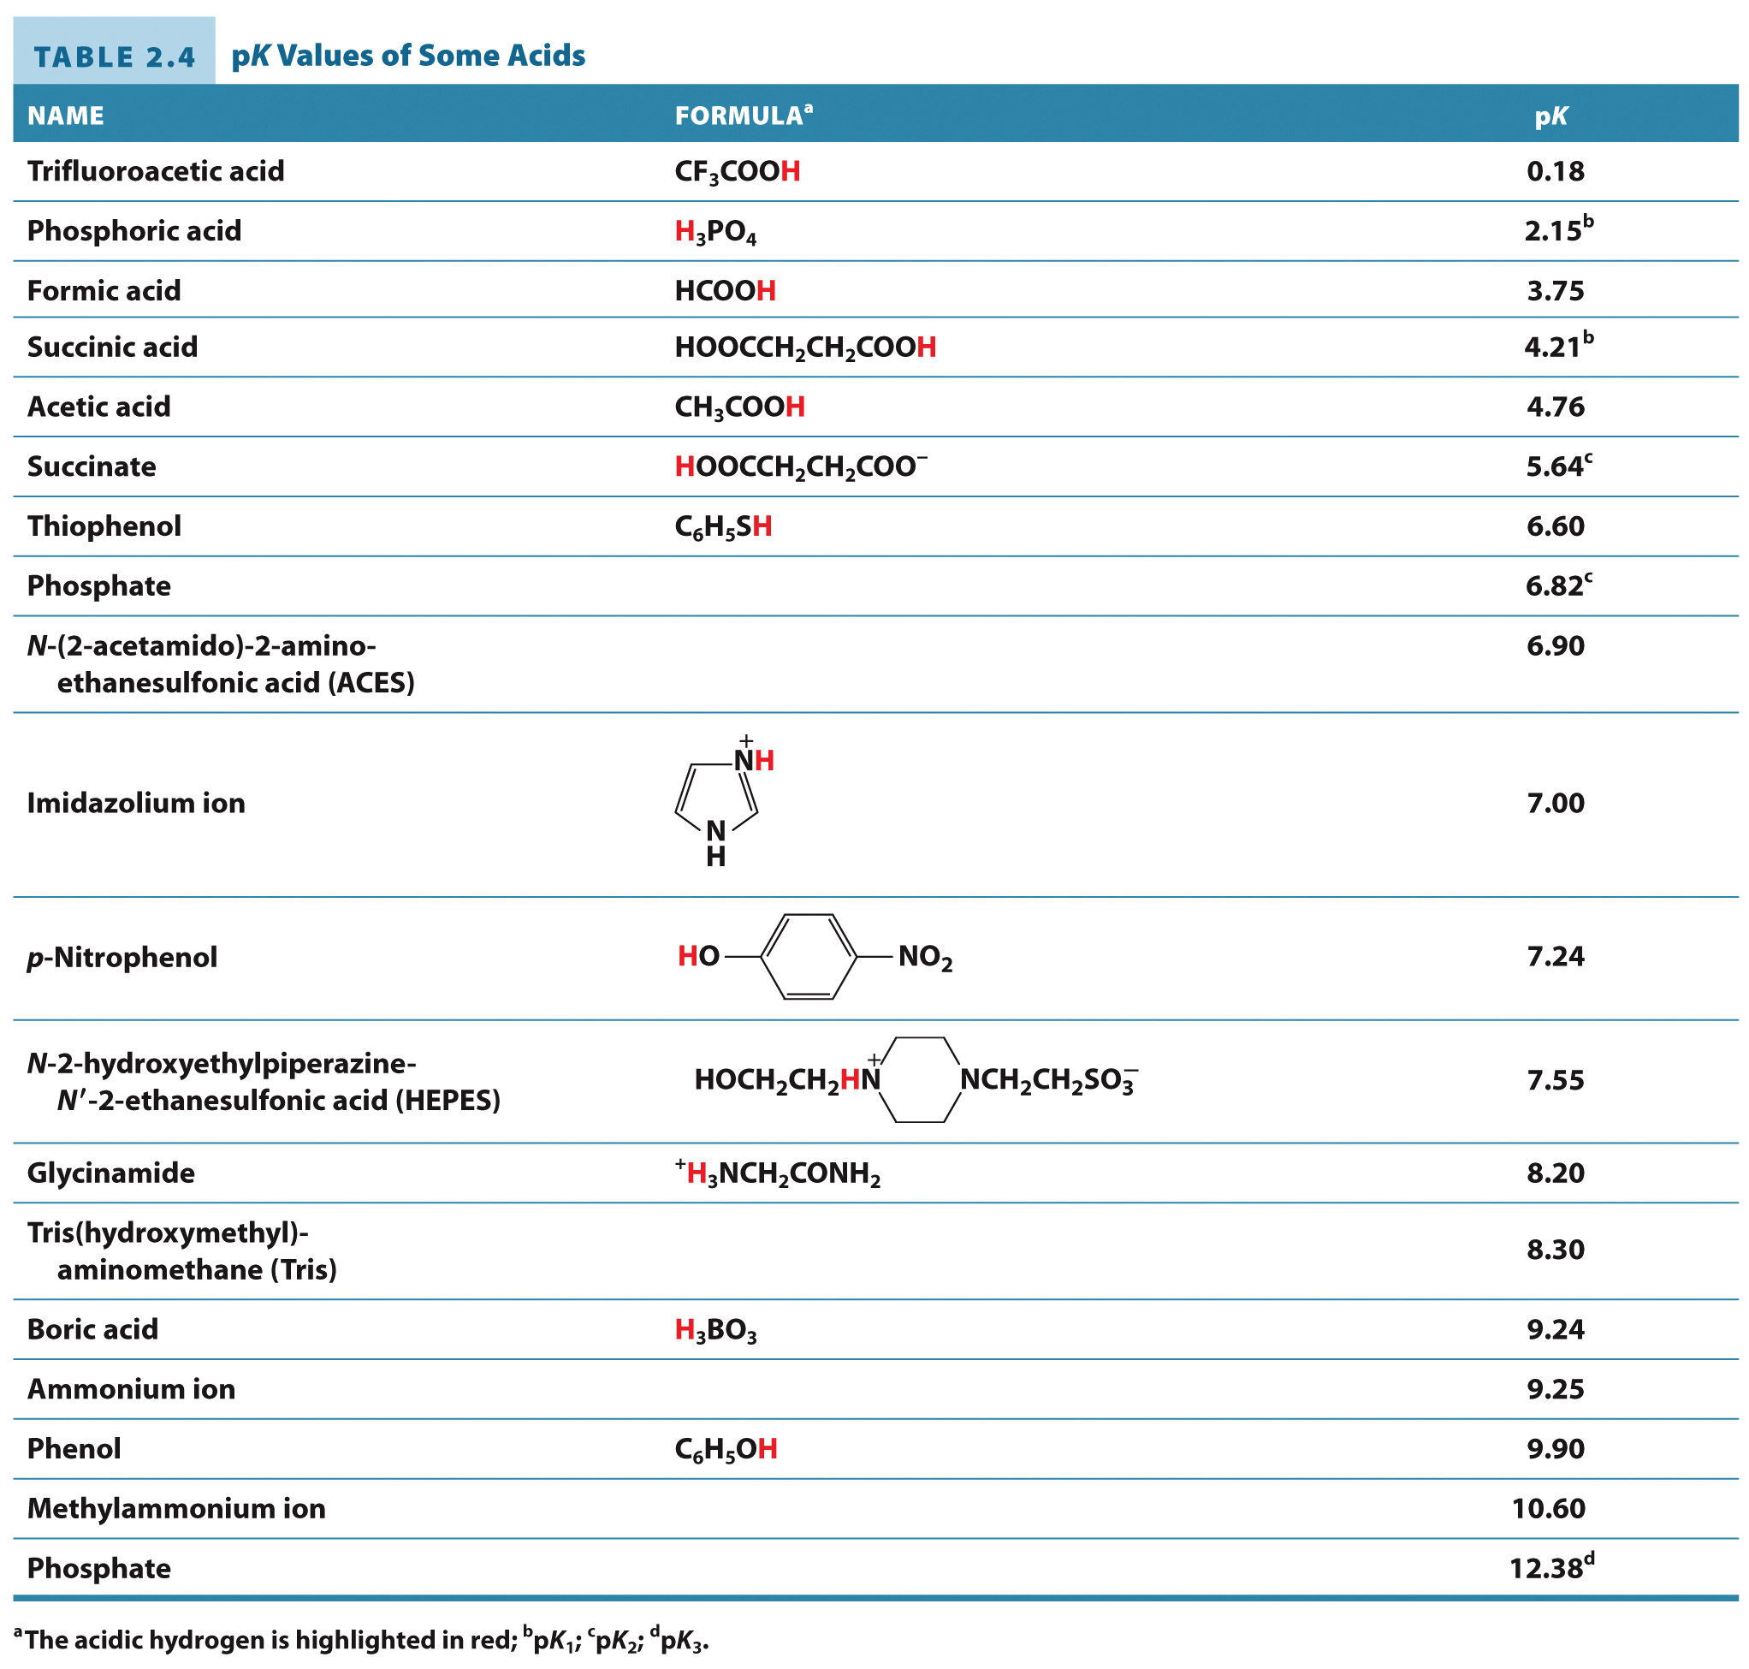
pK Values of Some Acids

Slide 27
pH is related to pK
Henderson-Hasselbalch Equation
[A–]
pH = pK + log
[HA]

Slide 28
Tools and Techniques: Buffers
Section 2.4
Learning Objective
Describe how buffer solutions resist changes in pH

Slide 29
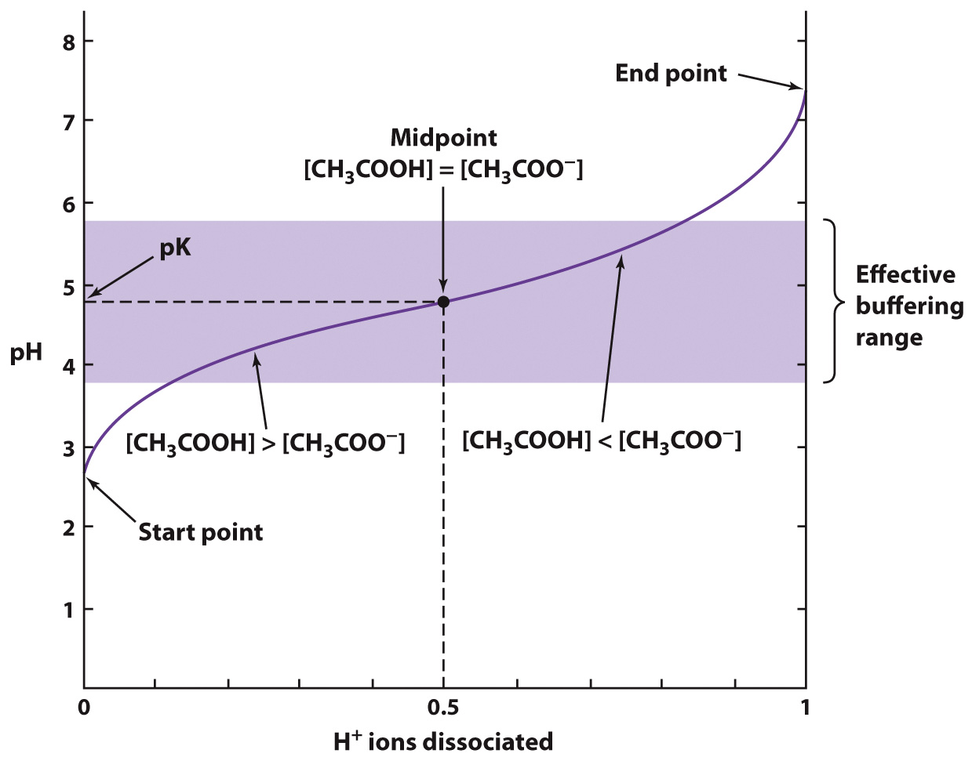
Buffer solutions resist changes in pH

Slide 30
Clinical Connection: Acid-Base Balance in Humans
Section 2.5
Learning Objective
Explain how the human body maintains a constant pH

Slide 31
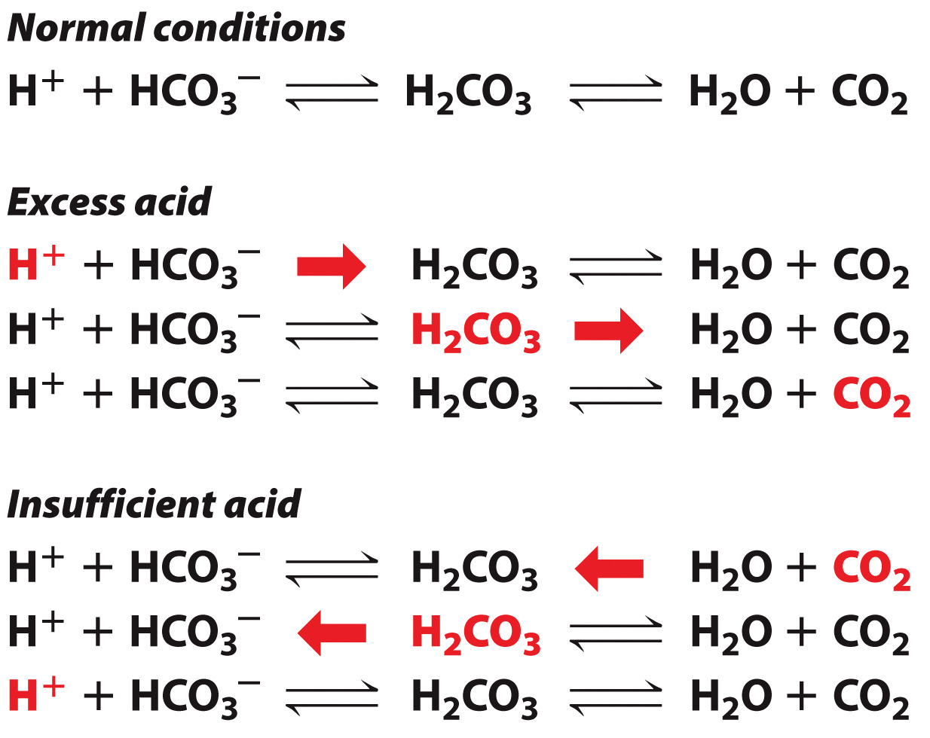
The Bicarbonate Buffer System

Slide 32
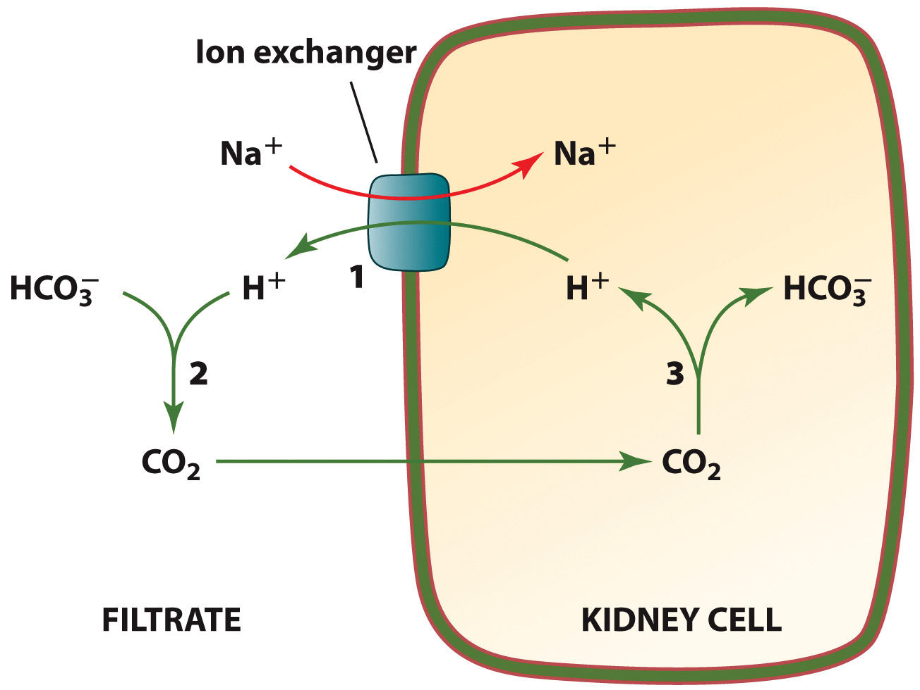
Bicarbonate Reabsorption

Slide 33
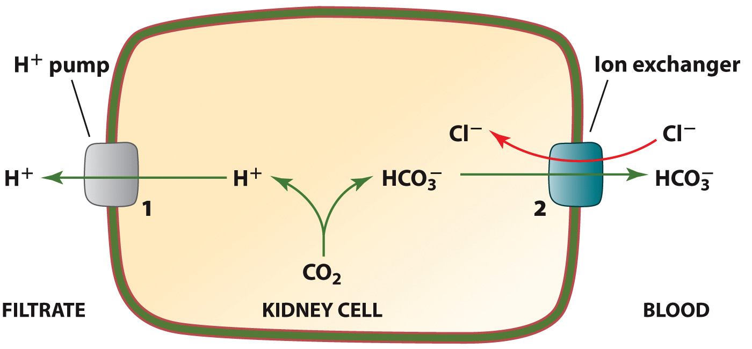
Bicarbonate Production

Slide 34
Some medical conditions can disrupt normal acid-base balance
ACIDOSIS
Metabolic acidosis
Respiratory acidosis
ALKYLOSIS
Metabolic alkylosis
Respiratory alkylosis

