Slide 1
Essential Biochemistry
Fourth Edition
Charlotte W. Pratt | Kathleen Cornely
Lecture Notes for
Chapter 1
The Chemical Basis of Life

Slide 2
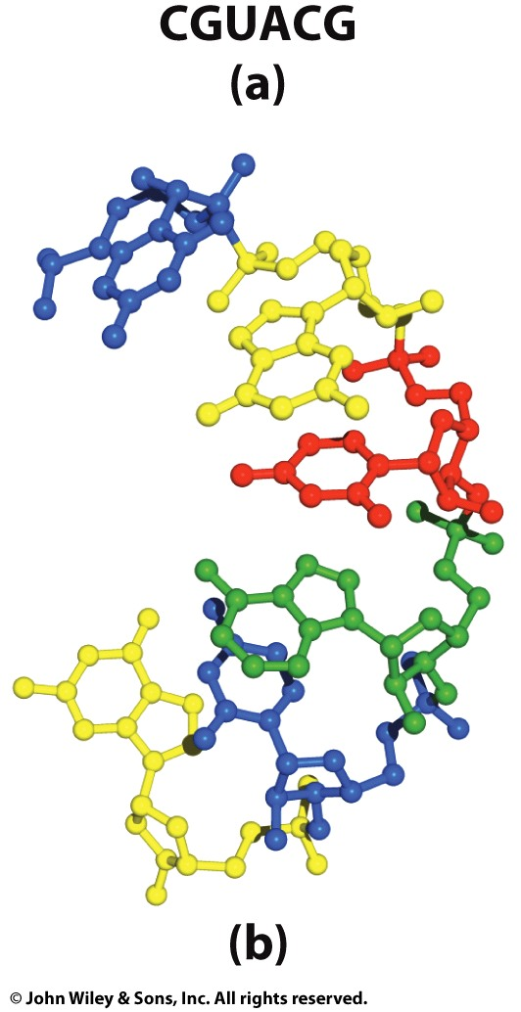
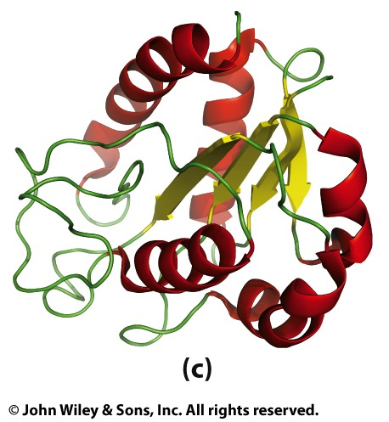
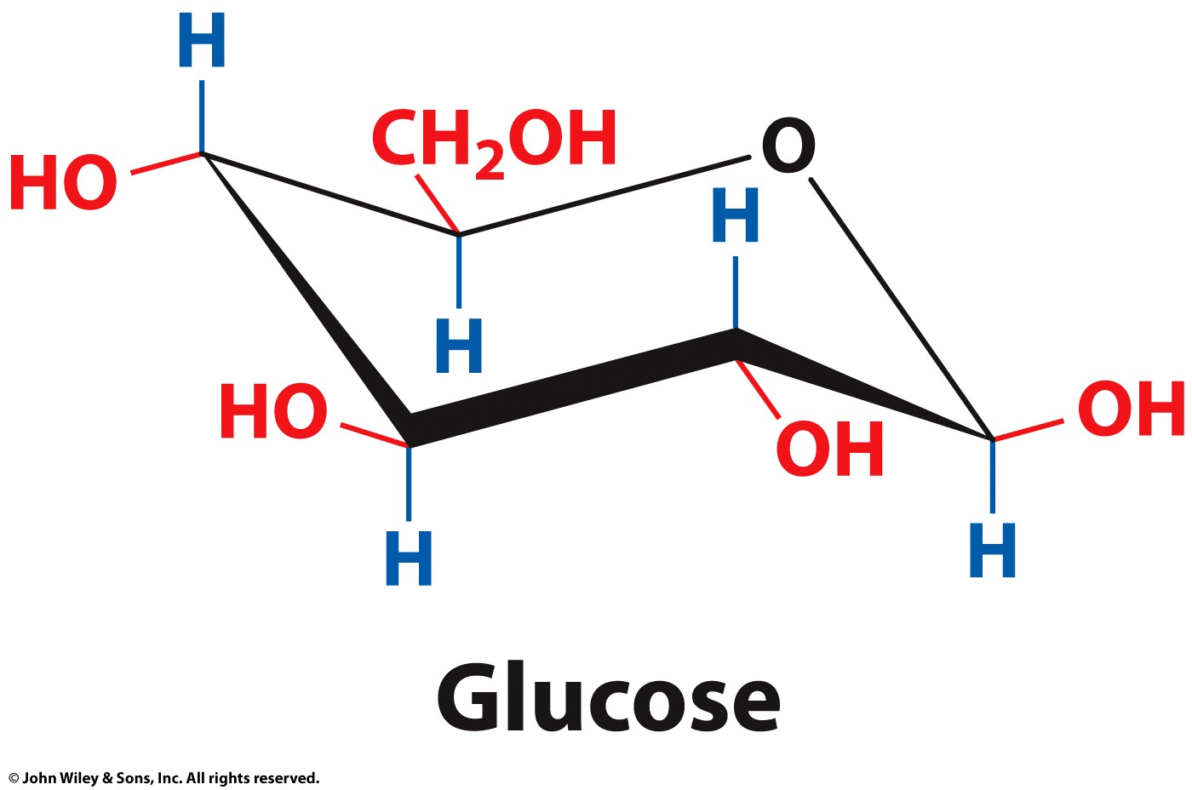
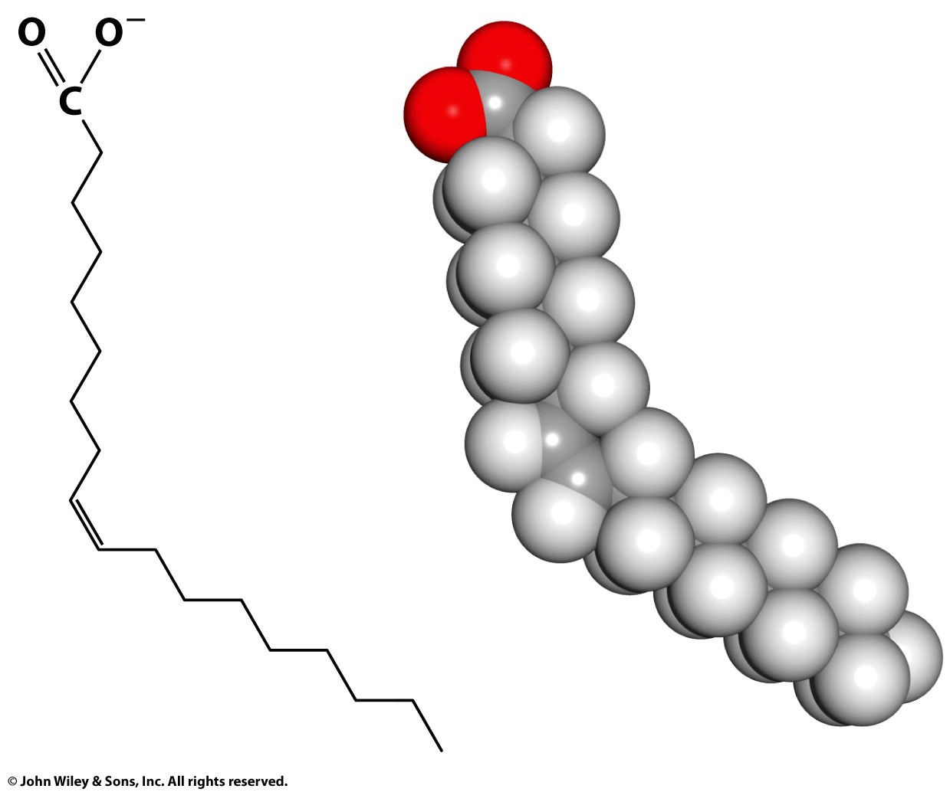
Biochemistry involves the study of 4 types of molecules.
Nucleic Acids
Proteins
Biochemistry The scientific discipline that seeks to explain life at the molecular level
Carbohydrates
Lipids

Slide 3
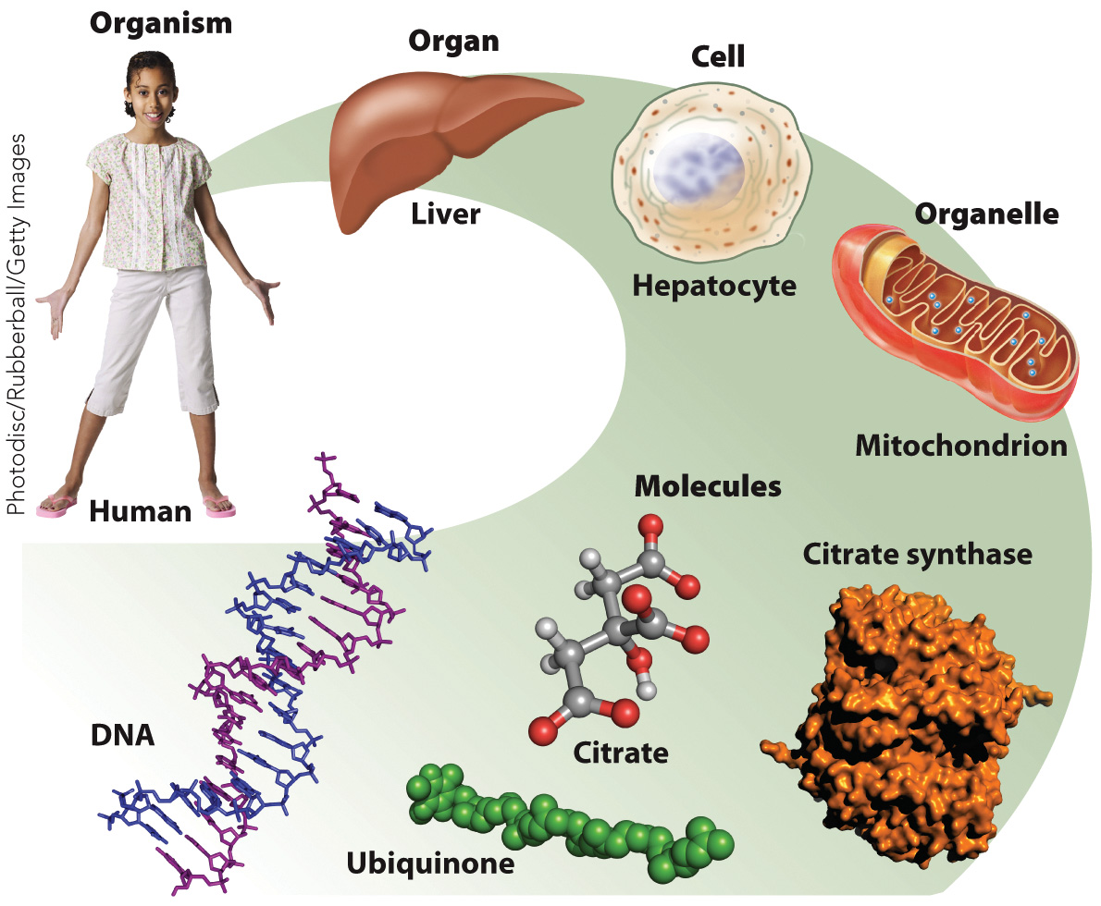
Biochemistry focuses on the structures and functions of molecules

Slide 4
Biological Molecules
Section 1.2
Learning Objective
Identify the major classes of biological molecules

Slide 5
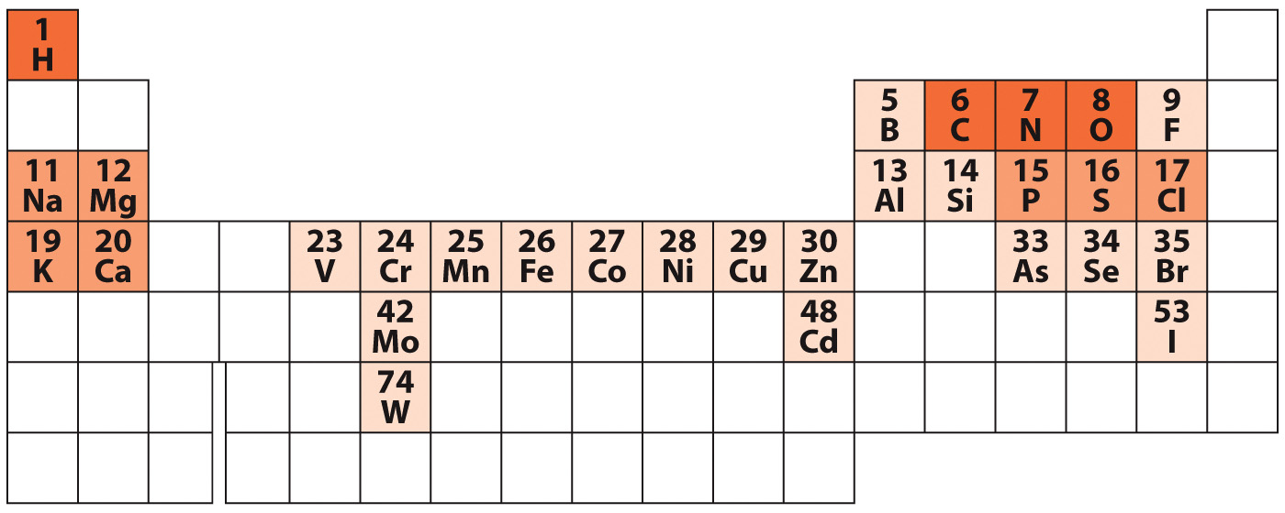
Elements Found in Biological Systems
Only a small subset of the known elements are found in living systems

Slide 6
Cells contain four major types of biological molecules
Amino acids
Carbohydrates (also called monosaccharides or sugars)
Nucleotides
Lipids

Slide 7
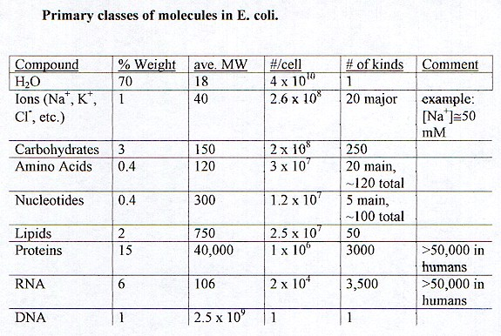

Slide 8
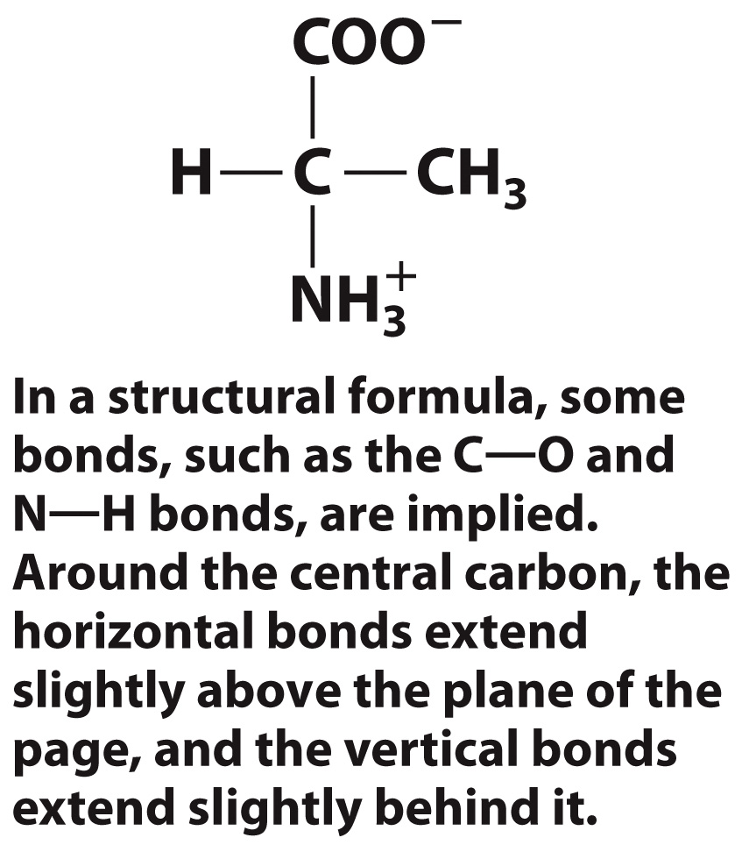
Amino acids are a major type of biological molecule
Amino acids contain:
An amino group
A carboxylic acid group
A side chain
Alanine
an amino acid with a
methyl group as its side chain

Slide 9
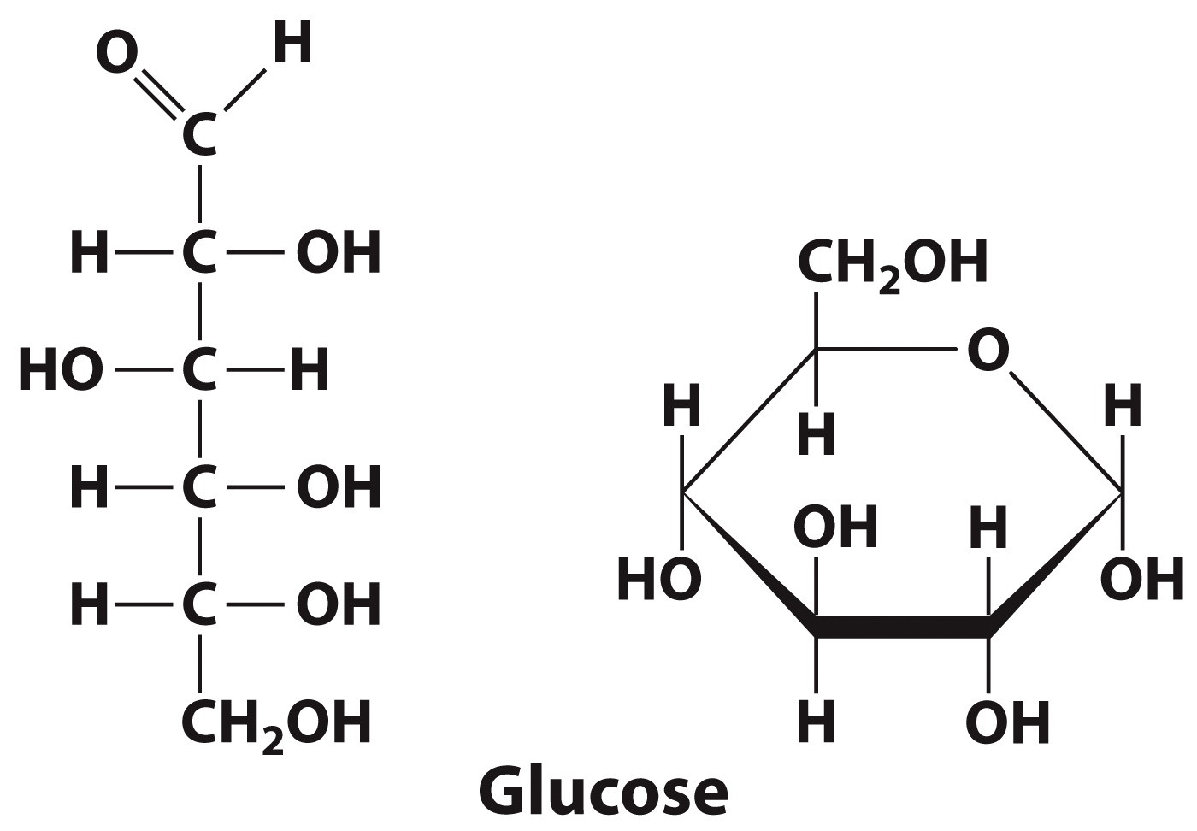
Carbohydrates are a major type of biological molecule
Carbohydrates are monosaccharides or sugars.
General chemical formula: (CH₂O)_{n} where n ≥ 3
Sugars can be drawn as a cyclical Haworth representation
Sugars can be drawn as a Fischer projection

Slide 10
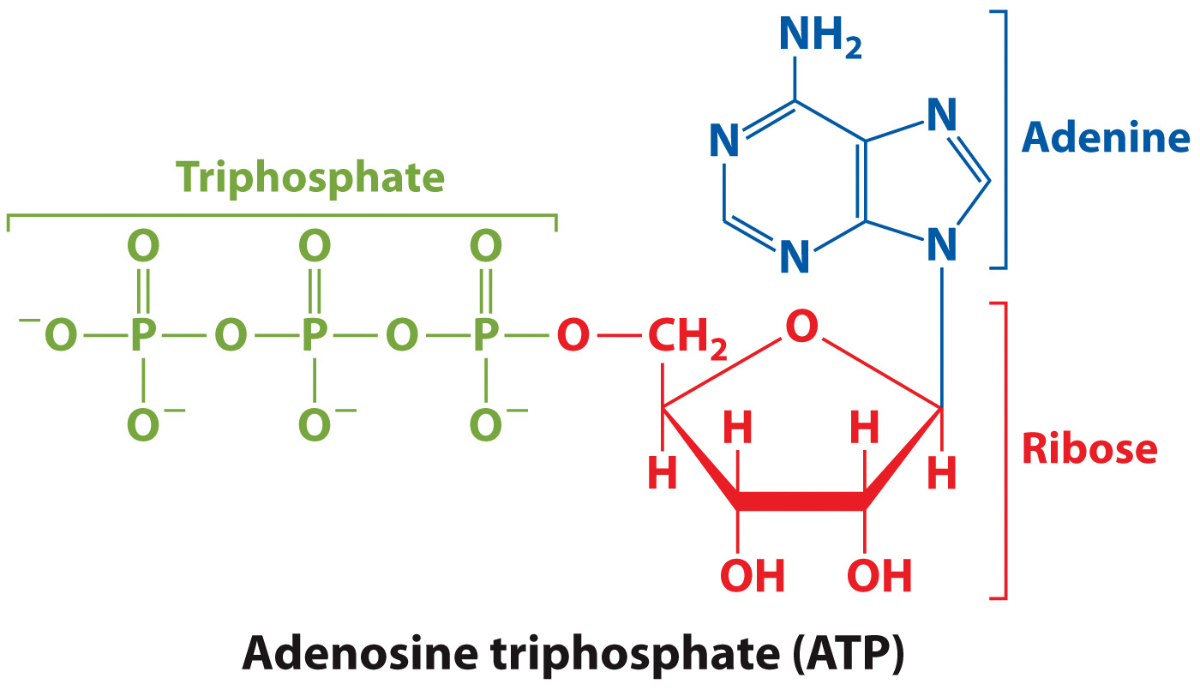
Nucleotides are a major type of biological molecule
Nucleotides are the building blocks of nucleic acids

Slide 11
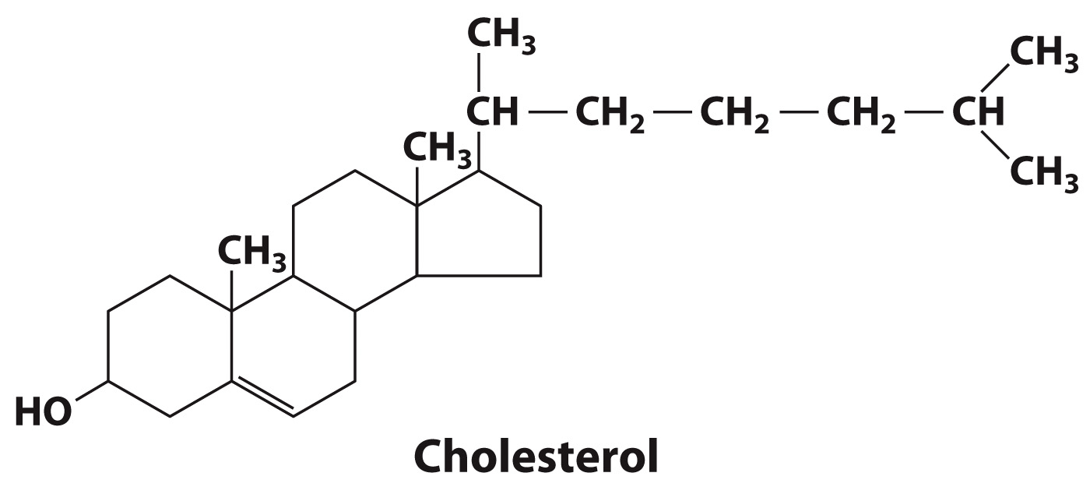
Lipids are a major type of biological molecule
Lipids (fats) have a variety of structures.
One of the most important lipids in human health is cholesterol.

Slide 12
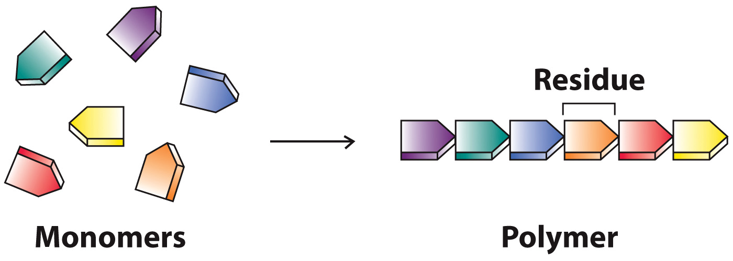
Monomers link sequentially to form polymers.

Slide 13
There are three major kinds of biological polymers.
Polypeptides and proteins
Nucleic acids
Polysaccharides

Slide 14
Amino acids link to form polypeptides and proteins
Amino acid residues are linked by peptide bonds.
Polypeptide sequences are always read from the N terminus to the C terminus.

Slide 15
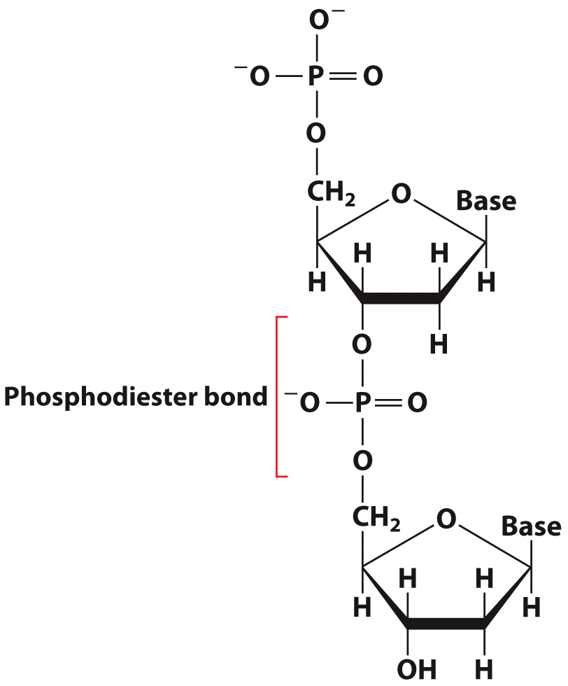
Nucleotide residues link via phosphodiester bonds. Polymers of nucleotides yield nucleic acids.

Slide 16
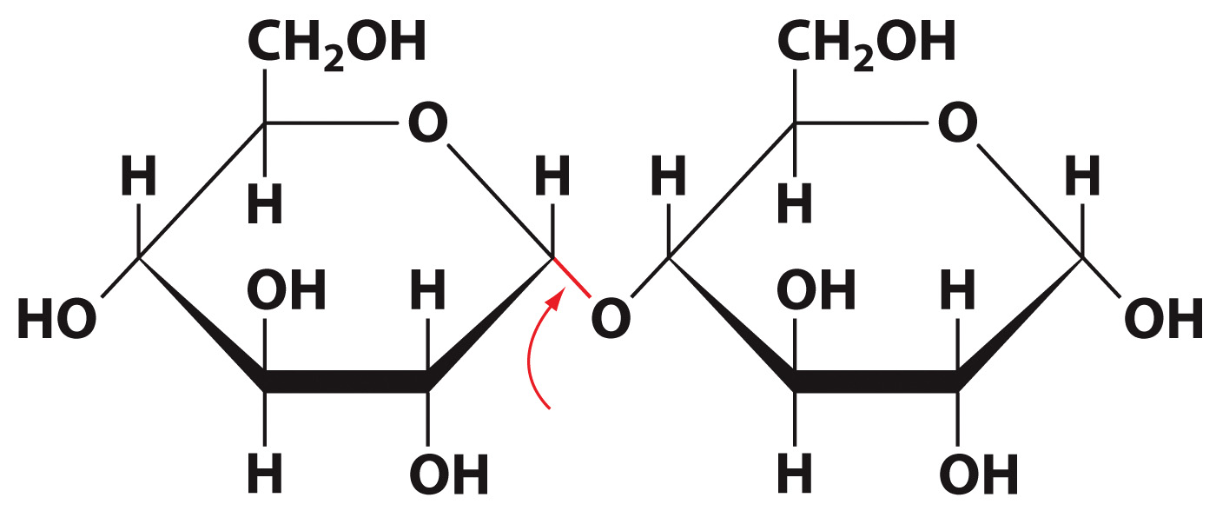
Polymers of sugars are polysaccharides

Slide 18
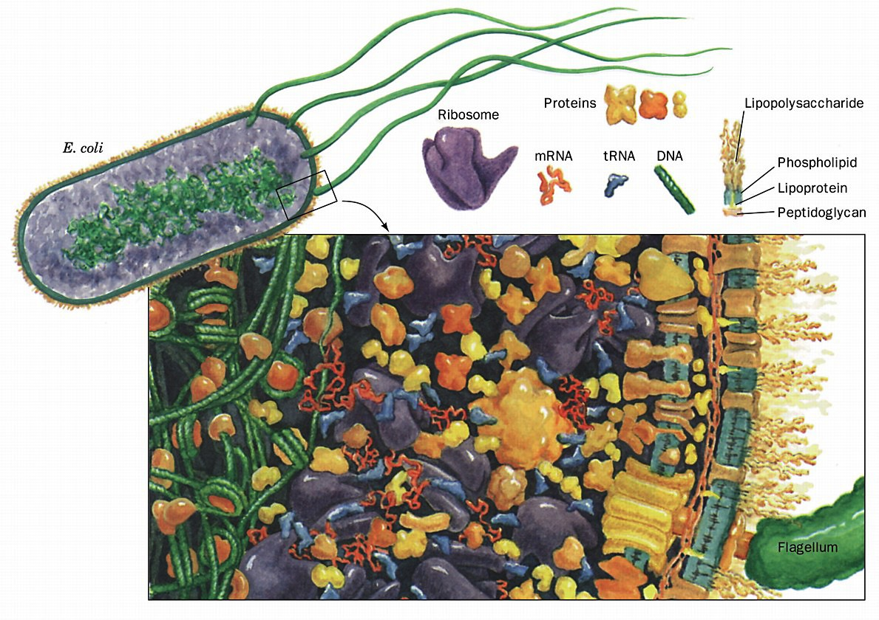
Simulated cross section of an E. coli cell magnified around one millionfold.

Slide 19
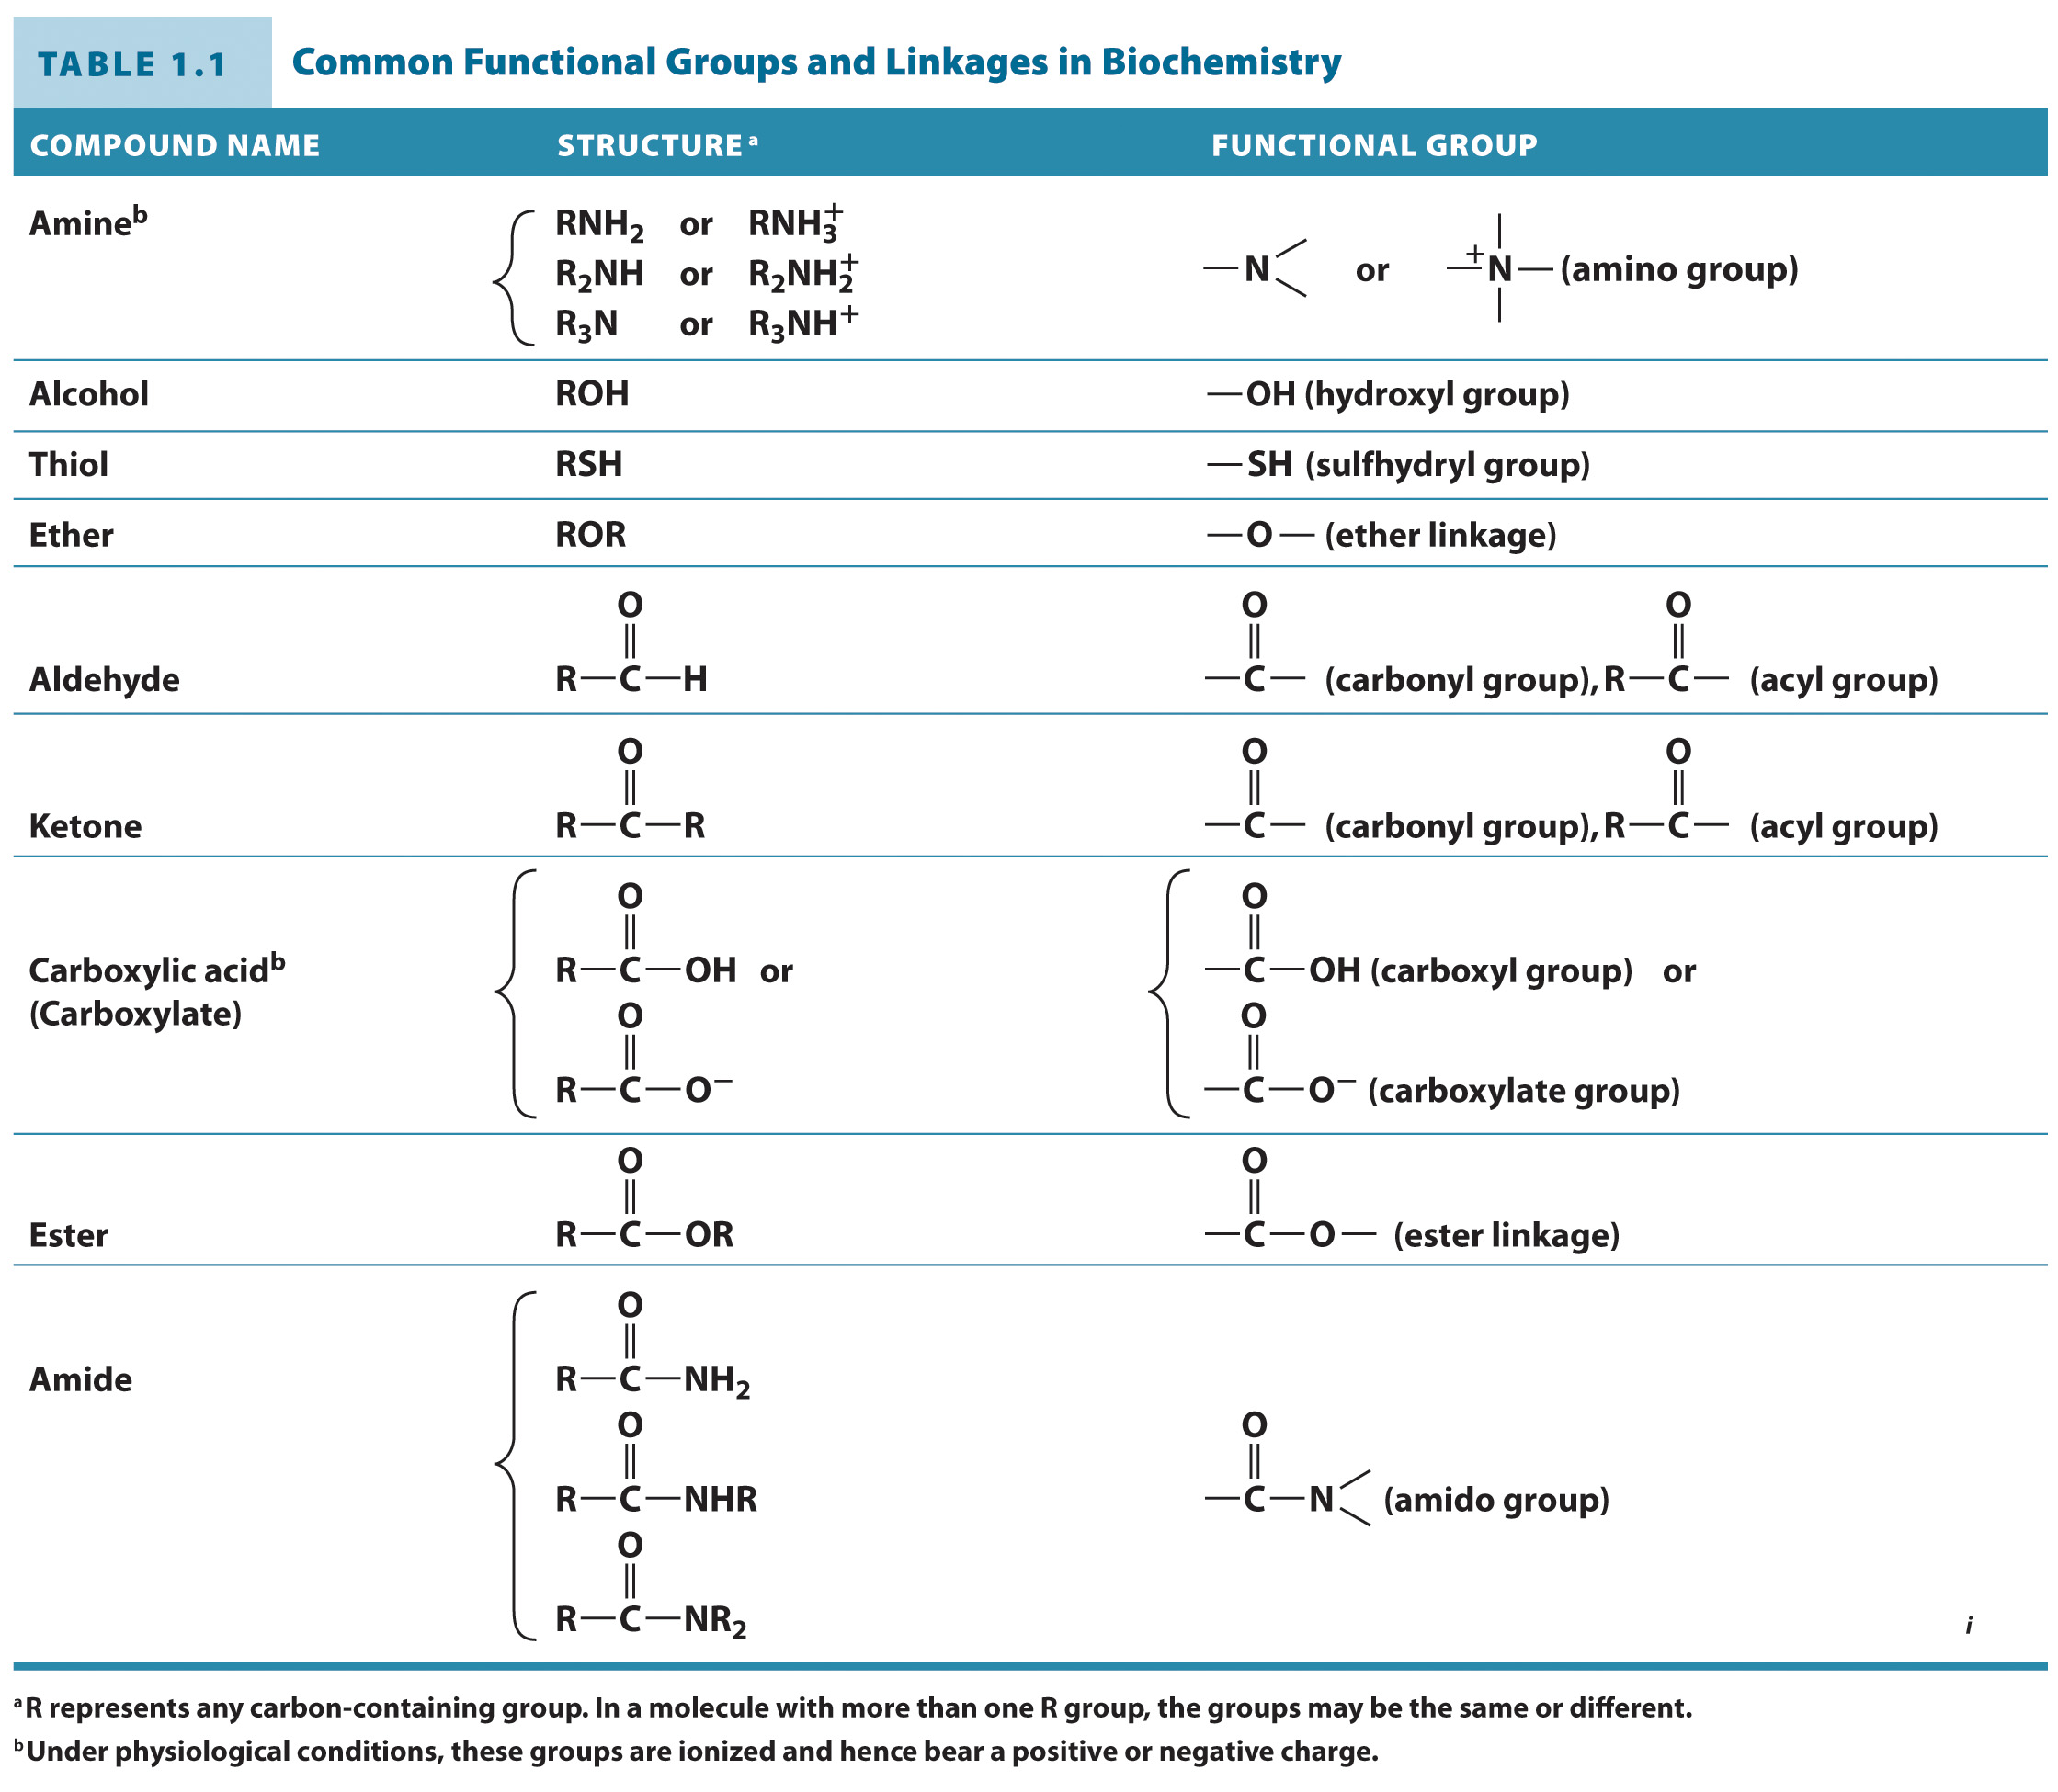
Biopolymers play different roles in living systems

Slide 20
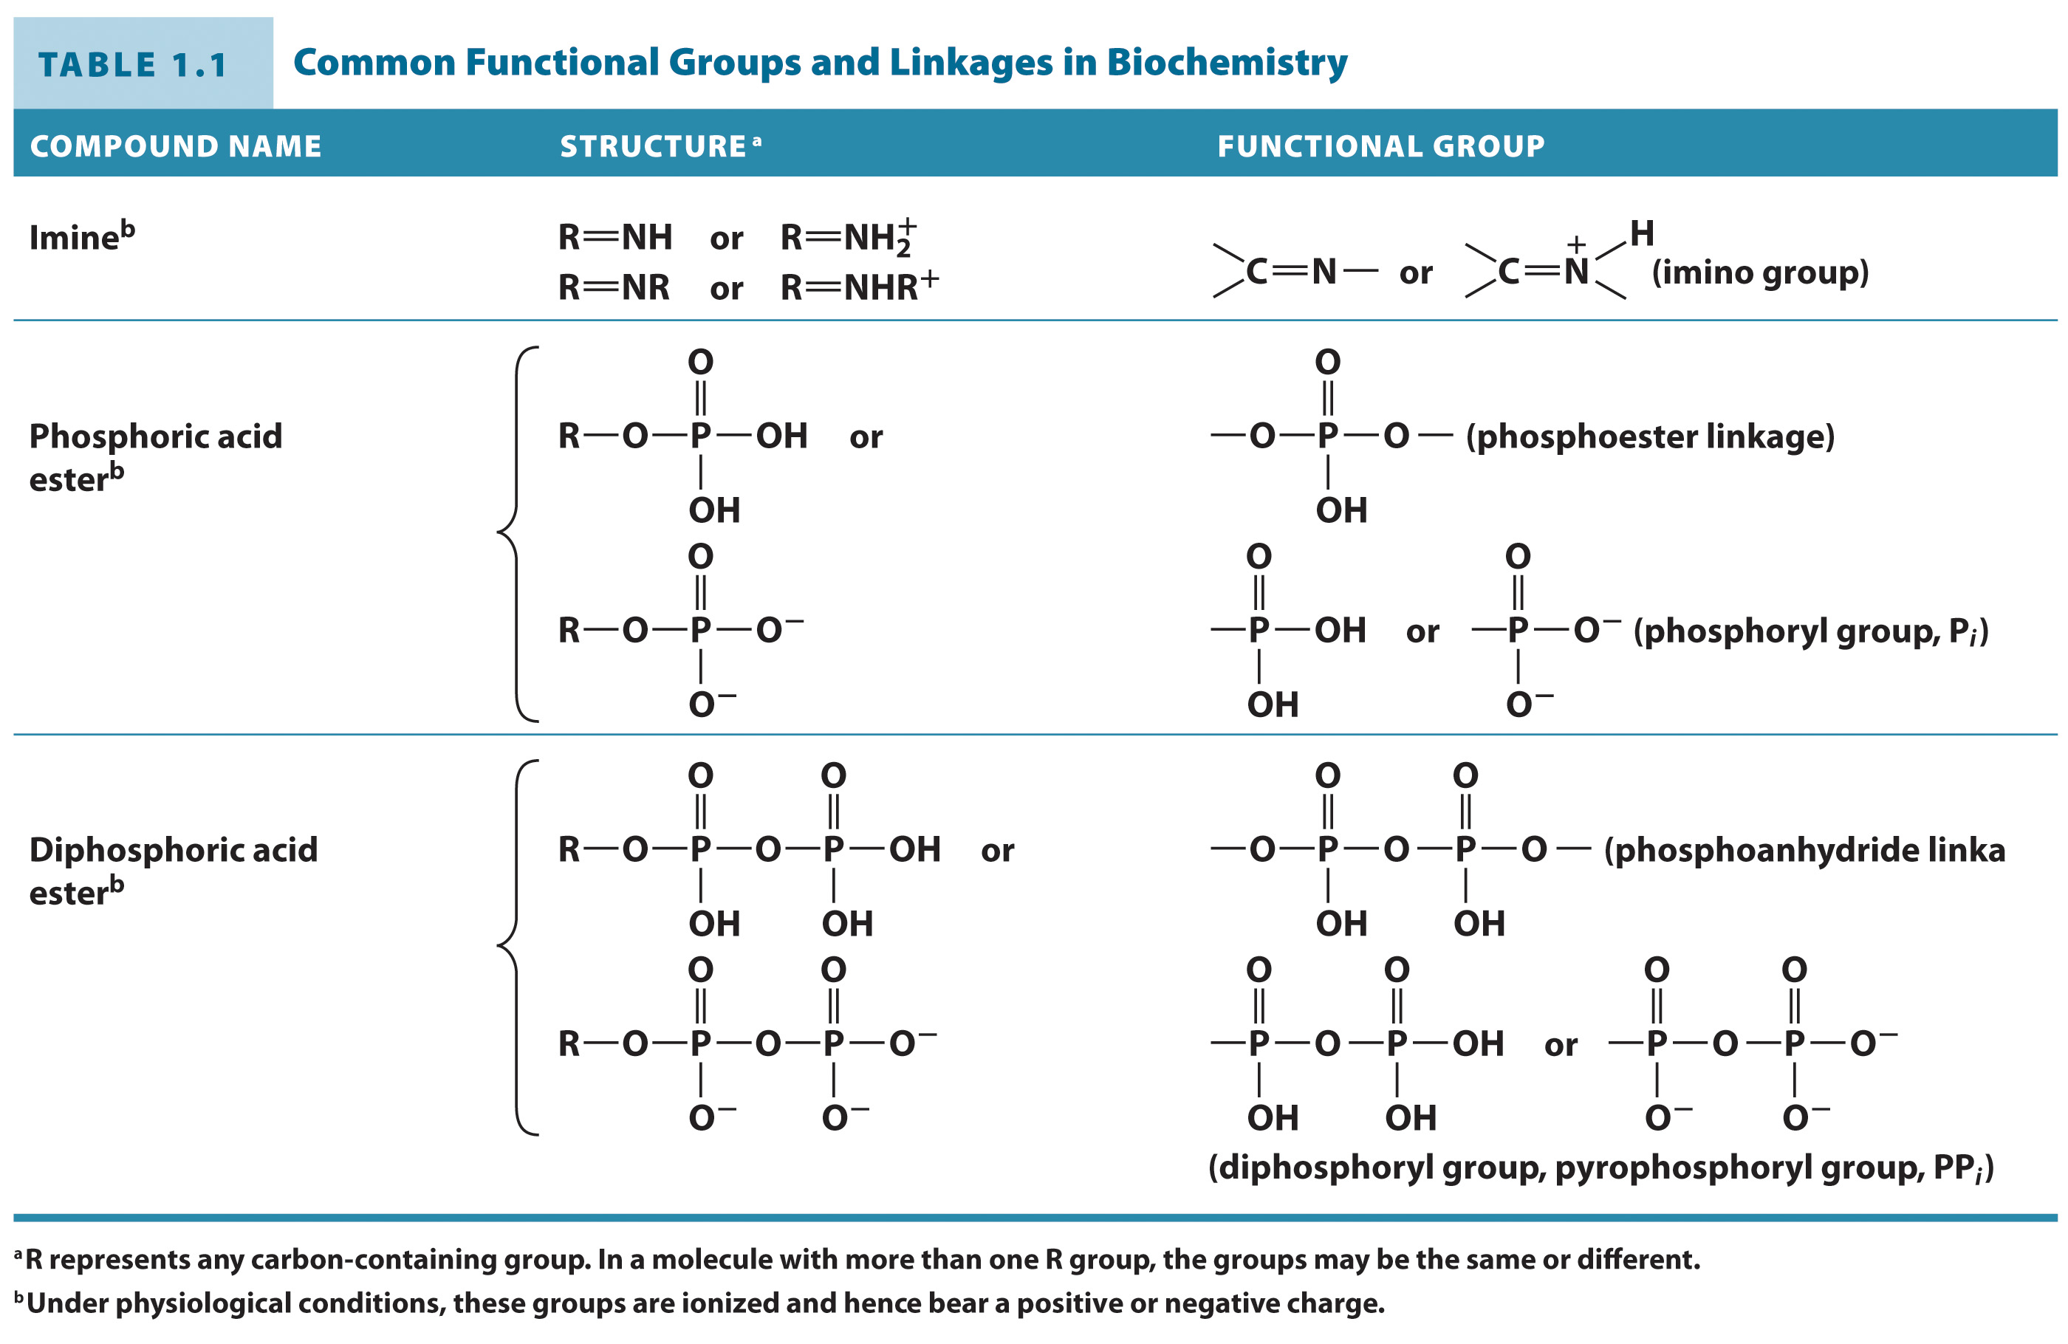
Biopolymers play different roles in living systems

Slide 21
Energy and Metabolism
Section 1.3
Learning Objective
Explain how enthalpy, entropy, and free energy apply to biological systems

Slide 22
Thermodynamic Terms
Enthalpy, H
The heat content of a system
Units = J • mol⁻¹
Entropy, S
A measure of the system’s disorder or randomness
Units = J • K⁻¹mol⁻¹
Gibbs free energy, G
A measure of the free energy of a system based on H and S
Units = J • mol

Slide 23
Enthalpy and entropy are components of free energy
It is easier to measure thermodynamic changes than discrete values.
ΔG = ΔH – TΔS
ΔG = Gibbs free energy change
ΔH = Enthalpy change
ΔS = Entropy change

Slide 24
The sign of ΔG is meaningful
When ΔG <0, the reaction is spontaneous or exergonic.
When ΔG >0, the reaction is nonspontaneous or endergonic.

Slide 25
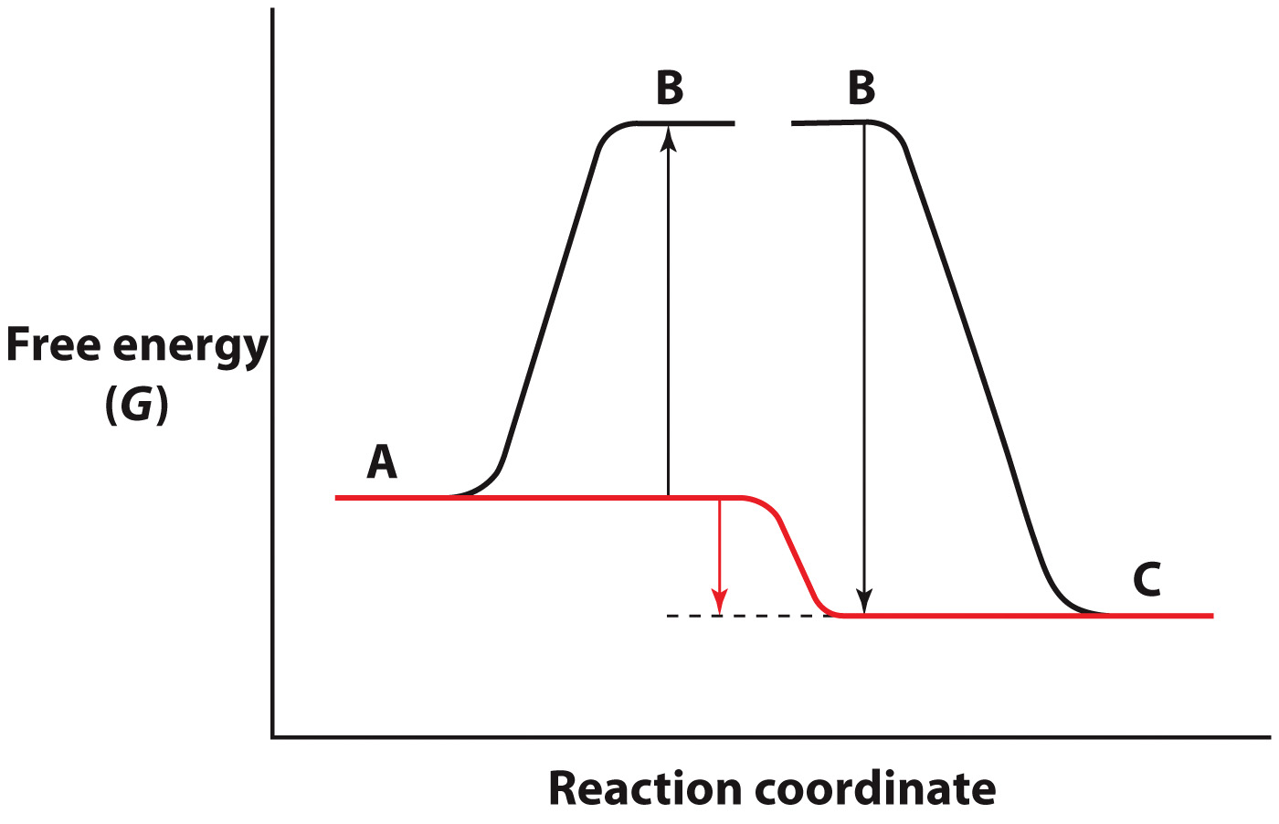
Free Energy Changes in Coupled Chemical Reactions
A→B transition
Nonspontaneous
B→C transition Spontaneous
Net reaction
(shown in red) occurs spontaneously

Slide 26
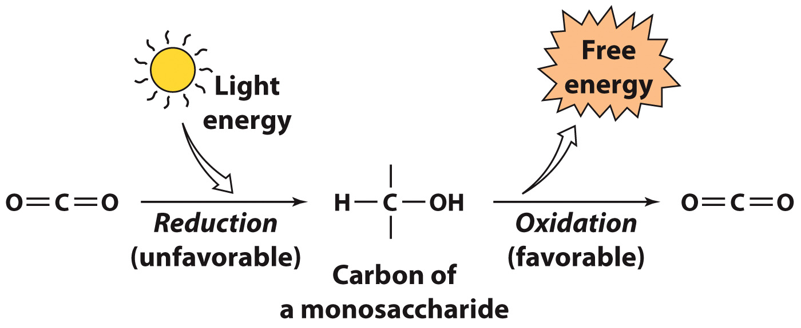
Energy from photosynthesis involves a coupled chemical reaction.
Reduction = gain of electrons Oxidation = loss of electrons

Slide 27
Carbon has different oxidation states

Slide 28
The Origin and Evolution of Life
Section 1.4
Learning Objective
Summarize the evolutionary history of cells

Slide 29
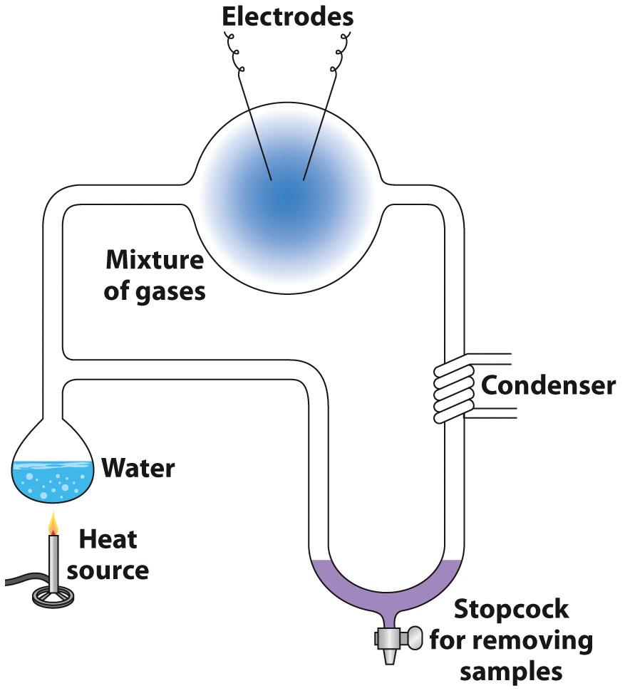
Theory: Early atmosphere inorganic compounds could have reacted with lightning to form the first biomolecules

Slide 30
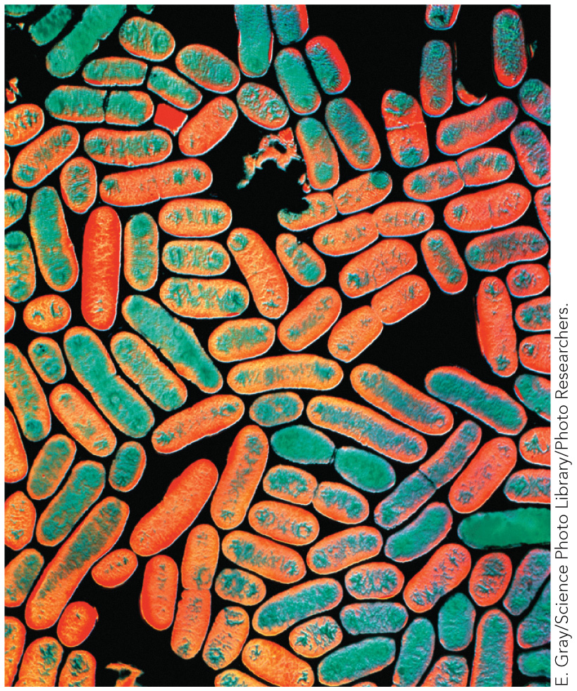
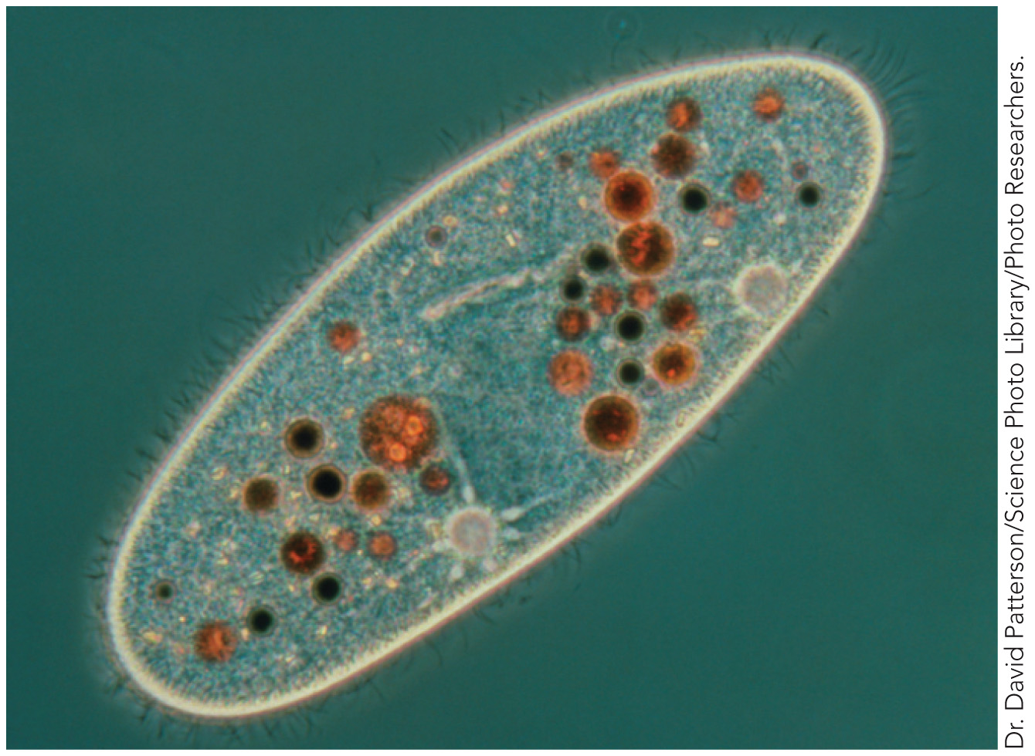
Cellular architecture falls into two categories
Prokaryotes
Eukaryotes

Slide 31
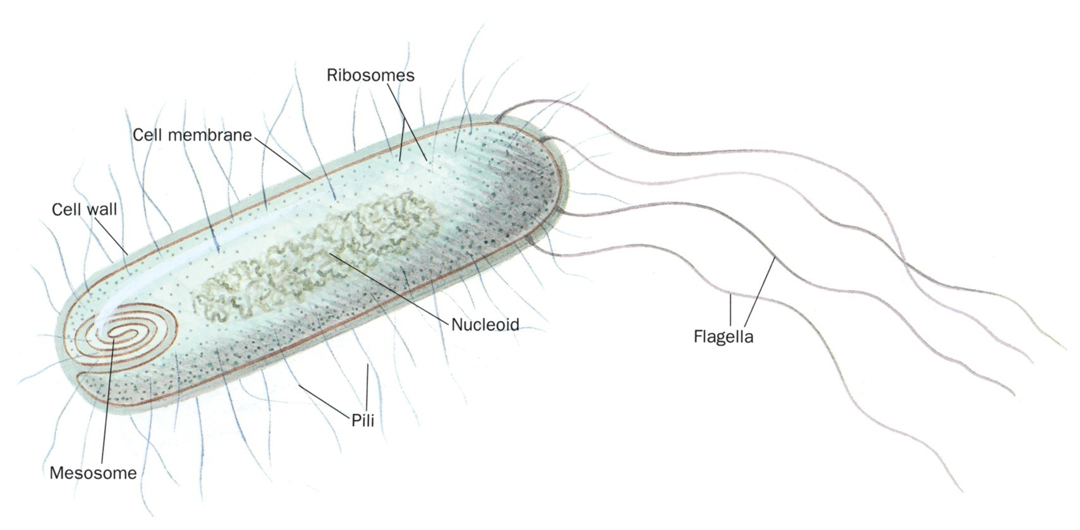
Schematic drawing of a prokaryotic cell.

Slide 32
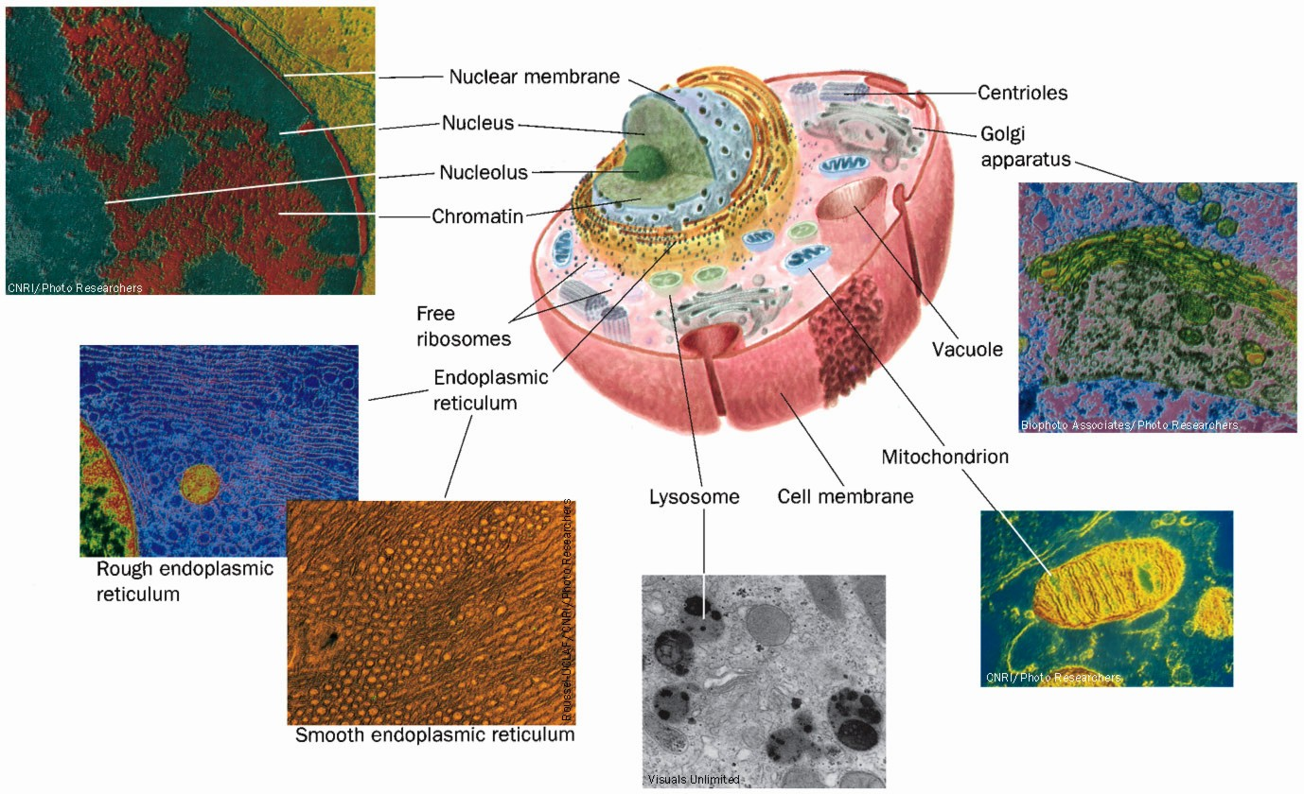
Schematic diagram of an animal cell accompanied by electron micrographs of its organelles.

Slide 33
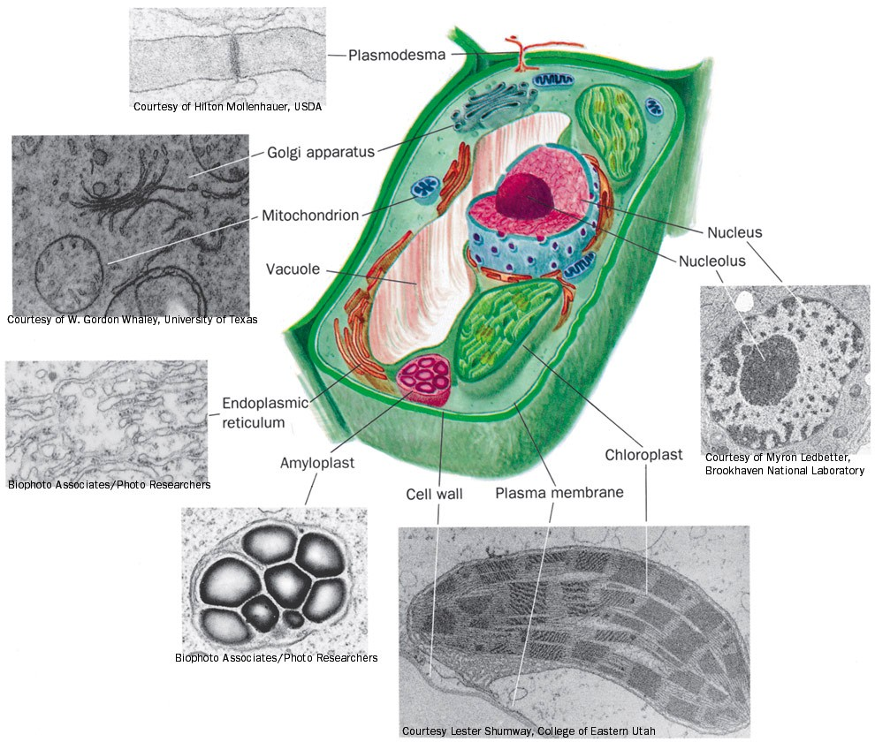
Drawing of a plant cell accompanied by electron micrographs of its organelles.

Slide 34
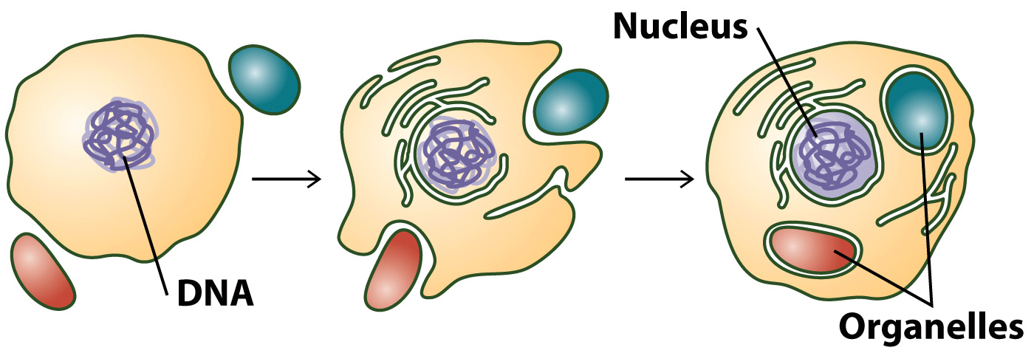
Possible Origin of Eukaryotic Cells

Slide 35
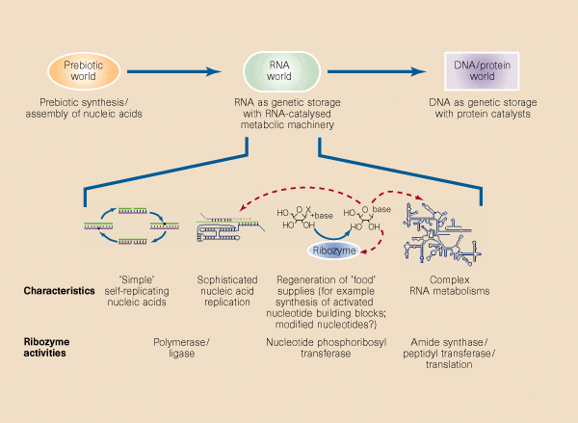

Slide 36
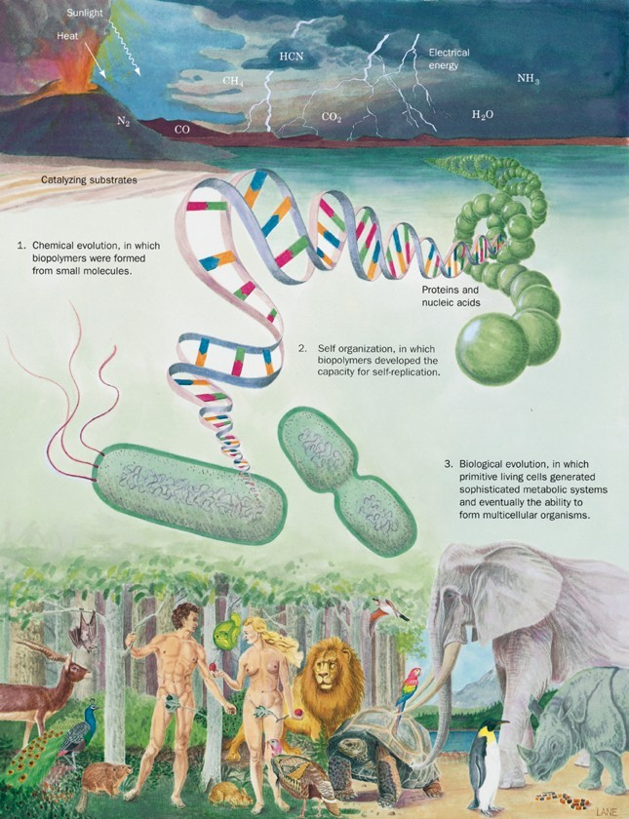
The three stages of the evolution of life.

Slide 37
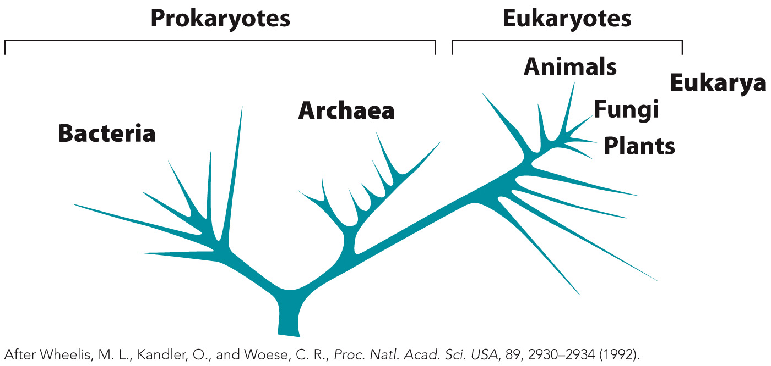
Evolutionary Tree Based on Nucleotide Sequences

