Slide 1
Biochemistry
23
Fatty Acid Metabolism
General, Organic, and Biochemistry 9th Edition
Katherine J. Denniston
Joseph J. Topping
Danaè R. Quirk Dorr
Robert L. Caret
Copyright © 2017 McGraw-Hill Education. Permission required for reproduction or display

Slide 2
23.1 Lipid Metabolism in Animals
1
Triglycerides (Tgl) are emulsified into fat droplets in the intestine by bile salts from the gallbladder
Bile: micelles of lecithin, cholesterol, protein, bile salts, inorganic ions, and bile pigments
Pancreatic lipase catalyzes hydrolysis of Tgl to monoglycerides and fatty acids
Absorbed by intestinal epithelial cells
Reassembled into Tgl
Combined with protein to form chylomicrons which transmit Tgl to adipocytes

Slide 3
Micelles
A micelle formed from the phospholipid lecithin
Straight lines represent long hydrophobic fatty acid tails
Spheres represent hydrophilic heads of phospholipids
23.1 Lipid Metabolism in Animals

Slide 4
Bile Salt Structures
Bile salts are made in the liver and stored in the gallbladder
Are secreted upon stimulus into the duodenum
Major bile salts:
Cholate
Chenodeoxycholate
23.1 Lipid Metabolism in Animals

Slide 5
Emulsification
Fat globule is broken up and coated by lecithin and bile salts
23.1 Lipid Metabolism in Animals

Slide 6
Fat Hydrolysis
Emulsification droplets are acted upon by pancreatic lipase
Hydrolyzes first and third fatty acids from triglycerides
Leaves the middle fatty acid
23.1 Lipid Metabolism in Animals

Slide 7
Action of Pancreatic Lipase
Emulsification droplets are acted upon by pancreatic lipase
Hydrolyzes first and third fatty acids from triglycerides
Leaves the middle fatty acid
23.1 Lipid Metabolism in Animals

Slide 8
Oxidation of Fatty Acids
Oxidation of phenyl-labeled amino acids occurs two carbons at a time
Final two carbons are designated ω–carbons (omega)
23.1 Lipid Metabolism in Animals

Slide 9
Micelle Formation
Several types of lipids form micelles coated with bile salts

Slide 10
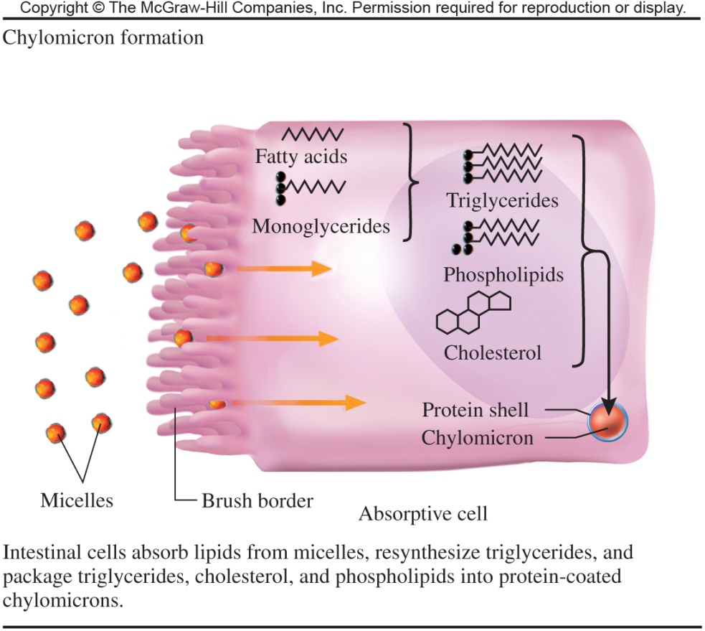
Chylomicron Formation
Intestinal cells
Absorb lipids from micelles
Resynthesize triglycerides
Package into protein-coated chylomicrons
Triglycerides
Cholesterol
Phospholipids
23.1 Lipid Metabolism in Animals

Slide 11
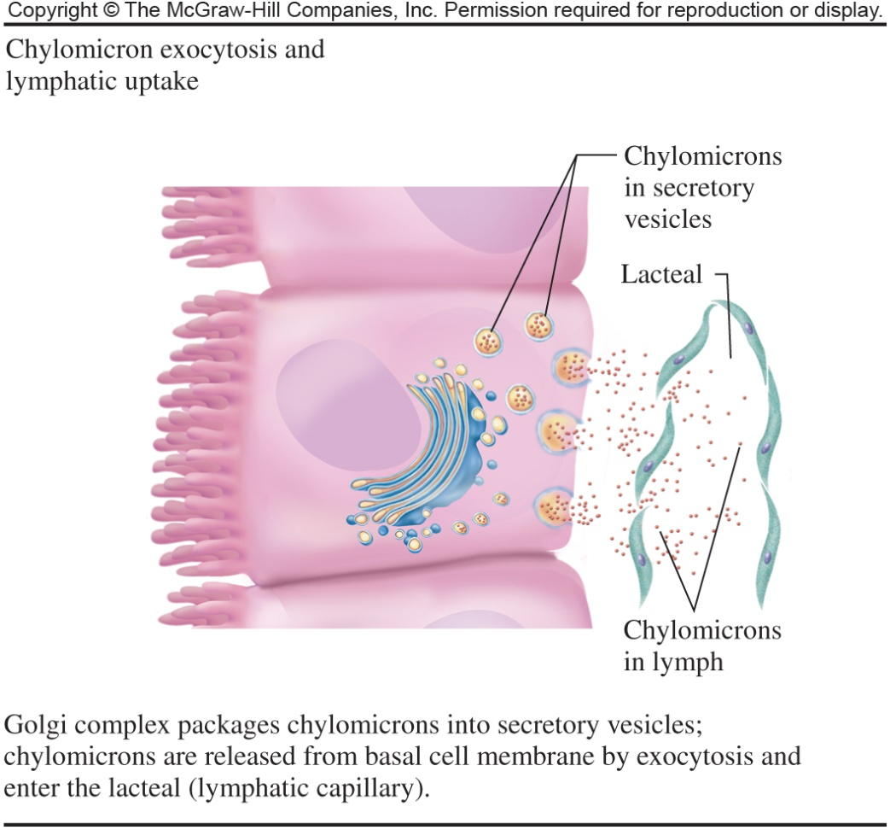
Chylomicron Exocytosis and Lymphatic Uptake
Golgi complex packages chylomicrons into secretory vesicles
Chylomicrons are released from basal cell membrane by exocytosis
Vesicles enter the lacteal, lymphatic cavity
23.1 Lipid Metabolism in Animals

Slide 12
Lipid Storage
Fatty acids are stored in adipocytes as triglycerides in the cells cytoplasm
When energy is needed, hydrolysis converts Tgl to fatty acids
The fatty acids are transported to the matrix of abundant mitochondria where they are oxidized
23.1 Lipid Metabolism in Animals

Slide 13
23.2 Fatty Acid Degradation
2
Overview
Fatty acids are degraded into 2-carbon fragments in a process called β-oxidation
Step 1 of β-oxidation : Activation
Steps 2 – 5 are a set of four reactions with a basic outline similar to the last four reactions of the citric acid cycle
Each pass through the cycle releases acetyl CoA and returns a fatty acyl CoA with 2 fewer carbons
One molecule of FADH₂ and one molecule of NADH are produced for each cycle of β-oxidation
3

Slide 14
Reactions of β-Oxidation
23.2 Fatty Acid Degradation

Slide 15
β-Oxidation – Step 1
2
Enzymes used in β-oxidation are located in the matrix space of mitochondria
Special transport mechanisms are required to move the fatty acids into the mitochondrial matrix
Step 1 in β-oxidation is the activation reaction that produces a fatty acyl CoA molecule
23.2 Fatty Acid Degradation

Slide 16
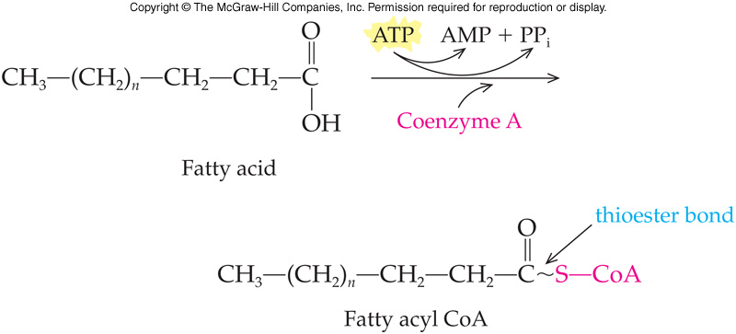
Activation Reaction
A high-energy thioester bond is formed between coenzyme A and the fatty acid
Reaction requires energy as ATP
Hydrolysis of two phosphoanhydride bonds
Energy invested at start of cycle returns greater amount of energy later in pathway
Reaction is catalyzed by acyl-CoA ligase located on the outer mitochondrial membrane
Product is an activated acyl group
23.2 Fatty Acid Degradation

Slide 17
Crossing Into the Matrix
2
The activated acyl group reacts with carnitine, a carrier molecule
Reaction is catalyzed by carnitine acyltransferase I
Transfers the fatty acyl group to carnitine, producing acylcarnitine and coenzyme A
The acylcarnitine crosses into the mitochondrial matrix via a carrier protein located in the mitochondrial inner membrane
Fatty acyl CoA is regenerated once in the matrix, in another transesterification reaction catalyzed by carnitine acyltransferase II
23.2 Fatty Acid Degradation

Slide 18
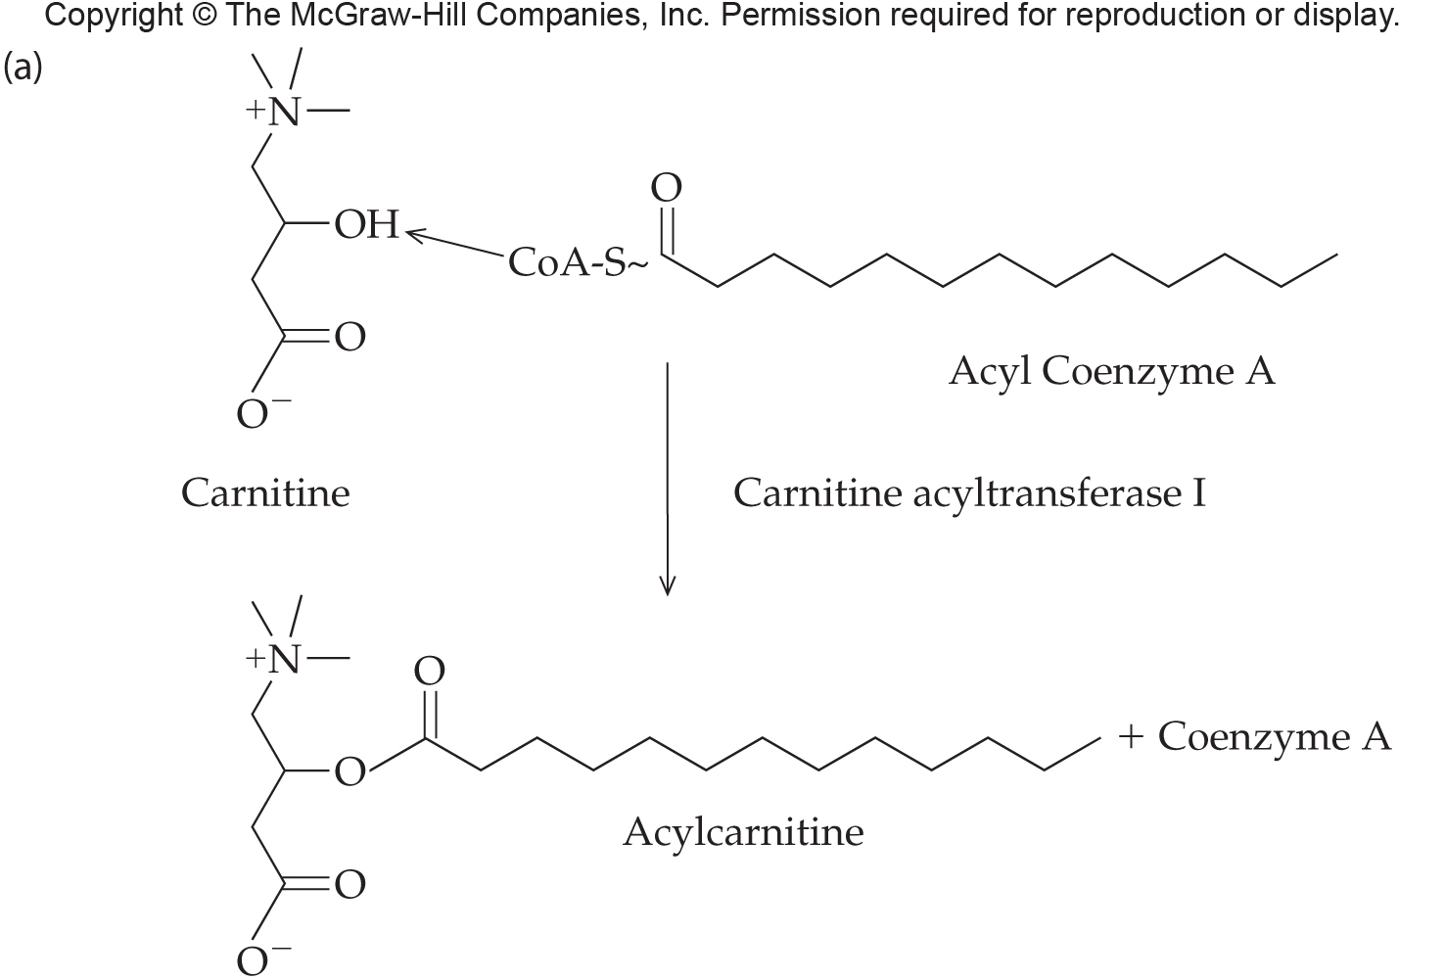
Formation of Acylcarnitine
2
23.2 Fatty Acid Degradation

Slide 19
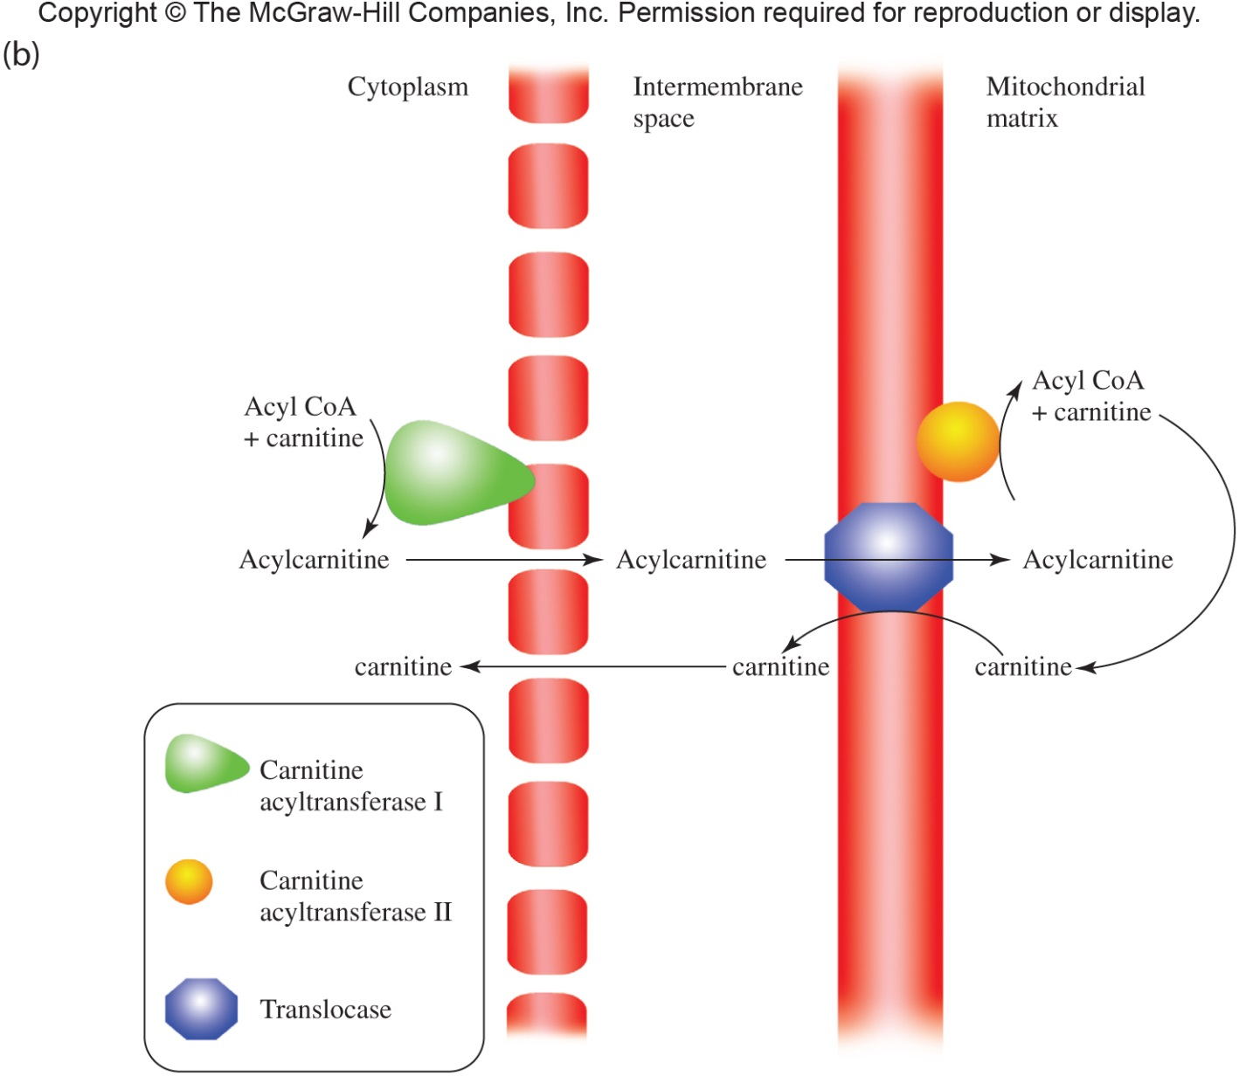
Representation of Crossing Into the Matrix
2
23.2 Fatty Acid Degradation

Slide 20
β-Oxidation – Step 2
This step is an oxidation reaction removing a pair of hydrogen atoms from the fatty acid
The hydrogen atoms are used to reduce FAD producing FADH₂
Dehydrogenation reaction catalyzed by acyl-CoA dehydrogenase resulting in formation of a carbon-carbon double bond
Oxidative phosphorylation yields 2 ATP molecules for each FADH₂ produced by this redox reaction
23.2 Fatty Acid Degradation

Slide 21
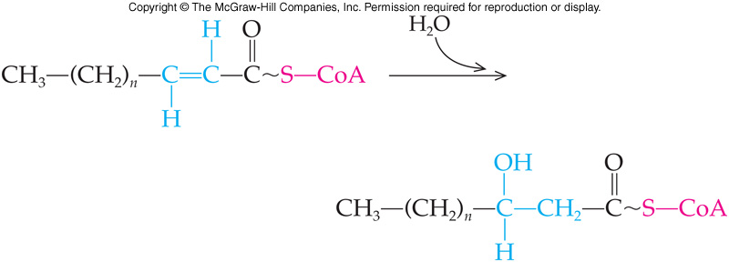
β-Oxidation – Step 3
The third step of the reaction is the hydration of the double bond produced in reaction 2
This results in hydroxylation of the β-carbon
Reaction catalyzed by the enzyme enoyl-CoA hydrase
23.2 Fatty Acid Degradation

Slide 22
β-Oxidation – Step 4
The previously hydroxylated β-carbon is now dehydrogenated in an oxidation reaction
NAD⁺ is reduced forming NADH
Produces 3 ATP by oxidative phosphorylation
The enzyme catalyzing the reaction is L-β-hydroxyacyl-CoA dehydrogenase
23.2 Fatty Acid Degradation

Slide 23
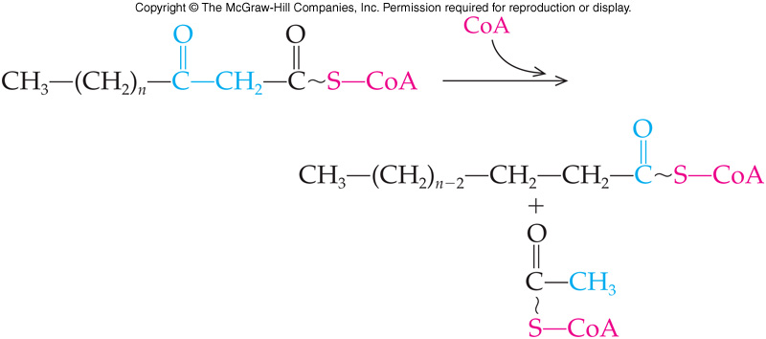
β-Oxidation – Step 5
Final reaction cleaves 2-C unit releasing acetyl CoA
The enzyme involved is thiolase
Reaction type is thiolysis, attack molecule of coenzyme A on β-carbon
In addition to the acetyl CoA, a fatty acyl CoA, two carbons shorter than the beginning fatty acid is also produced
23.2 Fatty Acid Degradation

Slide 24
β-Oxidation of Subsequent Acetyl Units
The shortened fatty acyl CoA is further oxidized with additional cycles until the entire chain is degraded to acetyl CoA
Each acetyl CoA produced enters the reactions of the citric acid cycle
12 ATP molecules will be produced for each acetyl CoA released during β-oxidation
23.2 Fatty Acid Degradation

Slide 25
Complete Oxidation of Palmitic Acid

Slide 26
ATP from Palmitic Acid Oxidation
Step 1 (activation)
Palmitic acid to Palmityl-CoA -2 ATP
Steps 2-5
7 FADH₂ + 2 ATP/FADH₂ 14 ATP
7 NADH x 3 ATP/NADH 21 ATP
8 Ac-CoA (to TCA cycle)
8 x 1 GTP x 1 ATP/GTP 8 ATP
8 x 3 NADH x 3 ATP/NADH 72 ATP
8 x 1 FADH₂ x 2 ATP/FADH₂ 16 ATP
NET 129 ATP
23.2 Fatty Acid Degradation

Slide 27
23.3 Ketone Bodies
Result if excess acetyl-CoA from β-oxidation
When glycolysis and β-oxidation occur at the same rate there is a steady supply of pyruvate to convert to oxaloacetate
If the supply of oxaloacetate is too low to allow all the acetyl CoA to enter the citric acid cycle:
Convert excess acetyl CoA to ketone bodies
β-hydroxybutyrate
Acetone
Acetoacetate
4

Slide 28
Ketosis
Ketosis is a condition with abnormally high levels of blood ketone bodies
Arises under some pathological conditions
Starvation
Extremely low in carbohydrates – high protein diet
Uncontrolled diabetes mellitus
Uncontrolled diabetics can have a very high concentration of ketone acids in the blood
Ketoacidosis
Ketone acids are relatively strong acids that readily dissociate to release H⁺
Blood pH then becomes acidic which can lead to death
23.3 Ketone Bodies

Slide 29
Ketogenesis
Production of ketone bodies begins with a reversal of the last step in β-oxidation
When oxaloacetate levels are low, two acetyl CoA molecules are fused to form acetoacetyl CoA
23.3 Ketone Bodies

Slide 30
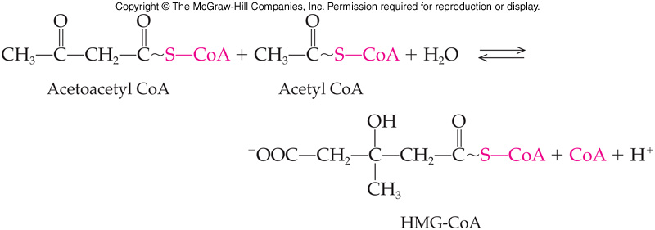
Formation of β-Hydroxy-β-methylglutaryl CoA
Combination of acetoacetyl CoA with a third acetyl CoA molecule yields β-hydroxy-β-methylglutarylCoA (HMG-CoA)
HMG-CoA formed in the cytoplasm is a precursor for cholesterol biosynthesis
23.3 Ketone Bodies

Slide 31
Formation of Acetoacetate and Acetyl CoA
In mitochondria HMG-CoA is cleaved to yield acetoacetate and acetyl CoA
23.3 Ketone Bodies

Slide 32
Acetoacetate
Small amounts of acetoacetate spontaneously lose CO₂ to produce acetone
This process can result in “acetone breath” often associated with uncontrolled diabetes mellitus
Typical reaction has acetoacetate reduced in an NADH-dependent reaction to produce β-hydroxybutyrate
Ketone bodies: acetoacetate, acetone, and β-hydroxybutyrate
Heart muscle main energy source is from ketone body oxidation
Can be reconverted to acetyl CoA
Produced in the liver
Diffuse into the blood
Circulate to other tissues
23.3 Ketone Bodies

Slide 33
Acetoacetate Reactions
23.3 Ketone Bodies

Slide 34
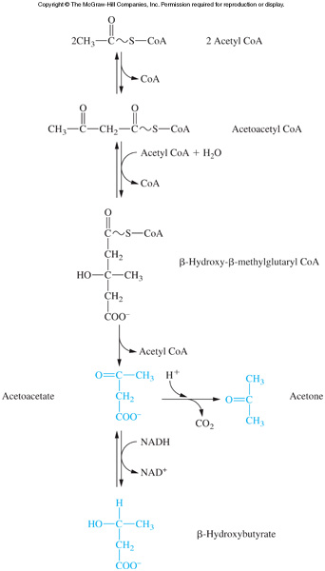
The Reactions of Ketogenesis
23.3 Ketone Bodies

Slide 35
23.4 Fatty Acid Synthesis
All organisms can synthesize fatty acids
Excess acetyl CoA from carbohydrate degradation is used to make fatty acids
These fatty acids are stored as triglycerides
Reactions occur in the cytoplasm
Acyl group carrier is acyl carrier protein (ACP)
Synthesis is by addition of 2-carbon units
Synthesis by a multienzyme complex known as fatty acid synthase
NADPH is the reducing agent
5

Slide 36
Comparison of β-Oxidation and Fatty Acid Biosynthesis
Intracellular location
Biosynthetic enzymes in cell cytoplasm
Degradative enzymes in mitochondria
Acyl group carriers
Biosynthetic carrier is acyl carrier protein
Degradative carrier is coenzyme A
Enzymes involved
Biosynthetic complex is fatty acid synthase
Degradative enzymes not associated in a complex
Electron carrier
Biosynthetic process uses NADPH
Degradative process uses NADH and FADH₂
23.4 Fatty Acid Synthesis

Slide 37
Comparison of Fatty Acid Biosynthesis and Degradation
 | Biosynthesis | Degradation
Intracellular location | cytoplasm | mitochondria
Acyl group carriers | Acyl carrier protein | Coenzyme A
Enzyme complex | Fatty acid synthase complex | No enzyme complex
Electron carriers | NADPH | NADH, FADH₂
23.4 Fatty Acid Synthesis

Slide 38
Fatty Acid Synthesis Reactions
Malonyl ACP is produced in two reactions:
Carboxylation of acetyl CoA
Transfer of malonyl acyl group from malonyl CoA to the ACP
Four remaining reactions:
Condensation – Acetoacetyl ACP
Reduction – β-Hydroxybutyryl ACP
Dehydration – Crotonyl ACP
Reduction – Butyryl ACP
23.4 Fatty Acid Synthesis

Slide 39
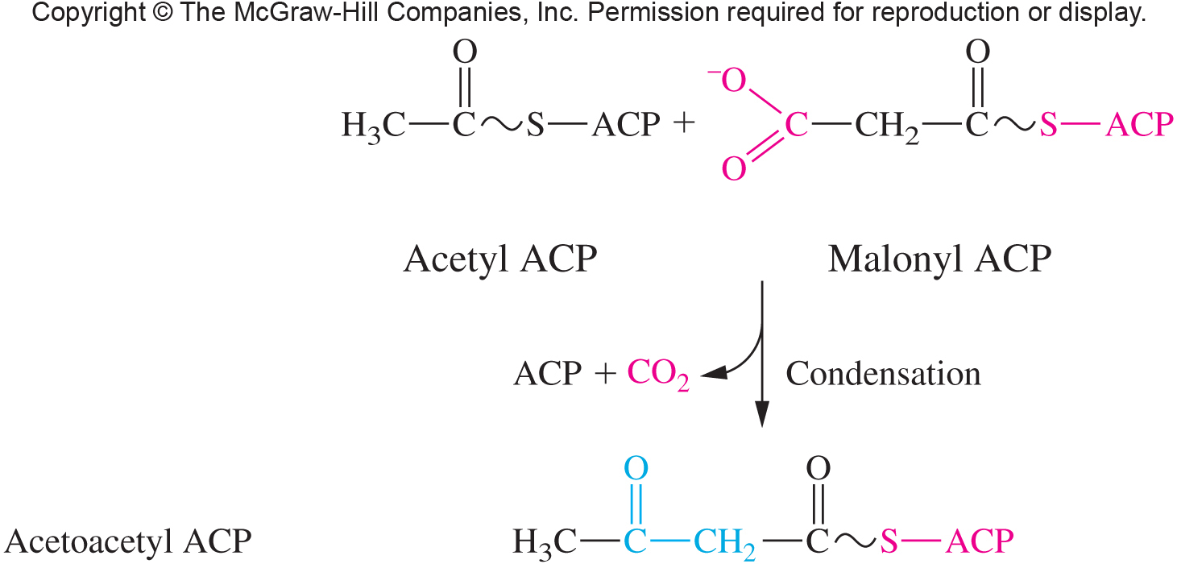
Formation of Acetoacetyl ACP
23.4 Fatty Acid Synthesis

Slide 40
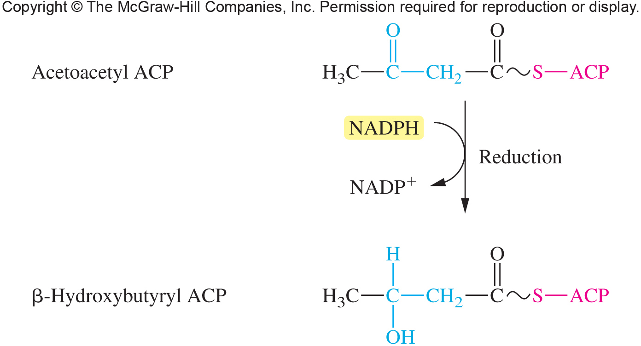
Formation of β-Hydroxybutryl ACP
23.4 Fatty Acid Synthesis

Slide 41
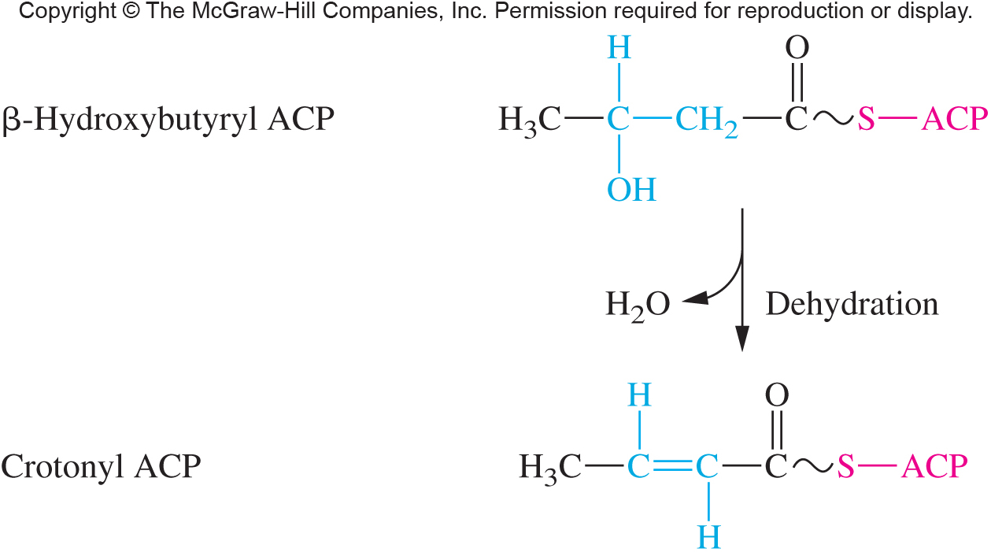
Formation of Crotonyl ACP
23.4 Fatty Acid Synthesis

Slide 42
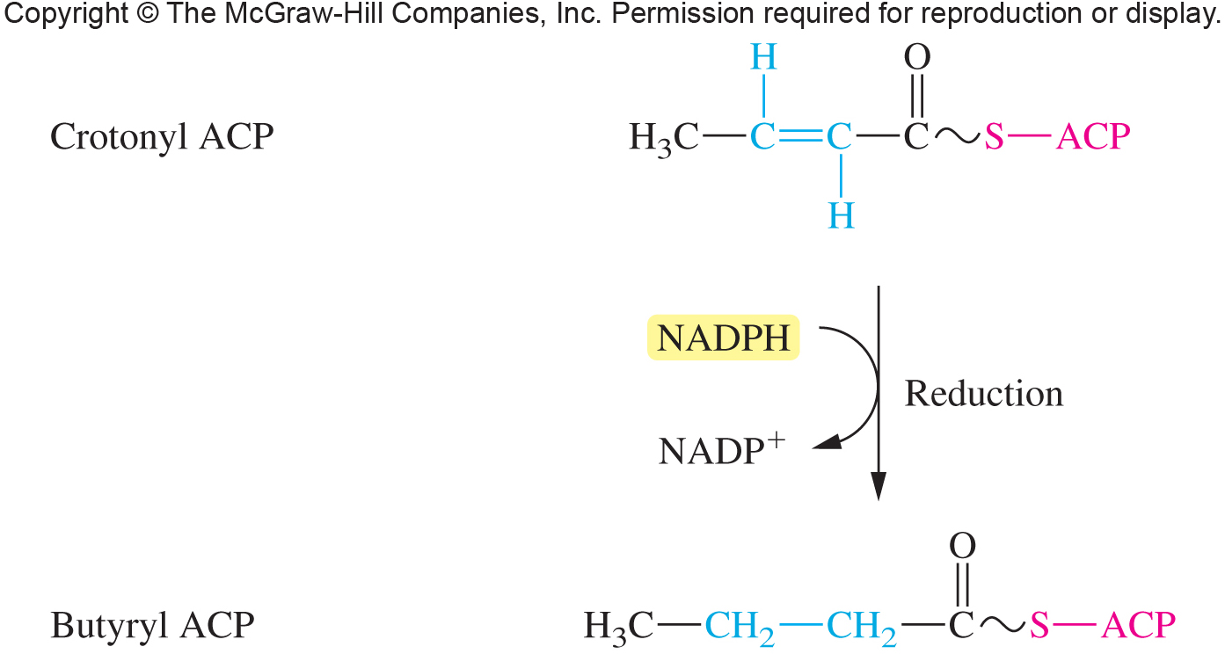
Formation of Butyryl ACP
23.4 Fatty Acid Synthesis

Slide 43
23.5 The Regulation of Lipid Metabolism
Metabolism of fatty acids occurs to a different extent in different organs
Compare several key organs
Liver
Adipose tissue
Muscle tissue
Brain
6

Slide 44
Representation of Liver and Lipid Metabolism

Slide 45
Liver and Lipid Metabolism
When excess fuel available, liver synthesizes fatty acids
Fatty acids produce Tgl transported from liver to adipose tissues by VLDL complexes
In starvation or fasting
Fatty acids converted to acetoacetate and other ketone bodies exported to other organs for oxidation to ATP
23.5 Regulation of Lipid Metabolism

Slide 46
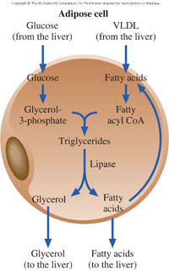
Adipose Tissue
Major storage depot for fatty acids
Fatty acids from the liver are sent to adipocytes
Lipases are under hormonal control and determine rate of Tgl hydrolysis
Synthesis of Tgl
Requires glycerol-3-phosphate
Depends on glycolysis for G-3-P
23.5 Regulation of Lipid Metabolism

Slide 47
Muscle Tissue
Resting muscle uses fatty acids for energy
Working muscle uses glycolysis
Heart muscle prefers ketone bodies
23.5 Regulation of Lipid Metabolism

Slide 48
23.6 The Effects of Insulin and Glucagon on Cellular Metabolism
Insulin is secreted in response to high blood glucose levels
Carbohydrate metabolism
Stimulates glycogen synthesis while inhibiting glycogenolysis and gluconeogenesis
Protein metabolism
Stimulates incorporation of amino acids into proteins
Lipid metabolism
Stimulates uptake of glucose by adipose cells and synthesis of triglycerides
7

Slide 49
Glucagon and Insulin
Glucagon is secreted in response to low blood glucose levels
Carbohydrate metabolism
Inhibits glycogen synthesis while stimulating glycogenolysis and gluconeogenesis
Lipid metabolism
Stimulates the breakdown of fats and ketogenesis
Protein metabolism
No direct effect
23.5 The Effects of Insulin and Glucose on Metabolism

Slide 50
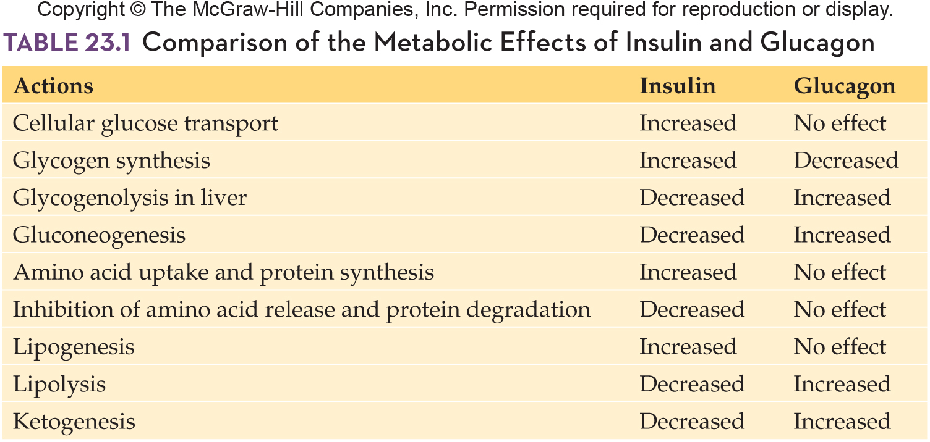
Comparison of the Metabolic Effects of Insulin and Glucagon
23.5 The Effects of Insulin and Glucose on Metabolism

Slide 51
Summary of the Antagonistic Effects of Insulin and Glucagon
23.5 The Effects of Insulin and Glucose on Metabolism

