Slide 1
Biochemistry
22
Aerobic Respiration and Energy Production
General, Organic, and Biochemistry 9th Edition
Katherine J. Denniston
Joseph J. Topping
Danaè R. Quirk Dorr
Robert L. Caret
Copyright © 2017 McGraw-Hill Education. Permission required for reproduction or display

Slide 2
22.1 The Mitochondria
Football shaped organelle about the size of a bacterial cell
Dual membrane structure:
Outer mitochondrial membrane
Inner mitochondrial membrane:
Highly folded membranes = christae
Has electron transport system and ATP synthase
Space between membranes is the intermembrane space
Interior is the matrix space containing enzymes
Citric acid cycle
β-oxidation of fatty acids
Degradation of amino acids
1

Slide 3
Structure and Function
Outer membranes have many pores for the passage of small molecules
Folds of the inner membrane create a large surface area with many transport proteins
22.1 The Mitochondria

Slide 4
22.2 Conversion of Pyruvate to Acetyl CoA
2
Under aerobic conditions, pyruvate from glycolysis is completely oxidized to CO₂
Enters the mitochondria and is converted to acetyl CoA
Activates the acetyl group for entry into the citric acid cycle
Kreb’s cycle
Tricarboxylic acid cycle
TCA cycle

Slide 5
Acetyl CoA
Pyruvate enters the mitochondria
Converted to a 2-carbon acetyl group
For further reactions, acetyl group must be activated
Activation occurs when the acetyl group is bonded to the thiol group of coenzyme A in a high-energy bond
Coenzyme A is a large thiol derived from ATP and pantothenic acid, a vitamin
22.2 Conversion of Pyruvate to Acetyl CoA

Slide 6
Structure of Acetyl CoA
22.2 Conversion of Pyruvate to Acetyl CoA

Slide 7
Overall Decarboxylation and Oxidation of Pyruvate
Pyruvate to acetyl CoA
Decarboxylation – loss of a carboxyl group as CO₂
Oxidation by NAD⁺ which accepts the hydride anion
Remaining acetyl group linked to coenzyme A via a high-energy thioester bond
Reactions catalyzed by 3 enzymes and 5 coenzymes bundled together as the pyruvate dehydrogenase complex
22.2 Conversion of Pyruvate to Acetyl CoA

Slide 8
Decarboxylation and Oxidation of Pyruvate
22.2 Conversion of Pyruvate to Acetyl CoA

Slide 9
Pyruvate Dehydrogenase Complex
Complex contains 5 coenzymes (4 vitamin-derived) and 3 enzymes
Thiamine pyrophosphate – thiamine
FAD – riboflavin
NAD⁺ – niacin
Coenzyme A – pantothenic acid
Lipoamide
22.2 Conversion of Pyruvate to Acetyl CoA

Slide 10
Role of Acetyl CoA in Cellular Metabolism
Acetyl CoA is central in cellular metabolism
Major function is to carry the acetyl group to the citric acid cycle
Also functions in biosynthetic reactions to produce cholesterol and fatty acids
Permits interconversion of energy sources
Fats
Proteins
Carbohydrates
Produced by degrading
Glucose
Fatty acids
Some amino acids
22.2 Conversion of Pyruvate to Acetyl CoA

Slide 11
22.3 Overview: Aerobic Respiration
Oxygen-requiring breakdown of food and production of ATP
Process also called oxidative phosphorylation as energy from oxidative reactions is used to phosphorylate ADP making ATP
Performed by enzymes in the mitochondrial matrix
Three oxidations transfer hydride to NAD⁺ or FAD
Electrons passed from NAD⁺ or FAD to the electron transport chain and then O₂
Protons are transferred to intermembrane space, leads to ATP synthesis as protons return to mitochondrial matrix
3

Slide 12
22.4 The Citric Acid Cycle
4
Citric acid cycle is the final stage in the breakdown of dietary nutrients
Acetyl CoA and oxaloacetate feed the citric acid cycle
The acetyl group is oxidized to two molecules of CO₂ and high energy electrons are transferred to NAD⁺ and FAD
Cycle comprises 8 enzymatic steps several of which are allosterically controlled

Slide 13
Reaction 1
A condensation reaction between the acetyl group of acetyl CoA and oxaloacetate
Aldol condensation reaction
Catalyzed by citrate synthase
Product is citrate
22.4 The Citric Acid Cycle

Slide 14
Reaction 2
A dehydration reaction of citrate followed by hydration to isocitrate
Dehydration reaction releasing H₂O
Hydration of cis-aconitate to isocitrate
Catalyzed by aconitase
Intermediate is cis-aconitate
Final product is isocitrate
22.4 The Citric Acid Cycle
1
2

Slide 15
Reaction 3
First oxidative step of the citric acid cycle
Complex 3-step reaction
Hydroxyl group of isocitrate is oxidized to a ketone
Carbon dioxide is released in a decarboxylation
NAD⁺ is reduced to NADH
Catalyzed by isocitrate dehydrogenase
Product is α-ketoglutarate
22.4 The Citric Acid Cycle

Slide 16
Reaction 4
Coenzyme A attaches to the a-ketoglutarate in a 3-step reaction similar to that of the pyruvate dehydrogenase complex
Enzyme involved is α-ketoglutarate dehydrogenase complex
First, a-ketoglutarate loses a carboxylate group as CO₂
Then, a-ketoglutarate is oxidized with NAD⁺ reduced to NADH
Coenzyme A combines with succinate to form succinyl CoA
Bond between succinate and coenzyme A is high-energy
22.4 The Citric Acid Cycle

Slide 17
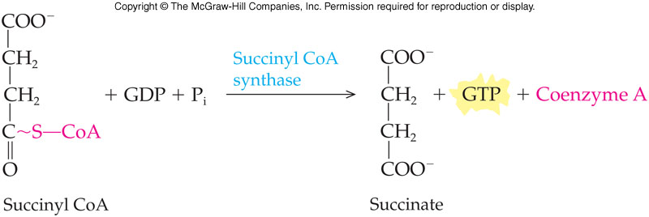
Reaction 5
A very chemically involved step where succinyl CoA is converted to succinate by the enzyme succinyl CoA synthase
The high-energy thioester bond is hydrolyzed adding an inorganic phosphate group to GDP making GTP
22.4 The Citric Acid Cycle

Slide 18
Reaction 5 continued
A second enzyme, dinucleotide diphosphokinase, catalyzes transfer of the inorganic phosphate group from GTP to ATP
22.4 The Citric Acid Cycle

Slide 19
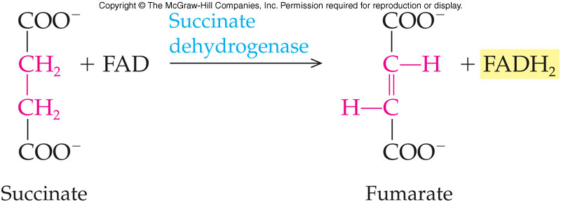
Reaction 6
Succinate is oxidized by succinate dehydrogenase to form fumarate
Oxidizing agent, FAD, flavin adenine dinucleotide, is reduced in this step to FADH₂
22.4 The Citric Acid Cycle

Slide 20
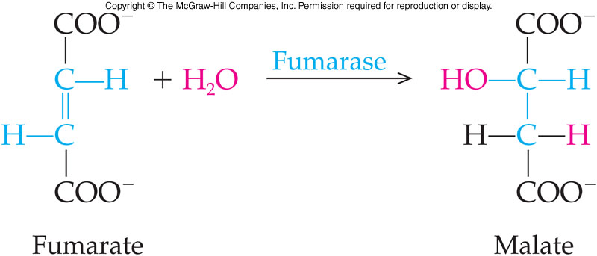
Reaction 7
Reducing the double bond of fumarate by the hydration or addition reaction of H₂O produces malate
Reaction is catalyzed by fumarase
22.4 The Citric Acid Cycle

Slide 21
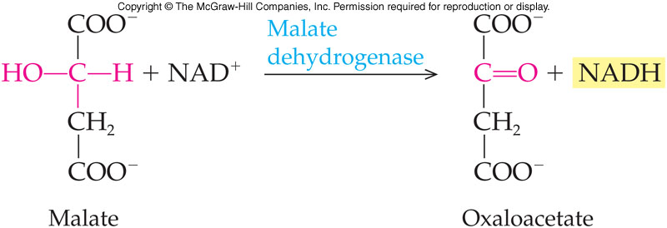
Reaction 8
Final reaction step uses malate dehydrogenase to
Reduce NAD⁺ to NADH
Oxidize malate to oxaloacetate
Cycle begins as an acetyl group is added to oxaloacetate, bring a full turn of the cycle
22.4 The Citric Acid Cycle

Slide 22
Reactions - Citric Acid Cycle
22.4 The Citric Acid Cycle

Slide 23
22.5 Control of the Citric Acid Cycle
As with glycolysis, citric acid cycle responds to the energy needs of the cell
Pathway speeds up when greater demand for energy
Four enzymes / enzyme complexes are allosterically regulated
Several regulated steps demonstrate the importance of precise control
5

Slide 24
Allosterically Regulated Reactions
Conversion of pyruvate to acetyl CoA
Inhibited by high concentrations of:
ATP
Acetyl CoA
NADH
Synthesis of citrate from oxaloacetate and acetyl CoA
Negative effector is high levels of ATP
Oxidation and decarboxylation of isocitrate to α-ketoglutarate
Positive effector, ADP controls this enzyme
Inhibited by high levels of NADH and ATP
Conversion of α-ketoglutarate to succinyl CoA
Inhibited by high concentrations of:
ATP
Succinyl CoA
NADH
22.5 Control of the Citric Acid Cycle

Slide 25
Regulation of the Pyruvate Dehydrogenase Complex
22.5 Control of the Citric Acid Cycle

Slide 26
22.6 Oxidative Phosphorylation
The respiratory electron transport system is made up of a series of electron carriers embedded in the inner mitochondrial membrane
At three sites in the electron transport system, protons, H⁺ can be pumped from the matrix to the intermembrane space
NADH provides three ATP molecules
FADH₂ provides two ATP molecules
ATP synthesis occurs at the ATP synthase
6

Slide 27
Electron Transport Systems
Embedded within the mitochondrial inner membrane are the electron transport systems, electron carriers
Coenzymes
Cytochromes
Arranged to allow them to pass electrons from one carrier to the next
This array is called the respiratory electron transport system
22.6 Oxidative Phosphorylation

Slide 28
The Hydrogen Ion Gradient
At three sites, protons, H⁺, can be pumped from the matrix to the intermembrane space
These protons contribute to a high-energy H⁺ reservoir
Each site pumps sufficient protons to produce one ATP molecule
NADH dehydrogenase passes electrons along all 3 sites
FADH₂ oxidation passes electrons along only 2 sites
Final component for oxidative phosphorylation is ATP synthase, a multiprotein complex
Spans the inner membrane serving as a channel for protons
A portion of the complex is an enzyme that catalyzes the phosphorylation of ADP to ATP
22.6 Oxidative Phosphorylation

Slide 29
Electron Flow Through Electron Carriers
22.6 Oxidative Phosphorylation

Slide 30
NADH and the Production of ATP
NADH carries electrons (original source glucose) to the first carrier of the electron transport system, NADH dehydrogenase
NADH is oxidized to NAD⁺ which returns to citric acid cycle
Pair of electrons passed to the next electron carrier and H⁺ are pumped to the intermembrane compartment
These electrons are passed through the electron transport system
With each transfer the electrons lose some energy
This energy is used to transport H⁺ across the inner membrane
22.6 Oxidative Phosphorylation

Slide 31
ATP Synthase and the Production of ATP
Electrons reach last carrier with too little energy to effect a transport
Must be placed with an electron acceptor = O₂
½ O₂ + 2 H⁺ → H₂O
The protons in the intermembrane space flow back through ATP synthase F₀ channel activating F₁
F₁ catalyzes phosphorylation of ADP to produce ATP
22.6 Oxidative Phosphorylation

Slide 32
Energy Yield from One Glucose
Glycolysis
Substrate-level phosphorylation 2 ATP
2 NADH X 2 ATP (cytoplasm) 4 ATP
Two Pyruvate to two Ac-CoA
2 NADH X 3 ATP/NADH 6 ATP
Citric Acid Cycle (Two turns)
2 GTP X 1 ATP/GTP 2 ATP
6 NADH X 3 ATP/NADH 18 ATP
2 FADH₂ X 2 ATP/FADH₂ 4 ATP
NET 36 ATP
22.6 Oxidative Phosphorylation

Slide 33
22.7 The Degradation of Amino Acids
7
When the body has depleted glycogen (starving), it can use amino acids for fuel
Degradation takes place in the liver in two stages
Removal of the α-amino group
Typically excreted in the urine
Degradation of the carbon skeleton leads to conversion into a variety of compounds
Pyruvate
Acetyl CoA
22.7 The Degradation of Amino Acids

Slide 34
Removal of α-Amino Groups: Transamination
Transaminase catalyzes transfer of α-amino group from α-amino acid to α-keto acid
The α-keto acid is often α-ketoglutarate
Transfer process appears simple, but very complex
Transaminase binds the amino acid in its active site
Transfer amino group to pyridoxal phosphate
Next move the amino group to a keto acid
22.7 The Degradation of Amino Acids

Slide 35
Pyridoxal Phosphate and Pyridoxine
Pyridoxal phosphate is the coenzyme required for all transamination reactions
Over 50 discovered, all use this coenzyme
Pyridoxine is also known as vitamin B₆, which is the source of pyridoxal phosphate
22.7 The Degradation of Amino Acids

Slide 36
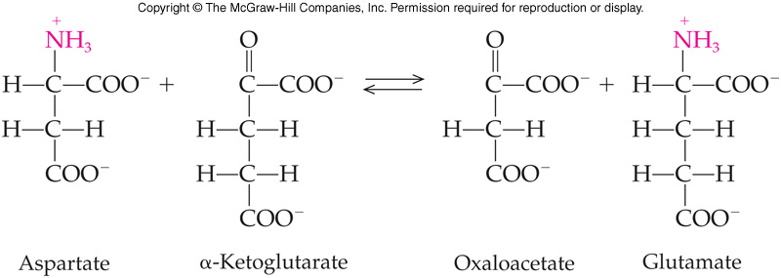
Aspartate Transaminase
This particular transaminase catalyzes the transfer of the α-amino acid of aspartate to α-ketoglutarate
Produces oxaloacetate and glutamate
22.7 The Degradation of Amino Acids

Slide 37
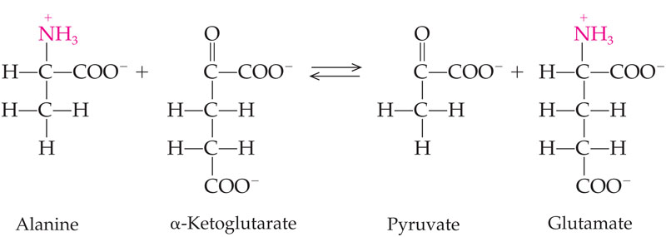
Alanine Transaminase
This transaminase catalyzes transfer of the α-amino group of alanine to α-ketoglutarate
Produces pyruvate and glutamate
Transaminases producing glutamate are called transglutaminases
Produce a citric acid cycle intermediate
Provide a direct link between amino acid degradation and the citric acid cycle
22.7 The Degradation of Amino Acids

Slide 38
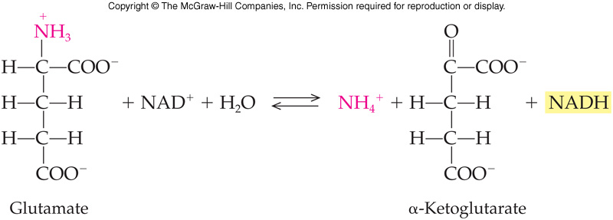
Removal of a-Amino Groups: Oxidative Deamination
Ammonium ion is liberated from the glutamate formed by the transaminase
Glutamate breakdown is catalyzed by glutamate dehydrogenase
22.7 The Degradation of Amino Acids

Slide 39
Mechanism of Transamination
Oxidative deamination is an oxidation-reduction process in which
NAD⁺ is reduced to NADH
Amino acid is deaminated (amino group removed)
22.7 The Degradation of Amino Acids

Slide 40
Deamination of an α-Amino Acid and the Fate of Ammonium Ion
22.7 The Degradation of Amino Acids

Slide 41
Fate of Carbon Skeleton
22.7 The Degradation of Amino Acids

Slide 42
22.8 The Urea Cycle
Oxidative deamination produces large amounts of ammonium ion
As ammonium ion is toxic it must be removed quickly from the body regardless of the energy required
Eliminate ammonium ion via the urea cycle. Urea is excreted in the urine
Failure of enzymes in the urea cycle can be genetic and leads to hyperammonemia
Severe cases lead to early death from toxic ammonium ion buildup
Also leads to retardation, convulsions, and vomiting
8
9

Slide 43
Schematic of the Urea Cycle
22.8 The Urea Cycle

Slide 44
Step 1
First step combines CO₂ and NH₄⁺ to form carbamoyl phosphate
Reaction requires ATP and H₂O
Takes place in the mitochondria
Catalyzed by carbamoyl phosphate synthase
22.8 The Urea Cycle

Slide 45
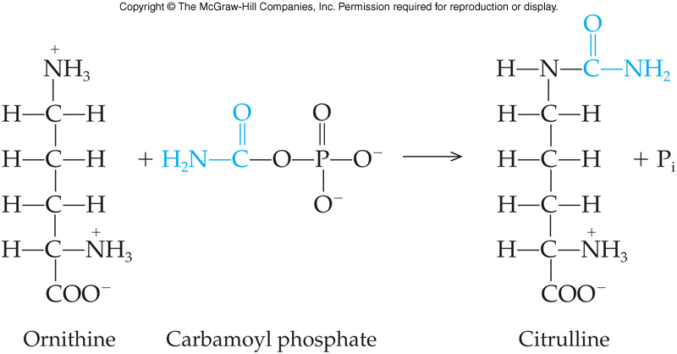
Step 2
Carbamoyl phosphate condenses with the amino acid ornithine to produce the amino acid citrulline
Occurs in the mitochondria
Catalyzed by ornithine transcarbamoylase
22.8 The Urea Cycle

Slide 46
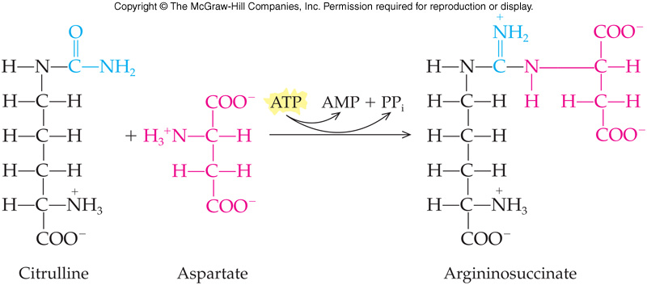
Step 3
Citrulline is transported to the cytoplasm
Condenses with aspartate to produce argininosuccinate
Catalyzed by argininosuccinate synthase
Requires energy released by ATP hydrolysis
22.8 The Urea Cycle

Slide 47
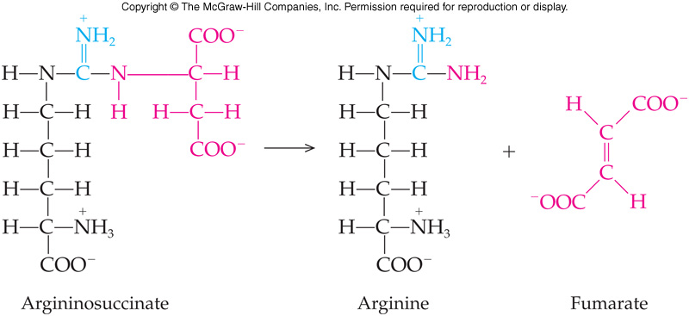
Step 4
Argininosuccinate cleaved to produce the amino acid arginine and fumarate of the citric acid cycle
Reaction catalyzed by argininosuccinate lyase
22.8 The Urea Cycle

Slide 48
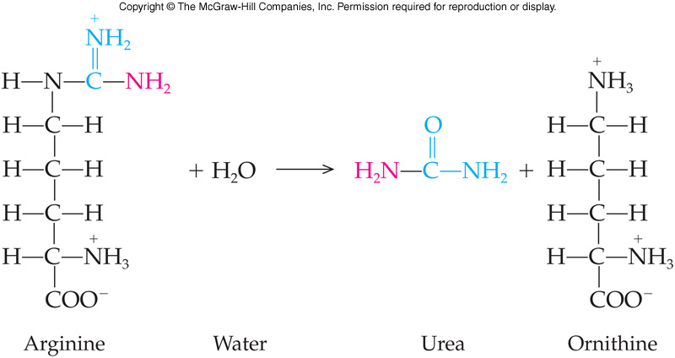
Step 5
Final reaction hydrolyzes arginine to generate urea – the reaction product that is excreted
Reaction also regenerates ornithine, the original reactant in the cycle
Reaction is catalyzed by arginase
22.8 The Urea Cycle

Slide 49
22.9 Overview of Anabolism: The Citric Acid Cycle as a Source of Biosynthetic Intermediates
10
The citric acid cycle functions as:
An energy-harvesting mechanism
Anabolism = biosynthesis
As amino acids can be converted to citric acid cycle intermediates, these can be used to make amino acids
Oxaloacetate is used to make aspartate
Asparagine is made from aspartate in an amination reaction
Glutamate is made from α-ketoglutarate
Glutamine, proline, and arginine are made from glutamate

Slide 50
Representation of the Urea Cycle
22.9 Overview of Anabolism

