Slide 1
Biochemistry
21
Carbohydrate Metabolism
General, Organic, and Biochemistry 9th Edition
Katherine J. Denniston
Joseph J. Topping
Danaè R. Quirk Dorr
Robert L. Caret
Copyright © 2017 McGraw-Hill Education. Permission required for reproduction or display

Slide 2
21.1 ATP: The Cellular Energy Currency
1
Catabolism: set of metabolic pathways that break down complex macromolecules into simpler ones and, in the process, harvest part of their potential energy for use by the cell.
One energy-requiring functions is anabolism, or biosynthesis
Cells use an energy conversion strategy that oxidizes glucose
Small amounts of energy are released at several points in this pathway
This energy is harvested and stored in bonds of ATP
ATP = universal energy currency OR adenosine triphosphate

Slide 3
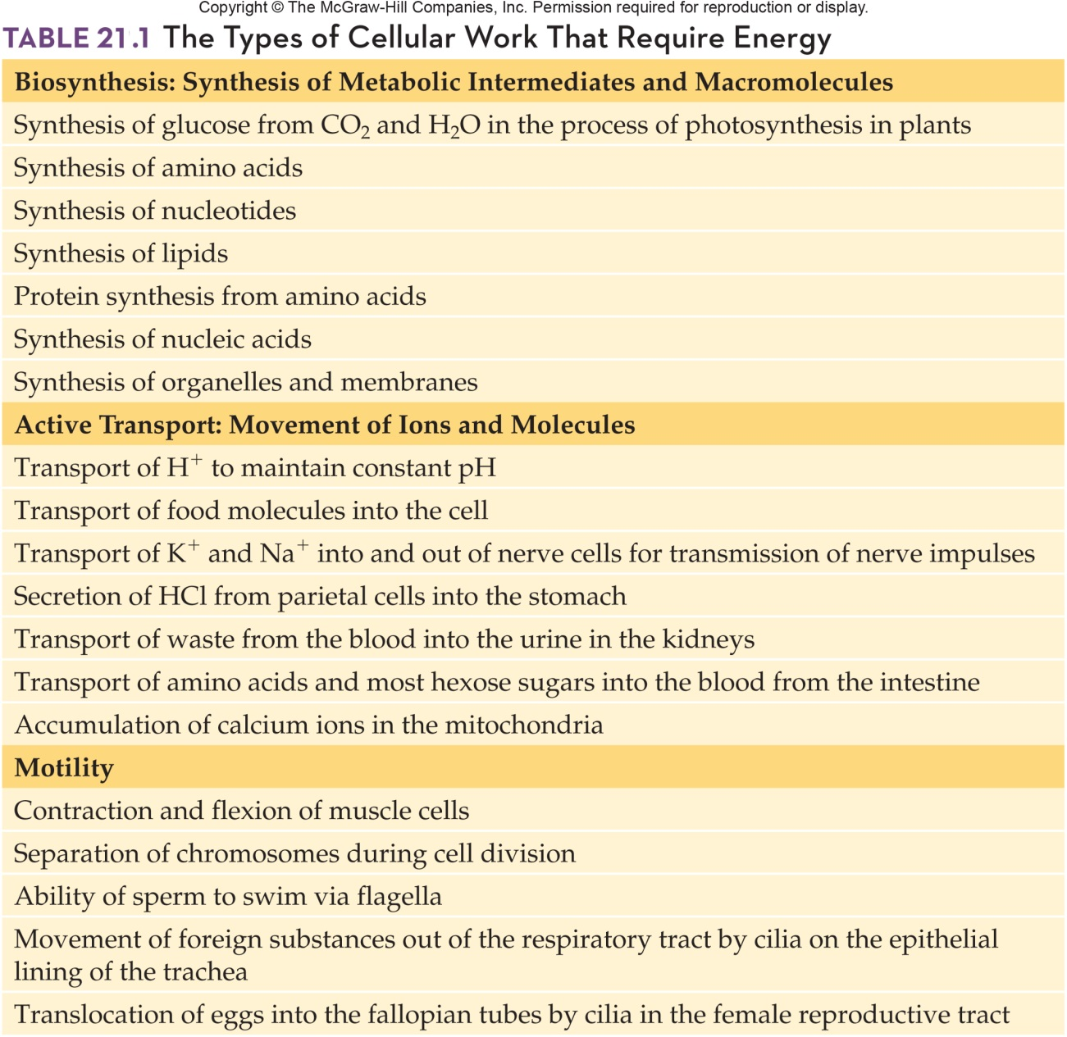
The Types of Cellular Work That Require Energy
21.1 APT: The Cellular Energy Currency

Slide 4
Adenosine Triphosphate
Adenosine triphosphate serves as a “go-between” molecule that couples
exergonic (energy releasing) catabolism reactions
endergonic (energy requiring) anabolic reactions
ATP “captures” energy as phosphoanhydride bonds
Hydrolysis of the anhydride bonds provides energy for anabolism
21.1 APT: The Cellular Energy Currency

Slide 5
ATP: The Molecule
ATP is a nucleotide, a molecule composed of:
Nitrogenous base
5-carbon sugar
One, two, or three phosphoryl groups
Phosphoester bond joins the first phosphoryl group to the 5-carbon sugar ribose
Second and third groups are joined by phosphoanhydride bonds = high-energy bonds
21.1 APT: The Cellular Energy Currency

Slide 6
Structure of ATP
21.1 APT: The Cellular Energy Currency

Slide 7
ATP: Hydrolysis of the Phosphoanhydride Bond
When these phosphoanhydride bonds are broken, large amounts of energy are released
This energy can be used for cellular work
Can drive cellular processes
Phosphorylation of glucose or fructose
Copyright © 2017 McGraw-Hill Education. Permission required for reproduction or display

Slide 8
Example of ATP Energy Use
Step 1 – Hydrolysis
ATP + H₂O ◊ ADP + P_{i} + 7 kcal/mol
Step 2 – Synthesis of Glucose-6-phosphate (G6P)
3.0 kcal/mol + C₆H₁₂O₆ + P_{i} ◊ G6P + H₂O
Combine the 2 equations
Glucose + ATP ◊ G6P + ADP + 4 kcal/mol
Overall energy release in the process
Reaction proceeds spontaneously to the right
21.1 APT: The Cellular Energy Currency

Slide 9
21.2 Overview of Catabolic Processes
2
Carbohydrates, fats, and proteins can be degraded to release energy
Carbohydrates are the most readily used energy source

Slide 10
Stage I: Hydrolysis of Dietary Macromolecules into Small Subunits
The purpose of Stage I in catabolism is to degrade food molecules into component subunits:
Polysaccharides degraded to monosaccharides
Begins in the mouth with amylase action on starch
Continues in small intestine with pancreatic amylase to form monosaccharides
Proteins digested to amino acids
Begins in the stomach with acid hydrolysis
Serine proteases act in the small intestine
Fats broken into fatty acids and glycerol
Begins in small intestine with fat globules
Disperse with bile salts
Degrade with pancreatic lipase
21.2 Overview of Catabolic Processes

Slide 11
Overview of Digestive Processes
Salivary glands secrete amylase to digest starches
Stomach secretes
HCl which denatures proteins
Pepsin which digests
Pancreas secretes
Serine proteases
Lipases
Liver / gallbladder deliver bile salts
Amino acids, monosaccharides enter cells via active transport
Fatty acids and glycerol move via passive transport
21.2 Overview of Catabolic Processes

Slide 12
Hydrolysis Reactions: Carbohydrates, Proteins and Fats
21.2 Overview of Catabolic Processes

Slide 13
Stage 2: Conversion of Monomers into a Form That Can Be Completely Oxidized
Assimilate the small subunits into the pathways of energy metabolism
Major pathways of energy metabolism:
Sugars enter glycolysis as glucose or fructose
Glycerol produced by hydrolysis of fats enters glycolysis
Sugars are converted to acetyl CoA and enter citric acid cycle
Proteins enter at many steps as the carbon skeleton of amino acids
Fatty acids enter the citric acid cycle after conversion to acetyl CoA

Slide 14
Stage 3: Complete Oxidation of Nutrients and the Production of ATP
Acetyl CoA carries acetyl groups, 2-carbon remnants of the nutrients
Acetyl CoA enters the citric acid cycle
Electrons and hydrogen atoms are harvested
Acetyl group is oxidized to produce CO₂
Electrons and hydrogen atoms harvested are used to produce ATP during oxidative phosphorylation
21.2 Overview of Catabolic Processes

Slide 15
21.3 Glycolysis (Embden-Meyerhof Pathway)
Glycolysis:
Pathway for carbohydrate catabolism
Begins with D-glucose as the substrate
All organisms can use glucose as an energy source
Requires no oxygen
Occurs free in the cytoplasm
Ten step pathway catalyzed by enzymes
Products:
Substrate-level phosphorylation gives 4 ATP
A phosphoryl group is transferred to ADP from 1,3-bisphosphoglycerate and phosphoenolpyruvate
NADH carries hydride anions with two electrons
Pyruvate: the fate depends on cellular conditions
3
4

Slide 16
Glycolysis Overview
The anaerobic oxidation of glucose to give two molecules of pyruvate
Glucose + 2 ADP + 2 P_{i} + 2 NAD⁺ 2 pyruvate + 2 ATP + 2 NADH + 2 H⁺ + 2 H₂O
Pyruvate used in follow-up reactions to sustain glycolysis
NADH must be reoxidized so that glycolysis can continue
21.3 Glycolysis

Slide 17
Summary of the Glycolysis Reactions
21.3 Glycolysis

Slide 18
Glycolysis Reaction 1
Reaction 1
Substrate glucose is phosphorylated by hexokinase
Product is glucose-6-phosphate
Source of the phosphoryl group is ATP
Expenditure of ATP early in the pathway works as energy “debt” necessary to get the pathway started
21.3 Glycolysis

Slide 19
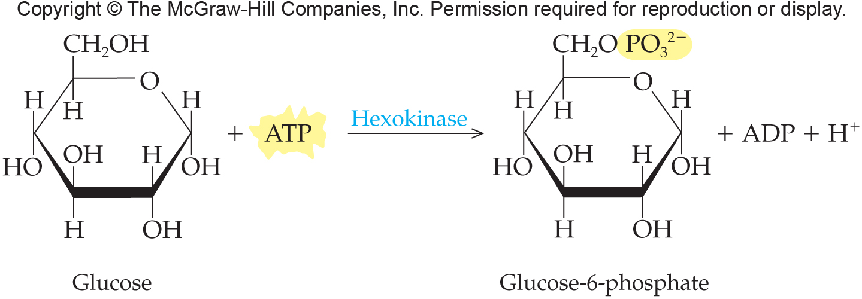
Glycolysis: Reaction 1
21.3 Glycolysis

Slide 20
Glycolysis Reaction 2
Reaction 2
Product of reaction 1 is rearranged to the structural isomer fructose-6-phosphate by enzyme phosphoglucose isomerase
Product has an “exposed” C-1, no longer part of the ring structure
Converts and aldose to a ketose
21.3 Glycolysis

Slide 21
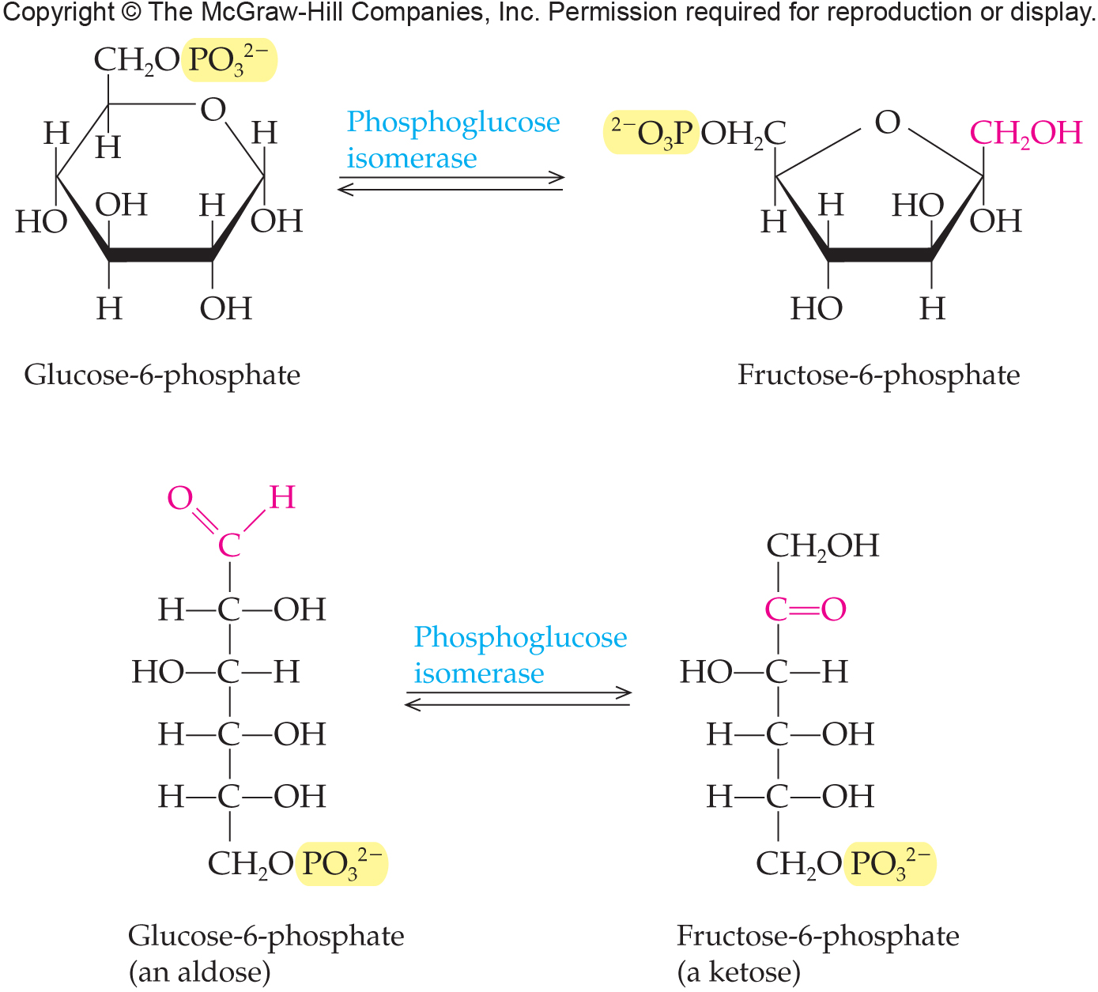
Glycolysis: Reaction 2
21.3 Glycolysis

Slide 22
Glycolysis Reaction 3
Reaction 3
Substrate fructose-6-phosphate is phosphorylated by phosphofructokinase
Product is fructose-1,6-bisphosphate
Source of the phosphoryl group is ATP
Again the expenditure of ATP early in the pathway works as energy “debt” necessary to get the pathway started
21.3 Glycolysis

Slide 23
Glycolysis: Reaction 3
21.3 Glycolysis

Slide 24
Glycolysis Reaction 4
Reaction 4
Product of reaction 3 is split into two 3-carbon intermediates by the enzyme aldolase forming:
Glyceraldehyde-3-phosphate (G3P)
substrate of next reaction
Dihydroxyacetone phosphate (DHAP)
21.3 Glycolysis

Slide 25
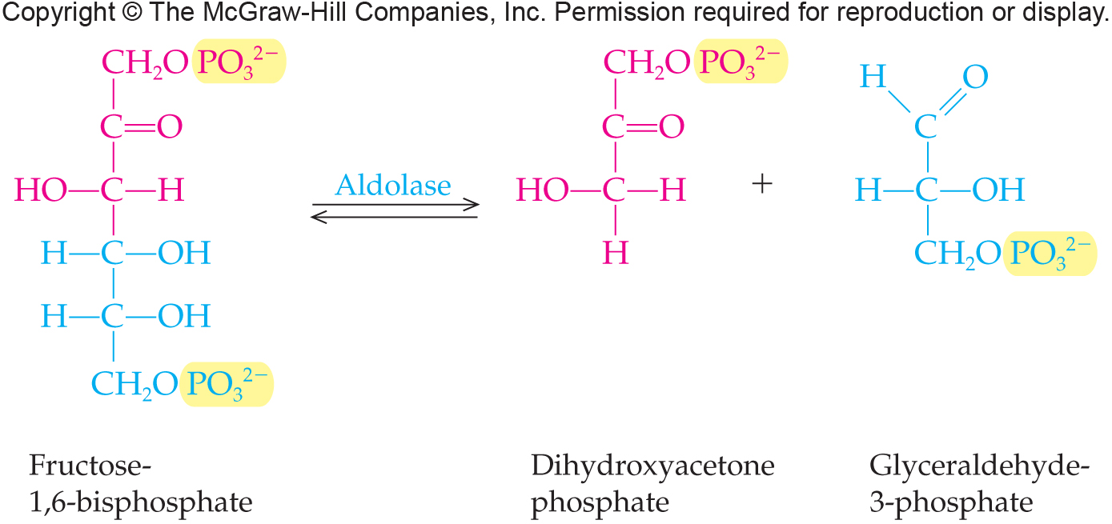
Glycolysis: Reaction 4
21.3 Glycolysis

Slide 26
Glycolysis Reaction 5
Reaction 5
Dihydroxyacetone phosphate (DHAP) is rearranged into a second glyceraldehyde-3-phosphate (G3P) by the enzyme triose phosphate isomerase
Glyceraldehyde-3-phosphate (G3P) is the only substrate for the next reaction
21.3 Glycolysis

Slide 27
Glycolysis: Reaction 5
21.3 Glycolysis

Slide 28
Glycolysis Reaction 6
Reaction 6
Substrate glyceraldehyde-3-phosphate (G3P) is oxidized to a carboxylic acid by glyceraldehyde-3-phosphate dehydrogenase
Reduces NAD⁺ to NADH
Transfers an inorganic phosphate group to the carboxyl group
First step in glycolysis to “harvest” energy
Product is 1,3-Bisphosphoglycerate
New phosphate group attached with a “high-energy” bond
This and all subsequent steps occur twice for each G-3-P
21.3 Glycolysis

Slide 29
Glycolysis: Reaction 6
21.3 Glycolysis

Slide 30
Glycolysis Reaction 7
Reaction 7
Harvest energy in the form of ATP
1,3-Bisphosphoglycerate high energy phosphate group is transferred to ADP by phosphoglycerate kinase:
3-Phosphoglycerate
ATP
This is the first substrate level phosphorylation of glycolysis
21.3 Glycolysis

Slide 31
Glycolysis: Reaction 7
21.3 Glycolysis

Slide 32
Glycolysis Reaction 8
Reaction 8
3-Phosphoglycerate is isomerized into 2-phosphoglycerate by the enzyme phosphoglycerate mutase
Moves the phosphate group from carbon-3 to carbon-2
21.3 Glycolysis

Slide 33
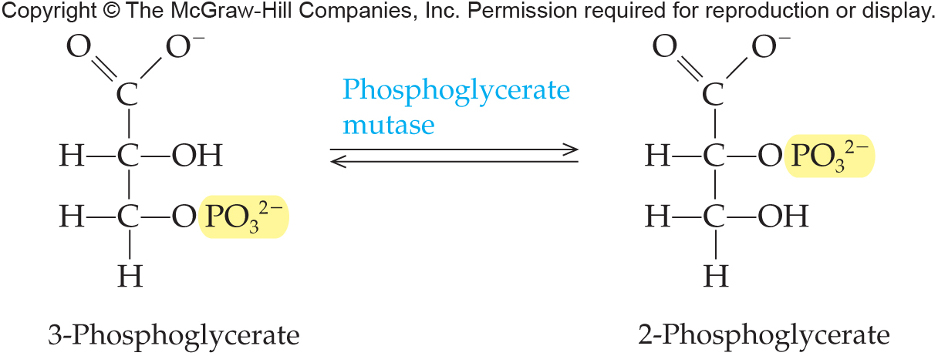
Glycolysis: Reaction 8
21.3 Glycolysis

Slide 34
Glycolysis Reaction 9
Reaction 9
The enzyme enolase catalyzes dehydration of 2-phospholgycerate
Phosphoenolpyruvate
Energy rich – highest energy phosphorylated compound in metabolism
21.3 Glycolysis

Slide 35
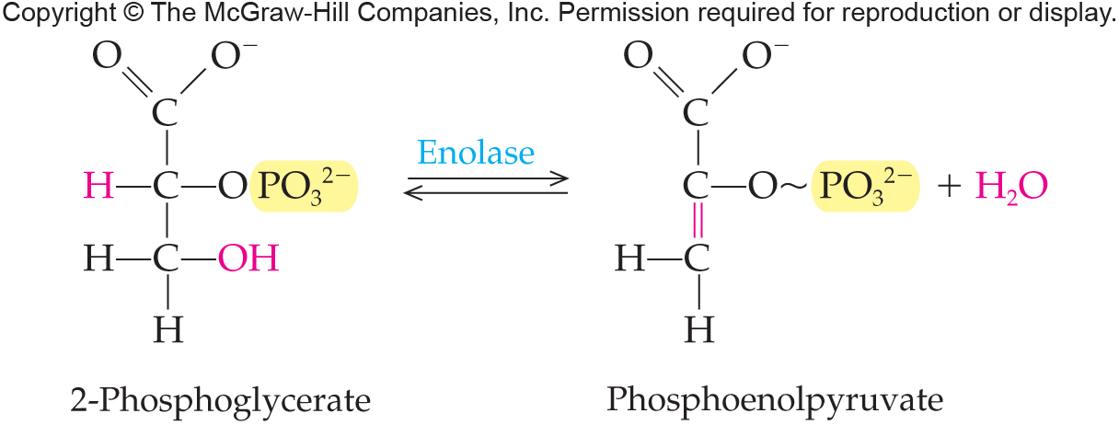
Glycolysis: Reaction 9
21.3 Glycolysis

Slide 36
Glycolysis Reaction 10
Reaction 10
Final substrate-level dehydration in the pathway
Phosphoenolpyruvate serves as donor of the phosphoryl group transferred to ADP by pyruvate kinase making ATP and releasing water
Pyruvate is the final product of glycolysis
A coupled reaction in which hydrolysis of the phosphoester bond provides energy for the formation of the phosphoanhydride bond of ATP
21.3 Glycolysis

Slide 37
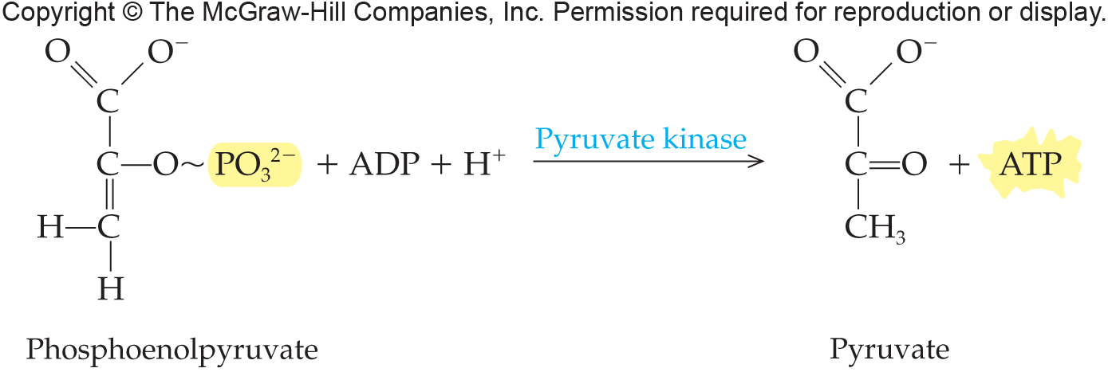
Glycolysis: Reaction 10
21.3 Glycolysis

Slide 38
Fructose Enters Glycolysis
Depending on the tissue, fructose enters glycolysis in different ways.
In muscle tissue there is abundant hexokinase that will phosphorylate the fructose to fructose-6-phosphate, which directly enters glycolysis.
21.3 Glycolysis

Slide 39
Fructose Conversion to G3P
In the liver, there is abundant fructokinase.
This will phosphorylate fructose into fructose-1-phosphate.
That product is cleaved into dihydroxyacetone phosphate (DHAP) and glyceraldehyde by the enzyme fructose-1-phosphate aldolase.
The glyceraldehyde is phosphorylated into glyceraldehyde-3-phosphate with enters into glycolysis along with DHAP.
21.3 Glycolysis

Slide 40
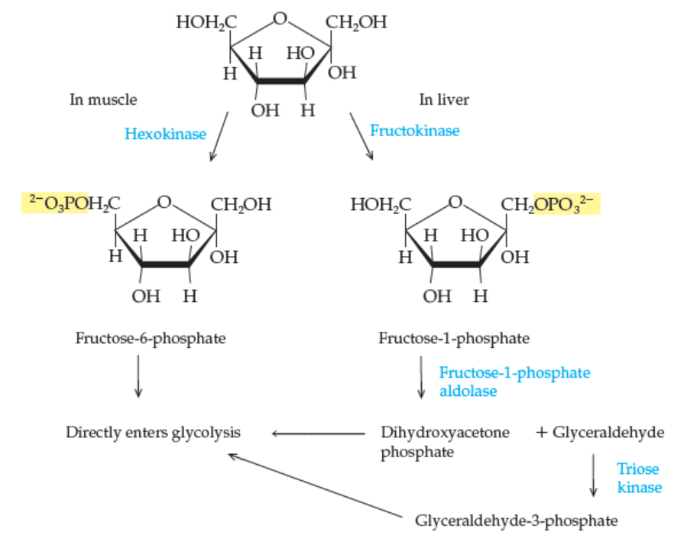
Entry of Fructose into Glycolysis
21.3 Glycolysis
Copyright © 2017 McGraw-Hill Education. Permission required for reproduction or display

Slide 41
Regulation of Glycolysis
5
Enzyme | Activator | Inhibitor
Hexokinase (Step 1) |  | Glucose-6-phosphate ATP
PFK (Step 3) | Fructose-2,6-bisphosphate AMP | Citrate ATP
Pyruvate kinase (Step 10) | Fructose-1,6-bisphosphate AMP | Acetyl-CoA ATP
21.3 Glycolysis
These enzymes are allosterically regulated

Slide 42
21.4 Fermentation
6
From glycolysis, pyruvate remains for further degradation and NADH must be reoxidized
In aerobic conditions, both will occur in cellular respiration
Under anaerobic conditions, fermentation reactions accomplish this
Fermentation reactions are catabolic reactions occurring with no net oxidation
Major fermentation pathways:
Lactate fermentation
Alcohol fermentation

Slide 43
Lactate Fermentation
Lactate fermentation is the anaerobic metabolism that occurs in exercising muscle
Bacteria also use lactate fermentation
Production of yogurt and cheese
This reaction produces NAD⁺ and degrades pyruvate
21.4 Fermentation

Slide 44
Alcohol Fermentation
Yeast ferment sugars of fruit and grains anaerobically, using pyruvate from glycolysis
Pyruvate decarboxylase removes CO₂ from the pyruvate producing ethanal (acetaldehyde)
Alcohol dehydrogenase catalyzes reduction of ethanal to ethanol, releasing NADH in the process
21.4 Fermentation
Copyright © 2017 McGraw-Hill Education. Permission required for reproduction or display

Slide 45
21.5 Pentose Phosphate Pathway
7
The Pentose Phosphate Pathway is an alternative to glycolysis for glucose oxidation
Stage 1, the oxidative stage, NADPH for biosynthesis is produced
Stage 2, three ribulose-5-phosphate result
Stage 3, ribose-5-phosphate and two xylulose-5-phosphate are produced along with two fructose-6-phosphate and glyceraldehyde-3-phosphate
The nonoxidative stages produce sugars with from 3 to 7 carbons
The ribose sugar is critical for nucleic acid synthesis

Slide 46
Major Stages of the Pentose Phosphate Pathway
21.5 The Pentose Phosphate Pathway

Slide 47
21.6 Gluconeogenesis: The Synthesis of Glucose
8
Gluconeogenesis makes glucose from noncarbohydrate starting materials
Lactate
Glycerol
Most amino acids (not leucine, lysine)
Glycerol and amino acids are used only in starvation conditions
Process occurs primarily in the liver

Slide 48
Comparison of Glycolysis and Gluconeogenesis
While basically opposite processes glycolysis and gluconeogenesis are not a simple reversal of each other
The three nonreversible steps of glycolysis must be bypassed with new routes
Pyruvate → Phosphoenolpyruvate
Fructose-1,6-bisphosphate → Fructose-6-phosphate
Glucose-6-phosphate → Glucose
21.6 Gluconeogenesis

Slide 49
Comparison of Glycolysis and Gluconeogenesis
21.6 Gluconeogenesis

Slide 50
Gluconeogenesis Regulation
Step 3 of glycolysis:
Catalyzed by phosphofructokinase
Stimulated by: high AMP, ADP, P_{i}
Inhibited by: high ATP
Reverse occurs in gluconeogenesis:
Fructose-1,6-bisphosphatase stimulated by high ATP
At times of excess energy (high ATP) gluconeogenesis is favored
21.6 Gluconeogenesis

Slide 51
Cori Cycle
In the Cori cycle,
Lactate from skeletal muscle is transferred to the liver
Converted to pyruvate then glucose
This glucose can be returned to the muscle
21.6 Gluconeogenesis

Slide 52
21.7 Glycogen Synthesis and Degradation
9
Glucose is the sole source of energy for mammalian red blood cells and the major source for brain
It is supplied:
In the diet
Via glycogenolysis
By gluconeogenesis

Slide 53
Structure of Glycogen
Glycogen is a highly branched α(1→4) and α(1→6) polymer of glucose
Exists as granules found in cytoplasm of liver and muscle cells
21.7 Glycogen Synthesis and Degradation

Slide 54
Glycogenolysis
Glycogen degradation is controlled by:
Glucagon
Pancreas responds to low blood sugar
Epinephrine
Adrenal gland to stress/threat
Step 1: Glycogen phosphorylase catalyzes removal of an end glucose as glucose-1-phosphate
Step 2: Debranching enzyme catalyzes removal of the last glucose at an α(1→6) branch as glucose
Step 3: Phosphoglucomutase converts glucose-1-phosphate to glucose-6-phosphate
21.7 Glycogen Synthesis and Degradation

Slide 55
Action of Glycogen Phosphorylase
21.7 Glycogen Synthesis and Degradation

Slide 56
Action of Debranching Enzyme
21.7 Glycogen Synthesis and Degradation

Slide 57
Action of Phosphoglucomutase
21.7 Glycogen Synthesis and Degradation

Slide 58
Glycogenesis: Glycogen Synthesis
Insulin stimulates synthesis of glycogen
glucose + ATP glucose-6-P + ADP + H⁺
Enzyme: glucokinase
glucose-6-P glucose-1-P
Enzyme: phosphoglucomutase
Glucose must be activated to add to the growing glycogen chain
G-1-P + UTP UDP-glucose + PP_{i}
UDP-glucose adds to the growing glycogen
21.7 Glycogen Synthesis and Degradation

Slide 59
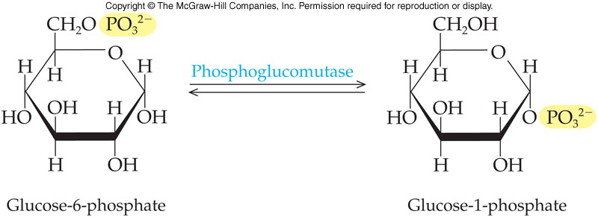
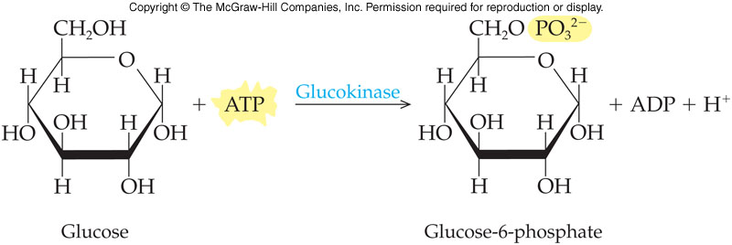
Reactions of Glycogenesis
21.7 Glycogen Synthesis and Degradation

Slide 60
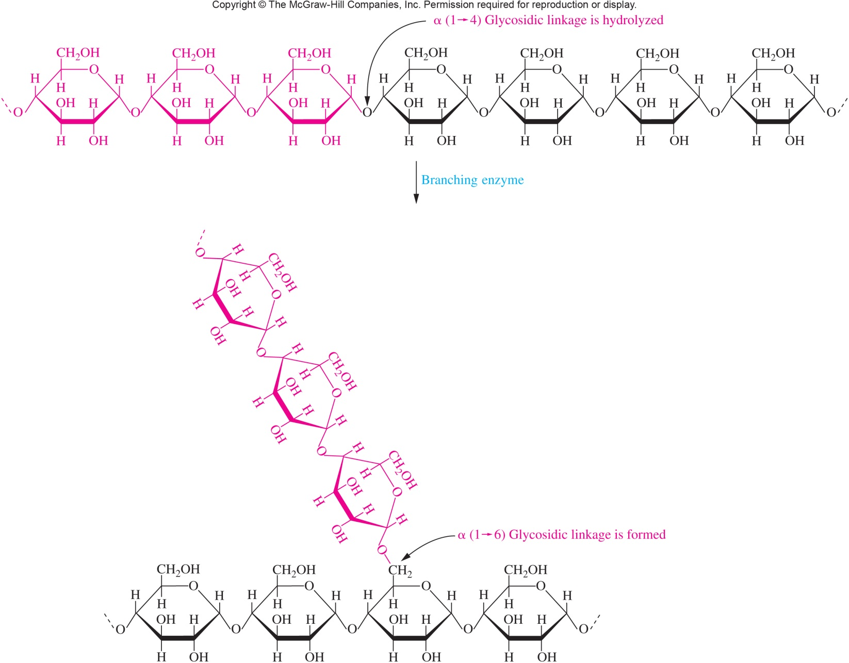
Action of Branching Enzyme
21.7 Glycogen Synthesis and Degradation

Slide 61
Glycogenesis vs Glycogenolysis
High blood sugar (hyperglycemia)
Insulin: stimulates glucose uptake
elevates glucokinase
activates glycogen synthetase
inhibits glycogen phosphorylase
Low blood sugar (hypoglycemia)
Glucagon: stimulates glycogen phosphorylase
Inhibits glycogen synthetase
Thus, glycogen synthesis and degradation do not compete
21.7 Glycogen Synthesis and Degradation

Slide 62
Opposing Effects of Insulin and Glucagon on Glycogen Metabolism
21.7 Glycogen Synthesis and Degradation

