Slide 1
Biochemistry
19
Enzymes
General, Organic, and Biochemistry
9th Edition
Katherine J. Denniston
Joseph J. Topping
Danaè R. Quirk Dorr
Robert L. Caret
Copyright © 2017 McGraw-Hill Education. Permission required for reproduction or display

Slide 2
19.1 Nomenclature and Classification
1
Enzymes are often classified by placing them in categories according to the reactions that they catalyze:
  Oxidoreductase
  Transferase
  Hydrolase
  Lyase
  Isomerase
  Ligase

Slide 3
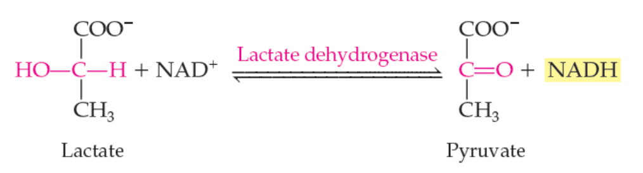
Oxidoreductases
Oxidoreductases catalyze redox reactions
  Reductases
  Oxidases
19.1 Nomenclature and Classification
Copyright © 2017 McGraw-Hill Education. Permission required for reproduction or display

Slide 4
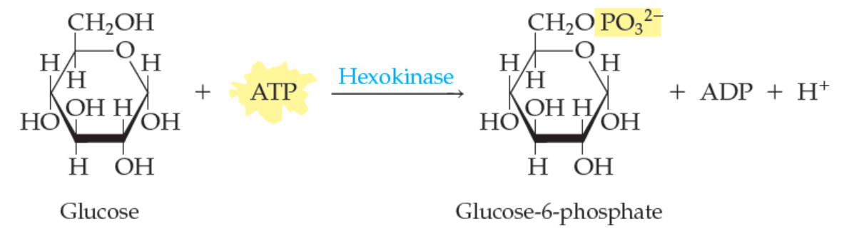
Transferases
Transferases transfer a group from one molecule to another
  Transaminases catalyze transfer of an amino group
  Transmethylase catalyzes the transfer of a methyl group
  Kinases transfer a phosphoryl group
19.1 Nomenclature and Classification
Copyright © 2017 McGraw-Hill Education. Permission required for reproduction or display

Slide 5
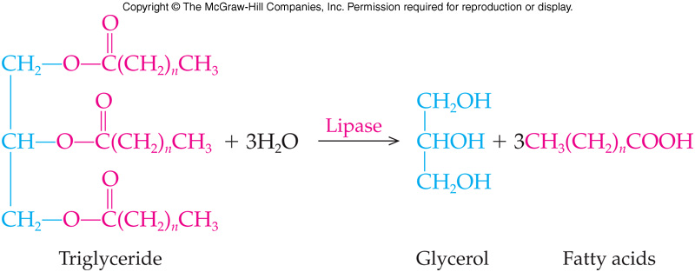
Hydrolases
Hydrolases cleave bonds by adding water
  Phosphatases
  Peptidases
  Lipases
  Glycosidases (example: amylase)
19.1 Nomenclature and Classification

Slide 6
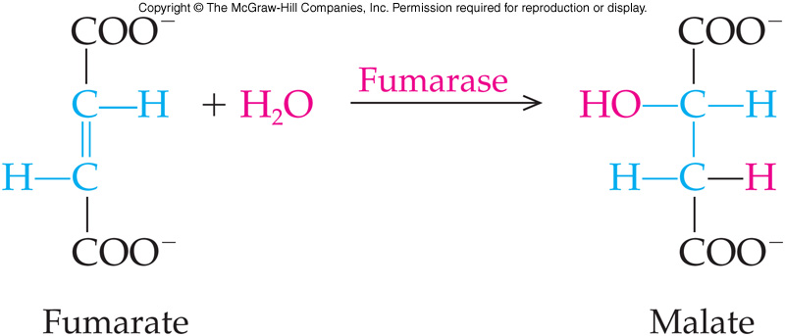
Lyases
Lyases catalyze removal of groups to form double bonds or the reverse break double bonds
  Decarboxylases
  Synthases
19.1 Nomenclature and Classification

Slide 7
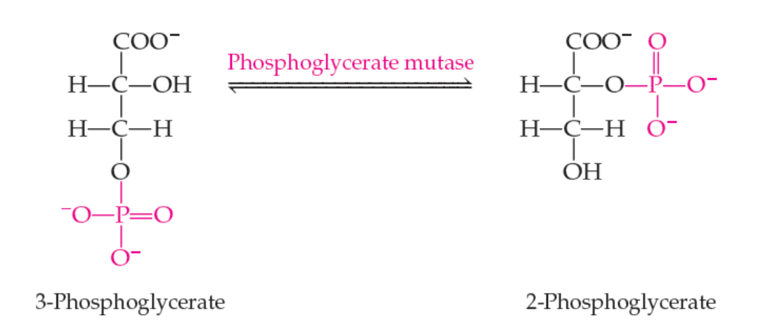
Isomeraes
Isomerases catalyze intramolecular rearrangements
  Epimerases
  Mutases
19.1 Nomenclature and Classification
Copyright © 2017 McGraw-Hill Education. Permission required for reproduction or display

Slide 8
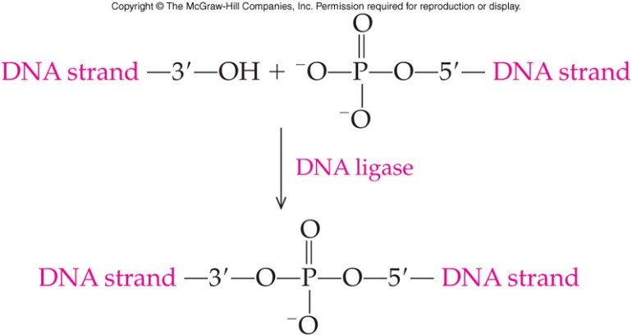
Ligases
Ligases catalyze a reaction in which a C-C, C-S, C-O, or C-N bond is made or broken
19.1 Nomenclature and Classification

Slide 9
Nomenclature of Enzymes
2
In most cases, enzyme names end in –ase
The common name for a hydrolase is derived from the substrate
  Urea: remove -a, replace with -ase = urease
  Lactose: remove -ose, replace with -ase = lactase
19.1 Nomenclature and Classification

Slide 10
Examples of Enzymes
Other enzymes are named for the substrate and the reaction catalyzed
  Lactate dehydrogenase
  Pyruvate decarboxylase
Some names are historical - no direct relationship to substrate or reaction type
  Catalase
  Pepsin
  Chymotrypsin
  Trypsin
2
19.1 Nomenclature and Classification

Slide 11

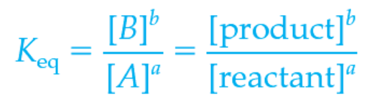
19.2 The Effect of Enzymes on the Activation Energy of a Reaction
3
An enzyme speeds a reaction by lowering the activation energy, changing the reaction pathway
  This provides a lower energy route for conversion of substrate to product
Every chemical reaction is characterized by an equilibrium constant, K_{eq}, which is a reflection of the difference in energy between reactants, aA, and products, bB
Copyright © 2017 McGraw-Hill Education. Permission required for reproduction or display

Slide 12
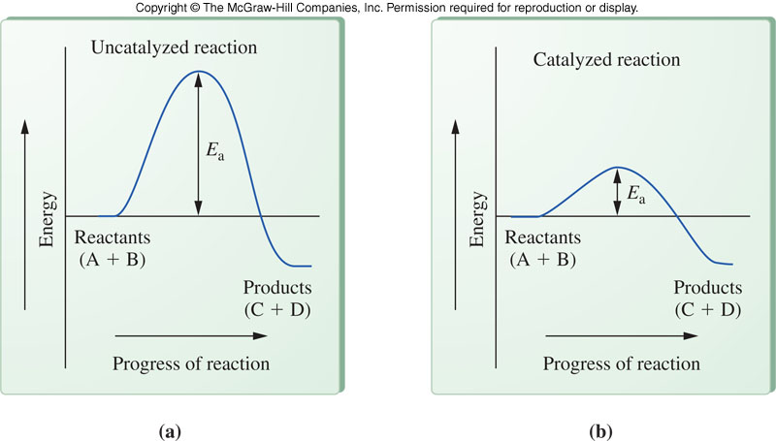
Diagram of Energy Difference Between Reactants and Products
19.2 Effect of Enzymes on Activation Energy
The uncatalyzed reaction has a large activation energy, E_{a}, seen at left above
In the catalyzed reaction, above right, the activation energy has been lowered significantly increasing the rate of the reaction

Slide 13
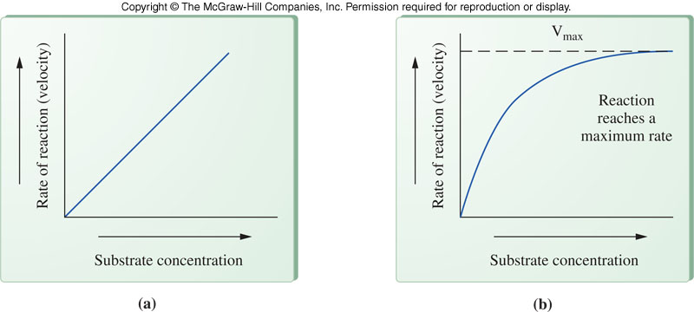
19.3 The Effect of Substrate Concentration on Enzyme-Catalyzed Reactions
Rates of uncatalyzed reactions increase as the substrate concentration increases
Rates of enzyme-catalyzed reactions show two stages
  The first stage is the formation of an enzyme-substrate complex
  This is followed by slow conversion of substrate into product
  Rate is limited by enzyme availability
Uncatalyzed Enzyme-Catalyzed
Reaction Reaction
4

Slide 14
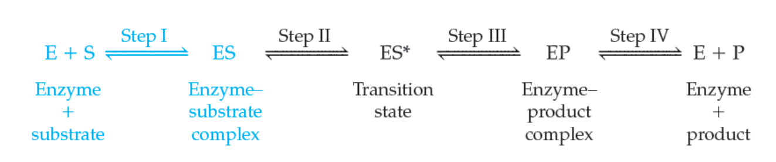
19.4 The Enzyme-Substrate Complex
These reversible reaction steps represent the steps in an enzyme catalyzed reaction
  The first step involves formation of an enzyme-substrate complex, E-S
  E-S* is the transition state
  E-P is the enzyme-product complex
4
Copyright © 2017 McGraw-Hill Education. Permission required for reproduction or display

Slide 15
Enzyme-Substrate Complex Details
The part of the enzyme combining with the substrate is the active site
Active sites characteristics include:
  Pockets or clefts in the surface of the enzyme
    R groups at active site are called catalytic groups
  Shape of active site is complimentary to the shape of the substrate
  The enzyme attracts and holds the enzyme using weak noncovalent interactions
  Conformation of the active site determines the specificity of the enzyme
19.4 The Enzyme-Substrate Complex

Slide 16
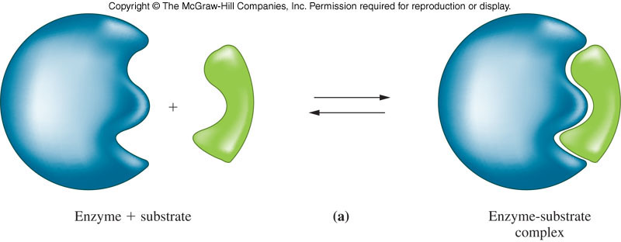
Lock and Key Enzyme Model
In the lock-and-key model, the enzyme is assumed to be the lock and the substrate the key
  The enzyme and substrate are made to fit exactly
  This model fails to take into account proteins conformational changes to accommodate a substrate molecule
19.4 The Enzyme-Substrate Complex

Slide 17
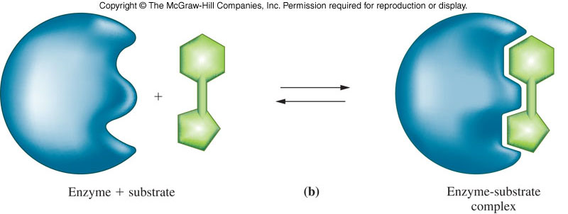
Induced Fit Enzyme Model
The induced-fit model of enzyme action assumes that the enzyme active site is more a flexible pocket whose conformation changes to accommodate the substrate molecule
19.4 The Enzyme-Substrate Complex

Slide 18
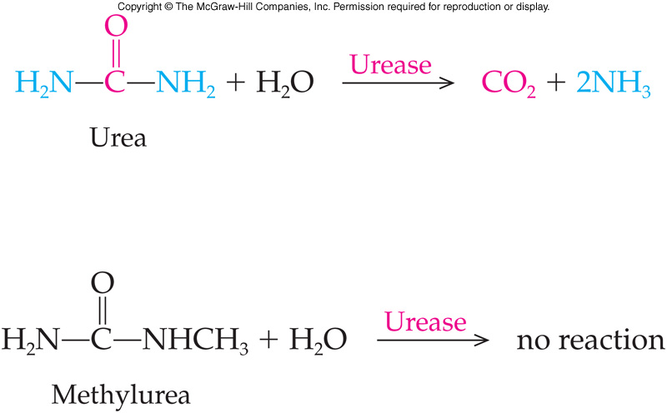
19.5 Specificity of the Enzyme-Substrate Complex
1
For enzyme and substrate to react, surfaces of each must be complementary
Enzyme specificity: the ability of an enzyme to bind only one, or a very few, substrates
  Urease is VERY specific or has a HIGH DEGREE of Specificity
5

Slide 19
Classes of Enzyme Specificity
Absolute: enzyme reacts with only one substrate
Group: enzyme catalyzes reaction involving any molecules with the same functional group
Linkage: enzyme catalyzes the formation or break up of only certain category or type of bond
Stereochemical: enzyme recognizes only one of two enantiomers
19.5 Specificity of the Enzyme-Substrate Complex

Slide 20
19.6 The Transition State and Product Formation
How does the enzyme promote a faster chemical reaction?
  As the substrate interacts with the enzyme, its shape changes and this new shape is less energetically stable
  This transition state has features of both substrate and product and falls apart to yield product, which dissociates from the enzyme
Copyright © 2017 McGraw-Hill Education. Permission required for reproduction or display

Slide 21
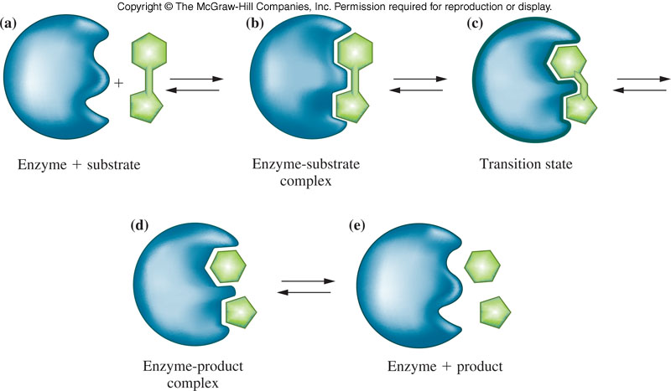
First Possible Transition State Change
The enzyme might put “stress” on a bond facilitating bond breakage
19.6 The Transition State and Product Formation

Slide 22
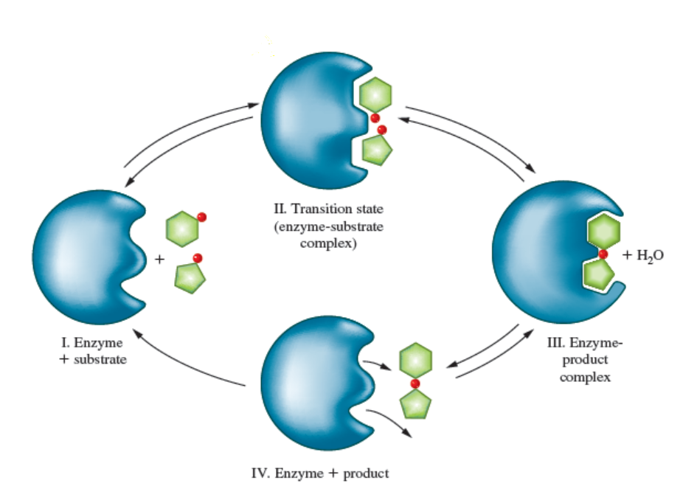
Second Possible Transition State Change
The enzyme brings two reactants close to one another and in proper orientation
Copyright © 2017 McGraw-Hill Education. Permission required for reproduction or display
19.6 The Transition State and Product Formation

Slide 23
Third Possible Transition State Change
The enzyme might modify the pH of the microenvironment, donating or accepting a H⁺
19.6 The Transition State and Product Formation

Slide 24
19.7 Cofactors and Coenzymes
Active enzyme / Holoenzyme:
  Polypeptide portion of enzyme (apoenzyme)
  Nonprotein prosthetic group (cofactor)
Cofactors are bound to the enzyme for it to maintain the correct configuration of the active site
  Organometallic compounds
  Metal ions
  Organic compounds
7

Slide 25
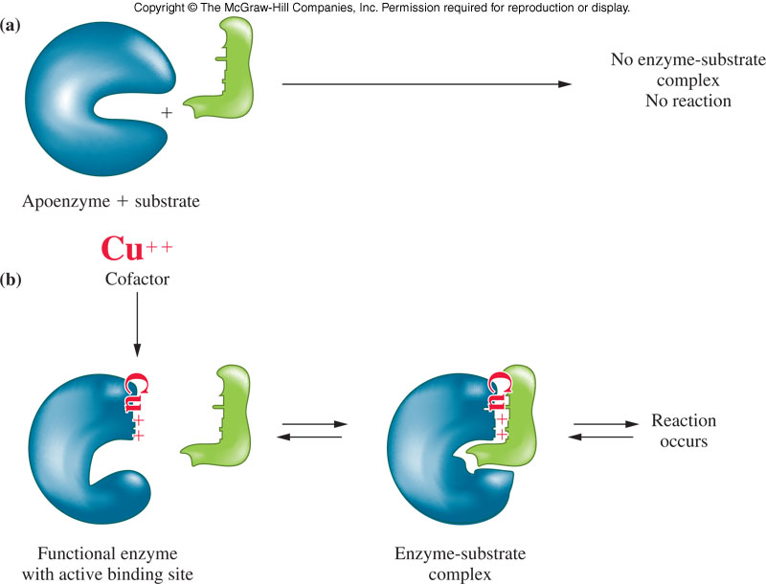
Representation of Apopenzyme and Cofactor
7
19.7 Cofactors and Coenzymes

Slide 26
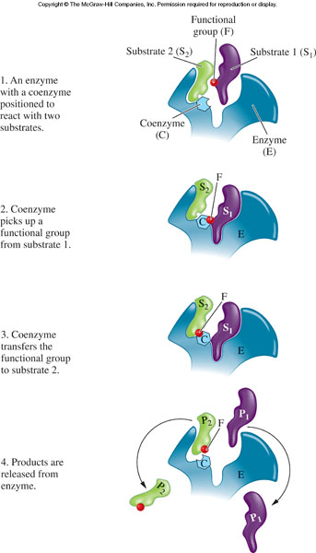
Coenzymes
A coenzyme is required by some enzymes
  An organic molecule bound to the enzyme by weak interactions / Hydrogen bonds
  Most coenzymes carry electrons or small groups
  Many have modified vitamins in their structure
19.7 Cofactors and Coenzymes

Slide 27
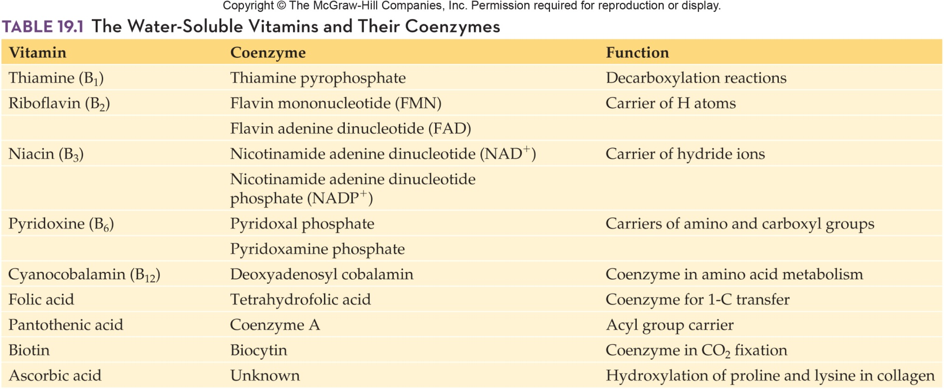
Water-Soluble Vitamins and Their Coenzymes
19.7 Cofactors and Coenzymes

Slide 28
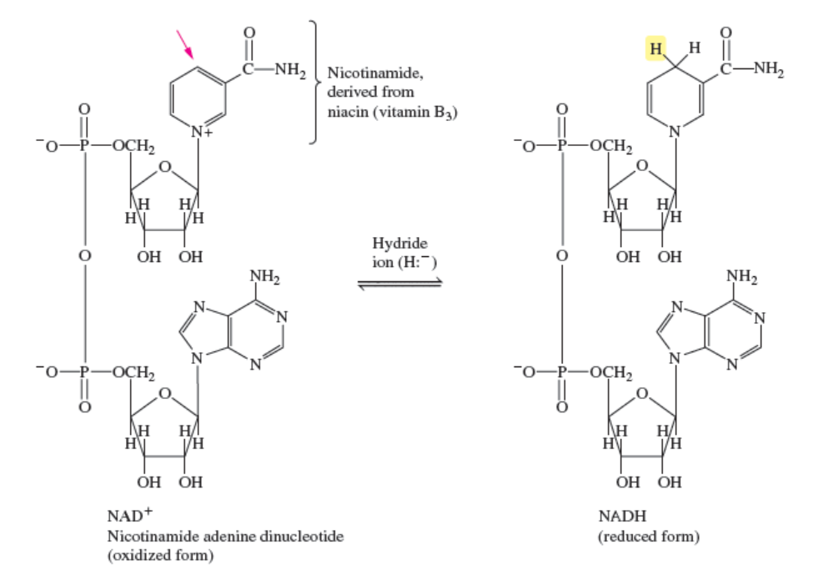
Nicotinamide Adenine Dinucleotide in Oxidized and Reduced Forms
19.7 Cofactors and Coenzymes
Copyright © 2017 McGraw-Hill Education. Permission required for reproduction or display

Slide 29
NAD⁺ to NADH Mechanism
The nicotinamide part of NAD⁺ accepts a hydride ion (H plus two electrons) from the alcohol to be oxidized
The alcohol loses a proton ( H⁺ ) to the solvent
19.7 Cofactors and Coenzymes

Slide 30
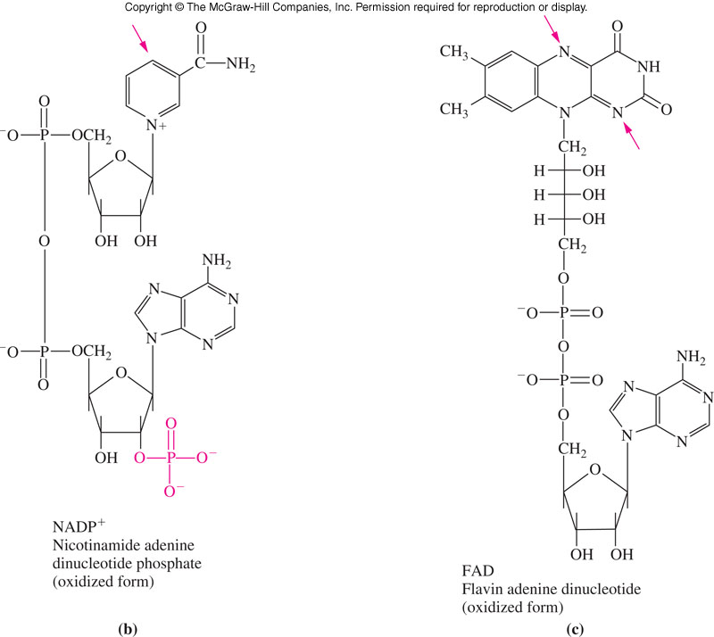
Two Other Adenine
Dinucleotide Coenzymes
19.7 Cofactors and Coenzymes

Slide 31
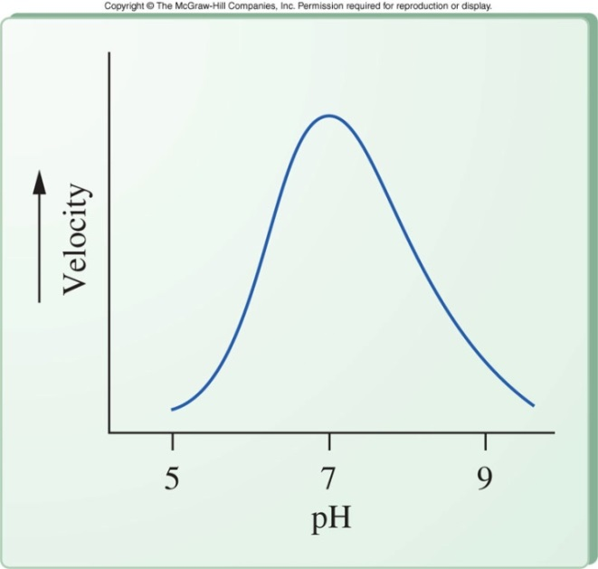
19.8 Environmental Effects
The environment surrounding an enzyme can have a direct effect on enzyme function
Enzymes work best within a particular range of pH
Extreme pH changes will denature the enzyme, destroying its catalytic ability
  Pepsin (stomach) has low optimum pH
  Ttrypsin (small intestine) has high optimum pH

Slide 32
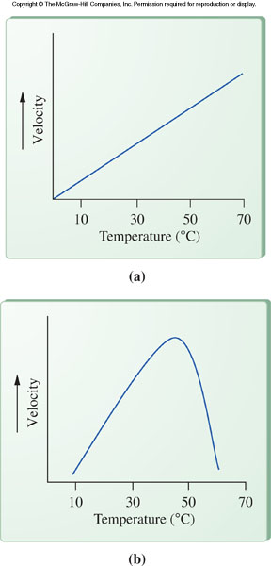
Temperature Effects
An enzyme has an optimum temperature associated with maximal function
The rate of an uncatalyzed reaction will increase proportionally with temperature increase
Optimum temperature is usually close to the temperature at which the enzyme typically exists
  37ºC for humans
Excessive heat can denature a enzyme making it completely nonfunctional
19.8 Environmental Effects

Slide 33
19.9 Regulation of Enzyme Activity
One of the major ways that enzymes differ from nonbiological catalysts is in the regulation of biological catalysts by cells
Some methods that organisms use to regulate enzyme activity are:
  Produce the enzyme only when the substrate is present – common in bacteria
  Allosteric enzymes
  Feedback inhibition
  Zymogens
  Protein modification
9

Slide 34
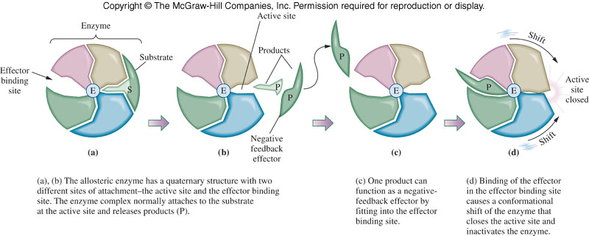
Allosteric Enzymes
Effector molecules change the activity of an enzyme by binding at a second site
  Positive allosterism - effector binding converts the active site to an active configuration
  Negative allosterism - effector binding converts the active site to an inactive configuration
19.9 Regulation of Enzyme Activity

Slide 35
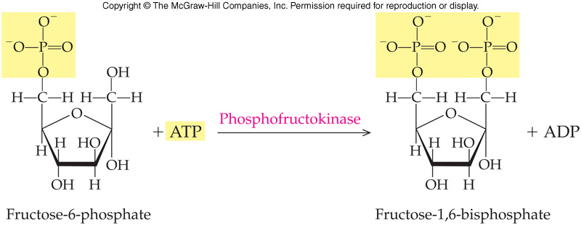
Allosteric Enzymes in Metabolism
The third reaction of glycolysis places a second phosphate on fructose-6-phosphate
ATP is a negative effector and AMP is a positive effector of the enzyme phosphofructokinase
19.9 Regulation of Enzyme Activity

Slide 36
Feedback Inhibition
Allosteric enzymes are the basis for feedback inhibition
With feedback inhibition, a product late in a series of enzyme-catalyzed reactions serves as an inhibitor for a previous allosteric enzyme earlier in the series
In this example, product F serves to inhibit the activity of enzyme E₁
  Product F acts as a negative allosteric effector on one of the early enzymes in the pathway
19.9 Regulation of Enzyme Activity

Slide 37
Proenzymes
A proenzyme, an enzyme made in an inactive form
It is converted to its active form
  By proteolysis (hydrolysis of the enzyme)
  When needed at the active site in the cell
    Pepsinogen is synthesized and transported to the stomach where it is converted to pepsin
19.9 Regulation of Enzyme Activity

Slide 38
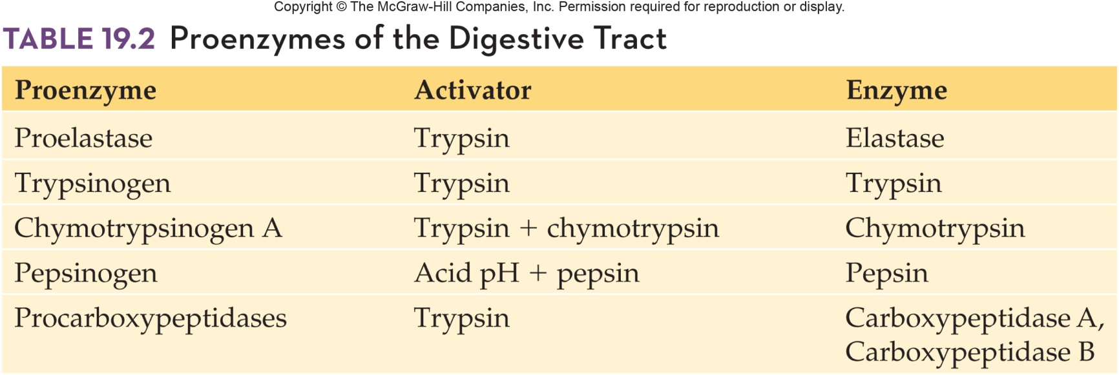
Proenzymes of the Digestive Tract
19.9 Regulation of Enzyme Activity

Slide 39
Protein Modification
In protein modification a chemical group is covalently added to or removed from the protein
  Covalent modification either activates or turns off the enzyme
The most common form of protein modification is addition or removal of a phosphate group
  This group is located at the R group (with a free –OH) of:
    Serine
    Threonine
    Tyrosine
19.9 Regulation of Enzyme Activity

Slide 40
19.10 Inhibition of Enzyme Activity
Chemicals can bind to enzymes and eliminate or drastically reduce catalytic activity
Classify enzyme inhibitors on the basis of reversibility and competition
  Irreversible inhibitors bind tightly to the enzyme and thereby prevent formation of the E-S complex
  Reversible competitive inhibitors often structurally resemble the substrate and bind at the normal active site
10

Slide 41
Irreversible Inhibitors
Irreversible enzyme inhibitors bind very tightly to the enzyme
  Binding of the inhibitor to one of the R groups of a amino acid in the active site
    This binding may block the active site binding groups so that the enzyme-substrate complex cannot form
    Alternatively, an inhibitor may interfere with the catalytic group of the active site eliminating catalysis
  Irreversible inhibitors include:
    Arsenic
    Snake venom
    Nerve gas
19.10 Inhibition of Enzyme Activity

Slide 42
Reversible, Competitive Inhibitors
Reversible, competitive enzyme inhibitors are also called structural analogs
  Molecules that resemble the structure and charge distribution of a natural substance for an enzyme
  Resemblance permits the inhibitor to occupy the enzyme active site
  Once inhibitor is at the active site, no reaction can occur and the enzyme activity is inhibited
Inhibition is competitive because the inhibitor and the substrate compete for binding to the active site
  Degree of inhibition depends on the relative concentrations of enzyme and inhibitor
19.10 Inhibition of Enzyme Activity

Slide 43
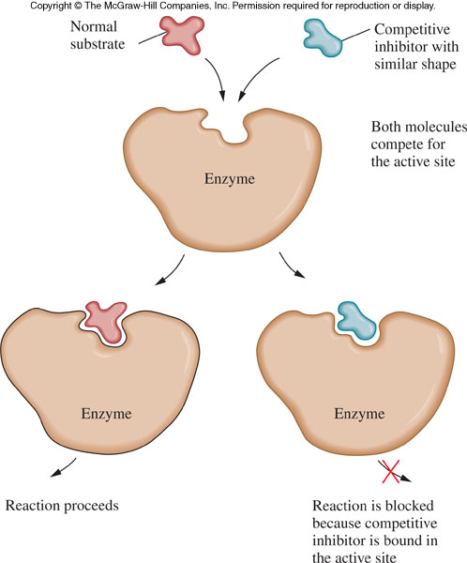
Representation of Reversible, Competitive Inhibitor
19.10 Inhibition of Enzyme Activity

Slide 44
19.11 Proteolytic Enzymes
Proteolytic enzymes cleave the peptide bond in proteins
  These enzymes break the peptide bonds that maintain the primary protein structure
These enzymes’ specificity depend on a hydrophobic pocket
  A cluster of hydrophobic amino acids brought together by the 3-D folding of the protein chain
11

Slide 45
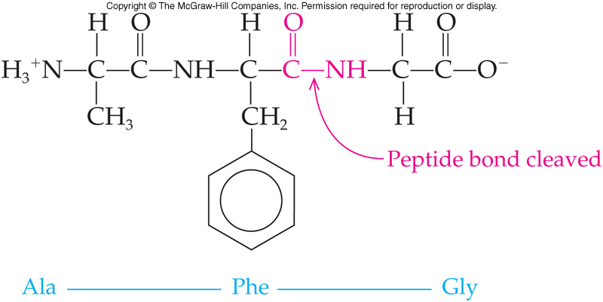
Chymotrypsin
Chymotrypsin cleaves the peptide bond at the carboxylic end of:
  Methionine
  Tyrosine
  Tryptophan
  Phenylalanine
11

Slide 46
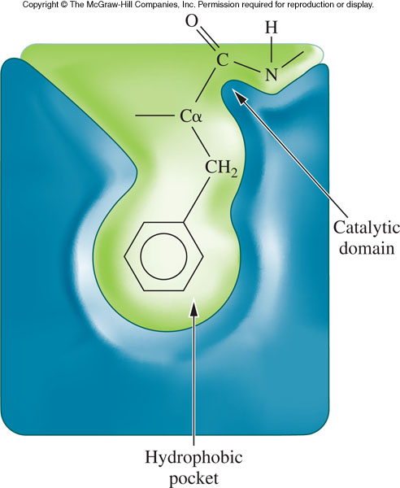
Specificity of the Proteolytic Enzyme, Chymotrypsin
19.11 Proteolytic Enzymes

Slide 47
Proteolytic Enzymes and Evolution
Pancreatic serine proteases are a category of enzymes which all hydrolyze peptide bonds
  Appear to have arisen through divergent evolution from a common ancestor
  Similar primary structures
  Similar tertiary structures
  Different specificities
Each enzyme has a different pocket to fit the specificity for the side chains of their substrates
  Different keys fit different locks
19.11 Proteolytic Enzymes

Slide 48
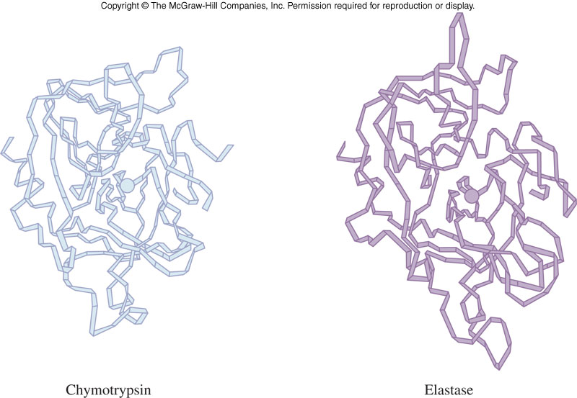
Proteolytic Enzyme Specificities
Chymotrypsin: cleaves peptide bonds on the carbonyl side of aromatic amino acids and large, hydrophobic amino acids
Trypsin: cleaves on the carbonyl side of basic amino acids
Elastase: cleaves on the carbonyl side of Gly and Ala
19.11 Proteolytic Enzymes

Slide 49
19.12 Uses of Enzymes in Medicine
Diagnostic – biomarker levels altered with disease
  Acute myocardial infarction:
    Creatine kinase - MB
    Myoglobin
    Troponin I
  Pancreatitis:
    Amylase
    Lipase

Slide 50
Other Uses of Enzymes in Medicine
Analytical reagents – enzyme used to
measure another substance
  Urea converted to NH₃ via urease
  Blood urea nitrogen (BUN) measured
Replacement therapy
  Administer genetically engineered β-glucocerebrosidase for Gaucher’s disease

