Slide 1
Biochemistry
18
Protein Structure and Function
General, Organic, and Biochemistry 9th Edition
Katherine J. Denniston
Joseph J. Topping
Danaè R. Quirk Dorr
Robert L. Caret
Copyright © 2017 McGraw-Hill Education. Permission required for reproduction or display

Slide 2
Biological Functions of Proteins
Protein means “of first importance”
Proteins play a crucial role in biological processes
Proteins are polymers of amino acids
Proteins have many important biological functions
Enzymes – biological catalysts
Antibodies – defense proteins
Transport proteins
Regulatory proteins
Structural proteins
Movement proteins
Nutrient Proteins
1

Slide 3
18.1 Protein Building Blocks: The α-Amino Acids
2
As the name implies, these compounds contains both an amine and an acid
Hundreds are formed both naturally and synthetically
20 are common in nature
All 20 are α-amino acids
Alpha means the amine is adjacent to the carboxylate group
19 out of the 20 are stereoisomers

Slide 4
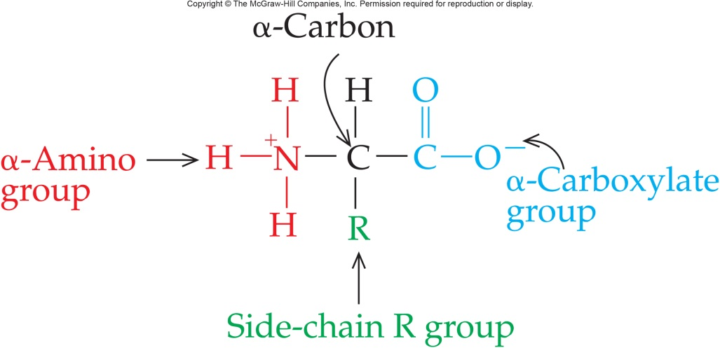
Amino Acids
Attach α-carbon to a:
Carboxylate group
Protonated amino group
At physiologic pH the amino acid has:
Carboxyl group in –COO⁻
Amino group in –NH₃⁺
Neutral molecule with equal number of + and – charges is a zwitterion
18.1 Protein Building Blocks

Slide 5
Zwitterions
Amino acids are white crystalline solids with high melting points and high water solubilities
The two charged groups, the basic amino group and the carboxylic acid, at the two ends lead to internal proton transfer – zwitterions
By changing the pH you can affect the net charge on the zwitterions
The pH point at which there is no net charge on the zwitterions is called the isoelectric point
18.1 Protein Building Blocks

Slide 6
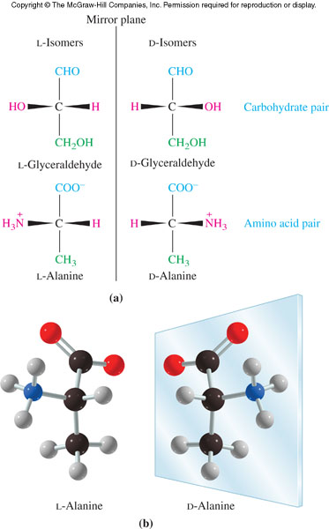
Stereoisomers of Amino Acids
The α-carbon of amino acids is chiral
Glycine is the only common amino acid that is not chiral
Amino acid configuration isolated from proteins is L-
Draw most oxidized end of the molecule, carbonyl, at the top
18.1 Protein Building Blocks

Slide 7
Classes of Amino Acids
All differences between amino acids depend upon their side-chain R groups
Some amino acids are hydrophobic
Hydrophilic amino acids can be subdivided:
Polar, neutral have a high affinity for water, but are not ionic at pH 7
Negatively charged have ionized carboxyl groups in their side chains
Positively charged are basic as the side chain reacts with water to release a hydroxide anion
18.1 Protein Building Blocks

Slide 8
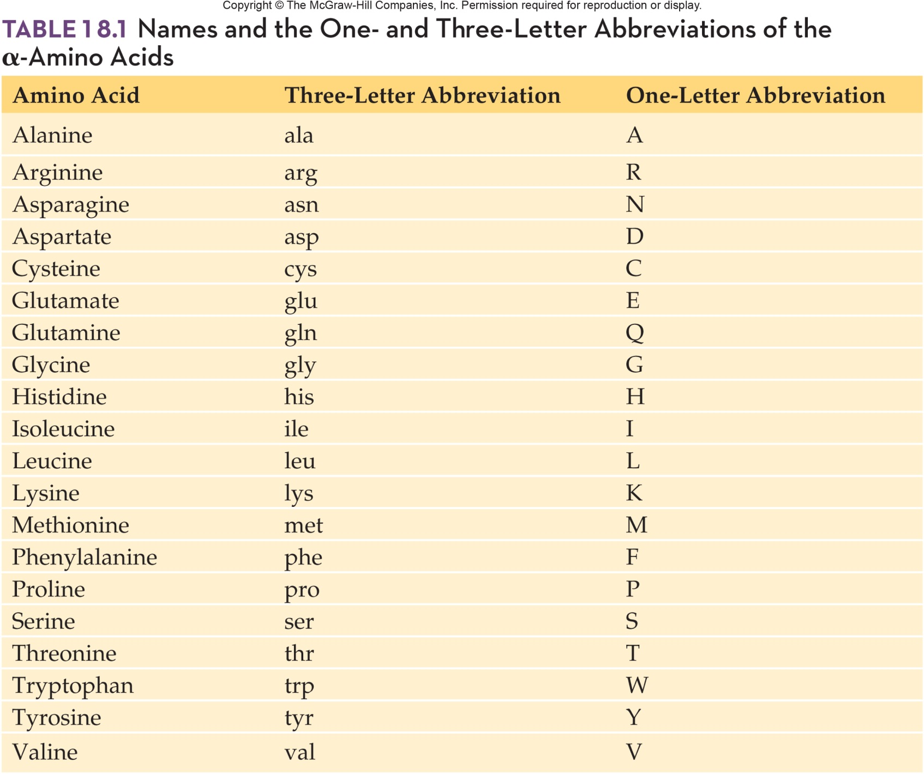
Names of Common Amino Acids
18.1 Protein Building Blocks

Slide 9
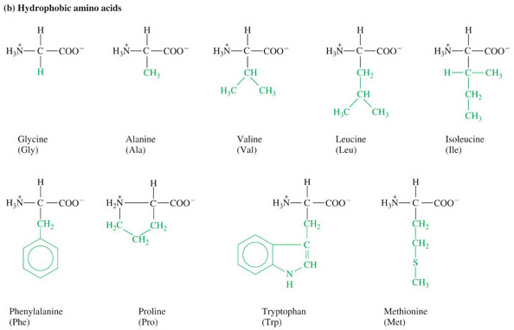
Hydrophobic Amino Acids

Slide 10
Polar Neutral Amino Acids

Slide 11
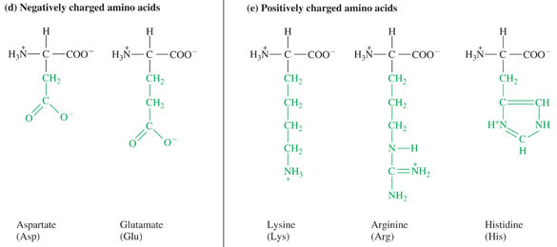
Charged Amino Acids

Slide 12
18.2 The Peptide Bond
Proteins are linear polymers of L-a-amino acids
Carboxyl group of one amino acid is linked to the amino group of another amino acid
Linkage is an amide bond or peptide linkage
This reaction is a dehydration reaction as water is released
3

Slide 13
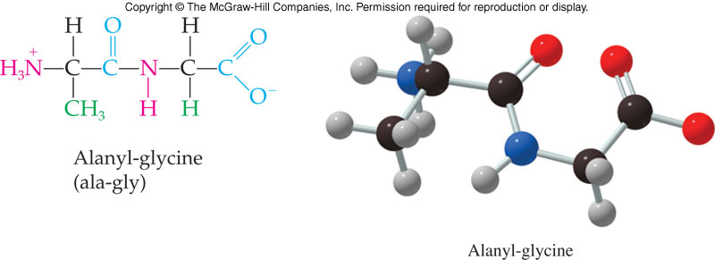
Dipeptides
Condensing or dehydrating two amino acids produces a dipeptide
Amino acid with a free α-NH₃⁺ group is the amino terminal amino acid, N-terminal for short
Amino acid with a free -COO⁻ group is the carboxyl terminal amino acid, C-terminal for short
Amino acid structures are written with the N-terminal on the left
18.2 The Peptide Bond

Slide 14
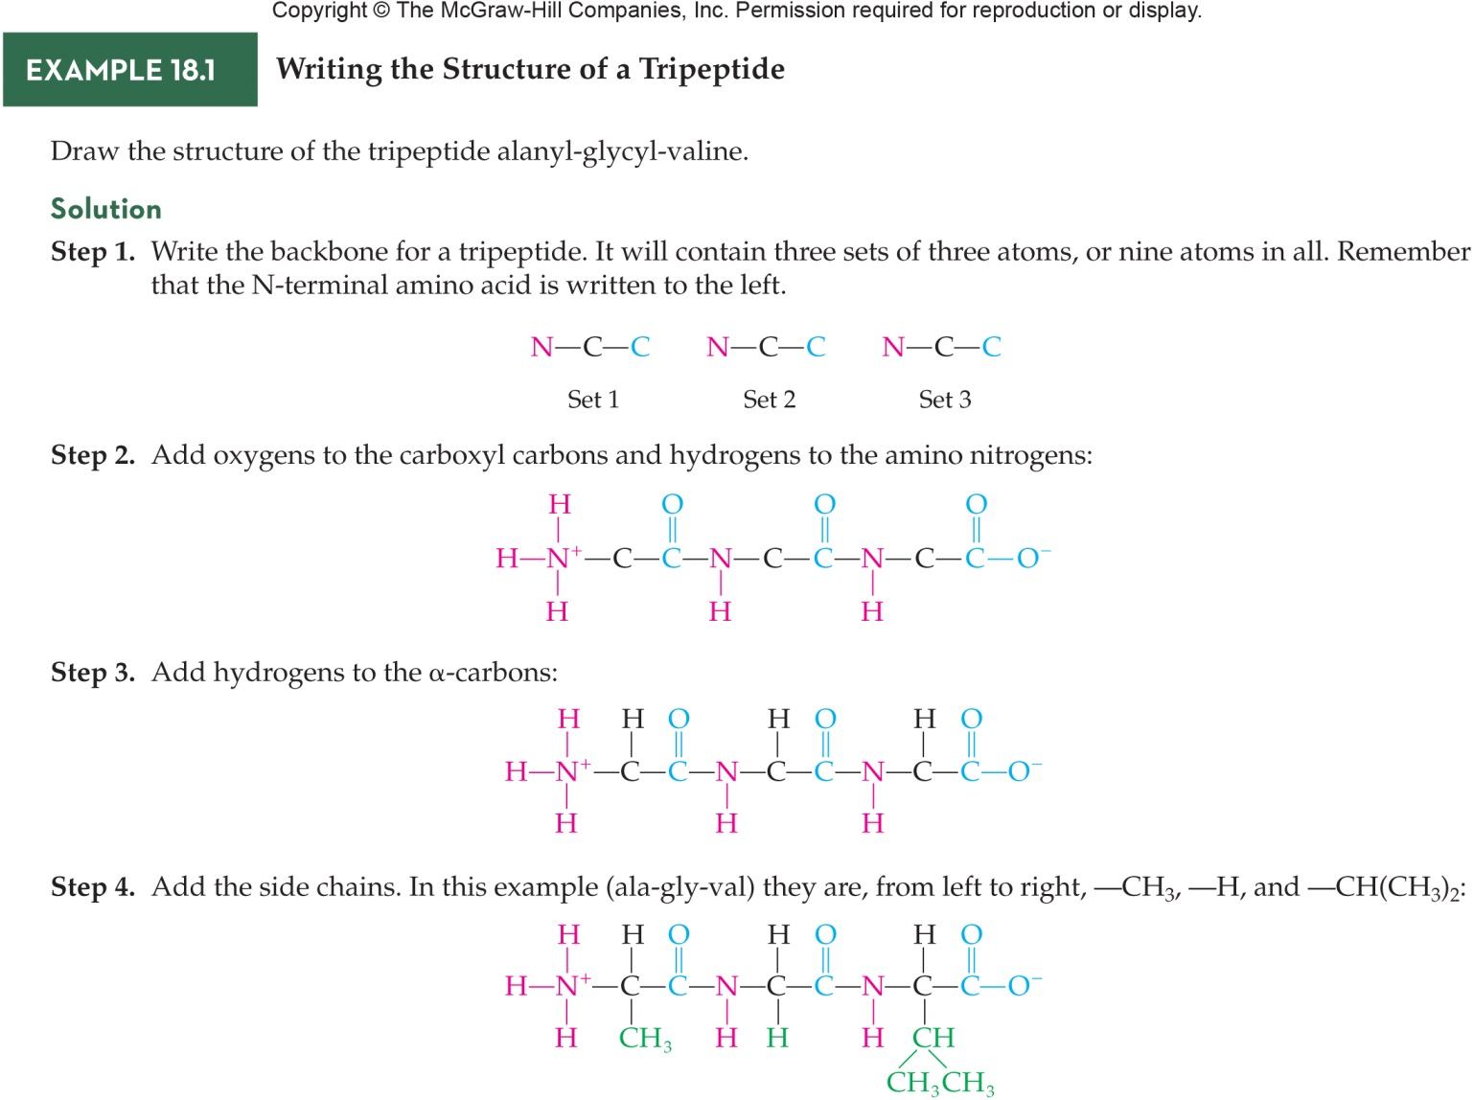
Writing the Structure of Peptides
4
18.2 The Peptide Bond

Slide 15
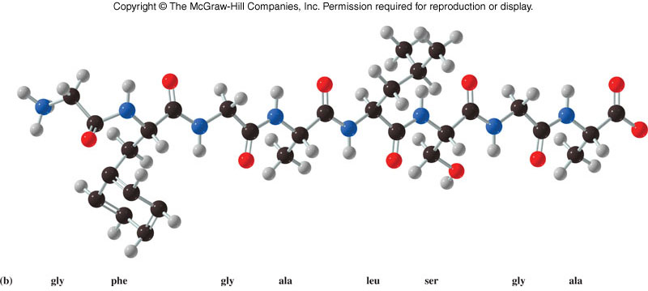
18.3 The Primary Structure of Proteins
4
Primary structure is the amino acid sequence of the polypeptide chain
A result of covalent bonding between the amino acids – the peptide bonds
Each protein has a different primary structure with different amino acids in different places along the chain

Slide 16
18.4 The Secondary Structure of Proteins
5
When the primary sequence of the polypeptide folds into regularly repeating structures, secondary structure is formed
Secondary structure results from hydrogen bonding between the amide hydrogens and carbonyl oxygens of the peptide bonds
Not all regions have a clearly defined secondary structure, some are random or nonregular
6

Slide 17
α-Helix
Most common type of secondary structure
Coiled, helical
Important features:
Each amide H and carbonyl O is involved in H bonds locking the helix in place
Carbonyl O links to amide H 4 amino acids away
H bonds are parallel to the long axis of the helix
Helix is right-handed
Repeat distance or pitch is 5.4 angstroms
3.6 amino acids per turn
18.4 The Secondary Structure of Proteins

Slide 18
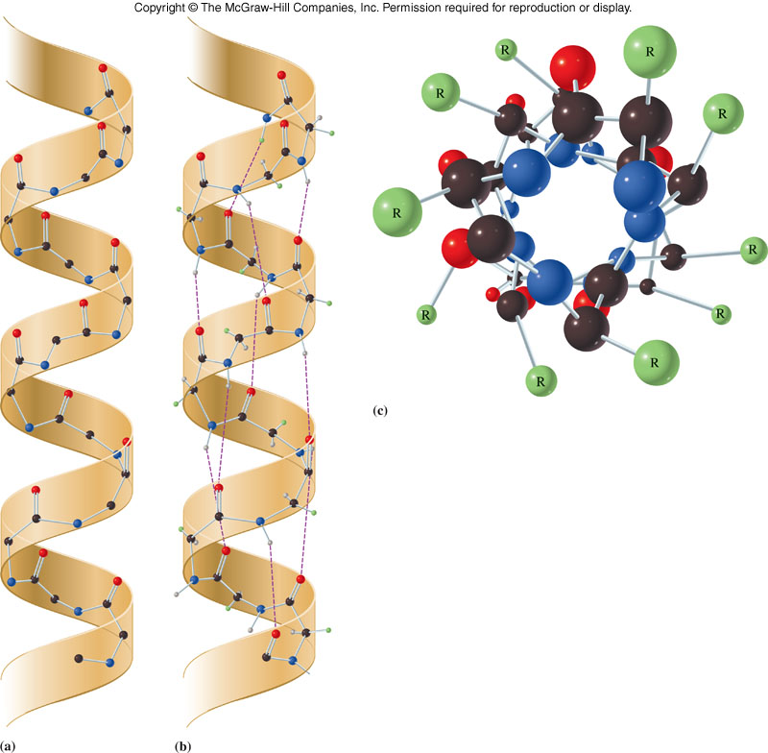
Representation of α-Helix Representation
18.4 The Secondary Structure of Proteins

Slide 19
α-Helices in Fibrils
7
Fibrous proteins are arranged in a secondary structure of fibers or sheets with only 1 type of secondary structure
Repeated coiling of helices
18.4 The Secondary Structure of Proteins

Slide 20
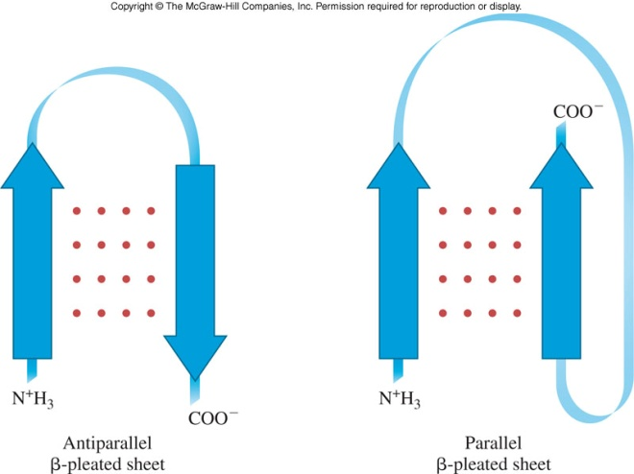
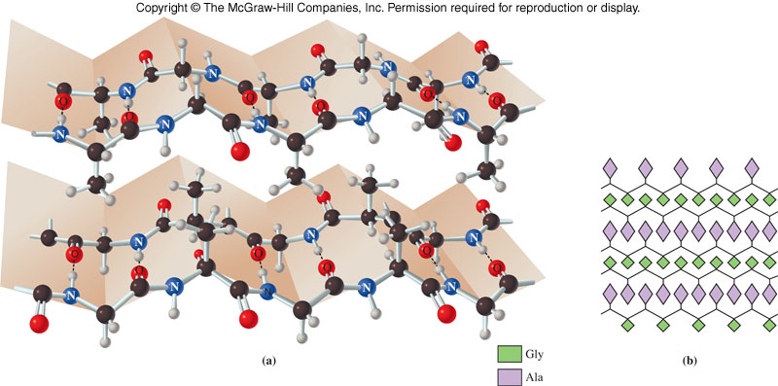
β-Pleated Sheet
Second most common secondary structure appears similar to folds of fabric
All of the carbonyl O and amide H are involved in the H bonds with the chain nearly completely extended
Two possible orientations
Parallel if the N-termini are head-to-head
Antiparallel if the N-terminus of one chain is aligned with the C-terminus of the other
7
18.4 The Secondary Structure of Proteins

Slide 21
18.5 Tertiary Structure
The three-dimensional structure of the entire peptide, which is distinct from secondary structure, is classified as tertiary structure
Globular tertiary structure forms spontaneously and is maintained by interactions among the side chains or R groups
Tertiary structure defines the biological function of proteins
8

Slide 22
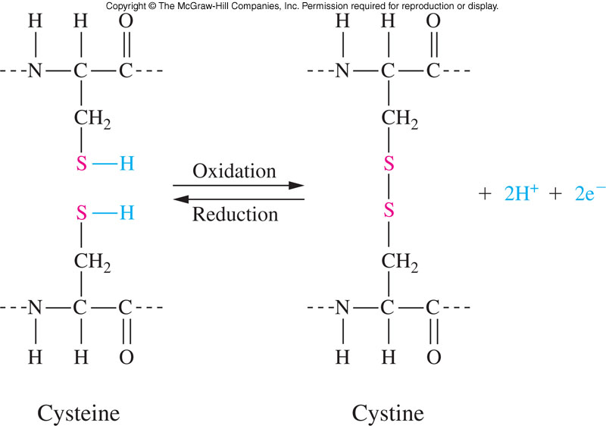
Types of Interactions Maintaining Tertiary Structure
Disulfide bridges between two cysteine residues
Salt bridges between ionic side chains -COO⁻ and -NH₃⁺
Hydrogen bonds between polar residue side chains
Hydrophobic interactions: two nonpolar groups are attracted by a mutual repulsion of water
9
18.5 The Tertiary Structure of Proteins

Slide 23
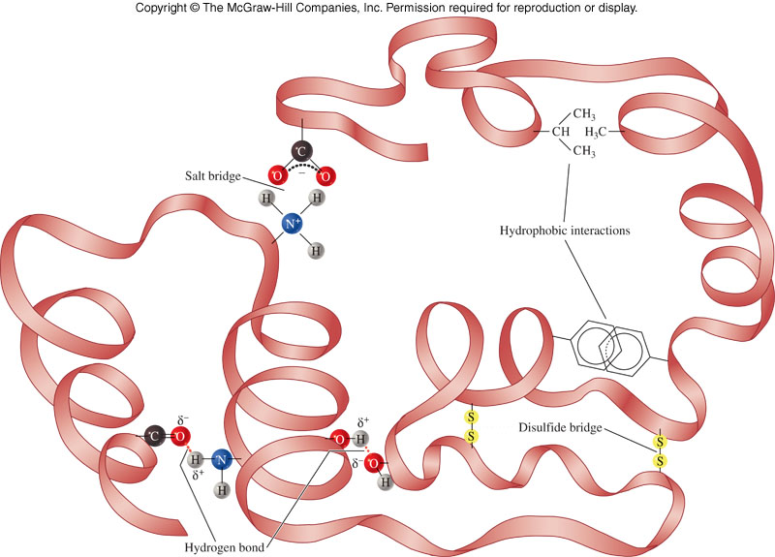
Interactions Involved in Tertiary Structure
18.5 The Tertiary Structure of Proteins

Slide 24
18.6 The Quaternary Structure of Proteins
The functional form of many proteins is not that of a single polypeptide chain, but actually an aggregate of several globular peptides
Quaternary structure: the arrangement of subunits or peptides that form a larger protein
Subunit: a polypeptide chain having primary, secondary, and tertiary structural features that is a part of a larger protein
Quaternary structure is maintained by the same forces which are active in maintaining tertiary structure
8

Slide 25
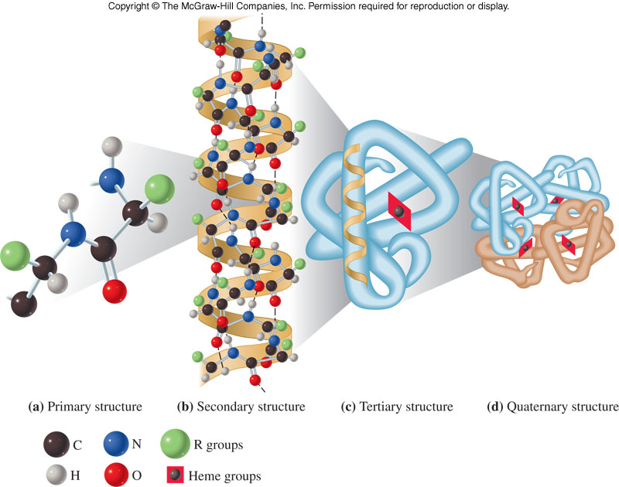
Hemoglobin Structure Demonstrating the Four Levels of Protein Structure
18.6 The Quaternary Structure of Proteins

Slide 26
Proteins Requiring Prosthetic Groups
10
Class | Prosthetic Group | Example
Nucleoprotein | Nucleic acids | Viruses
Lipoprotein | Lipids | Serum lipoproteins
Glycoprotein | Carbohydrates | Mucin in saliva
Phosphoprotein | Phosphate groups | Casein in milk
Hemoprotein | Heme | Hemoglobin, cytochormes
Metalloprotein | Iron, zinc | Ferritin, hemoglobin

Slide 27
18.7 An Overview of Protein Structure and Function
Types of Protein Structure and Their Interrelationships
Primary structure:
Amino acid sequence
Results from formation of covalent peptide bonds between amino acids
Secondary structure:
Includes α-helix and β-sheet
Hydrogen bonding between amide hydrogens and carbonyl oxygens of the peptide bonds
11

Slide 28
Types of Protein Structure and Their Interrelationships - continued
Tertiary structure:
Overall folding of the entire polypeptide chain
Interactions between different amino acid side chains
Quaternary structure:
Concerned with topological, spatial arrangement of two or more polypeptide chains
Involves both disulfide bridges and noncovalent interactions
18.7 An Overview of Protein Structure and Function

Slide 29
Protein Functions Follow Shape
Fibrous proteins:
Mechanical strength
Structural components
Movement
Globular proteins:
Transport
Regulatory
Enzymes
18.7 An Overview of Protein Structure and Function

Slide 30
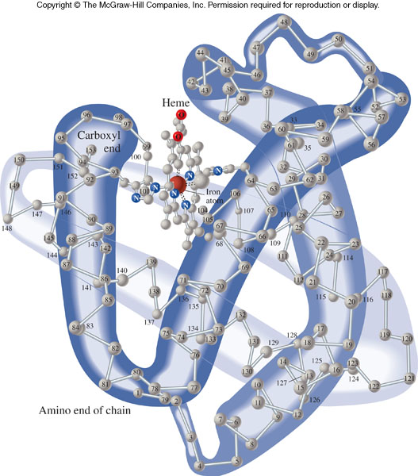
18.8 Myoglobin and Hemoglobin
12
Myoglobin and Oxygen Storage
Hemoglobin is the oxygen-transport protein of higher animals
Myoglobin is the oxygen storage protein of skeletal muscle
Oxygen is transferred from hemoglobin to myoglobin as myoglobin has a stronger attraction for oxygen than hemoglobin does

Slide 31
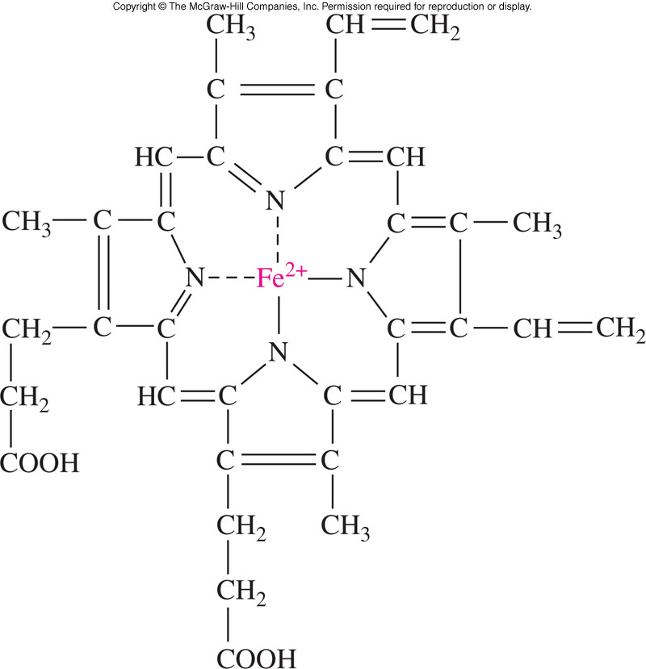
Heme and Oxygen Binding
Heme group is an essential component of the proteins hemoglobin and myoglobin
Fe²⁺ ion in the heme group is the oxygen binding site
Each hemoglobin contains a heme group which can hold 1 molecule of oxygen
18.8 Myoglobin and Hemoglobin

Slide 32
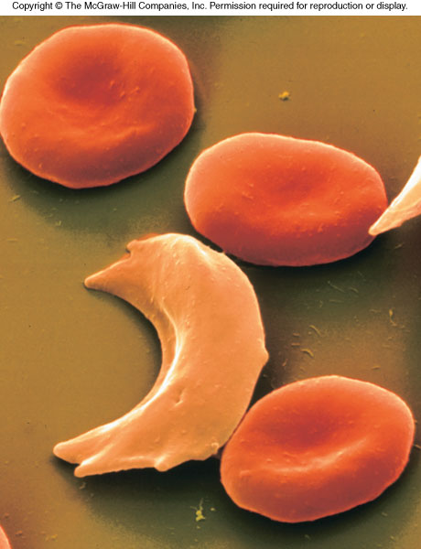
Hemoglobin Variants
A fetus has a unique type of hemoglobin with slightly greater affinity for oxygen than typical hemoglobin
Another variant is the sickle cell hemoglobin that causes red blood cells to appear altered as in this scanning electron micrograph
18.8 Myoglobin and Hemoglobin

Slide 33
18.9 Proteins in the Blood
Blood plasma contains 60-80 g/L of proteins, separated in 5 classes: α through γ.
The most abundant is albumin, a nonspecific transport molecule for poorly soluble metabolites such as bilirubin, Ca²⁺, and fatty acids.
The α-globulins are the next most abundant and include glycoproteins, high and very low density lipoproteins, ceruloplasmin, and prothrombin.
Next are β-globulins which include transferrin and low-density lipoproteins

Slide 34
18.9 Proteins in the Blood - continued
Fibrinogen, a protein involved in coagulation of blood, makes up 7% of plasma protein.
Finally, the γ-globulins, which are synthesized by the B lymphocytes.
Most of the remaining plasma proteins are synthesized in the liver.
A hallmark of liver disease is reduced amounts of one or more of the plasma proteins.

Slide 35
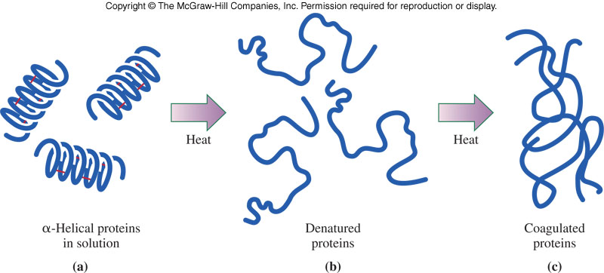
18.10 Denaturation of Proteins
Extremes of temperature and pH have a drastic effect on protein conformation
Denaturation
Is the loss of organized structure of a globular protein
Does not alter primary structure
13

Slide 36
Denaturation vs. Hydrolysis
Because structure and 3-D shape matters in activity, proteins are very susceptible to changes in conditions
Hydrolysis: breaking down into smaller peptides or amino acids
Changes in pH
Enzymes
Temperature
Denaturation: breaking up the 3-D shape
Temperature
Heavy metals
Detergents
Organic Solvents
Mechanical Stress
18.10 Denaturation of Proteins

Slide 37
The Effect of Temperature on Proteins
As the temperature of a solution of proteins increases, the first effect is the increase in the rate of molecular movement of the individual molecules within the solution.
Then, as the temperature increases further, the bonds within the proteins vibrate more violently.
Eventually, the weaker hydrogen bonds and hydrophobic interactions are disrupted, and the characteristic three-dimensional conformation of the protein is disorganized.
18.10 Denaturation of Proteins

Slide 38
The Effect of pH on Proteins
When the pH of the solution containing a protein is changed dramatically, the acid or base will change the charge of the protein.
This interferes with the salt bridges and hydrogen bonds that stabilize the tertiary structure.
18.10 Denaturation of Proteins

Slide 39
Other Denaturation Agents
Organic Solvents
Detergents
Heavy Metals (Hg²⁺ and Pb²⁺)
Mechanical Stress
18.10 Denaturation of Proteins

Slide 40
18.11 Dietary Protein and Protein Digestion
14
Proteins have several dietary purposes
Oxidize to provide energy
Amino acids liberated by hydrolysis can be used in biosynthesis
Amino acids which can not be made in the body are essential amino acids

Slide 41
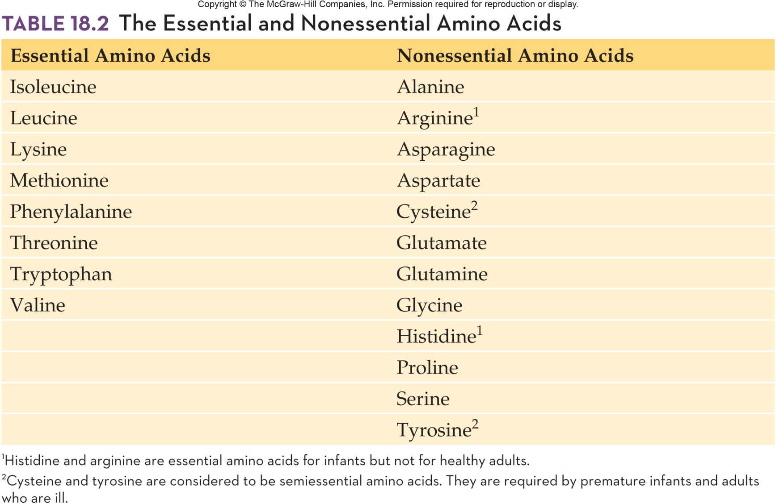
Essential and Nonessential Amino Acids
14
18.11 Dietary Protein and Protein Digestion

Slide 42
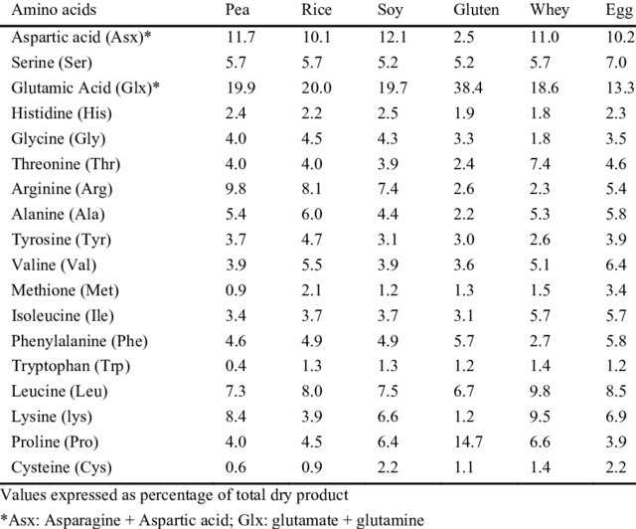

Slide 43
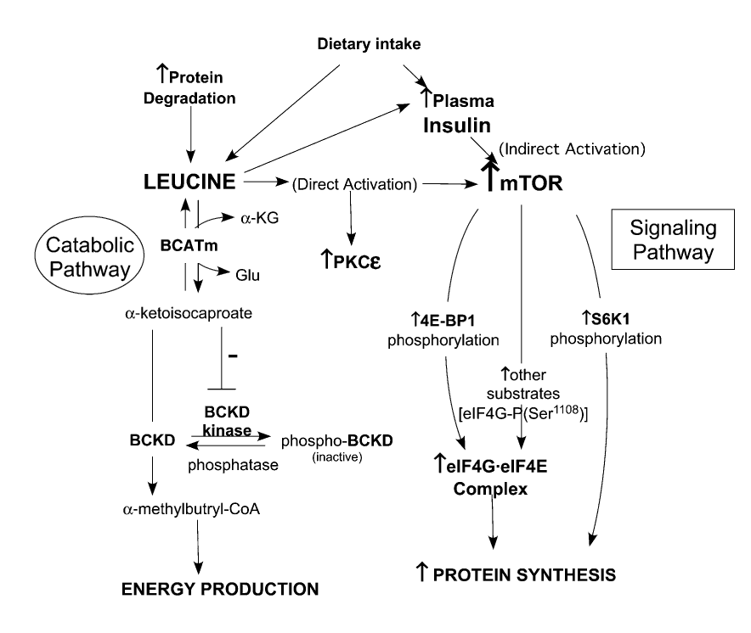
Vary & Lynch, 2007

Slide 44
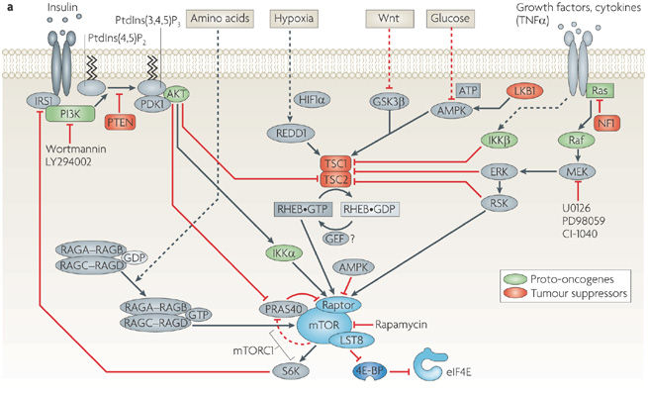
Xiaoju Max Ma & John Blenis, Nature Reviews Molecular Cell Biology 10, 307-318 (May 2009)
*Raptor: Regulatory-associated protein of mTOR
http://www.ibtimes.com/rapamycin-may-treat-progeria-can-it-slow-natural-aging-295419

