Slide 1
Biochemistry
17
Lipids and Their Functions in Biochemical Systems
General, Organic, and Biochemistry 9th Edition
Katherine J. Denniston
Joseph J. Topping
Danaè R. Quirk Dorr
Robert L. Caret
Copyright © 2017 McGraw-Hill Education. Permission required for reproduction or display

Slide 2
17.1 Biological Functions of Lipids
As an energy source, lipids provide 9 kcal of energy per gram
Triglycerides provide energy storage in adipocytes
Phosphoglycerides, sphingolipids, and steroids are structural components of cell membranes
Steroid hormones are critical intercellular messengers
Lipid-soluble vitamins (A, E, D, K)
Dietary fat acts as a carrier of lipid-soluble vitamins into cells of small intestine
Provide shock absorption and insulation
1

Slide 3
Classification of Lipids
Four Main Groups
Fatty Acids
Saturated
Unsaturated
Glycerides glycerol-containing lipids
Nonglyceride lipids
Sphingolipids
Steroids
Waxes
Complex lipids (lipoproteins)
17.1 Biological Functions of Lipids

Slide 4
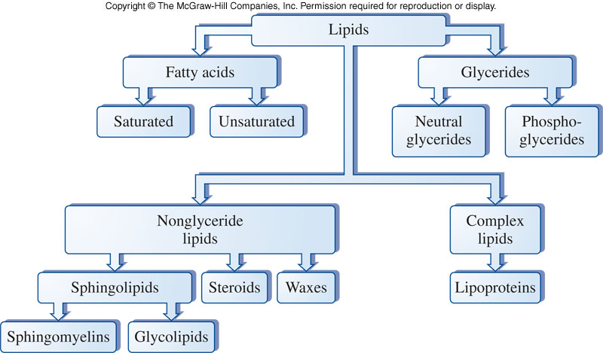
A Scheme to Classify Lipids
17.1 Biological Functions of Lipids

Slide 5
17.2 Fatty Acids
Long straight-chain carboxylic acids
no branching
Most common chains range from 10–20 carbons in length
Usually, an even number of carbons in the chain, including the carboxyl carbon
Can be saturated or unsaturated, but usually no other functional groups present
Any fatty acid that cannot be synthesized by the body is called an essential fatty acid

Slide 6
Structure
Stearic acid: a typical saturated fatty acid with 18 carbons in the chain
Oleic acid: a typical unsaturated fatty acid with 18 carbons in the chain
2
17.2 Fatty Acids

Slide 7
Saturated and Unsaturated Fatty Acids
Saturated fatty acids have no double bonds
Unsaturated fatty acids do contain double bonds
The double bond is normally in a cis configuration
Double bonds lower the melting temperature
The cis configuration doesn’t allow fatty
acids to pack as close together
17.2 Fatty Acids

Slide 8
Fatty Acids
An unsaturated fatty acid has one or more carbon-carbon double bonds in the chain
The first double bond is usually at the ninth carbon
The double bonds are not conjugated and are usually cis
cis double bonds result in a bent chain and lower melting point
17.2 Fatty Acids
Palmitoleic
acid

Slide 9
Fatty Acid Properties
3
Melting point increases with increasing carbon number
Melting point of a saturated fatty acid is higher than an unsaturated fatty acid with the same number of carbons
Typical saturated fatty acids are tightly packed together
cis- double bonds prevent good alignment of molecules in unsaturated fatty acids leading to poor packing
Double bonds lower melting point relative to saturated acid
17.2 Fatty Acids

Slide 10
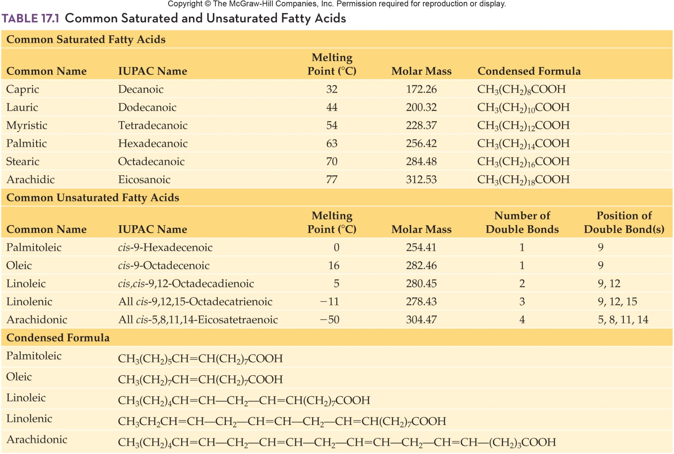
Common Fatty Acids
17.2 Fatty Acids

Slide 11
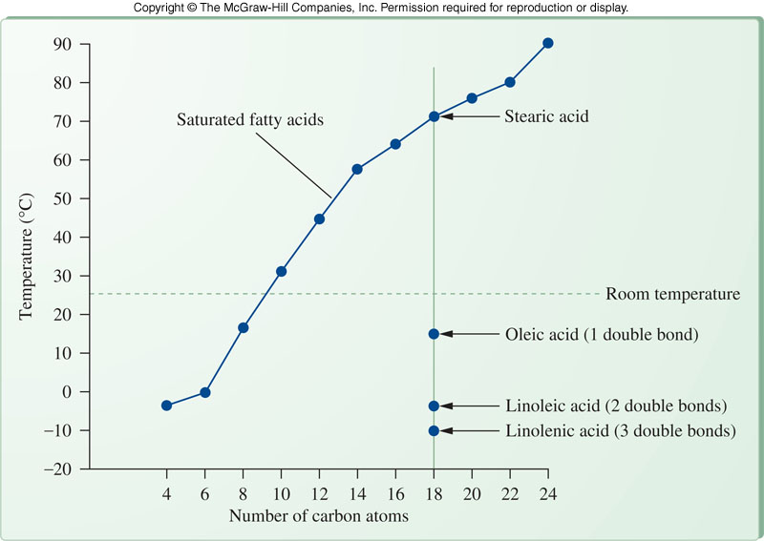
Melting Points of Fatty Acids
17.2 Fatty Acids

Slide 12
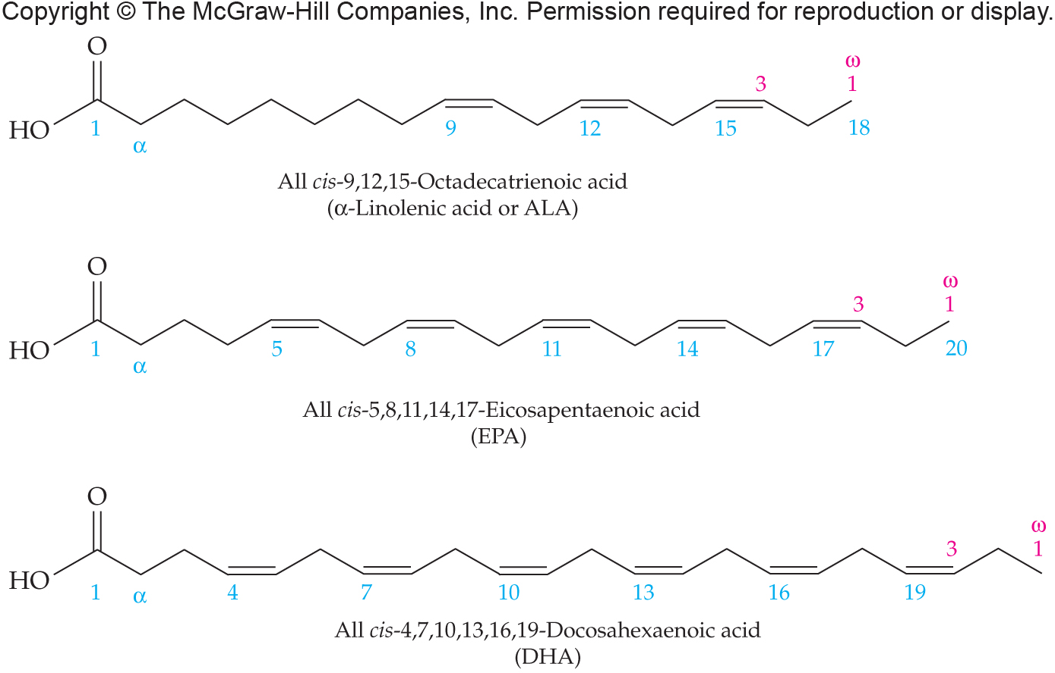
Omega-3 Fatty Acids
Omega-3 Fatty Acids, present in “oily” fish and in flaxseed and canola oils, have been recommended as a part of a healthy diet
17.2 Fatty Acids

Slide 13
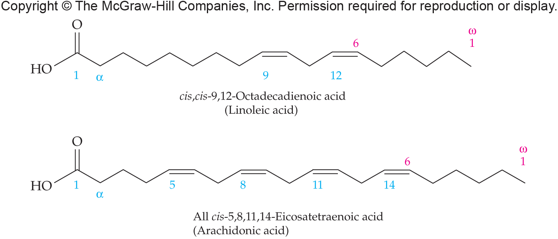
Omega-6 Fatty Acids
There are also some omega-6 fatty acids that are an important part of the diet
17.2 Fatty Acids

Slide 14
Eicosanoids: Prostaglandins, Leukotrienes, and Thromboxanes
Fatty acids which can’t be synthesized by the body are essential fatty acids
Linoleic acid is an essential fatty acid required to make arachadonic acid
Arachidonic acid (20 C) is the eicosanoid precursor
Eicosanoids are three groups of structurally related compounds
Prostaglandins
Leukotrienes
Thromboxanes
17.2 Fatty Acids

Slide 15
Prostaglandins
Potent biological molecules
They act like hormones in controlling the body’s processes
Structure
Synthesized from 20-carbon unsaturated fatty acids
Cyclic compounds including a 5-carbon ring
Names are based on ring substituents and number of side-chain double bonds
Made in most tissues
Exert their effects on cells that produce them and cells in the immediate vicinity
17.2 Fatty Acids

Slide 16
Biological Processes Regulated by Eicosanoids
4
Blood clotting
Thromboxane A₂ stimulates constriction of blood vessels and platelet aggregation
Prostacyclin dilates blood vessels and inhibits platelet aggregation
Inflammatory response
Prostaglandins mediate aspects of inflammatory response
Reproductive system
Stimulation of smooth muscle by PGE₂
17.2 Fatty Acids
5

Slide 17
Biological Processes Regulated by Eicosanoids - continued
Gastrointestinal tract
Prostaglandins inhibit gastric secretion
Prostaglandins increase secretion of protective mucus
Inhibition of hormone-sensitive lipases
Kidneys
Prostaglandins dilate renal blood vessels
Results in increased water and electrolyte excretion
Respiratory tract
Leukotrienes promote the constriction of bronchi
Prostaglandins promote bronchodilation
17.2 Fatty Acids

Slide 18
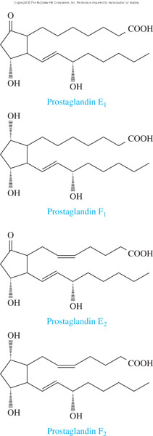
Structures of Four Prostaglandins
17.2 Fatty Acids

Slide 19
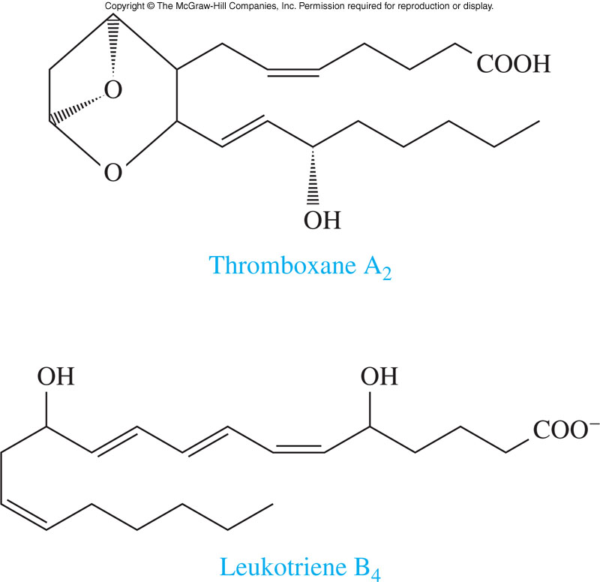
Thromboxane and Leukotriene Structures
17.2 Fatty Acids

Slide 20
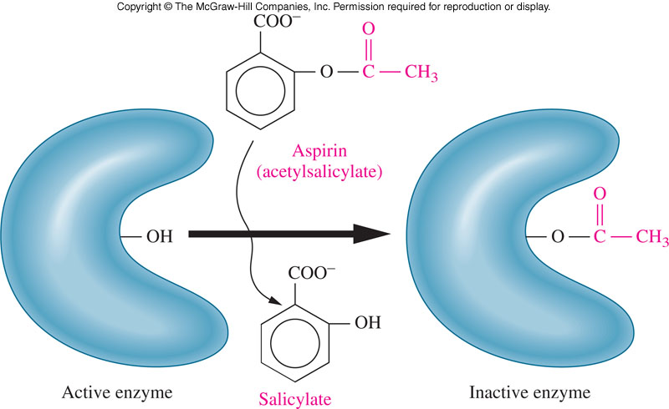
Aspirin and Prostaglandins
Aspirin inhibits prostaglandin synthesis by acetylating cyclooxygenase, an enzyme necessary for prostaglandin synthesis
17.2 Fatty Acids

Slide 21
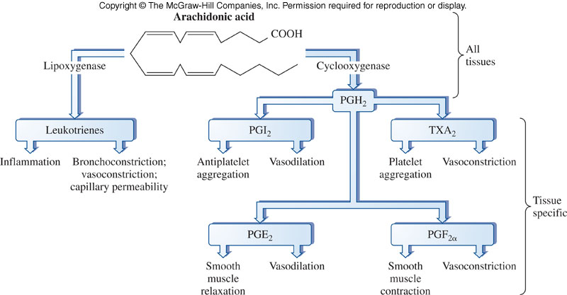
Overview of Prostaglandin Synthesis From Arachidonic Acid
17.2 Fatty Acids

Slide 22
17.3 Glycerides
Glycerides are lipid esters
Alcohol group of glycerol form an ester with a fatty acid
Esterification may occur at one, two, or all three alcohol positions producing:
Monoglyceride
Diglyceride
Triglyceride
A neutral triacylglycerol or a triglyceride
Triglycerides are nonionic and nonpolar
Triglycerides serve as energy storage in adipose cells

Slide 23
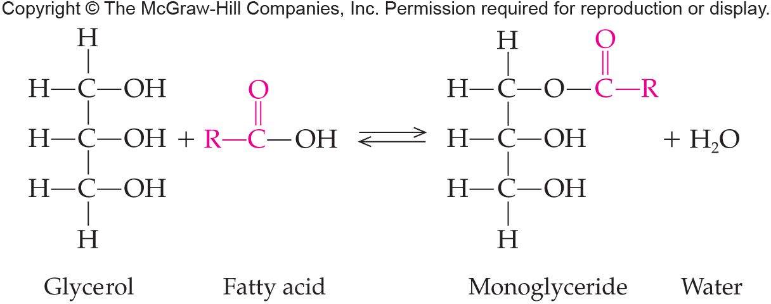
Monoglycerides
Glycerides are lipid esters
A monoglyceride places a fatty acid chain at one alcohol group of the glycerol
6
17.3 Glycerides

Slide 24
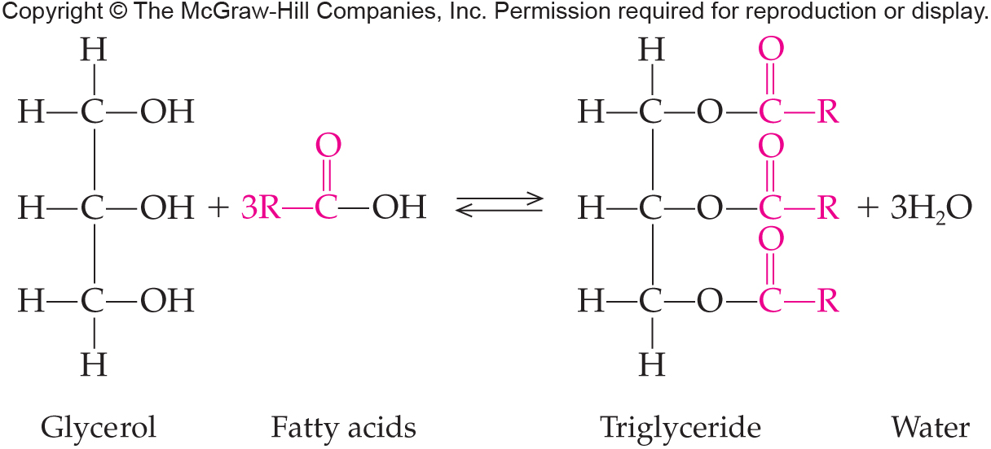
Triglycerides
6
A triglyceride places fatty acid chains at each alcohol group of the glycerol
17.3 Glycerides

Slide 25
Fats and Oils
Triglycerides or triacylglycerols
Fats are a combination of glycerol and the fatty acids
Fats mainly come from animals, unless from fish, and are solid at room temperature
Oils mainly come from plants, and are liquid at room temperature
17.3 Glycerides

Slide 26
Chemical Reactions
6
Triglycerides have typical ester and alkene chemical properties as they are composed of these two groups:
Fatty Acid Reactions
Esterification: reaction between the carboxyl of the fatty acid and the hydroxyl of an alcohol
Hydrogenation: saturates the double bonds
Glyceride Reactions
Hydrolysis: produces the fatty acids and glycerol, a reverse of formation
Saponification: replace H with salt from a strong base
17.3 Glycerides

Slide 27
Fatty Acid Esterification
6
Esterification reacts fatty acids with alcohols to form esters and water
17.3 Glycerides

Slide 28
Addition at the Double Bond
6
Hydrogenation is an addition reaction
Unsaturated fatty acids can be converted to saturated fatty acids
Hydrogenation is used in the food industry
17.3 Glycerides

Slide 29
Glyceride Hydrolysis
6
Acid Hydrolysis reverses esterification
Fatty acids are produced from esters
17.3 Glycerides

Slide 30
Glyceride Saponification
Saponification is the base-catalyzed hydrolysis of an ester
Products of the reaction are
An alcohol
An ionized carboxylic acid salt which is a soap
Soaps have a long uncharged hydrocarbon tail
Also have a negatively charged carboxylate group at end
Form micelles that dissolve oil and dirt particles
6
17.3 Glycerides

Slide 31
Saponification Reaction
6
17.3 Glycerides

Slide 32
“Hard” Water Problems
When “hard” water is used with soaps
“Hard” water contains high concentrations of Ca²⁺ and Mg²⁺
Cations in the water form fatty acid salts which precipitate
Interferes with emulsifying action of the soap
Leaves a crusty scum on the surface of the sink
17.3 Glycerides

Slide 33
Phosphoglycerides
7
Phospholipid is a more general term
Any lipid containing phosphorus
Phosphoglycerides (or phosphoacylglycerols) contain:
Glycerol
Fatty acid
Phosphoric acid with an amino alcohol
Replace an end fatty acid of a triglyceride with a phosphoric acid linked to an amino alcohol
G
l
y
c
e
r
o
l
Fatty Acid
17.3 Glycerides
Fatty Acid
Phosphoric Acid
Alcohol

Slide 34
Phosphoglyceride Properties
Have hydrophobic and hydrophilic domains
Structural components of membranes
Emulsifying agents
Suspended in water, they spontaneously rearrange into ordered structures
Hydrophobic group to center
Hydrophilic group to water
Basis of membrane structure
17.3 Glycerides

Slide 35
Types of Phosphoglycerides
The phospho-amino-alcohol is highly hydrophilic
They are used in:
Cell membranes
Emulsifying
Micelle-forming agents in the blood
Two types
Ones made with choline are called lecithin
Those made with either ethanolamine or serine are called cephalins
17.3 Glycerides

Slide 36
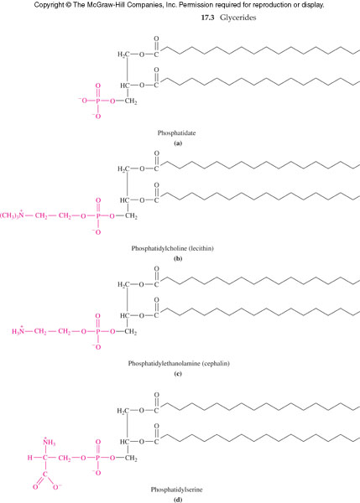
Phosphoglyceride Examples
17.3 Glycerides

Slide 37
17.4 Nonglyceride Lipids
Sphingolipids
These lipids are based on sphingosine
Long-chain
Nitrogen-containing
Alcohol
Amphipathic, like phospholipids
Polar head group
Two nonpolar fatty acid tail
8

Slide 38
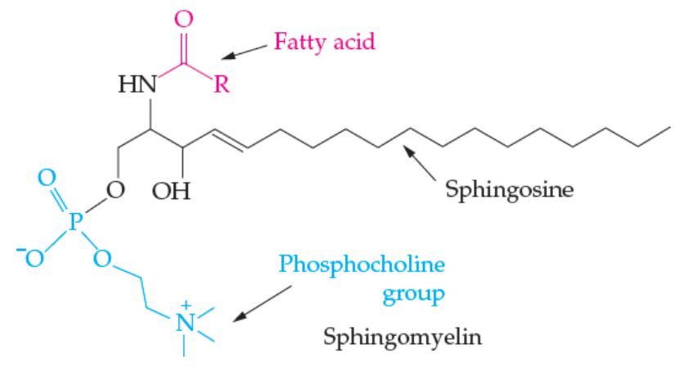
Sphingolipid Categories
Structural component of cellular membranes
Major categories
Sphingomyelins
Glycosphingolipids
8

Slide 39
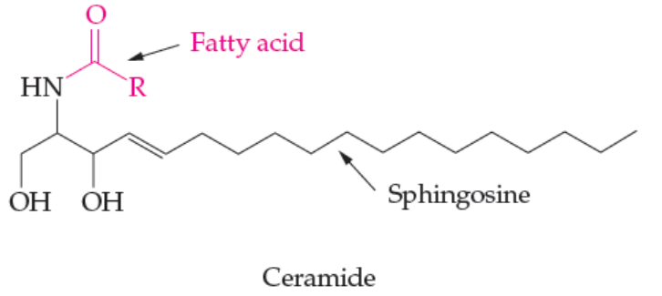
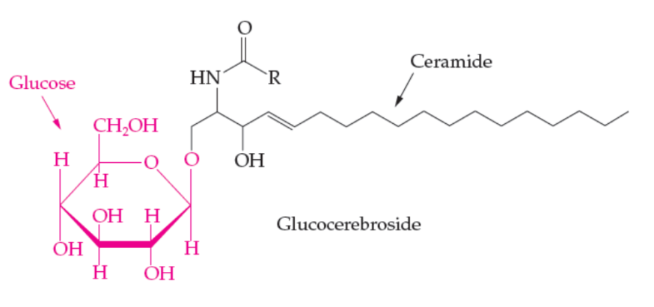
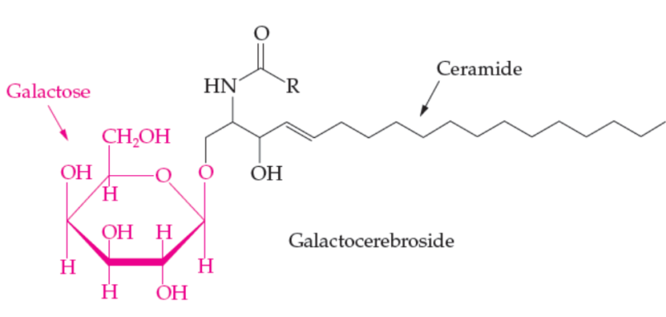
Types of Sphingolipids
Sphingomyelins
Structural lipid of nerve cell membranes
Myelin sheath feature
Glycosphingolipids
Built on a ceramide
Cerebrosides have a single monosaccharide head group
Glucocerebroside
Galactocerebroside
17.4 Nonglyceride Lipids

Slide 40
Sphingolipid Storage Diseases
Disease | Symptom | Sph. Lip | Enzyme
Tay-Sachs | Blindness, muscles weak | Ganglioside GM₂ | β-hexose- aminidase A
Gaucher’s | Liver & spleen enlarge, MR | Gluco-cerebroside | β-glucosidase
Krabbe’s | demyelation, MR | Galacto- cerebroside | β-galactosidase
Nieman-Pick | MR | Sphingomyelin | Sphingomyelinase

Slide 41
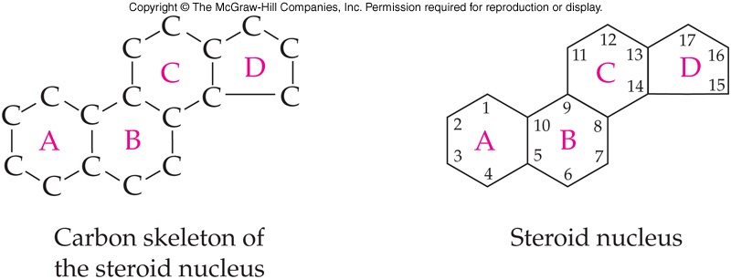
Steroid Structure
Steroids are synthesized from the five carbon isoprene unit (see Alkenes)
Part of a diverse collection of lipids called isoprenoids / terpenes
Contain the steroid carbon skeleton
A collection of 5 fused carbon rings
9
17.4 Nonglyceride Lipids

Slide 42
Cholesterol and Bile Salts
Cholesterol
Cell membranes, precursor to bile salts, male and female sex hormones, vitamin D, and the adrenocortical hormones
Have been linked to atherosclerosis
Bile salts
Important in the lipid digestion
17.4 Nonglyceride Lipids

Slide 43
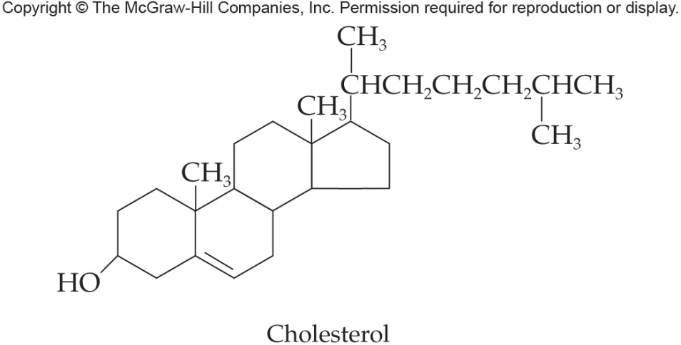
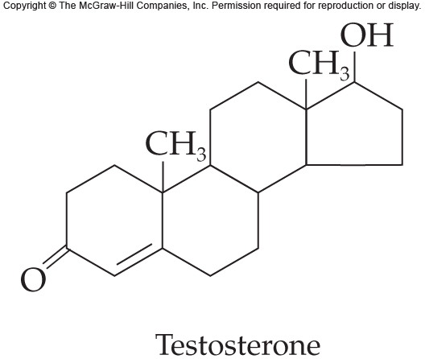
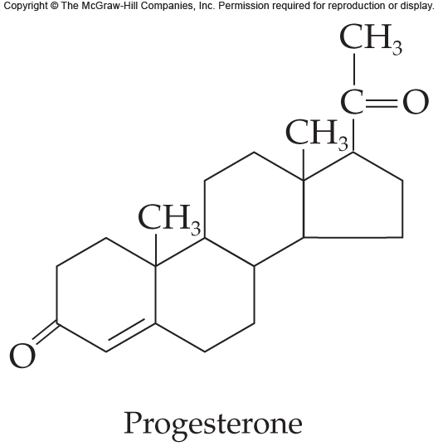
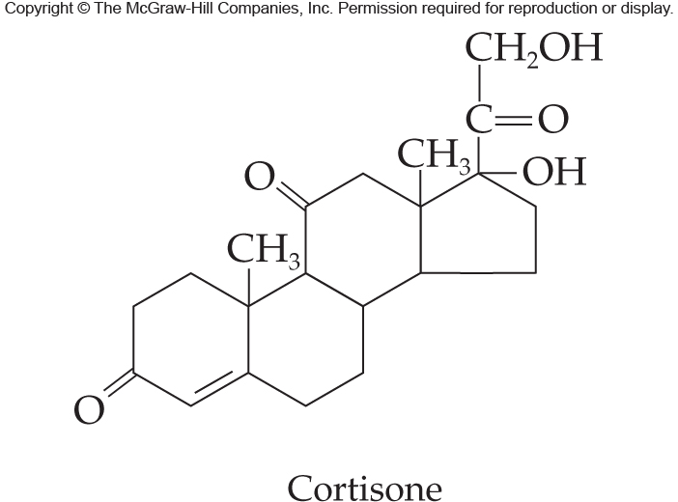
Steroid Examples

Slide 44
Steroid Hormones
Adrenocorticoids have two groups
Mineralocorticoids regulate ion concentrations
Glucocortiods enhance carbohydrate metabolism
Cortisol increases glucose and glycogen in the body
Along with its ketone derivative, cortisone; are anti-inflammatory
Another derivative is prednisolone for both asthma and inflammation
17.4 Nonglyceride Lipids

Slide 45
Waxes
Waxes are also esters like fats
Use one alcohol instead of glycerol
Esters of:
Long-chain fatty acid
Long-chain alcohol
The longer the chains, the higher the melting point
Protects the skin of plants and fur of animals
Examples of waxes include:
Carnuba, from Brazilian wax palm
Beeswax
17.4 Nonglyceride Lipids

Slide 46
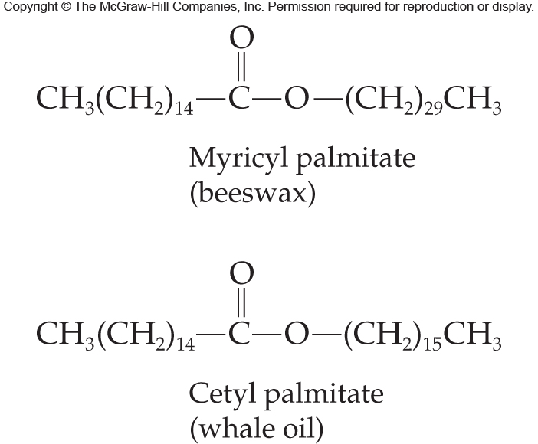
Examples of Waxes
17.4 Nonglyceride Lipids

Slide 47
17.5 Complex Lipids
Complex lipids are those bonded to other types of molecules
Lipoproteins
Molecular complexes found in blood plasma
Contain:
Neutral lipid core of cholesterol esters and/or TAGs
Surrounded by a layer of:
Phospholopid
Cholesterol
Protein
Classes: chylomicrons, VLDL, LDL, HDL
10

Slide 48
Major Classes of Lipoproteins
Chylomicrons:
Very large and very low density
Transport intestine→adipose
VLDL:
Made in liver
Transport lipids to tissues
LDL:
Carry cholesterol from liver to tissues
HDL:
Made in liver
Scavenge excess cholesterol esters
17.5 Complex Lipids

Slide 49
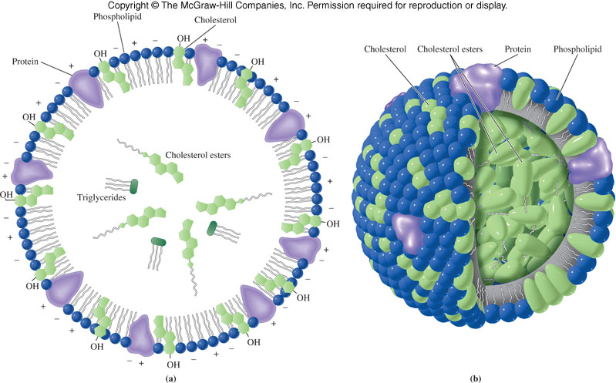
Model Structure of a Plasma Lipoprotein
17.5 Complex Lipids

Slide 50
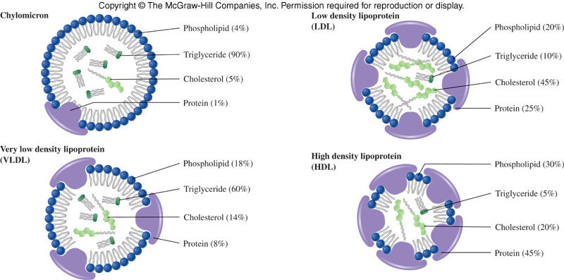
Relative Composition of Lipoproteins

Slide 51
Membrane Receptors
The LDL receptor was discovered during an investigation of familial hypercholesterolemia
When a cell needs cholesterol, it synthesizes the receptor, which migrates to a coated region of the membrane
The “captured” cholesterol is absorbed by endocytosis
Failure to make the receptor is the most common problem encountered
17.5 Complex Lipids

Slide 52
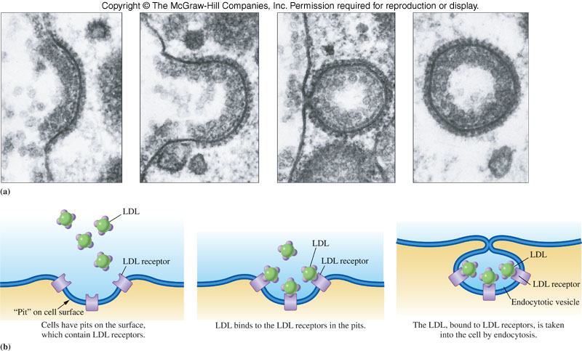
Receptor-Mediated Endocytosis
17.5 Complex Lipids

Slide 53
17.6 The Structure of Biological Membranes
Each type of cell has a unique membrane composition with varying percentages of lipids, proteins, and some carbohydrates
The currently accepted model of the membrane is the fluid mosaic model of a lipid bilayer
11

Slide 54
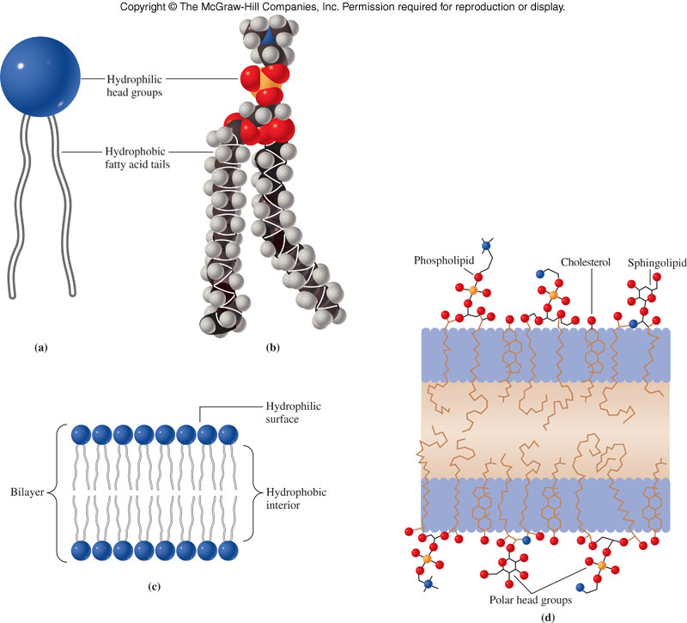
Phospholipid Bilayer
17.6 The Structure of Biological Membranes

Slide 55
Membrane Proteins
Most membranes require proteins to carry out their functions
Integral proteins are embedded in and/or extend through the membrane
Peripheral proteins are bound to membranes primarily through interactions with integral proteins
17.6 The Structure of Biological Membranes

Slide 56
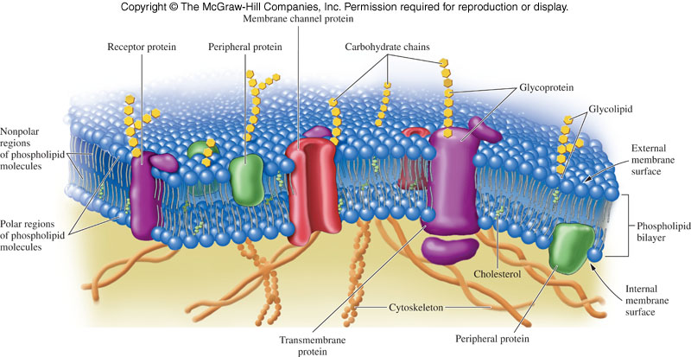
Fluid Mosaic Model of Membrane Structure
17.6 The Structure of Biological Membranes

