Slide 1
Biochemistry
16
Carbohydrates
General, Organic, and Biochemistry 9th Edition
Katherine J. Denniston
Joseph J. Topping
Danaè R. Quirk Dorr
Robert L. Caret
Copyright © 2017 McGraw-Hill Education. Permission required for reproduction or display

Slide 2
16.1 Types of Carbohydrates
Carbohydrates are synthesized by photosynthesis in plants
Grains, cereals, bread, sugar cane
Glucose is major energy source
A gram of digested carbohydrate gives about 4 kcal of energy
Complex carbohydrates are best for diet
USDA recommends about 45-65% daily calories from carbohydrates
1

Slide 3
Basic Carbohydrate Types
1
Monosaccharides
e.g., glucose, fructose
One sugar (saccharide) molecule
Disaccharides
e.g., sucrose, lactose
Two monosaccharides linked together
Linkage is called a glycosidic bond
Oligosaccharides
Three to ten monosaccharides linked by glycosidic bonds
Polysaccharides
e.g., starch, glycogen, cellulose
Chains of linked monosaccharide units
16.1 Types of Carbohydrates

Slide 4
16.2 Monosaccharides
Monosaccharides are composed of:
Carbon
Hydrogen
Oxygen
Basic Formula = (CH₂O)_{n} n = any integer 3 – 7
Many monosaccharides also contain chemical modifications
Amino groups
Phosphate groups
2

Slide 5
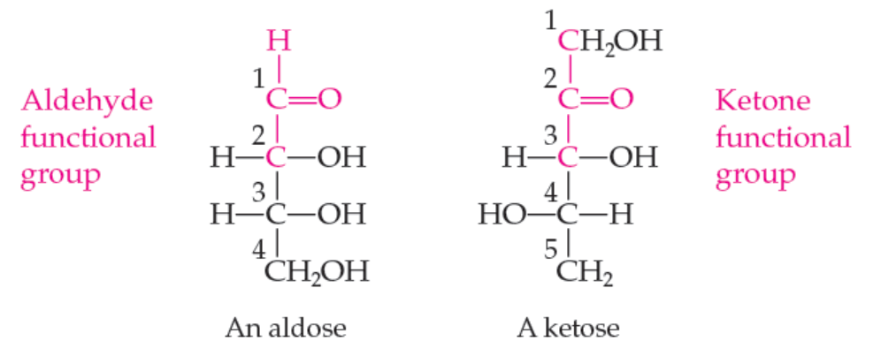
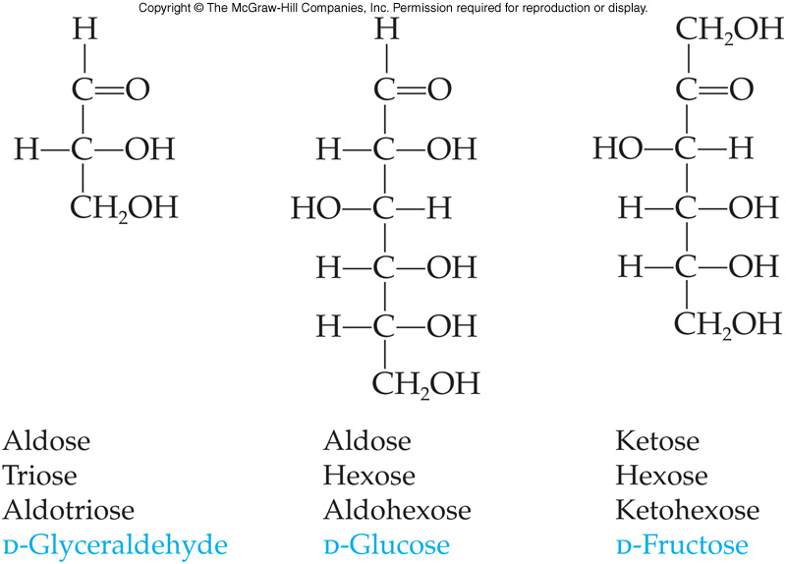
Naming Monosaccharides
Named on the basis of
Functional groups
Ketone carbonyl = ketose
Aldehyde carbonyl = aldose
Number of carbon atoms in the main skeleton
3 carbons = triose
4 carbons = tetrose
5 carbons = pentose
6 carbons = hexose
Combining both systems gives even more information
16.2 Monosaccharides
Copyright © 2017 McGraw-Hill Education. Permission required for reproduction or display

Slide 6
16.3 Stereoisomers and Stereochemistry
3
Prefixes D- and L- in a monosaccharide name identify one of two isomeric forms
These isomers differ in the spatial arrangement of atoms and are stereoisomers
Stereochemistry is the study of different spatial arrangements of atoms
The stereoisomers D- and L- glyceraldehyde are nonsuperimposable mirror image molecules and are called enantiomers (a subset of stereoisomers)
4
5

Slide 7
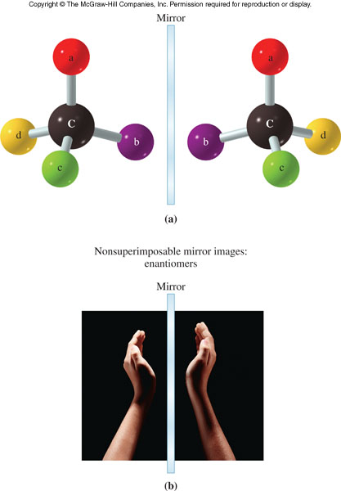
Enantiomers
16.3 Stereoisomers and Stereochemistry

Slide 8
Chirality
A carbon atom that has four different groups bonded to it is called a chiral carbon atom
Any molecule containing a chiral carbon can exist as a pair of enantiomers
Chirality in glyceraldehyde (the simplest carbohydrate) is conveyed by a chiral carbon
Larger biological molecules often have more than one chiral carbon
16.3 Stereoisomers and Stereochemistry

Slide 9
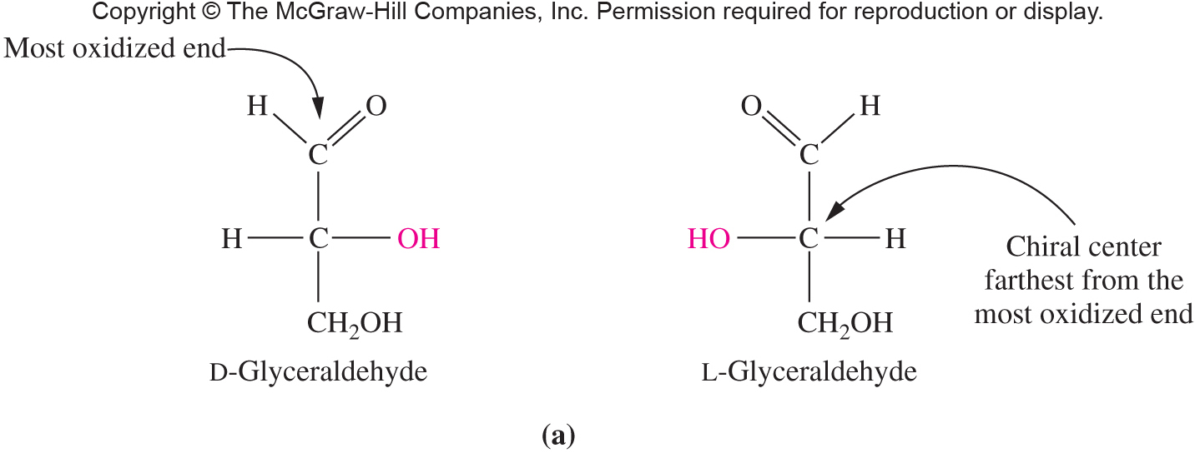
Chirality of Glyceraldehyde
Glyceraldehyde has a chiral carbon and thus, has two enantiomers
The D isomer has the -OH on the stereocenter to the right
The L isomer has the -OH on the stereocenter to the left
16.3 Stereoisomers and Stereochemistry

Slide 10
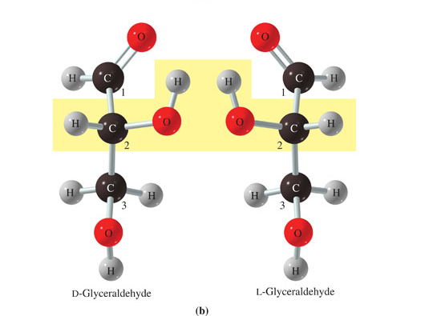
Structural Formulas of D- and L- Glyceraldehyde
16.3 Stereoisomers and Stereochemistry
Copyright © 2017 McGraw-Hill Education. Permission required for reproduction or display

Slide 11
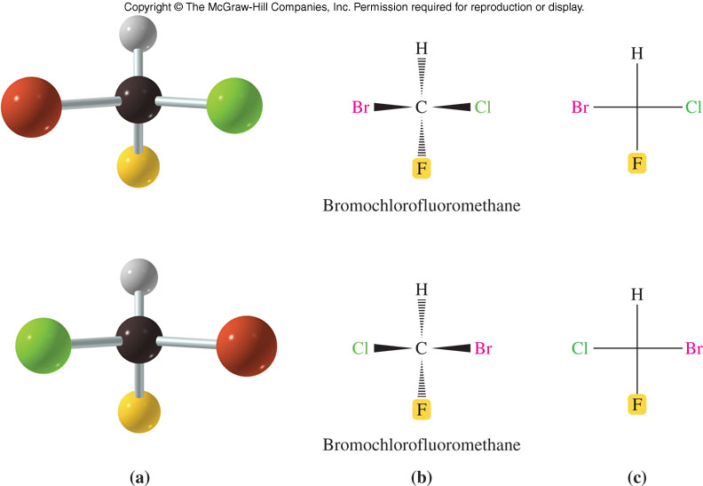
Fischer Projection Formulas
A Fischer projection uses lines crossing through a chiral carbon to represent bonds
Projecting out of the page (horizontal lines)
Projecting into the page (vertical lines)
Compare the wedge to the Fischer diagrams
16.3 Stereoisomers and Stereochemistry

Slide 12
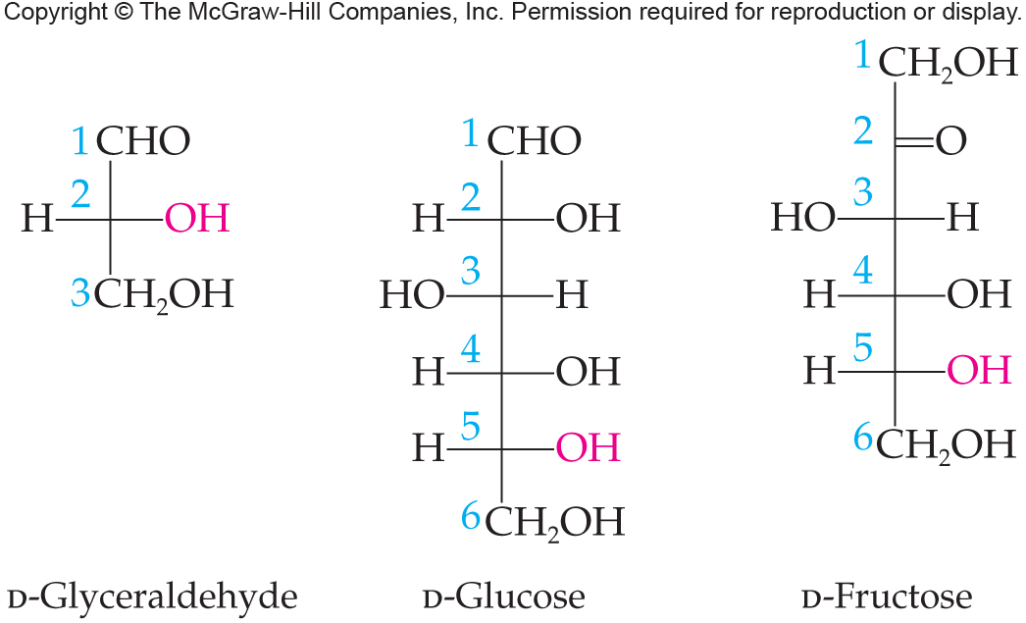
Fischer Projections of Monosaccharides
16.3 Stereoisomers and Stereochemistry

Slide 13
Compounds with Chiral Centers
Racemic Mixture
A mixture of equal amounts of a pair of enantiomers
Racemate
Optically inactive
Diastereomers
A pair of stereoisomers having two or more chiral centers and that are not enantiomers
Meso Compound
A compound with two or more chiral carbon atoms and an internal plane of symmetry that causes it to be optically inactive
16.3 Stereoisomers and Stereochemistry

Slide 14
The D- and L-System
Monosaccharides are drawn in Fischer projections
With the most oxidized carbon closest to the top
The carbons are numbered from the top
If the chiral carbon with the highest number has the OH to the right, the sugar is D
If the OH is to the left, the sugar is L
Most common sugars are in the D form
16.3 Stereoisomers and Stereochemistry

Slide 15
16.4 Biological Monosaccharides
Glucose is the most important sugar in the
human body
Found in many foods
Many common names: dextrose and blood sugar
Its concentration in the blood is regulated by insulin and glucagon
Under physiological conditions, glucose exists in a cyclic hemiacetal form where the C-5 hydroxyl reacts with the C-1 carbonyl group
Two isomers are formed which differ in the location of the -OH on the acetal carbon, C-1
An aldohexose with molecular formula C₆H₁₂O₆
6

Slide 16
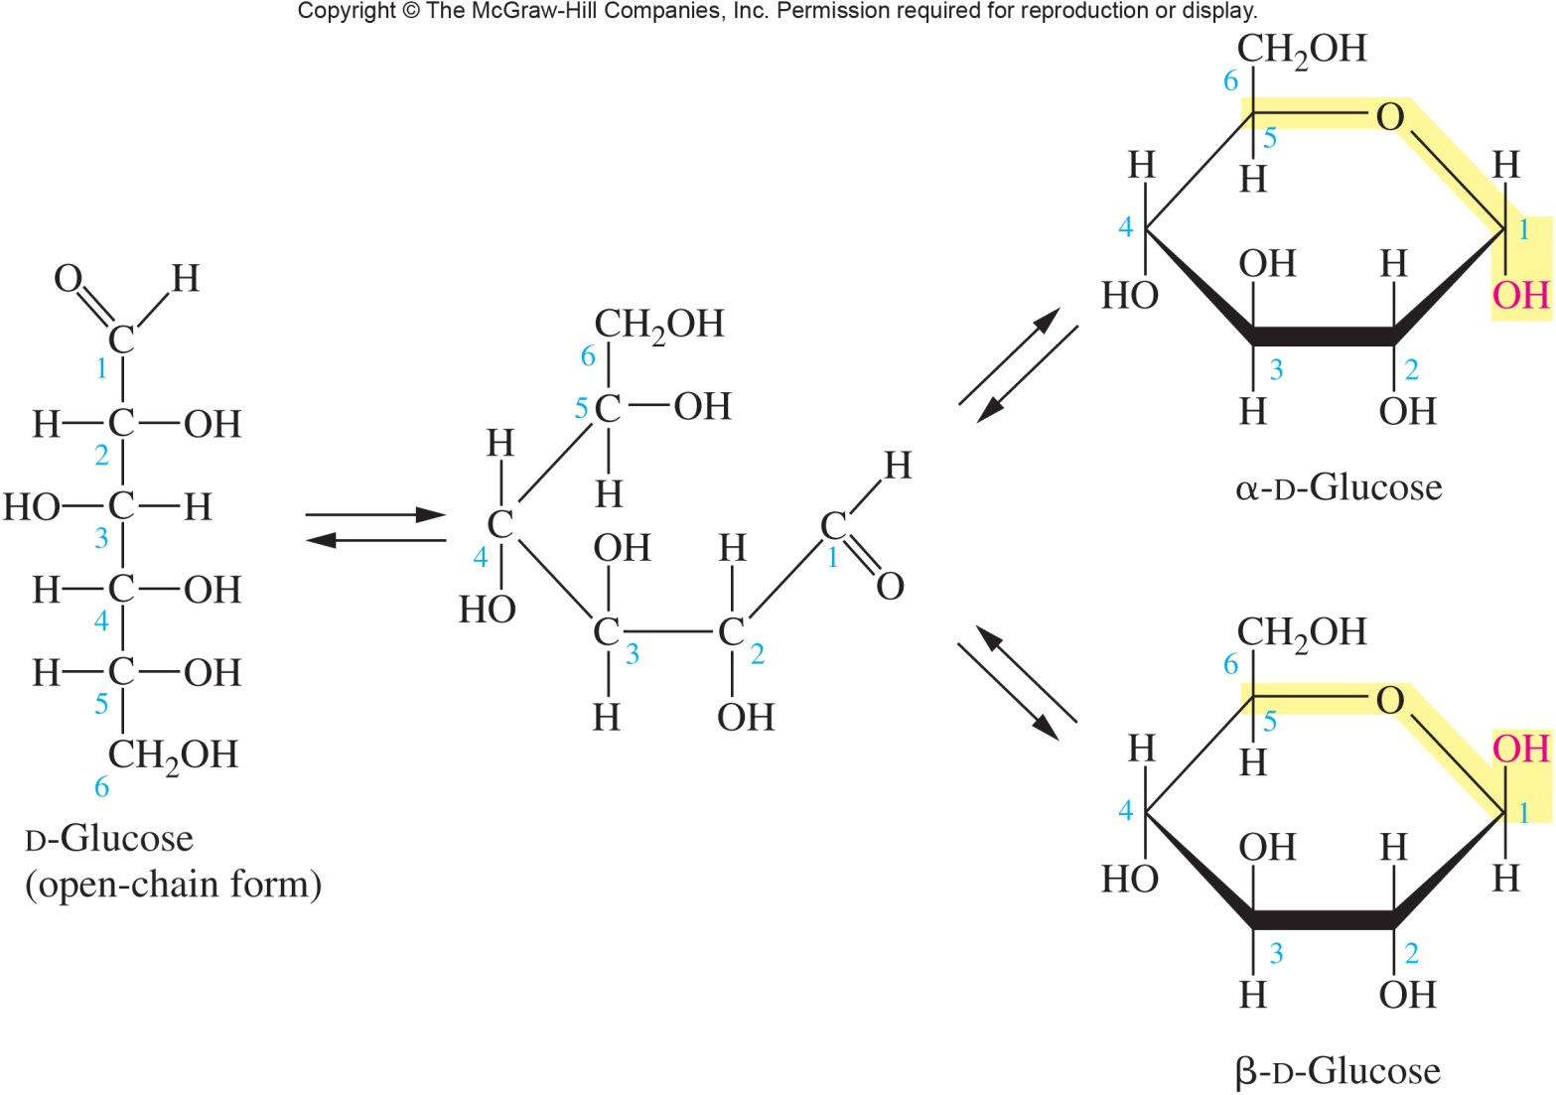
Cyclic Form of Glucose
The cyclic form of glucose is shown as a Haworth projection
7
16.4 Biological Monosaccharides

Slide 17
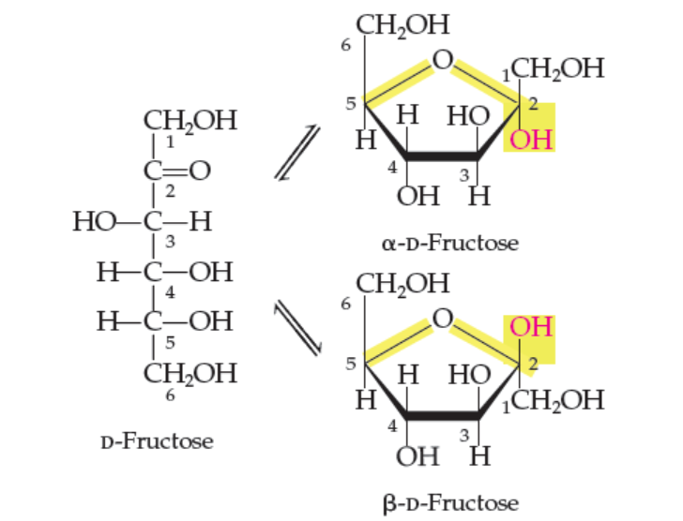
Fructose
Fructose is also called:
Levulose
Fruit sugar
Found in:
Honey
Corn syrup
Fruits
The sweetest
sugar
Ketohexose
16.4 Biological Monosaccharides
Copyright © 2017 McGraw-Hill Education. Permission required for reproduction or display

Slide 18
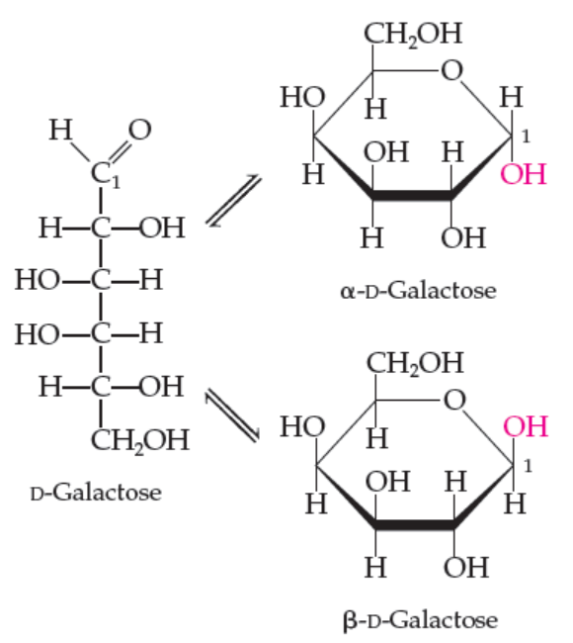
Galactose
Galactose is the principal sugar found in mammalian milk
Aldohexose very similar to glucose
β-D-galactosamine is a component of the blood group antigens
16.4 Biological Monosaccharides
Copyright © 2017 McGraw-Hill Education. Permission required for reproduction or display

Slide 19
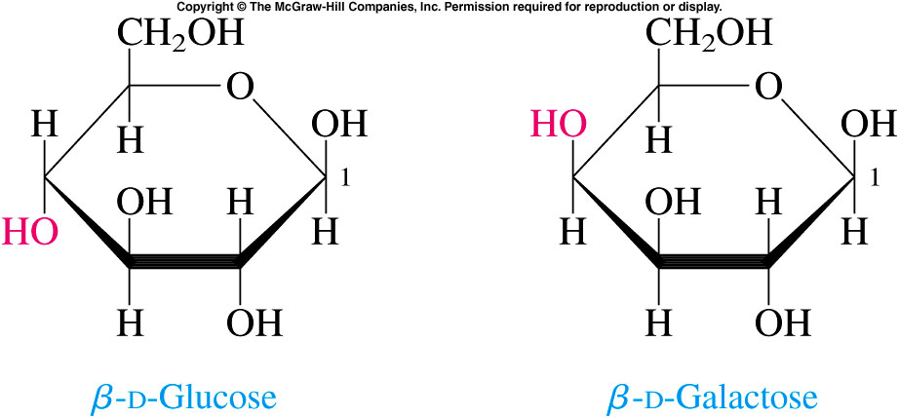
Galactose Orientation
Glucose and galactose differ only in
the orientation of one hydroxyl group
16.4 Biological Monosaccharides

Slide 20
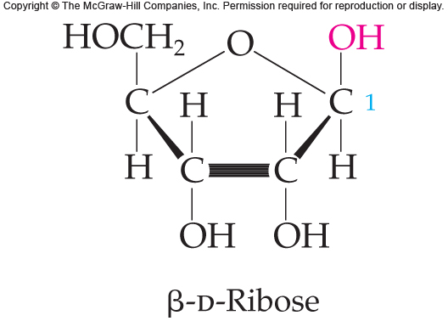
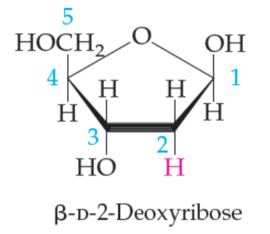
Ribose and Deoxyribose, Five-Carbon Sugars
Components of many biologically important molecules, that exist mainly in the cyclic form
Aldopentose
The only difference between the two is the absence of the –OH group on C-2 of β-D-2-deoxyribose
16.4 Biological Monosaccharides

Slide 21
Benedict’s Reagent
8
The aldehyde groups of aldoses are oxidized by Benedict’s reagent, an alkaline Cu²⁺ solution
The blue color of the reagent fades as reaction occurs reducing Cu²⁺ to Cu⁺ with a red-orange precipitate forming as Cu₂O results
Test can measure glucose in urine
16.4 Biological Monosaccharides
9

Slide 22
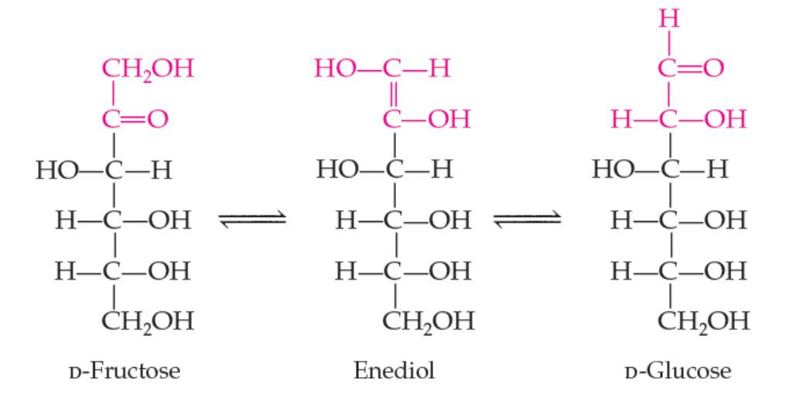
Reducing Sugars
All monosaccharides and the disaccharides except sucrose are reducing sugars
Ketoses can isomerize to aldoses via enediol reaction
16.4 Biological Monosaccharides
Copyright © 2017 McGraw-Hill Education. Permission required for reproduction or display

Slide 23
16.5 Biologically Important Disaccharides
10
The anomeric -OH can react with another -OH on an alcohol or sugar, forming a glycosidic bond
Water is lost to form an acetal

Slide 24
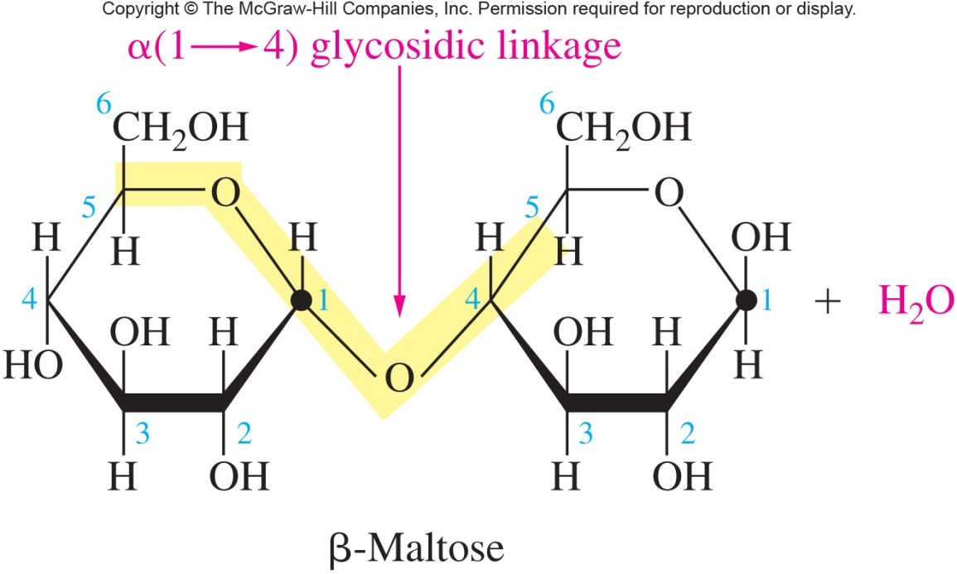
Maltose
Maltose is formed by linking two D-glucose molecules to give a 1,4 glycosidic linkage
Maltose is malt sugar
Formed as an intermediate in starch hydrolysis
Reducing sugar due to the hemiacetal hydroxyl
16.5 Biologically Important Disaccharides

Slide 25
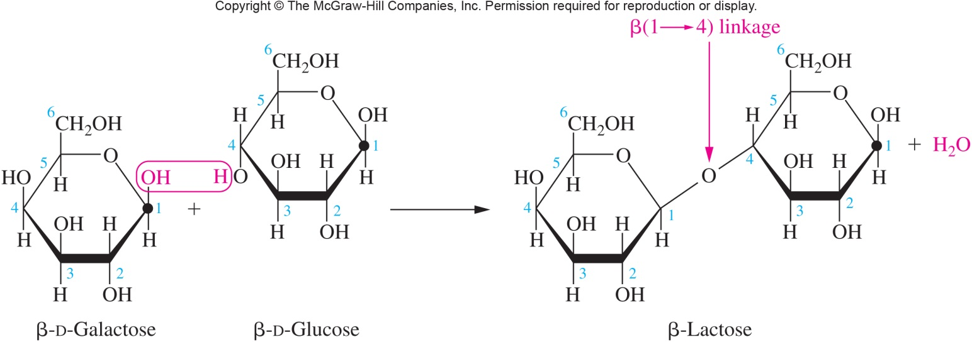
Lactose
Lactose is formed by joining β−D-galactose to D-glucose to give a β−1,4-glycoside
Lactose is milk sugar
For use as an energy source, must be hydrolyzed to glucose and galactose
Lactose intolerance results from lack of lactase to hydrolyze the glycosidic link of lactose
11
16.5 Biologically Important Disaccharides

Slide 26
Galactosemia
In order for lactose to be used as an energy source, galactose must be converted to a phosphorylated glucose molecule
When enzymes necessary for this conversion are absent, the genetic disease galactosemia results
People who lack the enzyme lactase (~20%) are unable to digest lactose and have the condition lactose intolerance
16.5 Biologically Important Disaccharides

Slide 27
Sucrose
Sucrose is formed by linking α−D-glucose with β−D-fructose to give a 1,2 glycosidic linkage
Nonreducing – negative reaction in Benedict test
The glycosidic O is part of an acetal
Important plant carbohydrate
Water soluble
Easily transported in plant circulatory system
Cannot by synthesized by animals
Sucrose called:
Table sugar
Cane sugar
Beet sugar
Linked to dental caries
16.5 Biologically Important Disaccharides

Slide 28
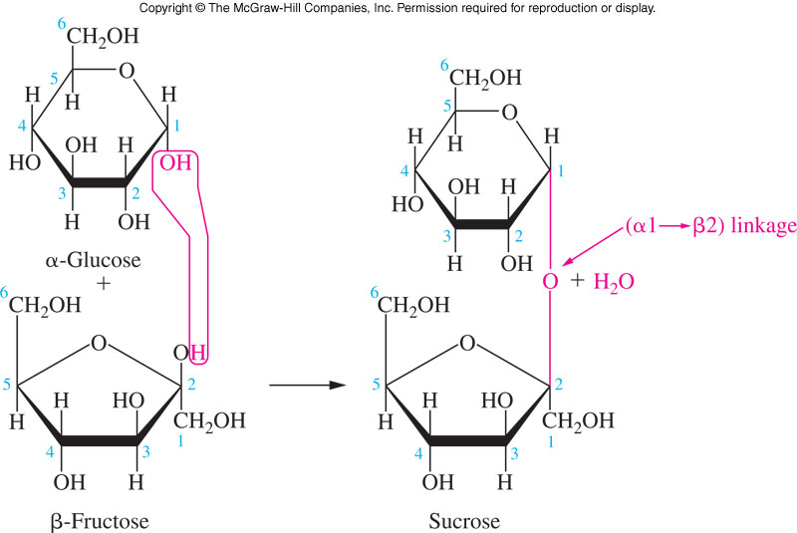
Glycosidic Bond Formed in Sucrose
16.5 Biologically Important Disaccharides

Slide 29
16.6 Polysaccharides
12
Starch
Starches are storage forms of glucose found in plants
They are polymers of α linked glucose
If the links are:
Only 1,4 links, the polymer is linear = amylose
Amylose usually assumes a helical configuration with six glucose units per turn
Comprises about 80% of plant starch
Both 1,4 and 1,6 links then, the polymer structure is branched = amylopectin
Highly branched with branches of approximately 20-25 glucose units

Slide 30
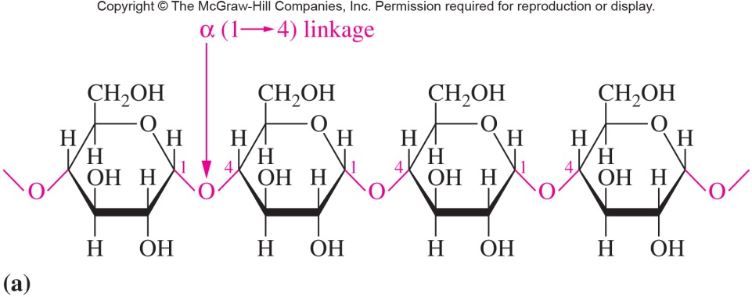
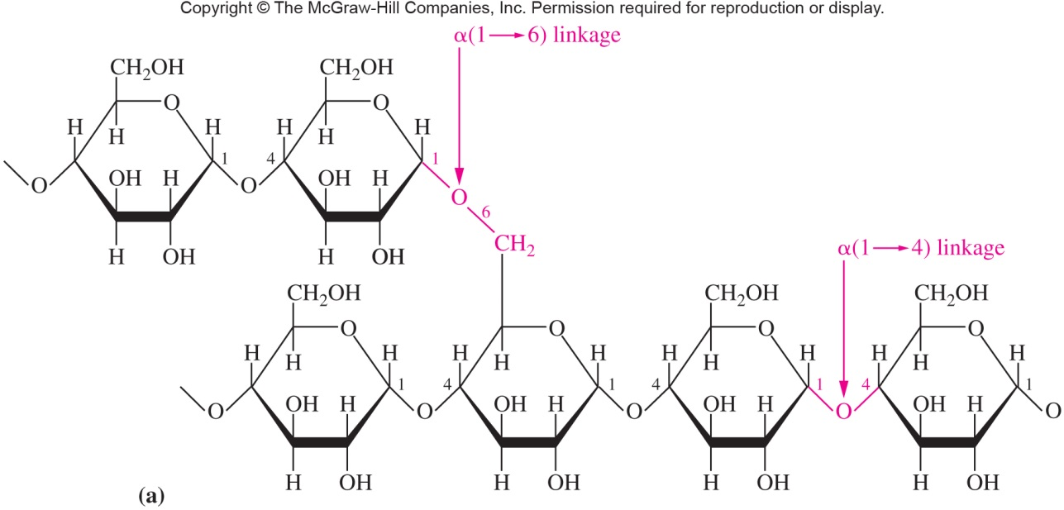
Comparison of Amylose to Amylopectin
Amylose:
16.6 Polysaccharides
Amylopectin:

Slide 31
Glycogen
12
The major glucose storage carbohydrate in animals is glycogen
A highly branched chain polymer like amylopectin
More frequent branching – 10 monomers
Glycogen is stored in:
Liver
Muscle cells
16.6 Polysaccharides

Slide 32
Cellulose
12
Cellulose is the major structural polymer in plants
It is a liner homopolymer composed of β-D-glucose units linked β-1,4
The repeating disaccharide of cellulose is β-cellobiose
Animals lack the enzymes necessary to hydrolyze cellulose
The bacteria in ruminants (e.g., cows) can digest cellulose so that they can eat grass, etc.
16.6 Polysaccharides

Slide 33
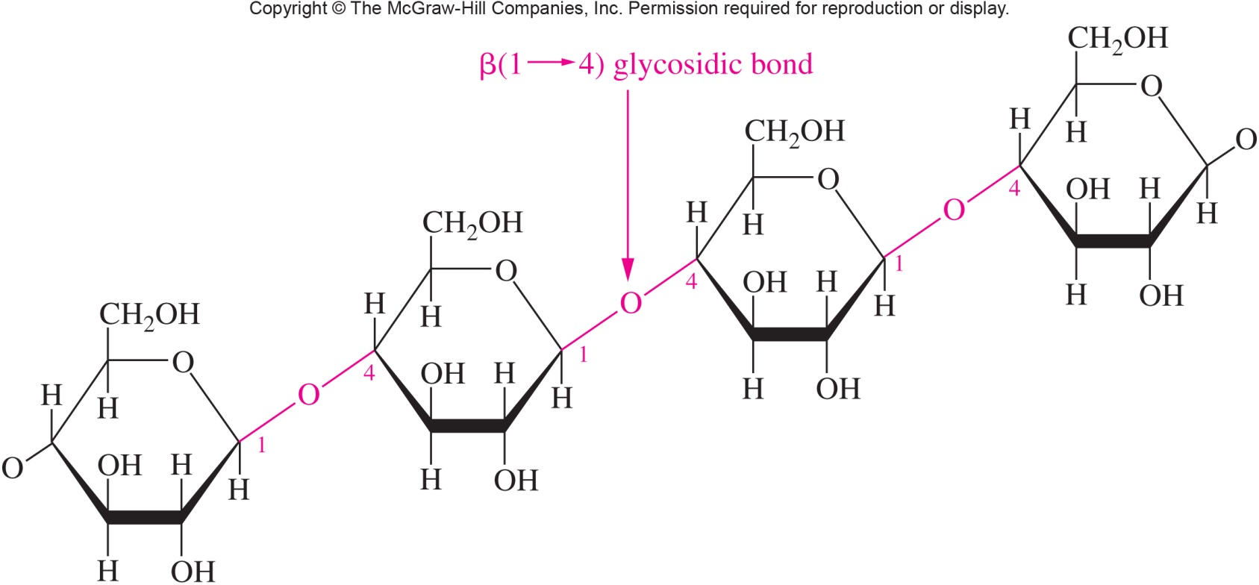
Structure of Cellulose
16.6 Polysaccharides

Slide 34
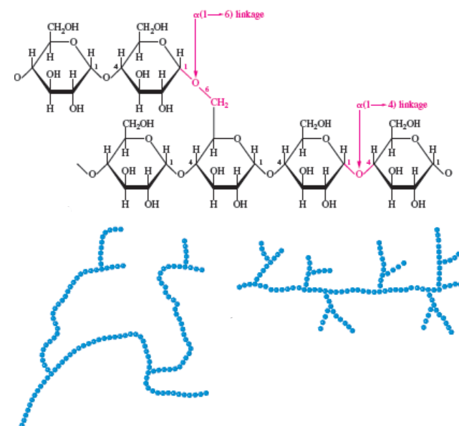
Glycogen and Amylopectin Structures
Glycogen and
Amylopectin are
α(1-4) chains
with α(1-6)
branches
16.6 Polysaccharides
Amylopectin
Glycogen
Copyright © 2017 McGraw-Hill Education. Permission required for reproduction or display

