Slide 1
ORGANIC CHEMISTRY
14
Carboxylic Acids and Carboxylic Acid Derivatives
General, Organic, and Biochemistry 9th Edition
Katherine J. Denniston
Joseph J. Topping
Danaè R. Quirk Dorr
Robert L. Caret
Copyright © 2017 McGraw-Hill Education. Permission required for reproduction or display

Slide 2
Functional Group Formulas
Ar= Aromatic hydrocarbon R = Aliphatic hydrocarbon

Slide 3
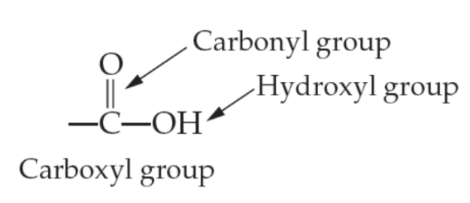
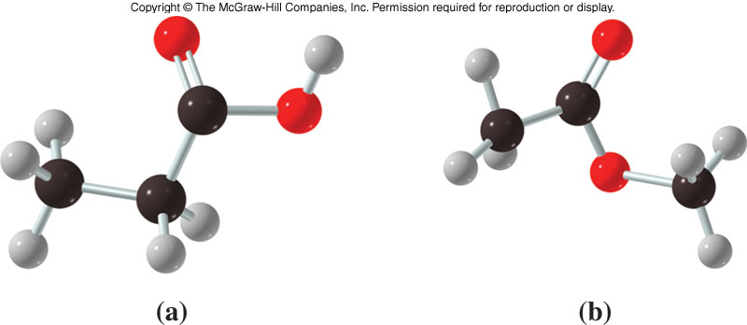
14.1 Carboxylic Acids
Structure
Carboxylic acid groups consist of two very polar functional groups
Carbonyl group
Hydroxyl group
Carboxylic acid groups are very polar
1
Carboxylic acid Ester – Carboxylic Acid Derivative
Copyright © 2017 McGraw-Hill Education. Permission required for reproduction or display

Slide 4
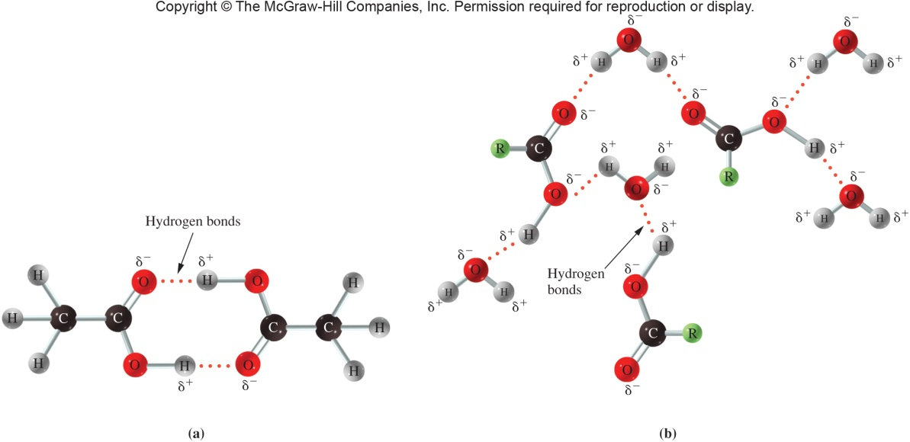
Physical Properties
Low molar mass carboxylic acids
Sharp, sour taste
Unpleasant aromas
High molar mass carboxylic acids
Fatty acids important in biochemistry
Low molar mass carboxylic acids are water soluble due to hydrogen bonding with:
Water
Each other
14.1 Carboxylic Acids
Copyright © 2017 McGraw-Hill Education. Permission required for reproduction or display

Slide 5
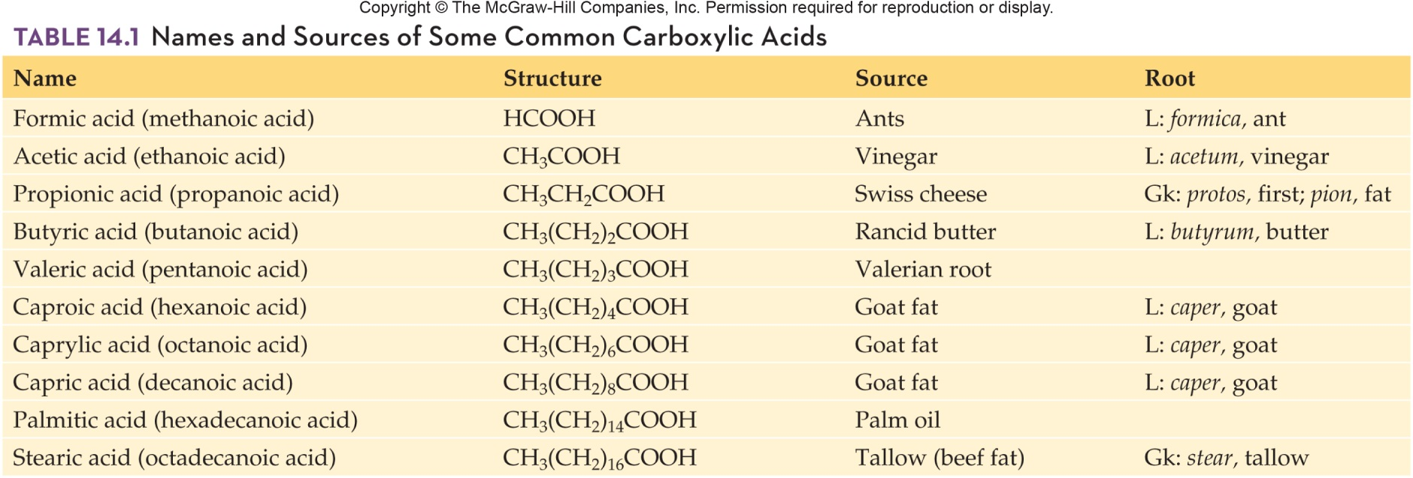
Names and Structures of Some Common Carboxylic Acids
14.1 Carboxylic Acids

Slide 6
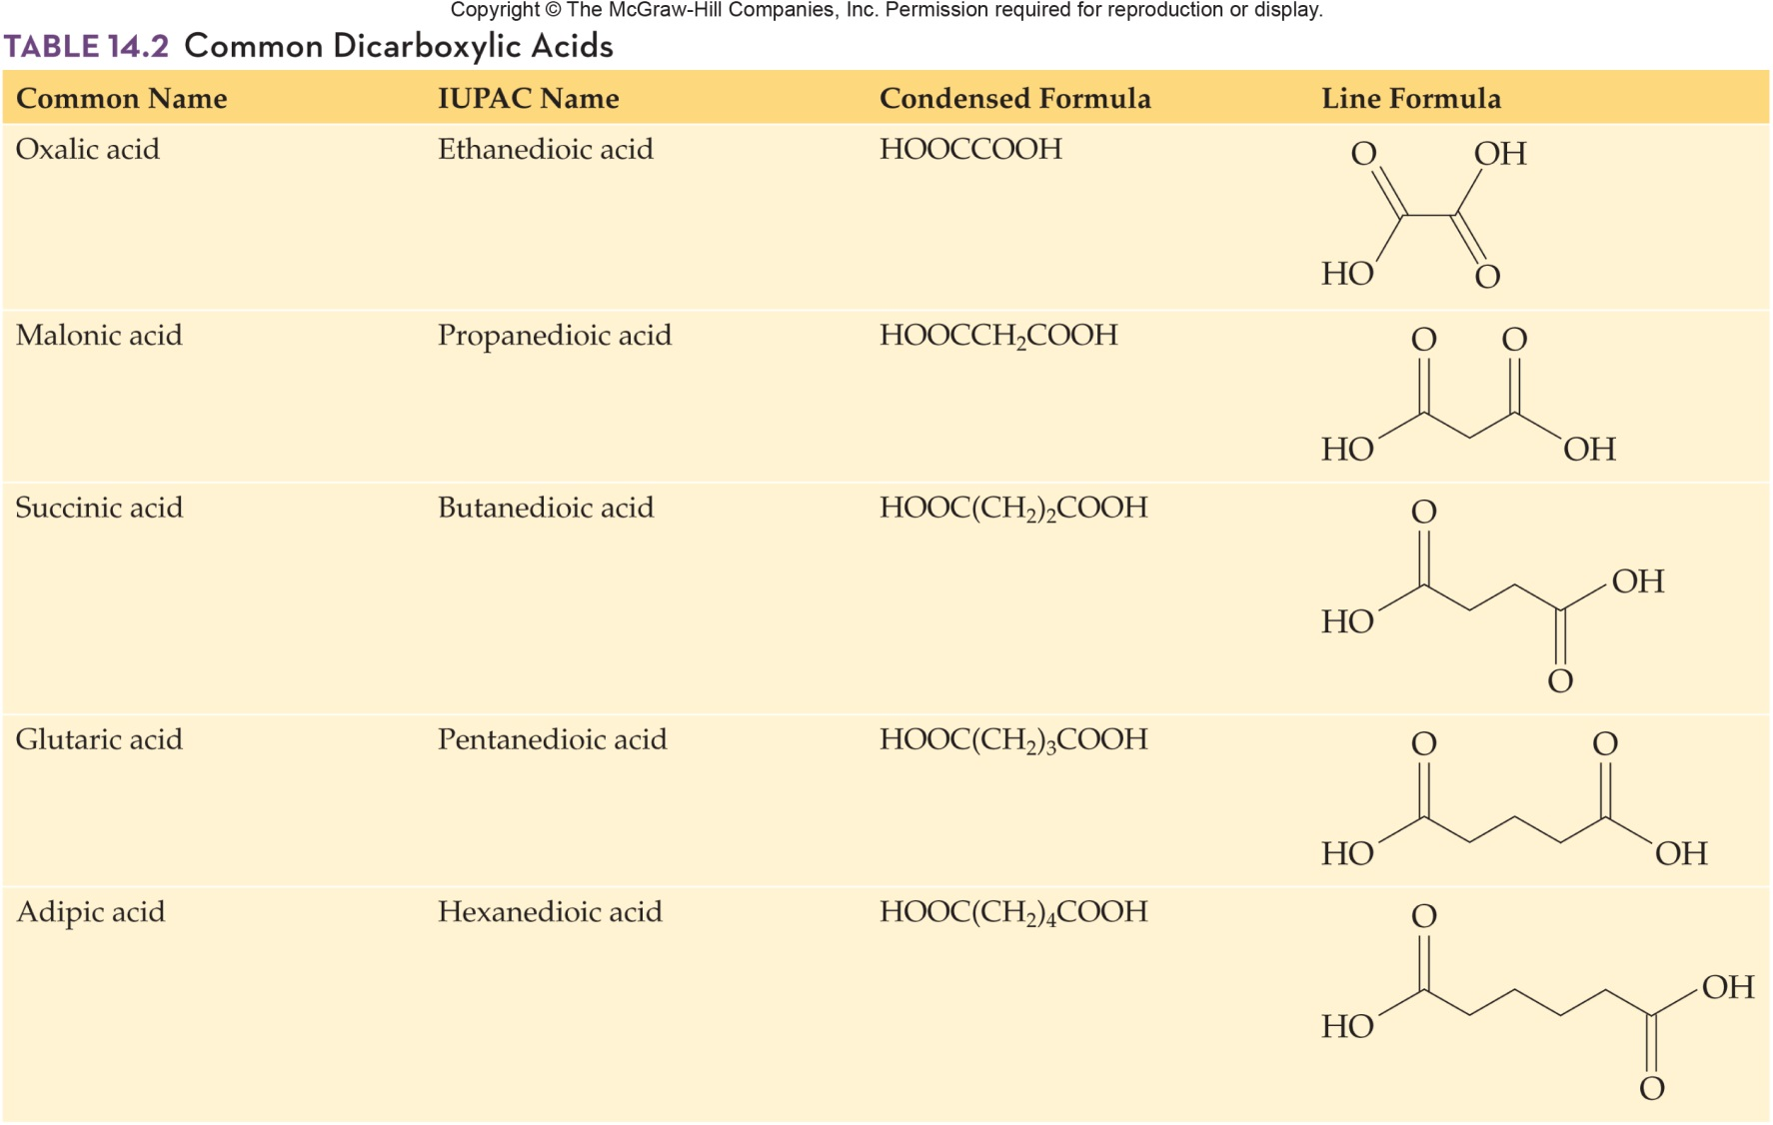
Common Dicarboxylic Acids
3
14.1 Carboxylic Acids

Slide 7
Some Important Carboxylic Acids
3
More complex carboxylic acids are found in a variety of foods
Citric Acid is found in citrus fruits
Bacteria in mild produce lactic acid as a product of fermentation of sugars
Tartaric acid is used in baking powder because it will react with carbonates in the dough
Malic acid gives the sour taste to green apples
Fatty acids are long chain carboxylic acids found in plant and animal sources
14.1 Carboxylic Acids

Slide 8
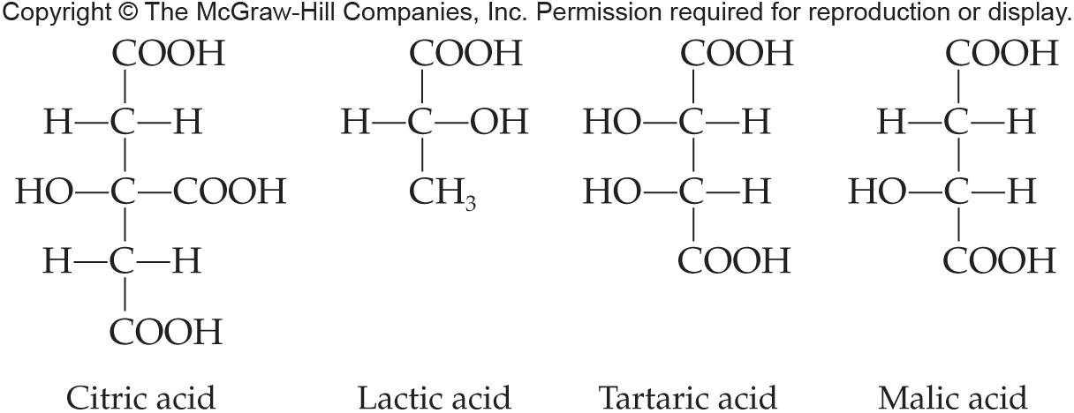
Carboxylic Acids Found in Food
3
14.1 Carboxylic Acids

Slide 9
Reactions Involving Carboxylic Acids
4
Carboxylic acids are prepared by oxidation of primary alcohols and aldehydes
14.1 Carboxylic Acids

Slide 10
Carboxylate Anion Formation
5
Carboxylic acids behave as acids because when they are dissolved in water they will deprotonate to form a carboxylate ion and the hydronium ion
Carboxylic acids are weak acids with dissociations of less than 5%
14.1 Carboxylic Acids
Copyright © 2017 McGraw-Hill Education. Permission required for reproduction or display

Slide 11
Neutralization Reactions
Carboxylic acids DO react with strong bases to form carboxylate salts
A process of neutralization
Acid protons are removed by the –OH⁻ to form H₂O and carboxylate ion
Equilibrium shifts to the right with removal of H⁺
14.1 Carboxylic Acids

Slide 12
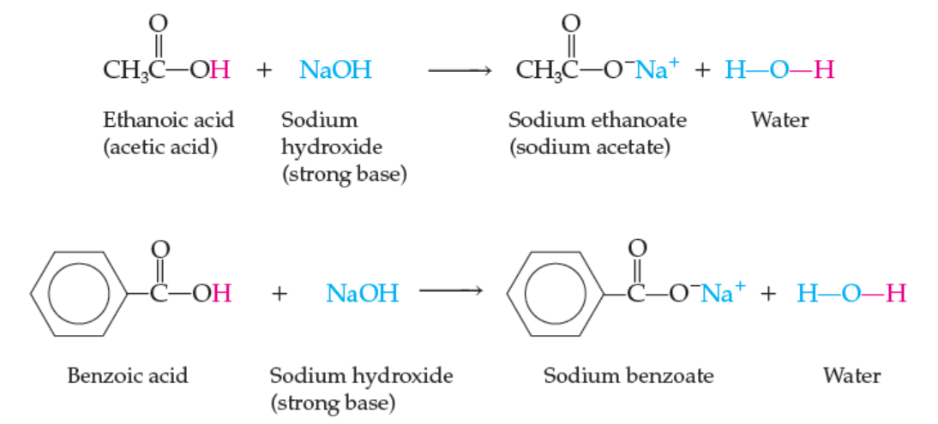
Acid-Base Reactions
14.1 Carboxylic Acids
Copyright © 2017 McGraw-Hill Education. Permission required for reproduction or display

Slide 13
Esterification
6
Carboxylic acids react with alcohols to form:
Esters
Water
14.1 Carboxylic Acids
Copyright © 2017 McGraw-Hill Education. Permission required for reproduction or display

Slide 14
Preparing Esters
6
Carboxylic acids react with alcohols to produce esters
The reaction is catalyzed by strong mineral acid
Heat is required
A molecule of water is also released as a product: reaction is a dehydration
14.2 Esters
Copyright © 2017 McGraw-Hill Education. Permission required for reproduction or display

Slide 15
Hydrolysis of Esters
9
The main reaction of esters is hydrolysis, reaction with water
This reaction is also called hydration = cleavage of any bond by the addition of a water molecule
However, the uncatalyzed reaction is slow and requires heat
The reaction can be either acid or base catalyzed
14.2 Esters

Slide 16
Acid hydrolysis of Esters
Acid hydrolysis products are:
Acid
Alcohol
14.2 Esters
Copyright © 2017 McGraw-Hill Education. Permission required for reproduction or display

Slide 17
Base Hydrolysis of Esters
10
The base catalyzed hydrolysis of an ester:
Saponification or soap-making
Products are:
Acid salt
Alcohol
Acid can’t exist in basic conditions, so the product is the salt of the carboxylic acid using the cation of the base catalyst
14.2 Esters
Copyright © 2017 McGraw-Hill Education. Permission required for reproduction or display

Slide 18
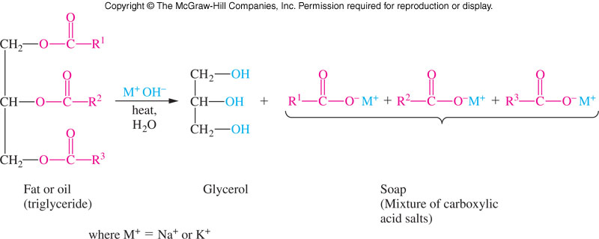
Saponification
Saponification (soap-making) is:
Base-catalyzed hydrolysis of fats (glycerol triesters)

Slide 19
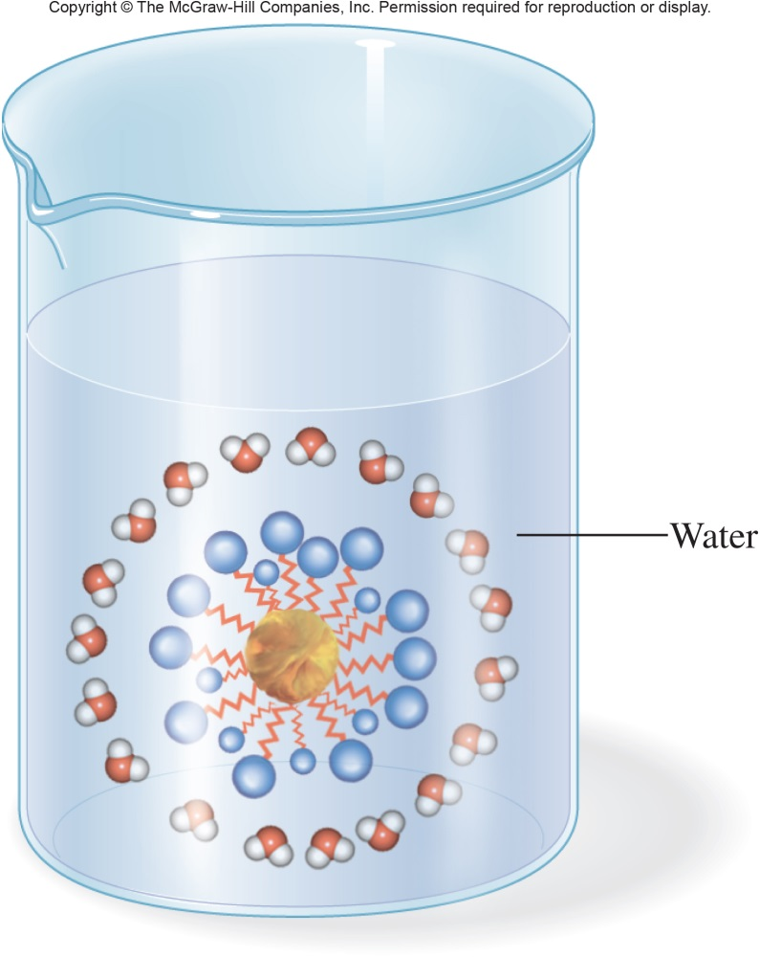
Simplified Action of Soap
The wiggly lines represent the long carbon chains of each soap molecule
Particles of oil and grease are surrounded by soap molecules to form a micelle
14.2 Esters

Slide 20
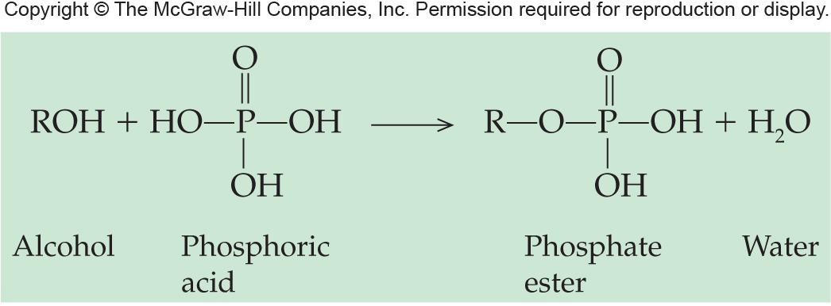
14.4 Nature’s High Energy Compounds: Phosphoesters and Thioesters
14
Phosphoric acid reacts with alcohols to produce a phosphate ester or phosphoester
The ester can then react with a second or third acid to give phosphoric acid anhydrides
ADP and ATP of biochemistry fame are important examples of phosphate esters

Slide 21
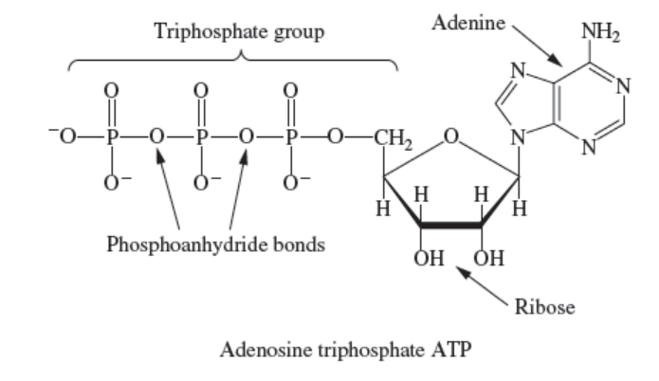
ATP – Adenosine Triphosphate
14.4 Nature’s High Energy Compounds: Phosphoesters and Thioesters
Copyright © 2017 McGraw-Hill Education. Permission required for reproduction or display

Slide 22
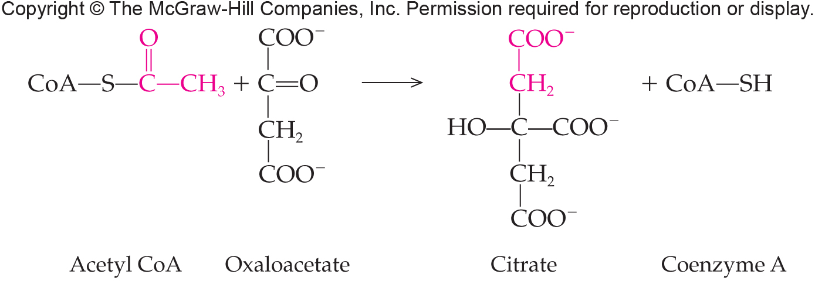
Thioesters
In biochemistry, acetyl coenzyme A (acetyl CoA-SH) reacts with acyl groups to “activate” them for further biological reaction by forming a thioester
14.4 Nature’s High Energy Compounds: Phosphoesters and Thioesters

