Slide 1
ORGANIC CHEMISTRY
13
Aldehydes and Ketones
General, Organic, and Biochemistry 9th Edition
Katherine J. Denniston
Joseph J. Topping
Danaè R. Quirk Dorr
Robert L. Caret
Copyright © 2017 McGraw-Hill Education. Permission required for reproduction or display

Slide 2
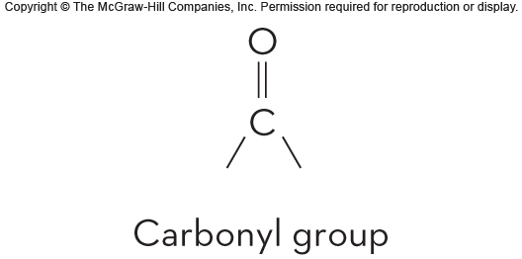
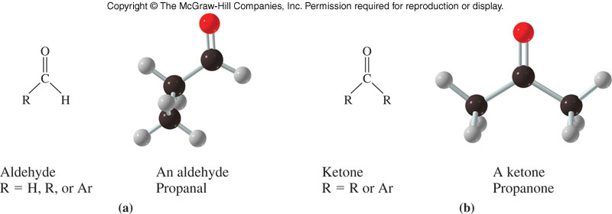
13.1 Structures and Physical Properties

Slide 3
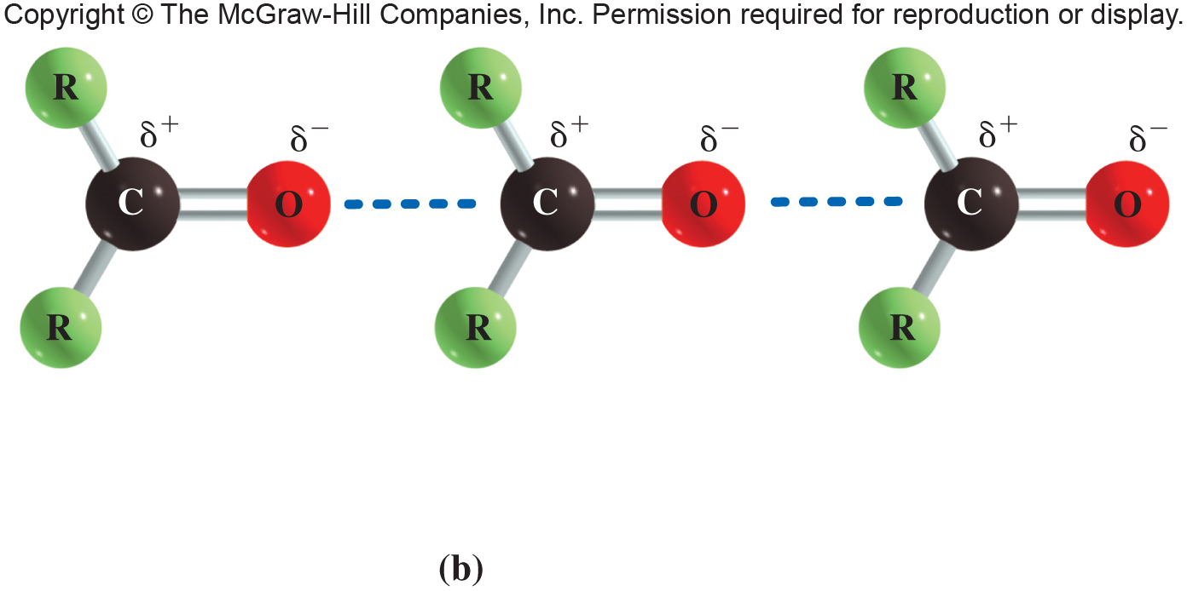
13.1 Structure and Physical Properties
Aldehydes and ketones are polar compounds
The carbonyl group is polar
The oxygen end is electronegative
1

Slide 4
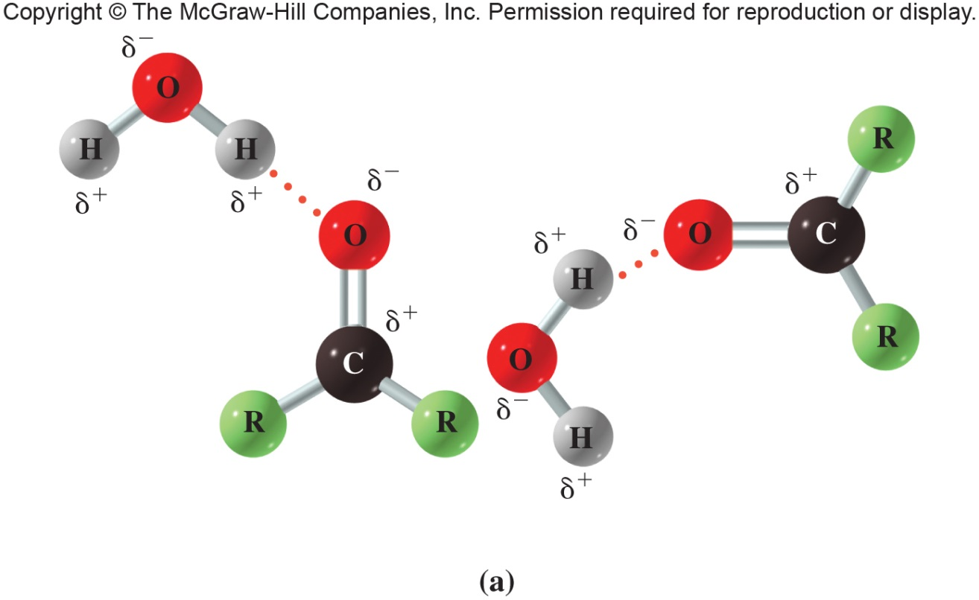
Hydrogen Bonding in Carbonyls
Aldehydes and ketones cannot form intermolecular hydrogen bonds
However, water can form hydrogen bonds to them
13.1 Structure and Physical Properties

Slide 5
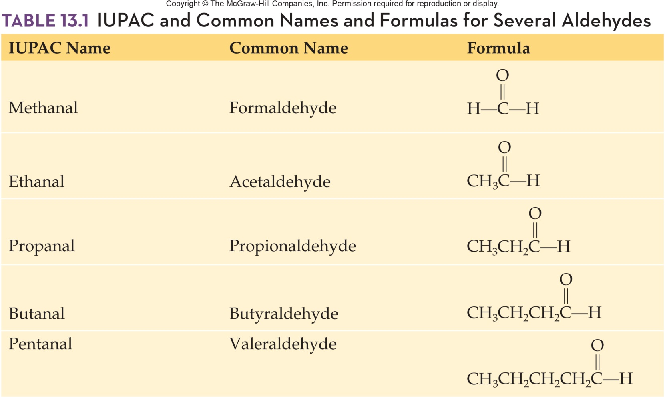
IUPAC and Common Names With Formulas for Several Aldehydes
13.2 Nomenclature and Common Names

Slide 6
13.3 Important Aldehydes and Ketones
3
Methanal (formaldehyde) - gas used in aqueous solutions as formalin to preserve tissue
Ethanal (acetaldehyde) - produced from ethanol in the liver causing hangover symptoms
Propanone (Acetone) - simplest possible ketone
Miscible with water
Flammable
Both acetone and methyl ethyl ketone (butanone) are very versatile solvents

Slide 7
Important Uses of Carbonyl Compounds
Used in many industries
Food chemicals
Natural food additives
Artificial additives
Fragrance chemicals
Medicines
Agricultural chemicals
13.3 Important Aldehydes and Ketone

Slide 8
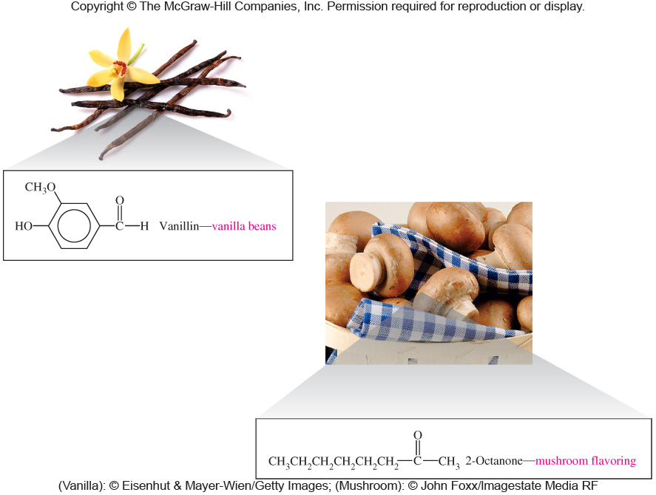
Vanillin and 2-Octanone
13.3 Important Aldehydes and Ketone

Slide 9
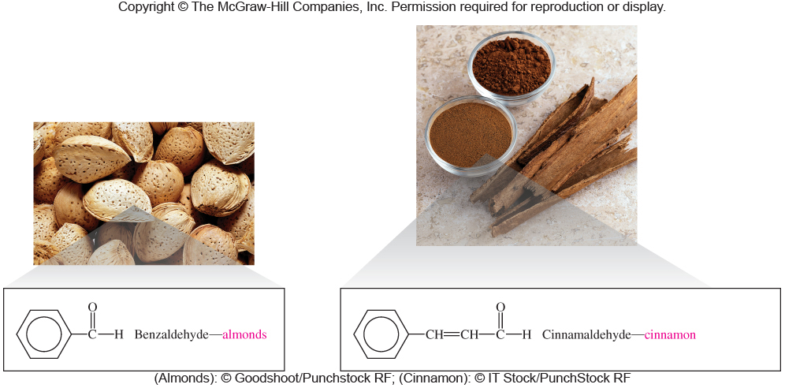
Benzaldehyde and Cinnamaldehyde
13.3 Important Aldehydes and Ketone

Slide 10
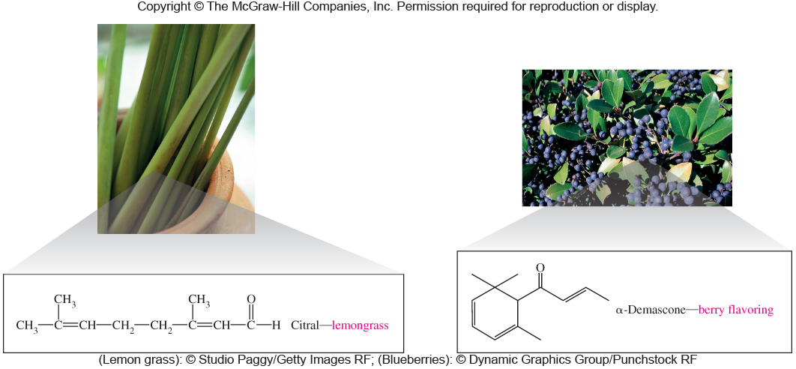
Citral and α-Demascone
13.3 Important Aldehydes and Ketone

Slide 11
1° Alcohol Oxidation
An aldehyde is formed
4
13.4 Reactions Involving Aldehydes and Ketones

Slide 12
2° Alcohol Oxidation
4
A ketone is formed
13.4 Reactions Involving Aldehydes and Ketones

Slide 13
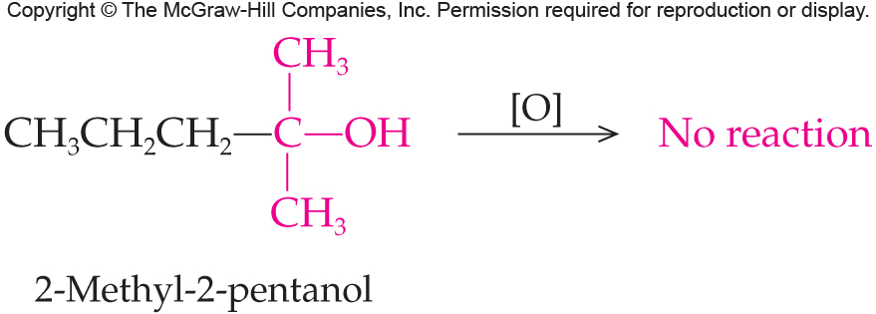
3° Alcohol
4
3º alcohols cannot undergo oxidation:
13.4 Reactions Involving Aldehydes and Ketones

Slide 14
Reactions of Aldehydes and Ketones
Oxidation and Reduction
Aldehydes: oxidized to carboxylic acids
Aldehydes and ketones are reduced to alcohols: aldehydes to primary alcohols and ketones to secondary alcohols
Addition
Alcohols to give hemiacetals and acetals,
13.4 Reactions Involving Aldehydes and Ketones

Slide 15
Oxidation of Aldehydes
5
Aldehydes are easily oxidized to carboxylic acids by almost any oxidizing agent
So easily oxidized that it is often difficult to prepare them as they continue on to carboxylic acids
13.4 Reactions Involving Aldehydes and Ketones

Slide 16
Visually Distinguishing Aldehydes From Ketones
Visual tests for the aldehyde functional group based on its easy oxidation are:
Tollen’s Test
Silver ion is reduced to silver metal
Use a basic solution of Ag(NH₃)₂⁺
The silver metal precipitates and coats the container producing a smooth silver mirror
13.4 Reactions Involving Aldehydes and Ketones

Slide 17
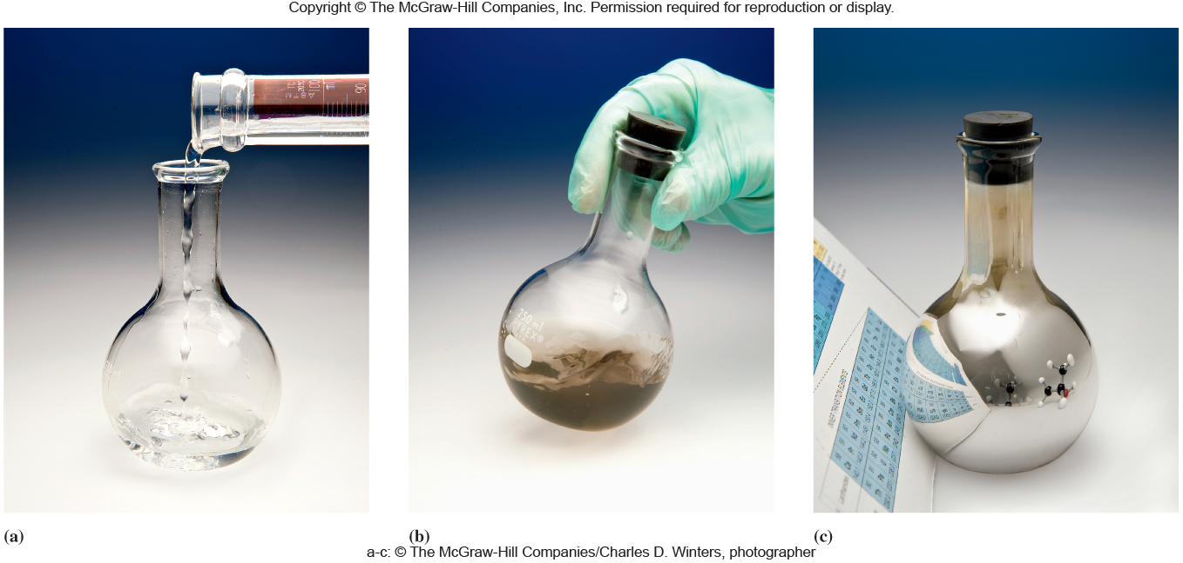
Tollen’s Test
13.4 Reactions Involving Aldehydes and Ketones

Slide 18
Benedict’s Test
Benedict’s Test
Reagent is a buffered aqueous solution of Cu(OH)₂ and sodium citrate
Reacts with aldehydes, but not with ketones
Cu²⁺ is reduced to Cu⁺
Solution of Cu²⁺ is a distinctive blue color
Color fades during the reaction as Cu⁺ precipitates as the red solid, copper(I) oxide, Cu₂O
13.4 Reactions Involving Aldehydes and Ketones

Slide 19
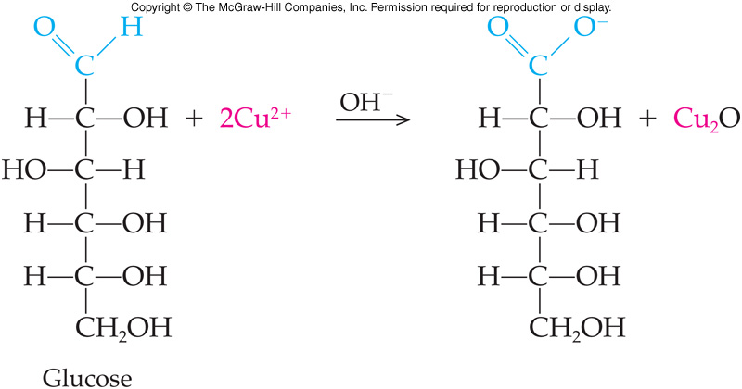
Benedict’s Test on Glucose
Benedict’s Test
13.4 Reactions Involving Aldehydes and Ketones

Slide 20
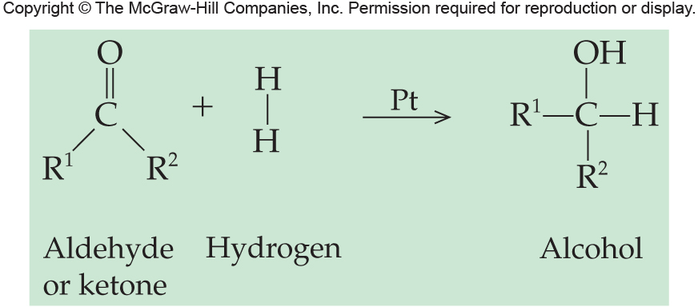
Reduction of Carbonyls
7
Both aldehydes and ketones are readily reduced to alcohols
Reduction occurs with hydrogen as the reducing agent
Classical reaction is hydrogenation
React with hydrogen gas
Requires a catalyst – Ni, Pt, Pd
13.4 Reactions Involving Aldehydes and Ketones

Slide 21
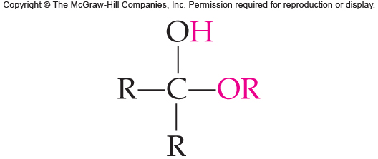
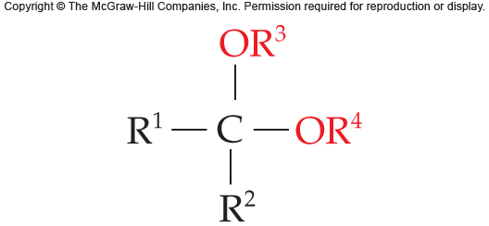
Hemiacetal and Acetal Formation
7
13.4 Reactions Involving Aldehydes and Ketones
Generalized structure of a hemiacetal
Generalized structure of an acetal

Slide 22
Aldehyde and Alcohol Reaction
Product of the addition reaction is a hemiacetal followed by formation of an acetal
13.4 Reactions Involving Aldehydes and Ketones

Slide 23
Ketone and Alcohol Reaction
13.4 Reactions Involving Aldehydes and Ketones

Slide 24
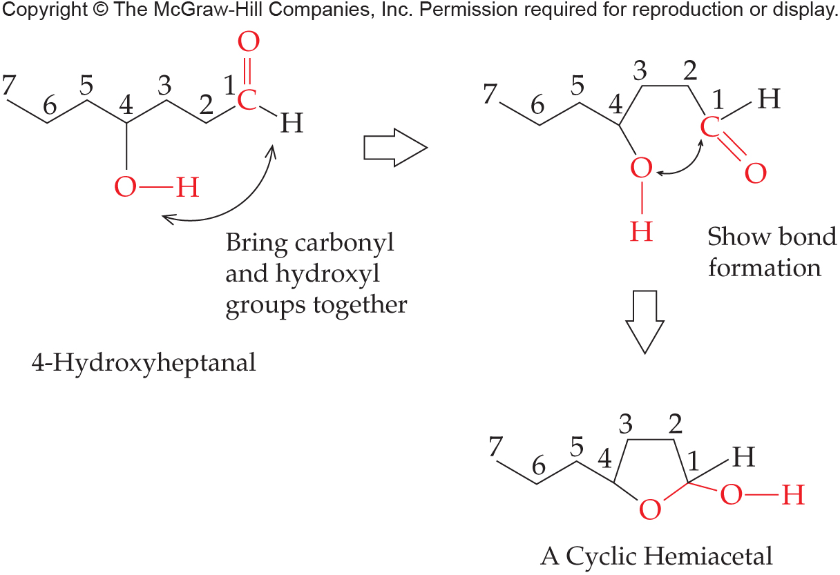
Intramolecular Hemiacetal Formation
The aldehyde and alcohol functional groups can both be parts of the same molecule in an intramolecular reaction
13.4 Reactions Involving Aldehydes and Ketones

Slide 25
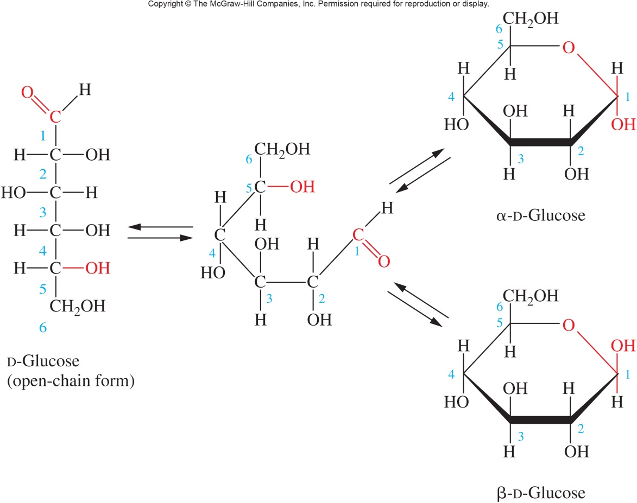
Hemiacetals and Carbohydrates
This reaction is important in the chemistry of carbohydrates, where hemiacetals are readily formed:
13.4 Reactions Involving Aldehydes and Ketones

Slide 26
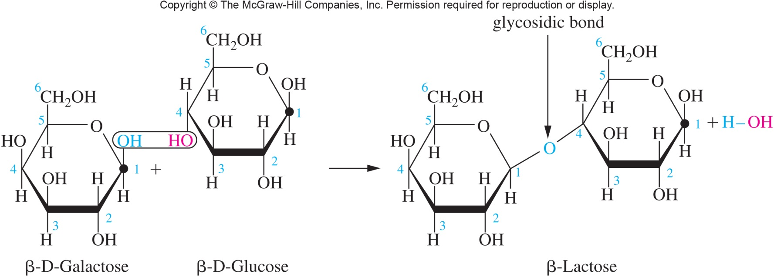
Acetals and Carbohydrates
The acetal is formed between the hemiacetal hydroxyl group in blue with the alcohol hydroxyl group in red on a second molecule
13.4 Reactions Involving Aldehydes and Ketones

