Slide 1
ORGANIC CHEMISTRY
12
Alcohols, Phenols,
Thiols, and Ethers
General, Organic, and Biochemistry
9th Edition
Katherine J. Denniston
Joseph J. Topping
Danaè R. Quirk Dorr
Robert L. Caret
Copyright © 2017 McGraw-Hill Education. Permission required for reproduction or display

Slide 2
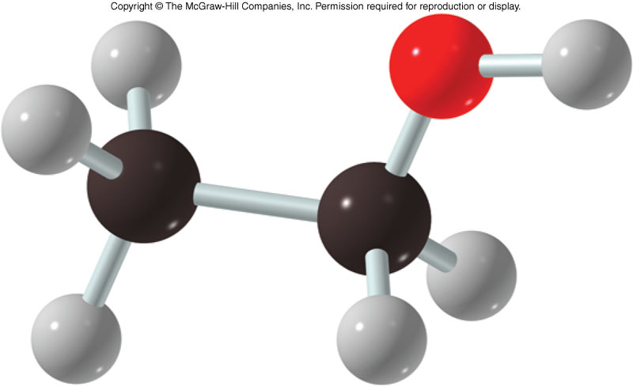
12.1 Alcohols: Structure and Physical Properties
1
An organic compound containing a hydroxyl group attached to an alkyl group
Alcohols have the general formula R-OH

Slide 3
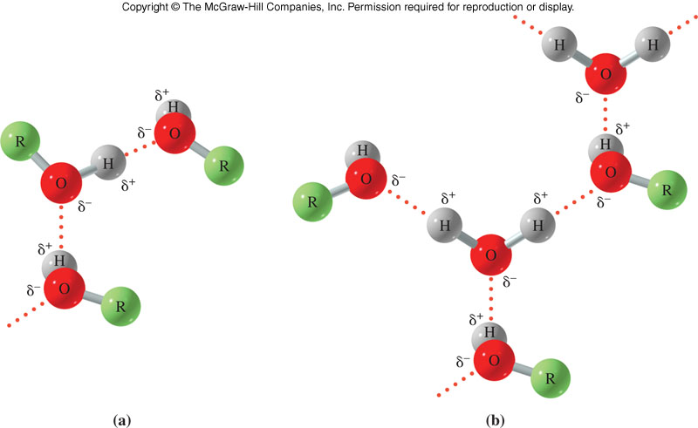
Physical Properties of Alcohols
R-O-H has a structure similar to that of water
Hydroxyl group is very polar
Hydrogen bonds can form readily
  High boiling points relative to their molar masses due to ability to hydrogen bond
2
12.1 Structure and Physical Properties

Slide 4
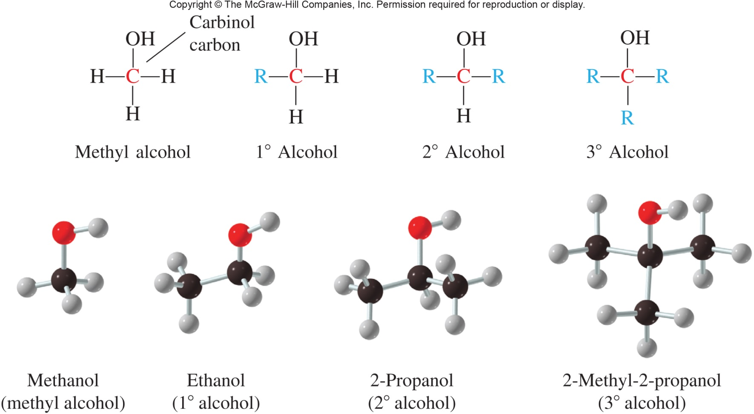
Alcohol Classification
12.1 Structure and Physical Properties

Slide 5
12.3 Medically Important Alcohols
Methanol
  Colorless and odorless liquid
  Used as a solvent
  Toxic, can cause blindness and death if ingested
  Can be used as a fuel
3

Slide 6
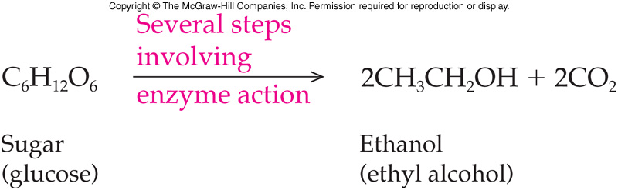
Ethanol
An odorless and colorless liquid
Widely used as a solvent
The alcohol in alcoholic beverages
  Derived from fermentation of carbohydrates
  Beverage produced varies with the starting material and the fermentation process
12.3 Medically Important Alcohols

Slide 7
2-Propanol (Isopropyl alcohol)
Colorless, but has a slight odor
Commonly called rubbing alcohol
Toxic when ingested
Used as a:
  Disinfectant
  Astringent
  Industrial solvent
12.3 Medically Important Alcohols

Slide 8
1,2-Ethanediol (Ethylene glycol)
Used as automobile antifreeze
Has a sweet taste, but is extremely poisonous
Added to water
  Lowers the freezing point
  Raises the boiling point
12.3 Medically Important Alcohols

Slide 9
1,2,3-Propanetriol (Glycerol)
Very viscous, thick
Has a sweet taste
Non-toxic
Highly water soluble
Used in:
  Cosmetics
  Pharmaceuticals
  Lubricants
Obtained as a by-product of fat hydrolysis
12.3 Medically Important Alcohols

Slide 10
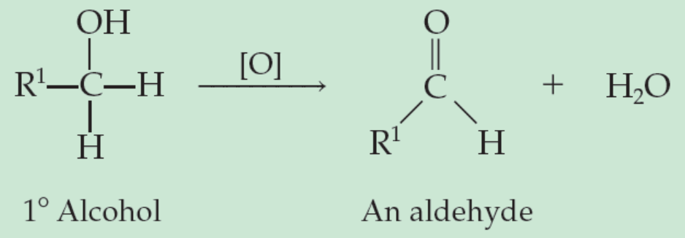
Oxidation Reaction of Primary Alcohols
Primary alcohols usually oxidize to carboxylic acids
  The symbol [O] represents an oxidizing agent (KMnO₄/OH⁻ or H₂CrO₄) which is used to oxidize a 1º alcohol to an aldehyde
12.4 Reactions Involving Alcohols
8
Copyright © 2017 McGraw-Hill Education. Permission required for reproduction or display

Slide 11
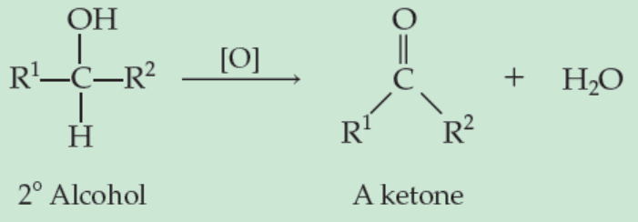
Oxidation Reaction of Secondary Alcohols
Secondary alcohols oxidize to ketones
  This reaction is also an elimination of 2H
12.4 Reactions Involving Alcohols
Copyright © 2017 McGraw-Hill Education. Permission required for reproduction or display

Slide 12
12.5 Oxidation and Reduction in Living Systems
9
Oxidation is the loss of electrons
Reduction is the gain of electrons
These changes are easily detected in inorganic systems with formation of charged ions
In organic systems it is often difficult to determine whether oxidation or reduction has taken place as there might be no change in charge

Slide 13
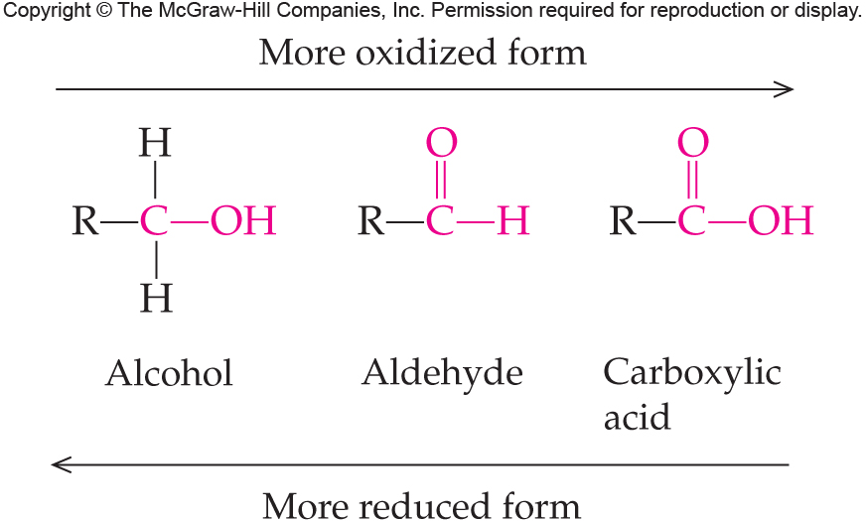
Organic Oxidation and Reduction
In organic systems changes may be tracked:
Oxidation:
  gain of oxygen
  loss of hydrogen
Reduction:
  loss of oxygen
  gain of hydrogen
12.5 Oxidation and Reduction in Living Systems

Slide 14
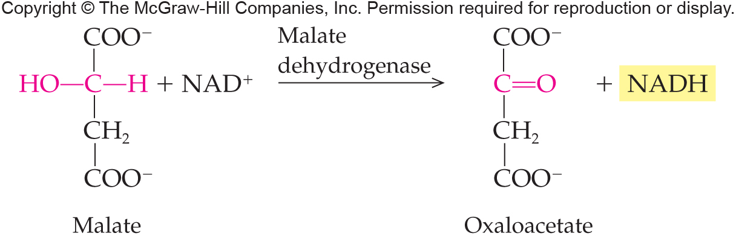
Biological Oxidation-Reduction
NAD⁺ is a coenzyme commonly involved in biological oxidation/reduction reactions:
12.5 Oxidation and Reduction in Living Systems

Slide 15
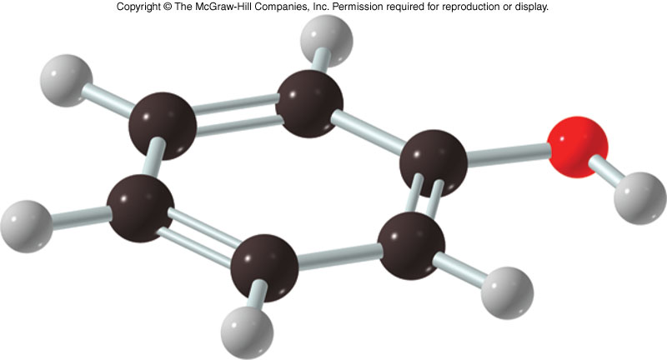
12.6 Phenol
Phenols are compounds in which the hydroxyl group is attached to a benzene ring
  Polar compounds due to the hydroxyl group
  Simpler phenols are somewhat water soluble
  Components of flavorings and fragrances
Phenols have the formula Ar-OH
  Ar must be an aromatic ring (e.g., Benzene)
10

Slide 16
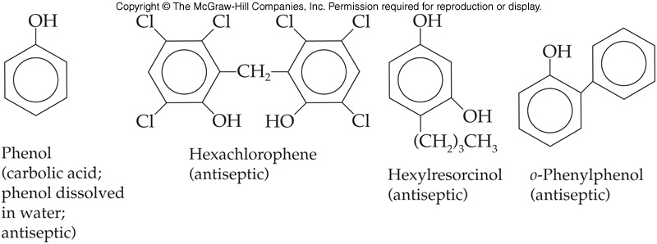
Phenol Derivatives
Widely used in healthcare as:
  Germicides
  Antiseptics
  Disinfectants
12.6 Phenols

Slide 17
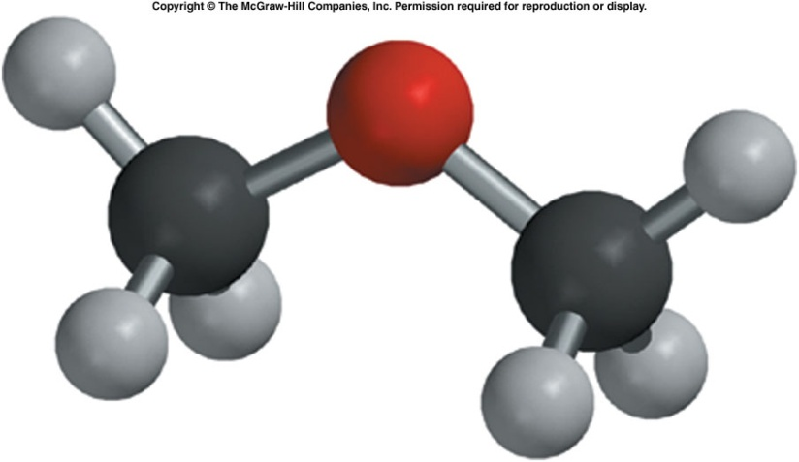
12.7 Ethers
Ethers have the formula R-O-R
  R can be aliphatic or aromatic
Ethers are slightly polar due to the polar C=O bond
Do not hydrogen bond to one another as there are no –OH groups
11

Slide 18
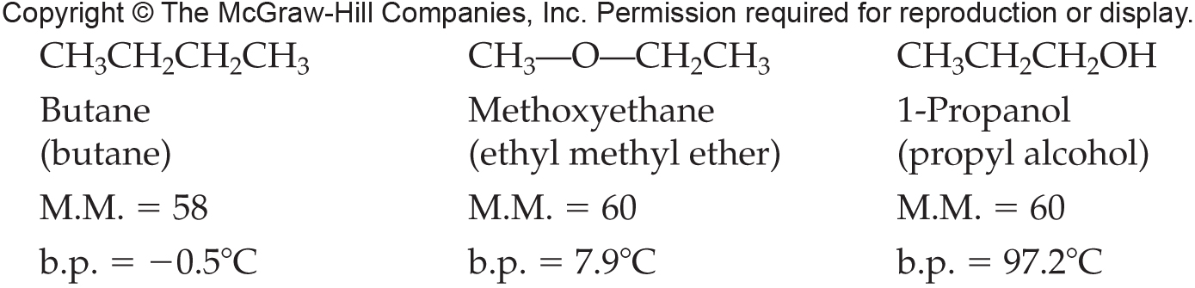
Ether Physical Properties
Ethers have much lower boiling points than alcohols due to the lack of hydrogen bonding
12.7 Ethers

Slide 19
Medical Uses of Ethers
Ethers are often used as anesthetics
Accumulate in the lipid material of nerve cells interfering with nerve impulse transmission
Today halogenated ethers are used routinely as general anesthetics
  Less flammable
  Safer to store and to work with
12.7 Ethers

Slide 20
12.8 Thiols
Thiols have the formula R-SH
Similar in structure to alcohols with S replacing O
Name is based on longest alkane chain with the suffix –thiol position indicated by number

Slide 21
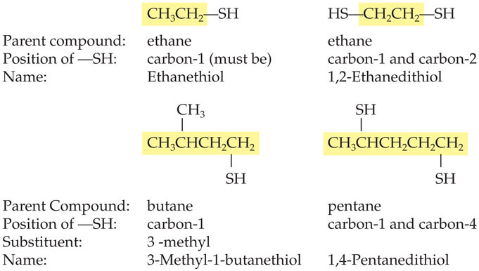
Naming Thiols
Write the IUPAC name for the thiols shown
12.8 Thiols

Slide 22
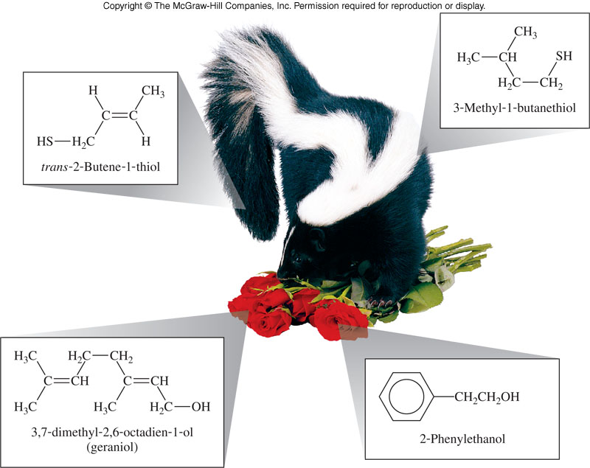
Thiols and Scent
Thiols, as many other sulfur-containing compounds can have nauseating aromas
  Defensive spray of North American striped skunk
  Onions and garlic
Compare with pleasant scents below
12.8 Thiols

Slide 23
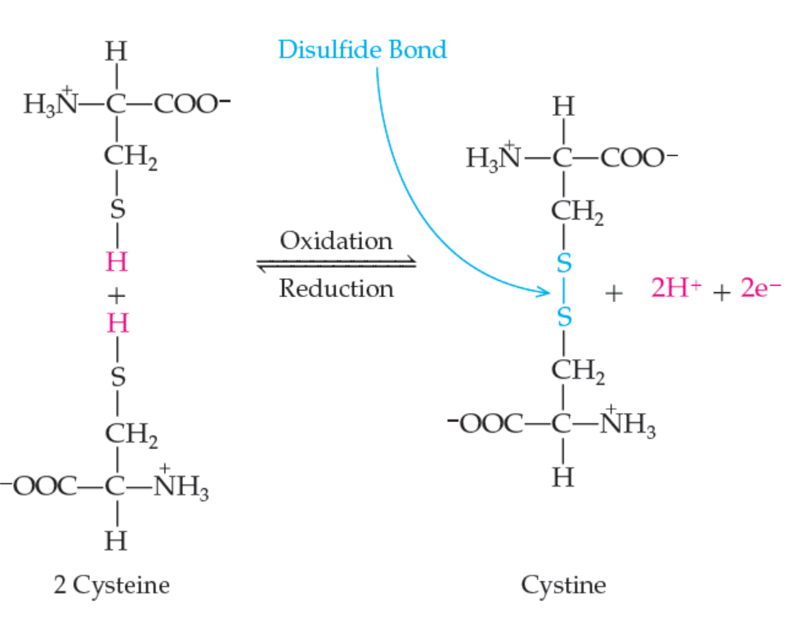
Disulfide Formation
The thiol-disulfide redox pair controls a critical factor in protein structure called a disulfide bridge
  Two cysteine molecules (amino acids) can undergo oxidation to form cystine
  Forms a new bond called a disulfide bond
12.8 Thiols
Copyright © 2017 McGraw-Hill Education. Permission required for reproduction or display

Slide 24
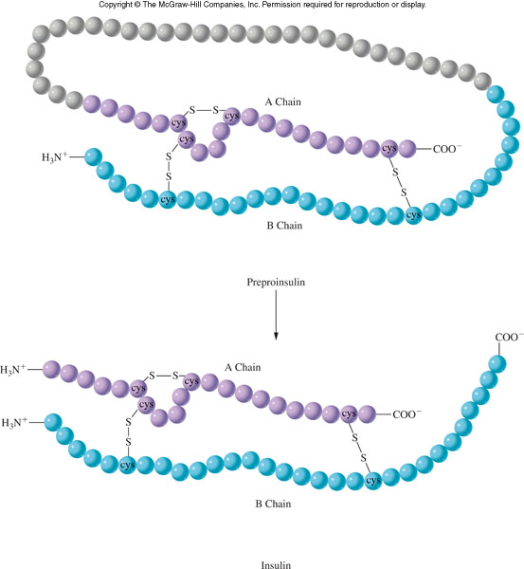
Disulfide Formation and Insulin Structure
12.8 Thiols

Slide 25
Reactions of Alcohols
1. Preparation of Alcohols
  a. Hydration of Alkenes
  b. Reduction of Aldehyde or Ketone
2. Reactions of Alcohols
  a. Dehydration
  b. Oxidation
    i. Primary alcohol to aldehyde
    ii. Secondary alcohol to ketone
    iii. Tertiary alcohol does not react
3. Dehydration Synthesis of an Ether

Slide 26
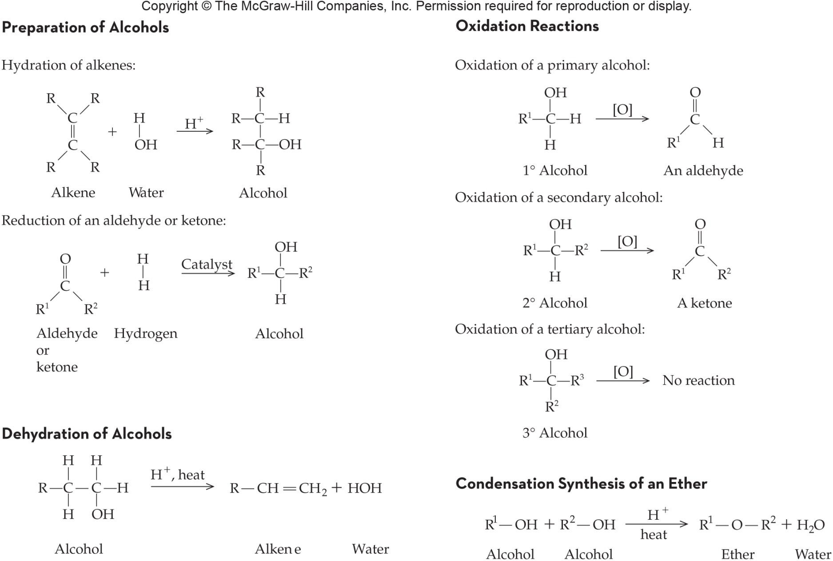
Summary of Reactions

