Slide 1
ORGANIC CHEMISTRY
11
The Unsaturated Hydrocarbons
Alkenes, Alkynes, and Aromatics
General, Organic, and Biochemistry
9th Edition
Katherine J. Denniston
Joseph J. Topping
Danaè R. Quirk Dorr
Robert L. Caret
Copyright © 2017 McGraw-Hill Education. Permission required for reproduction or display

Slide 2
11.1 Alkenes and Alkynes:
Structure and Physical Properties
1
Both alkenes and alkynes are unsaturated hydrocarbons
The alkene functional group is the carbon-carbon double bond
The alkyne functional group is the carbon-carbon triple bond
  Simplest alkene: ethene (ethylene) C₂H₄
  Simplest alkyne: ethyne (acetylene) C₂H₂

Slide 3
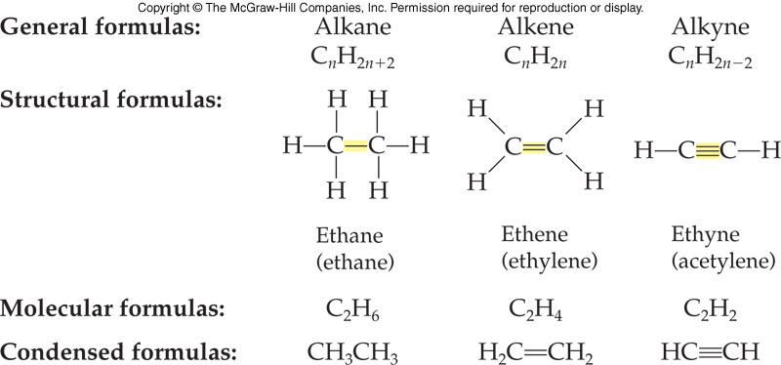
Aliphatic Hydrocarbon Structure Comparison
11.1 Structure and Physical
Properties

Slide 4
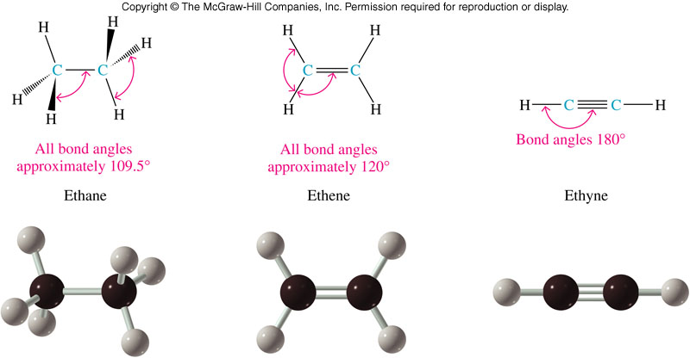
Bonding and Geometry of Two-Carbon Molecules
11.1 Structure and Physical
Properties

Slide 5
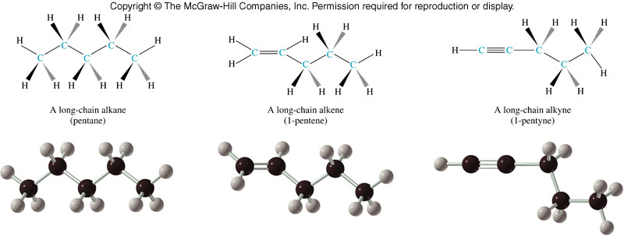
Structural Comparison of Five Carbon Molecules
11.1 Structure and Physical
Properties
Basic tetrahedral Planar around the Linear at the
zig-zag shape double bond triple bond

Slide 6
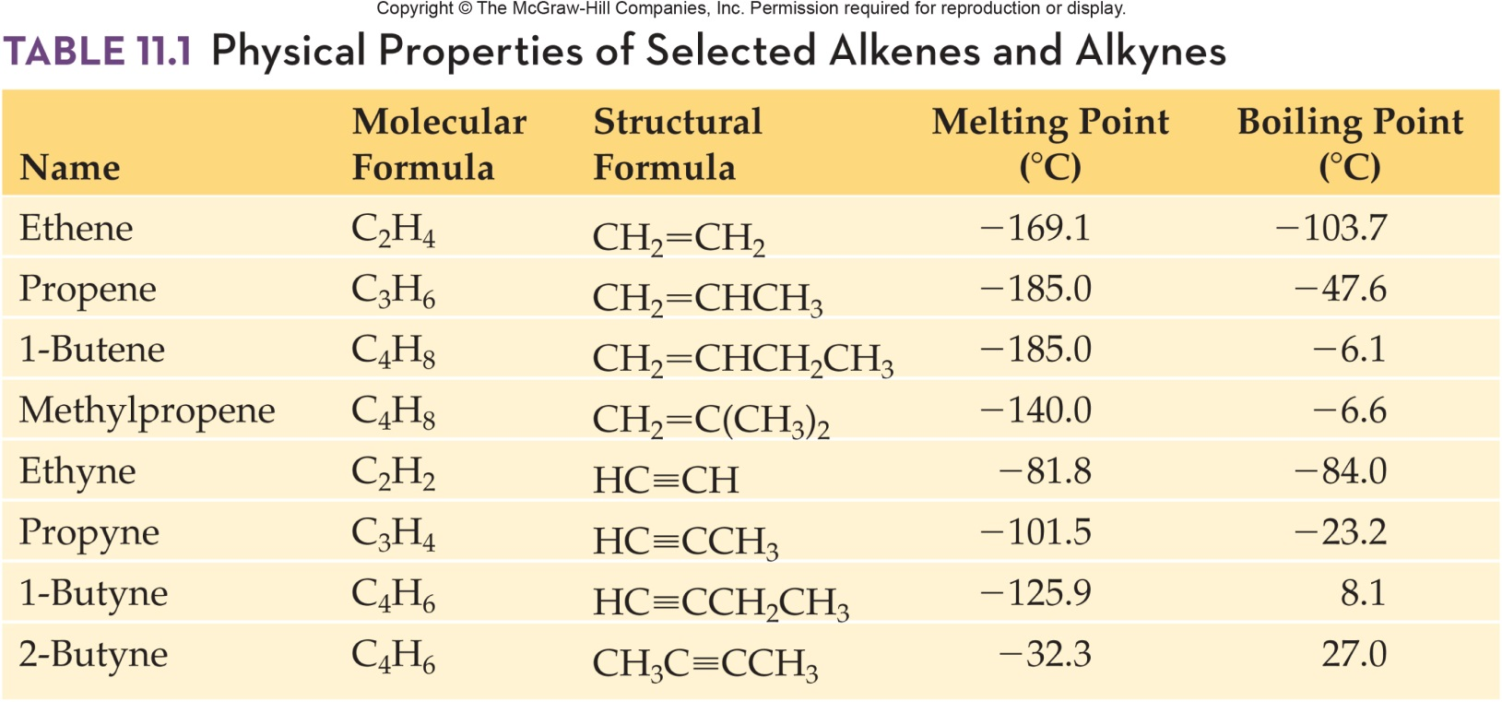
Physical Properties
Physical properties of the alkenes and alkynes are quite similar to those of alkanes
  Nonpolar
  Not soluble in water
  Highly soluble in nonpolar solvents
Boiling points rise with molecular weight
11.1 Structure and Physical
Properties

Slide 7
11.2 Alkenes and Alkynes: Nomenclature
2
Base name from longest chain containing the multiple bond
Change from -ane to -ene or -yne
Number from the end, that will give the first carbon of the multiple bond the lower number
Prefix the name with the number of the first multiple bond carbon
Prefix branch/substituent names as for alkanes

Slide 8
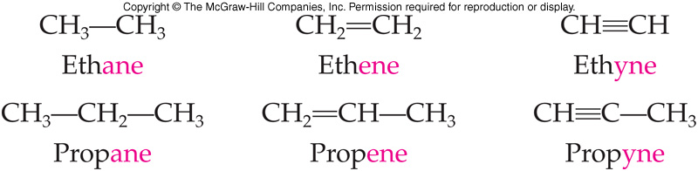
Comparison of Names
11.2 Nomenclature

Slide 9
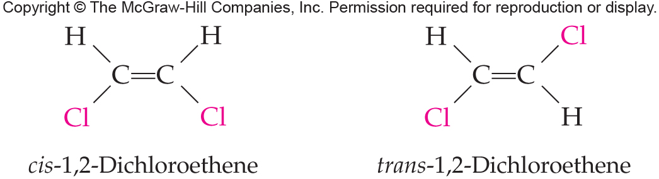
Naming Geometric Isomers
2-butene is the first example of an alkene which can have two different structures based on restricted rotation about the double bond
11.3 Geometric Isomers

Slide 10
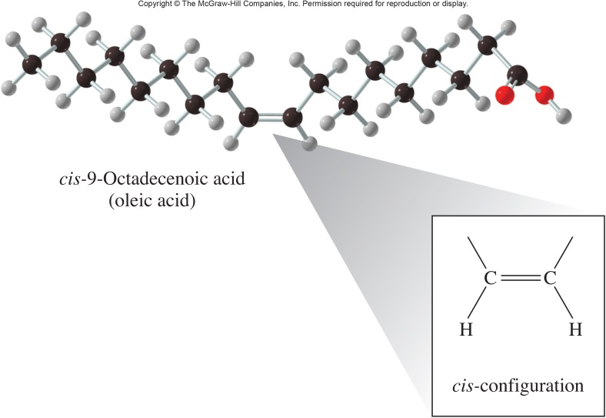
cis-Fatty Acids
Fatty acids are long-chain carboxylic acids found in vegetable oils (unsaturated fats) and animal fate (saturated fats)
The naturally occurring
fatty acid in olive oil
(oleic acid) is a cis-fatty acid:
11.3 Geometric Isomers

Slide 11
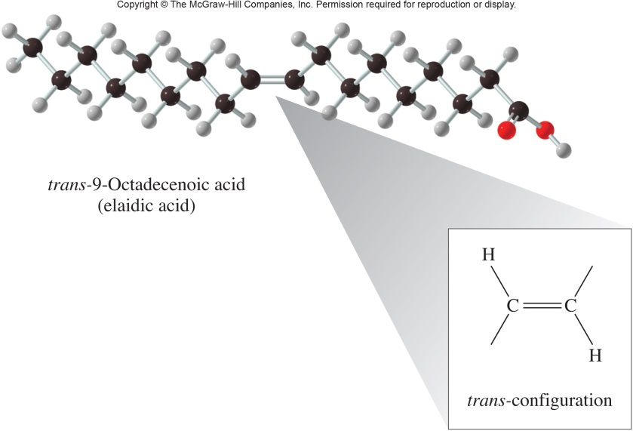
trans-Fatty acids
Its geometric isomer is a trans-fatty acid, with no natural source:
The majority of trans-fatty
acids result from
hydrogenation reactions
Trans-fatty acids have been reported
to lower levels of “good” HDL cholesterol in the body (and elevate “bad” LDL cholesterol)
11.3 Geometric Isomers

Slide 12
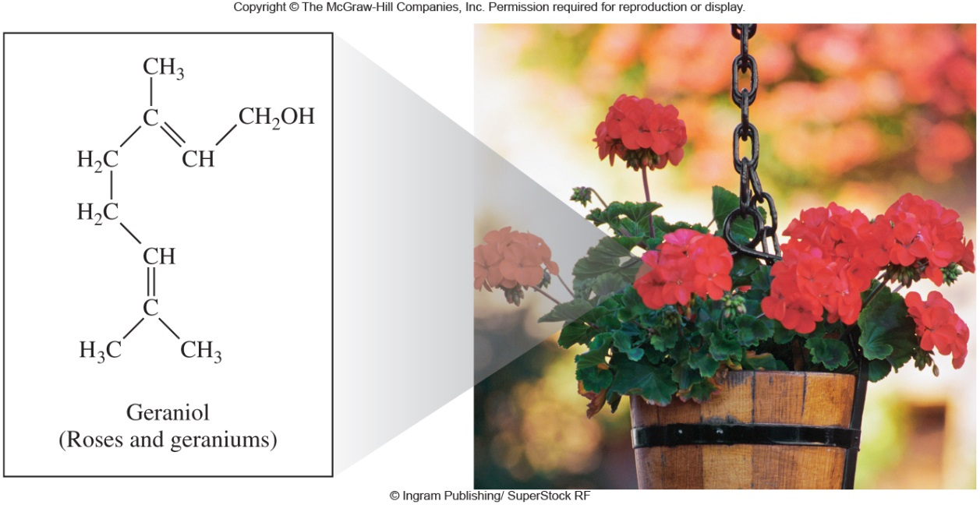
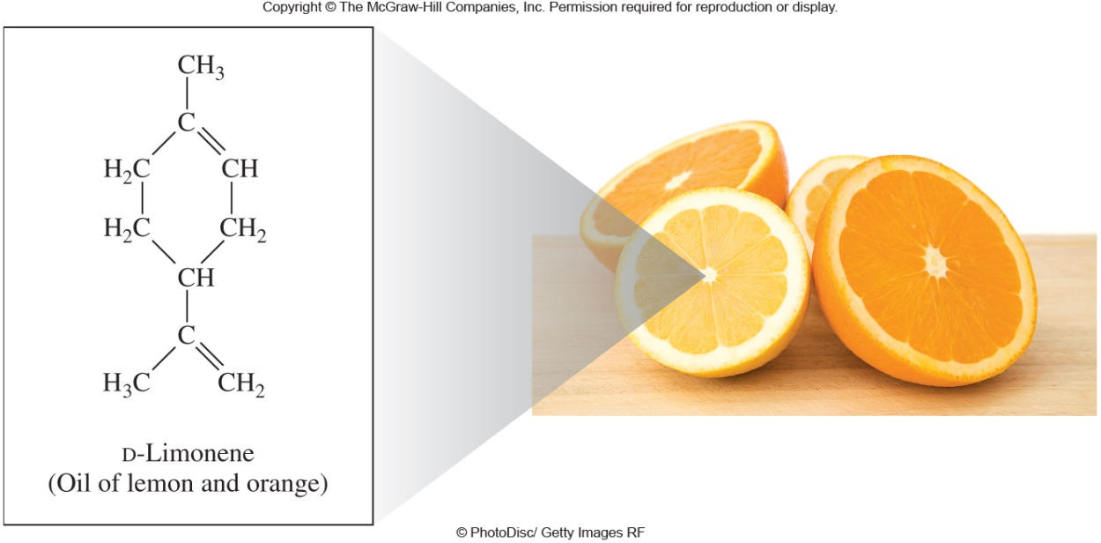
Isoprenoids – Geraniol and D-Limonene
11.4 Alkenes in Nature

Slide 13
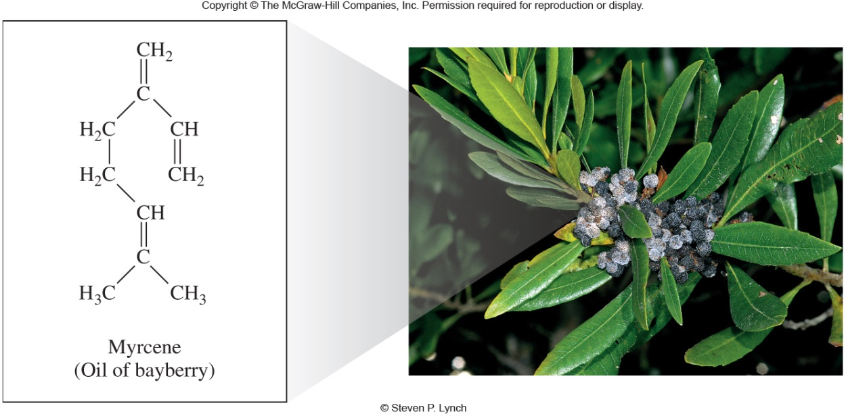
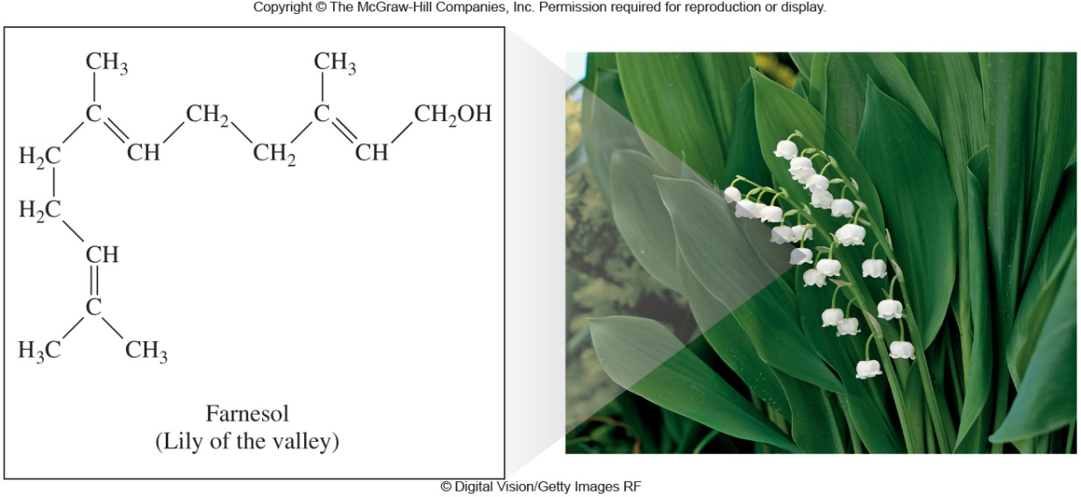
Isoprenoids – Myrcene and Farnesol
11.4 Alkenes in Nature

Slide 14
11.5 Reactions Involving Alkenes and Alkynes
4
The key reaction of alkenes:
  Addition: two molecules combine to give one new molecule
Hydrogenation – the addition of hydrogen atoms
Halogenation – the addition of halogen atoms
Hydration – the addition of a water molecule
Hydrohalogenation – the addition of a hydrogen halide molecule

Slide 15
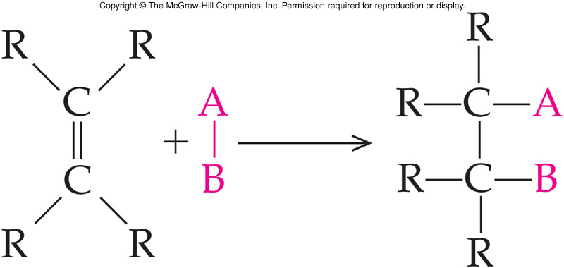
Addition: General Reaction
11.5 Reactions Involving Alkenes and Alkynes
A small molecule, AB, reacts with the pi electrons of the double bond
The pi bond breaks and its electrons are used to bond to the A and B pieces
Some additions require a catalyst

Slide 16
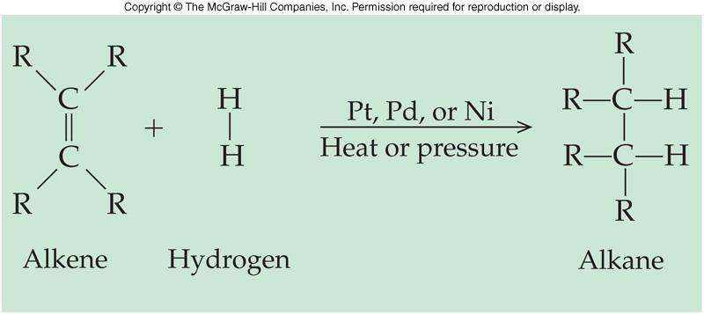
Hydrogenation: Addition of H₂
11.5 Reactions Involving Alkenes and Alkynes
Hydrogenation is the addition of a molecule of hydrogen (H₂) to a carbon-carbon double bond to produce an alkane
The double bond is broken
Two new C-H bonds result
Platinum, palladium, or nickel is required as a catalyst
Heat and/or pressure may also be required

Slide 17
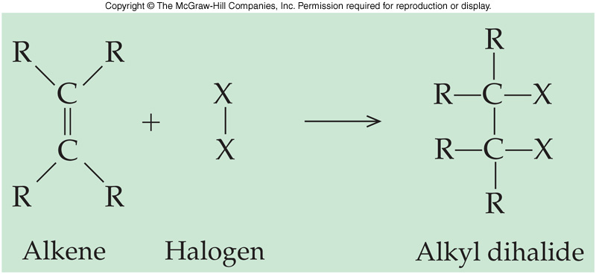
Halogenation: Addition of X₂
11.5 Reactions Involving Alkenes and Alkynes
Halogenation is the addition of a molecule of halogen (X₂) to a carbon-carbon double bond to produce an alkane
The double bond is broken
Two new C-X bonds result
Reaction occurs quite readily without a catalyst
Cl and Br are most often the halogen added

Slide 18
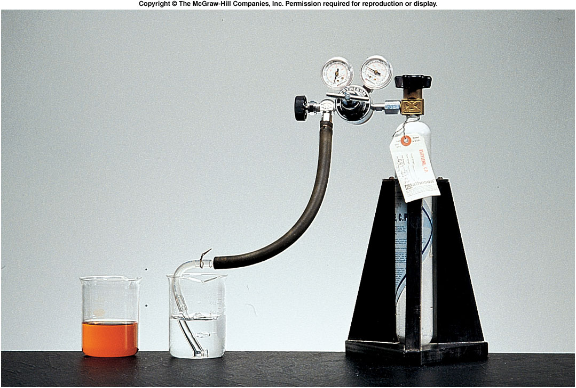
Bromination of an Alkene
11.5 Reactions Involving Alkenes and Alkynes
Left beaker contains bromine, but no unsaturated hydrocarbon
Right beaker contains bromine, but reaction with an unsaturated hydrocarbon results in a colorless solution

Slide 19
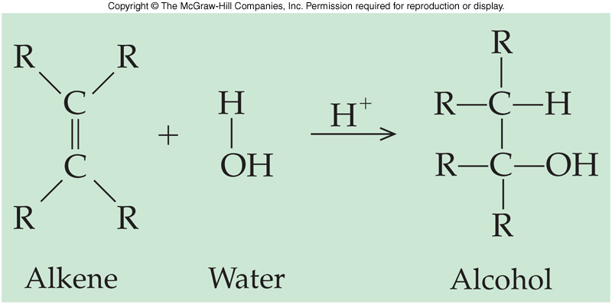
Hydration
11.5 Reactions Involving Alkenes and Alkynes
A water molecule can be added to an alkene
  The addition of a water molecule to an alkene is called hydration
Presence of strong acid is required as a catalyst
Product resulting is an alcohol

Slide 20
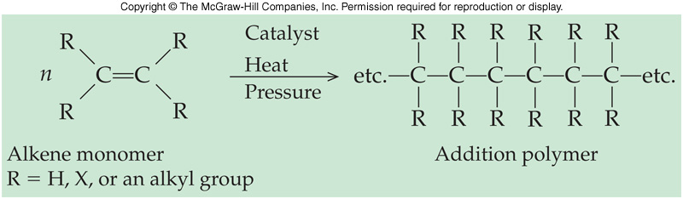
Addition Polymers of Alkenes
6
Polymers are macromolecules composed of repeating units called monomers
  Polymers can be made up of thousands of monomers linked together
Many commercially important materials are addition polymers made from alkenes and substituted alkenes
  Addition polymers are named for the fact that they are made by the sequential addition of the repeating alkene monomer
11.5 Reactions Involving Alkenes and Alkynes

Slide 21
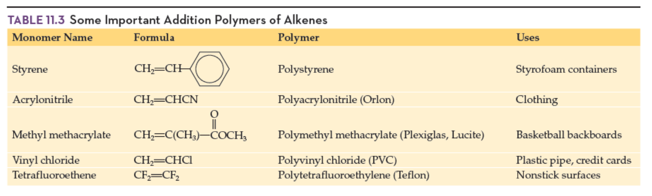
Some Important Addition Polymers of Alkenes
Copyright © 2017 McGraw-Hill Education. Permission required for reproduction or display

Slide 22
11.6 Aromatic Hydrocarbons
7
Benzene’s structure was first proposed 150 years ago
  A cyclic structure for benzene, C₆H₆
  Something special about benzene
    Although his structures showed double bonds, the molecule did not react as if it had any unsaturation
  Originally named aromatic compounds for the pleasant smell of resins from tropical trees (early source)

Slide 23
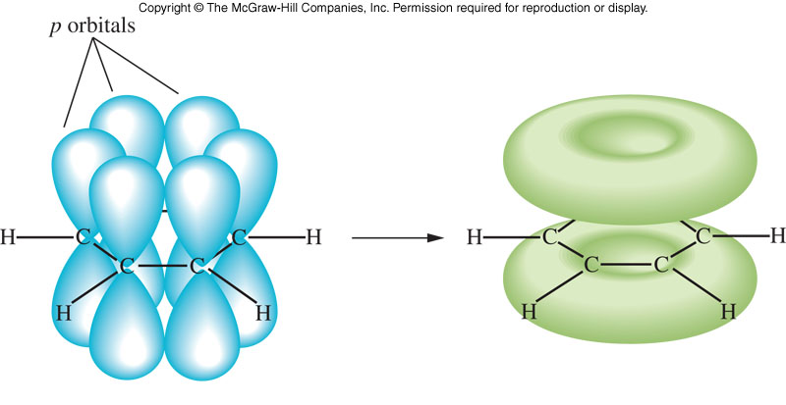
Model of Bonding in Benzene
  Remaining 6 electrons are located in p orbitals that are perpendicular to the plane of the carbon ring
    These p orbitals overlap laterally
    Form a cloud of electrons above and below the ring
11.6 Aromatic Hydrocarbons

Slide 24
Historical Nomenclature
7
Some members of the benzene family have unique names acquired before the IUPAC system was adopted that are still frequently used today
11.6 Aromatic Hydrocarbons
toluene
phenol
aniline
benzoic
acid

Slide 25
Disubstituted Benzene Derivatives
11.6 Aromatic Hydrocarbons
1-bromo-2-ethylbenzene
o-bromoethylbenzene
3-nitrotoluene
m-nitrotoluene
1,4-dichlorobenzene
p-dichlorobenzene

Slide 26
Benzene As a Substituent
When the benzene ring is a substituent on a chain (C₆H₅), it is called a phenyl group
  Note the difference between
    Phenyl
    Phenol (a functional group)
11.6 Aromatic Hydrocarbons
3-phenyl-1-butene

Slide 27
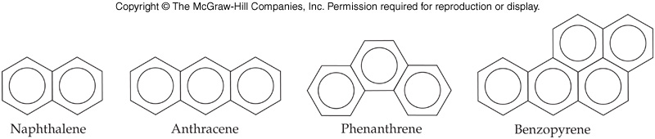
Polynuclear Aromatic Hydrocarbons
11.6 Aromatic Hydrocarbons
Polynuclear aromatic hydrocarbons (PAH) are composed of two or more aromatic rings joined together
  Many have been shown to cause cancer

Slide 28
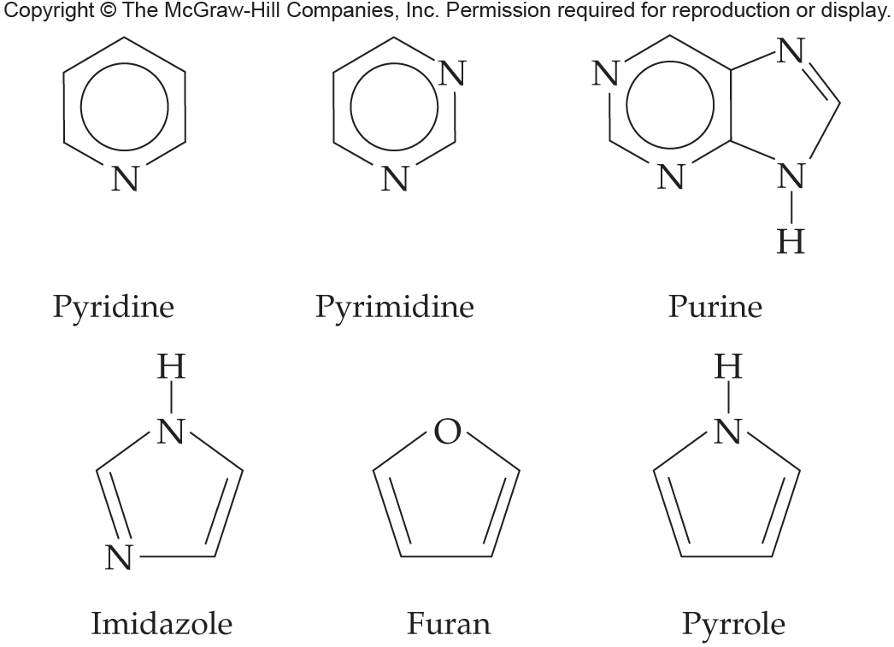
11.7 Heterocyclic Aromatic Compounds
Rings with at least one atom other than carbon as part of the structure of the aromatic ring
  This hetero atom is typically O, N, S
  The ring also has delocalized electrons
9

Slide 29
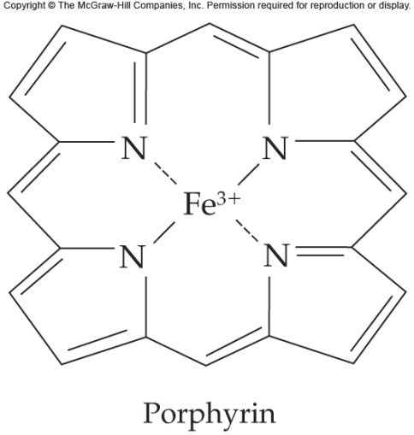
Heterocyclic Aromatics
Heterocyclic aromatics are similar to benzene in stability and chemical behavior
Many are significant biologically
  Purines and pyrimidines are components of DNA and RNA
  Pyridine is found in nicotine
  Pyrrole is a component of hemoglobin and chlorophyll
11.7 Heterocyclic Aromatic Compounds

