Slide 1
ORGANIC CHEMISTRY
An Introduction to
Organic Chemistry
The Saturated Hydrocarbons
10
General, Organic, and Biochemistry
9th Edition
Katherine J. Denniston
Joseph J. Topping
Danaè R. Quirk Dorr
Robert L. Caret
Copyright © 2017 McGraw-Hill Education. Permission required for reproduction or display

Slide 2
10.1 The Chemistry of Carbon
Why are there so many organic compounds?
Carbon forms stable, covalent bonds with other carbon atoms
  Carbon can form up to 4 covalent bonds with other carbon atoms
Carbon atoms form stable bonds with other elements, such as:
  Oxygen
  Nitrogen
  Sulfur
  Halogen
  The presence of these other elements confers many new physical and chemical properties on an organic compound

Slide 3
Why are there so many organic compounds? Reason 3
Carbon atoms form double or triple bonds with other atoms to produce a variety of structures with differing properties:
Double Bonds: Triple Bonds:
10.1 The Chemistry of Carbon

Slide 4
Why are there so many organic compounds? Reason 4
The number of ways to arrange carbon and other atoms is nearly limitless:
  Branched chains
  Ring structures
  Linear chains
Two organic compounds may even have the same number and kinds of atoms but completely different structures and thus, different properties
  These are called isomers
10.1 The Chemistry of Carbon

Slide 5
Important Differences Between Organic and Inorganic Compounds
1
Bond type
  Organics have covalent bonds (electron sharing)
  Inorganics usually have ionic bonds (electron transfer)
10.1 The Chemistry of Carbon

Slide 6
Structural Differences Between Organic and Inorganic Compounds
1
Structure
  Organics
    Molecules
    Nonelectrolytes
  Inorganics
    Three-dimensional crystal structures
    Often water-soluble, dissociating into ions -electrolytes
10.1 The Chemistry of Carbon

Slide 7
Physical Differences Between Organic and Inorganic Compounds
Melting Point & Boiling Point
  Organics have lower melting points
    Intermolecular forces broken fairly easily
  Inorganics usually have higher melting points
    Ionic bonds require more energy to break
Water Solubility
  Organics
    Nonpolar, water insoluble
  Inorganics
    Water-soluble, readily dissociate
10.1 The Chemistry of Carbon

Slide 8
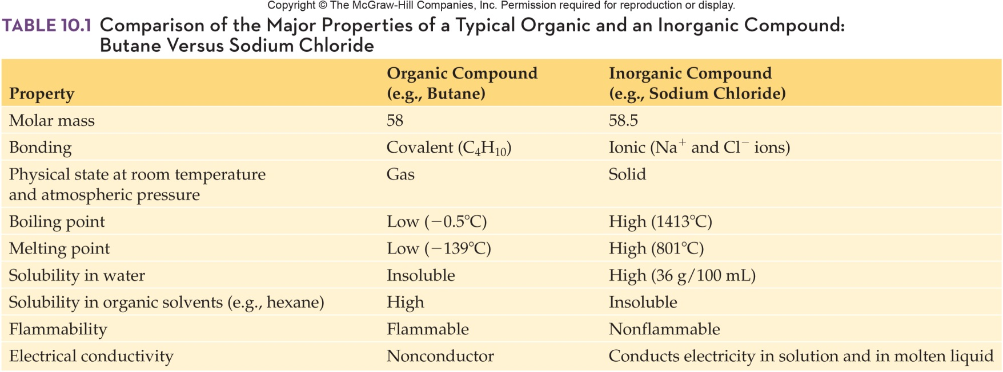
Comparison of Major Properties of Organic and Inorganic Compounds
10.1 The Chemistry of Carbon

Slide 9
Hydrocarbons
2
Hydrocarbons contain only carbon
and hydrogen
They are nonpolar molecules
  Not soluble in water (water is polar)
  Are soluble in typical nonpolar organic solvents
    Toluene
    Pentane
10.1 The Chemistry of Carbon

Slide 10
Substituted Hydrocarbons
2
Hydrocarbons are constructed of chains or rings of carbon atoms with sufficient hydrogen atoms to fulfill carbon’s need for four bonds
Substituted hydrocarbon is one in which one or more hydrogen atoms is replaced by another atom or group of atoms
10.1 The Chemistry of Carbon

Slide 11
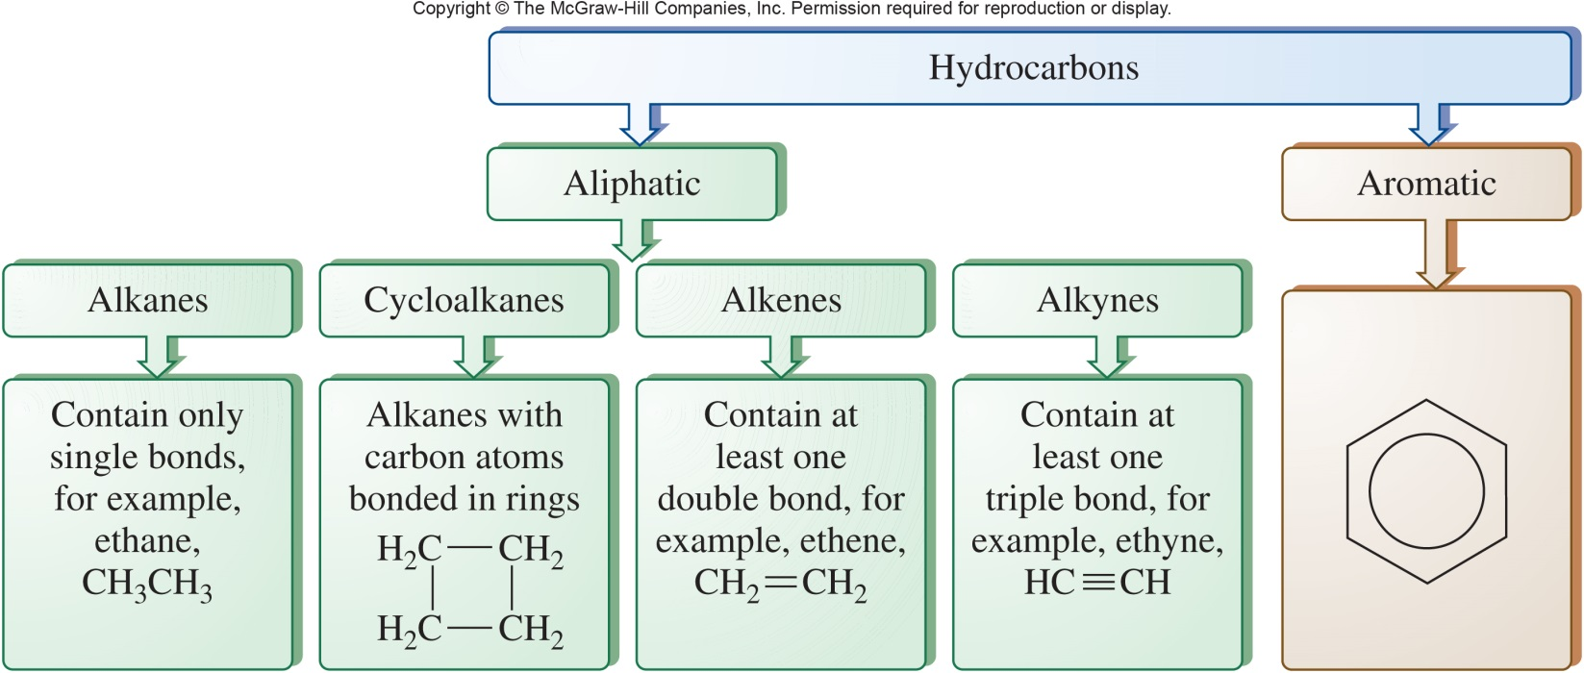
Division of the Family of Hydrocarbons
10.1 The Chemistry of Carbon

Slide 12
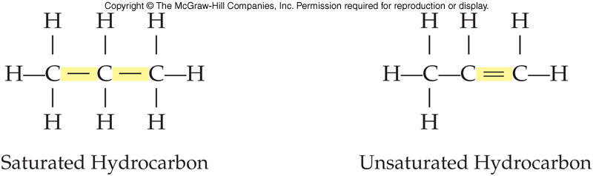
Hydrocarbon Saturation
Alkanes are compounds that contain only carbon-carbon and carbon-hydrogen single bonds
  A saturated hydrocarbon has no double or triple bonds
Alkenes and alkynes are unsaturated because they contain at least one carbon to carbon double or triple bond
10.1 The Chemistry of Carbon

Slide 13
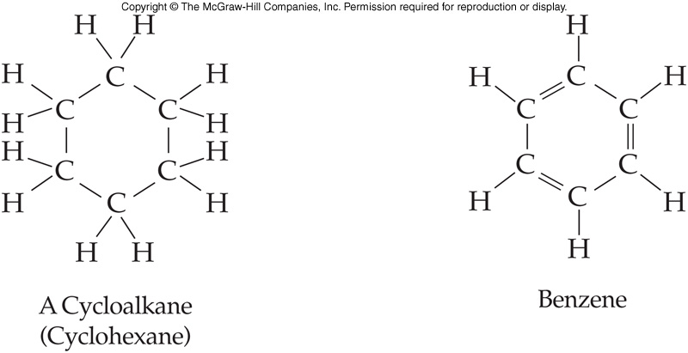
Cyclic Structure of Hydrocarbons
Some hydrocarbons are cyclic
  Form a closed ring
  Aromatic hydrocarbons contain a benzene ring or related structure
10.1 The Chemistry of Carbon

Slide 14
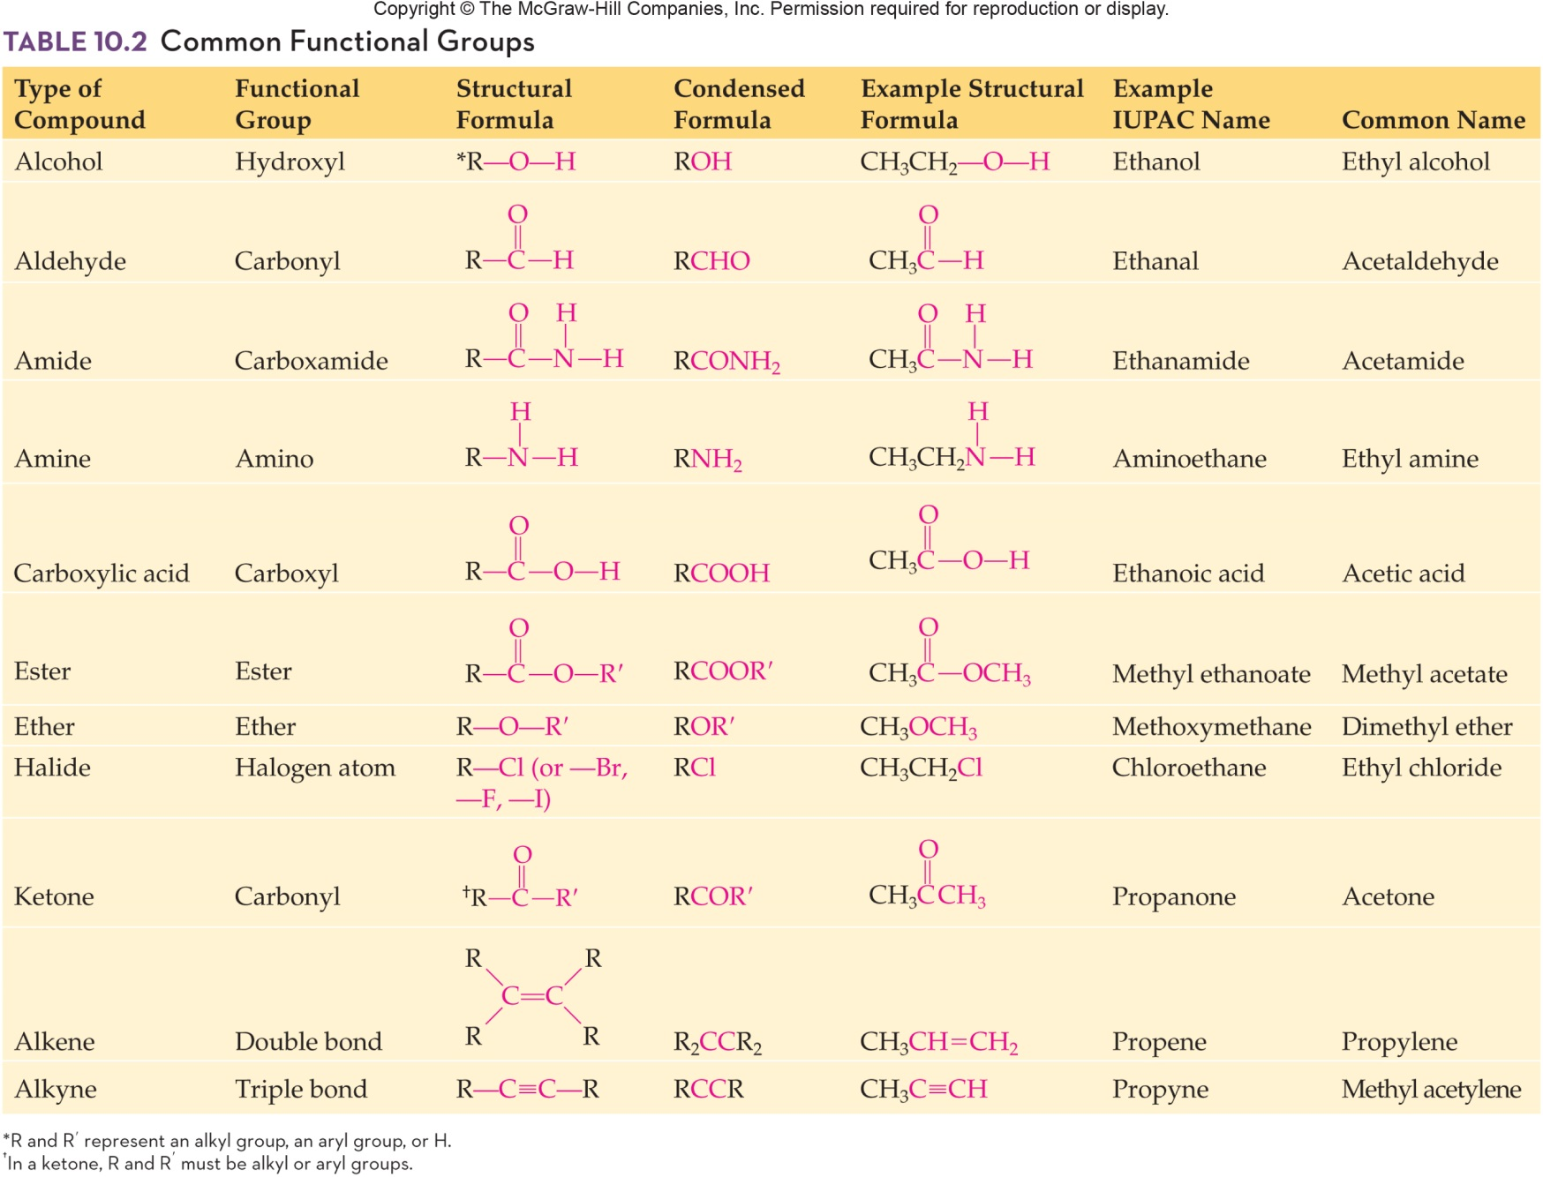
Common Functional Groups
10.1 The Chemistry of Carbon

Slide 15
10.2 Alkanes
The general formula for a chain alkane is C_{n}H_{2n+2}
  In this formula n = the number of carbon atoms in the molecule
Alkanes are saturated hydrocarbons
  Contain only carbon and hydrogen
  Bonds are carbon-hydrogen and carbon-carbon single bonds

Slide 16
Formulas Used in
Organic Chemistry
4
Molecular formula - lists kind and number of each type of atom in a molecule, no bonding pattern:
C₂H₆ C₃H₈
Structural formula - shows each atom and bond in a molecule
10.2 Alkanes

Slide 17
Condensed and Line Formulas
4
Condensed formula - shows all the atoms in a molecule in sequential order indicating which atoms are bonded to which
CH₃-CH₃ CH₃-CH₂-CH₃
Line formula - assume a carbon atom at any location where lines intersect
  Each carbon in the structure is bonded to the correct number of hydrogen atoms
10.2 Alkanes

Slide 18
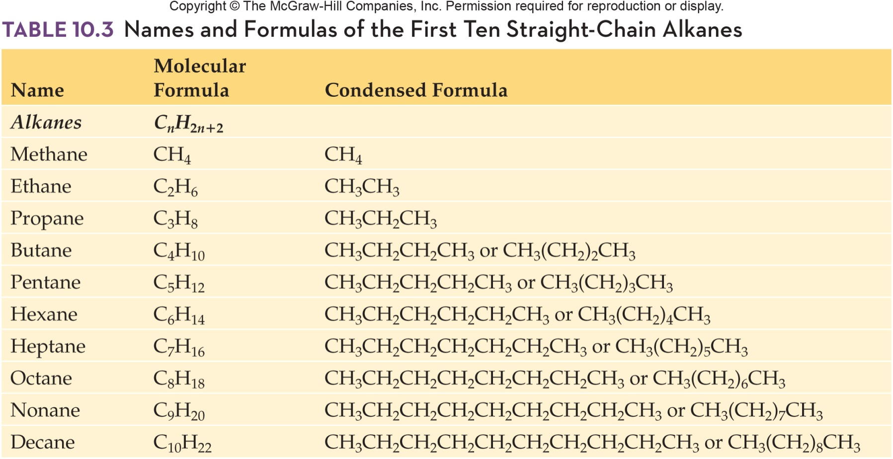
Names of First Ten Continuous-Chain Alkanes
4
10.2 Alkanes

Slide 19
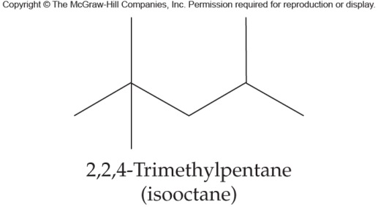
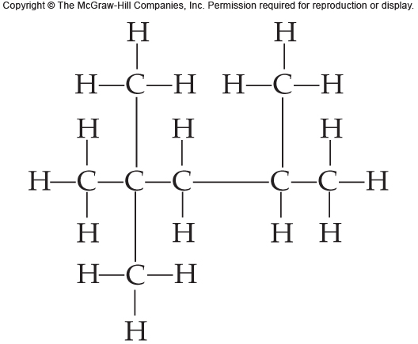
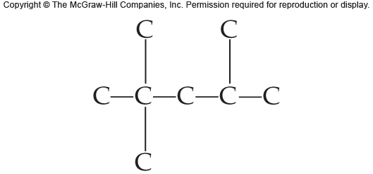
Formulas Used in
Organic Chemistry - Example
4
Write the structural and condensed formulas for the following line formula:
10.2 Alkanes
Next, add the correct
number of H atoms:
First, place the C skeleton:

Slide 20
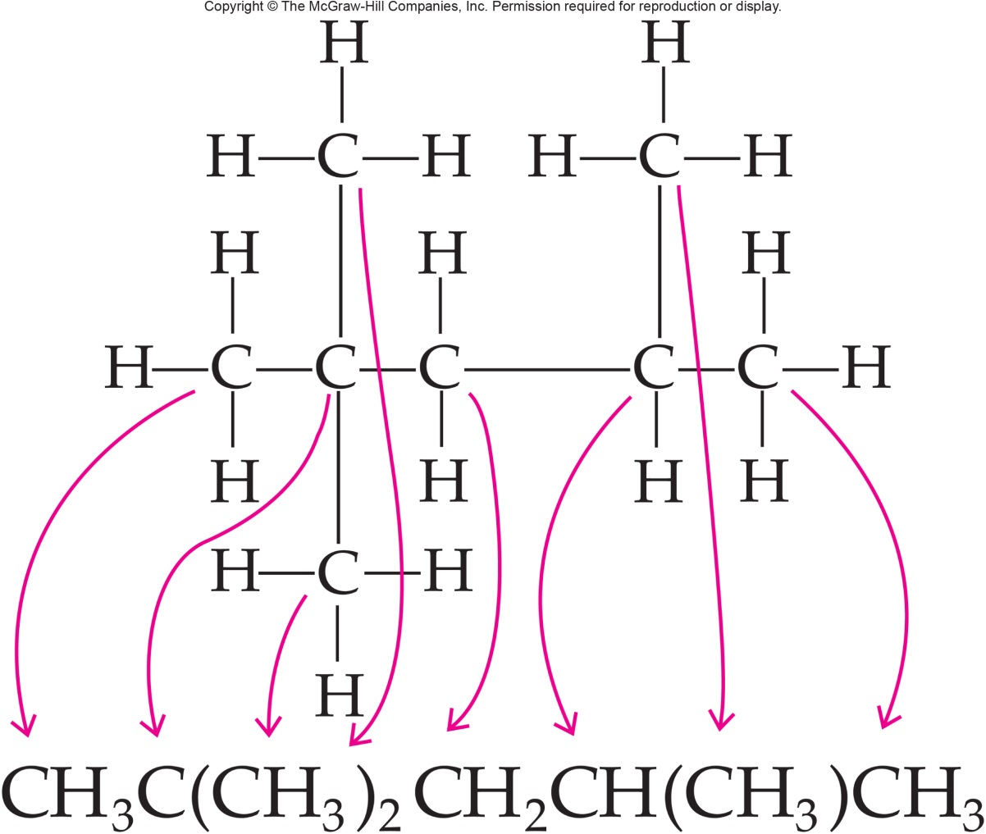
Writing Condensed from Structural Formula
4
Finally, condense the structure:
10.2 Alkanes

Slide 21
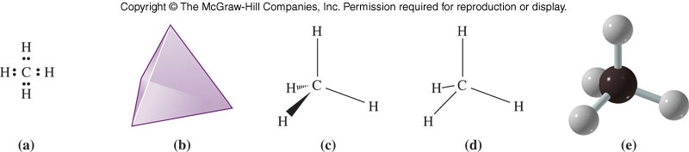
The Tetrahedral Carbon Atom
10.2 Alkanes
Lewis dot structure
The tetrahedral shape around the carbon atom
The tetrahedral carbon drawn with dashes and wedges
The stick drawing of the tetrahedral carbon atom
Ball and stick model of methane

Slide 22
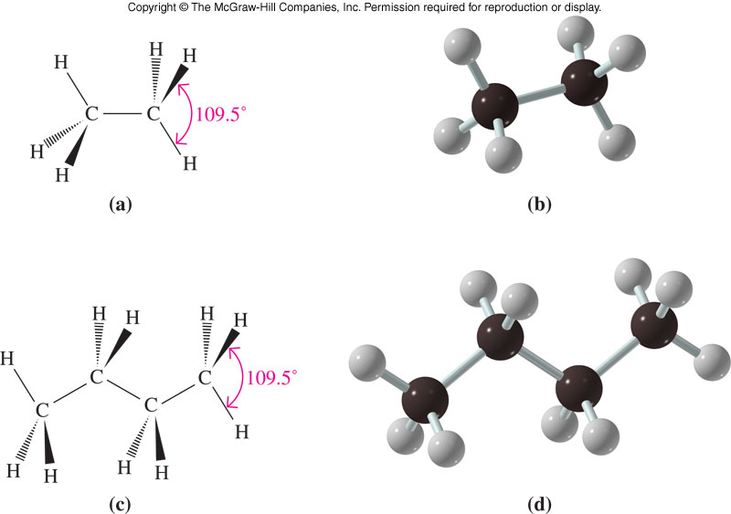
Comparison of Ethane and
Butane Structures
10.2 Alkanes

Slide 23
Isomers
Many carbon compounds exist in the form of isomers
Isomers are compounds with the same molecular formula but different structures
An isomer example: both are C₄H₁₀ but have different structures:
Butane Methylpropane
10.2 Alkanes

Slide 24
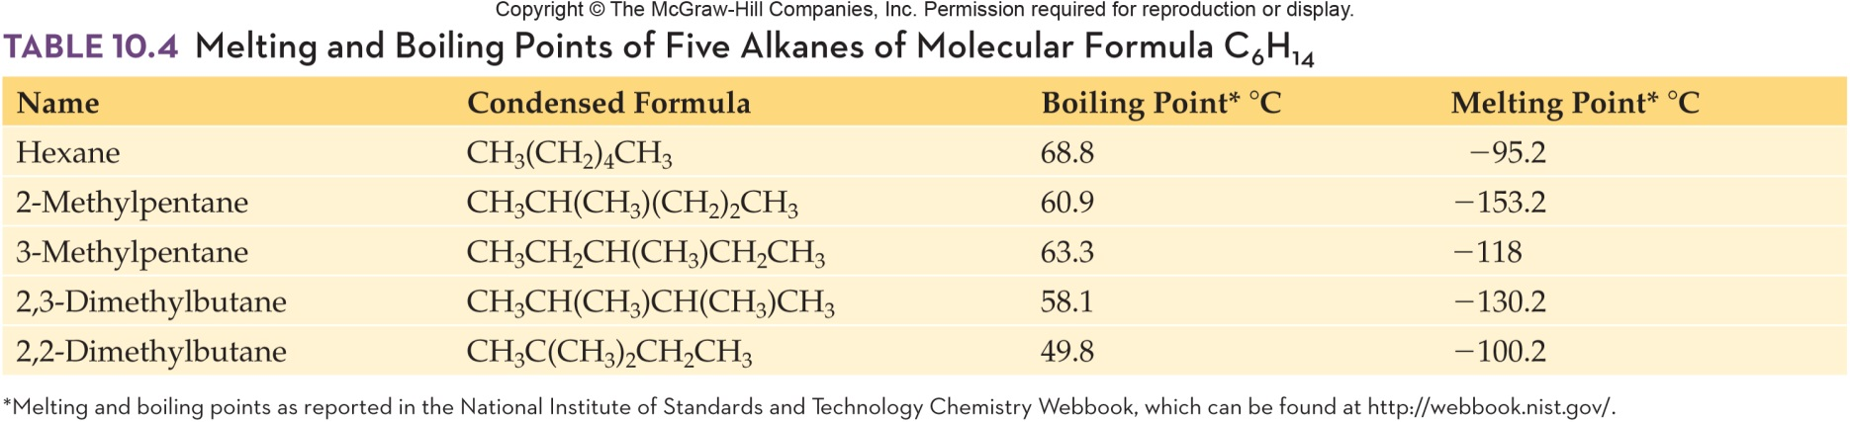
Physical Properties of Isomers
Isomers with the same molecular formula
have different physical properties:
10.2 Alkanes

Slide 25
Physical Properties of
Hydrocarbons
Nonpolar molecules
Not water soluble; soluble in nonpolar organic solvents
Low melting points and low boiling points
Generally less dense (lighter) than water
As length (molecular weight) increases, melting and boiling points increase as does the density
10.2 Alkanes

Slide 26
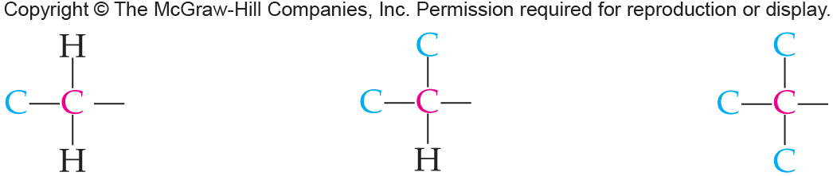
Carbon Classification
Carbon atoms are classified according to the number of other carbon atoms to which they are attached:
10.2 Alkanes
Primary (1º)
carbon
Secondary (2º)
carbon
Tertiary (3º)
carbon

Slide 27
Alkyl Groups
An alkyl group is an alkane with one hydrogen atom removed
It is named by replacing the -ane of the alkane name with -yl
Methane becomes a methyl group
10.2 Alkanes
methane
CH₄
methyl group
CH₃-

Slide 28
Ethyl Groups
For ethane, all 6 H’s are equivalent
Removing one H generates the ethyl group
All 3 structures shown at right are the same:
10.2 Alkanes
ethyl
groups =
ethane

Slide 29
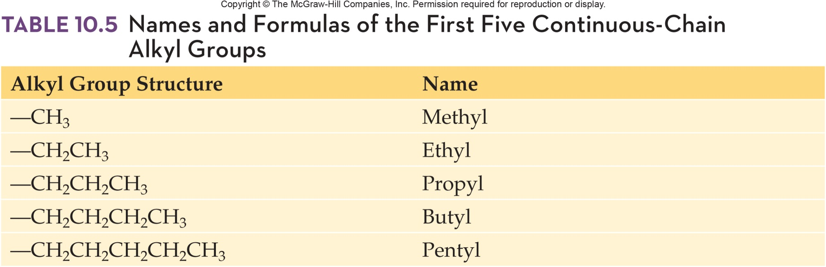
Names and Formulas of the First Five Alkyl Groups
10.2 Alkanes

Slide 30
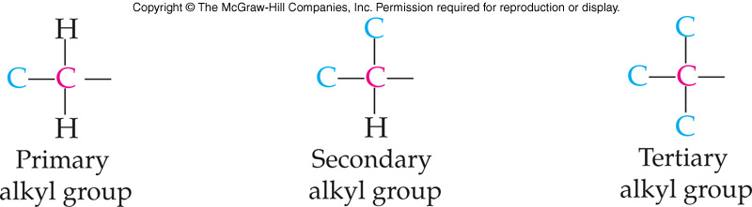
Alkyl Group Classification
Alkyl groups are classified according to the number of carbons attached to the carbon atom that joins the alkyl group to a molecule
All continuous chain alkyl groups are 1º
Isopropyl and sec-butyl are 2º groups
10.2 Alkanes

Slide 31
Iso- Alkyl Groups
Propane: removal of a hydrogen generates two different propyl groups depending on whether an end or center H is removed
propane
10.2 Alkanes
propyl group
isopropyl group

Slide 32
Sec- Alkyl Groups
Butane gives two butyl groups depending on whether an end (1º) or interior (2º) H is removed
butane
10.2 Alkanes
butyl group (1º)
sec-butyl group (2º)

Slide 33
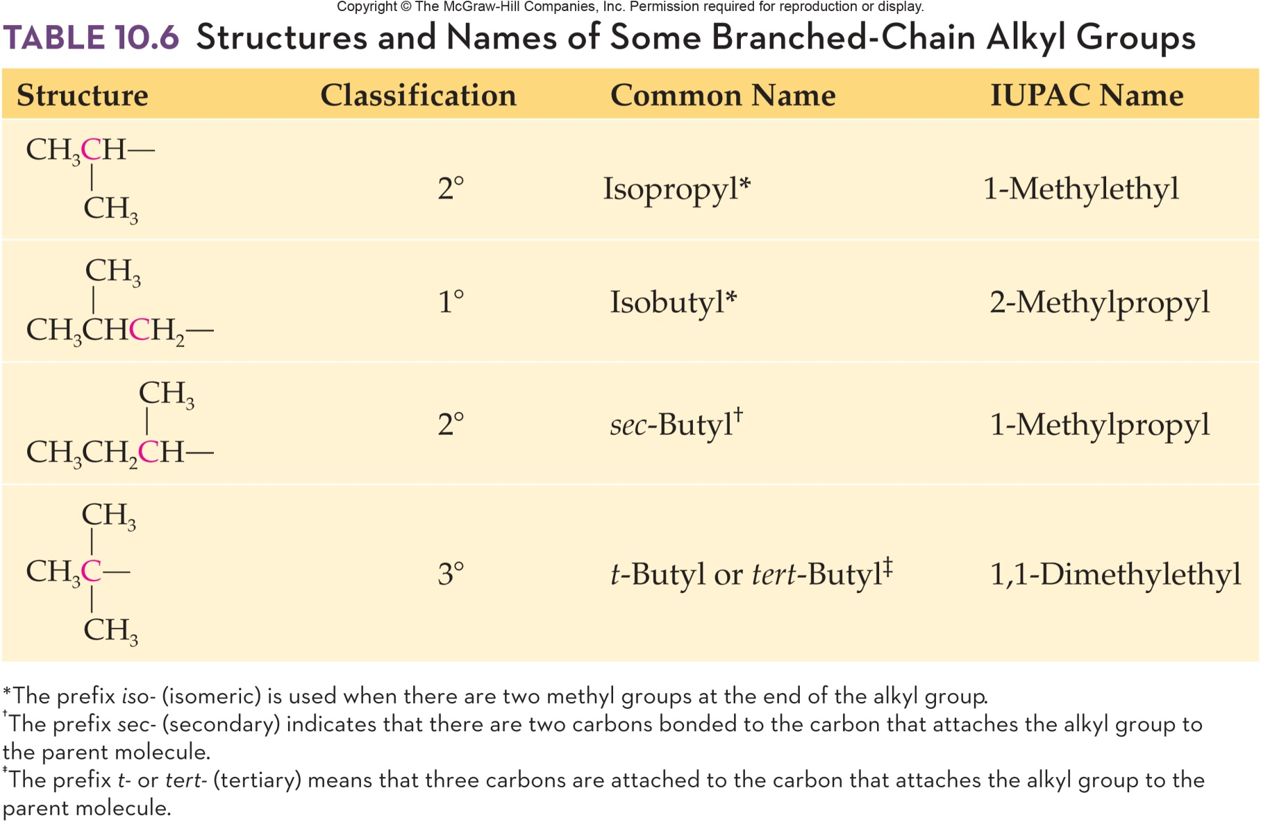
Structures and Names of Some Branched-Chain Alkyl Groups
10.2 Alkanes

Slide 34
More Alkyl Group Classification
Isobutane gives two butyl groups depending on whether a 1º or 3º H is removed
10.2 Alkanes
isobutane
isobutyl group (1º)
tert-butyl group (3º)

Slide 35
Nomenclature
6
The IUPAC (International Union of Pure and Applied Chemistry) is responsible for chemical names
Before learning the IUPAC rules for naming alkanes, the names and structures of eight alkyl groups must be learned
These alkyl groups are historical names accepted by the IUPAC and integrated into modern nomenclature
10.2 Alkanes

Slide 36
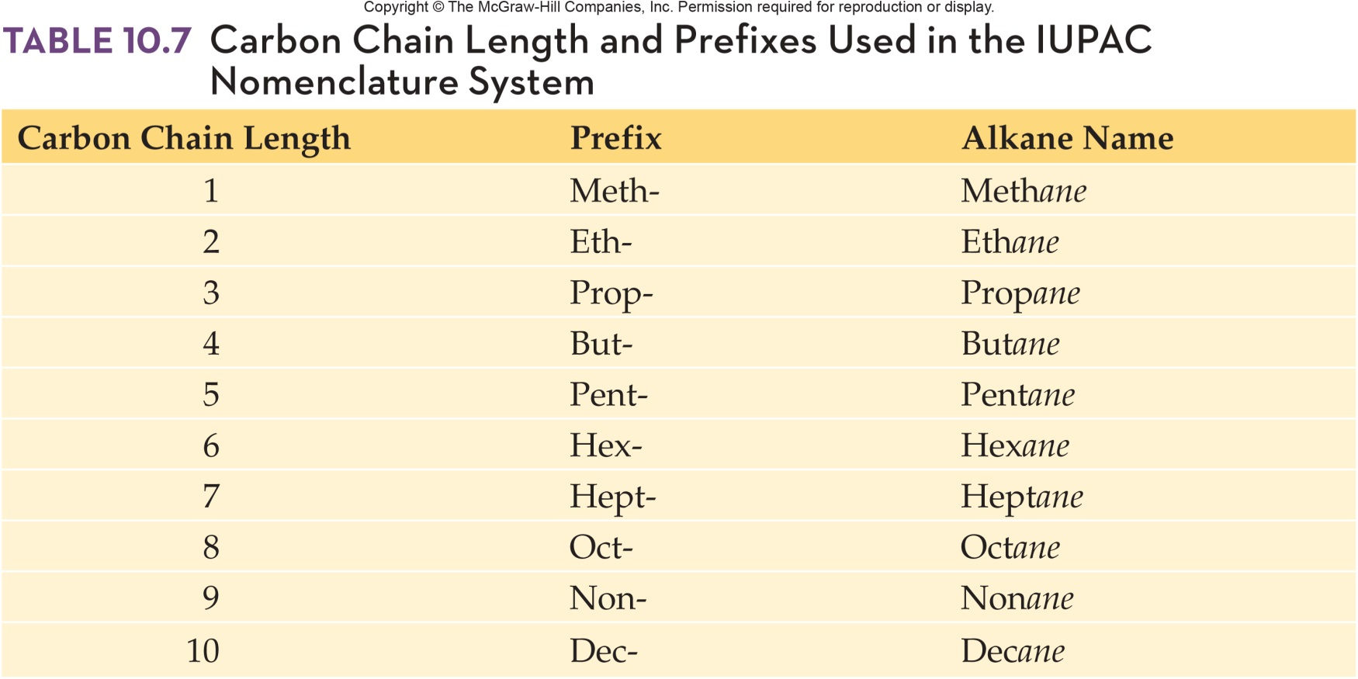
Carbon Chain Length and Prefixes
10.2 Alkanes

Slide 37
Structural Isomers
8
Constitutional/Structural Isomers differ in how atoms are connected
  Two isomers of butane have different physical properties
  The carbon atoms are connected in different patterns
10.2 Alkanes
Butane
Bp –0.4 ºC
Mp –139 ºC
Isobutane
Bp –12 ºC
Mp –145 ºC

Slide 38
10.3 Cycloalkanes
9
Cycloalkanes have two less hydrogens than the corresponding chain alkane
  Hexane=C₆H₁₄ versus cyclohexane=C₆H₁₂
To name cycloalkanes, prefix cyclo- to the name of the corresponding alkane
  Place substituents in alphabetical order before the base name as for alkanes
  For multiple substituents, use the lowest possible set of numbers; a single substituent requires no number

Slide 39
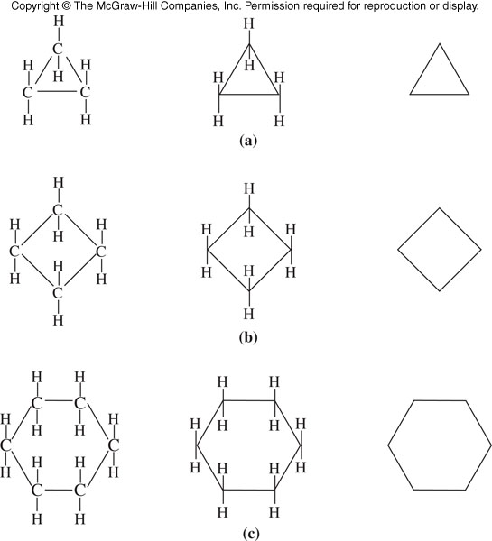
Cycloalkane Structures
Cyclopropane
Cyclobutane
Cyclohexane
10.3 Cycloalkanes
Type of Formula: Structural Condensed Line

Slide 40
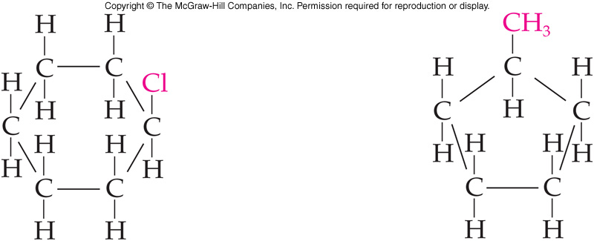
Naming a Substituted Cycloalkane
Name the two cycloalkanes shown below
Parent chain 6 carbon ring 5 carbon ring
cyclohexane cyclopentane
Substituent 1 chlorine atom a methyl group
chloro methyl
Name Chlorocyclohexane Methylcyclopentane
10.3 Cycloalkanes

Slide 41
cis-trans Isomers
10
Atoms of an alkane can rotate freely around the carbon-carbon single bond having an unlimited number of arrangements
Rotation around the bonds in a cyclic structure is limited by the fact that all carbons in the ring are interlocked
  Formation of cis-trans isomers, geometric isomers, is a consequence of the lack of free rotation
Stereoisomers are molecules that have the same structural formulas and bonding patterns, but different arrangements of atoms in space
  cis-trans isomers of cycloalkanes are stereoisomers whose substituents differ in spatial arrangement
10.3 Cycloalkanes

Slide 42
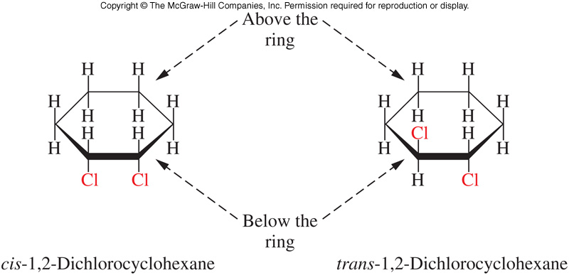
cis-trans Isomers in Cycloalkanes
Two groups may be on the same side (cis) of the imagined plane of the cycloring or they may be on the opposite side (trans)
Geometric isomers do not readily interconvert, only by breaking carbon-carbon bonds can they interconvert
10.3 Cycloalkanes

Slide 43
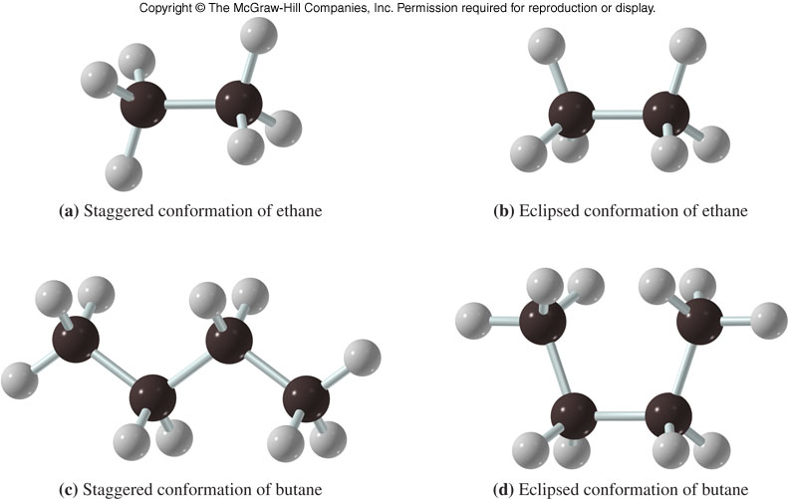
10.4 Conformations of Alkanes
11
Conformations differ only in rotation about carbon-carbon single bonds
Two conformations of ethane and butane are shown
  The first (staggered form) is more stable (energetically favorable) because it allows hydrogens to be farther apart and thus, the atoms are less crowded

Slide 44
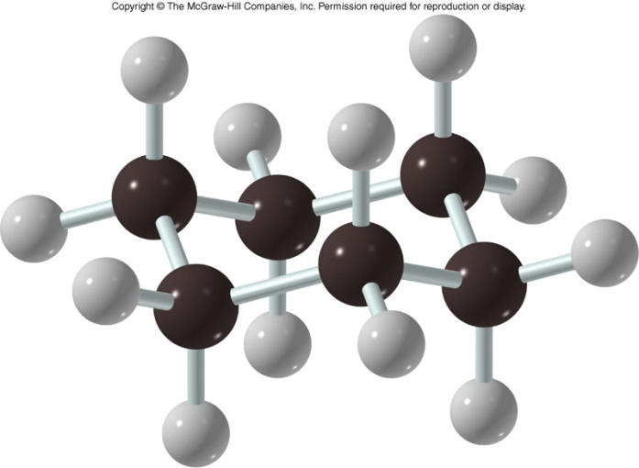
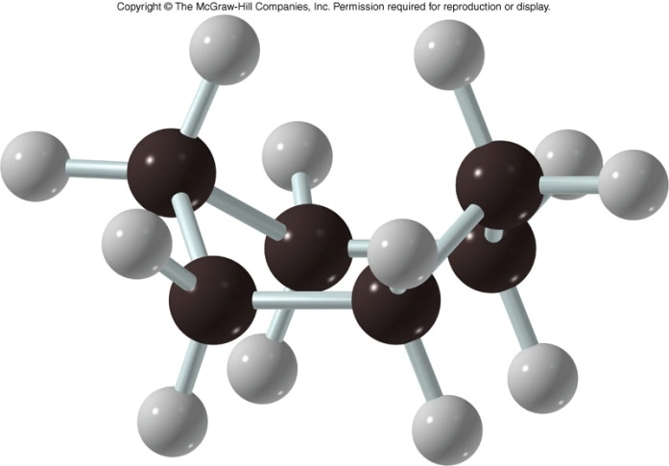
Two Conformations of Cyclohexane
12
10.4 Conformations of Alkanes and Cycloalkanes
Chair form (more stable) Boat form

Slide 45
10.5 Reactions of Alkanes
Alkanes, cycloalkanes, and other hydrocarbons can be:
  Oxidized (by burning) in the presence of excess molecular oxygen, in a process called combustion
  Reacted with a halogen (usually chlorine or bromine) in a halogenation reaction

Slide 46
Alkane Reactions
The majority of the reaction of alkanes are combustion reactions
  Complete CH₄ + 2O₂ CO₂ + 2H₂O Complete combustion produces
      Carbon dioxide and water
  Incomplete 2CH₄ + 3O₂ 2CO + 4H₂O
    Incomplete combustion produces
      Carbon monoxide and water
      Carbon monoxide is a poison that binds irreversibly to red blood cells
10.5 Reactions of Alkanes

Slide 47
Halogenation
Halogenation is a type of substitution reaction, a reaction that results in a replacement of one group for another
  Products of this reaction are:
    Alkyl halide or haloalkane
    Hydrogen halide
  This reaction is important in converting unreactive alkanes into many starting materials for other products
  Halogenation of alkanes ONLY occurs in the presence of heat and/or light (UV)
10.5 Reactions of Alkanes

Slide 48
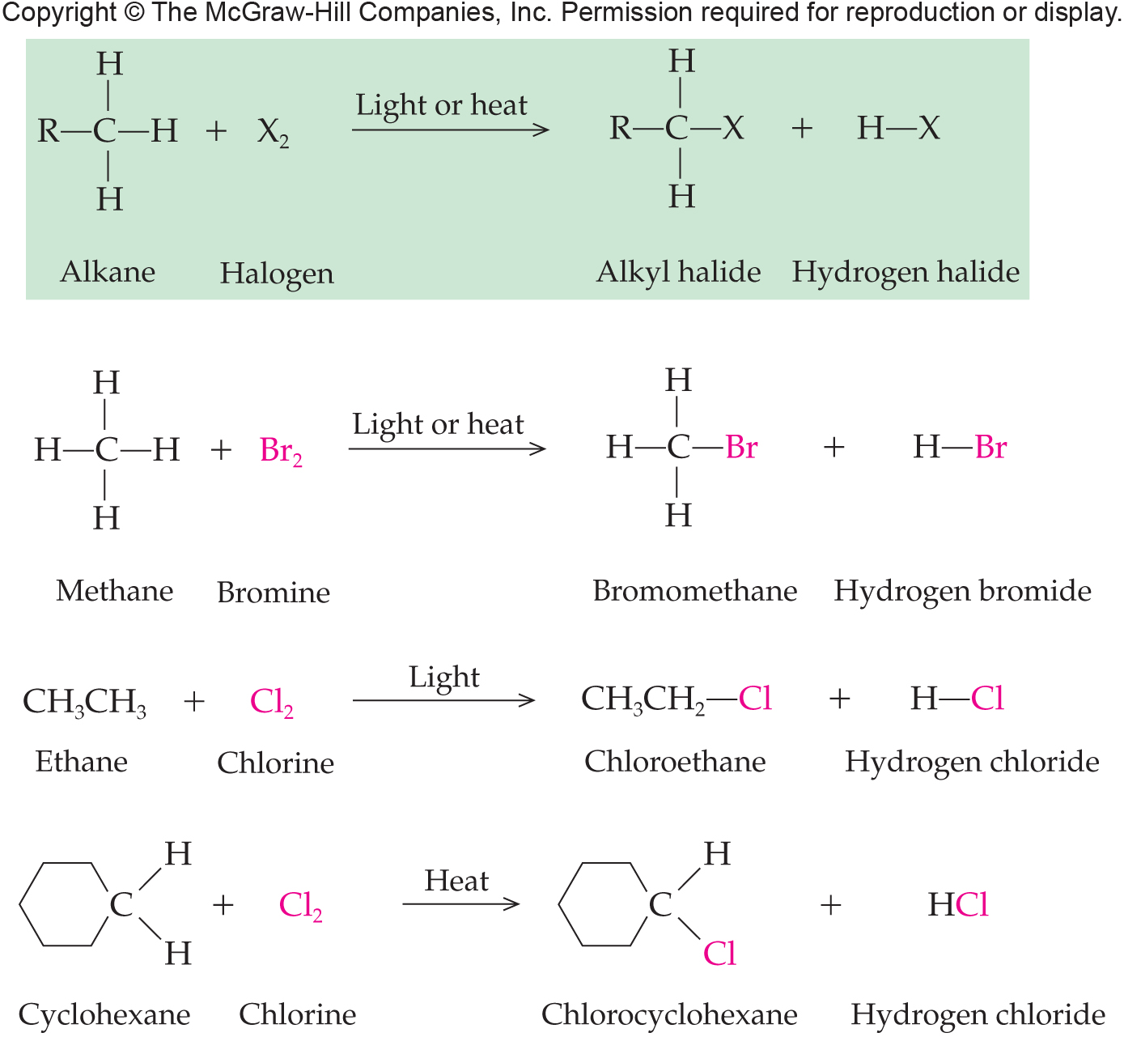
Halogenation Reaction Equations
10.5 Reactions of Alkanes

