Slide 1
GENERAL CHEMISTRY
7
Energy, Rate,
and Equilibrium
General, Organic, and Biochemistry
9th Edition
Katherine J. Denniston
Joseph J. Topping
Danaè R. Quirk Dorr
Robert L. Caret
Copyright © 2017 McGraw-Hill Education. Permission required for reproduction or display

Slide 2
7.1 Thermodynamics
Thermodynamics – the study of energy, work, and heat
  Applied to chemical change
    Calculate the quantity of heat obtained from combustions of one gallon of fuel oil
  Applied to physical change
    Determine the energy released by boiling water
The laws of thermodynamics help us to understand why some chemical reactions occur and others do not

Slide 3
The First Law of Thermodynamics
First Law of Thermodynamics – energy of the universe is constant
This law is also called the Law of Conservation of Energy
Where does the reaction energy come from that is released and where does the energy go when it is absorbed?
7.1 Thermodynamics

Slide 4
Exothermic and Endothermic Reactions
A-B + C-D → A-D + C-B
Consider the reaction converting AB and CD to AD and CB
Each chemical bond is stored chemical energy
If a reaction will occur
  Bonds must break
  Breaking bonds requires energy
7.1 Thermodynamics

Slide 5
Exothermic Reactions
1
If the energy required to break the bonds is less than the energy released when the bonds are formed, there is a net release of energy
  This is called an exothermic reaction
  Energy is a product in this reaction
7.1 Thermodynamics
A-B + C-D → A-D + C-B
These bonds must be broken in the reaction, requiring energy
These bonds are formed, releasing energy

Slide 6
Endothermic Reactions
1
If the energy required to break the bonds is greater than the energy released when the bonds are formed, there will need to be an external supply of energy
  This is called an endothermic reaction
7.1 Thermodynamics
A-B + C-D → A-D + C-B
These bonds must be broken in the reaction, requiring energy
These bonds are formed, releasing energy

Slide 7
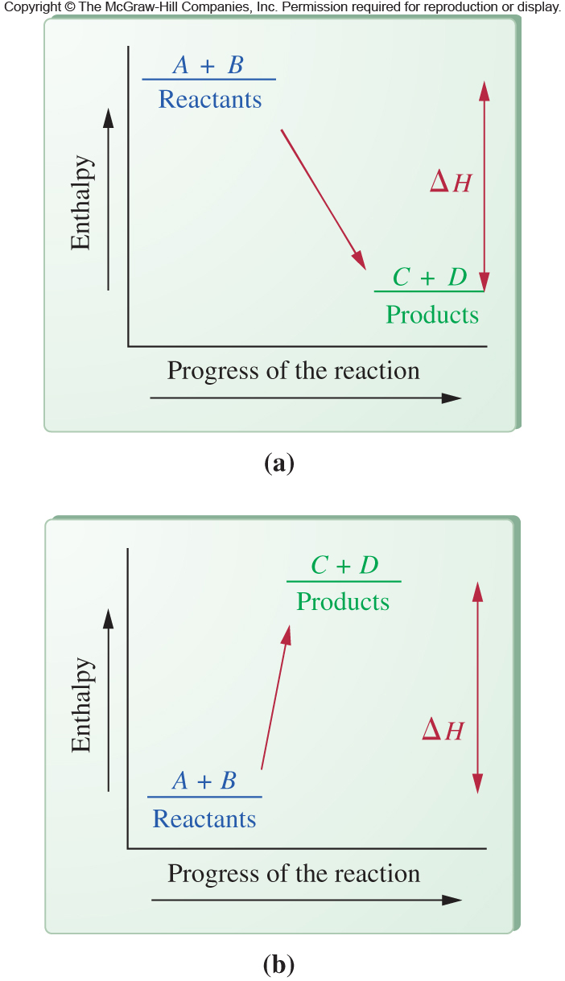
Reaction Models
Exothermic Reaction
Combustion
CH₄(g) + 2O₂(g)→
CO₂(g) + 2H₂O(g) + 211 kcal
7.1 Thermodynamics
Endothermic Reaction
Decomposition
22 kcal + 2NH₃(g) →
N₂(g) + 3H₂(g)

Slide 8
Enthalpy
Enthalpy – represents heat energy
Change in Enthalpy (ΔH) – energy difference between the products and reactants of a chemical reaction
The ΔH over the course of a reaction can be determined by:
ΔH_{reaction} = ΔH_{products} − ΔH_{reactants}
2
7.1 Thermodynamics

Slide 9
Sign of Enthalpy
If energy is released in a reaction, the reaction is exothermic. The sign of ΔH will be negative (−)
  In the exothermic combustion of CH₄,
  ΔH = −211 kcal
If energy is absorbed in a reaction, the reaction is endothermic. The sign of ΔH will be positive (+)
  In the endothermic decomposition of NH₃, ΔH = +22 kcal
2
7.1 Thermodynamics

Slide 10
Enthalpy of Reactions
Are the following processes exothermic or endothermic?
  Fuel oil is burned in a furnace
  C₆H₁₂O₆(s) 2C₂H₅OH(l) + 2CO₂(g)
  ΔH=-16 kcal
  N₂O₅(g) + H₂O(l) 2HNO₃(l) + 18.3 kcal
7.1 Thermodynamics

Slide 11
Spontaneous and Nonspontaneous Reactions
Most, but not all, exothermic reactions are spontaneous
Most, but not all, endothermic reactions are nonspontaneous
Thermodynamics is used to help predict if a reaction will occur spontaneously
Another factor is needed, Entropy (S)
7.1 Thermodynamics

Slide 12
The Second Law of Thermodynamics
2
Second Law of Thermodynamics – the universe spontaneously tends toward increasing disorder or randomness
Entropy (S) – a measure of the randomness of a chemical system
  High entropy – highly disordered system, the absence of a regular, repeating pattern
  Low entropy – well organized system such as a crystalline structure
  No such thing as negative entropy
7.1 Thermodynamics

Slide 13
Entropy Example
Which substance has the greatest entropy?
  He(g) or Na(s)
  H₂O(l) or H₂O(g)
7.1 Thermodynamics

Slide 14
The Second Law of Thermodynamics
ΔS_{reaction}= S_{products} - S_{reactants}
A positive ΔS_{reaction} means an increase in disorder for the reaction
A negative ΔS_{reaction} means a decrease in disorder for the reaction
7.1 Thermodynamics

Slide 15
The Second Law of Thermodynamics
Representation
Phase change
Melting
Vaporization
Dissolution
7.1 Thermodynamics
All of these processes have a positive ΔS

Slide 16
Entropy and Reaction Spontaneity
If exothermic and positive ΔS…
SPONTANEOUS
If endothermic and negative ΔS…
NONSPONTANEOUS
For any other situations, it depends on the relative size of ΔH and ΔS
7.1 Thermodynamics

Slide 17
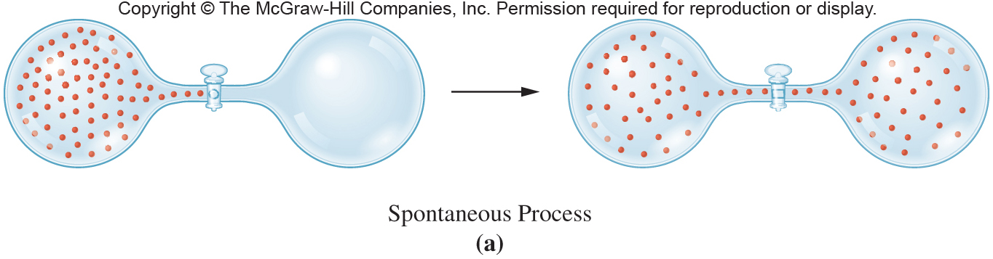
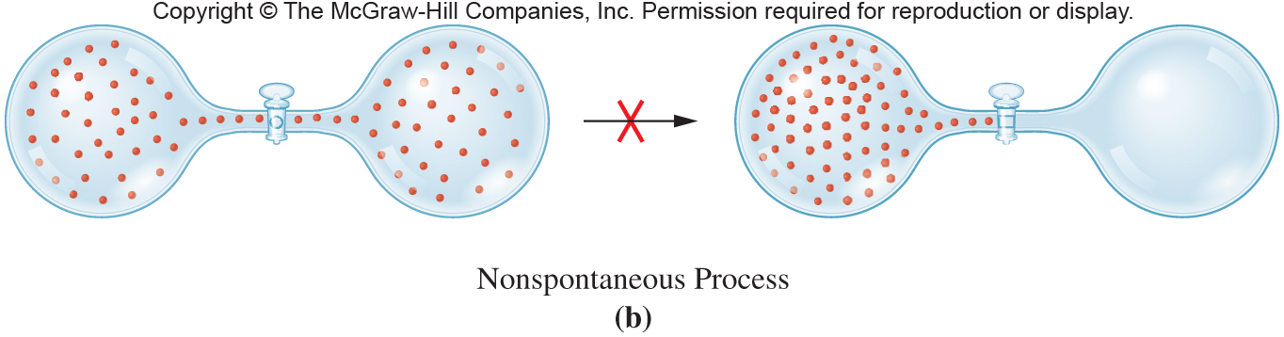
Entropy and Reaction Spontaneity Representation
7.1 Thermodynamics
ΔS is positive
ΔS is negative

Slide 18
Free Energy and Spontaneity
2
Free energy (ΔG) – represents the combined contribution of the enthalpy and entropy values for a chemical reaction
Free energy predicts spontaneity of chemical reactions
  Negative ΔG, always Spontaneous
  Positive ΔG, never Spontaneous
7.1 Thermodynamics
ΔG = ΔH - TΔS
T in Kelvin

Slide 19
Free Energy
Need to know both ΔH and ΔS to predict the sign of ΔG, making a statement on reaction spontaneity
Temperature also may determine direction of spontaneity
  ΔH +, ΔS - : ΔG always +, regardless of T
  ΔH -, ΔS + : ΔG always -, regardless of T
  ΔH +, ΔS + : ΔG sign depends on T
  ΔH -, ΔS - : ΔG sign depends on T
7.1 Thermodynamics

Slide 20
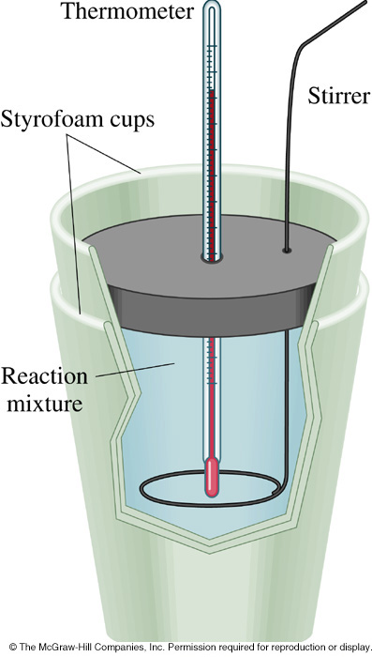
7.2 Experimental Determination of Energy Change in Reactions
3
Calorimetry – the measurement of heat energy changes in a reaction
Calorimeter – device which measures heat changes in calories
The change in temperature is used to measure the loss or gain of heat

Slide 21
Heat Energy in Reactions
Change in temperature of a solution, caused by a chemical reaction, can be used to calculate the gain or loss of heat energy (Q) for the reaction
  Exothermic reaction – heat released by reaction is absorbed by the surrounding solution
  Endothermic reaction – reactants absorb heat from the surrounding solution
7.2 Determination of Energy Change in Reactions

Slide 22
Specific Heat
Specific heat (SH) – the number of calories of heat needed to raise the temperature of 1 g of the substance 1 ºC
SH of water is 1.00 cal/gºC
To determine heat (Q) released or absorbed, you need to know:
  specific heat (SH_{s})
  mass of the solution in grams (m_{s})
  temperature change, final − initial (ΔT_{s})
7.2 Determination of Energy Change in Reactions

Slide 23
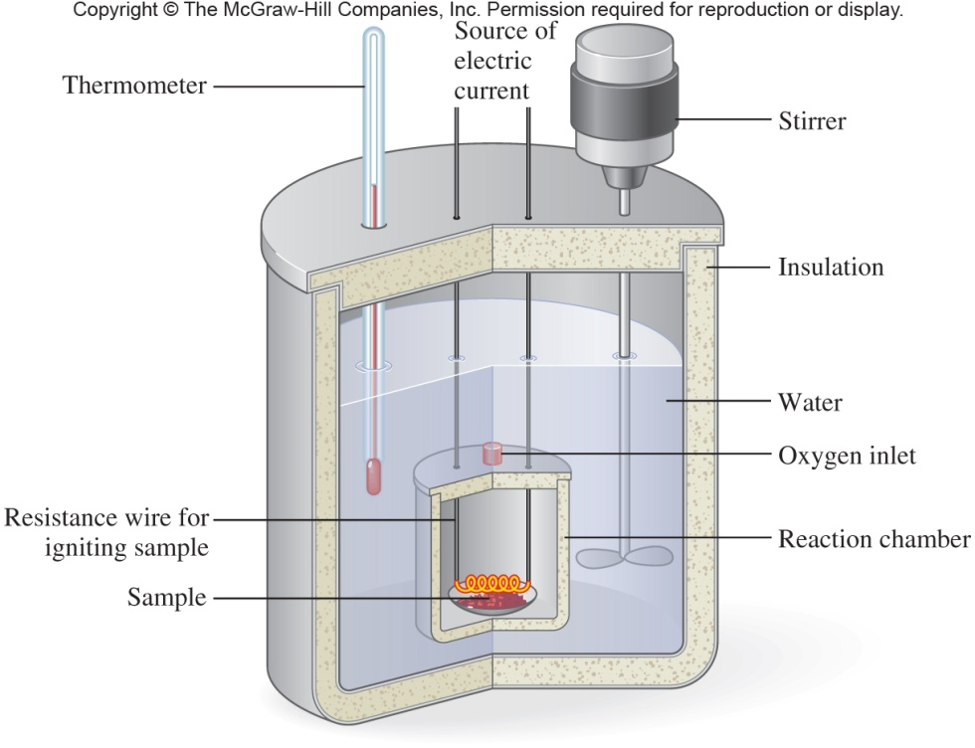
Bomb Calorimeter and Measurement of Calories in Foods
3
nutritional Calorie (large “C” Calorie) =
  1 kilocalorie (1kcal)
  1000 calories
7.2 Determination of Energy Change in Reactions
  Fuel value of food
  Bomb calorimeter is used to measure Cal

Slide 24
7.3 Kinetics
4
Thermodynamics determines if a reaction will occur spontaneously but tells us nothing about the amount of time the reaction will take
Kinetics – the study of the rate (or speed) of chemical reactions
  Also supplies an indication of the mechanism – step-by-step description of how reactants become products

Slide 25
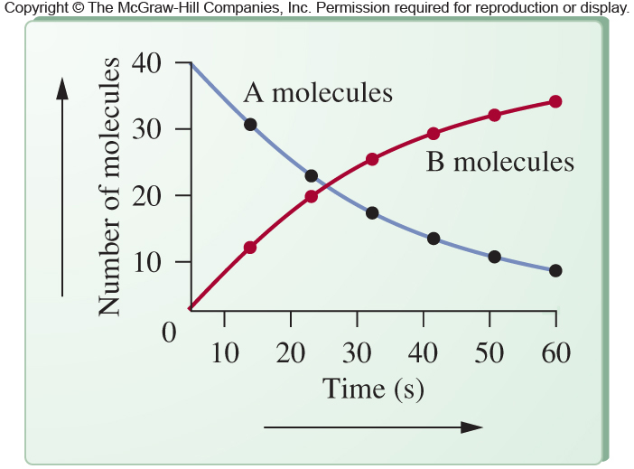
Kinetic Information
Kinetic information represents changes over time, seen here:
  disappearance of reactant, A
  appearance of product, B
7.3 Kinetics

Slide 26
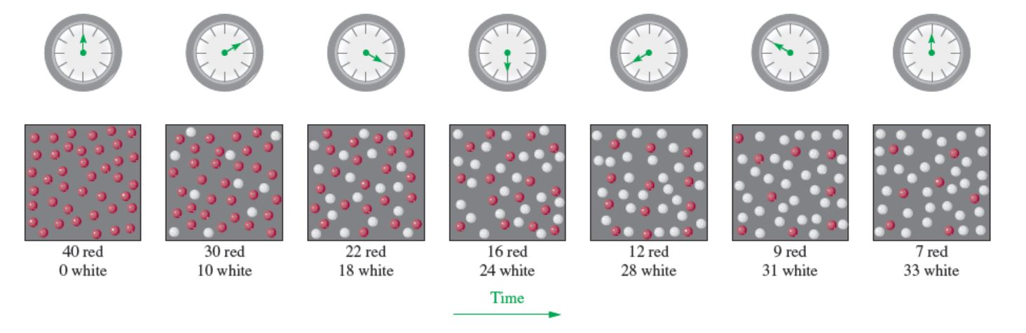
Alternative Presentation of Kinetic Data
Rather than the graph shown before, this figure demonstrates the change from red reactant to white product over time from the molecular perspective
Copyright © 2017 McGraw-Hill Education. Permission required for reproduction or display

Slide 27
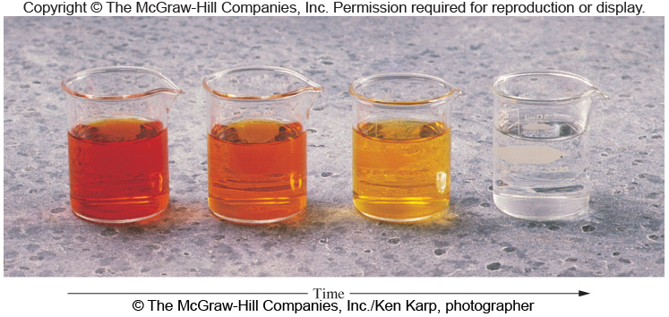
Kinetic Data Assessed by Color Change
Change in color over time can be used to monitor the progress of a chemical reaction
The rate of color change can aid in calculating the rate of the chemical reaction
7.3 Kinetics

Slide 28
The Chemical Reaction
CH₄(g) + 2O₂(g) → CO₂(g) +2H₂O(g) + 211 kcal
C-H and O=O bonds must be broken
C=O and O-H bonds must be formed
Energy is required to break the bonds
  Energy comes from the collision of the molecules
  If sufficient energy available, bonds break and atoms recombine in a lower energy arrangement
  Effective collision is one that produces product molecules
7.3 Kinetics

Slide 29
Activation Energy and the Activated Complex
5
Activation energy (Ea) – the minimum amount of energy required to initiate a chemical reaction
Picture a chemical reaction in terms of changes in potential energy occurring during the reaction
  Activated complex – an extremely unstable, short-lived intermediate complex
  Formation of this activated complex requires energy (E_{a}) to overcome the energy barrier to start the reaction
7.3 Kinetics

Slide 30
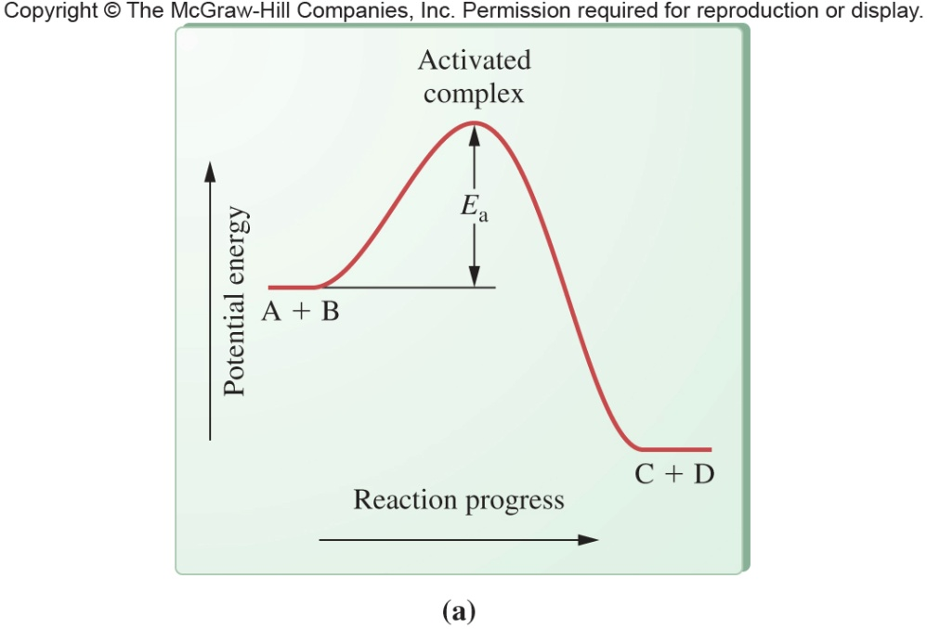
Model of Activation Energy and the Activated Complex
5
Reaction proceeds from reactants to products via the activated complex
Activated complex – can’t be isolated from the reaction mixture
Activation energy (E_{a}) - the difference between the energy of the reactants and that of the activated complex
7.3 Kinetics
To be an Exothermic reaction requires a net release of energy (ΔH)

Slide 31
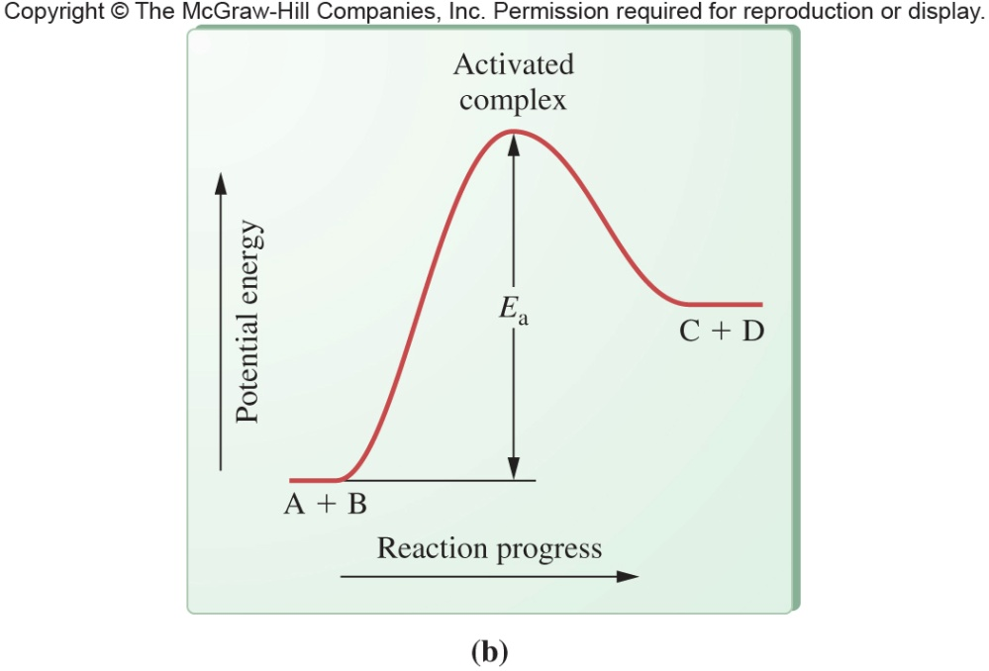
Activation Energy in the Endothermic Reaction
Endothermic reaction
Reaction takes place slowly due to the large activation energy required
The energy of the products is greater than that of the reactants
7.3 Kinetics

Slide 32
Factors That Affect Reaction Rate
6
Structure of the reacting species
Molecular shape and orientation
Concentration of reactants
Temperature of reactants
Physical state of reactants
Presence of a catalyst
7.3 Kinetics

Slide 33
The Temperature of Reactants
Rate increases as the temperature increases
  Increased temperature relates directly to increased average kinetic energy
  Greater kinetic energy increases the speed of particles
  Faster particles increases likelihood of collision
Higher kinetic energy means a higher percentage of these collisions will result in product formation
7.3 Kinetics

Slide 34
The Physical State of Reactants
Reactions occur when reactants can collide frequently with sufficient energy to react
  Solid state: atoms, ions, compounds are close together but restricted in motion
  Gaseous state: particles are free to move but often are far apart causing collisions to be relatively infrequent
  Liquid state: particles are free to move and are in close proximity
Reactions are fastest in the liquid state and slowest in the solid state (Liquid > Gas> Solid)
7.3 Kinetics

Slide 35
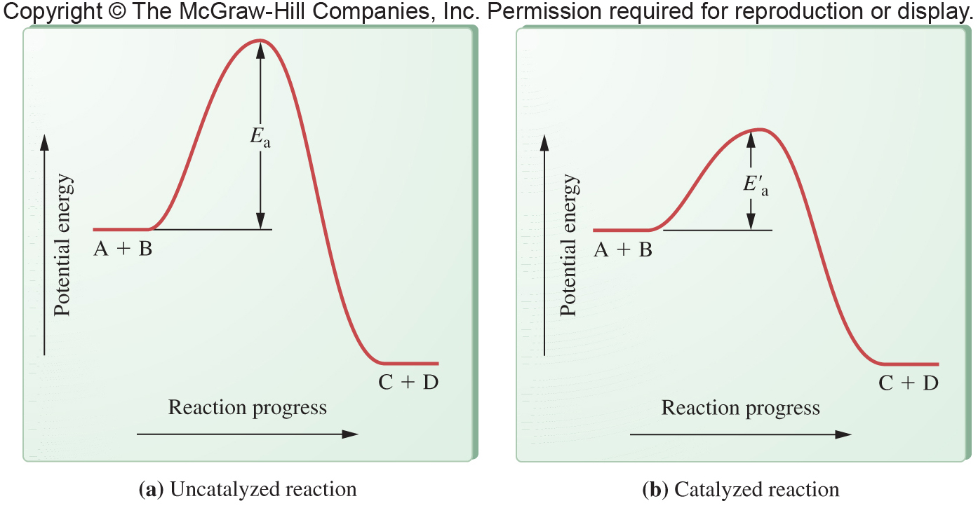
The Presence of a Catalyst
Catalyst – a substance that increases the reaction rate
  Undergoes no net change
  Does not alter the final product of the reaction
  Interacts with the reactants to create an alternative pathway for product production
7.3 Kinetics

Slide 36
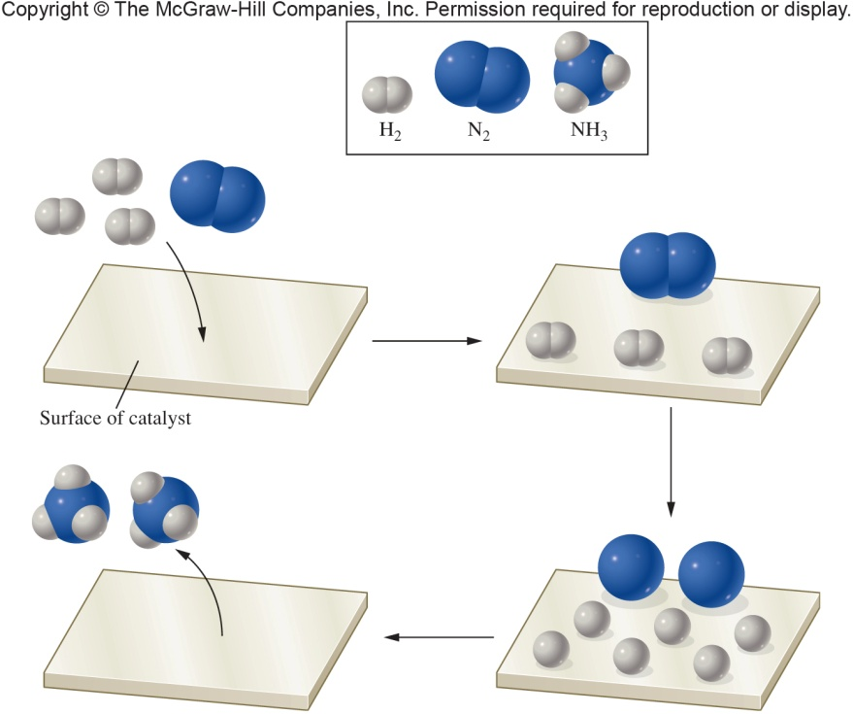
Use of a Solid Phase Catalyst
N₂+3H₂ → 2NH₃
7.3 Kinetics
Haber Process is a synthesis of ammonia facilitated by a solid phase catalyst
  Diatomic gases bind to the surface
  Bonds are weakened
  Dissociation of diatomic gases and reformation of NH₃
  Newly formed NH₃ leaves the solid surface with catalyst unchanged

Slide 37
7.4 Equilibrium
Physical equilibrium are reversible
  Two phases of the same substance
    Dissolved oxygen in lake water
    Stalactite and stalagmite formation
    Sugar dissolved in water
Reversible reaction – a process that can occur in both directions
  Use equilibrium arrow symbol
Dynamic equilibrium – the rate of the forward process in a reversible reaction is exactly balanced by the rate of the reverse process
8

Slide 38
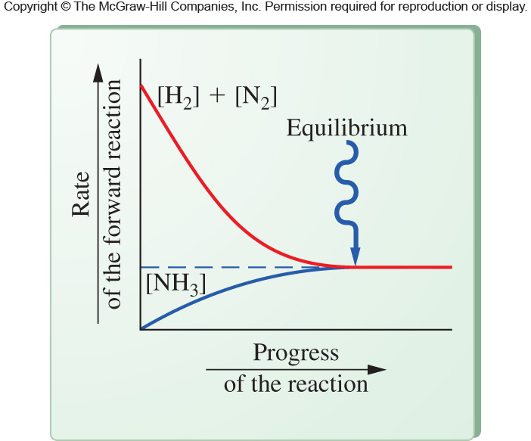
Chemical Equilibrium
N₂(g) + 3H₂(g) 2NH₃(g)
Initially the forward reaction is rapid
  Reactant concentrations are high
  Product concentration negligible
Forward reaction rate decreases with time
  Concentrations of reactants are decreasing
  Product concentration increasing
7.4 Equilibrium
Equilibrium occurs when the rate of reactant depletion is
equal to the rate of product depletion
Rates of forward and reverse reactions are Equal

Slide 39
The Generalized Equilibrium Expression for a Chemical Reaction
aA + bB cC + dD
A and B are reactants
C and D are products
a, b, c, and d are the coefficients of the balanced equation
7.4 Equilibrium

Slide 40
Interpreting Equilibrium Constants - continued
K_{eq} less than 1 × 10⁻³
  Small value of K_{eq} indicates numerator (product term) <<< denominator (reactant term)
  At equilibrium mostly reactant present
K_{eq} between 1 × 10⁻³ and 1 × 10³
  Equilibrium mixture contains significant concentration of both reactants and products
7.4 Equilibrium

Slide 41
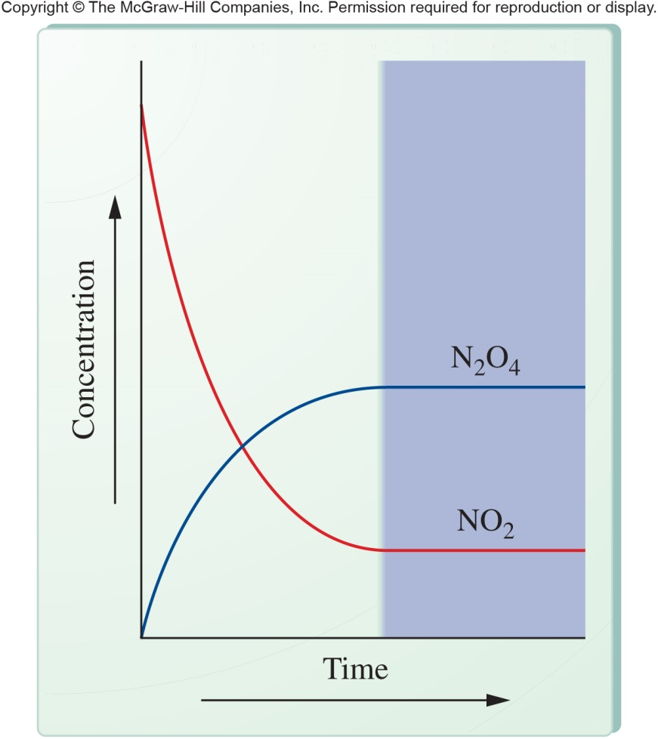
Calculating Equilibrium Constants
9
A reversible reaction is allowed to proceed until the system reaches equilibrium
Amount of reactants and products no longer changes
Analyze reaction mixture to determine molar concentrations of each product and reactant
2NO₂(g) N₂O₄(g)
7.4 Equilibrium

Slide 42
LeChatelier’s Principle
LeChatelier’s Principle – if a stress is placed on a system at equilibrium, the system will respond by altering the equilibrium composition in such a way as to minimize the stress
If reactants and products are present in a fixed volume and more NH₃ is added into the container, the system will be stressed
  Stressed = the equilibrium will be disturbed
10
7.4 Equilibrium
N₂(g) + 3H₂(g) 2NH₃(g)

Slide 43
LeChatelier’s Principle Example
Adding NH₃ to the system causes stress
  To relieve stress, remove as much of added material as possible by converting it to reactants
Adding N₂ or H₂ to the system causes stress
  To relieve stress, remove as much of added material as possible by converting it to product
7.4 Equilibrium
N₂(g) + 3H₂(g) 2NH₃(g)
Equilibrium shifted
Product introduced:
Reactant introduced:

Slide 44
Effect of Concentration
N₂(g) + 3H₂(g) 2NH₃(g)
Adding or removing either reactants or products at a fixed volume is saying that the concentration is changed
Removing material decreases concentration
System will react to this stress to return concentrations to the appropriate ratio
7.4 Equilibrium

Slide 45
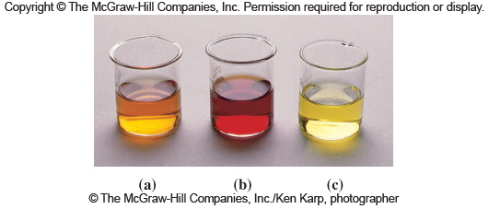
Effect of Concentration Example
FeSCN²⁺(aq) Fe³⁺(aq) + SCN⁻(aq)
Red
Yellow
Colorless
7.4 Equilibrium
A: Reaction at equilibrium
B: Shift to reactant with more red color
C: Shift to product with loss of red color

Slide 46
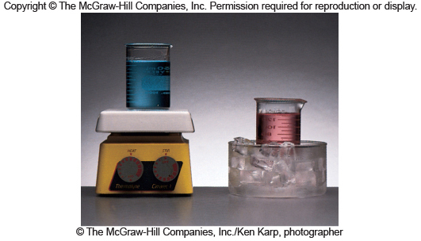
Effect of Heat – Exothermic Reaction
Exothermic reactions: treat heat as a product
N₂(g) + 3H₂(g) 2NH₃(g) + 22 kcal
Addition of heat is treated as increasing the amount of product
More product shifts equilibrium to the left
  Increases amount of reactants
  Decreases amount of product
7.4 Equilibrium
Heat favors the blue species
while cold favors the pink

Slide 47
Effect of Heat
Endothermic Reaction – treat heat as a reactant
39 kcal + 2N₂(g) + O₂(g) 2NH₃(g)
This reaction will shift to the right if heat is added by increasing the temperature
7.4 Equilibrium

Slide 48
Effect of Pressure
Pressure affects the equilibrium only if one or more substances in the reaction are gases
Relative number of gas moles on reactant and product side must differ
When pressure goes up, shift to side with less moles of gas
When pressure goes down, shift to side with more moles of gas
7.4 Equilibrium

Slide 49
Effect of a Catalyst
A catalyst has no effect on the equilibrium composition
It increases the rate of both the forward and reverse reaction to the same extent
While equilibrium composition and concentration do not change, equilibrium is reached in a shorter time
7.4 Equilibrium

