Slide 1
GENERAL CHEMISTRY
5
States of Matter Gases, Liquids and Solids
General, Organic, and Biochemistry 9th Edition
Katherine J. Denniston
Joseph J. Topping
Danaè R. Quirk Dorr
Robert L. Caret
Copyright © 2017 McGraw-Hill Education. Permission required for reproduction or display

Slide 2
Changes in State
Changes in state are considered to be physical changes
During a change of physical state, many other physical properties may also change
This chapter focuses on the important differences in physical properties among
Gases
Liquids
Solids

Slide 3
Comparison of Physical Properties of Gases, Liquids, and Solids

Slide 4
5.1 The Gaseous State
Ideal Gas Concept
Ideal gas - a model of the way that gas particles behave at the atomic/molecular level
We can measure the following of a gas:
temperature
volume
pressure
mass
We can systematically change one of the properties and see the effect on the others

Slide 5
Measurement of Gases
Gas laws involve the relationship between:
number of moles (n) of gas
volume (V)
temperature (T)
pressure (P)
Pressure - force per unit area
Gas pressure is a result of force exerted by the collision of particles with the walls of the container
5.1 The Gaseous State

Slide 6
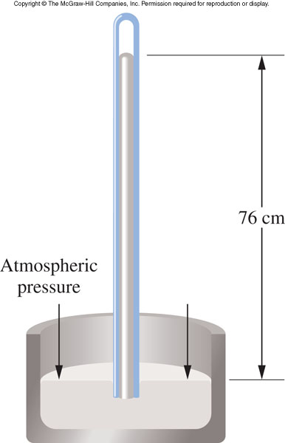
Barometer
Measures atmospheric pressure
Invented by Evangelista Torricelli
Common units of pressure
atmosphere (atm)
torr (in Torricelli’s honor)
pascal (Pa) (in honor of Blaise Pascal)
1 atm is equal to:
760 mmHg
760 torr
76.0 cmHg
5.1 The Gaseous State
1

Slide 7
Kinetic Molecular Theory of Gases
2
Gases are made up of small atoms or molecules that are in constant, random, and linear motion
The distance of separation is very large compared to the size of the individual atoms or molecules
Gas is mostly empty space
All gas particles behave independently
No attractive or repulsive forces exist between them
5.1 The Gaseous State

Slide 8
Kinetic Molecular Theory – pt 4
Gas particles collide with each other and with the walls of the container without losing energy
The energy is transferred from one atom or molecule to another
These collisions cause random changes in direction
5.1 The Gaseous State

Slide 9
Kinetic Molecular Theory – pt 5
The average kinetic energy of the atoms or molecules increases or decreases in proportion to absolute temperature
As temperature increases, particle speed (kinetic energy) also increases
5.1 The Gaseous State

Slide 10
Properties of Gases
3
Gases are easily compressible
Gas is mostly empty space, and particles can be pushed together
Gases will expand to fill any available volume
They move freely with sufficient energy to overcome attractive forces
Gases readily diffuse through each other as they are in continuous motion and paths are readily available
Due to large space between adjacent particles
5.1 The Gaseous State

Slide 11
Gases have low density
They are mostly empty space, gases have low mass per unit volume
Gases exert pressure on their containers
This pressure results from the collisions of gas particles with the walls of their container
Gases behave most ideally at low pressure and high temperature:
At low pressure the average distance of separation is greatest, which minimizes interactive forces
At high temperature, rapid motion overcomes interactive forces more easily
5.1 The Gaseous State

Slide 12
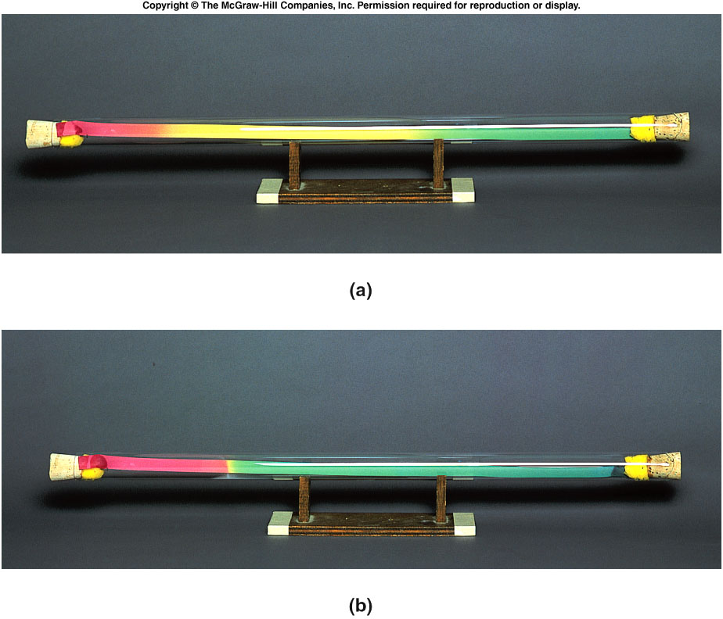
Gaseous Diffusion
Top:
Start of expt
5.1 The Gaseous State
Hydrogen chloride (36.5g/mol)
Ammonia (17.0g/mol)
Bottom:
End of expt
Ammonia diffused farther in same time; lighter moves faster.

Slide 13
The Ideal Gas Law
4
Combining:
Boyle’s law (relating volume and pressure)
Charles’s law (relating volume and temperature)
Avogadro’s law (relating volume to the number of moles)
gives the Ideal Gas Law:
5.1 The Gaseous State
PV = nRT

Slide 14
The Ideal Gas Law and Constant
3
PV = nRT
R is a constant called the ideal gas constant
R = 0.0821 L.Atm/mol.K
If units are P in atm, V in L, n in number of moles, T in K
5.1 The Gaseous State

Slide 15
Dalton’s Law of Partial Pressures
4
Dalton’s law – a mixture of gases exerts a pressure that is the sum of the pressures that each gas would exert if it were present alone under the same conditions
5.1 The Gaseous State
P_{t} = p₁ + p₂ + p₃ + …

Slide 16
Dalton’s Law of Partial Pressures Equation
Total pressure of our atmosphere is equal to the sum of the pressures of N₂ and O₂
(principal components of air)
5.1 The Gaseous State
P_{air} = p_{N} + p_{O}
2
2

Slide 17
Ideal Gases vs. Real Gases
7
In reality there is no such thing as an ideal gas
It is a useful model to explain gas behavior
Nonpolar gases behave more ideally than polar gases because attractive forces are present in polar gases
5.1 The Gaseous State

Slide 18
5.2 The Liquid State
Compressibility - liquids are practically incompressible
Enables brake fluid to work in your car
Viscosity - a measure of a liquid’s resistance to flow
A function of both attractive forces between molecules and molecular geometry
Complex or polar molecules tend to have higher viscosity than simpler or nonpolar molecules
Viscosity decreases as temperature increases
8

Slide 19
Surface Tension
Surface tension - a measure of the attractive forces exerted among molecules at the surface of a liquid
Surface molecules are surrounded and attracted by fewer liquid molecules than those below
Net attractive forces on surface molecules pull them downward
Surfactant - substance added which decreases the surface tension (soap)
5.2 The Liquid State

Slide 20
Vapor Pressure of a Liquid
Place water in a sealed container
Both liquid water and water vapor will exist in the container
How does this happen below the boiling point?
Temperature is too low for boiling conversion
Kinetic theory - liquid molecules are in continuous motion, with their average kinetic energy directly proportional to the Kelvin temperature
9
5.2 The Liquid State

Slide 21
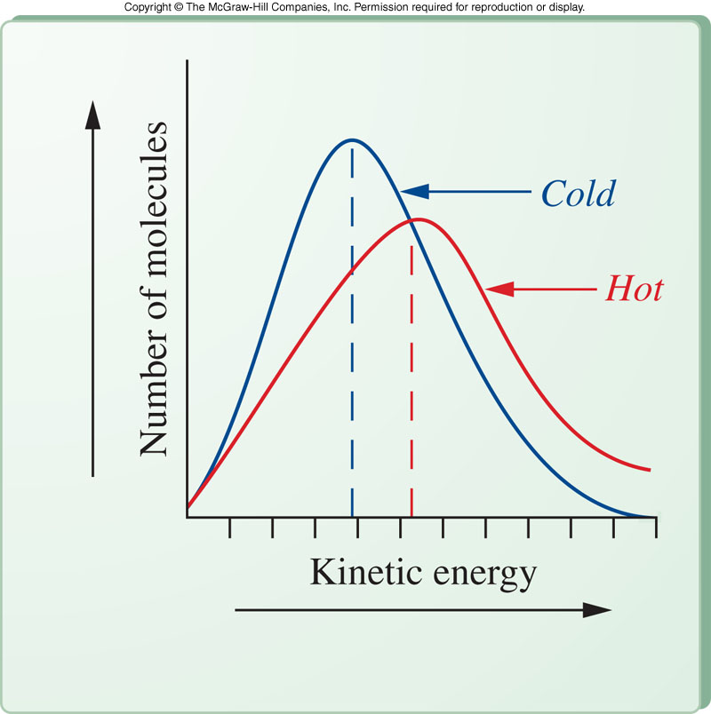
Temperature Dependence of Liquid Vapor Pressure
energy + H₂O(l) → H₂O(g)
Average molecular kinetic energy increases as temperature increases
Some high energy molecules have sufficient energy to escape from the liquid phase
Even at cold temperatures, some molecules can be converted
5.2 The Liquid State

Slide 22
Movement From Gas Back to Liquid
H₂O(g) → H₂O(l) + energy
Molecules in the vapor phase can lose energy and be converted back to the liquid phase
Evaporation - the process of conversion of liquid to gas at a temperature too low to boil
Condensation - conversion of gas to the liquid state
5.2 The Liquid State

Slide 23
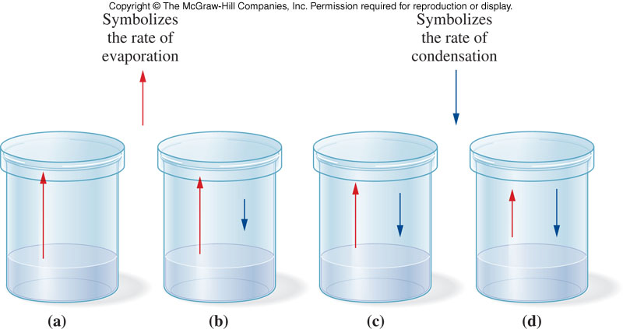
Liquid Water in Equilibrium With Water Vapor
5.2 The Liquid State
When the rate of evaporation equals the rate of condensation, the system is at equilibrium
Vapor pressure of a liquid - the pressure exerted by the vapor at equilibrium

Slide 24
Boiling Point
Boiling point - the temperature at which the vapor pressure of the liquid becomes equal to the atmospheric pressure
Normal boiling point - temperature at which the vapor pressure of the liquid is equal to 1 atm
What happens when you go to a mountain where the atmospheric pressure is lower than 1 atm?
The boiling point lowers
Boiling point is dependent on intermolecular forces
Polar molecules have higher b.p. than nonpolar molecules
5.2 The Liquid State

Slide 25
Van der Waals Forces
10
Physical properties of liquids are explained in terms of their intermolecular forces
Van der Waals forces are intermolecular forces having two subtypes:
Dipole-dipole interactions
Attractive forces between polar molecules
London dispersion forces
As electrons are in continuous motion, a nonpolar molecule could have an instantaneous dipole
These temporary dipoles attract other temporary dipoles
5.2 The Liquid State

Slide 26
Hydrogen Bonding
11
Hydrogen bonding:
not considered a Van der Waals force
is a special type of dipole-dipole attraction
is a very strong intermolecular attraction causing higher than expected boiling point and melting point
Requirement for hydrogen bonding:
molecules have hydrogen directly bonded to O, N, or F
5.2 The Liquid State

Slide 27
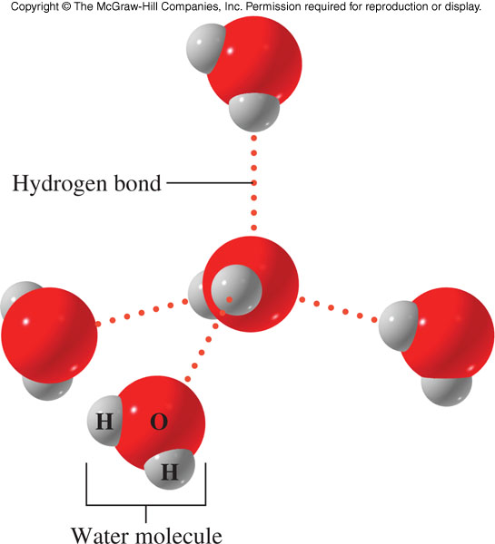
Examples of Hydrogen Bonding
Hydrogen bonding has an extremely important influence on the behavior of many biological systems
H₂O
NH₃
HF
5.2 The Liquid State

Slide 28
5.3 The Solid State
12
Particles are closely packed due to attractive forces strong enough to resist motion
Solids have a fixed shape and volume
Properties of solids:
Virtually incompressible
Melting point depends on strength of attractive force between particles
May be a crystalline solid or an amorphous solid

Slide 29
Types of Crystalline Solids
1. Ionic solids
Made up of positive and negative ions
High melting and boiling points
Hard and brittle
Example: NaCl
2. Covalent solids
Held together by covalent bonds
High melting and boiling points
Extremely hard
Example: Diamond
5.3 The Solid State

Slide 30
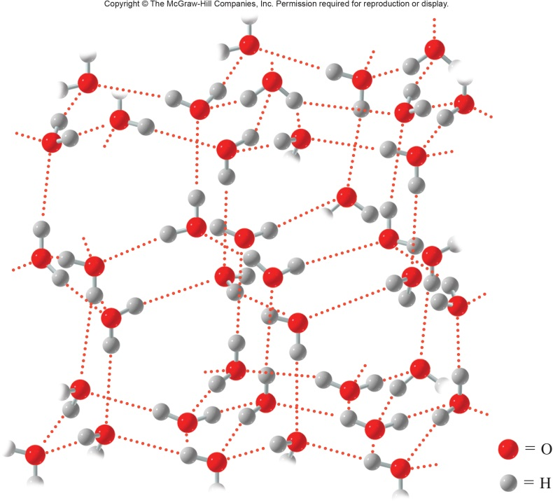
3rd Type of Crystalline
3. Molecular Solids
Made up of molecules held together by intermolecular attractive forces
Usually soft with low melting point
Volatile and poor electrical conductors
Example: Ice
5.3 The Solid State

Slide 31
4th Type of Crystalline Solids
4. Metallic Solids
Made up of metal atoms held together by metallic bonds
Metallic bonds are formed by the overlap of metal atomic orbitals
Regions of high electron density, which are very mobile and move freely from atom to atom
High conductivity
Examples: Ag and Cu
5.3 The Solid State

Slide 32
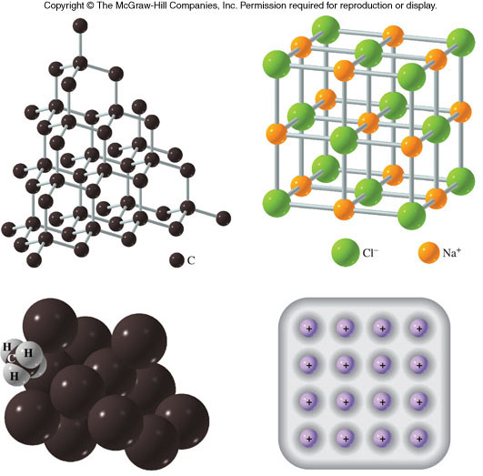
Four Types of Crystalline Solids
5.3 The Solid State

Slide 33
Sublimation of Solids
Sublimation – process of conversion of molecules in the solid state directly to the gaseous state
Example: Dry ice, solid carbon dioxide
Converts directly to a gas at atmospheric pressure
5.3 The Solid State

