Slide 1
GENERAL CHEMISTRY
Calculations,
Chemical Changes,
and the Chemical Equation
4
General, Organic, and Biochemistry 9th Edition
Katherine J. Denniston
Joseph J. Topping
Danaè R. Quirk Dorr
Robert L. Caret
Copyright © 2017 McGraw-Hill Education. Permission required for reproduction or display

Slide 2
4.1 The Mole Concept and Atoms
1
Atoms are exceedingly small
Unit of measurement for mass of an atom is atomic mass unit (amu) – unit of measure for the mass of atoms
Carbon-12 assigned the mass of exactly 12 amu
1 amu = 1.661 × 10⁻²⁴ g
Periodic table gives atomic masses in amu

Slide 3
4.1 The Mole Concept and Atoms
Mass of Atoms
What is the atomic mass of one atom of fluorine? Answer: 19.00 amu
What would be the mass of this one atom in grams?
Chemists usually work with much larger quantities
It is more convenient to work with grams than amu when using larger quantities

Slide 4
The Mole and Avogadro’s Number
Practical unit for defining a collection of atoms is the mole
1 mole of atoms = 6.022 × 10²³ atoms
Avogadro’s number
Basis for the concept of the mole
2
4.1 The Mole Concept and Atoms

Slide 5
The Mole
To make this connection we must define the mole as a counting unit
The mole is abbreviated mol
A mole is simply a unit that defines an amount of something
Dozen defines 12
Gross defines 144
4.1 The Mole Concept and Atoms

Slide 6
Molar Mass
Atomic mass - one atom of an element corresponds to average mass of a single atom in amu
Molar mass – one mole of an element corresponds to the mass of a mole of atoms in grams
1 atom of F is 19.00 amu 19.00 amu/atom F
1 mole of F is 19.00 g 19.00 g/mole F
4.1 The Mole Concept and Atoms
=19.00 g F/mol F or 19.00 g/mol F

Slide 7
Strategy for Calculations
Calculate the number of atoms of S in 1.00 g of S.
Map out a pattern for the required conversion
Two conversions are required:
Step 1: Convert g to mol using Molar Mass of S
Step 2: Convert mol to atoms using Avogadro’s Number
4.1 The Mole Concept and Atoms

Slide 8
Interconversion Between Moles, Particles, and Grams
Copyright © 2017 McGraw-Hill Education. Permission required for reproduction or display

Slide 9
4.2 The Chemical Formula, Formula Mass, and Molar Mass
4
Chemical formula - a combination of symbols of the various elements that make up the compound
Formula unit - the smallest collection of atoms that provide two important pieces of information
The identity of the atoms or ions
The relative number of each type of atom or ion

Slide 10
Chemical Formula
Consider the following formulas:
H₂ – 2 atoms of hydrogen are chemically bonded forming diatomic hydrogen, subscript 2
H₂O – 2 atoms of hydrogen and 1 atom of oxygen, lack of subscript means one atom
NaCl – 1 ion each of sodium and chlorine
Ca(OH)₂ – 1 ion of calcium and 2 ions of the hydroxide polyatomic ion, subscript outside parentheses applies to all atoms inside
4.2 The Chemical Formula, Formula Mass and Molar Mass

Slide 11
Chemical Formula Examples
Consider the following formulas:
(NH₄)₂SO₄ – 2 ammonium ions and 1 sulfate ion
Ammonium ion contains 1 nitrogen and 4 hydrogen
Sulfate ion contains 1 sulfur and 4 oxygen
Compound contains 2 N, 8 H, 1 S, and 4 O
CuSO₄.5H₂O
This is an example of a hydrate - compounds containing one or more water molecules as an integral part of their structure
5 units of water with 1 CuSO₄
4.2 The Chemical Formula, Formula Mass and Molar Mass

Slide 12
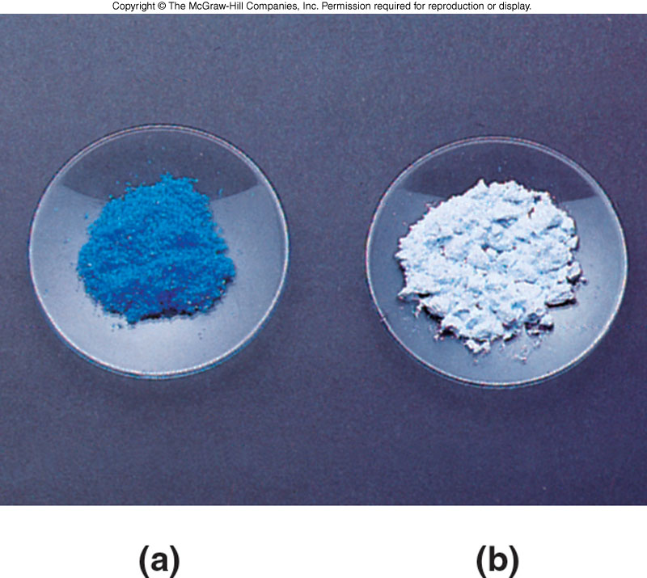
Comparison of Hydrated and Anhydrous Copper Sulfate
4.2 The Chemical Formula, Formula Mass and Molar Mass
Hydrated copper sulfate
Anhydrous copper sulfate
Marked color difference illustrates the fact
that these are different compounds

Slide 13
Molar Mass Defined
Molar mass - The mass in grams of 1 mole of atoms
What is the molar mass of carbon?
12.01 g/mol C
This means a mole of Carbon atoms (6.022 × 10²³) would have a mass of 12.01 g
One mole of any element contains the same number of atoms, 6.022 × 10²³ (Avogadro’s number)
4.2 The Chemical Formula, Formula Mass and Molar Mass

Slide 14
4.3 The Chemical Equation and the Information It Conveys
5
Chemical equation - shorthand notation of a chemical reaction
Describes all of the substances that react and all the products that form, physical states, and experimental conditions
Reactants – (starting materials) – the substances that undergo change in the reaction
Products – substances produced by the reaction

Slide 15
Features of a Chemical Equation
4.3 The Chemical Equation
and the Information It Conveys
Products and reactants must be specified using chemical symbols
Reactants – written on the left of arrow
Products – written on the right
Δ – energy is needed
Physical states are shown in parentheses

Slide 16
Combination Reactions
The joining of two or more elements or compounds, producing a product of different composition
4.3 The Chemical Equation
and the Information It Conveys
A + B → AB
Examples:
2Na(s) + Cl₂(g) → 2NaCl(s)
MgO(s) + CO₂(g) → MgCO₃(s)

Slide 17
Types of Combination Reactions
Combination of a metal and a nonmetal to form a salt
Combination of hydrogen and chlorine molecules to produce hydrogen chloride
Formation of water from hydrogen and oxygen molecules
Reaction of magnesium oxide and carbon dioxide to produce magnesium carbonate
4.3 The Chemical Equation
and the Information It Conveys

Slide 18
Decomposition Reactions
Produce two or more products from a single reactant
Reverse of a combination reaction
4.3 The Chemical Equation
and the Information It Conveys
AB → A + B
Examples:
2HgO(s) → 2Hg(l) + O₂(g)
CaCO₃(s) → CaO(s) + CO₂(g)

Slide 19
Types of Decomposition Reactions
Heating calcium carbonate to produce calcium oxide and carbon dioxide
Removal of water from a hydrated material
4.3 The Chemical Equation
and the Information It Conveys

Slide 20
Single - Replacement Reactions
Single-replacement
One atom replaces another in the compound producing a new compound
Examples:
Cu(s)+2AgNO₃(aq) → 2Ag(s)+Cu(NO₃)₂(aq)
2Na(s) + 2H₂O(l) → 2NaOH(aq) + H₂(g)
4.3 The Chemical Equation
and the Information It Conveys
A + BC → B + AC

Slide 21
Replacement Reaction Examples
Replacement of copper by zinc in copper sulfate
Replacement of aluminum by sodium in aluminum nitrate
4.3 The Chemical Equation
and the Information It Conveys

Slide 22
Double-Replacement Reactions
Double-replacement
Two compounds undergo a “change of partners”
Two compounds react by exchanging atoms to produce two new compounds
4.3 The Chemical Equation
and the Information It Conveys
AB + CD → AD + CB

Slide 23
Types of Double-Replacement
Reaction of an acid with a base to produce water and salt
HCl(aq)+NaOH(aq) →NaCl(aq)+H₂O(l)
Formation of solid lead chloride from lead nitrate and sodium chloride
Pb(NO₃)₂(aq) + 2NaCl(aq) →
PbCl₂(s) + 2NaNO₃(aq)
4.3 The Chemical Equation
and the Information It Conveys
AB + CD → AD + CB

Slide 24
4.4 Balancing Chemical Equations
A chemical equation shows the molar quantity of reactants needed to produce a particular molar quantity of products
The relative number of moles of each product and reactant is indicated by placing a whole-number coefficient before the formula of each substance in the chemical equation

Slide 25
Law of Conservation of Mass
Law of conservation of mass - matter cannot be either gained or lost in the process of a chemical reaction
The total mass of the products must equal the total mass of the reactants
4.4 Balancing Chemical
Equations

Slide 26
Balancing
7
Coefficient - how many of that substance are in the reaction
4.4 Balancing Chemical
Equations
The equation must be balanced
All the atoms of every reactant must also appear in the products
Number of Hg on left? 2
on right 2
Number of O on left? 2
on right 2

Slide 27
Examine the Equation
H₂ + O₂ → H₂O
Is the law of conservation of mass obeyed as written? NO
Balancing chemical equations uses coefficients to ensure that the law of conservation of mass is obeyed
You may never change subscripts!
WRONG: H₂ + O₂ → H₂O₂
4.4 Balancing Chemical
Equations

Slide 28
Steps in Equation Balancing
The steps to balancing:
H₂ + O₂ → H₂O
Step 1. Count the number of moles of atoms of each element on both product and reactant sides
4.4 Balancing Chemical
Equations
Reactants Products
2 mol H 2 mol H
2 mol O 1 mol O

Slide 29
Steps 2 and 3 in Equation Balancing
H₂ + O₂ → H₂O
Step 2. Determine which elements are not balanced – do not have same number on both sides of the equation
Oxygen is not balanced
Step 3. Balance one element at a time by changing the coefficients
4.4 Balancing Chemical
Equations
H₂ + O₂ → 2H₂O
This balances oxygen, but is hydrogen still balanced?

Slide 30
Step 4 in Equation Balancing
H₂ + O₂ → 2H₂O
How will we balance hydrogen?
2H₂ + O₂ → 2H₂O
Step 4. Check! Make sure the law of conservation of mass is obeyed
4.4 Balancing Chemical
Equations
Reactants Products
4 mol H 4 mol H
2 mol O 2 mol O

Slide 31
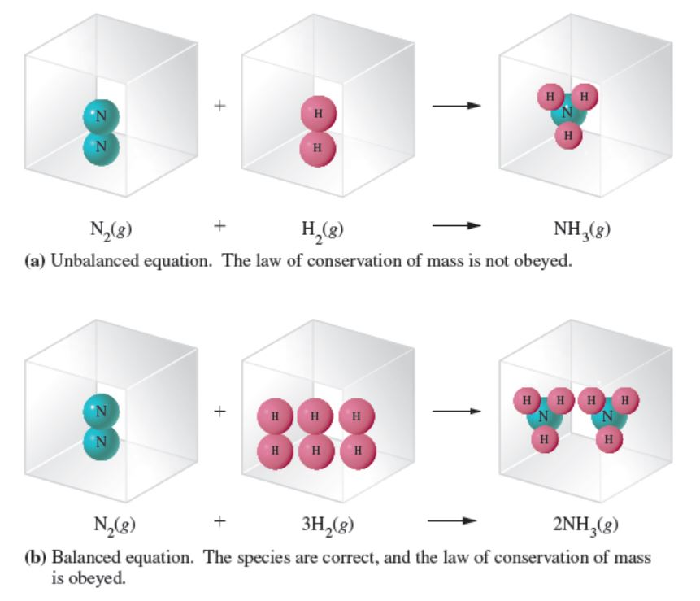
Balancing an Equation
4.4 Balancing Chemical
Equations
Copyright © 2017 McGraw-Hill Education. Permission required for reproduction or display

Slide 32
4.5 Precipitation Reactions
8
Precipitation Reactions
Chemical change in a solution that results in one or more insoluble products, precipitates
To predict if a precipitation reaction can occur it is helpful to know the solubilities of ionic compounds
4.5 Precipitation Reactions

Slide 33
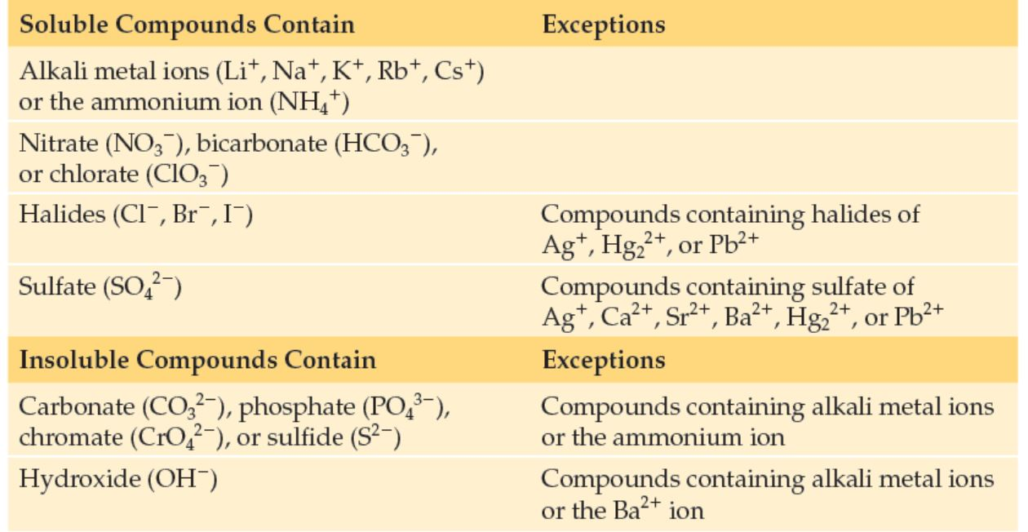
Solubilities of Some Common Ionic Compounds
Copyright © 2017 McGraw-Hill Education. Permission required for reproduction or display

Slide 34
Predicting Whether Precipitation Will Occur
8
Recombine the ionic compounds to have them exchange partners
Examine the new compounds formed and determine if any are insoluble according to the rules in Table 4.1
Any insoluble salt will be the precipitate
Pb(NO₃)₂(aq) + 2 NaCl(aq) →
4.3 The Chemical Equation
and the Information It Conveys
(s)
PbCl₂ (?) + 2NaNO₃ ( ?)
(aq)

Slide 35
4.7Acid-Base Reactions
9
These reactions involve the transfer of a hydrogen ion (H⁺) from one reactant (acid) to another (base)
HCl(aq) + NaOH(aq) → NaCl(aq) + H₂O(l)
4.7 Acid-Base Reactions
The H⁺ on HCl was transferred to the oxygen in OH⁻, giving H₂O
When equal molar quantities of acid and base
are mixed, the reaction is a neutralization reaction

Slide 36
4.8 Oxidation-Reduction Reactions
10
Oxidation-reduction processes are responsible for many types of chemical change
Oxidation - defined by one of the following
loss of electrons
loss of hydrogen atoms
gain of oxygen atoms
Example: Mg → Mg²⁺ + 2e⁻
Oxidation half-reaction

Slide 37
4.8 Oxidation-Reduction Reactions
Oxidation-Reduction Reactions
Reduction - defined by one of the following:
gain of electrons
gain of hydrogen
loss of oxygen
Example: Cl₂ + 2e⁻ → 2Cl⁻
Reduction half-reaction
Cannot have oxidation without reduction

Slide 38
Oxidation and Reduction as Complementary Processes
Mg → Mg²⁺ + 2e⁻ (oxidation half-reaction)
Cl₂ + 2e⁻ → 2Cl⁻ (reduction half-reaction)
4.8 Oxidation-Reduction Reactions
Mg + Cl₂ → Mg²⁺ + 2Cl⁻
Oxidizing Agent
Is reduced
Gains electrons
Causes oxidation
Reducing Agent
Is oxidized
Loses electrons
Causes reduction

Slide 39
Voltaic Cells
Voltaic cell – electrochemical cell that converts stored chemical energy into electrical energy
Consider the following reaction:
Zn(s) + Cu²⁺(aq) → Zn²⁺(aq) + Cu(s)
11
4.8 Oxidation-Reduction Reactions
Zn is being oxidized
Cu²⁺ is reduced

Slide 40
Voltaic Cells - Example
Zn(s) + Cu²⁺(aq) → Zn²⁺(aq) + Cu(s)
If the two reactants are placed in the same flask they cannot produce electrical current
A voltaic cell separates the two half reactions
This makes the electrons flow through a wire to allow the oxidation and reduction to occur
4.8 Oxidation-Reduction Reactions

Slide 41
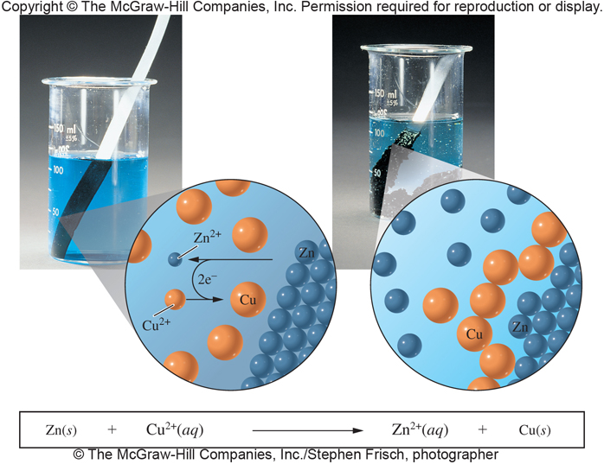
Voltaic Cell Generating Electrical Current
4.8 Oxidation-Reduction Reactions
Cu²⁺ + 2e⁻ → Cu
Reduction
cathode – electrode where reduction occurs
Zn → Zn²⁺ + 2e⁻
Oxidation
anode – electrode
where oxidation occurs

Slide 42
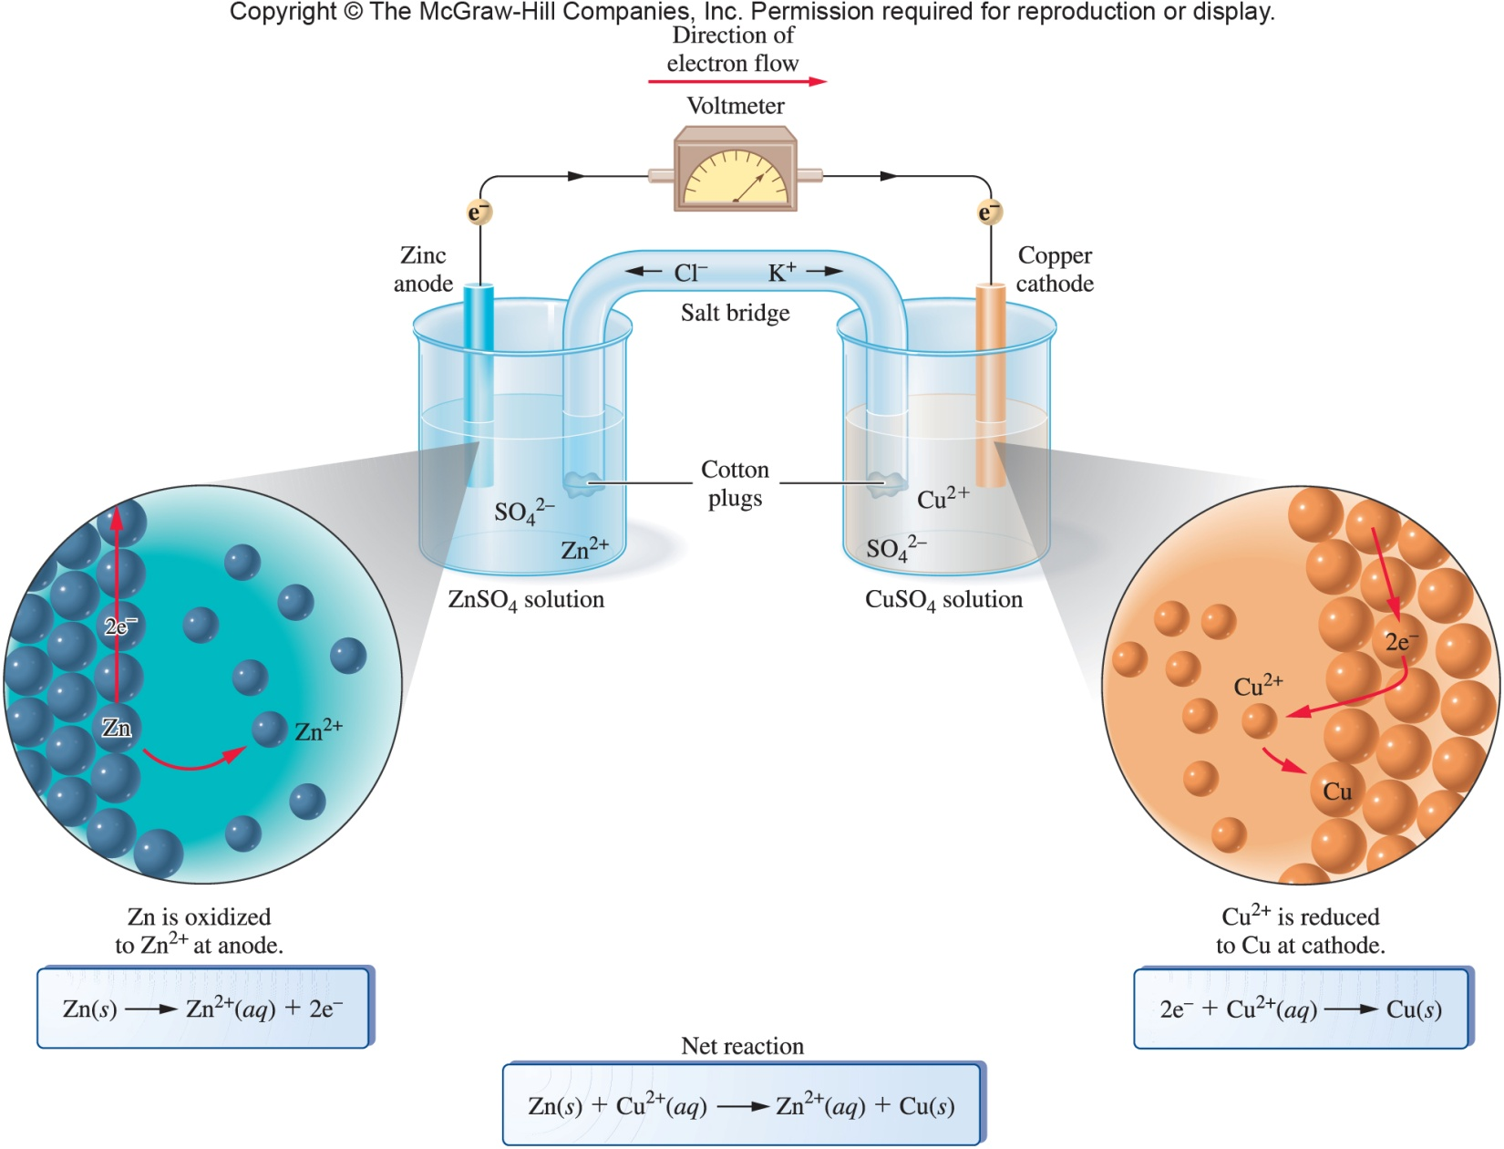
Voltaic Cell Representation
4.8 Oxidation-Reduction Reactions

Slide 43
Electrolysis
Electrolysis – uses electrical energy to cause nonspontaneous oxidation-reduction reactions to occur
These reactions are the reverse of a voltaic cell
Rechargeable battery
When powering a device behaves as voltaic cell
With time the chemical reaction nears completion
Battery appears to “run down”
Cell reaction is reversible when battery attached to charger
4.8 Oxidation-Reduction Reactions
11

Slide 44
Applications of Oxidation and Reduction
12
Corrosion - the deterioration of metals caused by an oxidation-reduction process
Example: rust (oxidation of iron)
4Fe(s) + 3O₂(g) → 2Fe₂O₃(s)
Combustion of Fossil Fuels
Example: natural gas furnaces
CH₄(g) + 2O₂(g) → CO₂(g) + 2H₂O(g)
4.8 Oxidation-Reduction Reactions

Slide 45
Applications of Oxidation and Reduction: Bleaching
Bleaching
Most bleaching agents are oxidizing agents
The oxidation of the stains produces compounds that do not have color
Example: Chlorine bleach - sodium hypochlorite (NaOCl)
4.8 Oxidation-Reduction Reactions

Slide 46
Applications of Oxidation and Reduction: Metabolism and Microbes
Metabolism
Break down of molecules into smaller pieces by enzymes
Ethanol is oxidized to acetaldehyde
Acetaldehyde is oxidized to acetic acid
Acetic acid is oxidized to carbon dioxide
Chemical Control of Microbes
Antiseptics and Disinfectants
Hydrogen peroxide - H₂O₂
4.8 Oxidation-Reduction Reactions

Slide 47
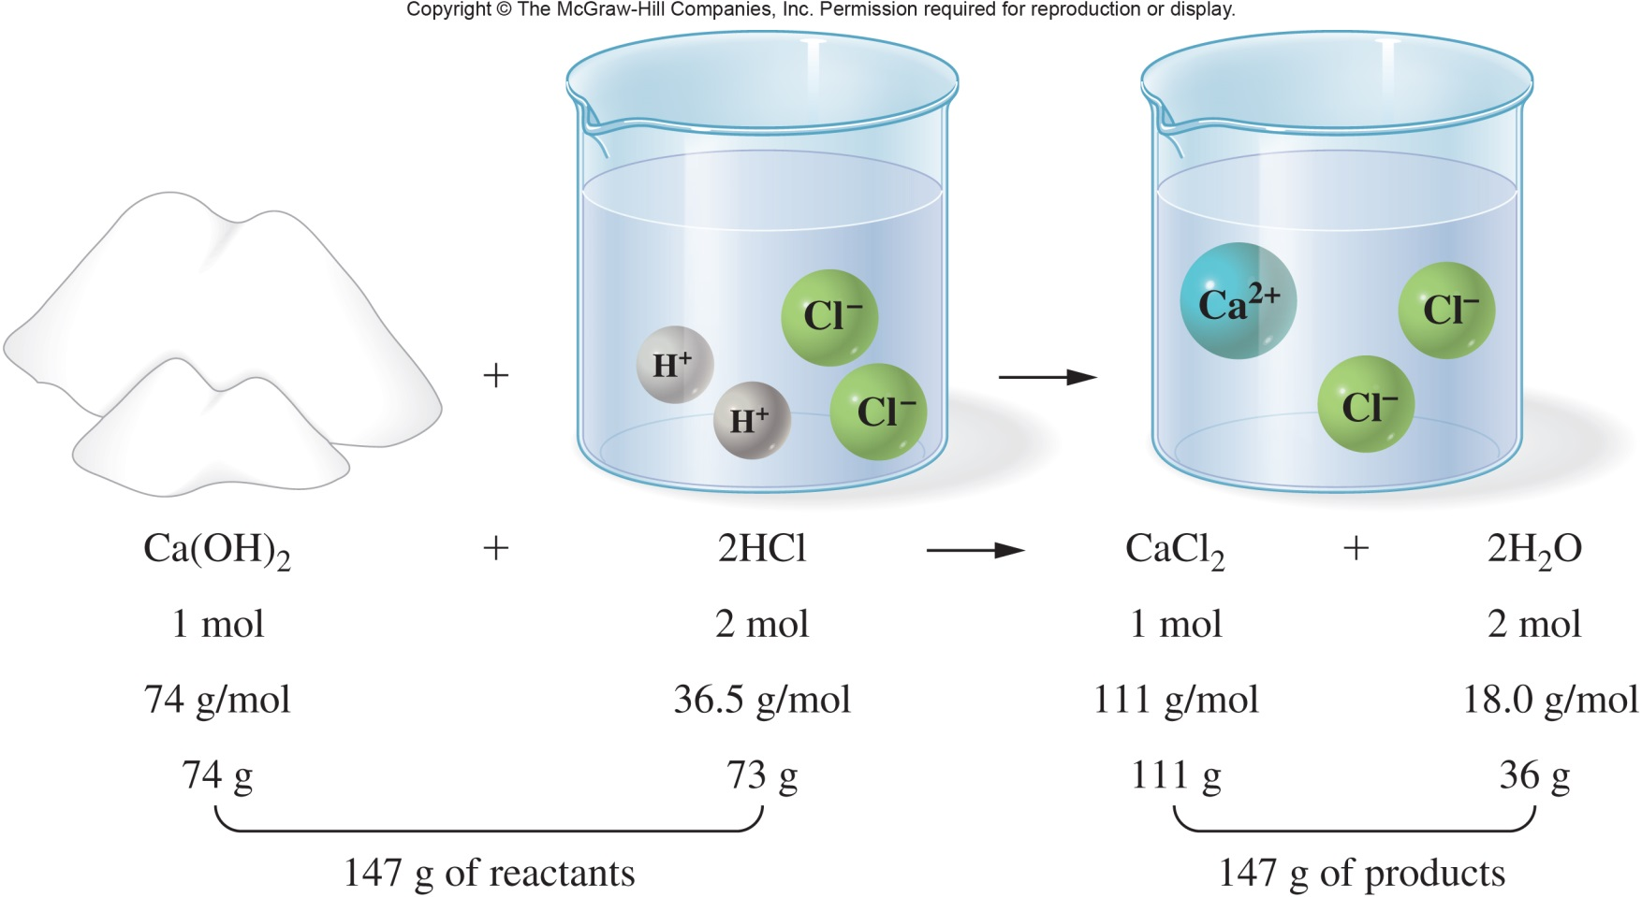
A Visual Example of the Law of Conservation of Mass
4.9 Calculations Using the Chemical Equation

Slide 48
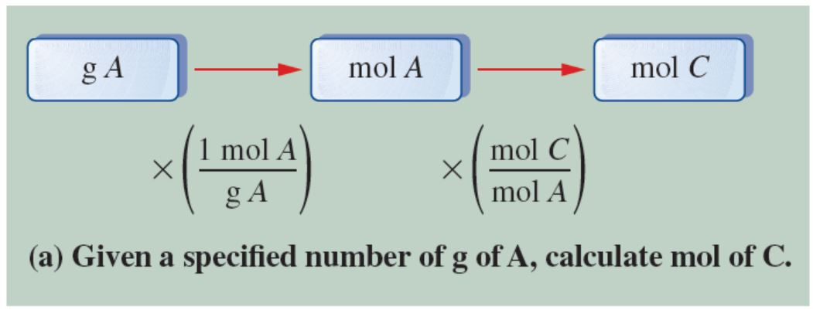
General Problem-Solving Strategy
Copyright © 2017 McGraw-Hill Education. Permission required for reproduction or display

