Slide 1
GENERAL CHEMISTRY
Structure and Properties of Ionic and Covalent Compounds
3
General, Organic, and Biochemistry 9th Edition
Katherine J. Denniston
Joseph J. Topping
Danaè R. Quirk Dorr
Robert L. Caret
Copyright © 2017 McGraw-Hill Education. Permission required for reproduction or display

Slide 2
3.1 Chemical Bonding
Chemical bond - the force of attraction between any two atoms in a compound
This attractive force overcomes the repulsion of the positively charged nuclei of the two atoms participating in the bond
Interactions involving valence electrons are responsible for the chemical bond

Slide 3
Lewis Symbols
1
Lewis symbol - a way to represent atoms using the element symbol and valence electrons as dots
As only valence electrons participate in bonding, this makes it much easier to work with the octet rule
The number of dots used corresponds directly to the number of valence electrons located in the outermost shell of the atoms of the element
3.1 Chemical Bonding

Slide 4
Writing Lewis Symbols
The four sides around the atomic symbol can each have two dots for a maximum of eight (octet of electrons).
Writing Lewis symbols
Place one dot on each side until there are four dots around the symbol
Then add a second dot to each side in turn
The number of valence electrons limits the number of dots placed
Each unpaired dot (unpaired valence electron) is available to form a chemical bond
3.1 Chemical Bonding

Slide 5
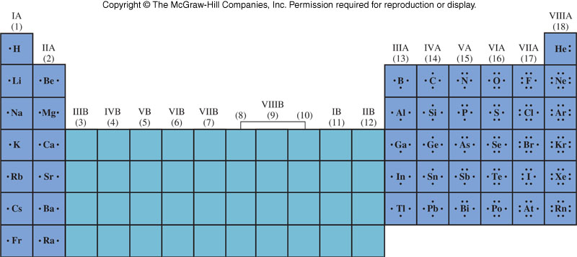
Lewis Symbols for Representative Elements
3.1 Chemical Bonding

Slide 6
Principal Types of Chemical Bonds: Ionic and Covalent
2
Ionic bond - attractive force due to the transfer of one or more electrons from one atom to another
The attraction is due to the opposite charges of the ions
https://youtu.be/ljvX-RMv_lw
Covalent bond - attractive force due to the sharing of electrons between atoms
Some bonds have characteristics of both types and not easily identified as one or the other
3.1 Chemical Bonding

Slide 7
Ionic Bonding
2
Representative elements form ions that obey the octet rule
Electrons are lost by a metal and they are gained by a nonmetal
Each atom achieves a “Noble Gas” configuration
2 ions are formed; a cation and anion, which are attracted to each other
Ions of opposite charge attract each other creating the ionic bond
3.1 Chemical Bonding

Slide 8
Ionic Bonding: NaCl
Consider the formation of NaCl
Na + Cl → NaCl
Chlorine has a high
electron affinity
When chlorine gains
an electron, it gains
the Ar configuration
3.1 Chemical Bonding
Sodium has a low
ionization energy (it
readily loses this
electron)
Na → Na⁺ + e⁻
When sodium loses the
electron, it gains the
Ne configuration

Slide 9
Essential Features of Ionic Bonding
Metals tend to form cations because they have low I.E. and low E.A.
Nonmetals tend to form anions because they have high I.E. and high E.A.
Ions are formed by the transfer of electrons
The oppositely charged ions formed are held together by an electrostatic force
Reactions between metals and nonmetals tend to form ionic compounds
3.1 Chemical Bonding

Slide 10
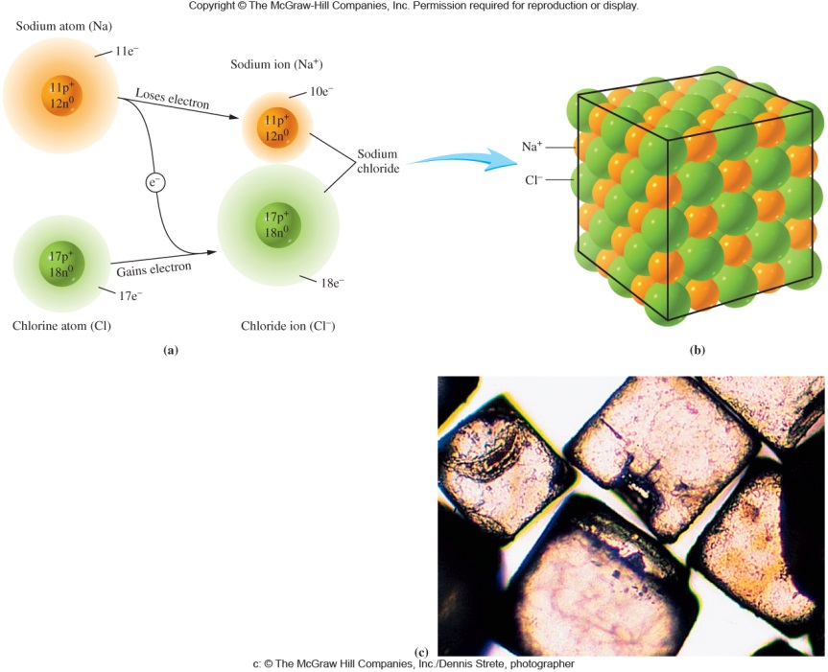
Ion Arrangement in a Crystal
As a sodium atom loses one electron, it becomes a smaller sodium ion
When a chlorine atom gains that electron, it becomes a larger chloride ion
Attraction of the Na cation with the Cl anion forms NaCl ion pairs that aggregate into a crystal
3.1 Chemical Bonding

Slide 11
Covalent Bonding
Consider the formation of H₂:
H + H → H₂
Each hydrogen has one electron in its valance shell
If it were an ionic bond it would look like this:
However, both hydrogen atoms have an equal tendency to gain or lose electrons
Electron transfer from one H to another usually will not occur under normal conditions
2
3.1 Chemical Bonding

Slide 12
Covalent Bond
Instead, each atom attains a noble gas configuration by sharing electrons
3.1 Chemical Bonding
Each hydrogen atom now has two electrons around it and attained a He configuration
The shared
electron
pair is called a
Covalent Bond

Slide 13
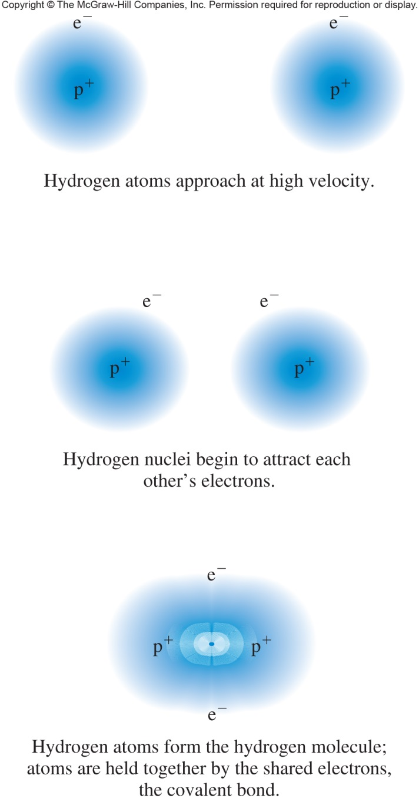
Covalent Bonding in Hydrogen
3.1 Chemical Bonding

Slide 14
Features of Covalent Bonds
Covalent bonds form between atoms with similar tendencies to gain or lose electrons
Compounds containing covalent bonds are called covalent compounds or molecules
The diatomic elements have completely covalent bonds (totally equal sharing)
H₂, N₂, O₂, F₂, Cl₂, Br₂, I₂
3.1 Chemical Bonding
Each fluorine is surrounded by 8 electrons – Ne configuration

Slide 15
Examples of Covalent Bonding
2e– from 2H 2e– for H
6e– from O 8e– for O
3.1 Chemical Bonding
4e– from 4H 2e– for H
4e– from C 8e– for C

Slide 16
Polar Covalent Bonding and Electronegativity
The Polar Covalent Bond
Ionic bonding involves the transfer of electrons
Covalent bonding involves the sharing of electrons
Polar covalent bonding - bonds made up of unequally shared electron pairs
3.1 Chemical Bonding

Slide 17
Polar Covalent Bond
somewhat positively charged
somewhat negatively charged
The electrons spend more time with fluorine
This sets up a polar covalent bond
A truly covalent bond can only occur when both atoms are identical
These two
electrons are
not shared equally

Slide 18
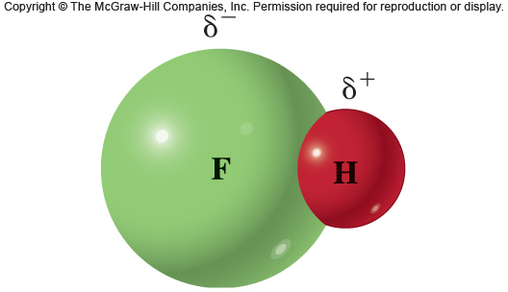
Polar Covalent Bonding in HF
Fluorine is electron rich = δ⁻
Hydrogen is electron deficient = δ⁺
This results in unequal sharing of electrons in the pairs = polar covalent bonds
3.1 Chemical Bonding

Slide 19
Electronegativity
Electronegativity - a measure of the ability of an atom to attract electrons in a chemical bond
Elements with high electronegativity have a greater ability to attract electrons than do elements with low electronegativity
Consider the covalent bond as competition for electrons between 2 positive centers
The difference in electronegativity determines the extent of bond polarity
3.1 Chemical Bonding

Slide 20
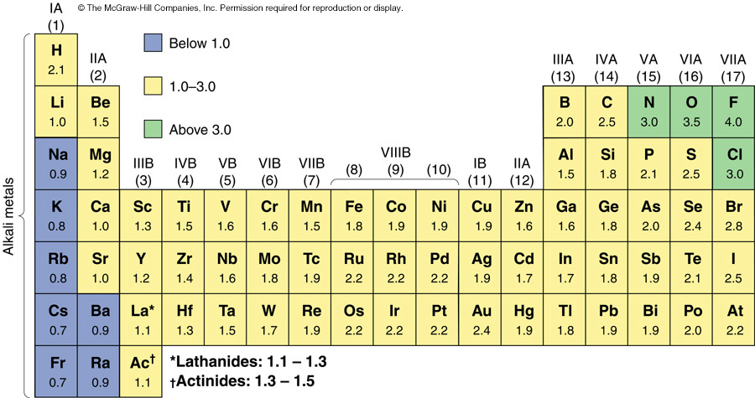
Electronegativities of Selected Elements
The most electronegative elements are found in the upper right corner of the periodic table
The least electronegative elements are found in the lower left corner of the periodic table
3.1 Chemical Bonding
electronegativity increases
electronegativity increases

Slide 21
Electronegativity Calculations
The greater the difference in electronegativity between two atoms, the greater the polarity of their bond
Which would be more polar, a H-F bond or H-Cl bond?
H-F … 4.0 - 2.1 = 1.9
H-Cl … 3.0 - 2.1 = 0.9
The HF bond is more polar than the HCl bond
3.1 Chemical Bonding

Slide 22
3.2 Naming Compounds and Writing Formulas of Compounds
Nomenclature - the assignment of a correct and unambiguous name to each and every chemical compound
Two naming systems:
ionic compounds
covalent compounds
3

Slide 23
Formulas of Compounds
A formula is the representation of the fundamental compound using chemical symbols and numerical subscripts
The formula identifies the number and type of the various atoms that make up the compound unit
The number of like atoms in the unit is shown by the use of a subscript
Presence of only one atom is understood when no subscript is present
3.2 Naming Compounds and Writing Formulas of Compounds

Slide 24
Ionic Compounds
Metals and nonmetals usually react to form ionic compounds
The metals are cations and the nonmetals are anions
The cations and anions arrange themselves in a regular three-dimensional repeating array called a crystal lattice
Formula of an ionic compound is the smallest whole-number ratio of ions in the substance
3.2 Naming Compounds and Writing Formulas of Compounds

Slide 25
Writing Names of Ionic Compounds from the Formula of the Compound
Name the cation followed by the name of the anion
A positive ion retains the name of the element; change the anion suffix to -ide

Slide 26
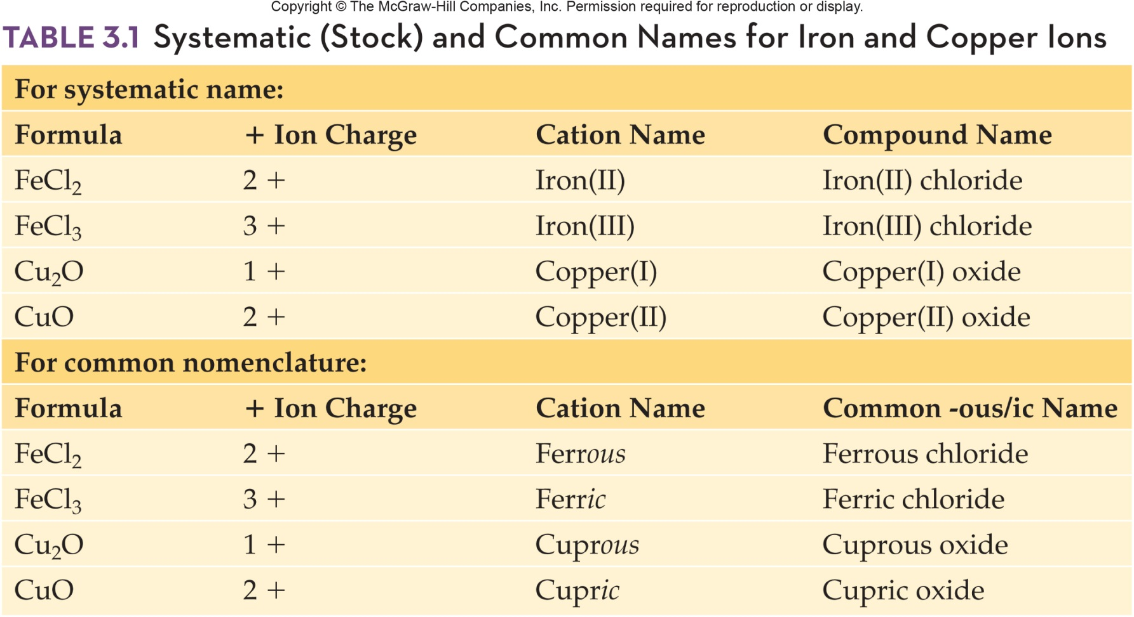
Stock and Common Names for Iron and Copper Ions
3.2 Naming Compounds and Writing Formulas of Compounds

Slide 27
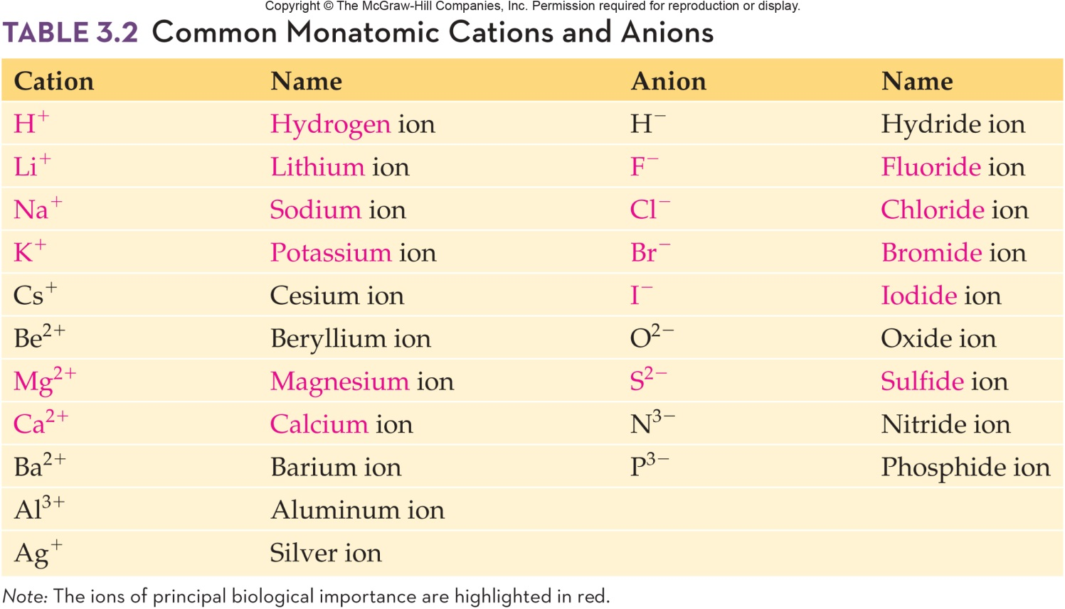
Common Monatomic Cations and Anions
3.2 Naming Compounds and Writing Formulas of Compounds
Monatomic ions - ions consisting of a single charged atom

Slide 28
Polyatomic Ions
Polyatomic ions - ions composed of 2 or more atoms bonded together with an overall positive or negative charge
Within the ion itself, the atoms are bonded using covalent bonds
The positive and negative ions will be bonded to each other with ionic bonds
Examples:
NH₄⁺ ammonium ion
SO₄²⁻ sulfate ion
3.2 Naming Compounds and Writing Formulas of Compounds

Slide 29
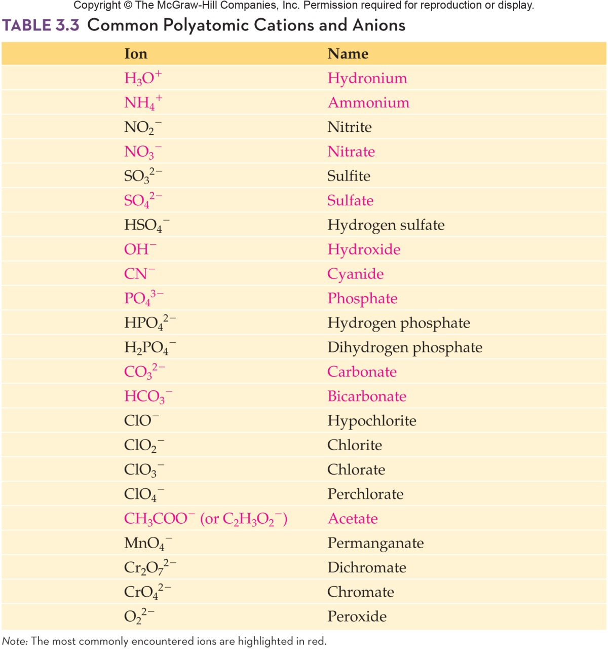
Common Polyatomic Cations and Anions
3.2 Naming Compounds and Writing Formulas of Compounds

Slide 30
Writing Formulas of Ionic Compounds from the Name of the Compound
3
Determine the charge of each ion
Write the formula so that the resulting compound is neutral
Example:
Barium chloride:
Barium is 2⁺, Chloride is 1⁻
Formula is BaCl₂
3.2 Naming Compounds and Writing Formulas of Compounds

Slide 31
Covalent Compounds
Covalent compounds are typically formed from nonmetals
Molecules - compounds characterized by covalent bonding
Not a part of a massive three-dimensional crystal structure
Exist as discrete molecules in the solid, liquid, and gas states
3.2 Naming Compounds and Writing Formulas of Compounds

Slide 32
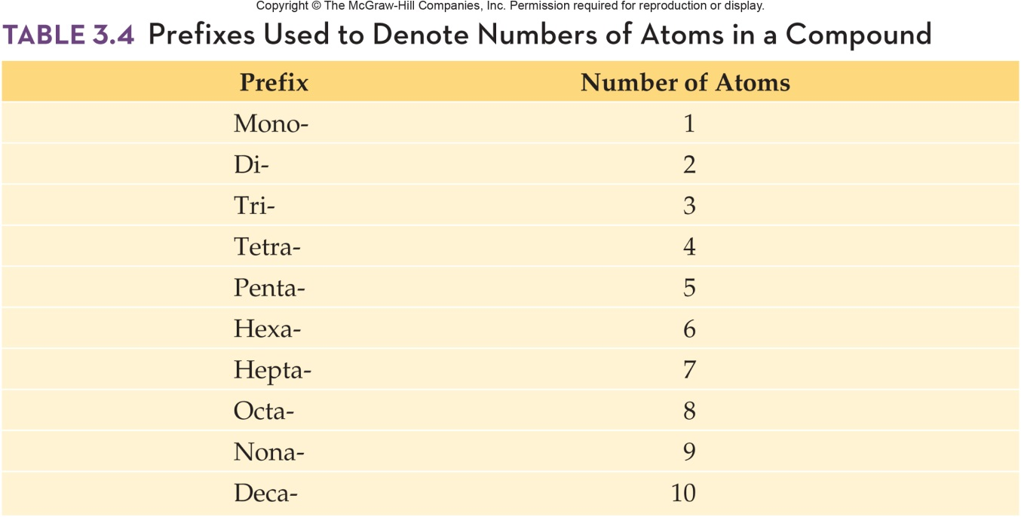
Naming Covalent Compounds
The names of the elements are written in the order in which they appear in the formula
A prefix indicates the number of each kind of atom
4
3.2 Naming Compounds and Writing Formulas of Compounds

Slide 33
Naming Covalent Compounds - continued
If only one atom of a particular element is present in the molecule, the prefix mono- is usually omitted from the first element
Example: CO is carbon monoxide
The stem of the name of the last element is used with the suffix –ide
The final vowel in a prefix is often dropped before a vowel in the stem name
3.2 Naming Compounds and Writing Formulas of Compounds

Slide 34
Writing Formulas of Covalent Compounds
Use the prefixes in the names to determine the subscripts for the elements
Examples:
nitrogen trichloride NCl₃
diphosphorus pentoxide P₂O₅
Some common names that are used:
H₂O water
NH₃ ammonia
C₂H₅OH ethanol or ethyl alcohol
C₆H₁₂O₆ glucose
4
3.2 Naming Compounds and Writing Formulas of Compounds

Slide 35
3.3 Properties of Ionic and Covalent Compounds
Physical State
Ionic compounds are usually solids at room temperature
Covalent compounds can be solids, liquids, and gases
Melting and Boiling Points
Melting point - the temperature at which a solid is converted to a liquid
Boiling point - the temperature at which a liquid is converted to a gas
5

Slide 36
Physical Properties
Melting and Boiling Points
Ionic compounds have much higher melting points and boiling points than covalent compounds
A large amount of energy is required to break the electrostatic attractions between ions
Ionic compounds typically melt at several hundred degrees Celsius
Structure of Compounds in the Solid State
Ionic compounds are crystalline
Covalent compounds are crystalline or amorphous – having no regular structure
3.3 Properties of Ionic and Covalent Compounds

Slide 37
Electrolytes and Nonelectrolytes
Solutions of Ionic and Covalent Compounds
Ionic compounds often dissolve in water, where they dissociate - form positive and negative ions in solution
Electrolytes - ions present in solution allowing the solution to conduct electricity
Covalent solids usually do not dissociate and do not conduct electricity - nonelectrolytes
3.3 Properties of Ionic and Covalent Compounds

Slide 38
Comparison of Ionic vs. Covalent Compounds
 | Ionic | Covalent
Often Composed of | Metal + nonmetal | 2 nonmetals
Electrons | Transferred | Shared
Physical state | Solid / crystal | Any / crystal OR amorphous
Dissociation | Yes, electrolytes | No, nonelectrolytes
Boiling/Melting | High | Low
3.3 Properties of Ionic and Covalent Compounds

Slide 39
Lewis Structure, Stability, Multiple Bonds, and Bond Energies
7
Single bond - one pair of electrons are shared between two atoms
Double bond - two pairs of electrons are shared between two atoms
Triple bond - three pairs of electrons are shared between two atoms
Very stable
3.4 Drawing Lewis Structures of Molecules

Slide 40
Bond Energy and Bond Length
Bond energy - the amount of energy required to break a bond holding two atoms together
triple bond > double bond > single bond
Bond length - the distance separating the nuclei of two adjacent atoms
single bond > double bond > triple bond
3.4 Drawing Lewis Structures of Molecules

Slide 41
Odd Electron
Odd electron - if there is an odd number of valence electrons, it is not possible to give every atom eight electrons
Let’s look at NO, nitric oxide
It is impossible to pair all electrons as the compound contains an ODD number of valence electrons
3.4 Drawing Lewis Structures of Molecules
N = O

Slide 42
Lewis Structures and Molecular Geometry; VSEPR Theory
8
Molecular shape plays a large part in determining properties and shape
VSEPR theory - Valance Shell Electron Pair Repulsion theory
Used to predict the shape of the molecules
All electrons around the central atom arrange themselves so they can be as far away from each other as possible – to minimize electronic repulsion.
3.4 Drawing Lewis Structures of Molecules

Slide 43
VSEPR Theory
In the covalent bond, bonding electrons are localized around the nucleus
The covalent bond is directional, having a specific orientation in space between the bonded atoms
Ionic bonds have electrostatic forces which have no specific orientation in space
3.4 Drawing Lewis Structures of Molecules

Slide 44
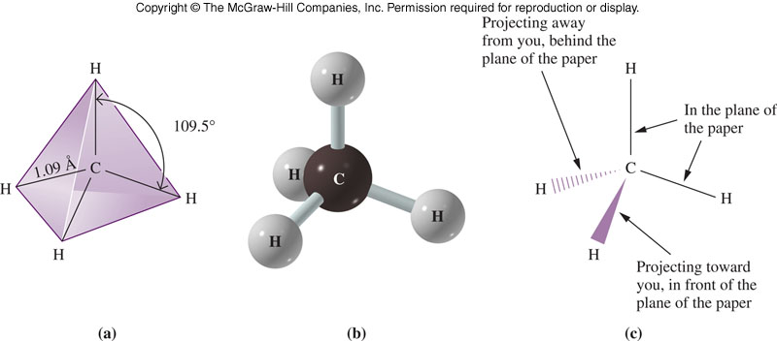
Basic Electron Pair Repulsion of a Full Octet
Consider CH₄
There are 4 bonded atoms around the central carbon
Minimal electron repulsion when electrons are placed at the four corners of a tetrahedron
Each H-C-H bond angle is 109.5°
Tetrahedron is the primary structure of a full octet
3.4 Drawing Lewis Structures of Molecules

Slide 45
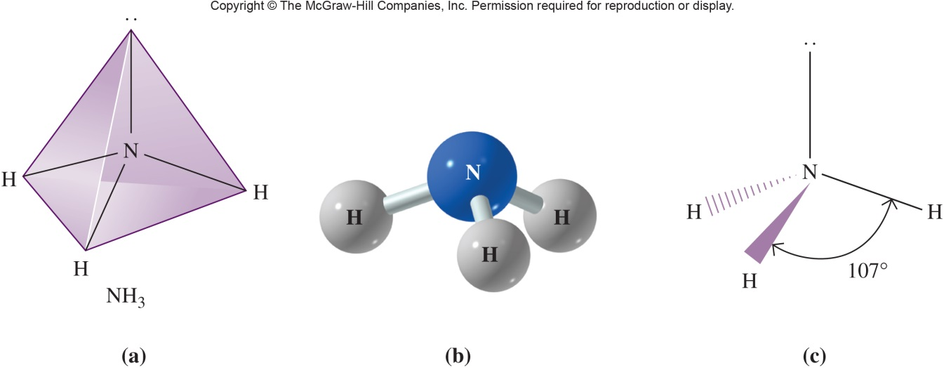
Basic Electron Pair Repulsion of a Full Octet with One Lone Pair
Consider NH₃
There are three bonded atoms and one lone pair (four groups)
A lone pair is more electronegative with a greater electron repulsion
The lone pair takes one of the corners of the tetrahedron without being visible, distorting the arrangement of electron pairs
Ammonia has a trigonal pyramidal structure with 107°bond angles
3.4 Drawing Lewis Structures of Molecules

Slide 46
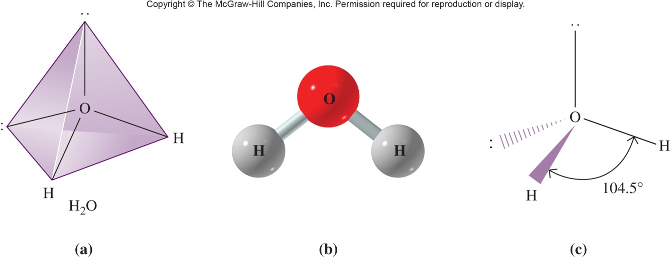
Basic Electron Pair Repulsion of a Full Octet with Two Lone Pairs
Consider H₂O
There are two bonded atoms and two lone pair (four groups)
All 4 electron pairs are approximately tetrahedral to each other
The lone pairs take two of the corners of the tetrahedron without being visible, distorting the arrangement of electron pairs
Water has a bent or angular structure with 104.5° bond angles
3.4 Drawing Lewis Structures of Molecules

Slide 47
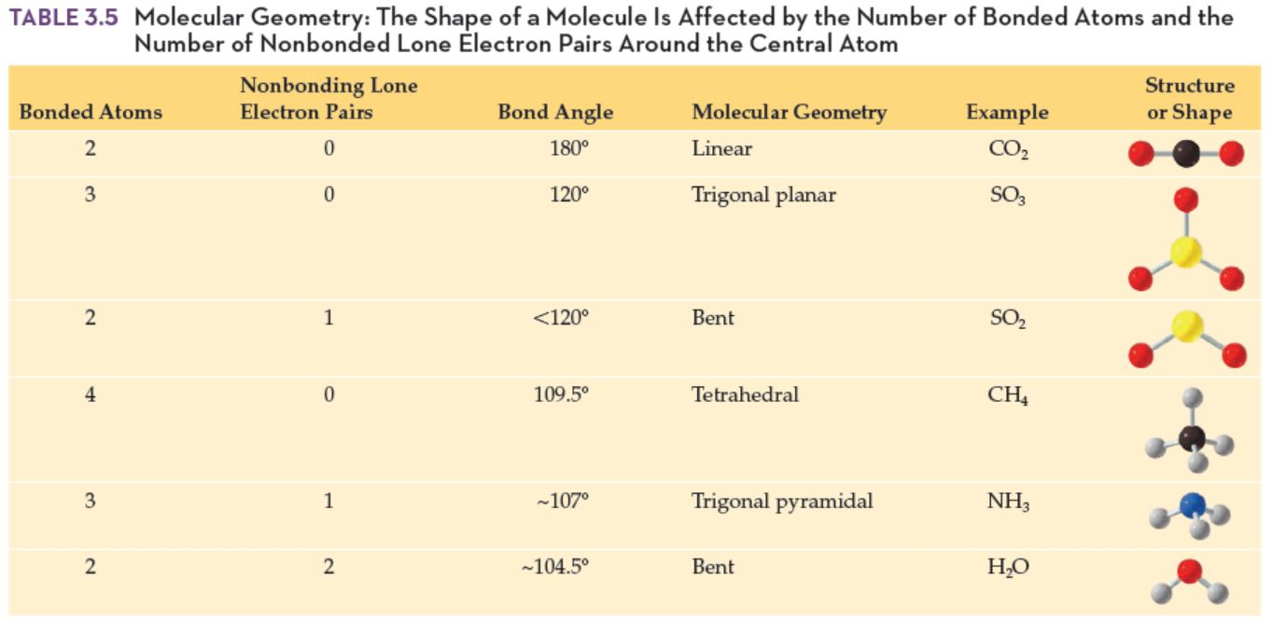
Predicting Geometric Shape Using Electron Pairs
Copyright © 2017 McGraw-Hill Education. Permission required for reproduction or display

Slide 48
Basic Procedure to Determine Molecular Shape
Write the Lewis structure
Count the number of bonded atoms and lone pairs around the central atom
If no lone pairs are present, geometry is:
2 bonded atoms - linear
3 bonded atoms - trigonal planar
4 bonded atoms - tetrahedral
If there are lone pairs, look at the arrangement of the atoms and name the geometry. Names include:
Angular
Trigonal pyramid
3.4 Drawing Lewis Structures of Molecules

Slide 49
Lewis Structures and Polarity
Polar molecules when placed in an electric field will align themselves in the field
Molecules that are polar behave as a dipole (having two “poles” or ends)
One end is positively charged the other is negatively charged
Nonpolar molecules will not align themselves in an electric field
9
3.4 Drawing Lewis Structures of Molecules

Slide 50
Determining Polarity
To determine if a molecule is polar:
Write the Lewis structure
Draw the geometry
Use the following symbol to denote the polarity of each bond
3.4 Drawing Lewis Structures of Molecules
Positive end of the bond, the less electronegative atom
Negative end of the bond, more electronegative atom attracts the electrons more strongly towards it

Slide 51
Guidelines for Determining Polarity
Molecules that have no lone pair on the central atom, and all terminal atoms are the same are nonpolar
Molecules with one lone pair on the central atom are polar
Molecules with more than one lone pair on the central atom are usually polar
3.4 Drawing Lewis Structures of Molecules

Slide 52
3.5 Properties Based on Molecular Geometry and Intermolecular Forces
Intramolecular forces – attractive forces within molecules
Example: Chemical bonds
Intermolecular forces – attractive forces between molecules
Intermolecular forces determine many physical properties
Intermolecular forces are a direct consequence of the intramolecular forces in the molecules
10

Slide 53
3.5 Properties Based on Molecular Geometry & Intermolecular Forces
Solubility
Solubility - the maximum amount of solute that dissolves in a given amount of solvent at a specific temperature
“Like dissolves like”
Polar molecules are most soluble in polar solvents
Nonpolar molecules are most soluble in nonpolar solvents
Does ammonia, NH₃, dissolve in water?
Yes, both molecules are polar

Slide 54
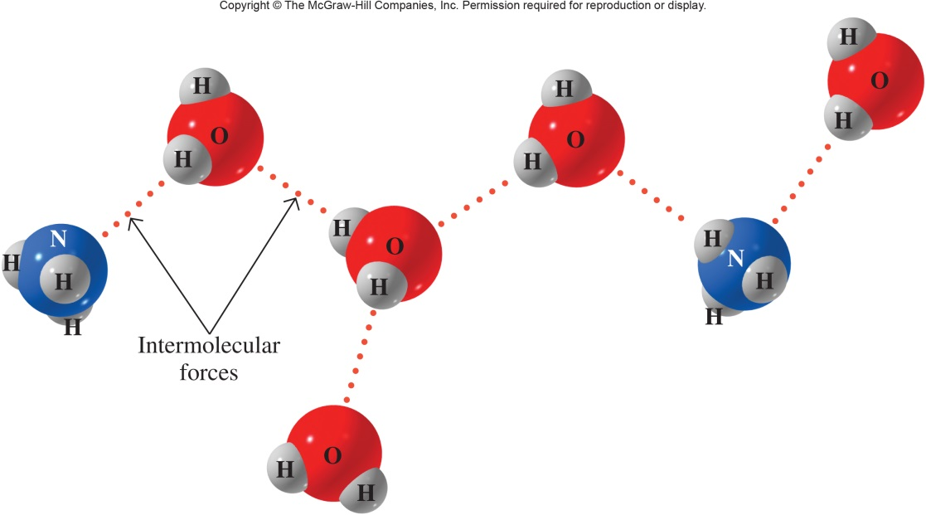
Interaction of Water and Ammonia
3.5 Properties Based on Molecular Geometry & Intermolecular Forces
The δ⁻ end of ammonia, N, is attracted to the δ⁺ end of the water molecule, H
The δ⁺ end of ammonia, H, is attracted to the δ⁻ end of the water molecule, O

Slide 55
Water and Ammonia: Hydrogen Bonds
3.5 Properties Based on Molecular Geometry & Intermolecular Forces
The attractive forces, called hydrogen bonds, pull ammonia into water, distributing the ammonia molecules throughout the water, forming a homogeneous solution

Slide 56
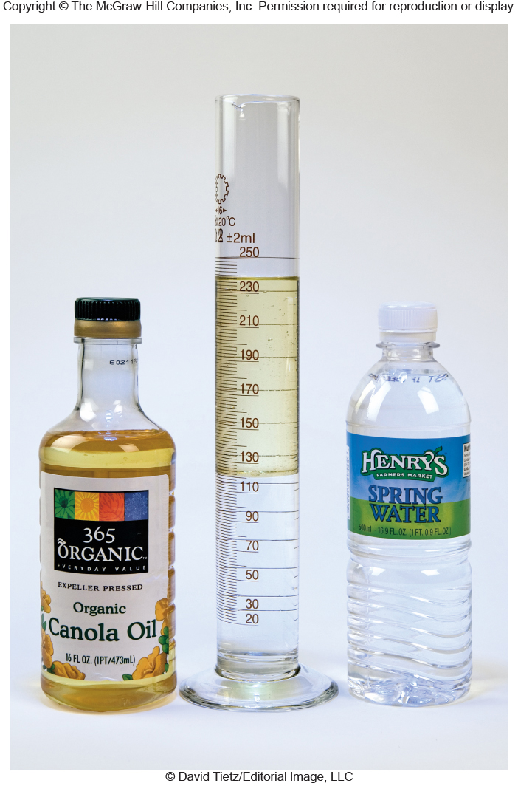
Interaction of Water and Oil
What do you know about oil and water?
“They don’t mix”
Why?
Because water is polar and oil is nonpolar
3.5 Properties Based on Molecular Geometry & Intermolecular Forces

Slide 57
Water and Oil
Water molecules exert their attractive forces on other water molecules
Oil remains insoluble and floats on the surface of the water as it is less dense
3.5 Properties Based on Molecular Geometry & Intermolecular Forces

Slide 58
Boiling Points of Liquids and Melting Points of Solids
Energy is used to overcome the intermolecular attractive forces in a substance, driving the molecules into a less associated phase
The greater the intermolecular force, the more energy is required leading to
Higher melting point (m.p.) of a solid
Higher boiling point (b.p.) of a liquid
3.5 Properties Based on Molecular Geometry & Intermolecular Forces

Slide 59
Factors Influencing Boiling and Melting Points
Strength of the attractive force holding the substance in its current physical state
Molecular mass
Larger molecules have higher m.p. and b.p. than smaller molecules as it is more difficult to convert a larger mass to another phase
Polarity
Polar molecules have higher m.p. and b.p. than nonpolar molecules of similar molecular mass due to their stronger attractive force
3.5 Properties Based on Molecular Geometry & Intermolecular Forces

Slide 60
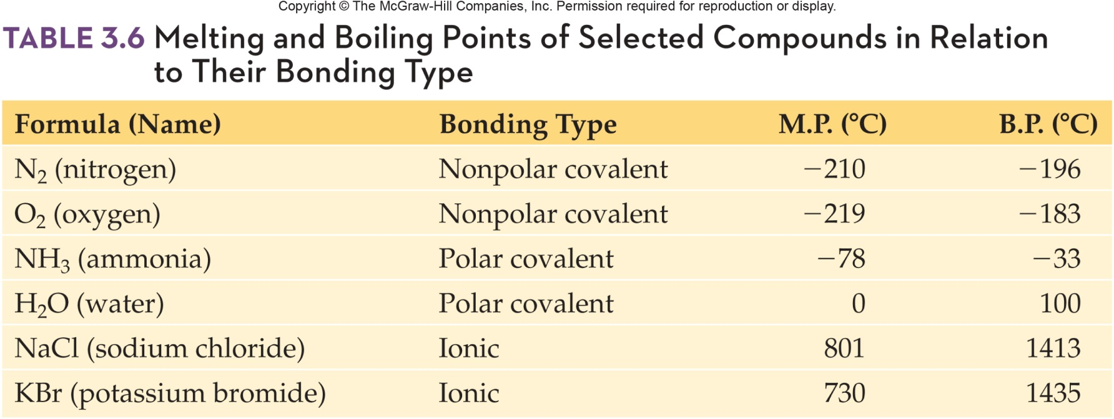
Melting and Boiling Points Selected Compounds by Bonding Type

