Slide 1
GENERAL CHEMISTRY
1
Chemistry: Methods and Measurement
General, Organic, and Biochemistry 9th Edition
Katherine J. Denniston
Joseph J. Topping
Danaè R. Quirk Dorr
Robert L. Caret
Copyright © 2017 McGraw-Hill Education. Permission required for reproduction or display

Slide 2
1.1 The Discovery Process
Chemistry:
the study of matter
its chemical and physical properties
the chemical and physical changes it undergoes
As matter undergoes changes, it gains or loses energy
Matter - anything that has mass and occupies space
Energy - the ability to do work to accomplish some change
1

Slide 3
Role of Chemistry
pharmaceutical industry
public health
1.1 The Discovery Process
CHEMISTRY
food science
medical practitioners
forensic sciences

Slide 4
THE SCIENTIFIC METHOD
a systematic approach to the discovery of new information
2
Characteristics:
Observation
Formulation of a question
Pattern recognition
Developing theories
Experimentation
Data: the individual result of a single measurement
Results: the outcome of an experiment
Summarizing information
1.1 The Discovery Process
3

Slide 5
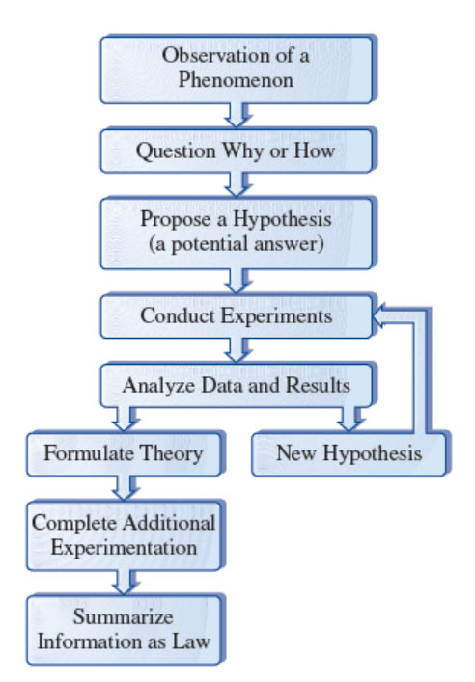
Representation of the Scientific Method
1.1 The Discovery Process
Copyright © 2017 McGraw-Hill Education. Permission required for reproduction or display

Slide 6
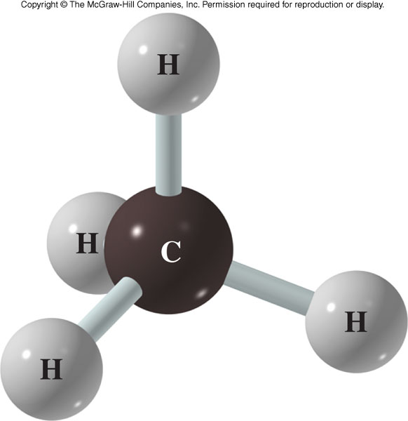
Models in Chemistry
Aid in the understanding of a chemical unit or system
often based on everyday experience
Ball and stick model of methane
color coded balls (atoms)
sticks (attractive forces holding atoms together)
1.1 The Discovery Process

Slide 7
1.2 The Classification of Matter
Properties - characteristics of matter scientists can use to categorize different types of matter
Ways to Categorize matter:
By State
By Composition

Slide 8
Three States of Matter
4
1. Gas - particles widely separated, no definite shape or volume solid
2. Liquid - particles closer together, definite volume but no definite shape
3. Solid - particles are very close together, define shape and definite volume
1.2 The Classification of Matter

Slide 9
Composition of Matter
5
1.2 The Classification of Matter
Pure substance - a substance that has only one component
Mixture - a combination of two or more pure substances in which each substance retains its own identity, not undergoing a chemical reaction

Slide 10
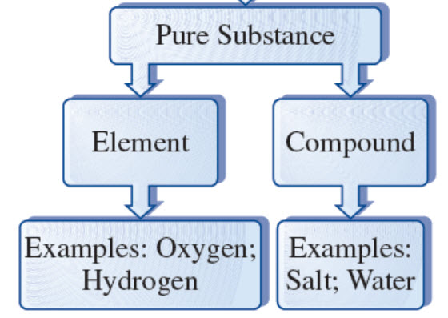
Pure Substances
Copyright © 2017 McGraw-Hill Education. Permission required for reproduction or display
5
1.2 The Classification of Matter
Element - a pure substance that cannot be changed into a simpler form of matter by any chemical reaction
Compound - a pure substance resulting from the combination of two or more elements in a definite, reproducible way, in a fixed ratio

Slide 11
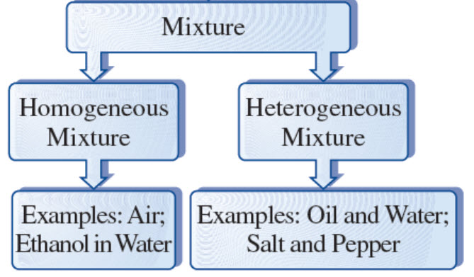
Mixture
Copyright © 2017 McGraw-Hill Education. Permission required for reproduction or display
5
1.2 The Classification of Matter
Mixture - a combination of two or more pure substances in which each substance retains its own identity
Homogeneous - uniform composition, particles well mixed, thoroughly intermingled
Heterogeneous – nonuniform composition, random placement

Slide 12
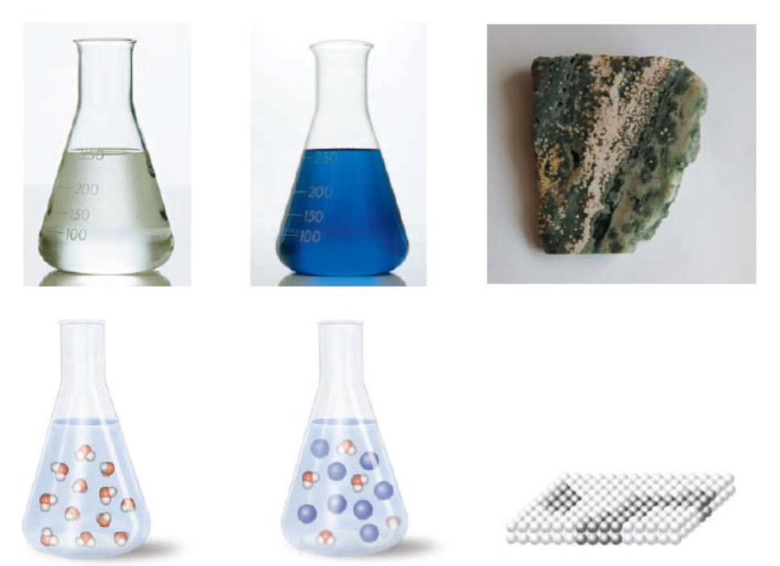
Classes of Matter
Copyright © 2017 McGraw-Hill Education. Permission required for reproduction or display
1.2 The Classification of Matter
(a) Pure Substance (b) Homogenous Mixture (c) Heterogeneous Mixture

Slide 13
Physical Property vs. Physical Change
6
Physical property - is observed without changing the composition or identity of a substance
Physical change - produces a recognizable difference in the appearance of a substance without causing any change in its composition or identity
conversion from one physical state to another
melting an ice cube
1.2 The Classification of Matter

Slide 14
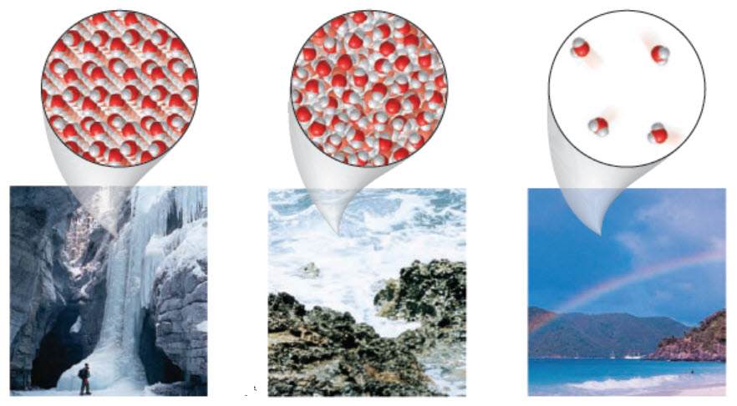
Physical Properties and Physical Change
Copyright © 2017 McGraw-Hill Education. Permission required for reproduction or display
(a) Solid (b) Liquid (c) Gas

Slide 15
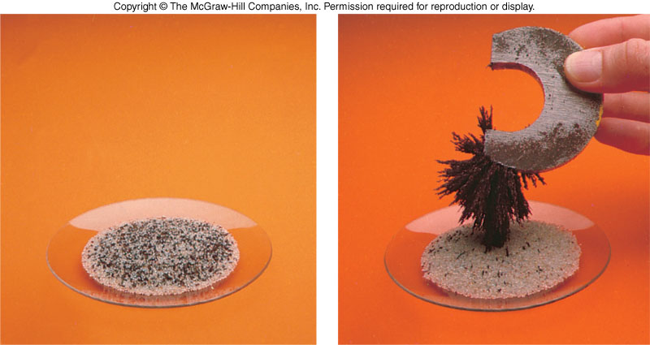
Separation by Physical Properties
Magnetic iron is separated from other nonmagnetic
substances, such as sand. This property is used as
a large-scale process in the recycling industry.

Slide 16
Chemical Property vs. Chemical Reaction
6
Chemical property - results in a change in composition and can be observed only through a chemical reaction
Chemical reaction (chemical change) - a chemical substance is converted in to one or more different substances by rearranging, removing, replacing, or adding atoms
1.2 The Classification of Matter
hydrogen + oxygen → water
reactants
products

Slide 17
Intensive and Extensive Properties
7
Intensive properties - a property of matter that is independent of the quantity of the substance
Color
Melting Point
Extensive properties - a property of matter that depends on the quantity of the substance
Mass
Volume
1.2 The Classification of Matter

Slide 18
1.3 The Units of Measurement
Units - the basic quantity of mass, volume or whatever quantity is being measured
A measurement is useless without its units
8
English system - a collection of functionally unrelated units
Difficult to convert from one unit to another
1 foot = 12 inches = 0.33 yard = 1/5280 miles
Metric System - composed of a set of units that are related to each other decimally, systematic
Units relate by powers of tens

Slide 19
Metric System Units
8
Mass - the quantity of matter in an object
not synonymous with weight
Weight = mass x acceleration due to gravity
standard unit is the gram (g)
The pound (lb) is the common English unit
1 lb = 454 g
Mass must be measured on a balance (not a scale)
1.3 The Units of Measurement

Slide 20
Metric System Units - continued
Length - the distance between two points
standard unit is the meter (m)
The yard is the common English unit
1 yd = 0.914 m
Volume - the space occupied by an object
standard unit is the liter (L)
The quart is the common English unit
1 qt = 0.946 L
Time
The metric unit is the second (s)
1.3 The Units of Measurement

Slide 21
Metric System Prefixes
Basic units are the units of a quantity without any metric prefix
Copyright © 2017 McGraw-Hill Education. Permission required for reproduction or display

Slide 22
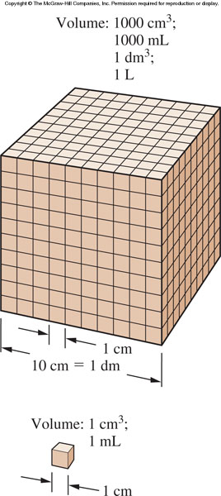
Relationship among various volume units
Volume =
Length x width x height
1.3 The Units of Measurement
Volume =
1 m x 1 m x 1 m =
1 m³
1 m³ = 1 L

Slide 23
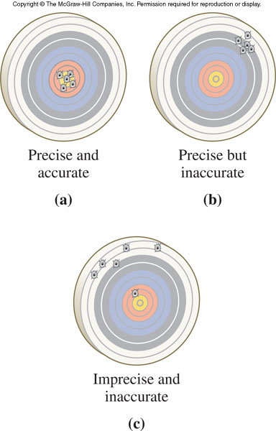
Accuracy and Precision
10
Accuracy - the degree of agreement between the true value and the measured value
Error - the difference between the true value and our estimation
Random
Systematic
Precision - a measure of the agreement of replicate measurements
Deviation – amount of variation present in a set of replicate measurements
1.4 The Numbers of Measurement

Slide 24
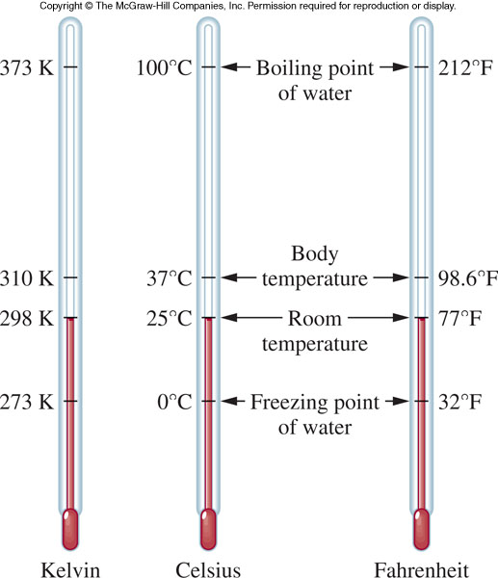
1.6 Additional Experimental Quantities
Temperature - the degree of “hotness” of an object

Slide 25
Kelvin Temperature Scale
The Kelvin (K) scale is another temperature scale
It is of particular importance because it is directly related to molecular motion
As molecular speed increases, the Kelvin temperature proportionately increases
1.6 Additional Experimental Quantities
T
=
T
+ 273.15
K
ºC

Slide 26
Energy
Energy - the ability to do work
kinetic energy - the energy of motion (energy of action)
potential energy - the energy of position (stored energy)
Energy is also categorized by form:
light
heat
electrical
mechanical
chemical
1.6 Additional Experimental Quantities

Slide 27
Characteristics of Energy
Energy cannot be created or destroyed
Energy may be converted from one form to another
Energy conversion always occurs with less than 100% efficiency
All chemical reactions involve either a “gain” or “loss” of energy
1.6 Additional Experimental Quantities

Slide 28
Units of Energy
Basic Units:
calorie or joule
1 calorie (cal) = 4.18 joules (J)
kilocalorie (kcal) = food Calorie
1 kcal = 1 Calorie = 1000 calories
1 calorie = amount of heat energy required to increase the temperature of 1 gram of water 1ºC
1.6 Additional Experimental Quantities

Slide 29
Concentration
Concentration:
the number or mass of particles of a substance contained in a specified volume
Often used to represent the mixtures of different substances
Concentration of oxygen in the air
Pollen counts
Proper dose of an antibiotic
1.6 Additional Experimental Quantities

Slide 30
Density and Specific Gravity
Density
the ratio of mass to volume
an extensive property
use to characterize a substance as each substance has a unique density
Units for density include:
g/mL
g/cm³
g/cc
13
1.6 Additional Experimental Quantities

Slide 31
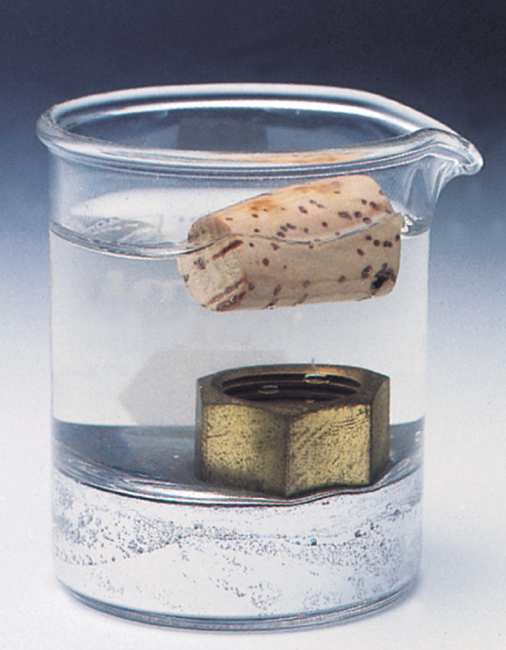
Density Examples
cork
1.6 Additional Experimental Quantities
water
brass nut
liquid mercury

Slide 32
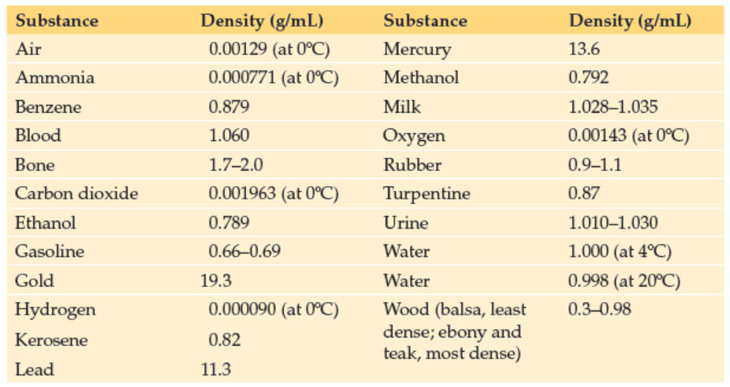
Densities of Some Common Materials
Copyright © 2017 McGraw-Hill Education. Permission required for reproduction or display

Slide 33
Specific Gravity
Values of density are often related to a standard
Specific gravity - the ratio of the density of the object in question to the density of pure water at 4ºC
Specific gravity is a unitless term because the 2 units cancel
Often the health industry uses specific gravity to test urine and blood samples
1.6 Additional Experimental Quantities

